Slide 1
A10
Weight:
Wxy:
x : Coming from x node
y : Going to y nod
Node:
Axy :
x : Layer no.
y : Node no.
Bias:
Bx:
x : Layer no.
Feather: (Input)
Fx:
x : Feather #
Class: (Output)
Cx:
x : Class #
W00
A20
A00
W00
W01
C0
W02
F0
W01
A11
W02
W00
W03
W01
W02
A21
W00
C1
A01
W01
W00
A12
F1
W02
W01
W03
W02
A22
W00
W01
C2
Weight: Need to initialize Randomly.
Bias : Need to initialize with zeros.
Target Needs to one hot encoding.
Bias : needs to broad cast
A13
W02
B1
B2
Input Layer
Hidden Layer
Output Layer

Slide 2
Input : 0,1 Target Output : 2(class 3)
Activation : Relu
A10
Activation : Softmax
Predicted O/P
Target O/P
Loss
W00
A20
A00
W00
W01
C0
0.10
0
0
W02
0
F0
W01
A11
W02
W00
W03
W01
W02
A21
C1
0.20
0
0
W00
A01
W01
W00
A12
1
F1
W02
W01
W03
W02
A22
W00
W01
C2
0.80
1
0.20
A13
W02
B1
B2
Input Layer
Hidden Layer
Output Layer

Slide 3
n = No of Data Point
k = No of Features
c = No of Classes
h = # of node in layer
W1
W2
X
(Input)
Z1
A1
Z2
A2
Y(CAP)
(Prediction)
B1
B2
X1,X2
Z1 = W*X+B1
A1 = Relu(Z1)
Z2 = W*A1+B2
A2 = Softmax(Z2)
Y(CAP) C0,C1,C2
Notation
A1 =
Z2 =
n X h2
A2 =
n X h2
X =
n X hn0
Z1 =
n X h1
n X h1
W1 =
h0 X h1
W2 =
h1 X h2
B2 =
1 X h2
h0 = k
h2 = c
Since we have only 1 hidden layer
B1 =
1 X h1
B2 (After Broadcast) =
B1 (After Broadcast) =
h0 X h1
h1 X h2
Eg
X =
300 X 2
Z1 =
300 X 4
Z2 =
300 X 3
A2 =
300 X 3
A1 =
300 X 4
W1 =
2 X 4
W2 =
4 X 3
B1 =
1 X 4
B2 =
1 X 3

Slide 4
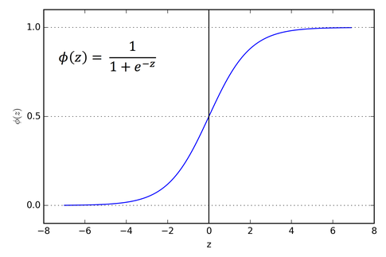
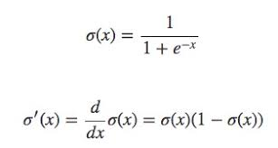
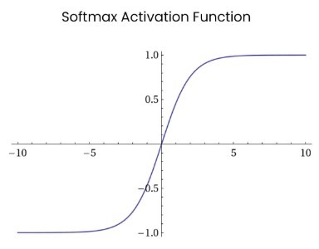
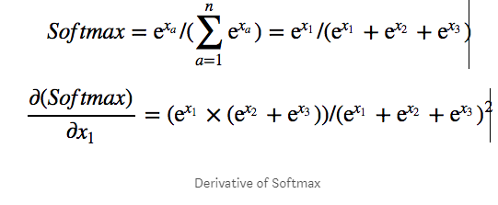
Activation Functions:
1.Sigmoid
2.Softmax
3. Relu
Sigmoid:
Limitations:
It can not work for multi class classification since it changes the output in the range of 0 to 1. for each node in output layer if it gives probability in the range of 0 to 1 then there can be chance for two classes have same probability.
Use case:
Binary classification we can use for Output layer
2. Softmax:
Limitations:
It’s having vanishing gradient problem if we use it in hidden layer, since it will convert probably to range 0 to 1 .
Use case:
we need to use it in output layer since we required probability in output layer.

Slide 5
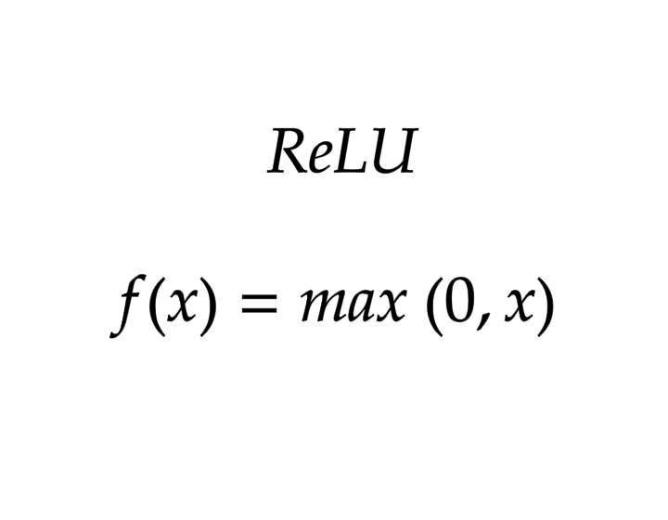
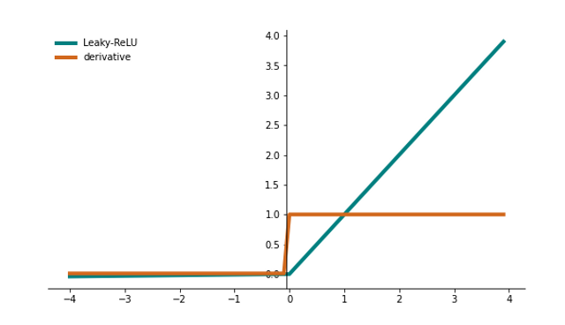
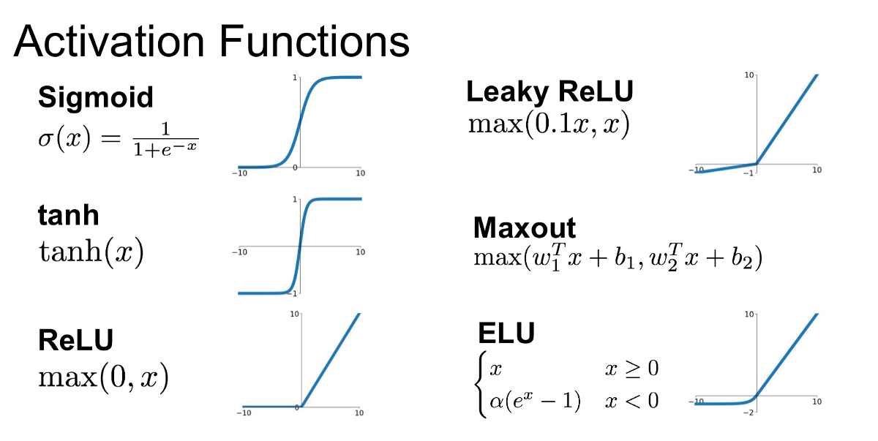
Activation Functions:
3. Relu:
Limitations:
It’s having vanishing gradient problem if we use it in hidden layer, since it will convert probably to range 0 to 1 .
Use case:
we need to use it in output layer since we required probability in output layer.
Other Activation functions:

Slide 6
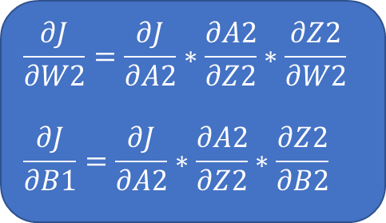
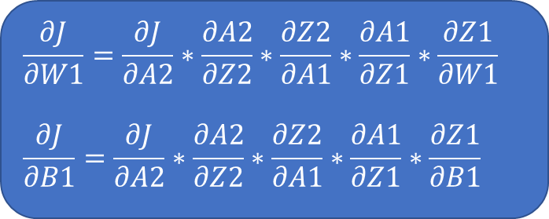
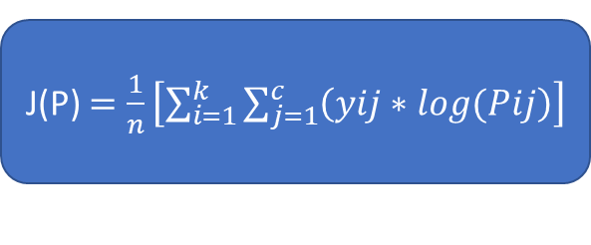
Backword Propagation
W1
W2
X
(Input)
Z1
A1
Z2
A2
Y(CAP)
(Prediction)
Y
(Actual)
B1
B2
$$\frac{∂J}{∂W1}=\frac{∂J}{∂A2}∗\frac{∂A2}{∂Z2}∗\frac{∂Z2}{∂A1}∗\frac{∂A1}{∂Z1}∗\frac{∂Z1}{∂W1}$$
$$\frac{∂J}{∂B1}=\frac{∂J}{∂A2}∗\frac{∂A2}{∂Z2}∗\frac{∂Z2}{∂A1}∗\frac{∂A1}{∂Z1}∗\frac{∂Z1}{∂B1}$$
$$\frac{∂J}{∂W2}=\frac{∂J}{∂A2}∗\frac{∂A2}{∂Z2}∗\frac{∂Z2}{∂W2}$$
$$\frac{∂J}{∂B1}=\frac{∂J}{∂A2}∗\frac{∂A2}{∂Z2}∗\frac{∂Z2}{∂B2}$$
J(P) $=\frac{1}{n}\left[\sum_{i=1}^{k}{\sum_{j=1}^{c}{\left(yij∗log(Pij\right)}}\right]$

Slide 7
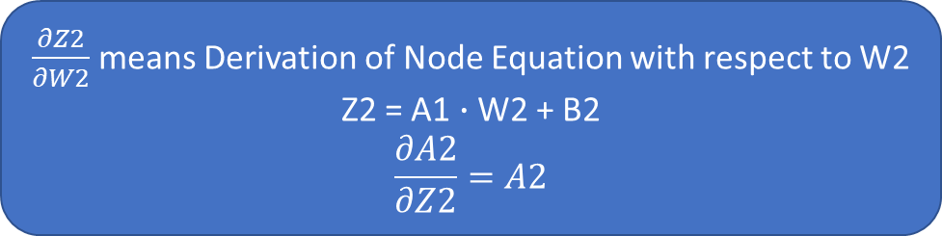
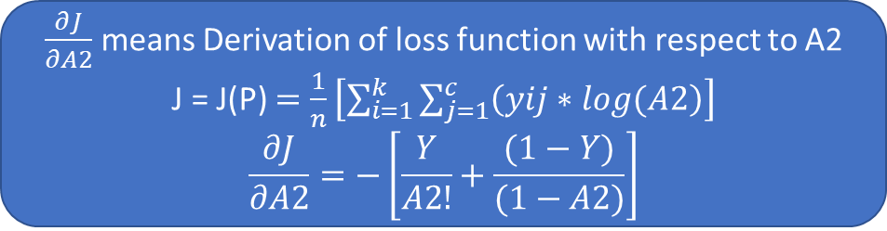
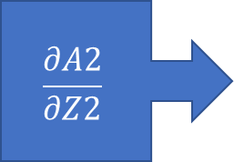
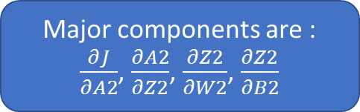
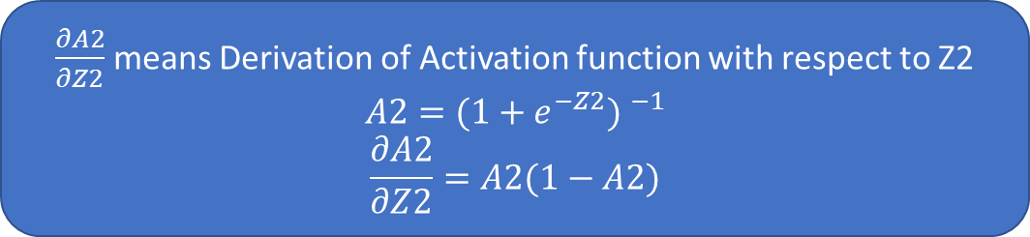
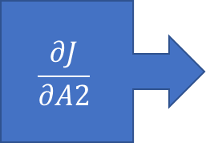
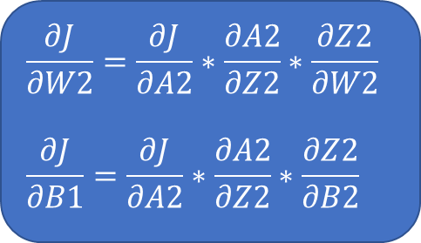
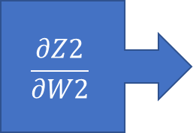
Backword Propagation
$$\frac{∂J}{∂W2}=\frac{∂J}{∂A2}∗\frac{∂A2}{∂Z2}∗\frac{∂Z2}{∂W2}$$
$$\frac{∂J}{∂B1}=\frac{∂J}{∂A2}∗\frac{∂A2}{∂Z2}∗\frac{∂Z2}{∂B2}$$
Major components are :
$\frac{∂J}{∂A2}$, $\frac{∂A2}{∂Z2}$, $\frac{∂Z2}{∂W2}$, $\frac{∂Z2}{∂B2}$
$\frac{∂J}{∂A2}$ means Derivation of loss function with respect to A2
J = J(P) $=\frac{1}{n}\left[\sum_{i=1}^{k}{\sum_{j=1}^{c}{\left(yij∗log(A2\right)}}\right]$
$$\frac{∂J}{∂A2}=−\left[\frac{Y}{A2!}+\frac{(1−Y)}{(1−A2)}\right]$$
$$\frac{∂J}{∂A2}$$
$\frac{∂A2}{∂Z2}$ means Derivation of Activation function with respect to Z2
$$A2={(1+e^{−Z2}) }^{−1}$$
$$\frac{∂A2}{∂Z2}=A2(1−A2)$$
$$\frac{∂A2}{∂Z2}$$
$\frac{∂Z2}{∂W2}$ means Derivation of Node Equation with respect to W2
Z2 = A1 $∙$ W2 + B2
$$\frac{∂A2}{∂Z2}=A2$$
$$\frac{∂Z2}{∂W2}$$

Slide 8


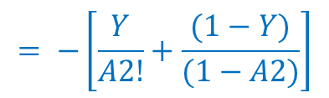
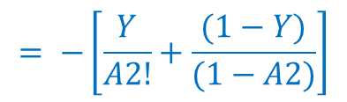
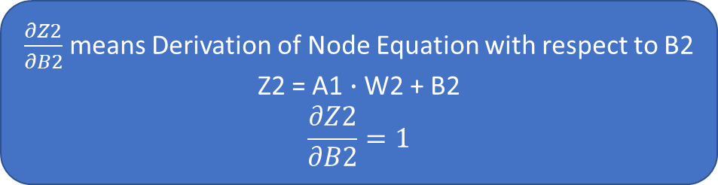
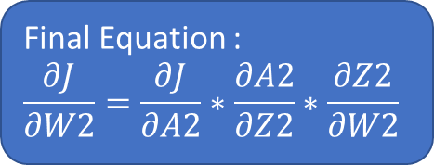
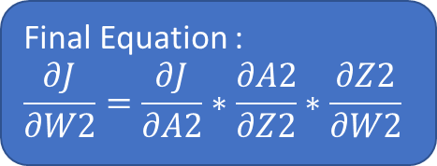
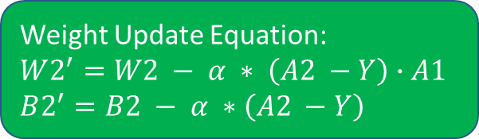
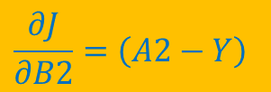
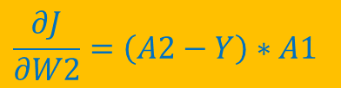
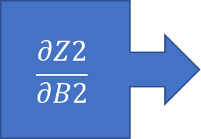


Backword Propagation
$$\frac{∂J}{∂W2}=\frac{∂J}{∂A2}∗\frac{∂A2}{∂Z2}∗\frac{∂Z2}{∂W2}$$
$$\frac{∂J}{∂B1}=\frac{∂J}{∂A2}∗\frac{∂A2}{∂Z2}∗\frac{∂Z2}{∂B2}$$
$\frac{∂Z2}{∂B2}$ means Derivation of Node Equation with respect to B2
Z2 = A1 $∙$ W2 + B2
$$\frac{∂Z2}{∂B2}=1$$
$$\frac{∂Z2}{∂B2}$$
Final Equation :
$$\frac{∂J}{∂W2}=\frac{∂J}{∂A2}∗\frac{∂A2}{∂Z2}∗\frac{∂Z2}{∂W2}$$
$$\frac{∂J}{∂W2}=\left(A2−Y\right)∗A1$$
$$A1$$
Weight Update Equation:
$$W2^{′}=W2 − α ∗ \left(A2 −Y\right)∙A1$$
$$B2^{′}=B2 − α ∗\left(A2 −Y\right)$$
$$= −\left[\frac{Y}{A2!}+\frac{(1−Y)}{(1−A2)}\right]$$
$$=A2(1−A2)$$
Final Equation :
$$\frac{∂J}{∂W2}=\frac{∂J}{∂A2}∗\frac{∂A2}{∂Z2}∗\frac{∂Z2}{∂W2}$$
$$\frac{∂J}{∂B2}=\left(A2−Y\right)$$
$$1$$
$$= −\left[\frac{Y}{A2!}+\frac{(1−Y)}{(1−A2)}\right]$$
$$=A2(1−A2)$$

Slide 9
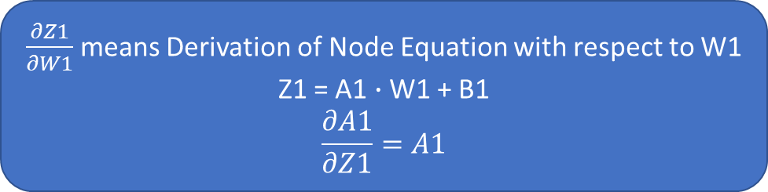
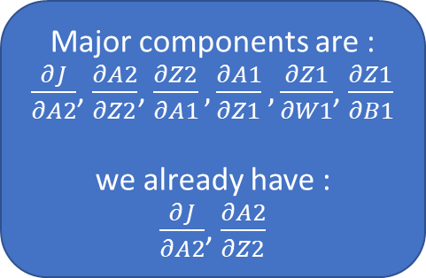
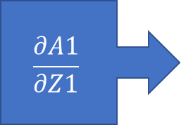
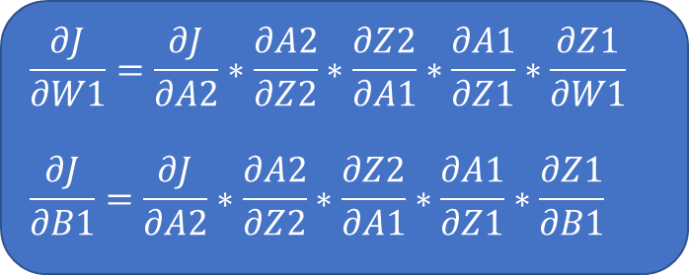
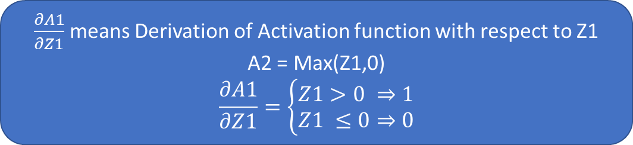
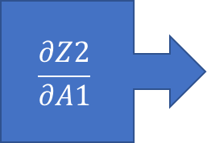
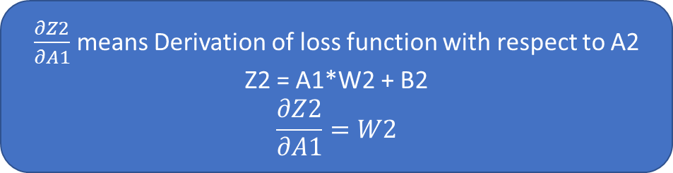
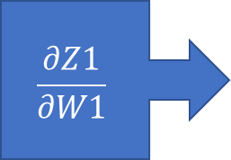
Backword Propagation
$$\frac{∂J}{∂W1}=\frac{∂J}{∂A2}∗\frac{∂A2}{∂Z2}∗\frac{∂Z2}{∂A1}∗\frac{∂A1}{∂Z1}∗\frac{∂Z1}{∂W1}$$
$$\frac{∂J}{∂B1}=\frac{∂J}{∂A2}∗\frac{∂A2}{∂Z2}∗\frac{∂Z2}{∂A1}∗\frac{∂A1}{∂Z1}∗\frac{∂Z1}{∂B1}$$
Major components are :
$\frac{∂J}{∂A2}$, $\frac{∂A2}{∂Z2}$, $\frac{∂Z2}{∂A1},\frac{∂A1}{∂Z1},\frac{∂Z1}{∂W1}$, $\frac{∂Z1}{∂B1}$
we already have :
$\frac{∂J}{∂A2}$, $\frac{∂A2}{∂Z2}$
$\frac{∂Z2}{∂A1}$ means Derivation of loss function with respect to A2
Z2 = A1*W2 + B2
$$\frac{∂Z2}{∂A1}=W2$$
$$\frac{∂Z2}{∂A1}$$
Check the graph of relu it’s 45` line and derivation of it is constant
$\frac{∂A1}{∂Z1}$ means Derivation of Activation function with respect to Z1
A2 = Max(Z1,0)
$$\frac{∂A1}{∂Z1}=\left\{\begin{aligned}Z1>0 ⇒1 \\ Z1 ≤0⇒0\end{aligned}\right.$$
$$\frac{∂A1}{∂Z1}$$
$\frac{∂Z1}{∂W1}$ means Derivation of Node Equation with respect to W1
Z1 = A1 $∙$ W1 + B1
$$\frac{∂A1}{∂Z1}=A1$$
$$\frac{∂Z1}{∂W1}$$

Slide 10


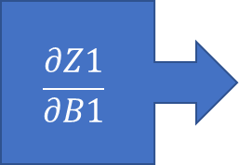
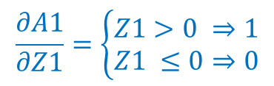
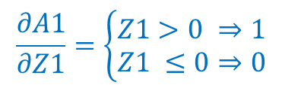
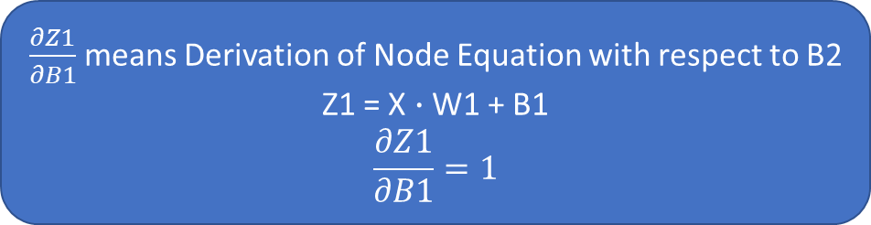


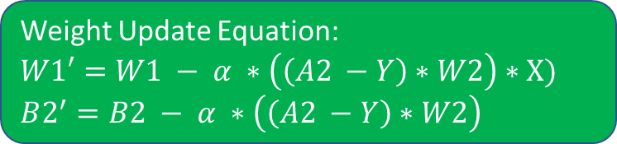
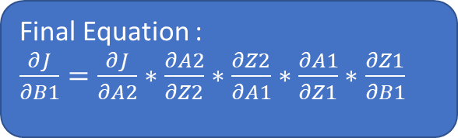
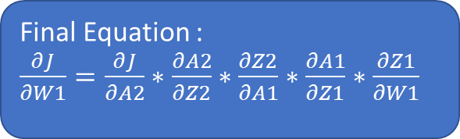
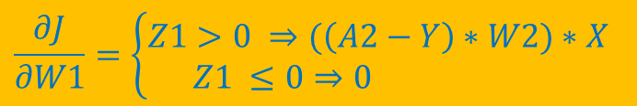
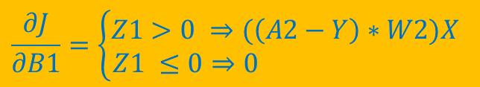
Backword Propagation
$$\frac{∂J}{∂W1}=\frac{∂J}{∂A2}∗\frac{∂A2}{∂Z2}∗\frac{∂Z2}{∂A1}∗\frac{∂A1}{∂Z1}∗\frac{∂Z1}{∂W1}$$
$$\frac{∂J}{∂B1}=\frac{∂J}{∂A2}∗\frac{∂A2}{∂Z2}∗\frac{∂Z2}{∂A1}∗\frac{∂A1}{∂Z1}∗\frac{∂Z1}{∂B1}$$
$\frac{∂Z1}{∂B1}$ means Derivation of Node Equation with respect to B2
Z1 = X $∙$ W1 + B1
$$\frac{∂Z1}{∂B1}=1$$
$$\frac{∂Z1}{∂B1}$$
Final Equation :
$\frac{∂J}{∂W1}=\frac{∂J}{∂A2}∗\frac{∂A2}{∂Z2}∗\frac{∂Z2}{∂A1}∗\frac{∂A1}{∂Z1}∗\frac{∂Z1}{∂W1}$
$$\frac{∂J}{∂W1}=\left\{\begin{aligned}Z1>0 ⇒(\left(A2−Y\right)∗W2)∗X \\ Z1 ≤0⇒0 \end{aligned}\right.$$
$$X$$
Weight Update Equation:
$$W1′=W1 − α ∗\left(\left(A2 −Y\right)∗W2\right)∗X)$$
$$B2^{′}=B2 − α ∗\left(\left(A2 −Y\right)∗W2\right)$$
$$\left(A2−Y\right)∗W2$$
$$\frac{∂A1}{∂Z1}=\left\{\begin{aligned}Z1>0 ⇒1 \\ Z1 ≤0⇒0\end{aligned}\right.$$
Final Equation :
$\frac{∂J}{∂B1}=\frac{∂J}{∂A2}∗\frac{∂A2}{∂Z2}∗\frac{∂Z2}{∂A1}∗\frac{∂A1}{∂Z1}∗\frac{∂Z1}{∂B1}$
$$\frac{∂J}{∂B1}=\left\{\begin{aligned}Z1>0 ⇒(\left(A2−Y\right)∗W2)X \\ Z1 ≤0⇒0 \end{aligned}\right.$$
$$1$$
$$\left(A2−Y\right)∗W2$$
$$\frac{∂A1}{∂Z1}=\left\{\begin{aligned}Z1>0 ⇒1 \\ Z1 ≤0⇒0\end{aligned}\right.$$

Slide 11
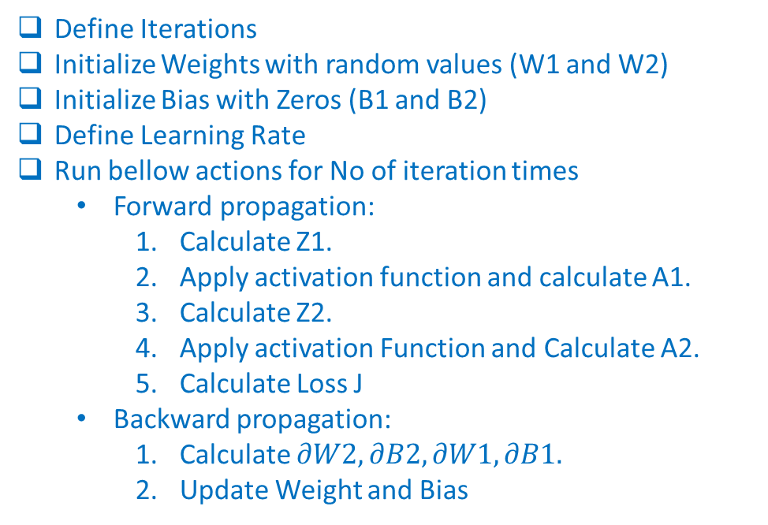
Full Process
Define Iterations
Initialize Weights with random values (W1 and W2)
Initialize Bias with Zeros (B1 and B2)
Define Learning Rate
Run bellow actions for No of iteration times
Forward propagation:
Calculate Z1.
Apply activation function and calculate A1.
Calculate Z2.
Apply activation Function and Calculate A2.
Calculate Loss J
Backward propagation:
Calculate $∂W2, ∂B2,∂W1,∂B1.$
Update Weight and Bias
Still Validation/ testing are pending need to added

