Slide 1

Pattern Matching Algorithm in Genome Sequence

Slide 2
Pattern Matching Algorithm in Genome Sequence :
PROBLEM STATEMENT:
Given a DNA pattern and DNA. The problem is to find out all
the occurrences of the pattern in the DNA.
The solution to this problem can be found by using the following algorithmic approaches –
Brute-force algorithm
Boyer Moore algorithm
KMP algorithm

Slide 3
Naïve String Matching (Brute force)
Algorithm:
Consider all the substrings with length of the given pattern.
Compare each substring with the given pattern.
If a match is found, print it.
We need to check n-m such substrings each of length m.

Slide 4
Code:
//a is text and b is pattern to be searched
// n= length of text (string a)
// m= length of pattern (string b)
for(i=0;i<=n-m;i++)
{
flag=1;
for(j=0 ; j < m && flag==1; j++)
{
if(b[j]!=a[i+j])
flag=-1;
}
if(flag==1)
cout<<“Pattern found at position "<<i+1<<endl;
}

Slide 5
Pattern length (b) = m
Text Length (a) = n
Step | Time
For i: 0 to n-m; | O(n)
For j: 0 to m | O(m)
Total | O(n*m)
Overall Space Complexity | O(1)

Slide 6
Boyer- Moore Algorithm (DP)
Algorithm:
Preprocessing:
Construct a bad match table p of size 26 (alphabets).
Initialize the value of every index to the length of pattern (b.size)
Update the table as follows (except for the last index) :
p[ b[i] ]= (length of pattern ) - i -1
p[b[n-1]] = length of the pattern

Slide 7
Boyer- Moore Algorithm
Algorithm:
Searching :
Initially the window of text is taken from starting index of text (size same as that of pattern)
We start comparison of pattern with characters of current window of text both from the right side.
We keep matching characters of the text window and pattern and keep decrementing the indices till we find a mismatch.
When we see a mismatch:
We use p array to find the next index from where the searching has to be progressed again.
If we reach the end of the pattern without a mismatch then print the occurrence and begin next iteration.

Slide 8
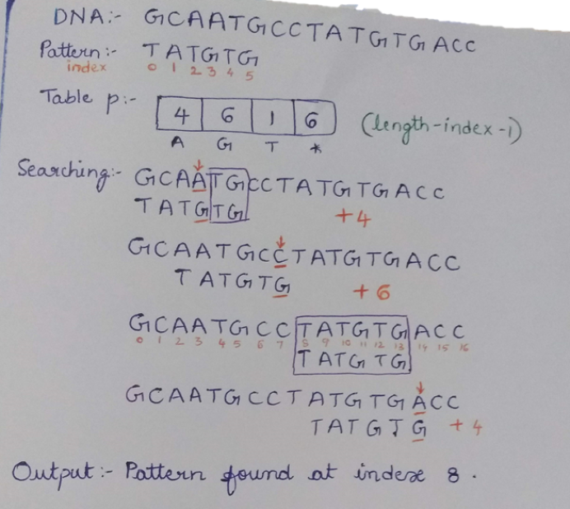
Working of the algorithm

Slide 9
//a is text and b is pattern to be searched
// n= length of text (string a)
// m= length of pattern (string b)
vector <int> p(26,m);
for(i=0;i<m-1;i++)
p[b[i]-'A']=m-1-i;
p[b[i]-'A']=m;
j=m-1; i=n-1;
while(i<n&&i>=0&&j>=0)
{
int k=i;
while( a[k]==b[j] && j>=0 && k>=0)
{
k--; j--;
}
if(j==-1)
{
cout<<"Pattern found at "<<k+2<<endl;
i++;
}
i=k+p[a[k]-'A'];
j=m-1;
}
Code

Slide 10
Pattern length (b) = m
Text Length (a) = n
Step | Best | Worst
Pre Processing (Finding values of vector p) | O(m) | O(m)
Searching | O(n) | O(m*n)
Total | O(n) | O(m*n)
Overall Space Complexity | O(1)

Slide 11
KMP Algorithm (DP)
Algorithm:
Preprocessing:
Construct an array p of size m (same as size of pattern) which
is used to skip characters while matching.
The array holds indices of the longest proper prefix which is
also suffix. A proper prefix is prefix with whole string not allowed.
p[i] = the longest proper prefix of b[0..i] which is also a suffix of b[0..i].

Slide 12
KMP Algorithm
Algorithm:
Searching:
Initially the window of text is taken from starting index of text (size same as that of pattern)
We start comparison of pattern with characters of current window of text both from the left side.
We keep matching characters of the text window and pattern and keep incrementing the indices till we find a mismatch.
When we see a mismatch:
We use p array to find the next index from where the searching has to be progressed again.
If we reach the end of the pattern without a mismatch then print the occurrence and begin next iteration.

Slide 13
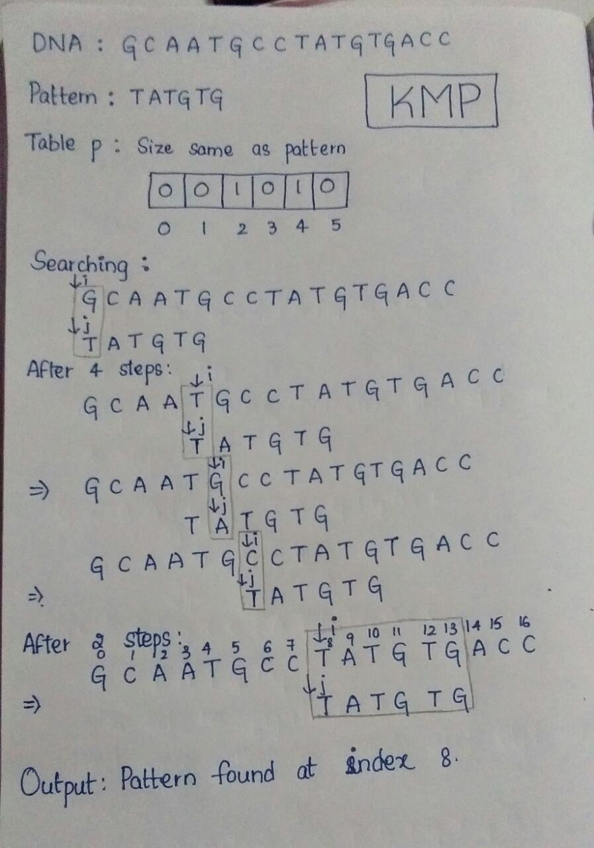
Working of the algorithm

Slide 14
//a is text and b is pattern to be searched
// n= length of text (string a)
// m= length of pattern (string b)
vector <int> p(m,0);
j=0; i=1;
while(i<m)
{
if(b[i]==b[j])
{
p[i]=j+1;
j++; j++;
}
else
{
while(b[j]!=b[i]&&j!=0)
j=p[j-1];
if(b[j]!=b[i])
{
p[i]=0;
i++;
}
}
}
Code:

Slide 15
j=0; i=0;
while(i<n)
{
if(a[i]==b[j]) {i++;j++;}
else
{
while(b[j]!=a[i]&&j!=0)
j=p[j-1];
if(a[i]!=b[j])
i++;
}
if(j==b.length())
{
cout<<"Pattern found at "<<i-b.length()+1<<endl;
j=0;
}
}

Slide 16
Pattern length (b) = m
Text Length (a) = n
Step | Time
Pre Processing (Finding values of vector p) | O(m)
Searching | O(n+m)
Total | O(n+m)
Overall Space Complexity | O(m)

Slide 17
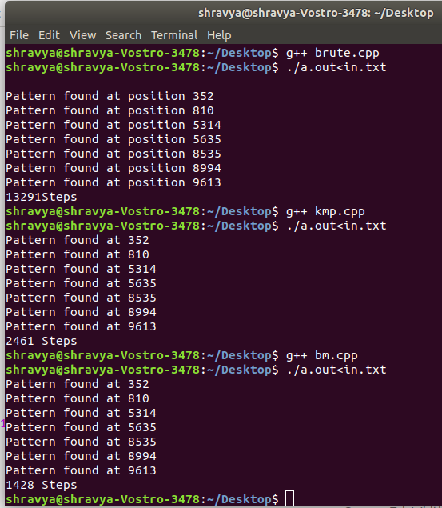
Comparison of the Algorithms (Performance)
Brute force < KMP < Boyer Moore

Slide 18
Applications of Pattern matching
Locating DNA sequences.
Fingerprint assessment.
Soil patterns reporting.
Retinal blood vessel assessment.
Diseases caused by genetic factors are also detected.
The intensity and existence of the disease can be predicted with the number of occurrences of a particular sequence in the DNA.

Slide 19
References:
https://pdfs.semanticscholar.org/2a08/3422a388c2773668a8808b3 3207b8cf37241.pdf
http://ijsetr.com/uploads/625413IJSETR2868-162.pdf
https://en.wikipedia.org/wiki/String-searching_algorithm
Thank You!

