Slide 2
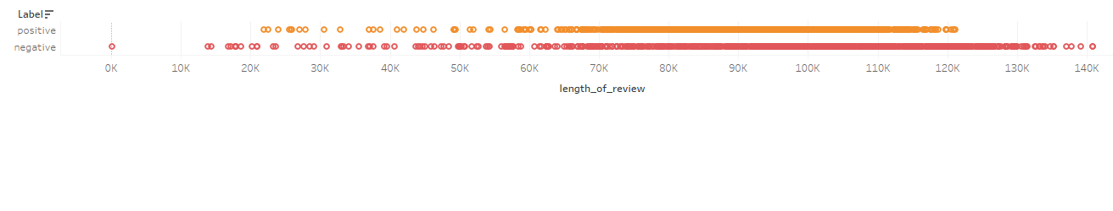
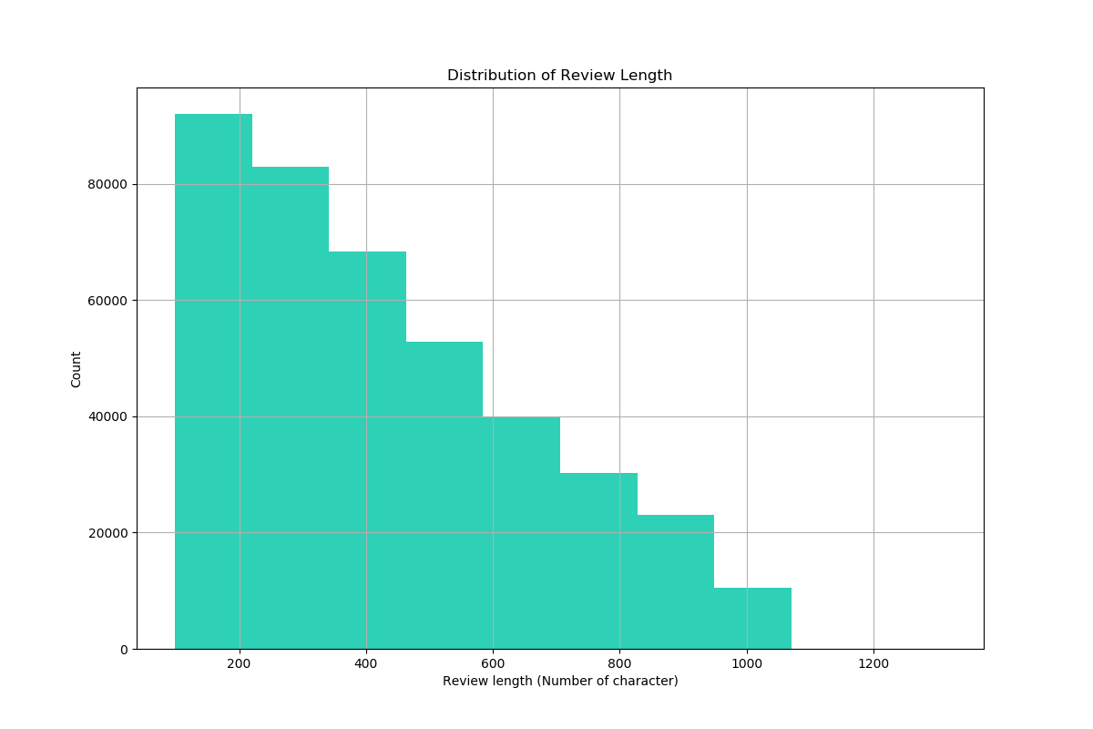
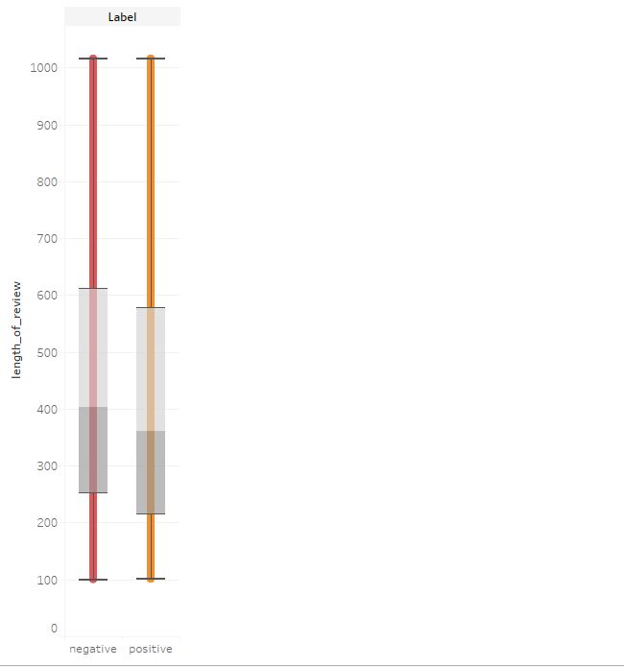
EXPLORATORY VISUALIZATION
LENGTH OF THE REVIEW DISTRIBUTION

Slide 3


EXPLORATORY VISUALIZATION

Slide 4
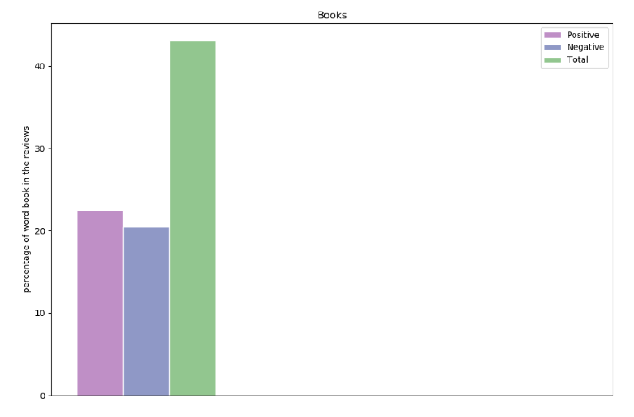

Slide 5
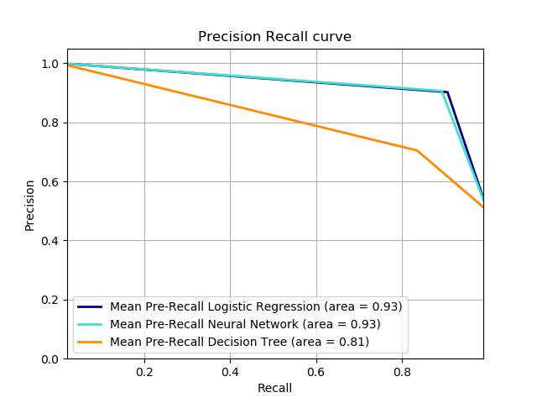
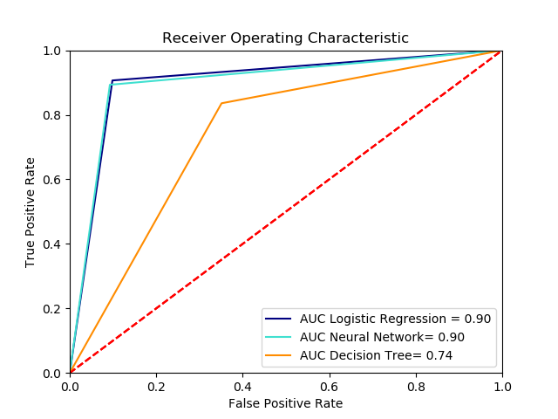

Slide 6
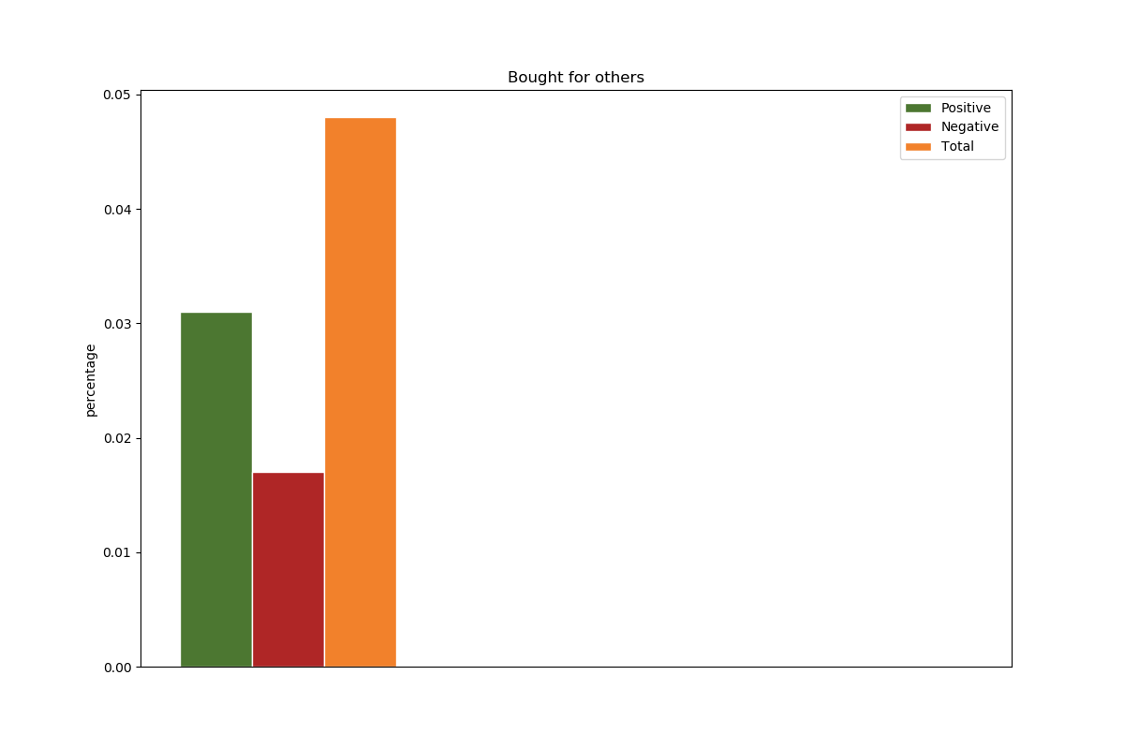
SOME ANALYSIS ON THE DATA
Reviewers often mentioned the purpose of buying the product Only a small percentage of reviewers (96 reviewers) mentioned that a product was “bought for” someone else, not for themselves.

Slide 7
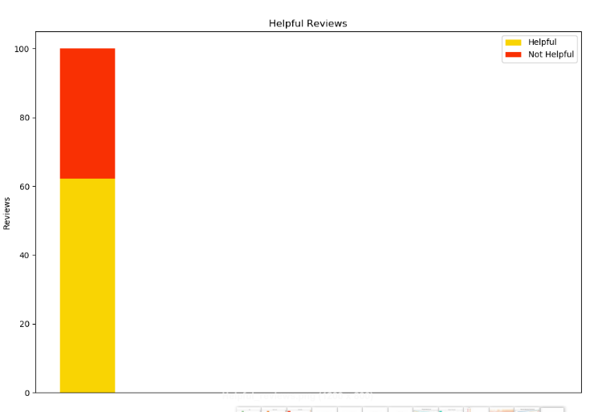
Anatomical features:
Length of the review
Sentence count
Character count
Number of exclamation and question marks
Number of words in all caps
Analysis :
Helpful reviews: (248542, 62.14 %)

