Slide 1
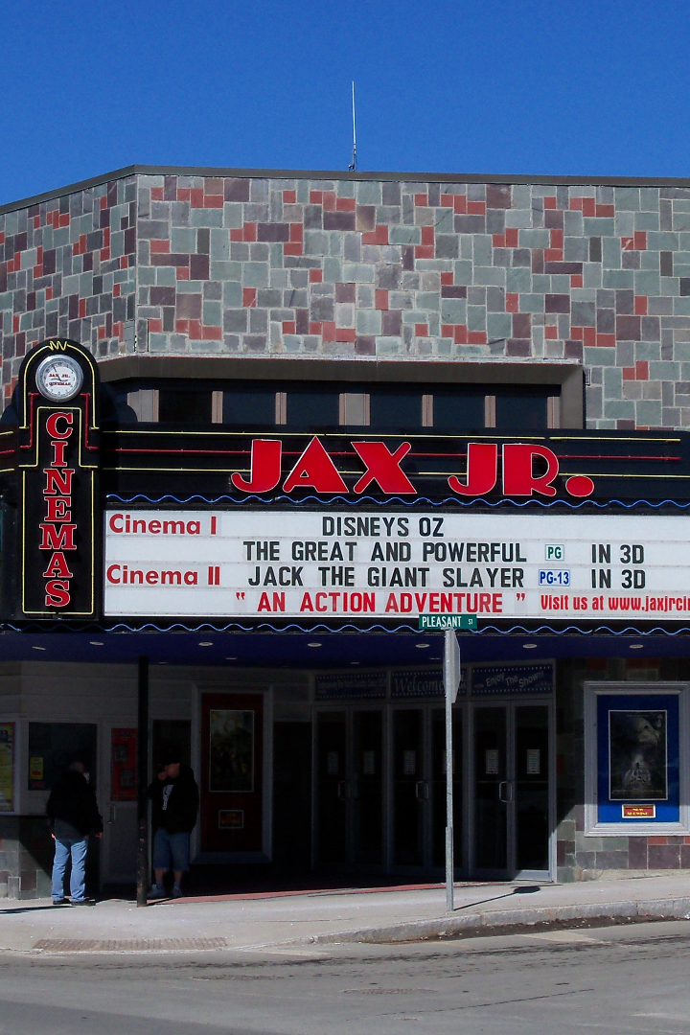

Movie Recommender Engine
In today's world, personalization plays a major role in every industry. This presentation will give you insights into building a movie recommendation engine that can cater to the unique interests of customers.
by Jagunmolu Odebamike

Slide 2

Motivation for the Project
A personalized recommendation engine provides a unique level of personalization and assistance, which can help businesses increase sales and engagement. This is the driving force behind building an effective movie recommendation engine.

Slide 3
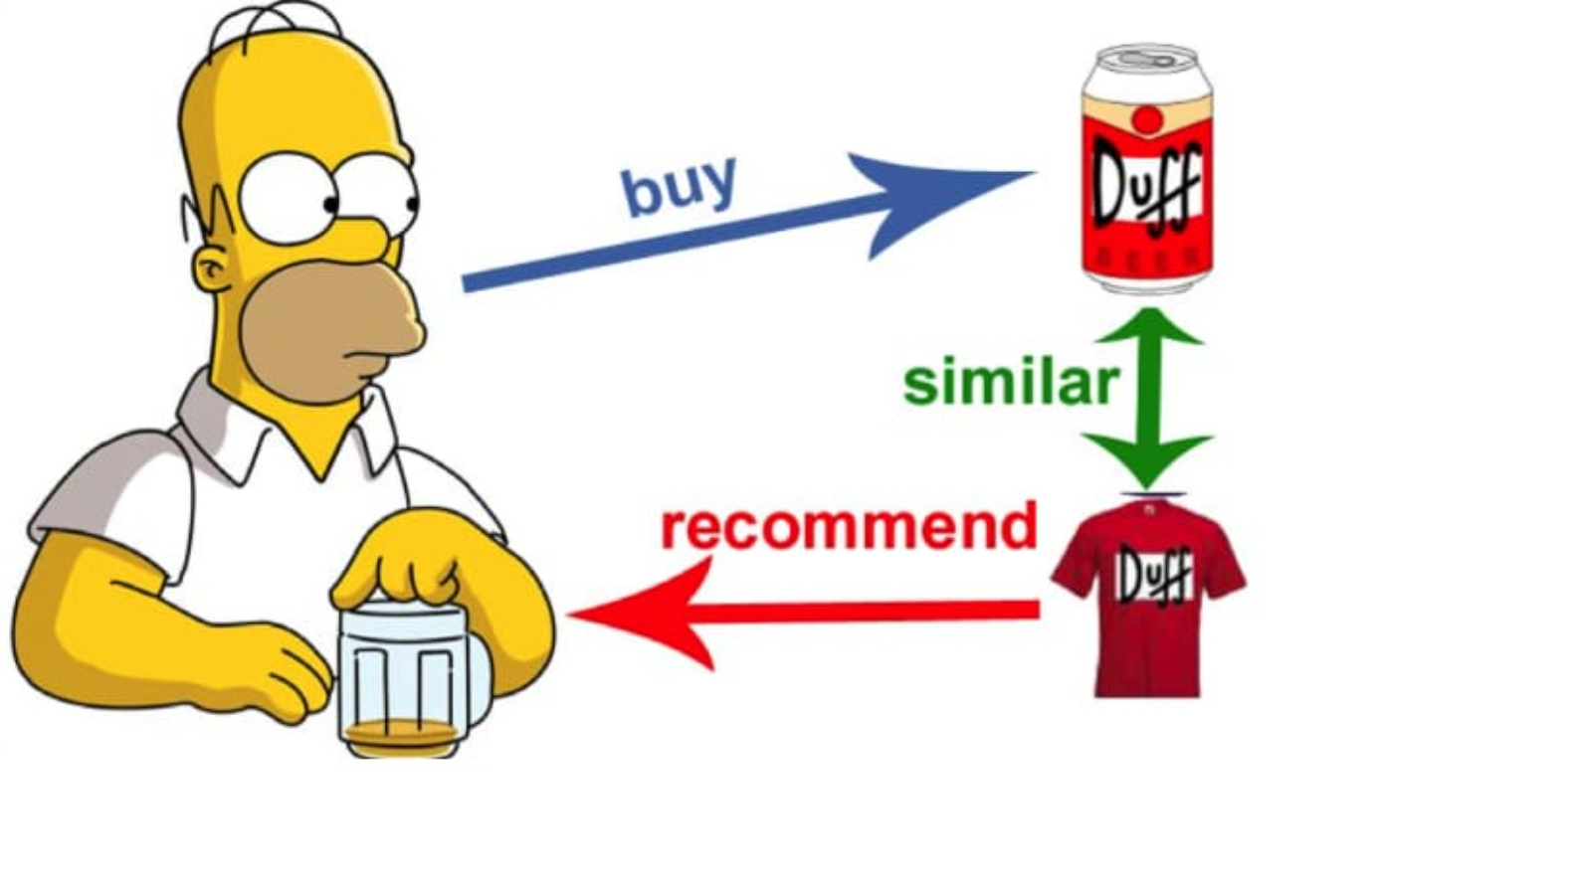
What are Recommender Engines
Recommender engines are systems that help predict a user's preferences and provide personalized recommendations. These systems are tailored to meet individual preferences and provide users with a seamless experience.

Slide 4

Overview
The movie recommendation system provides personalized recommendations based on genre, keywords, tagline, cast, and directors. By analyzing this information, the engine can provide a list of movies that users are more likely to enjoy.

Slide 5
Dataset
The dataset contains movie information, including genre, release date, revenue, title, and other columns. The dataset has 4803 rows and 24 columns, allowing us to extract and analyze various information to develop an effective recommendation engine.

Slide 6
Data Overview
Genres
Release Date
Revenue
Genres like comedy, thriller, romance etc. provide information about the style and tone of the movies, which plays a major role in the type of recommendation presented to the user.
The release date provides information about the movie's era, the audience it targets and the type of content it contains.
The revenue provides an indication of the popularity of the movie which is often the result of many factors.
Title
The title of the movie provides valuable information about the content and genre of the movie, and it is an important information point when building a recommendation engine.

Slide 7

Model Building
To build an effective movie recommendation engine, I used the Tfid Vectorizer and the cosine similarity algorithm. This method enables us to compare each movie to all movies and rank them based on how similar they are. This helps us present a list of similar movies to the user.

Slide 8

Advantages of Recommendation Engines
1
Personalization
2
Increased Sales
The engine provides a personalized experience, catering to specific user interests and preferences.
The movie recommendation system can increase sales by presenting users with a list of movies that are more likely to appeal to them.
3
Improved Engagement
The movie recommendation system helps to improve engagement by making it easier for users to discover and enjoy new movies.

Slide 9
How does it Benefit Businesses?
1
2
3
User Experience
Customer Retention
Increased Sales
Users receive personalized and relevant recommendations, resulting in a better customer experience.
User's are more likely to return to a service if they receive tailored recommendations, which can increase customer retention.
Presenting users with a tailored selection of movies they are more likely to enjoy can increase sales and revenue for businesses.

Slide 10
