Slide 1



22CSE43 – Operating Systems
UNIT III
Dr.N.SHANTHI
PROFESSOR
COMPUTER SCIENCE & ENGINEERING
1

Slide 2
Course Overview

Slide 3
Unit III
Process Synchronization : The Critical Section Problem - Peterson’s solution – Hardware support for Synchronization – Mutex Locks – Semaphores – Monitors. Deadlocks: Deadlock Characterization – Methods for handling deadlocks - Deadlock Prevention and Avoidance – Deadlock Detection – Recovery from Deadlock
CO3: apply different methods for process synchronization and deadlock handling

Slide 4
Outline
System Model
Deadlock Characterization
Methods for Handling Deadlocks
Deadlock Prevention
Deadlock Avoidance
Deadlock Detection
Recovery from Deadlock

Slide 5
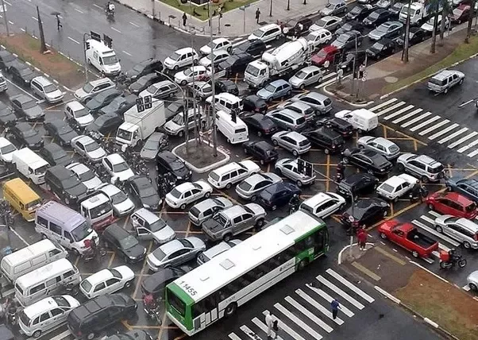
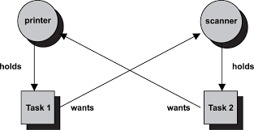
Deadlock
Deadlock is a situation in which every process in a set of processes is waiting for an event that can be caused only by another process in the set.

Slide 6
Chapter Objectives
Illustrate how deadlock can occur when mutex locks are used
Define the four necessary conditions that characterize deadlock
Identify a deadlock situation in a resource allocation graph
Evaluate the four different approaches for preventing deadlocks
Apply the banker’s algorithm for deadlock avoidance
Apply the deadlock detection algorithm
Evaluate approaches for recovering from deadlock

Slide 7
System Model
System consists of resources
Resource types R₁, R₂, . . ., R_{m}
CPU cycles, memory space, I/O devices
Each resource type R_{i} has W_{i} instances.
Each process utilizes a resource as follows:
request - The thread requests the resource
use - The thread can operate on the resource
Release - The thread releases the resource
The request and release of resources may be system calls
Examples are the request() and release() of a device, open() and close() of a file, and allocate() and free() memory system calls

Slide 8
Deadlock with Semaphores
Data:
A semaphore S1 initialized to 1
A semaphore S2 initialized to 1
Two processes P1 and P2
P1:
wait(s1)
wait(s2)
P2:
wait(s2)
wait(s1)

Slide 9
Deadlock Characterization
Deadlock can arise if four conditions hold simultaneously.
Mutual exclusion: only one process at a time can use a resource
Hold and wait: a process holding at least one resource is waiting to acquire additional resources held by other processes
No preemption: a resource can be released only voluntarily by the process holding it, after that process has completed its task
Circular wait: there exists a set {P₀, P₁, …, P_{n}} of waiting processes such that P₀ is waiting for a resource that is held by P₁, P₁ is waiting for a resource that is held by P₂, …, P_{n–1} is waiting for a resource that is held by P_{n}, and P_{n} is waiting for a resource that is held by P₀.

Slide 10
Resource-Allocation Graph
A set of vertices V and a set of edges E.
V is partitioned into two types:
P = {P₁, P₂, …, P_{n}}, the set consisting of all the processes in the system
R = {R₁, R₂, …, R_{m}}, the set consisting of all resource types in the system
request edge – directed edge P_{i} → R_{j}
assignment edge – directed edge R_{j} → P_{i}

Slide 11
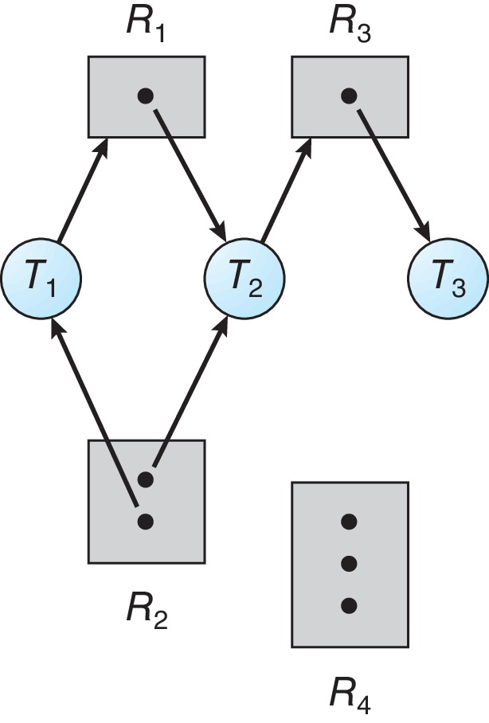
Resource Allocation Graph Example
One instance of R1
Two instances of R2
One instance of R3
Three instance of R4
T1 holds one instance of R2 and is waiting for an instance of R1
T2 holds one instance of R1, one instance of R2, and is waiting for an instance of R3
T3 is holds one instance of R3

Slide 12
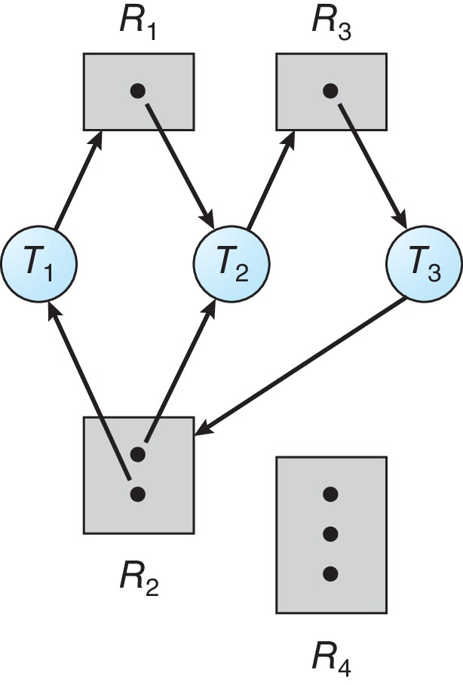
Resource Allocation Graph with a Deadlock
T1 → R1 → T2 → R3 → T3 → R2 → T1
T2 → R3 → T3 → R2 → T2

Slide 13
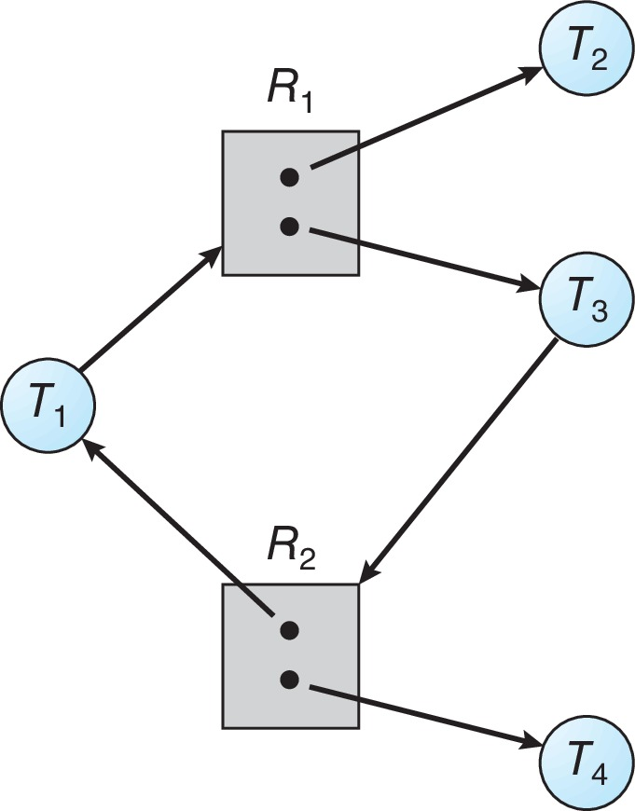
Graph with a Cycle But no Deadlock
T1 → R1 → T3 → R2 → T1

Slide 14
Basic Facts
If graph contains no cycles ⇒ no deadlock
If graph contains a cycle ⇒
if only one instance per resource type, then deadlock
if several instances per resource type, possibility of deadlock

Slide 15
Methods for Handling Deadlocks
Ensure that the system will never enter a deadlock state:
Deadlock prevention
Deadlock avoidance
Allow the system to enter a deadlock state and then recover
Ignore the problem and pretend that deadlocks never occur in the system.

Slide 16
Deadlock Prevention
Deadlock prevention provides a set of methods to ensure that at least one of the necessary conditions cannot hold.
Invalidate one of the four necessary conditions for deadlock
Mutual Exclusion – not required for sharable resources (e.g., read-only files); must hold for non-sharable resources
Hold and Wait – must guarantee that whenever a process requests a resource, it does not hold any other resources
Require process to request and be allocated all its resources before it begins execution, or allow process to request resources only when the process has none allocated to it.
Low resource utilization; starvation possible

Slide 17
Deadlock Prevention (Cont.)
No Preemption:
If a process that is holding some resources requests another resource that cannot be immediately allocated to it, then all resources currently being held are released
Preempted resources are added to the list of resources for which the process is waiting
Process will be restarted only when it can regain its old resources, as well as the new ones that it is requesting
Circular Wait:
Impose a total ordering of all resource types, and require that each process requests resources in an increasing order of enumeration

Slide 18
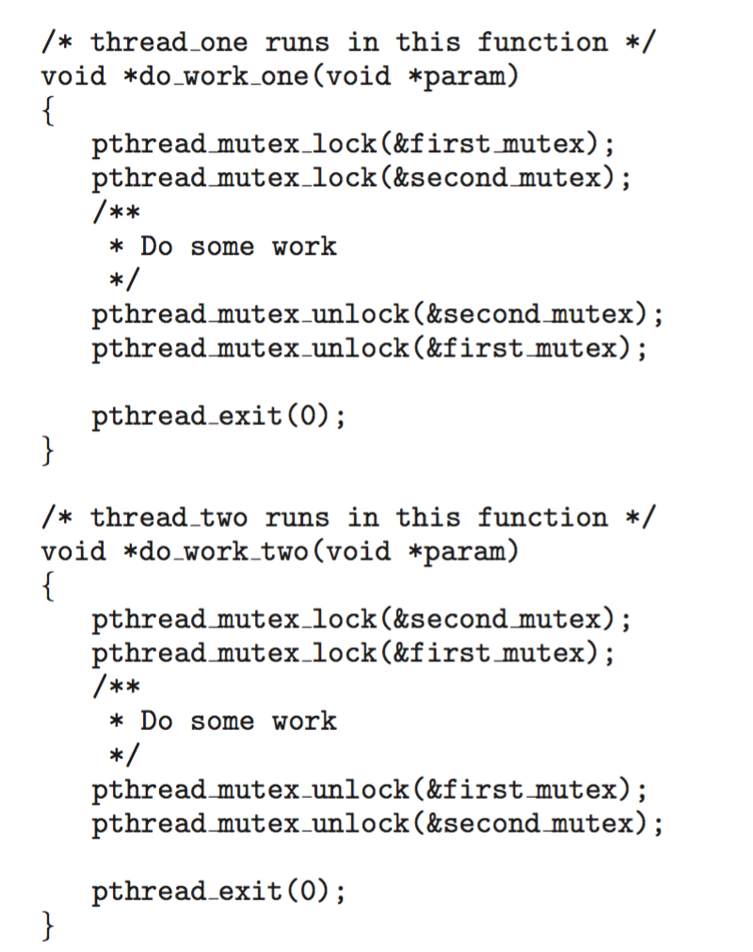
Circular Wait
Invalidating the circular wait condition is most common.
Simply assign each resource (i.e., mutex locks) a unique number.
Resources must be acquired in order.
If: F(first_mutex) = 1 F(second_mutex) = 5 code for thread_two could not be written as follows:
The thread can request an instance of resource R_{j} if and only if F(R_{j}) > F(R_{i})

Slide 19
Deadlock Avoidance
Deadlock-prevention algorithms prevent deadlocks by limiting how requests can be made.
Deadlock avoidance requires that the operating system be given additional information in advance concerning which resources a thread will request and use during its lifetime.
Requires that the system has some additional a priori information available
Simplest and most useful model requires that each process declare the maximum number of resources of each type that it may need
The deadlock-avoidance algorithm dynamically examines the resource-allocation state to ensure that there can never be a circular-wait condition
Resource-allocation state is defined by the number of available and allocated resources, and the maximum demands of the processes

Slide 20
Safe State
A state is safe if the system can allocate resources to each thread (up to its maximum) in some order and still avoid a deadlock
When a process requests an available resource, system must decide if immediate allocation leaves the system in a safe state
System is in safe state if there exists a sequence <P₁, P₂, …, P_{n}> of ALL the processes in the systems such that for each P_{i}, the resources that P_{i} can still request can be satisfied by currently available resources + resources held by all the P_{j}, with j < i
That is:
If P_{i} resource needs are not immediately available, then P_{i} can wait until all P_{j} have finished
When P_{j} is finished, P_{i} can obtain needed resources, execute, return allocated resources, and terminate
When P_{i} terminates, P_{i +1} can obtain its needed resources, and so on
If no such sequence exists, then the system state is said to be unsafe.

Slide 21
Basic Facts
If a system is in safe state ⇒ no deadlocks
If a system is in unsafe state ⇒ possibility of deadlock
Avoidance ⇒ ensure that a system will never enter an unsafe state.

Slide 22
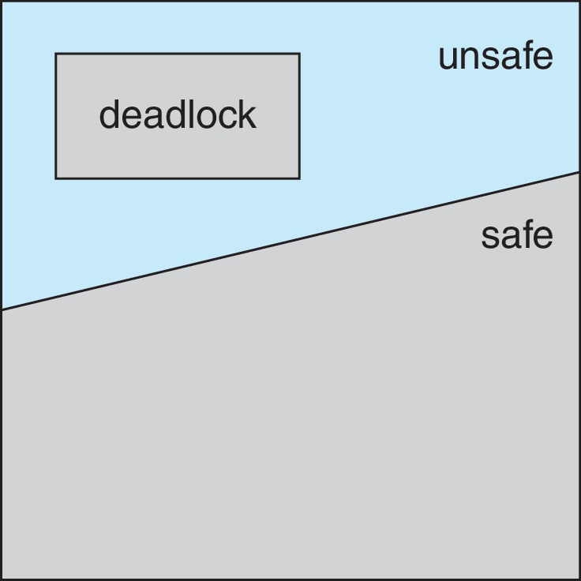
Safe, Unsafe, Deadlock State

Slide 23
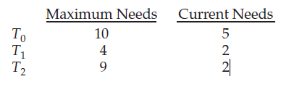
Example
Consider a system with 12 resources and 3 threads: T₀, T₁, and T₂.
Thread T₀ requires 10 resources, thread T₁ may need as many as 4, and thread T₂ may need up to 9 resources.
Suppose that, at time t₀, thread T₀ is holding 5 resources, thread T₁ is holding 2 resources, and thread T2 is holding 2 resources.
At time t₀, the system is in a safe state. The sequence <T₁, T₀, T₂> satisfies the safety condition.
A system can go from a safe state to an unsafe state. Suppose that, at time t₁, thread T₂ requests and is allocated one more resource. The system is no longer in a safe state.

Slide 24
Avoidance Algorithms
Single instance of a resource type
Use a resource-allocation graph
Multiple instances of a resource type
Use the Banker’s Algorithm

Slide 25
Resource-Allocation Graph Scheme
Claim edge P_{i} → R_{j} indicated that process P_{j} may request resource R_{j}; represented by a dashed line
request edge – directed edge P_{i} → R_{j}
assignment edge – directed edge R_{j} → P_{i}
Claim edge converts to request edge when a process requests a resource
Request edge converted to an assignment edge when the resource is allocated to the process
When a resource is released by a process, assignment edge reconverts to a claim edge
Resources must be claimed a priori in the system

Slide 26
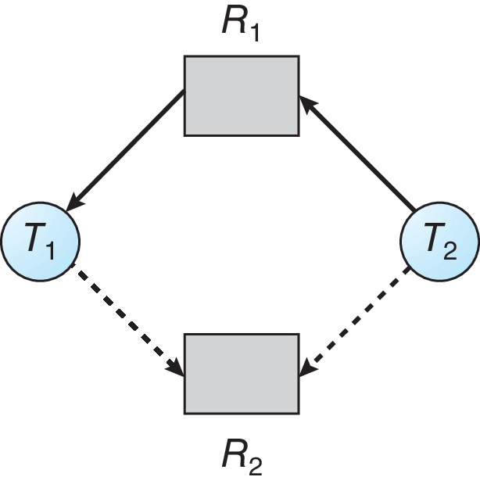
Resource-Allocation Graph

Slide 27
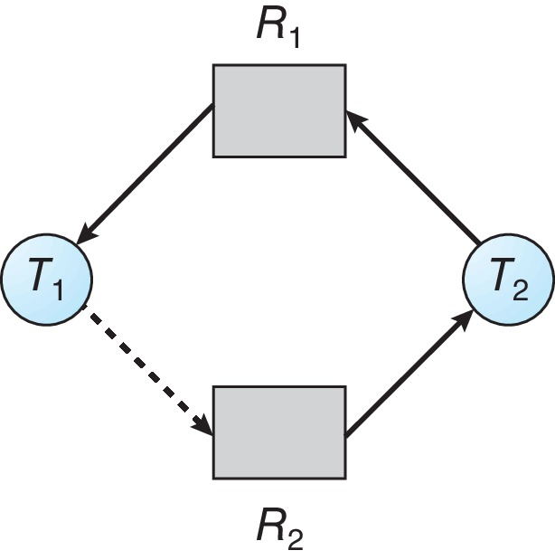
Unsafe State In Resource-Allocation Graph

Slide 28
Resource-Allocation Graph Algorithm
Suppose that process P_{i} requests a resource R_{j}
The request can be granted only if converting the request edge to an assignment edge does not result in the formation of a cycle in the resource allocation graph

Slide 29
Banker’s Algorithm
Multiple instances of resources
Each process must a priori claim maximum use
When a process requests a resource it may have to wait
When a process gets all its resources it must return them in a finite amount of time

Slide 30
Data Structures for the Banker’s Algorithm
Let n = number of processes, and m = number of resources types.
Available: Vector of length m. If available [j] = k, there are k instances of resource type R_{j} available
Max: n x m matrix. If Max [i,j] = k, then process P_{i} may request at most k instances of resource type R_{j}
Allocation: n x m matrix. If Allocation[i,j] = k then P_{i} is currently allocated k instances of R_{j}
Need: n x m matrix. If Need[i,j] = k, then P_{i} may need k more instances of R_{j} to complete its task
Need [i,j] = Max[i,j] – Allocation [i,j]

Slide 31
Safety Algorithm
Let Work and Finish be vectors of length m and n, respectively. Initialize:
Work = Available
Finish [i] = false for i = 0, 1, …, n- 1
Find an i such that both:
(a) Finish [i] = false
(b) Need_{i} ≤ Work
If no such i exists, go to step 4
Work = Work + Allocation_{i} Finish[i] = true go to step 2
If Finish [i] == true for all i, then the system is in a safe state

Slide 32
Resource-Request Algorithm for Process P_{i}
Request_{i} = request vector for process P_{i}. If Request_{i} [j] = k then process P_{i} wants k instances of resource type R_{j}
If Request_{i} ≤ Need_{i} go to step 2. Otherwise, raise error condition, since process has exceeded its maximum claim
If Request_{i} ≤ Available, go to step 3. Otherwise P_{i} must wait, since resources are not available
Pretend to allocate requested resources to P_{i} by modifying the state as follows:
Available = Available – Request_{i};
Allocation_{i} = Allocation_{i} + Request_{i};
Need_{i} = Need_{i} – Request_{i};
If safe ⇒ the resources are allocated to P_{i}
If unsafe ⇒ P_{i} must wait, and the old resource-allocation state is restored

Slide 33
Example of Banker’s Algorithm
5 processes P₀ through P₄;
3 resource types:
A (10 instances), B (5instances), and C (7 instances)
Snapshot at time T₀:
Allocation Max Available
A B C A B C A B C
P₀ 0 1 0 7 5 3 3 3 2
P₁ 2 0 0 3 2 2
P₂ 3 0 2 9 0 2
P₃ 2 1 1 2 2 2
P₄ 0 0 2 4 3 3

Slide 34
Example (Cont.)
The content of the matrix Need is defined to be Max – Allocation
Need Available
A B C A B C
P₀ 7 4 3 3 3 2
P₁ 1 2 2
P₂ 6 0 0
P₃ 0 1 1
P₄ 4 3 1
The system is in a safe state since the sequence < P₁, P₃, P₄, P₂, P₀> satisfies safety criteria

Slide 35
Example: P₁ Request (1,0,2)
Check that Request ≤ Available (that is, (1,0,2) ≤ (3,3,2) ⇒ true
Allocation Need Available
A B C A B C A B C
P₀ 0 1 0 7 4 3 2 3 0
P₁ 3 0 2 0 2 0
P₂ 3 0 2 6 0 0
P₃ 2 1 1 0 1 1
P₄ 0 0 2 4 3 1
Executing safety algorithm shows that sequence < P₁, P₃, P₄, P₀, P₂> satisfies safety requirement
Can request for (3,3,0) by P₄ be granted?
Can request for (0,2,0) by P₀ be granted?

Slide 36
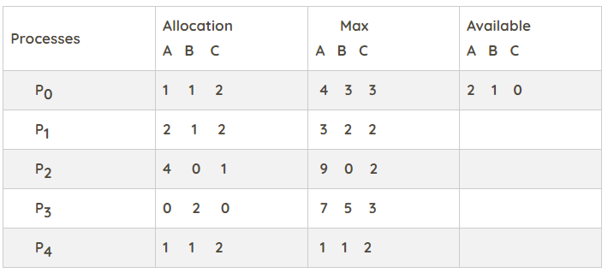
Bankers Algorithm
5 processes P₁ through P₅;
Snapshot at time T₀:
Calculate the content of the need matrix.
Is the system in a safe state?
Determine the total amount of resources of each type?

Slide 37
Steps
1. For process P₀, Need = (3, 2, 1) and Available = (2, 1, 0)
Need < Available = False
So, the system will move for the next process.
2. For Process P_{1,} Need = (1, 1, 0) and Available = (2, 1, 0)
Need < Available = True
Request of P₁ is granted.
Available = Available +Allocation
= (2, 1, 0) + (2, 1, 2)
= (4, 2, 2) (New Available)
3. For Process P2, Need = (5, 0, 1) and Available = (4, 2, 2)
Need < Available = False
So, the system will move to the next process.

Slide 38
Steps
4. For Process P_{3,} Need = (7, 3, 3) and Available = (4, 2, 2)
Need < Available = False
So, the system will move to the next process.
5. For Process P₄, Need = (0, 0, 0) and Available = (4, 2, 2)
Need < Available = True
Request of P₄ is granted.
Available = Available + Allocation
= (4, 2, 2) + (1, 1, 2)
= (5, 3, 4) now, (New Available)
6. Now again check for Process P_{2,} Need = (5, 0, 1) and Available = (5, 3, 4)
Need < Available = True
Request of P₂ is granted.
Available = Available + Allocation
= (5, 3, 4) + (4, 0, 1)
= (9, 3, 5) now, (New Available)

Slide 39
Steps
7. Now again check for Process P₃, Need = (7, 3, 3) and Available = (9, 3, 5)
Need < Available = True
Request of P₃ is granted.
Available = Available +Allocation
= (9, 3, 5) + (0, 2, 0) = (9, 5, 5)
8. Now again check for Process P₀, = Need (3, 2, 1) and Available (9, 5, 5)
Need < Available = True
So, the request will be granted to P₀.
Safe sequence: < P_{1,} P_{4,} P_{2,} P_{3,} P_{0>}
The system allocates all the needed resources to each process. So, we can say that system is in a safe state.
3. The total amount of resources = sum of columns of allocation + Available
= [8 5 7] + [2 1 0] = [10 6 7]

Slide 40
Deadlock Detection
Allow system to enter deadlock state
Detection algorithm
Recovery scheme

Slide 41
Single Instance of Each Resource Type
Maintain wait-for graph
Nodes are processes
P_{i} → P_{j} if P_{i} is waiting for P_{j}
Periodically invoke an algorithm that searches for a cycle in the graph. If there is a cycle, there exists a deadlock
An algorithm to detect a cycle in a graph requires an order of n² operations, where n is the number of vertices in the graph

Slide 42
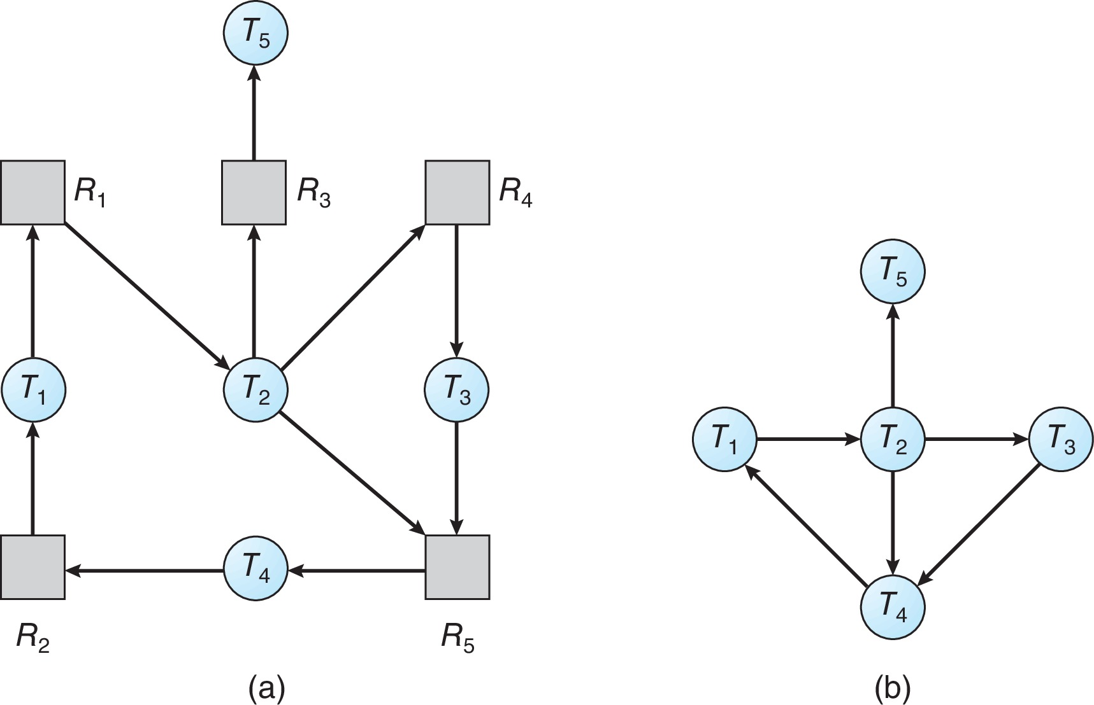
Resource-Allocation Graph and Wait-for Graph
Resource-Allocation Graph
Corresponding wait-for graph

Slide 43
Several Instances of a Resource Type
Available: A vector of length m indicates the number of available resources of each type
Allocation: An n x m matrix defines the number of resources of each type currently allocated to each process
Request: An n x m matrix indicates the current request of each process. If Request [i][j] = k, then process P_{i} is requesting k more instances of resource type R_{j}.

Slide 44
Detection Algorithm
Let Work and Finish be vectors of length m and n, respectively Initialize:
Work = Available
For i = 1,2, …, n, if Allocation_{i} ≠ 0, then Finish[i] = false; otherwise, Finish[i] = true
Find an index i such that both:
Finish[i] == false
Request_{i} ≤ Work
If no such i exists, go to step 4

Slide 45
Detection Algorithm (Cont.)
Work = Work + Allocation_{i} Finish[i] = true go to step 2
If Finish[i] == false, for some i, 1 ≤ i ≤ n, then the system is in deadlock state. Moreover, if Finish[i] == false, then P_{i} is deadlocked
Algorithm requires an order of O(m x n²) operations to detect whether the system is in deadlocked state

Slide 46
Example of Detection Algorithm
Five processes P₀ through P₄; three resource types A (7 instances), B (2 instances), and C (6 instances)
Snapshot at time T₀:
Allocation Request Available
A B C A B C A B C
P₀ 0 1 0 0 0 0 0 0 0
P₁ 2 0 0 2 0 2
P₂ 3 0 3 0 0 0
P₃ 2 1 1 1 0 0
P₄ 0 0 2 0 0 2
Sequence <P₀, P₂, P₃, P₁, P₄> will result in Finish[i] = true for all i

Slide 47
Example (Cont.)
P₂ requests an additional instance of type C
Allocation Request Available New Request
A B C A B C A B C A B C
P₀ 0 1 0 0 0 0 0 0 0 0 0 0
P₁ 2 0 0 2 0 2 2 0 2
P₂ 3 0 3 0 0 0 0 0 1
P₃ 2 1 1 1 0 0 1 0 0
P₄ 0 0 2 0 0 2 0 0 2
State of system?
Can reclaim resources held by process P₀, but insufficient resources to fulfill other processes; requests
Deadlock exists, consisting of processes P₁, P₂, P₃, and P₄

Slide 48
Detection-Algorithm Usage
When, and how often, to invoke depends on:
How often a deadlock is likely to occur?
How many processes will need to be rolled back?
one for each disjoint cycle
If detection algorithm is invoked arbitrarily, there may be many cycles in the resource graph and so we would not be able to tell which of the many deadlocked processes “caused” the deadlock.

Slide 49
Recovery from Deadlock: Process Termination
Abort all deadlocked processes
Abort one process at a time until the deadlock cycle is eliminated
In which order should we choose to abort?
Priority of the process
How long process has computed, and how much longer to completion
Resources the process has used
Resources process needs to complete
How many processes will need to be terminated
Is process interactive or batch?

Slide 50
Recovery from Deadlock: Resource Preemption
Selecting a victim – minimize cost
Rollback – return to some safe state, restart process for that state
Starvation – same process may always be picked as victim, include number of rollback in cost factor

Slide 51
Course Outcome
On completion of the course, the students will be able to
CO1 : explain operating system structure, services and system calls and identify appropriate system calls for a given service
CO2 : make use of process management strategies for scheduling processes
CO3 : apply different methods for process synchronization and deadlock handling
CO4 : make use of memory management strategies and apply page replacement policies to address demand paging
CO5 : apply various disk scheduling algorithms and elaborate file systems concepts

