Slide 1




20CSE43 – Operating Systems
UNIT III
1

Slide 2
Course Overview

Slide 3
Unit III
Process Synchronization : The Critical Section Problem - Peterson’s solution – Hardware support for Synchronization – Mutex Locks – Semaphores – Monitors. Deadlocks: Deadlock Characterization – Methods for handling deadlocks - Deadlock Prevention and Avoidance – Deadlock Detection – Recovery from Deadlock
CO3: apply different methods for process synchronization and deadlock handling

Slide 4
Background
A cooperating process is one that can affect or be affected by other processes executing in the system.
Processes can execute concurrently
May be interrupted at any time, partially completing execution
Concurrent access to shared data may result in data inconsistency
Maintaining data consistency requires mechanisms to ensure the orderly execution of cooperating processes

Slide 5
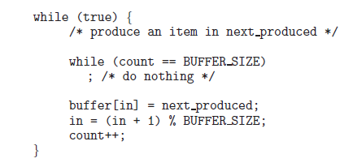
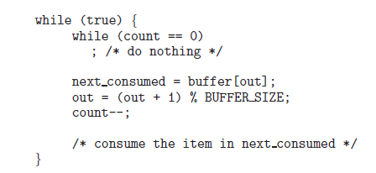


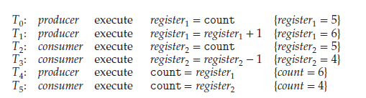
Race Condition - Example
Producer
Consumer
Count ++
Count --
Race Condition

Slide 6
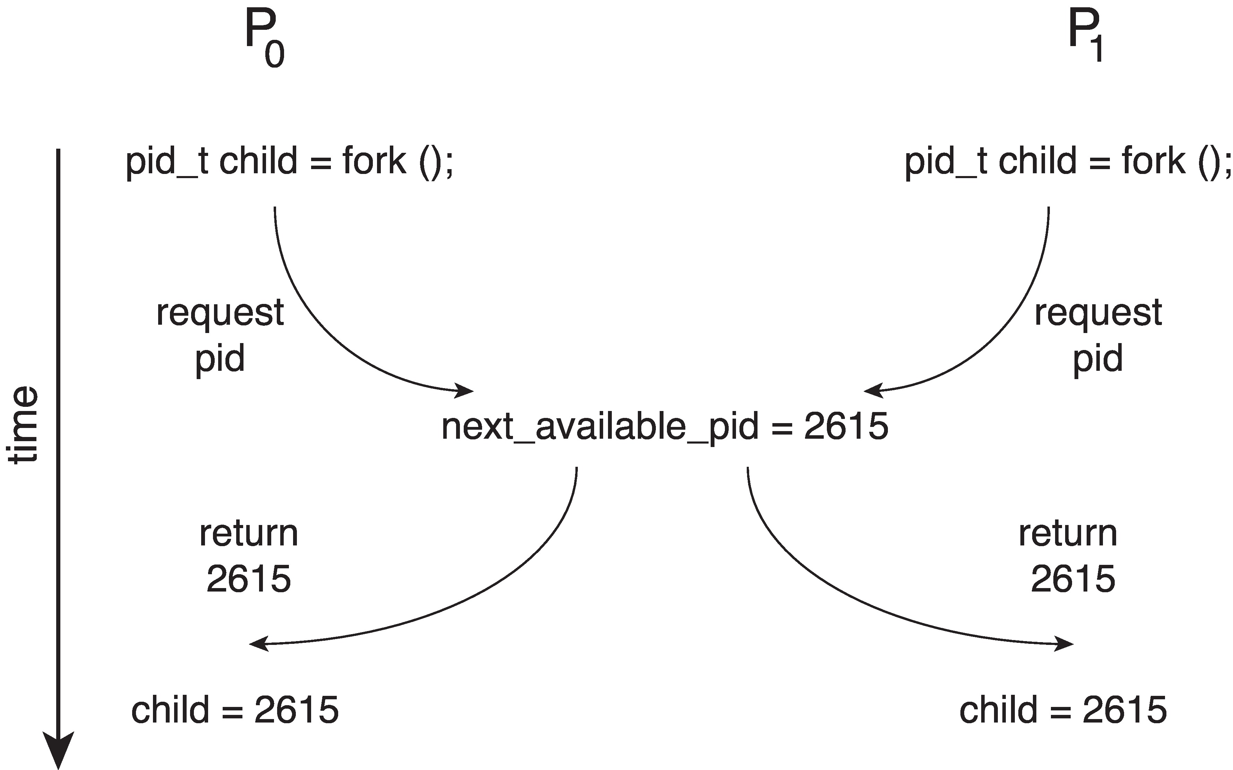
Race Condition
A situation where several processes access and manipulate the same data concurrently and the outcome of the execution depends on the particular order in which the access takes place, is called a race condition.
Processes P₀ and P₁ are creating child processes using the fork() system call
Race condition on kernel variable next_available_pid which represents the next available process identifier (pid) Unless there is a mechanism to prevent P₀ and P₁ from accessing the variable next_available_pid the same pid could be assigned to two different processes!

Slide 7
Critical Section Problem
Consider system of n processes {p₀, p₁, … p_{n-1}}
Each process has critical section segment of code
Process may be changing common variables, updating table, writing file, etc.
When one process in critical section, no other may be in its critical section
Critical section problem is to design a protocol to solve this
Each process must ask permission to enter critical section in entry section, may follow critical section with exit section, then remainder section

Slide 8
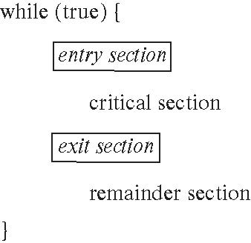
Critical Section
General structure of process P_{i}

Slide 9
Critical-Section Problem (Cont.)
Requirements for solution to critical-section problem
Mutual Exclusion - If process P_{i} is executing in its critical section, then no other processes can be executing in their critical sections
Progress - Progress means that if a process is not using the critical section, then it should not stop any other process from accessing it. In other words, any process can enter a critical section if it is free
Bounded Waiting - Bounded waiting means that each process must have a limited waiting time. It should not wait endlessly to access the critical section.

Slide 10
Peterson’s Solution
Two process solution
The two processes share two variables:
int turn;
boolean flag[2]
The variable turn indicates whose turn it is to enter the critical section
The flag array is used to indicate if a process is ready to enter the critical section.
flag[i] = true implies that process P_{i} is ready!

Slide 11
Algorithm for Process P_{i}
Algorithm for Process P_{j}
while (true)
{
flag[i] = true;
turn = j;
while (flag[j] && turn == j);
/* critical section */
flag[i] = false;
/* remainder section */
}
while(true)
{
flag[j] = true;
turn = i;
while (flag[i] && turn ==i);
/* critical section */
flag[j] = false;
/* remainder section */
}

Slide 12
Correctness of Peterson’s Solution
Provable that the three CS requirement are met:
1. Mutual exclusion is preserved
P_{i} enters CS only if:
either flag[j] = false or turn = i
2. Progress requirement is satisfied
3. Bounded-waiting requirement is met

Slide 13
Peterson’s Solution and Modern Architecture
Although useful for demonstrating an algorithm, Peterson’s Solution is not guaranteed to work on modern architectures.
To improve performance, processors and/or compilers may reorder operations that have no dependencies
Understanding why it will not work is useful for better understanding race conditions.
For single-threaded this is ok as the result will always be the same.
For multithreaded the reordering may produce inconsistent or unexpected results!

Slide 14
Modern Architecture Example
Two threads share the data: boolean flag = false; int x = 0;
Thread 1 performs while (!flag) ; print x
Thread 2 performs x = 100; flag = true
What is the expected output?
100

Slide 15
Modern Architecture Example (Cont.)
However, since the variables flag and x are independent of each other, the instructions:
flag = true; x = 100;
for Thread 2 may be reordered
If this occurs, the output may be 0!

Slide 16
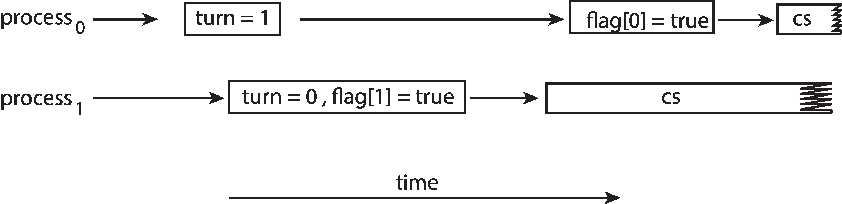
Peterson’s Solution Revisited
The effects of instruction reordering in Peterson’s Solution
This allows both processes to be in their critical section at the same time!
To ensure that Peterson’s solution will work correctly on modern computer architecture we must use Memory Barrier.

Slide 17
Peterson’s Solution Revisited
Process₀
Process₁
while (true)
{
turn = 1;
flag[0] = true;
while (flag[1] && turn == 1);
/* critical section */
flag[0] = false;
/* remainder section */
}
while(true)
{
turn = 0;
flag[1] = true;
while (flag[0] && turn ==0);
/* critical section */
flag[1] = false;
/* remainder section */
}

Slide 18
Hardware Support for Synchronization
Many systems provide hardware support for implementing the critical section code.
Uniprocessors – could disable interrupts
Currently running code would execute without preemption
Generally too inefficient on multiprocessor systems
Three hardware instructions that provide support for solving the critical-section problem are
Memory Barriers
Hardware Instructions
Atomic Variables

Slide 19
Memory Barriers
Memory model are the memory guarantees a computer architecture makes to application programs.
Memory models may be either:
Strongly ordered – where a memory modification of one processor is immediately visible to all other processors.
Weakly ordered – where a memory modification of one processor may not be immediately visible to all other processors.
A memory barrier is an instruction that forces any change in memory to be propagated (made visible) to all other processors.

Slide 20
Memory Barrier Instructions
When a memory barrier instruction is performed, the system ensures that all loads and stores are completed before any subsequent load or store operations are performed.
Therefore, even if instructions were reordered, the memory barrier ensures that the store operations are completed in memory and visible to other processors before future load or store operations are performed.

Slide 21
Memory Barrier Example
Returning to the example of slides 6.17 - 6.18
We could add a memory barrier to the following instructions to ensure Thread 1 outputs 100:
Thread 1 now performs while (!flag) memory_barrier(); print x
Thread 2 now performs x = 100; memory_barrier(); flag = true
For Thread 1 we are guaranteed that that the value of flag is loaded before the value of x.
For Thread 2 we ensure that the assignment to x occurs before the assignment flag.

Slide 22
Hardware Instructions
Special hardware instructions that allow us to either test-and-modify the content of a word, or to swap the contents of two words atomically (uninterruptedly.)
Test-and-Set instruction
Compare-and-Swap instruction
Test and set
A hardware solution to the synchronization problem
There is a shared lock variable which can take either 0 or 1
Before entering into the critical section, a process enquires about the lock
If it is locked, it keeps on waiting until it becomes free
If it is not locked, it takes the lock and executes the critical section

Slide 23
The test_and_set Instruction
Definition
boolean test_and_set (boolean *target)
{
boolean rv = *target;
*target = true;
return rv:
}
Properties
Executed atomically
Returns the original value of passed parameter
Set the new value of passed parameter to true
Atomic Operation

Slide 24
Solution Using test_and_set()
Shared boolean variable lock, initialized to false
Solution:
do { while (test_and_set(&lock))
; /* do nothing */
/* critical section */
lock = false;
/* remainder section */
} while (true);
Does it solve the critical-section problem?

Slide 25
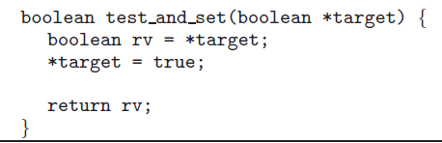
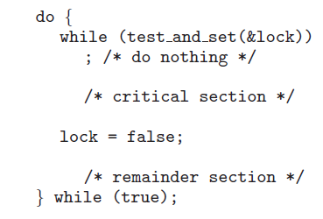
Solution Using test_and_set()
Process 1
Process 2

Slide 26
The compare_and_swap Instruction
Definition
int compare_and_swap(int *value, int expected, int new_value)
{
int temp = *value;
if (*value == expected)
*value = new_value;
return temp;
}
Properties
Executed atomically
Returns the original value of passed parameter value
Set the variable value the value of the passed parameter new_value but only if *value == expected is true. That is, the swap takes place only under this condition.

Slide 27
Solution using compare_and_swap
Shared integer lock initialized to 0;
Solution:
while (true){ while (compare_and_swap(&lock, 0, 1) != 0)
; /* do nothing */
/* critical section */
lock = 0;
/* remainder section */
}
Does it solve the critical-section problem?

Slide 28
Bounded-waiting with compare-and-swap
while (true) { waiting[i] = true; key = 1; while (waiting[i] && key == 1)
key = compare_and_swap(&lock,0,1);
waiting[i] = false;
/* critical section */
j = (i + 1) % n;
while ((j != i) && !waiting[j])
j = (j + 1) % n;
if (j == i)
lock = 0;
else
waiting[j] = false;
/* remainder section */
}
process Pi can enter its critical section only if either waiting[i] == false or
key == 0.

Slide 29
Atomic Variables
Typically, instructions such as compare-and-swap are used as building blocks for other synchronization tools.
One tool is an atomic variable that provides atomic (uninterruptible) updates on basic data types such as integers and booleans.
For example:
Let sequence be an atomic variable
Let increment() be operation on the atomic variable sequence
The Command:
increment(&sequence);
ensures sequence is incremented without interruption:

Slide 30
Atomic Variables
The increment() function can be implemented as follows: void increment(atomic_int *v) { int temp; do { temp = *v; } while (temp != (compare_and_swap(&v,temp,temp+1)); }

Slide 31
Mutex Locks
Previous solutions are complicated and generally inaccessible to application programmers
OS designers build software tools to solve critical section problem
Simplest is mutex lock
Boolean variable indicating if lock is available or not
Protect a critical section by
First acquire() a lock
Then release() the lock
Calls to acquire() and release() must be atomic
But this solution requires busy waiting. Busy waiting also wastes CPU cycles
This lock therefore called a spinlock because the process “spins” while waiting for the lock to become available.

Slide 32
Mutex Locks
Spinlock is a locking system mechanism. It allows a thread to acquire it to simply wait in loop until the lock is available i.e. a thread waits in a loop or spin until the lock is available. Spinlock is held for a short period of time. Spinlock are useful in multiprocessor system
Locks are either contended or uncontended.
A lock is considered contended if a thread blocks while trying to acquire the lock.
If a lock is available when a thread attempts to acquire it, the lock is considered uncontended.

Slide 33
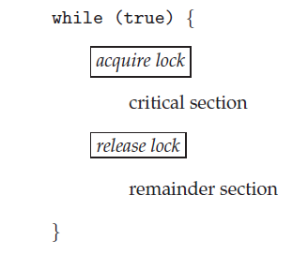
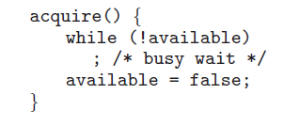

Solution to CS Problem Using Mutex Locks

Slide 34
Semaphore
Synchronization tool that provides more sophisticated ways (than Mutex locks) for processes to synchronize their activities.
Semaphore is a non negative variable shared between threads
Semaphore S – integer variable
Can only be accessed via two indivisible (atomic) operations
wait() and signal()
Originally called P() and V()
Definition of the wait() operation
wait(S) {
while (S <= 0)
; // busy wait
S--;
}
Definition of the signal() operation
signal(S) {
S++;
}

Slide 35
Semaphore (Cont.)
Counting semaphore – integer value can range over an unrestricted domain
Counting semaphore is initialized to the no. of resources available.
Binary semaphore – integer value can range only between 0 and 1
With semaphores we can solve various synchronization problems

Slide 36
Semaphore Usage Example
Solution to the CS Problem [ only one resource- Binary semaphore]
Create a semaphore “S” initialized to 1
Wait(S);
CS
signal(S);
Consider P₁ and P₂ that with two statements S₁ and S₂ and the requirement that S₁ to happen before S₂
Create a semaphore “S” initialized to 0
P1:
S₁;
signal(S);
P2:
wait(S);
S₂;

Slide 37
Semaphore Implementation
Wait ()
wait(S) {
while (S <= 0)
; // busy wait
S--;
}
busy waiting- unnecessarily wasting CPU cycles in executing the while loop in entry section.
Note that applications may spend lots of time in critical sections and therefore this is not a good solution

Slide 38
Semaphore Implementation with No Busy waiting
With each semaphore there is an associated waiting queue
Each entry in a waiting queue has two data items:
Value (of type integer)
Pointer to next record in the list
Two operations:
Sleep – place the process invoking the operation on the appropriate waiting queue
wakeup – remove one of processes in the waiting queue and place it in the ready queue

Slide 39
Implementation with no Busy waiting
Semaphore definition
typedef struct
{
int value;
struct process *list;
} semaphore;
wait(semaphore *S)
{
S->value--;
if (S->value < 0) { add this process to S->list;
sleep();
}
}
signal(semaphore *S)
{
S->value++;
if (S->value >= 0) { remove a process P from S->list;
wakeup(P);
}
}

Slide 40
Problem
A counting semaphore was initialized to 5. Then 6P (wait) operations and 4V (signal) operations were completed on this semaphore. The resulting value of the semaphore is
Answer : 5-6+4 = 3

Slide 41
Problem
The following two functions P1 and P2 that share a variable B with an initial value of 2 execute concurrently.
P1()
{
C = B – 1;
B = 2*C;
}
P2()
{
D = 2 * B;
B = D - 1;
}
The number of distinct values that B can possibly take after the execution is

Slide 42
Solution
C = B – 1; // C = 1
B = 2*C; // B = 2
D = 2 * B; // D = 4
B = D - 1; // B = 3
If we execute P2 process after P1 process, then B = 3
If we execute P1 process after P2 process, then B = 4
If we did preemption between P1 & P2 processes, then B = 2 (Preemption have done from P1 to P2) or B = 3 (Preemption have done from P2 to P1). So, among 2 & 3 values, only one value will be saved in B.
So, total no. of distinct values that B can possibly take after the execution is 3.

Slide 43
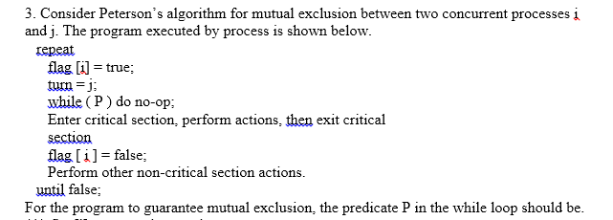
Problem

Slide 44
Solution
flag[j] = true and turn = j

Slide 45
Problem
Consider a non-negative counting semaphore S. The operation P(S) decrements S, and V(S) increments S. During an execution, 20 P(S) operations and 12 V(S) operations are issued in some order. The largest initial value of S for which at least one P(S) operation will remain blocked is _________.

Slide 46
Solution
We can assume the largest initial value of S for which at least one P(S) operation → X P(S) operation remain in blocked state therefore it will -1. The negative value of the counting semaphore indicates the number of processes in suspended list (or blocked). Take any sequence of 20P and 12V operations, at least one process will always remain blocked. So, X - 20 + 12 = -1 Here P(S) = 20 and V(S) = 12 X = 7

Slide 47
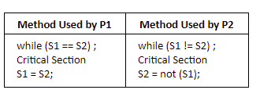
Problem
Consider the methods used by processes P1 and P2 for accessing their critical sections whenever needed, as given below. The initial values of shared boolean variables S1 and S2 are randomly assigned. Note : P1 may not be interested in entering the CS.
Which one of the following statements describes the properties achieved?
A | Mutual exclusion but not progress
B | Progress but not mutual exclusion
C | Neither mutual exclusion nor progress
D | Both mutual exclusion and progress

Slide 48
Solution
In this mutual exclusion is satisfied because at any point of time either S1 = S2 or S1 ≠ S2, but not both.
But here progress is not satisfied because suppose S1 = 1 and S2 = 0 and P1 is not interested to enter into critical section but P2 wants to enter into critical section, and P2 will not be able to enter, because until P1 will not enter critical section, S1 will not become equal to S2.
So if one process do not interested in entering critical section, will not allow other process to enter critical section which is interested. So progress is not satisfied.

Slide 49
Problems with Semaphores
Incorrect use of semaphore operations:
signal(mutex) …. wait(mutex)
wait(mutex) … wait(mutex)
Omitting of wait (mutex) and/or signal (mutex)
These – and others – are examples of what can occur when semaphores and other synchronization tools are used incorrectly.

Slide 50
Advantages of Monitors
Monitors are easy to implement than semaphores.
Mutual exclusion in monitors is automatic while in semaphores, mutual exclusion needs to be implemented explicitly.
Monitors can overcome the timing errors that occur while using semaphores.
Shared variables are global to all processes in the monitor while shared variables are hidden in semaphores.

Slide 51
Monitors
A high-level abstraction that provides a convenient and effective mechanism for process synchronization
ADT—encapsulates data with a set of functions to operate on that data that are independent of any specific implementation of the ADT.
Abstract data type, internal variables only accessible by code within the procedure
A monitor type is an ADT that includes a set of programmer-defined operations that are provided with mutual exclusion within the monitor
Only one process may be active within the monitor at a time

Slide 52
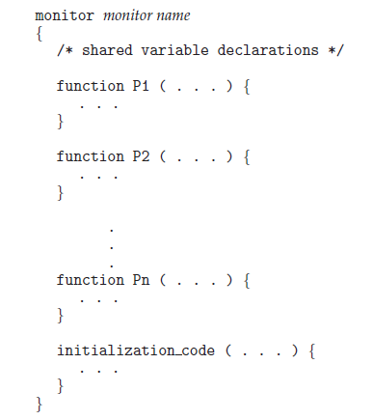
Pseudocode syntax of a monitor

Slide 53
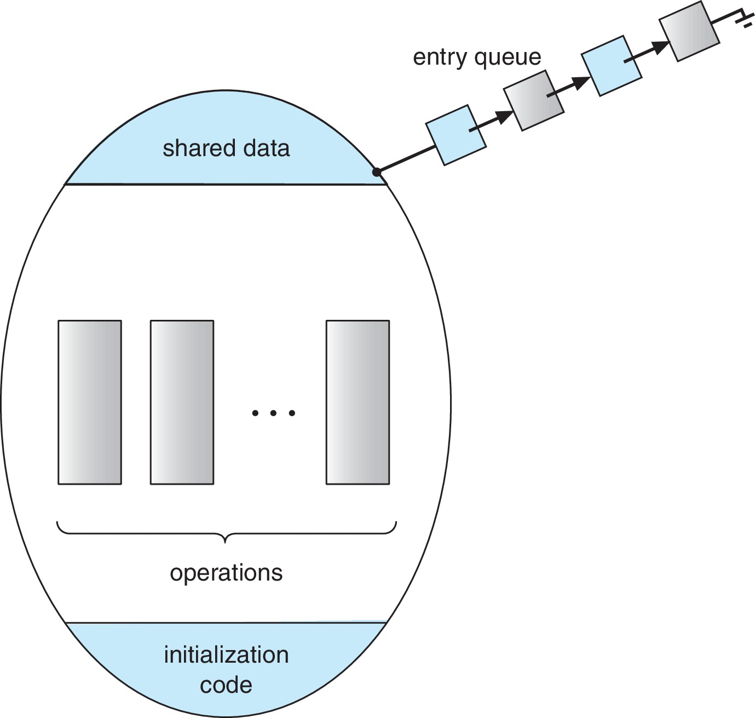
Schematic view of a Monitor

Slide 54
Condition Variables
Additional synchronization mechanisms are provided by the condition construct.
condition x, y;
Two operations are allowed on a condition variable:
x.wait() – the process invoking this operation is suspended until another process invokes x.signal();
x.signal() – resumes one of processes (if any) that invoked x.wait()
If no x.wait() on the variable, then it has no effect on the variable

Slide 55
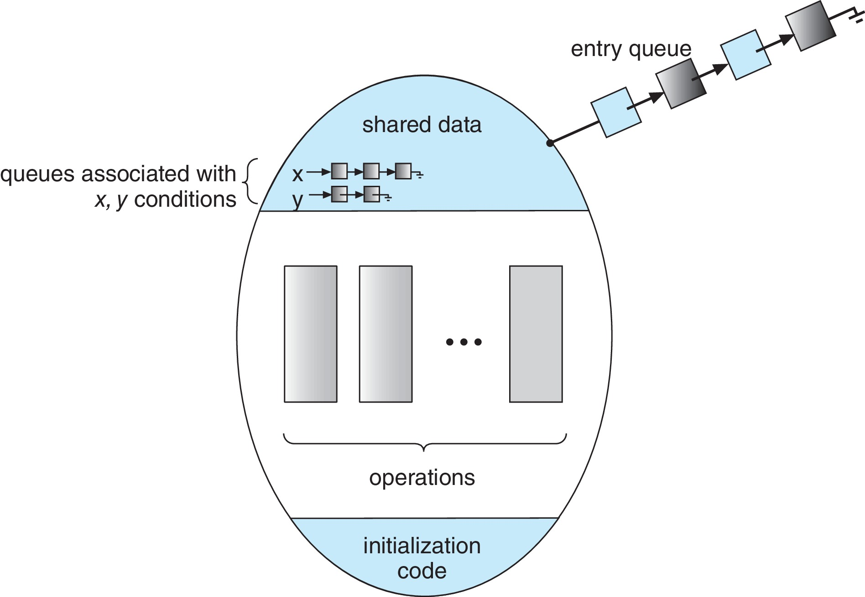
Monitor with Condition Variables

Slide 56
Usage of Condition Variable Example
Consider P₁ and P₂ that need to execute two statements S₁ and S₂ and the requirement that S₁ to happen before S₂
Create a monitor with two procedures F₁ and F₂ that are invoked by P₁ and P₂ respectively
One condition variable “x” initialized to 0
One Boolean variable “done”
F1:
S₁;
done = true;
x.signal();
F2:
if done = false
x.wait()
S₂;

Slide 57
Condition Variables Choices
If process P invokes x.signal(), and process Q is suspended in x.wait(), what should happen next?
Both Q and P cannot execute in parallel. If Q is resumed, then P must wait
Options include
Signal and wait – P waits until Q either leaves the monitor or it waits for another condition
Signal and continue – Q waits until P either leaves the monitor or it waits for another condition

Slide 58
Monitor Implementation Using Semaphores
Variables
semaphore mutex
mutex = 1
Each procedure P is replaced by
wait(mutex);
…
body of P;
…
signal(mutex);
Mutual exclusion within a monitor is ensured

Slide 59
Monitor Implementation Using Semaphores
Variables
semaphore mutex; // (initially = 1)
semaphore next; // (initially = 0)
int next_count = 0; // number of processes waiting inside the monitor
Each function P will be replaced by
wait(mutex);
…
body of P;
…
if (next_count > 0)
signal(next)
else
signal(mutex);
Mutual exclusion within a monitor is ensured

Slide 60
Implementation – Condition Variables
For each condition variable x, we have:
semaphore x_sem; // (initially = 0)
int x_count = 0;
The operation x.wait() can be implemented as:
x_count++;
if (next_count > 0)
signal(next);
else
signal(mutex);
wait(x_sem);
x_count--;

Slide 61
Implementation (Cont.)
The operation x.signal() can be implemented as:
if (x_count > 0) {
next_count++;
signal(x_sem);
wait(next);
next_count--;
}

Slide 62
Resuming Processes within a Monitor
If several processes queued on condition variable x, and x.signal() is executed, which process should be resumed?
FCFS frequently not adequate
Use the conditional-wait construct of the form
x.wait(c)
where:
c is an integer (called the priority number)
The process with lowest number (highest priority) is scheduled next

Slide 63
Single Resource allocation
Allocate a single resource among competing processes using priority numbers that specifies the maximum time a process plans to use the resource
R.acquire(t);
...
access the resurce;
...
R.release;
Where R is an instance of type ResourceAllocator
Where t is the maximum time a process plans to use the resource

Slide 64
A Monitor to Allocate Single Resource
monitor ResourceAllocator
{
boolean busy;
condition x;
void acquire(int time) {
if (busy)
x.wait(time);
busy = true;
}
void release() {
busy = false;
x.signal();
}
initialization code() {
busy = false;
}
}

Slide 65
Single Resource Monitor (Cont.)
Usage:
acquire
...
release
Incorrect use of monitor operations
release() … acquire()
acquire() … acquire())
Omitting of acquire() and/or release()

Slide 66
Course Outcome
On completion of the course, the students will be able to
CO1 : explain operating system structure, services and system calls and identify appropriate system calls for a given service
CO2 : make use of process management strategies for scheduling processes
CO3 : apply different methods for process synchronization and deadlock handling
CO4 : make use of memory management strategies and apply page replacement policies to address demand paging
CO5 : apply various disk scheduling algorithms and elaborate file systems concepts

