Slide 1




20CSE43 – Operating Systems
UNIT II
1

Slide 2
Unit II
Process Management:: Process Concept, Process Scheduling, Operations on Processes, Interprocess Communication – IPC in Shared Memory and Message Passing Systems. CPU Scheduling: Scheduling Criteria – Scheduling Algorithms. Multithreaded Programming: Threads Overview, Multicore Programming, Multithreading Models.
CO2: make use of process management strategies for scheduling processes

Slide 3
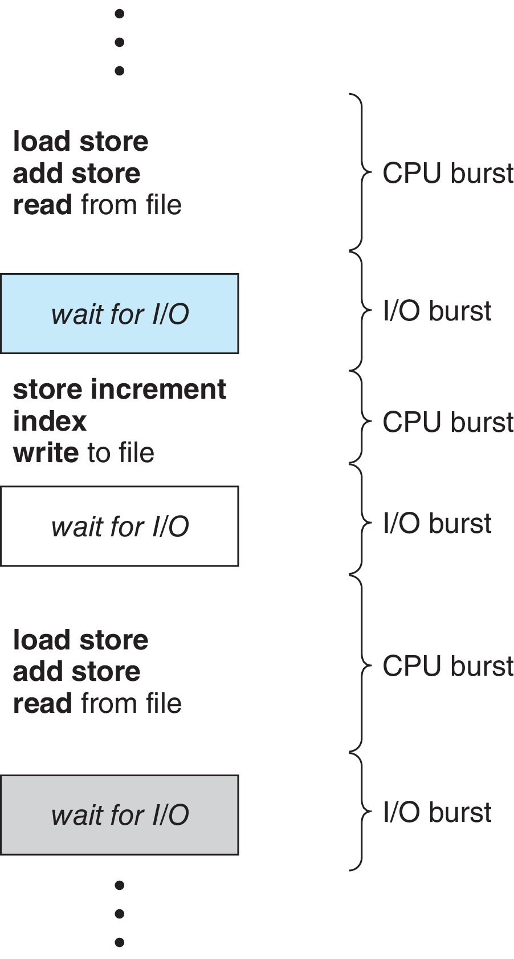
Basic Concepts
Maximum CPU utilization obtained with multiprogramming
Scheduling is a fundamental operating-system function
CPU Burst: Time that a process spends on the CPU executing some code.
I/O Burst: Time that a process spends in waiting for the completion of the I/O request
CPU–I/O Burst Cycle – Process execution consists of a cycle of CPU execution and I/O wait
CPU burst followed by I/O burst
CPU burst distribution is of main concern

Slide 4
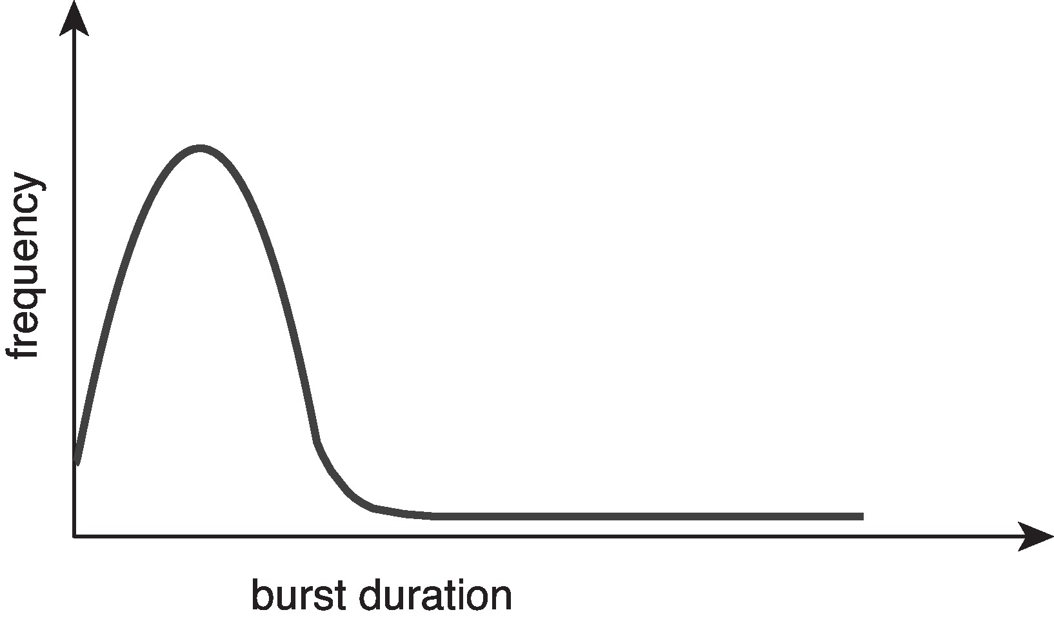
Histogram of CPU-burst Times
Large number of short CPU bursts
Small number of longer CPU bursts
An I/O-bound program typically has many short CPU bursts.
A CPU-bound program might have a few long CPU bursts.

Slide 5
CPU Scheduler
The CPU scheduler selects from among the processes in ready queue, and allocates a CPU core to one of them
Queue may be ordered in various ways as FIFO queue, a priority queue, a tree, or simply an unordered linked list
The records in the queues are generally process control blocks (PCBs) of the processes.
CPU scheduling decisions may take place when a process:
1. Switches from running to waiting state
2. Switches from running to ready state
3. Switches from waiting to ready
4. Terminates
For situations 1 and 4, there is no choice in terms of scheduling. A new process (if one exists in the ready queue) must be selected for execution.
For situations 2 and 3, however, there is a choice.

Slide 6
Preemptive and Nonpreemptive Scheduling
When scheduling takes place only under circumstances 1 and 4, the scheduling scheme is nonpreemptive.
Otherwise, it is preemptive.
In preemptive scheduling, the CPU is allocated to the processes for a limited time.
Under Nonpreemptive scheduling, once the CPU has been allocated to a process, the process keeps the CPU until it releases it either by terminating or by switching to the waiting state.
Virtually all modern operating systems including Windows, MacOS, Linux, and UNIX use preemptive scheduling algorithms.

Slide 7
Preemptive Scheduling and Race Conditions
Preemptive scheduling can result in race conditions when data are shared among several processes.
Consider the case of two processes that share data. While one process is updating the data, it is preempted so that the second process can run. The second process then tries to read the data, which are in an inconsistent state.

Slide 8
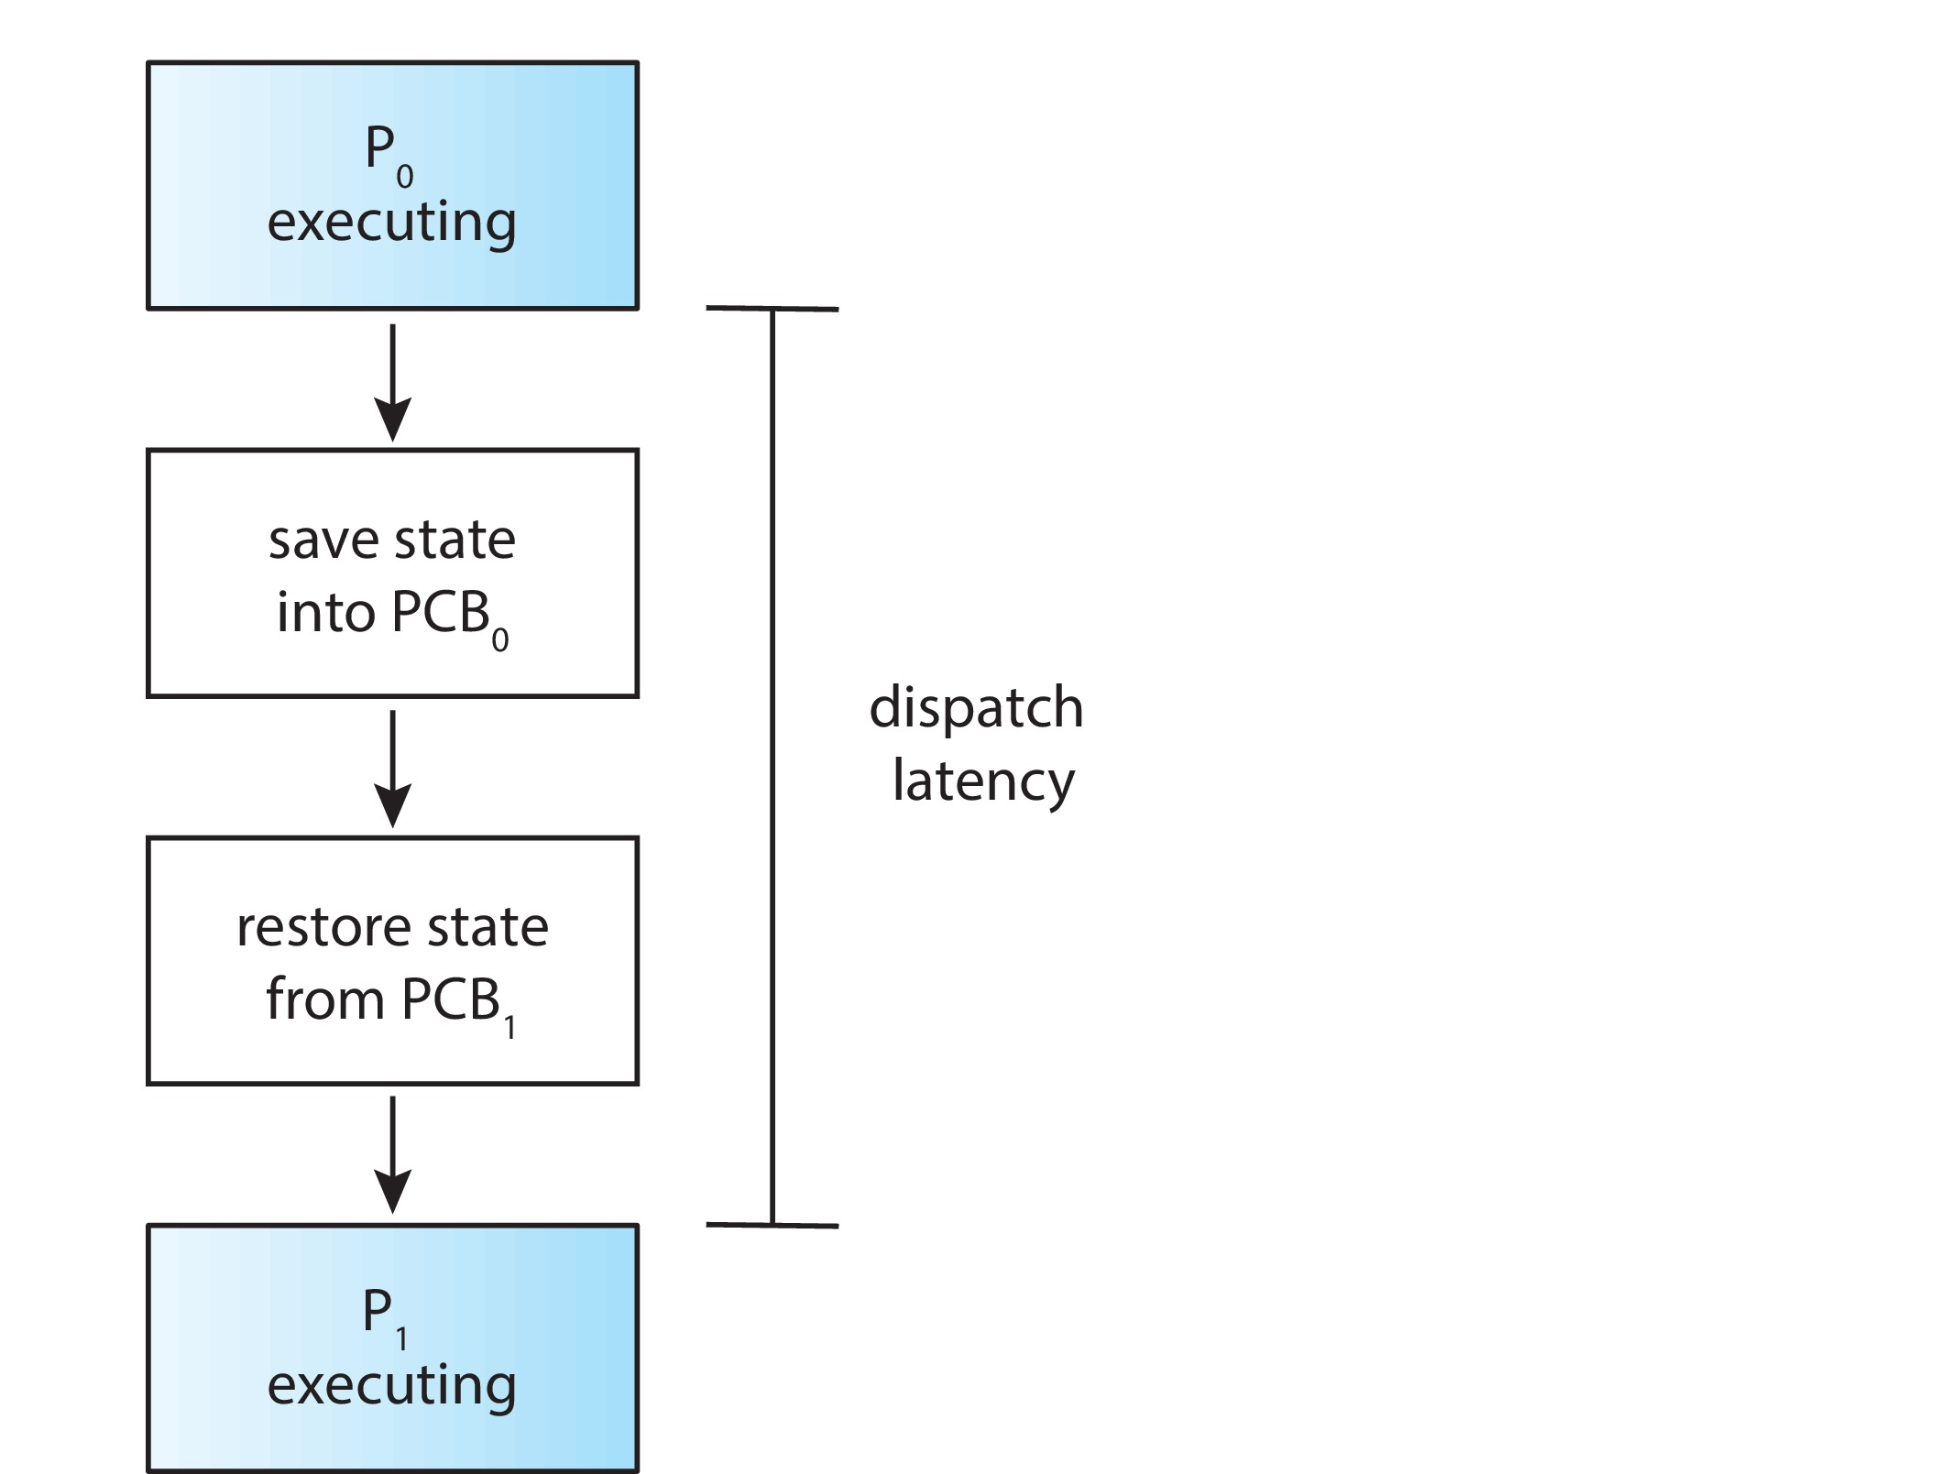
Dispatcher
Dispatcher module gives control of the CPU to the process selected by the CPU scheduler; this involves:
Switching context
Switching to user mode
Jumping to the proper location in the user program to restart that program
Dispatch latency – time it takes for the dispatcher to stop one process and start another running

Slide 9
Scheduling Criteria
CPU utilization – keep the CPU as busy as possible – 40 to 90%
Throughput – # of processes that complete their execution per time unit
Turnaround time – amount of time to execute a particular process. sum of the periods spent waiting in the ready queue, executing on the CPU, and doing I/O.
Turn Around Time = Completion Time – Arrival Time
Turn around time = Waiting Time + Burst Time
Waiting time – amount of time a process has been waiting in the ready queue
Waiting Time = Turnaround time – Burst Time
Response time – amount of time it takes from when a request was submitted until the first response is produced.

Slide 10
Scheduling Algorithm Optimization Criteria
Max CPU utilization
Max throughput
Min turnaround time
Min waiting time
Min response time

Slide 11
Scheduling Algorithm
First-Come, First-Served Scheduling
Shortest-Job-First Scheduling
Shortest-remaining time-first Scheduling
Round-Robin Scheduling
Priority Scheduling
Multilevel Queue Scheduling
Multilevel Feedback Queue Scheduling

Slide 12
First- Come, First-Served (FCFS) Scheduling
The process that requests the CPU first is allocated the CPU first
Process Burst Time
P₁ 24
P₂ 3
P₃ 3
Suppose that the processes arrive in the order: P₁ , P₂ , P₃ The Gantt Chart for the schedule is:
Waiting time for P₁ = 0; P₂ = 24; P₃ = 27
Average waiting time: (0 + 24 + 27)/3 = 17

Slide 13
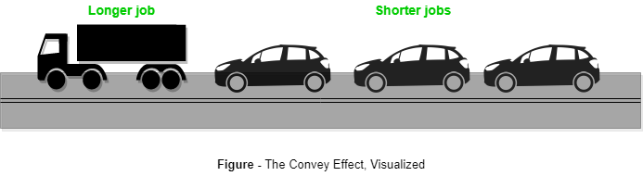
FCFS Scheduling (Cont.)
Suppose that the processes arrive in the order: P₂ , P₃ , P₁
The Gantt chart for the schedule is:
Waiting time for P₁ = 6; P₂ = 0; P₃ = 3
Average waiting time: (6 + 0 + 3)/3 = 3
Much better than previous case
Convoy effect - short process behind long process
Consider one CPU-bound and many I/O-bound processes

Slide 14
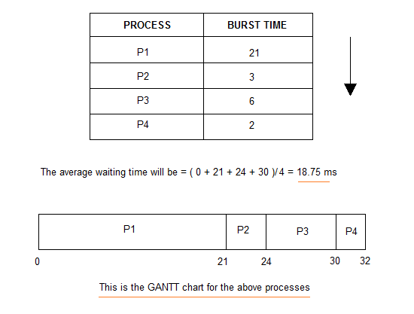
FCFS Scheduling (Cont.)

Slide 15
FCFS Scheduling (Cont.)

Slide 16
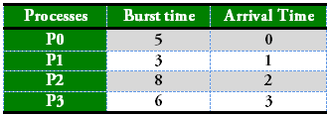
FCFS Scheduling (Processes with different arrival times)

Slide 17
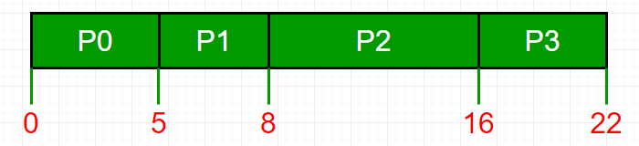
FCFS Scheduling (Processes with different arrival times)
Waiting time for P₀ = 0; P₁ = 5-1 = 4; P₂ = 8-2=6 P₃ = 16-3 = 13
Average Waiting time = (0+4+6+13)/4=5.75

Slide 18
FCFS Scheduling (Processes with different arrival times)
Process | Arrival Time | CPU Burst Time
P1 | 0 | 3
P2 | 1 | 1
P3 | 3 | 3
P4 | 4 | 2

Slide 19
FCFS Scheduling (Processes with different arrival times)
Process | Arrival Time | CPU Burst Time
P1 | 0 | 3
P2 | 1 | 1
P3 | 3 | 3
P4 | 4 | 2
P1(3) | P2(1) | P3(3) | P4(2)
0 | 3 | 4 | 7 9
Waiting time for P₁ = 0; P₂ = 3-1 = 2; P₃ = 4-3=1 P₄ = 7-4 = 3
Average Waiting time = (0+2+1+3)/4=1.5

Slide 20
Shortest-Job-First (SJF) Scheduling
Associate with each process the length of its next CPU burst
Use these lengths to schedule the process with the shortest time
SJF is optimal – gives minimum average waiting time for a given set of processes
Preemptive version called shortest-remaining-time-first

Slide 21
Example of SJF
ProcessArriva l Time Burst Time
P₁ 0.0 6
P₂ 2.0 8
P₃ 4.0 7
P₄ 5.0 3
SJF scheduling chart
Average waiting time = (3 + 16 + 9 + 0) / 4 = 7

Slide 22
Example of SJF

Slide 23
Example of SJF
P4(2) | P2(3) | P3(6) | P1(21)
0 | 2 | 5 | 32
Waiting time for P₁ = 11; P₂ = 2; P₃ = 5 P₄ = 0
Average Waiting time = (11+2+5+0)/4=4.5

Slide 24
Example of Shortest-remaining-time-first
Now we add the concepts of varying arrival times and preemption to the analysis
ProcessA arri Arrival TimeT Burst Time
P₁ 0 8
P₂ 1 4
P₃ 2 9
P₄ 3 5
Preemptive SJF Gantt Chart
Average waiting time = [(10-1)+(1-1)+(17-2)+(5-3)]/4 = 26/4 = 6.5

Slide 25
Example of Shortest-remaining-time-first
Process | Arrival Time | CPU Burst Time
P1 | 0 | 3
P2 | 1 | 1
P3 | 3 | 3
P4 | 4 | 2
P1(1) | P2(1) | P1(2) | P4(2) | P3(3)
0 | 1 | 2 | 4 | 6 9
Waiting time for P₁ = 1; P₂ = 0; P₃ = 3 P₄ = 0
Average Waiting time = (1+0+3+0)/4=1
Turn around time= waiting time + burst time
Turn around time=P₁ = 4; P₂ = 1; P₃ = 6 P₄ = 2

Slide 26
Round Robin (RR)
Each process gets a small unit of CPU time (time quantum q), usually 10-100 milliseconds. After this time has elapsed, the process is preempted and added to the end of the ready queue.
If there are n processes in the ready queue and the time quantum is q, then each process gets 1/n of the CPU time in chunks of at most q time units at once. No process waits more than (n-1)q time units.
Timer interrupts every quantum to schedule next process
Performance
q large ⇒ FIFO
q small ⇒ q must be large with respect to context switch, otherwise overhead is too high

Slide 27
Example of RR with Time Quantum = 4
Process Burst Time
P₁ 24
P₂ 3
P₃ 3
The Gantt chart is:
Typically, higher average turnaround than SJF, but better response
q should be large compared to context switch time
q usually 10 milliseconds to 100 milliseconds,
Context switch < 10 microseconds

Slide 28
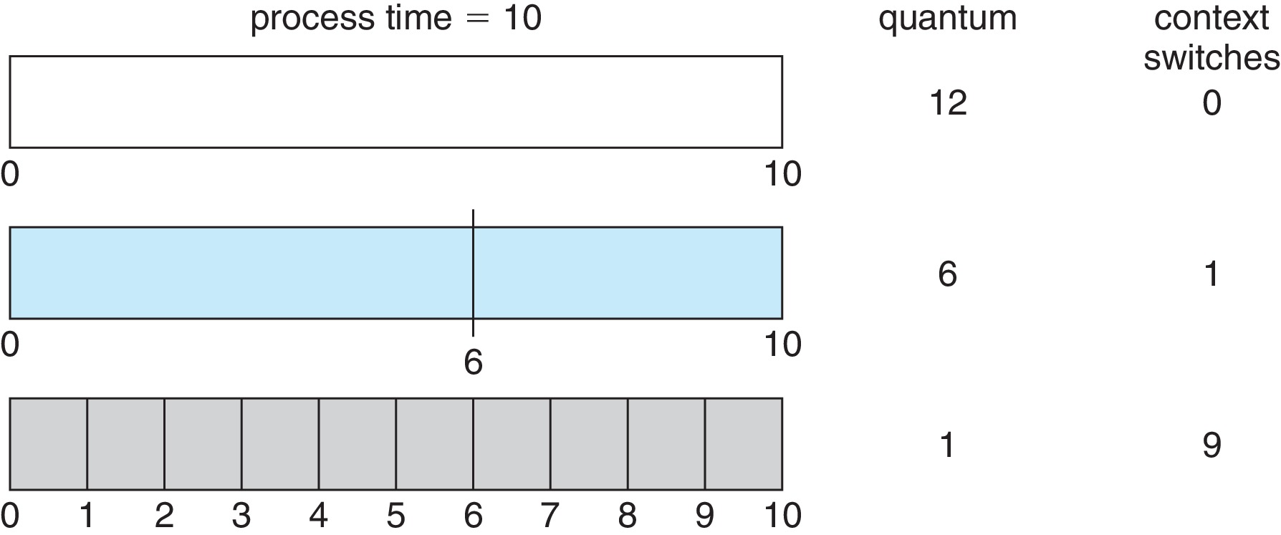
Time Quantum and Context Switch Time

Slide 29
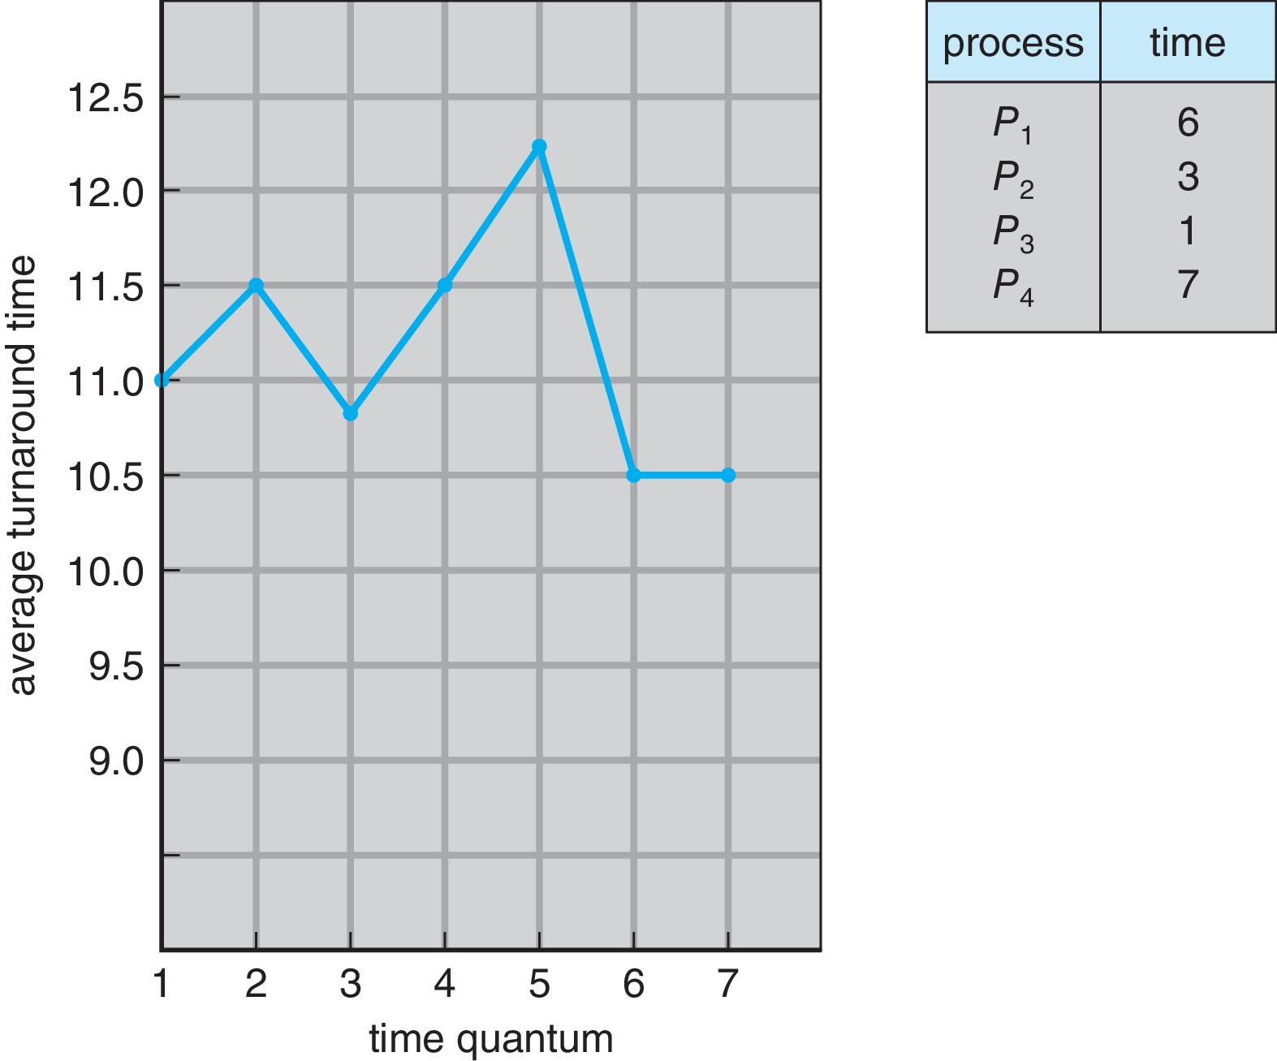
Turnaround Time Varies With The Time Quantum
80% of CPU bursts should be shorter than q

Slide 30
Priority Scheduling
A priority number (integer) is associated with each process
The CPU is allocated to the process with the highest priority (smallest integer = highest priority)
Preemptive
Nonpreemptive
SJF is priority scheduling where priority is the inverse of predicted next CPU burst time
Problem ≡ Starvation – low priority processes may never execute
Solution ≡ Aging – as time progresses increase the priority of the process

Slide 31
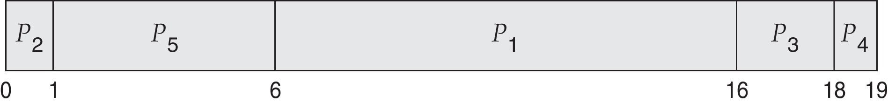
Example of Priority Scheduling
ProcessA arri Burst TimeT Priority
P₁ 10 3
P₂ 1 1
P₃ 2 4
P₄ 1 5
P₅ 5 2
Priority scheduling Gantt Chart
Average waiting time = 8.2

Slide 32
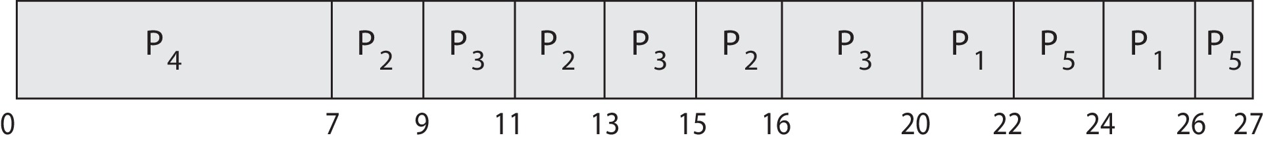
Priority Scheduling w/ Round-Robin
ProcessA arri Burst TimeT Priority
P₁ 4 3
P₂ 5 2
P₃ 8 2
P₄ 7 1
P₅ 3 3
Run the process with the highest priority. Processes with the same priority run round-robin
Gantt Chart with time quantum = 2

Slide 33
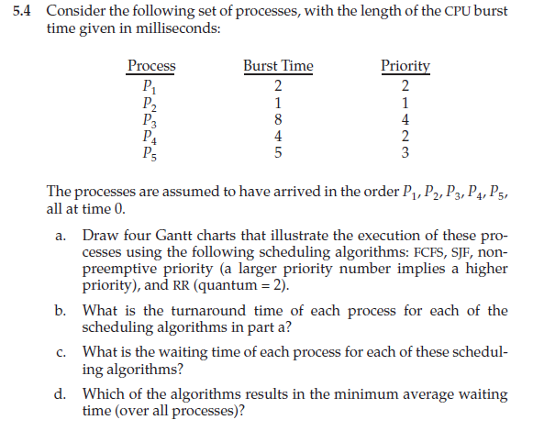
Problem

Slide 34
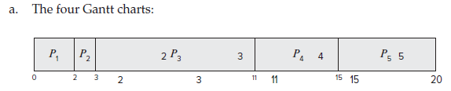
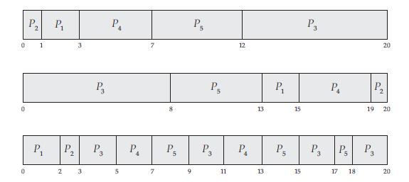
Solution

Slide 35
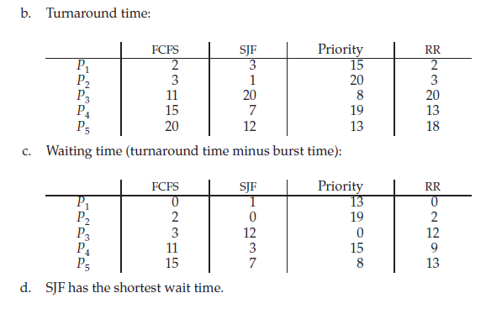
Solution

Slide 36
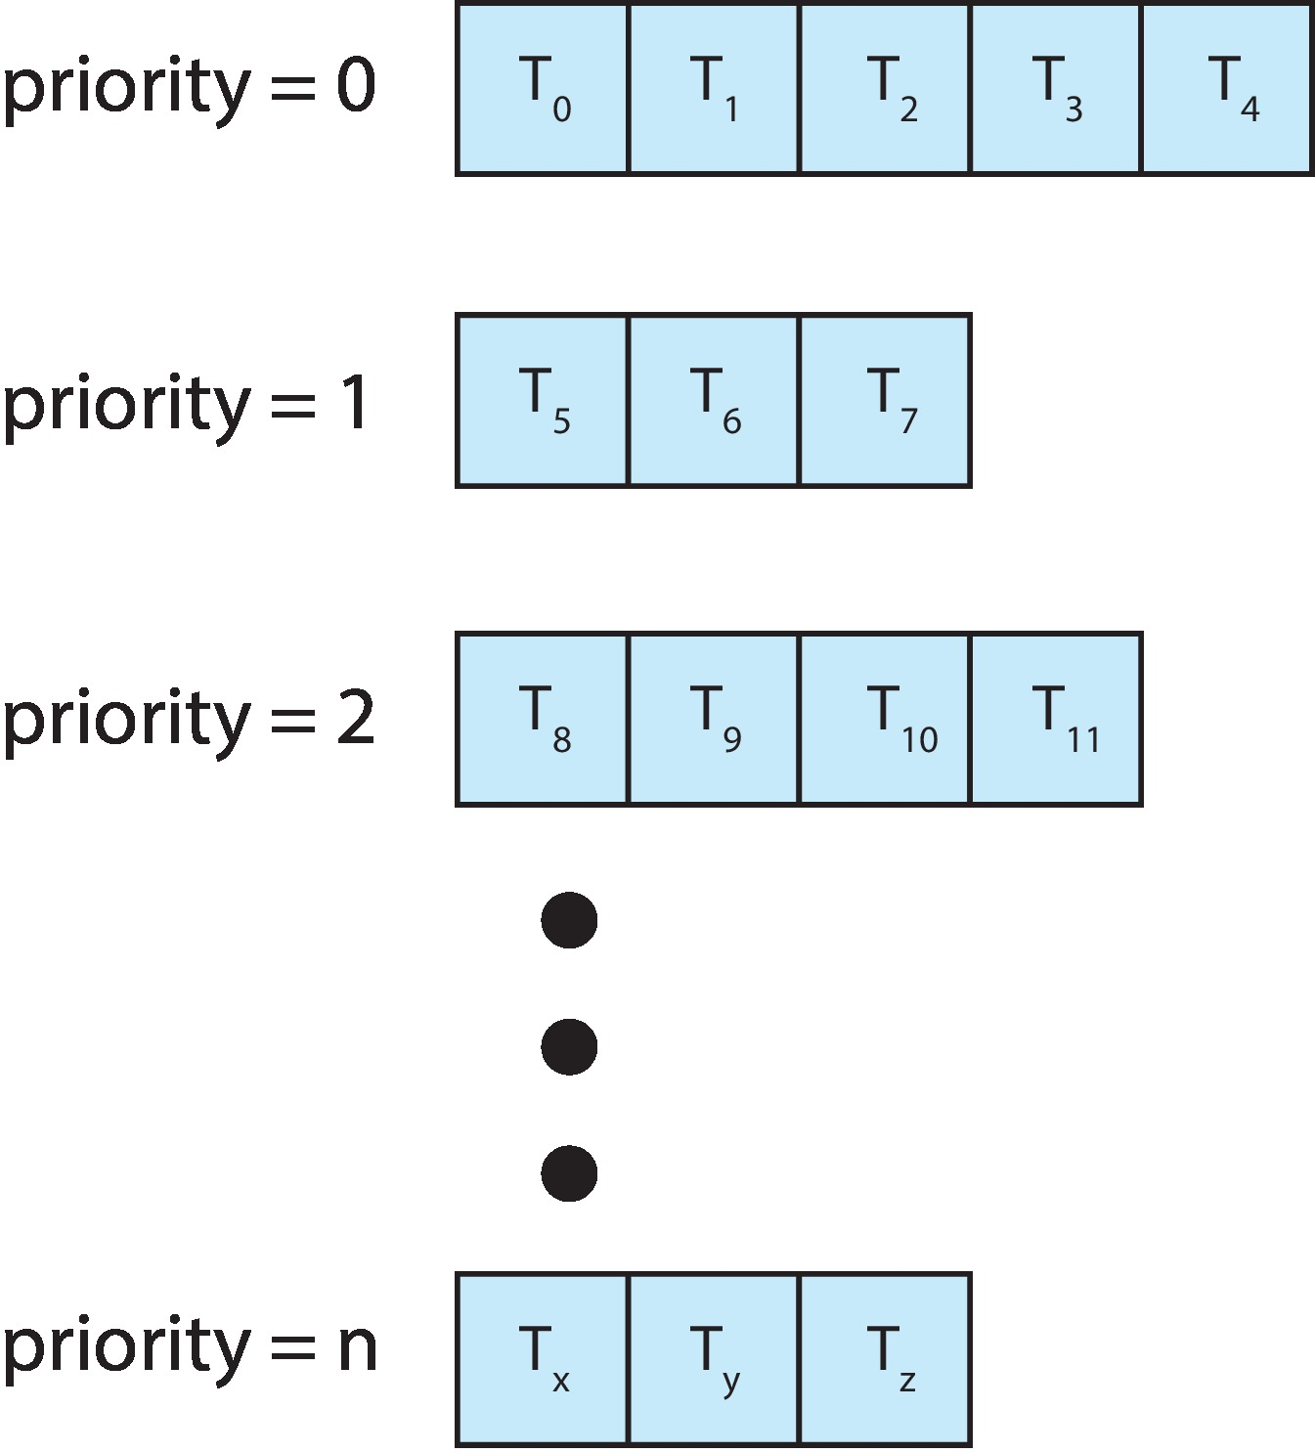
Multilevel Queue
With priority scheduling, have separate queues for each priority.
Schedule the process in the highest-priority queue!

Slide 37
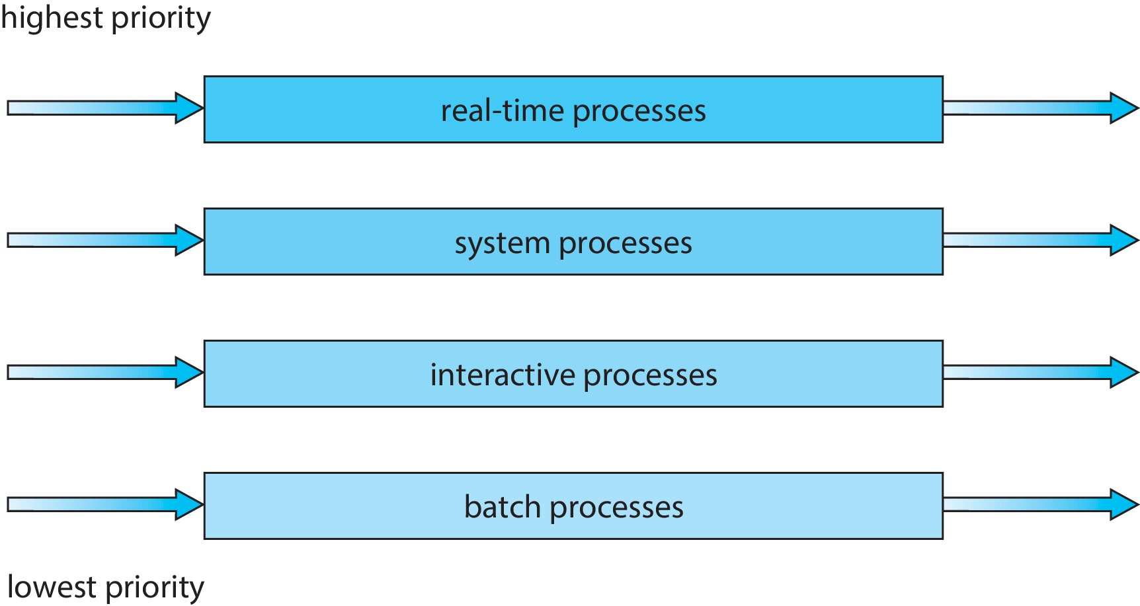
Multilevel Queue
Prioritization based upon process type

Slide 38
Multilevel Feedback Queue
A process can move between the various queues.
Multilevel-feedback-queue scheduler defined by the following parameters:
Number of queues
Scheduling algorithms for each queue
Method used to determine when to upgrade a process
Method used to determine when to demote a process
Method used to determine which queue a process will enter when that process needs service
Aging can be implemented using multilevel feedback queue

Slide 39
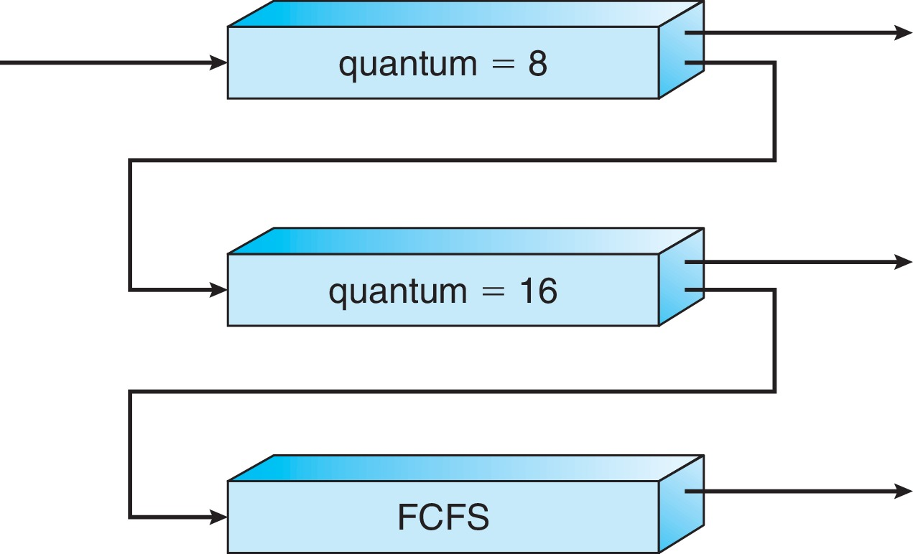
Example of Multilevel Feedback Queue
Three queues:
Q₀ – RR with time quantum 8 milliseconds
Q₁ – RR time quantum 16 milliseconds
Q₂ – FCFS
Scheduling
A new process enters queue Q₀ which is served in RR
When it gains CPU, the process receives 8 milliseconds
If it does not finish in 8 milliseconds, the process is moved to queue Q₁
At Q₁ job is again served in RR and receives 16 additional milliseconds
If it still does not complete, it is preempted and moved to queue Q₂

