Slide 1

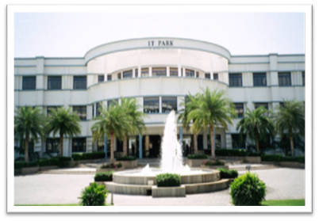


20CSE43 – Operating Systems
UNIT IV
1

Slide 2
UNIT IV
Memory Management
Main Memory: Background – Contiguous Memory Allocation – Segmentation – Paging – Swapping. Virtual Memory: Background – Demand Paging – Page Replacement – Case study: Intel 32 Architecture.
2

Slide 3
Objectives
To provide a detailed description of various ways of organizing memory hardware
To discuss various memory-management techniques,
To provide a detailed description of the Intel Pentium, which supports both pure segmentation and segmentation with paging

Slide 4
Background
Program must be brought (from disk) into memory and placed within a process for it to be run
Main memory and registers are only storage, CPU can access directly
Memory unit only sees a stream of:
addresses + read requests, or
address + data and write requests
Register access is done in one CPU clock (or less)
Main memory can take many cycles, causing a stall
Cache sits between main memory and CPU registers
Protection of memory required to ensure correct operation

Slide 5
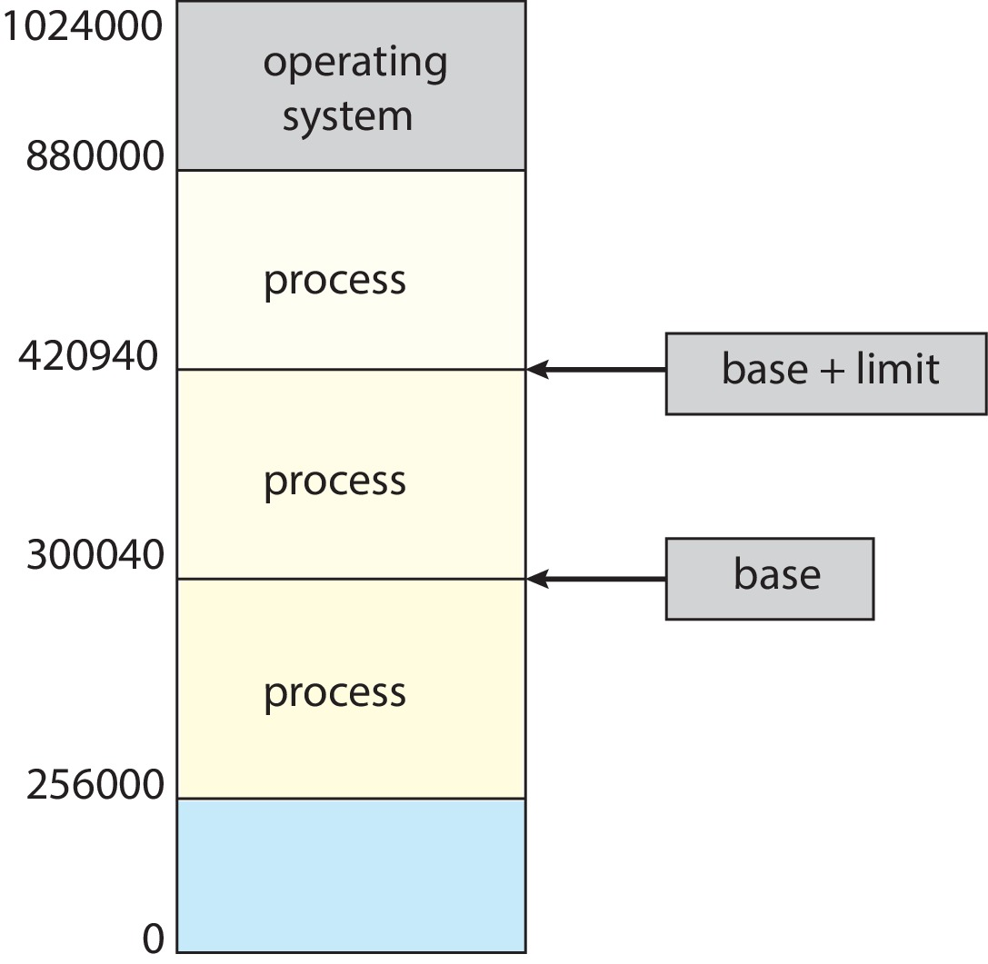
Protection
Need to ensure that a process can access only those addresses in its address space.
We can provide this protection by using a pair of base and limit registers define the logical address space of a process
Base register – holds smallest legal physical memory address
Limit register - specifies the size of the range

Slide 6
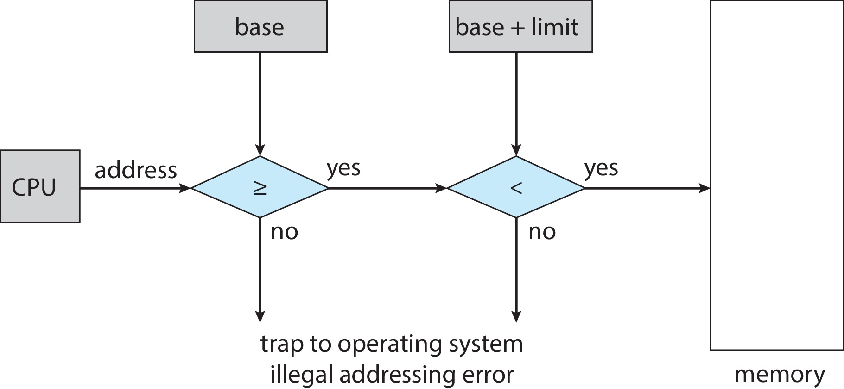
Hardware Address Protection
CPU must check every memory access generated in user mode to be sure it is between base and limit for that user
the instructions to loading the base and limit registers are privileged

Slide 7
Address Binding
Programs on disk, ready to be brought into memory to execute form an input queue
Most systems allow a user process to reside in any part of the physical memory. Although the address space of the computer may start at 00000, the first address of the user process need not be
Addresses represented in different ways at different stages of a program’s life
Source code addresses usually symbolic
Compiled code addresses bind to relocatable addresses
i.e., “14 bytes from beginning of this module”
Linker or loader will bind relocatable addresses to absolute addresses
i.e., 74014
Each binding maps one address space to another

Slide 8
Binding of Instructions and Data to Memory
Address binding of instructions and data to memory addresses can happen at three different stages
Compile time: If memory location known a priori, absolute code can be generated; must recompile code if starting location changes
Load time: Must generate relocatable code if memory location is not known at compile time
Execution time: Binding delayed until run time if the process can be moved during its execution from one memory segment to another
Need hardware support for address maps (e.g., base and limit registers)

Slide 9
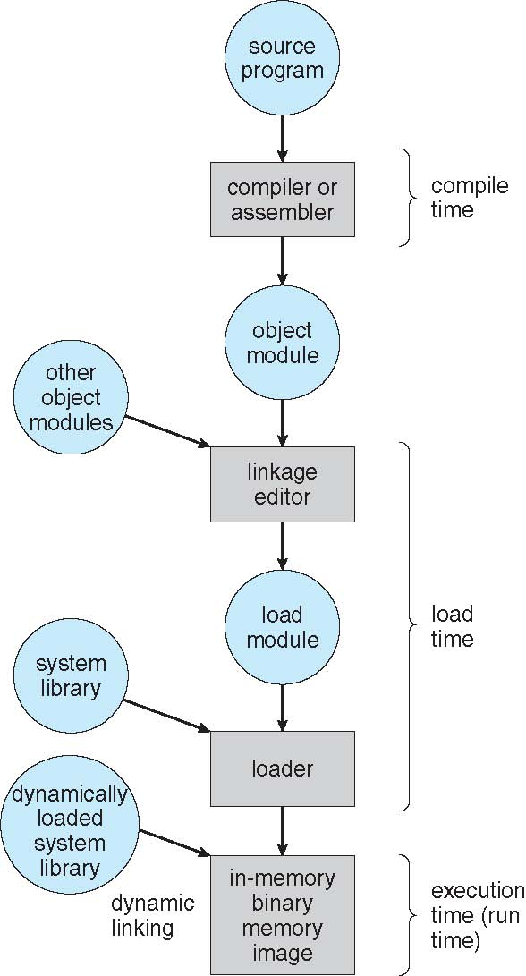
Multistep Processing of a User Program

Slide 10
Logical vs. Physical Address Space
The concept of a logical address space that is bound to a separate physical address space is central to proper memory management
Logical address – generated by the CPU; also referred to as virtual address
Physical address – address seen by the memory unit
Logical and physical addresses are the same in compile-time and load-time address-binding schemes; logical (virtual) and physical addresses differ in execution-time address-binding scheme
Logical address space is the set of all logical addresses generated by a program
Physical address space is the set of all physical addresses generated by a program

Slide 11
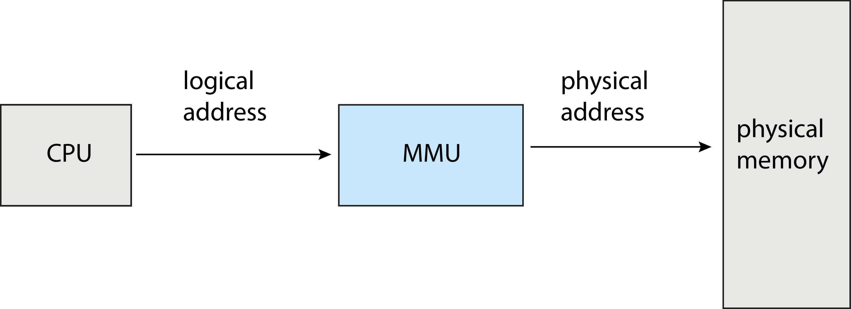
Memory-Management Unit (MMU)
Hardware device that at run time maps virtual to physical address
Many methods possible, covered in the rest of this chapter

Slide 12
Memory-Management Unit (Cont.)
Consider simple scheme. which is a generalization of the base-register scheme.
The base register now called relocation register
The value in the relocation register is added to every address generated by a user process at the time it is sent to memory
The user program deals with logical addresses; it never sees the real physical addresses
Execution-time binding occurs when reference is made to location in memory
Logical address bound to physical addresses

Slide 13
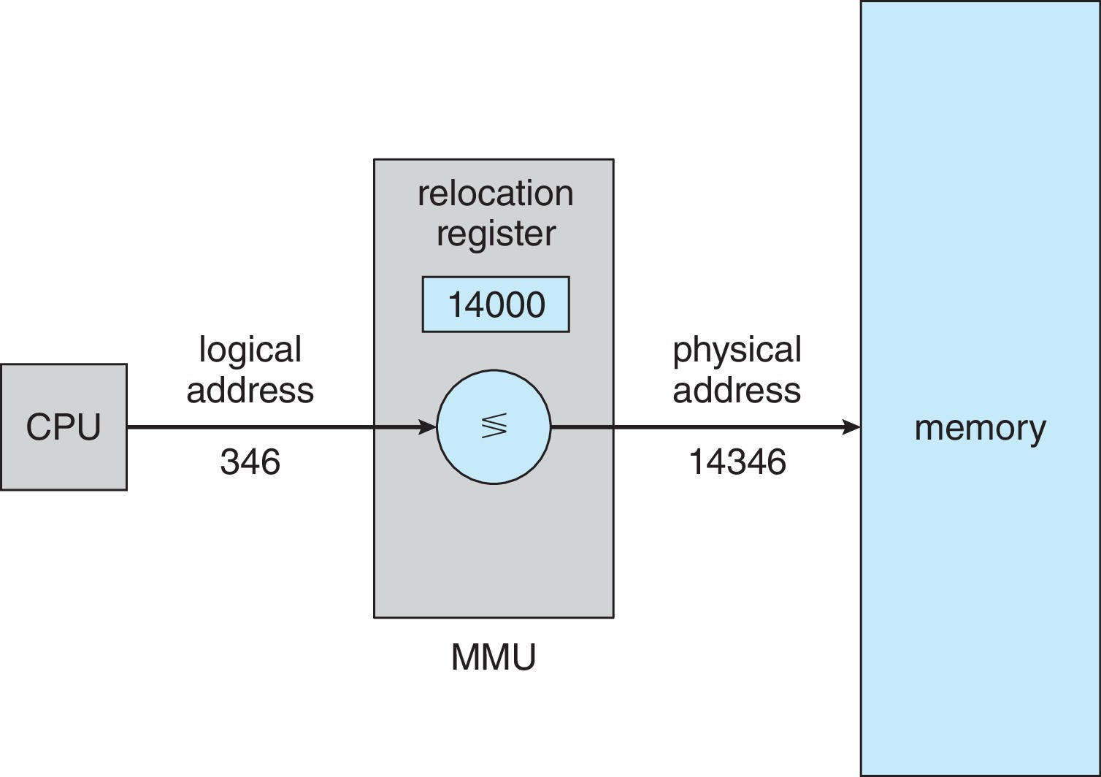
Memory-Management Unit (Cont.)
Consider simple scheme. which is a generalization of the base-register scheme.
The base register now called relocation register
The value in the relocation register is added to every address generated by a user process at the time it is sent to memory

Slide 14
Dynamic Loading
The entire program does need to be in memory to execute
Routine is not loaded until it is called
Better memory-space utilization; unused routine is never loaded
All routines kept on disk in relocatable load format
Useful when large amounts of code are needed to handle infrequently occurring cases
No special support from the operating system is required
Implemented through program design
OS can help by providing libraries to implement dynamic loading

Slide 15
Dynamic Linking
Static linking – system libraries and program code combined by the loader into the binary program image
Dynamic linking –linking postponed until execution time
Small piece of code, stub, used to locate the appropriate memory-resident library routine
Stub replaces itself with the address of the routine, and executes the routine
Operating system checks if routine is in processes’ memory address
If not in address space, add to address space
Dynamic linking is particularly useful for libraries
System also known as shared libraries
Consider applicability to patching system libraries
Versioning may be needed

Slide 16
Contiguous Allocation
Main memory must support both OS and user processes
Limited resource, must allocate efficiently
Contiguous allocation is one early method
Main memory usually divided into two partitions:
Resident operating system, usually held in low memory with interrupt vector
User processes then held in high memory
Each process contained in single contiguous section of memory

Slide 17
Contiguous Allocation (Cont.)
Relocation registers used to protect user processes from each other, and from changing operating-system code and data
Base register contains value of smallest physical address
Limit register contains range of logical addresses – each logical address must be less than the limit register
MMU maps logical address dynamically
Can then allow actions such as kernel code being transient and kernel changing size

Slide 18
Memory Allocation
Contiguous allocation : only one memory segment (with continuous memory )
Fixed – size partition or static partitioning
Variable-size partition or dynamic partitioning
first-fit, best-fit, worst-fit
Non- Contiguous allocation : many segment ( not continuous) are allocated
Paging
segmentation

Slide 19
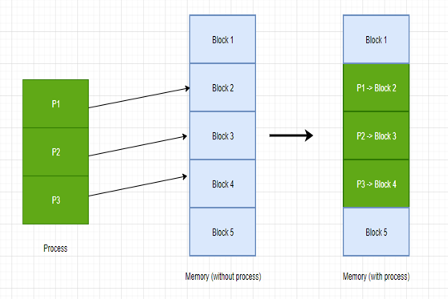
Contiguous allocation
Non-Contiguous allocation

Slide 20
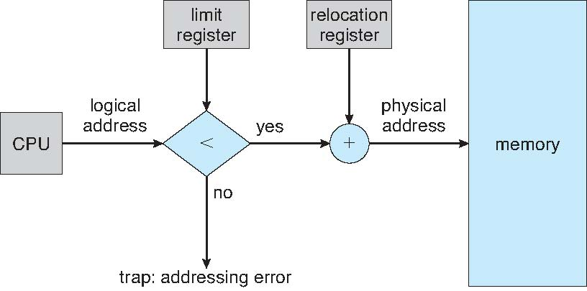
Hardware Support for Relocation and Limit Registers

Slide 21
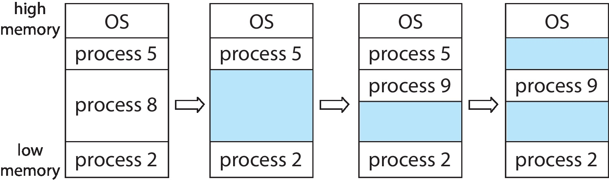
Variable Partitioning
Multiple-partition allocation
Degree of multiprogramming limited by number of partitions
Variable-partition sizes for efficiency (sized to a given process’ needs)
Hole – block of available memory; holes of various size are scattered throughout memory
When a process arrives, it is allocated memory from a hole large enough to accommodate it
Process exiting frees its partition, adjacent free partitions combined
Operating system maintains information about: a) allocated partitions b) free partitions (hole)

Slide 22
Dynamic Storage-Allocation Problem
How to satisfy a request of size n from a list of free holes?
First-fit: Allocate the first hole that is big enough
Best-fit: Allocate the smallest hole that is big enough; must search entire list, unless ordered by size
Produces the smallest leftover hole
Worst-fit: Allocate the largest hole; must also search entire list
Produces the largest leftover hole
First-fit and best-fit better than worst-fit in terms of speed and storage utilization

Slide 23
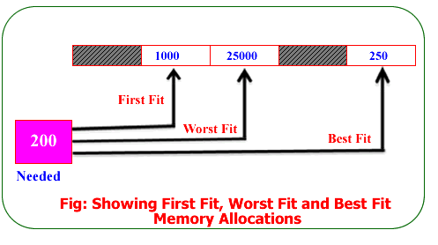
Dynamic Storage-Allocation Problem

Slide 24
Fragmentation
External Fragmentation – total memory space exists to satisfy a request, but it is not contiguous
Internal Fragmentation – allocated memory may be slightly larger than requested memory; this size difference is memory internal to a partition, but not being used
First fit analysis reveals that given N blocks allocated, 0.5 N blocks lost to fragmentation
1/3 may be unusable -> 50-percent rule

Slide 25
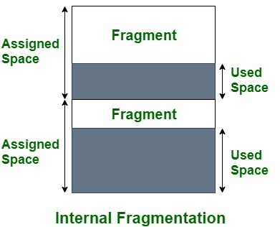
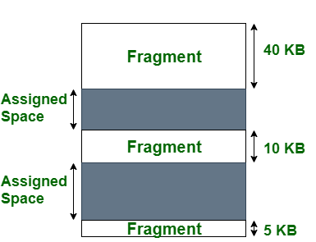
Internal Vs External Fragmentation
External Fragmentation

Slide 26
Fragmentation (Cont.)
Reduce external fragmentation by compaction
Shuffle memory contents to place all free memory together in one large block
Compaction is possible only if relocation is dynamic, and is done at execution time
I/O problem
Latch job in memory while it is involved in I/O
Do I/O only into OS buffers
Now consider that backing store has same fragmentation problems

Slide 27
Problem
Given six memory partitions of 300 KB, 600 KB, 350 KB, 200 KB, 750 KB, and 125 KB (in order), how would the first-fit, best-fit, and worst-fit algorithms place processes of size 115 KB, 500 KB, 358 KB, 200 KB, and 375 KB (in order)?

Slide 28
Solution – First Fit
115 KB is put in 300-KB partition, leaving 185 KB, 600 KB, 350 KB, 200 KB, 750 KB, 125 KB
500 KB is put in 600-KB partition, leaving 185 KB, 100 KB, 350 KB, 200 KB, 750 KB, 125 KB
358 KB is put in 750-KB partition, leaving 185 KB, 100 KB, 350 KB, 200 KB, 392 KB, 125 KB
200 KB is put in 350-KB partition, leaving 185 KB, 100 KB, 150 KB, 200 KB, 392 KB, 125 KB
375 KB is put in 392-KB partition, leaving 185 KB, 100 KB, 150 KB, 200 KB, 17 KB, 125 KB

Slide 29
Solution – Best Fit
115 KB is put in 125-KB partition, leaving 300 KB, 600 KB, 350 KB, 200 KB, 750 KB, 10 KB
500 KB is put in 600-KB partition, leaving 300 KB, 100 KB, 350 KB, 200 KB, 750 KB, 10 KB
358 KB is put in 750-KB partition, leaving 300 KB, 100 KB, 350 KB, 200 KB, 392 KB, 10 KB
200 KB is put in 200-KB partition, leaving 300 KB, 100 KB, 350 KB, 0 KB, 392 KB, 10 KB
375 KB is put in 392-KB partition, leaving 300 KB, 100 KB, 350 KB, 0 KB, 17 KB, 10 KB

Slide 30
Solution – Worst Fit
115 KB is put in 750-KB partition, leaving 300 KB, 600 KB, 350 KB, 200 KB, 635 KB, 125 KB
500 KB is put in 635-KB partition, leaving 300 KB, 600 KB, 350 KB, 200 KB, 135 KB, 125 KB
358 KB is put in 600-KB partition, leaving 300 KB, 242 KB, 350 KB, 200 KB, 135 KB, 125 KB
200 KB is put in 350-KB partition, leaving 300 KB, 242 KB, 150 KB, 200 KB, 135 KB, 125 KB
375 KB must wait

Slide 31
Problem
Suppose a computer system has six memory partitions with sizes of 200 KB, 350 KB, 125 KB, 600 KB, 300 KB, and 750 KB (in order). Assume that the system uses the first-fit, best-fit, and worst-fit algorithms for memory allocation. Determine how each algorithm would allocate memory for processes with sizes of 100 KB, 450 KB, 375 KB, 200 KB, and 550 KB (in order).
Given memory partition of 100K ,500K, 200K, 300K and 600K (in order). How would each of the first fit, best fit and worst fit algorithm place process of 212 K, 417 K, 112K, and 426 K(in order)? Which algorithm makes the most efficient use of memory?

Slide 32
Paging
Physical address space of a process can be noncontiguous; process is allocated in physical memory whenever the latter is available
Avoids external fragmentation
Avoids problem of varying sized memory chunks
Divide physical memory into fixed-sized blocks called frames
Size is power of 2, between 512 bytes and 16 Mbytes
Divide logical memory into blocks of same size called pages
Keep track of all free frames
To run a program of size N pages, need to find N free frames and load program
Set up a page table to translate logical to physical addresses
Backing store likewise split into pages
Still have Internal fragmentation

Slide 33
Address Translation Scheme
Address generated by CPU is divided into:
Page number (p) – used as an index into a per-process page table which contains base address of each page in physical memory
Page offset (d) – combined with base address to define the physical memory address that is sent to the memory unit
For given logical address space 2^{m} and page size 2^{n}

Slide 34
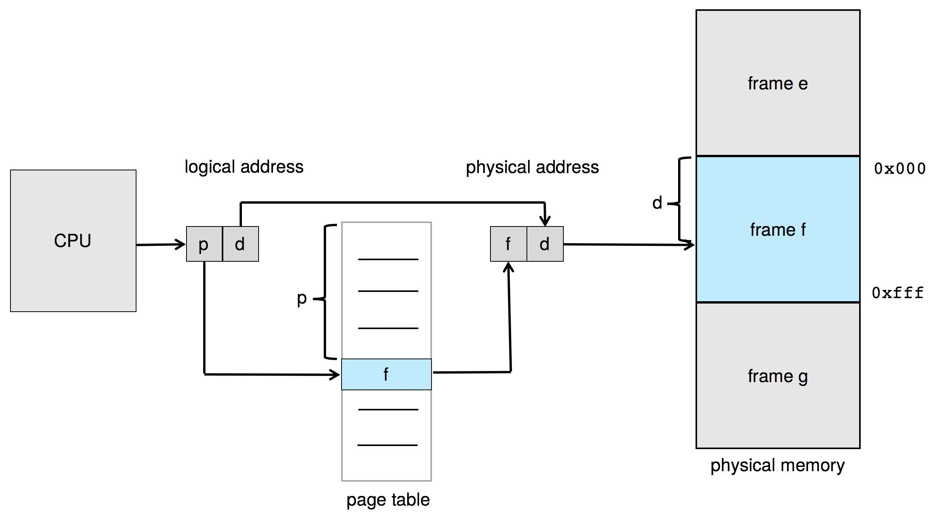
Paging Hardware

Slide 35
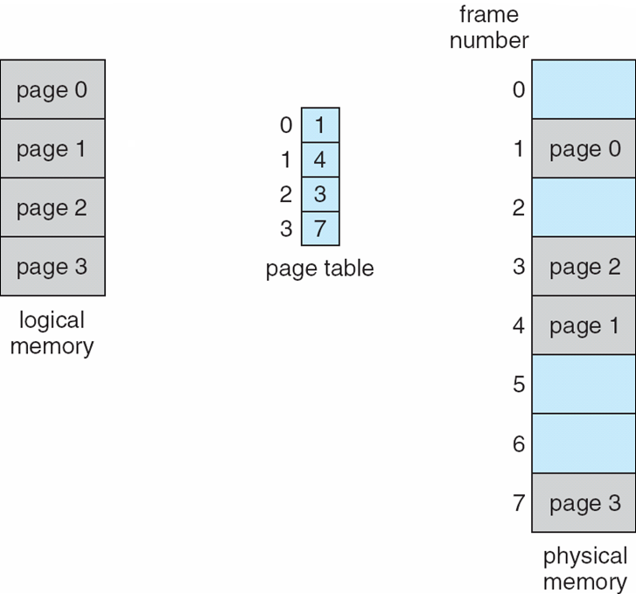
Paging Model of Logical and Physical Memory

Slide 36
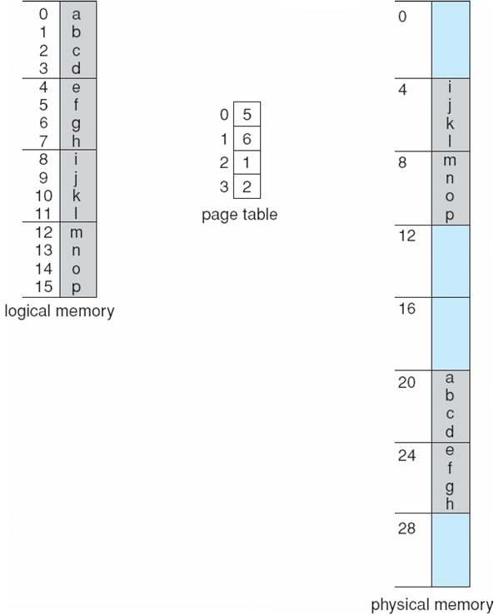
Paging Example
Logical address: n = 2 and m = 4. Using a page size of 4 bytes and a physical memory of 32 bytes (8 pages)
Thus, logical address 0 maps to physical address 20 [= (5 × 4) + 0].
Logical address 3 (page 0, offset 3) maps to physical address 23 [= (5 × 4) + 3].
Logical address 13 maps to physical address = ?

Slide 37
Paging -- Calculating internal fragmentation
Page size = 2,048 bytes
Process size = 72,766 bytes
35 pages + 1,086 bytes
Internal fragmentation of 2,048 - 1,086 = 962 bytes
Worst case fragmentation = 1 frame – 1 byte
On average fragmentation = 1 / 2 frame size
So small frame sizes desirable?
But each page table entry takes memory to track
Page sizes growing over time
Solaris supports two page sizes – 8 KB and 4 MB

Slide 38
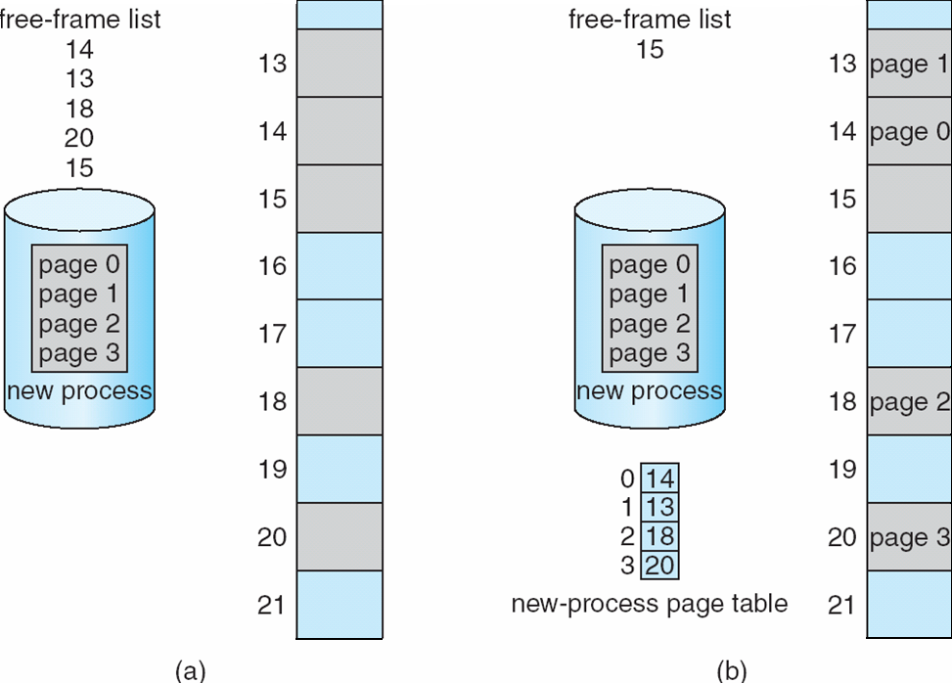
Free Frames
Before allocation
After allocation

Slide 39
Problem
Consider a logical address space of 64 pages of 1024 words each, mapped onto a physical memory of 32 frames.
a. How many bits are there in the logical address?
b. How many bits are there in the physical address?

Slide 40
Solution
a. Size of logical address space = 2^{m} = # of pages × page size
2^{m} = 64 × 1024
2^{m} = 2⁶ × 2¹⁰
2^{m} =2¹⁶ »» m=16 bit
b. Size of physical address space = 2^{x}
Size of physical address space = # of frames × frame size
(frame size = page size )
Size of physical address space = 32 × 1024
2^{x} =2⁵ × 2¹⁰
2^{x} = 2¹⁵
»» number of required bits in the physical address=x =15 bit

Slide 41
Implementation of Page Table
Page table is kept in main memory
Page-table base register (PTBR) points to the page table
Page-table length register (PTLR) indicates size of the page table
In this scheme every data/instruction access requires two memory accesses
One for the page table and one for the data / instruction
The two-memory access problem can be solved by the use of a special fast-lookup hardware cache called translation look-aside buffers (TLBs) (also called associative memory).

Slide 42
Translation Look-Aside Buffer
Some TLBs store address-space identifiers (ASIDs) in each TLB entry – uniquely identifies each process to provide address-space protection for that process
Otherwise need to flush at every context switch
TLBs typically small (64 to 1,024 entries)
On a TLB miss, value is loaded into the TLB for faster access next time
Replacement policies must be considered
Some entries can be wired down for permanent fast access

Slide 43
Hardware
Associative memory – parallel search
Address translation (p, d)
If p is in associative register, get frame # out
Otherwise get frame # from page table in memory

Slide 44
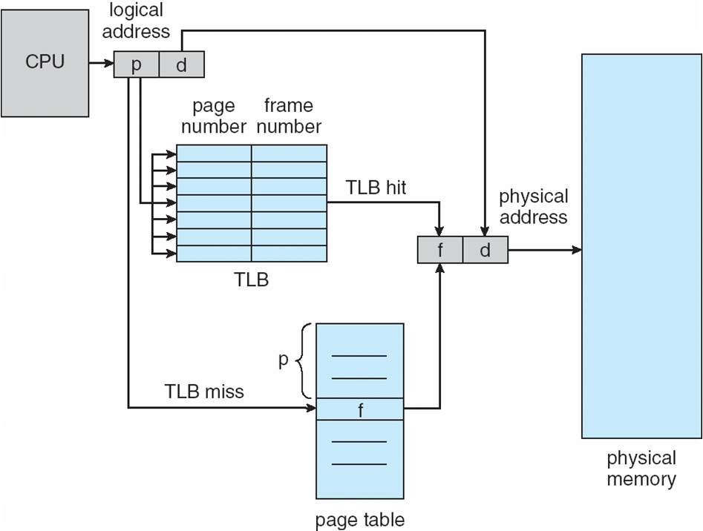
Paging Hardware With TLB

Slide 45
Effective Access Time
Hit ratio – percentage of times that a page number is found in the TLB
An 80% hit ratio means that we find the desired page number in the TLB 80% of the time.
Suppose that 10 nanoseconds to access memory.
If we find the desired page in TLB then a mapped-memory access take 10 ns
Otherwise we need two memory access so it is 20 ns
Effective Access Time (EAT)
EAT = 0.80 x 10 + 0.20 x 20 = 12 nanoseconds
implying 20% slowdown in access time
Consider a more realistic hit ratio of 99%,
EAT = 0.99 x 10 + 0.01 x 20 = 10.1ns
implying only 1% slowdown in access time.

Slide 46
Memory Protection
Memory protection implemented by associating protection bit with each frame to indicate if read-only or read-write access is allowed
Can also add more bits to indicate page execute-only, and so on
Valid-invalid bit attached to each entry in the page table:
“valid” indicates that the associated page is in the process’ logical address space, and is thus a legal page
“invalid” indicates that the page is not in the process’ logical address space
Or use page-table length register (PTLR)
Any violations result in a trap to the kernel

Slide 47
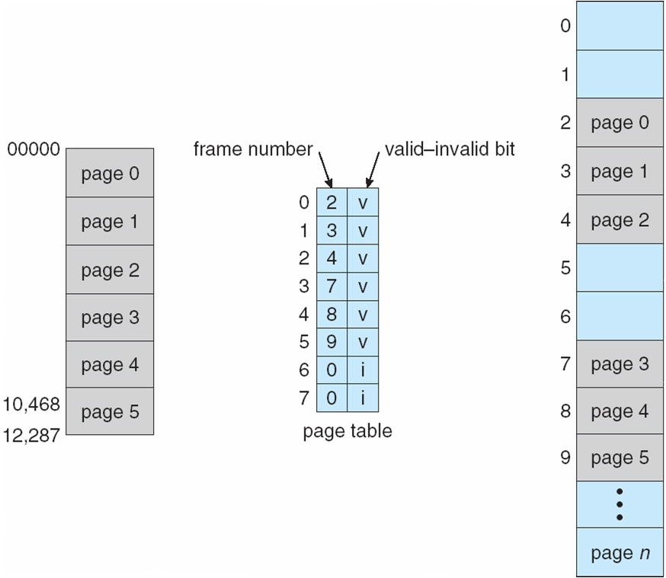
Valid (v) or Invalid (i) Bit In A Page Table

Slide 48
Shared Pages
Shared code
One copy of read-only (reentrant) code shared among processes (i.e., text editors, compilers, window systems)
Similar to multiple threads sharing the same process space
Also useful for interprocess communication if sharing of read-write pages is allowed
Private code and data
Each process keeps a separate copy of the code and data
The pages for the private code and data can appear anywhere in the logical address space

Slide 49
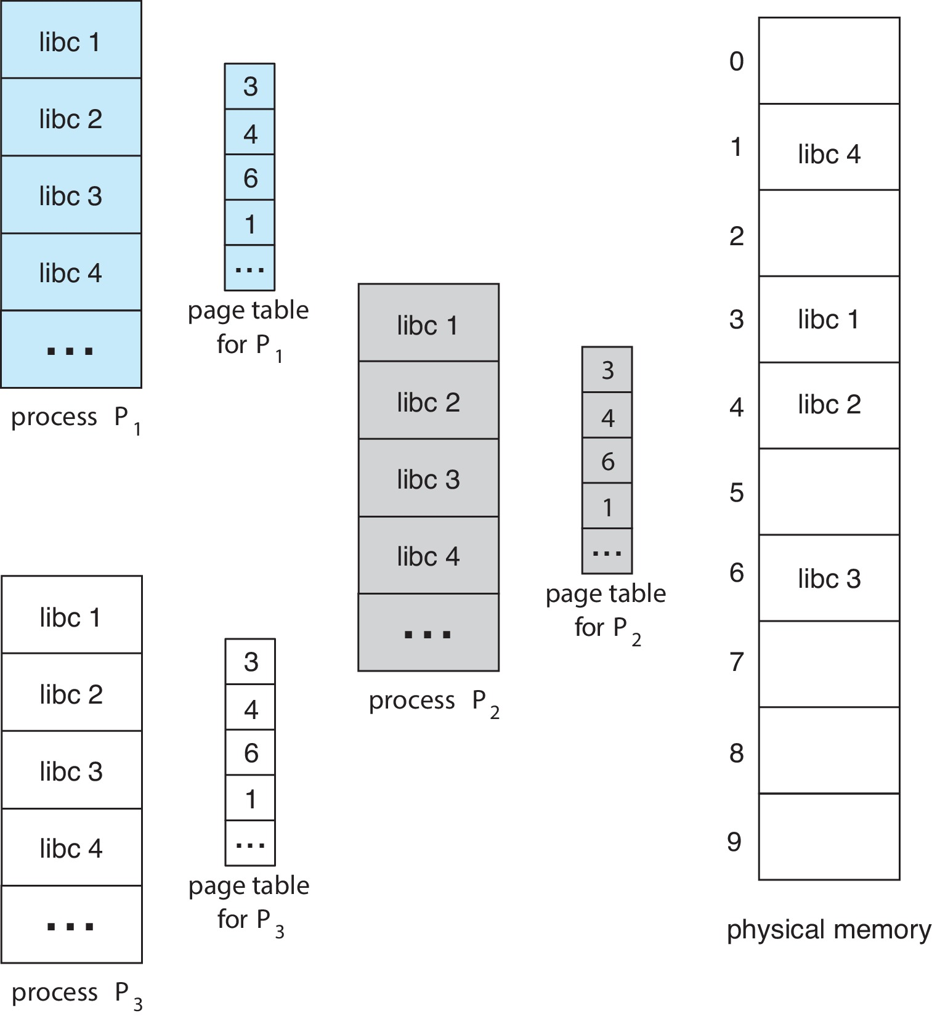
Shared Pages Example

Slide 50
Segmentation
Memory-management scheme that supports user view of memory
A program is a collection of segments
A segment is a logical unit such as:
main program
procedure
function
method
object
local variables, global variables
common block
stack
symbol table
arrays

Slide 51
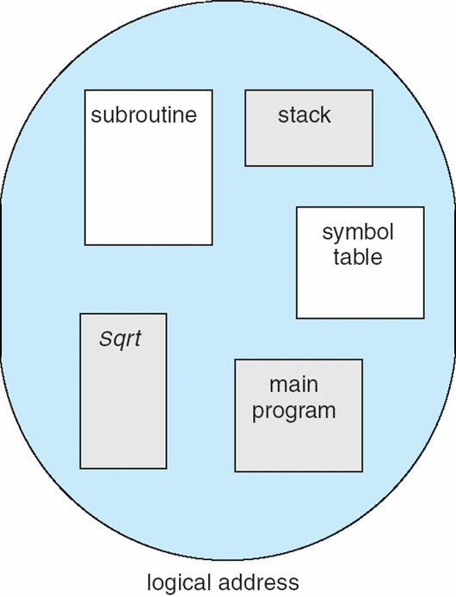
User’s View of a Program

Slide 52
Logical View of Segmentation
1
1
4
2
3
4
2
3
user space
physical memory space

Slide 53
Segmentation Architecture
Logical address consists of a two tuple:
<segment-number, offset>,
Segment table – maps two-dimensional physical addresses; each table entry has:
base – contains the starting physical address where the segments reside in memory
limit – specifies the length of the segment
Segment-table base register (STBR) points to the segment table’s location in memory
Segment-table length register (STLR) indicates number of segments used by a program;
segment number s is legal if s < STLR

Slide 54
Segmentation Architecture (Cont.)
Protection
With each entry in segment table associate:
validation bit = 0 ⇒ illegal segment
read/write/execute privileges
Protection bits associated with segments; code sharing occurs at segment level
Since segments vary in length, memory allocation is a dynamic storage-allocation problem
A segmentation example is shown in the following diagram

Slide 55
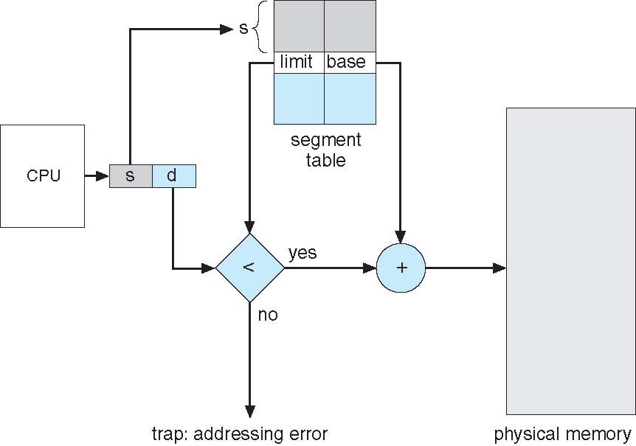
Segmentation Hardware

Slide 56
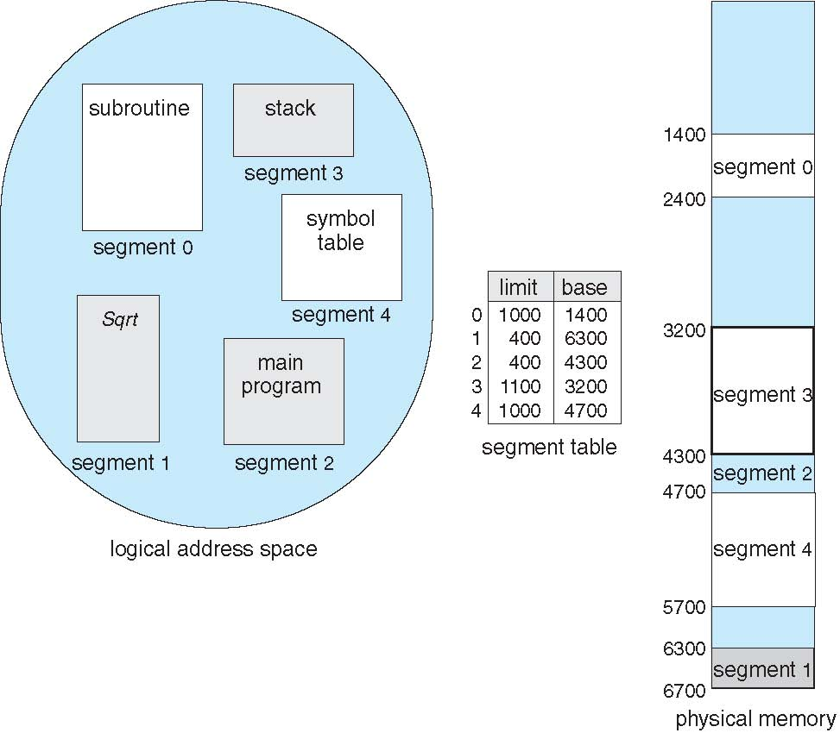
Example of Segmentation

Slide 57
Swapping
A process can be swapped temporarily out of memory to a backing store, and then brought back into memory for continued execution
Total physical memory space of processes can exceed physical memory
Backing store – fast disk large enough to accommodate copies of all memory images for all users; must provide direct access to these memory images
Roll out, roll in – swapping variant used for priority-based scheduling algorithms; lower-priority process is swapped out so higher-priority process can be loaded and executed
Major part of swap time is transfer time; total transfer time is directly proportional to the amount of memory swapped
System maintains a ready queue of ready-to-run processes which have memory images on disk

Slide 58
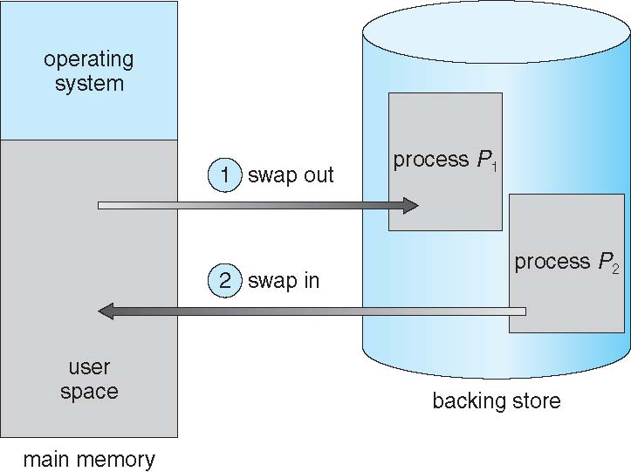
Schematic View of Swapping
If next processes to be put on CPU is not in memory, need to swap out a process and swap in target process

Slide 59
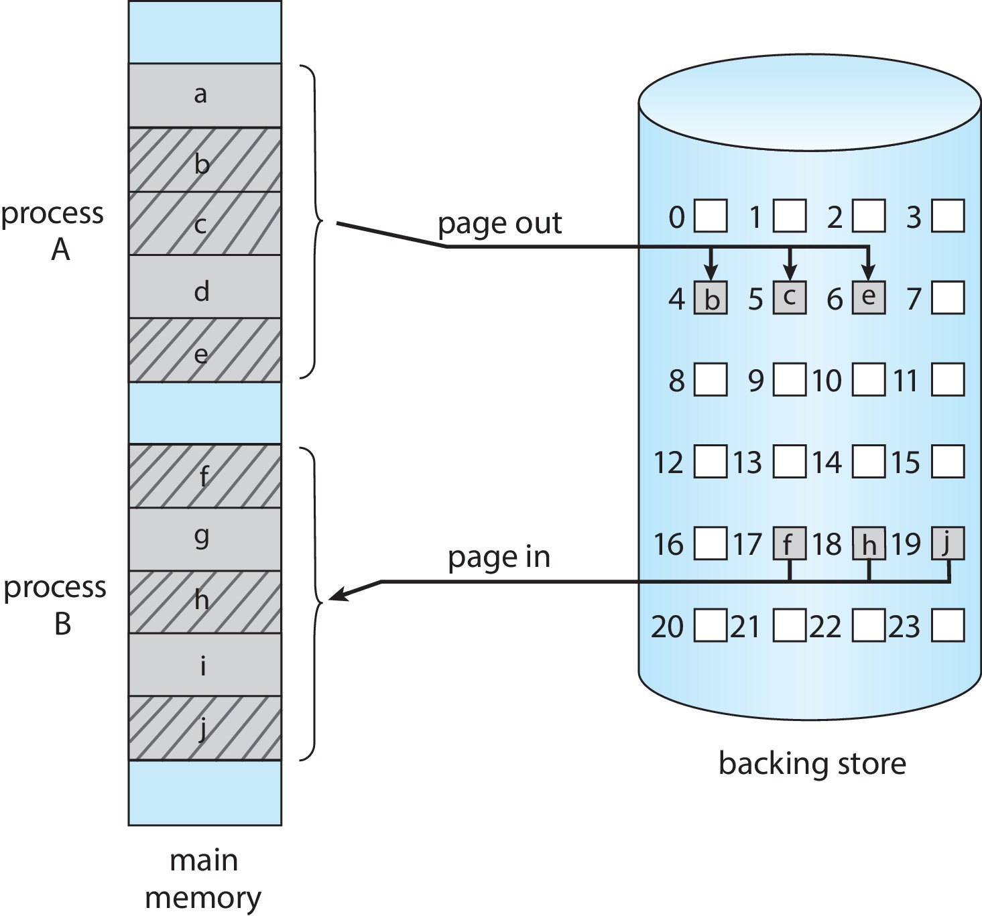
Swapping with Paging
A page out operation moves a page from memory to the backing store; the reverse process is known as a page in.

Slide 60
Example: The Intel 32-bit Architectures
Dominant industry chips
Pentium CPUs are 32-bit and called IA-32 architecture
Current Intel CPUs are 64-bit and called IA-64 architecture
Many variations in the chips, cover the main ideas here

Slide 61
Example: The Intel IA-32 Architecture
Supports both segmentation and segmentation with paging
Each segment can be 4 GB
Up to 16 K segments per process
Divided into two partitions
First partition of up to 8 K segments are private to process (kept in local descriptor table (LDT))
Second partition of up to 8K segments shared among all processes (kept in global descriptor table (GDT))

Slide 62

Example: The Intel IA-32 Architecture (Cont.)
CPU generates logical address
The logical address is a pair (selector, offset), where the selector is a 16-bit number:
s designates the segment number,
g indicates whether the segment is in the GDT or LDT
p deals with protection.
The offset is a 32-bit number specifying the location of the byte within the segment
Selector is given to segmentation unit
Which produces linear addresses (32 bit)
Linear address given to paging unit
Which generates physical address in main memory
Paging units form equivalent of MMU
Pages sizes can be 4 KB or 4 MB

Slide 63
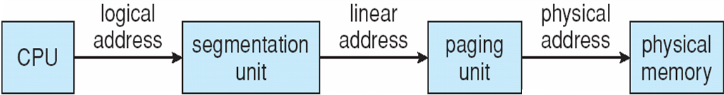
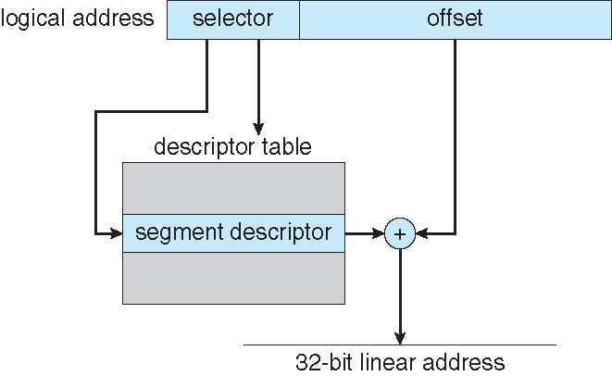
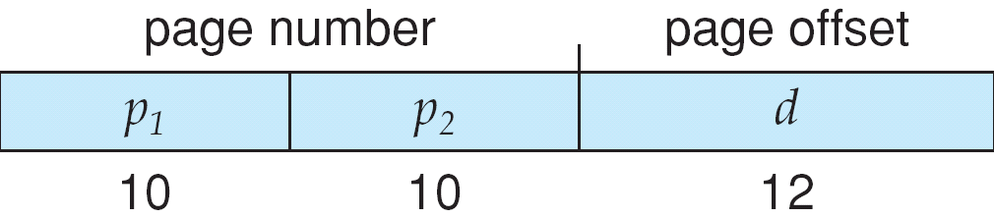
Logical to Physical Address Translation in IA-32
32 bit Linear Address

Slide 64
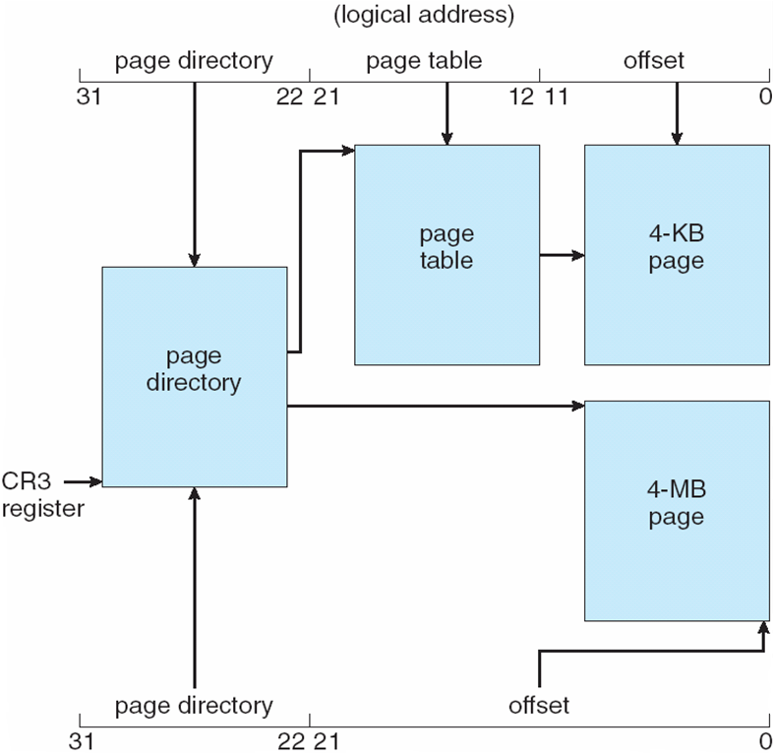
Intel IA-32 Paging Architecture

Slide 65
Course Outcome
On completion of the course, the students will be able to
CO1 : explain operating system structure, services and system calls and identify appropriate system calls for a given service
CO2 : make use of process management strategies for scheduling processes
CO3 : apply different methods for process synchronization and deadlock handling
CO4 : make use of memory management strategies and apply page replacement policies to address demand paging
CO5 : apply various disk scheduling algorithms and elaborate file systems concepts

