Slide 1

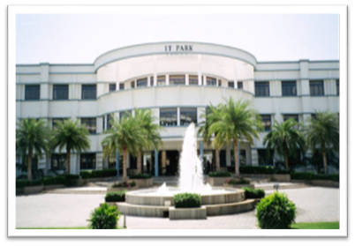
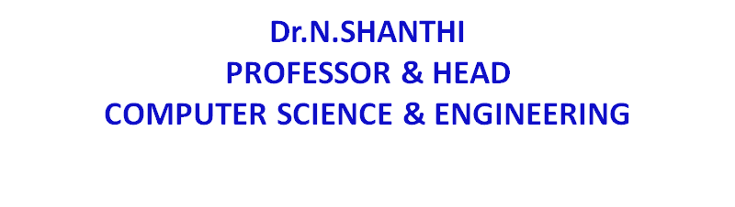

20CSE43 – Operating Systems
UNIT IV
1

Slide 2
UNIT IV
Memory Management
Main Memory: Background – Contiguous Memory Allocation – Segmentation – Paging – Swapping. Virtual Memory: Background – Demand Paging – Page Replacement – Case study: Intel 32 Architecture.
2

Slide 3
Background
Code needs to be in memory to execute, but entire program rarely used
Error code, unusual routines, large data structures
Entire program code not needed at same time
Consider ability to execute partially-loaded program
Program no longer constrained by limits of physical memory
Each program takes less memory while running -> more programs run at the same time
Increased CPU utilization and throughput with no increase in response time or turnaround time
Less I/O needed to load or swap programs into memory -> each user program runs faster

Slide 4
Virtual memory
Virtual memory is a technique that allows the execution of processes that are not completely in memory
Virtual memory – separation of user logical memory from physical memory
Only part of the program needs to be in memory for execution
Logical address space can therefore be much larger than physical address space
Allows address spaces to be shared by several processes
Allows for more efficient process creation
More programs running concurrently
Less I/O needed to load or swap processes

Slide 5
Virtual memory (Cont.)
Virtual address space – logical view of how process is stored in memory
Usually start at address 0, contiguous addresses until end of space
Meanwhile, physical memory organized in page frames
MMU must map logical to physical page frames
Virtual memory can be implemented via:
Demand paging
Demand segmentation

Slide 6
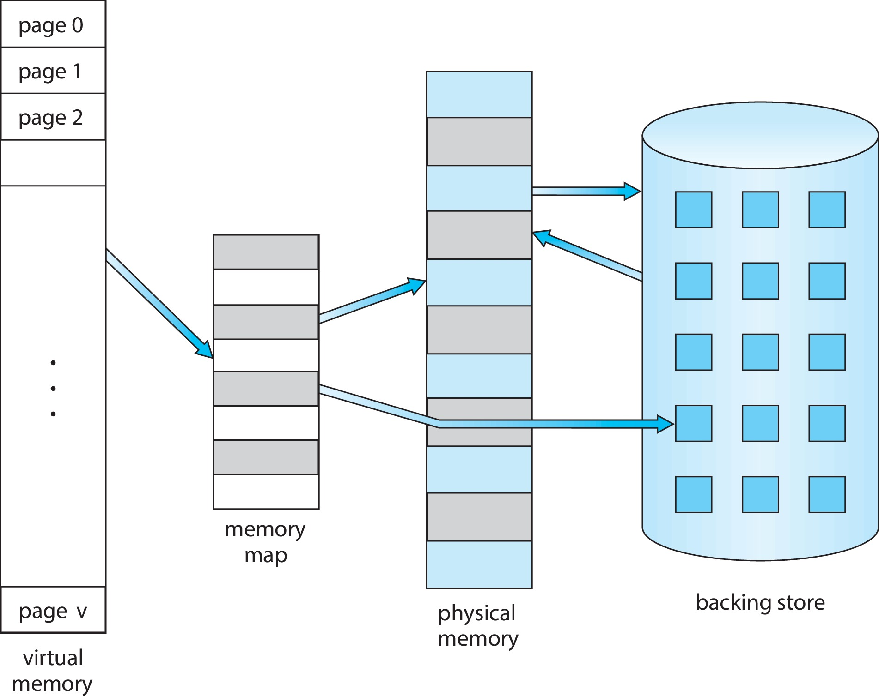
Virtual Memory That is Larger Than Physical Memory

Slide 7
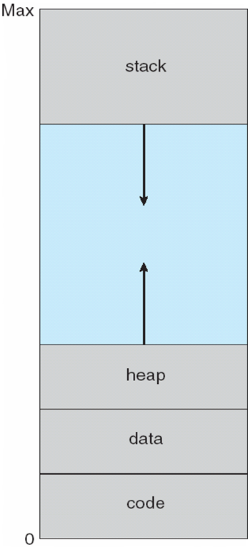
Virtual-address Space
Usually design logical address space for stack to start at Max logical address and grow “down” while heap grows “up”
Maximizes address space use
Unused address space between the two is hole
No physical memory needed until heap or stack grows to a given new page
Enables sparse address spaces with holes left for growth, dynamically linked libraries, etc.
System libraries shared via mapping into virtual address space
Shared memory by mapping pages read-write into virtual address space
Pages can be shared during fork(), speeding process creation

Slide 8
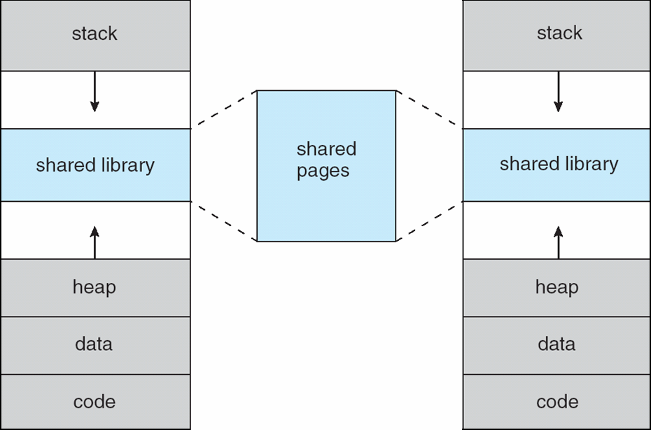
Shared Library Using Virtual Memory

Slide 9
Demand Paging
Could bring entire process into memory at load time
Or bring a page into memory only when it is needed
Less I/O needed, no unnecessary I/O
Less memory needed
Faster response
More users
Similar to paging system with swapping
Page is needed ⇒ reference to it
invalid reference ⇒ abort
not-in-memory ⇒ bring to memory
Lazy swapper – never swaps a page into memory unless page will be needed
Swapper that deals with pages is a pager

Slide 10
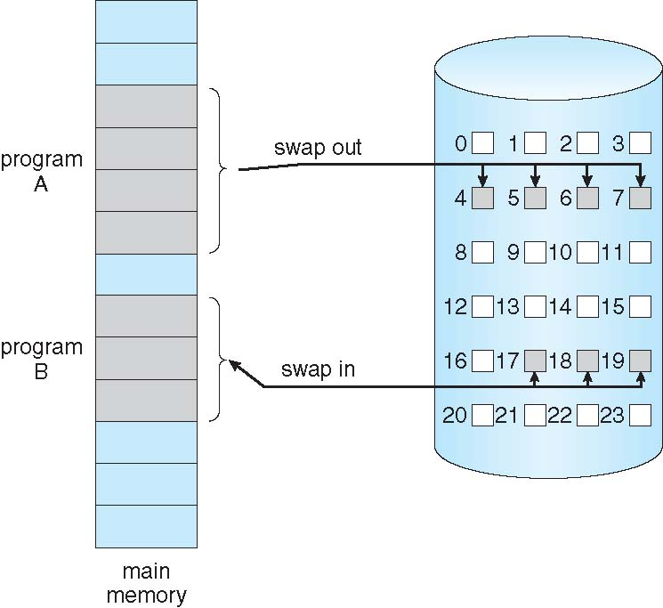
Demand Paging

Slide 11
Basic Concepts
With swapping, pager guesses which pages will be used before swapping out again
Instead, pager brings in only those pages into memory
How to determine that set of pages?
Need new MMU functionality to implement demand paging
If pages needed are already memory resident
No difference from non demand-paging
If page needed and not memory resident
Need to detect and load the page into memory from storage
Without changing program behavior
Without programmer needing to change code

Slide 12
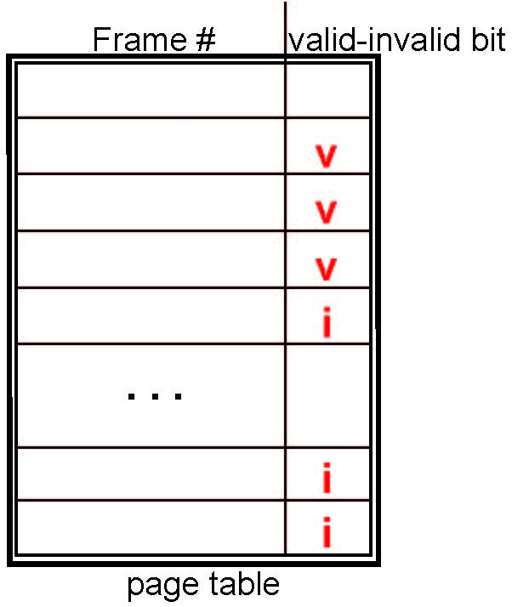
Valid-Invalid Bit
With each page table entry a valid–invalid bit is associated (v ⇒ in-memory – memory resident, i ⇒ not-in-memory)
Initially valid–invalid bit is set to i on all entries
Example of a page table snapshot:
During MMU address translation, if valid–invalid bit in page table entry is i ⇒ page fault

Slide 13
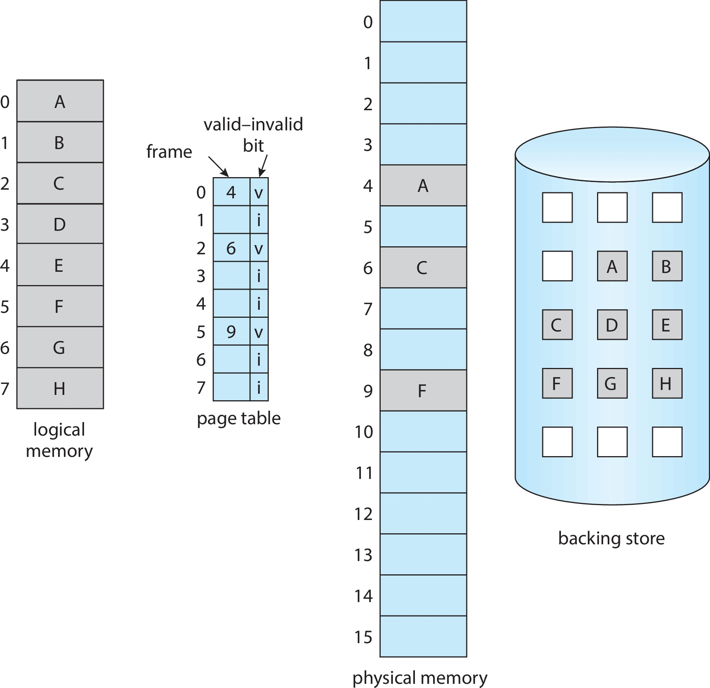
Page Table When Some Pages Are Not in Main Memory

Slide 14
Steps in Handling Page Fault
If there is a reference to a page, first reference to that page will trap to operating system
Page fault
Operating system looks at another table to decide:
Invalid reference ⇒ abort
Just not in memory
Find free frame
Swap page into frame via scheduled disk operation
Reset tables to indicate page now in memory Set validation bit = v
Restart the instruction that caused the page fault

Slide 15
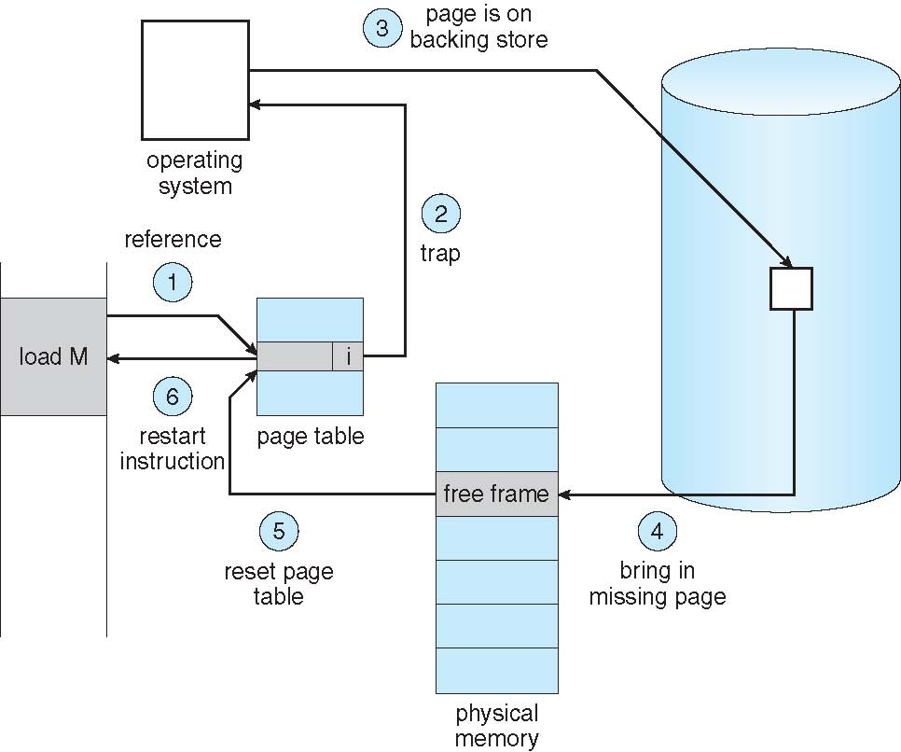
Steps in Handling a Page Fault (Cont.)

Slide 16
Aspects of Demand Paging
Extreme case – start process with no pages in memory
OS sets instruction pointer to first instruction of process, non-memory-resident -> page fault
And for every other process pages on first access
Pure demand paging - never bring a page into memory until it is required
Actually, a given instruction could access multiple pages -> multiple page faults
Consider fetch and decode of instruction which adds 2 numbers from memory and stores result back to memory
Pain decreased because of locality of reference
Hardware support needed for demand paging
Page table with valid / invalid bit
Secondary memory (swap device with swap space)
Instruction restart

Slide 17
Free-Frame List
When a page fault occurs, the operating system must bring the desired page from secondary storage into main memory.
Most operating systems maintain a free-frame list -- a pool of free frames for satisfying such requests.
Operating system typically allocate free frames using a technique known as zero-fill-on-demand -- the content of the frames zeroed-out before being allocated.
When a system starts up, all available memory is placed on the free-frame list.

Slide 18
Performance of Demand Paging
Demand paging can significantly affect the performance of a computer system.
Page Fault Rate 0 ≤ p ≤ 1
if p = 0 no page faults
if p = 1, every reference is a fault
Effective Access Time (EAT)
EAT= (1 − p) × memory access + p × page fault time

Slide 19
Demand Paging Example
Memory access time = 200 nanoseconds
Average page-fault service time = 8 milliseconds
EAT = (1 – p) x 200 + p (8 milliseconds)
= (1 – p) x 200 + p x 8,000,000
= 200 + p x 7,999,800
If one access out of 1,000 causes a page fault, then
EAT = 8.2 microseconds.
This is a slowdown by a factor of 40!!
If want performance degradation < 10 percent
220 > 200 + 7,999,800 x p 20 > 7,999,800 x p
p < .0000025
< one page fault in every 400,000 memory accesses

Slide 20
What Happens if There is no Free Frame?
Used up by process pages
Also in demand from the kernel, I/O buffers, etc
How much to allocate to each?
Page replacement – find some page in memory, but not really in use, page it out (replace that page)
Algorithm – needed to find the optimal page for replacement
Performance – want an algorithm which will result in minimum number of page faults
Same page may be brought into memory several times

Slide 21
Page Replacement
Prevent over-allocation of memory by modifying page-fault service routine to include page replacement
Use modify (dirty) bit to reduce overhead of page transfers – only modified pages are written to disk
Page replacement completes separation between logical memory and physical memory – large virtual memory can be provided on a smaller physical memory

Slide 22
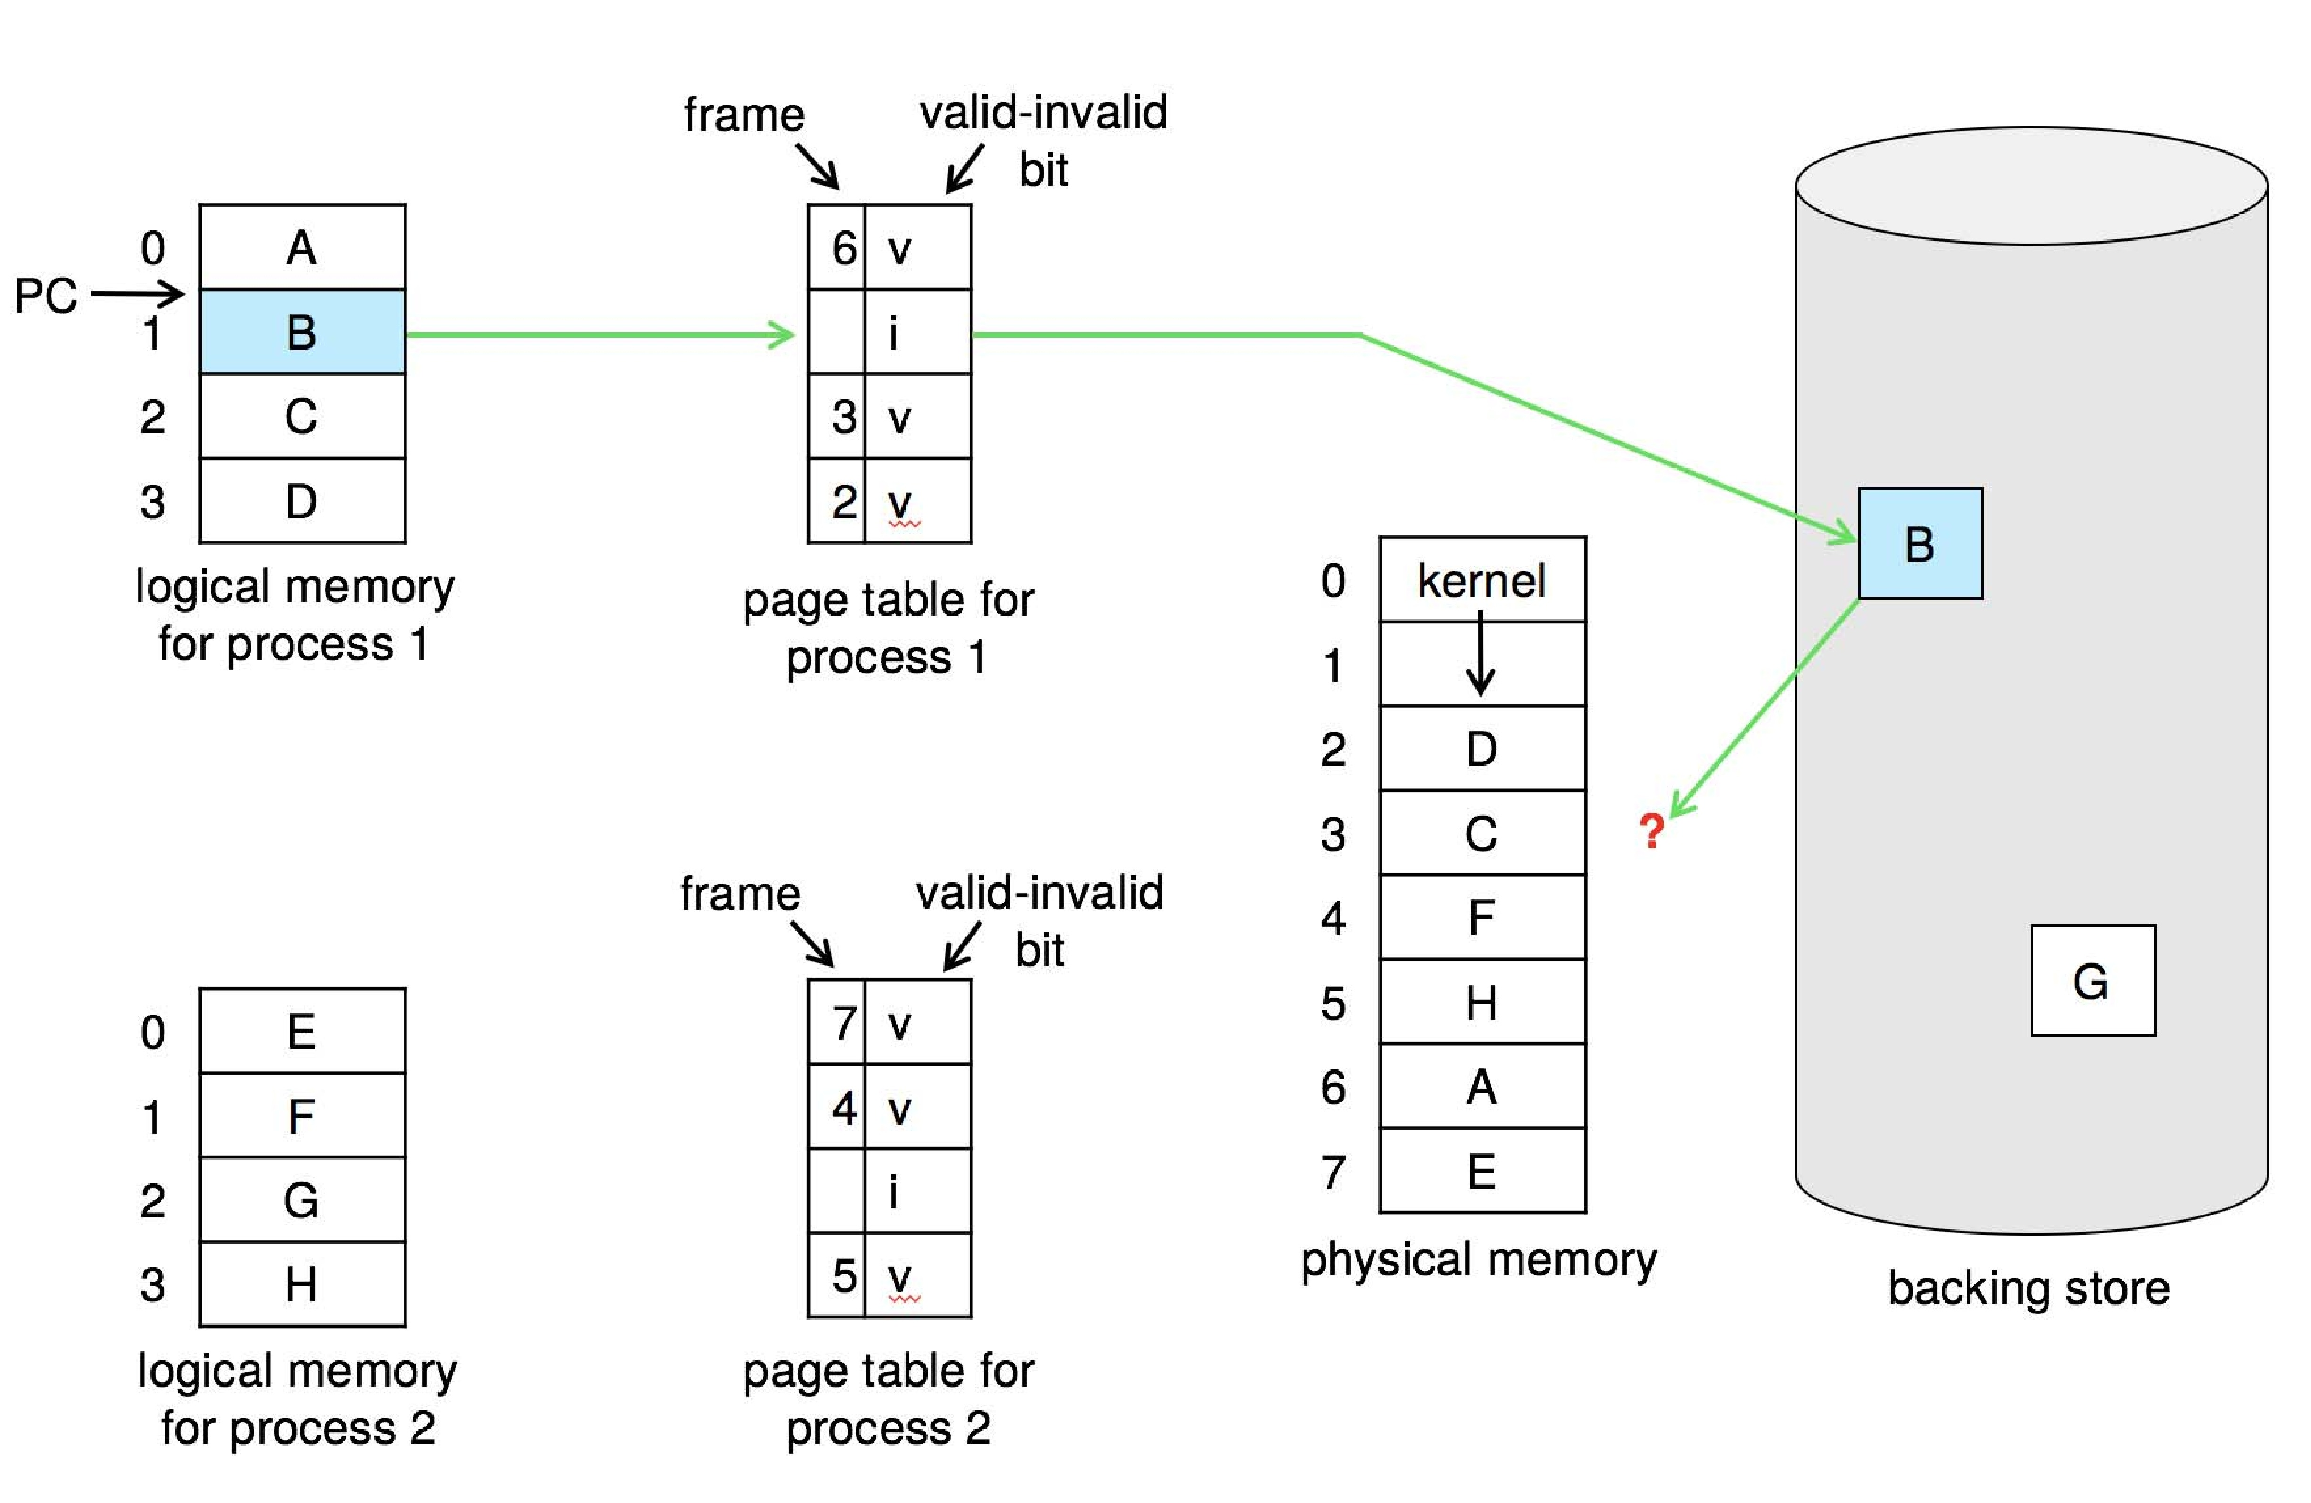
Need For Page Replacement

Slide 23
Basic Page Replacement
Find the location of the desired page on disk
Find a free frame: - If there is a free frame, use it - If there is no free frame, use a page replacement algorithm to select a victim frame - Write victim frame to disk if dirty
Bring the desired page into the (newly) free frame; update the page and frame tables
Continue the process by restarting the instruction that caused the trap
Note now potentially 2 page transfers for page fault – increasing EAT

Slide 24
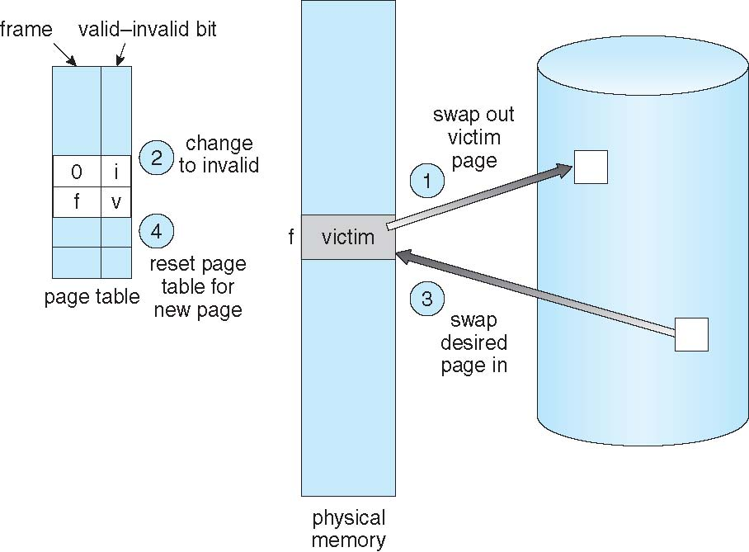
Page Replacement

Slide 25
Page and Frame Replacement Algorithms
Frame-allocation algorithm determines
How many frames to give each process
Which frames to replace
Page-replacement algorithm
Want lowest page-fault rate on both first access and re-access
Evaluate algorithm by running it on a particular string of memory references (reference string) and computing the number of page faults on that string
String is just page numbers, not full addresses
Repeated access to the same page does not cause a page fault
Results depend on number of frames available
In all our examples, the reference string of referenced page numbers is
7,0,1,2,0,3,0,4,2,3,0,3,0,3,2,1,2,0,1,7,0,1

Slide 26
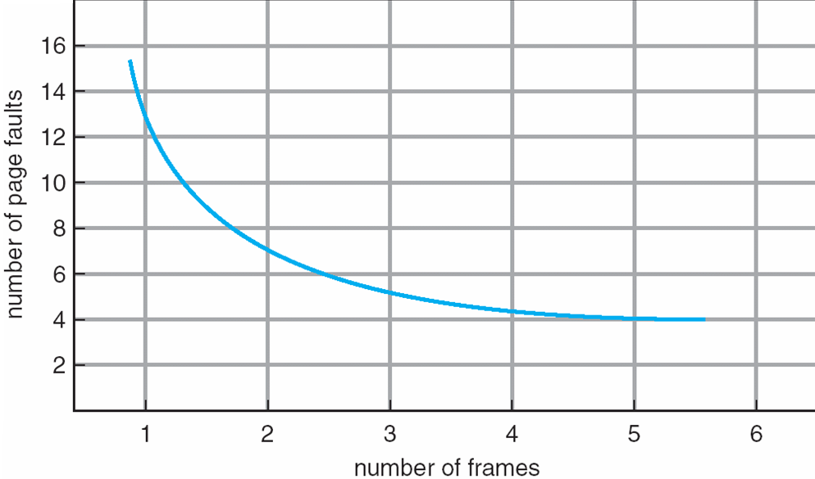
Graph of Page Faults Versus the Number of Frames

Slide 27
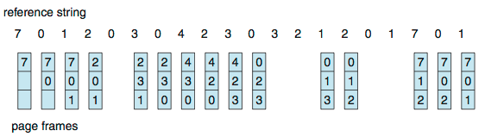
First-In-First-Out (FIFO) Algorithm
Reference string: 7,0,1,2,0,3,0,4,2,3,0,3,0,3,2,1,2,0,1,7,0,1
3 frames (3 pages can be in memory at a time per process)
Can vary by reference string: consider 1,2,3,4,1,2,5,1,2,3,4,5
Adding more frames can cause more page faults!
Belady’s Anomaly
How to track ages of pages?
Just use a FIFO queue
15 page faults

Slide 28
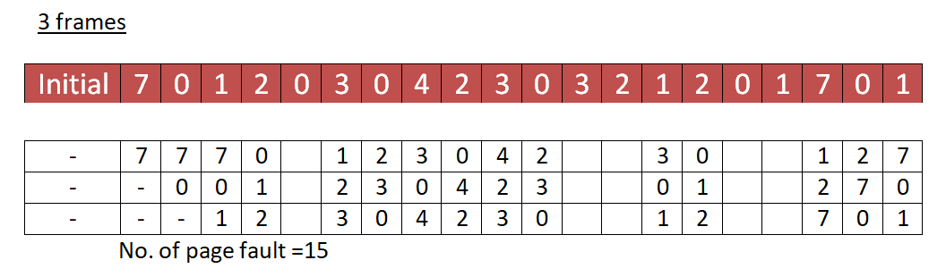
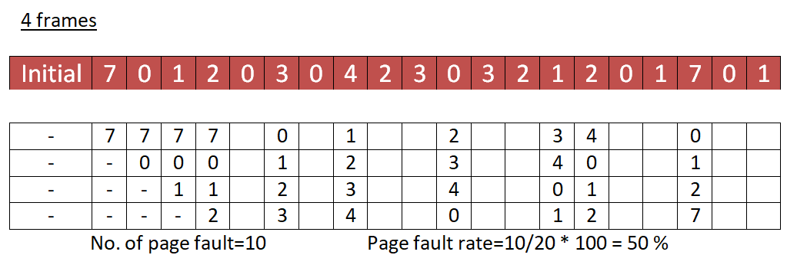
First-In-First-Out (FIFO) Algorithm

Slide 29
FIFO Illustrating Belady’s Anomaly
Belady’s Anomaly
Adding more frames can cause more page faults!
Can vary by reference string: consider 1,2,3,4,1,2,5,1,2,3,4,5

Slide 30
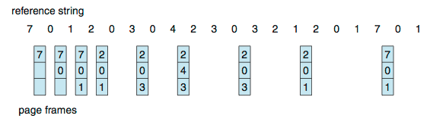
Optimal Algorithm
Replace page that will not be used for longest period of time
9 is optimal for the example
How do you know this?
Can’t read the future
Used for measuring how well your algorithm performs

Slide 31
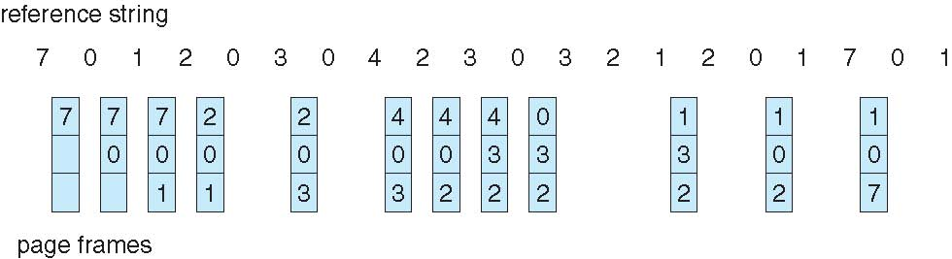
Least Recently Used (LRU) Algorithm
Use past knowledge rather than future
Replace page that has not been used in the most amount of time
Associate time of last use with each page
12 faults – better than FIFO but worse than OPT
Generally good algorithm and frequently used

Slide 32
Problems
Assume that there are 3 page frames which are initially empty. If the page reference string is 1, 2, 3, 4, 2, 1, 5, 3, 2, 4, 6, Find the number of page faults.
Consider the virtual page reference string 1, 2, 3, 2, 4, 1, 3, 2, 4, 1 On a demand paged virtual memory system running on a computer system that main memory size of 3 pages frames which are initially empty. Let LRU, FIFO and OPTIMAL denote the number of page faults under the corresponding page replacements policy. Compare the performance.

Slide 33
LRU Algorithm (Cont.)
Counter implementation
Every page entry has a counter; every time page is referenced through this entry, copy the clock into the counter
When a page needs to be changed, look at the counters to find smallest value
Search through table needed
Stack implementation
Keep a stack of page numbers in a double link form:
Page referenced:
move it to the top
requires 6 pointers to be changed
But each update more expensive
No search for replacement

Slide 34
LRU Algorithm (Cont.)
LRU and OPT are cases of stack algorithms that don’t have Belady’s Anomaly
Use Of A Stack to Record Most Recent Page References

Slide 35
LRU Approximation Algorithms
LRU needs special hardware and still slow
Reference bit
With each page associate a bit, initially = 0
When page is referenced bit set to 1
Replace any with reference bit = 0 (if one exists)
We do not know the order, however

Slide 36
LRU Approximation Algorithms (cont.)
Second-chance algorithm
Generally FIFO, plus hardware-provided reference bit
Clock replacement
If page to be replaced has
Reference bit = 0 -> replace it
reference bit = 1 then:
set reference bit 0, leave page in memory
replace next page, subject to same rules

Slide 37
Second-chance Algorithm

Slide 38
Enhanced Second-Chance Algorithm
Improve algorithm by using reference bit and modify bit (if available) in concert
Take ordered pair (reference, modify):
(0, 0) neither recently used nor modified – best page to replace
(0, 1) not recently used but modified – not quite as good, must write out before replacement
(1, 0) recently used but clean – probably will be used again soon
(1, 1) recently used and modified – probably will be used again soon and need to write out before replacement
When page replacement called for, use the clock scheme but use the four classes replace page in lowest non-empty class
Might need to search circular queue several times

Slide 39
Counting Algorithms
Keep a counter of the number of references that have been made to each page
Not common
Least Frequently Used (LFU) Algorithm:
Replaces page with smallest count
Most Frequently Used (MFU) Algorithm:
Based on the argument that the page with the smallest count was probably just brought in and has yet to be used

Slide 40
Page-Buffering Algorithms
Keep a pool of free frames, always
When a page fault occurs, a victim frame is chosen
Read page into free frame and select victim to evict and add to free pool
When convenient, evict victim
Possibly, keep list of modified pages
When backing store otherwise idle, write pages there and set to non-dirty
Possibly, keep free frame contents intact and note what is in them
If referenced again before reused, no need to load contents again from disk
Generally useful to reduce penalty if wrong victim frame selected

Slide 41
Thrashing
If a process does not have “enough” pages, the page-fault rate is very high
Page fault to get page
Replace existing frame
But quickly need replaced frame back
This high paging activity is called thrashing.
Thrashing is a condition or a situation when the system is spending a major portion of its time servicing the page faults, but the actual processing done is very negligible.
Thrashing results in severe performance problems.

Slide 42
Course Outcome
On completion of the course, the students will be able to
CO1 : explain operating system structure, services and system calls and identify appropriate system calls for a given service
CO2 : make use of process management strategies for scheduling processes
CO3 : apply different methods for process synchronization and deadlock handling
CO4 : make use of memory management strategies and apply page replacement policies to address demand paging
CO5 : apply various disk scheduling algorithms and elaborate file systems concepts

