Slide 1

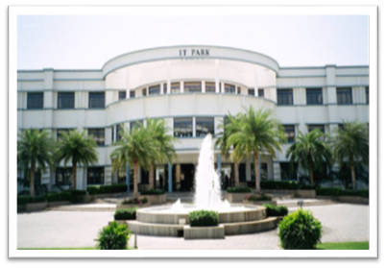


20CST43 - OPERATING SYSTEMS
UNIT V
1

Slide 2
UNIT V
Storage Management: Mass Storage Structure: Overview – HDD Scheduling. File System: File Concept – Access Methods – Directory Structure – Protection. File System Implementation: File System Structure – File System Operations – Directory Implementation – Allocation Methods - Free Space Management – Security : The Security Problem – program Threats - Case study: Linux System.

Slide 3
File-System Structure
File structure
Logical storage unit
Collection of related information
File system resides on secondary storage (disks)
Provided user interface to storage, mapping logical to physical
Provides efficient and convenient access to disk by allowing data to be stored, located retrieved easily
Disk provides in-place rewrite and random access
I/O transfers performed in blocks of sectors (usually 512 bytes or 4096 bytes)
File control block (FCB) – storage structure consisting of information about a file
Device driver controls the physical device
File system organized into layers

Slide 4
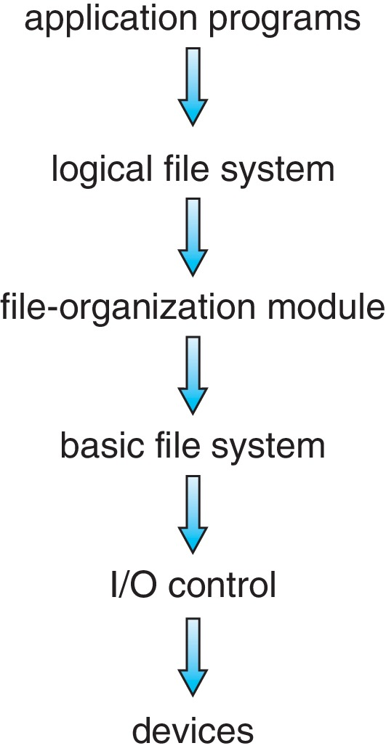
Layered File System

Slide 5
File System Layers
Device drivers manage I/O devices at the I/O control layer
Given commands like
read drive1, cylinder 72, track 2, sector 10, into memory location 1060
Outputs low-level hardware specific commands to hardware controller
Basic file system given command like “retrieve block 123” translates to device driver
Also manages memory buffers and caches (allocation, freeing, replacement)
Buffers hold data in transit
Caches hold frequently used data
File organization module understands files, logical address, and physical blocks
Translates logical block # to physical block #
Manages free space, disk allocation

Slide 6
File System Layers (Cont.)
Logical file system manages metadata information
Translates file name into file number, file handle, location by maintaining file control blocks (inodes in UNIX)
FCB contains information about the file, including ownership, permissions, and location of the file contents.
Directory management
Protection
Layering useful for reducing complexity and redundancy, but adds overhead and can decrease performance
Logical layers can be implemented by any coding method according to OS designer

Slide 7
File System Layers (Cont.)
Many file systems, sometimes many within an operating system
Each with its own format:
CD-ROM is ISO 9660;
Unix has UFS, Fast File System(FFS);
Windows has FAT, FAT32, NTFS as well as floppy, CD, DVD Blu-ray,
Linux has more than 130 types, with extended file system ext3 and ext4 leading; plus distributed file systems, etc.)
New ones still arriving – ZFS, GoogleFS, Oracle ASM, FUSE

Slide 8
File-System Operations
We have system calls at the API level, but how do we implement their functions?
On-disk and in-memory structures
Boot control block contains info needed by system to boot OS from that volume
Needed if volume contains OS, usually first block of volume
Volume control block (superblock(UFS), master file table(NTFS)) contains volume details
Total # of blocks, # of free blocks, block size, free block pointers or array
Directory structure organizes the files
Names and inode numbers, master file table

Slide 9
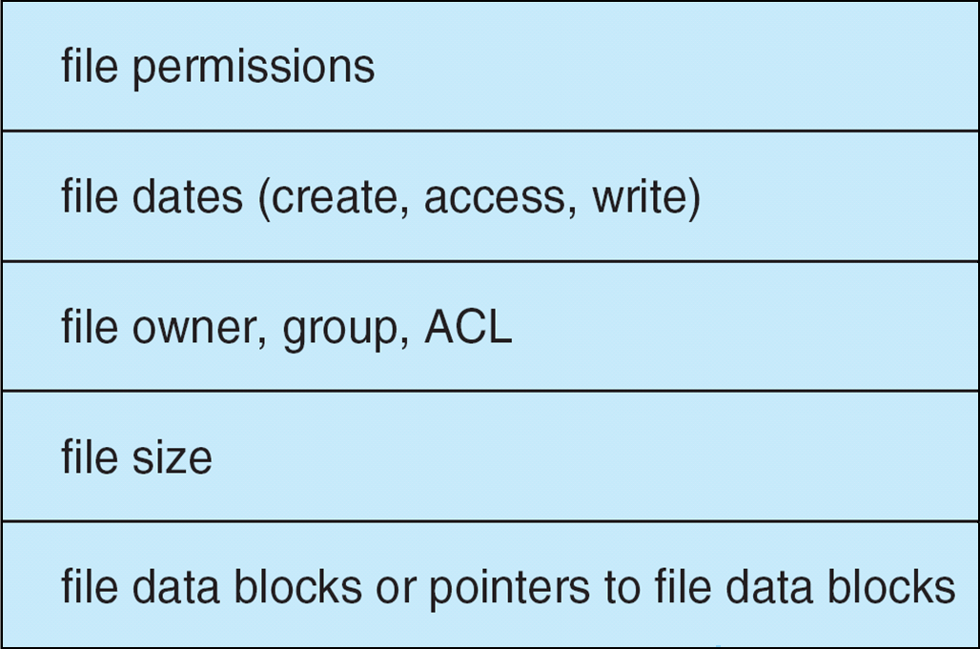
File Control Block (FCB)
OS maintains FCB per file, which contains many details about the file
Typically, inode number, permissions, size, dates
Example

Slide 10
In-Memory File System Structures
Mount table storing file system mounts, mount points, file system types
System-wide open-file table contains a copy of the FCB of each file and other info
Per-process open-file table contains pointers to appropriate entries in system-wide open-file table as well as other info

Slide 11
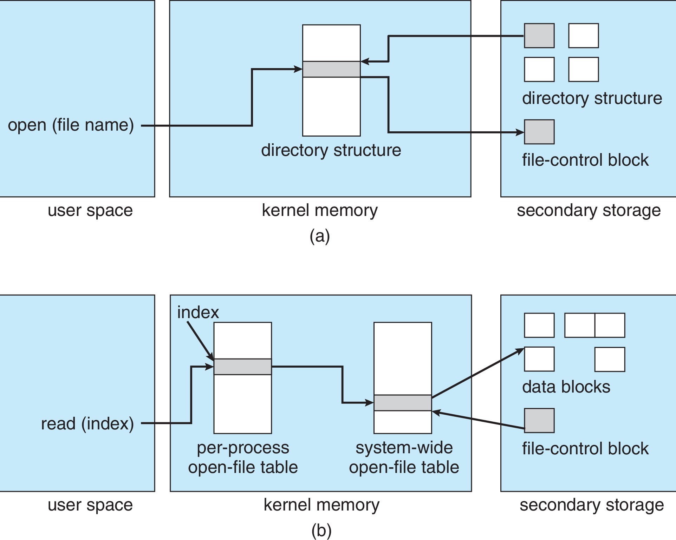
In-Memory File System Structures (Cont.)
Figure (a) refers to opening a file
Figure (b) refers to reading a file

Slide 12
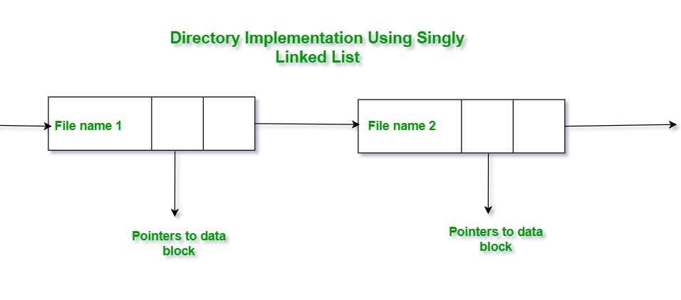
Directory Implementation
Linear list of file names with pointer to the data blocks
Simple to program
Time-consuming to execute
Linear search time
Could keep ordered alphabetically via linked list or use B+ tree

Slide 13
Directory Implementation (Linked List)
To create a new file the entire list has to be checked such that the new file does not exist previously.
The new file then can be added to the end of the list or at the beginning of the list.
In order to delete a file, we first search the directory with the name of the file to be deleted. After searching we can delete that file by releasing the space allocated to it.
To reuse the directory entry we can mark that entry as unused or we can append it to the list of free directories.
To delete a file linked list is the best choice as it takes less time.

Slide 14
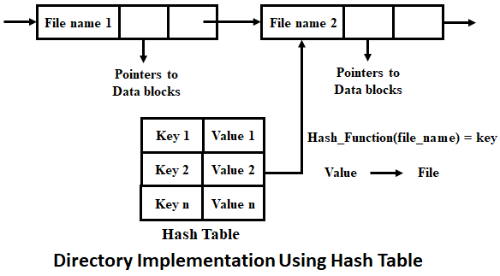
Directory Implementation
Hash Table – linear list with hash data structure
Decreases directory search time
Collisions – situations where two file names hash to the same location
Only good if entries are fixed size, or use chained-overflow method

Slide 15
Allocation Method
An allocation method refers to how disk blocks are allocated for files:
Contiguous
Linked
File Allocation Table (FAT)
Indexed Allocation
The main idea behind these methods is to provide:
Efficient disk space utilization.
Fast access to the file blocks.

Slide 16
Contiguous Allocation Method
An allocation method refers to how disk blocks are allocated for files:
Each file occupies set of contiguous blocks
Best performance in most cases
Simple – only starting location (block #) and length (number of blocks) are required
Problems include:
Finding space on the disk for a file,
Knowing file size,
External fragmentation, need for compaction off-line (downtime) or on-line
Allocation of too little space or large space

Slide 17
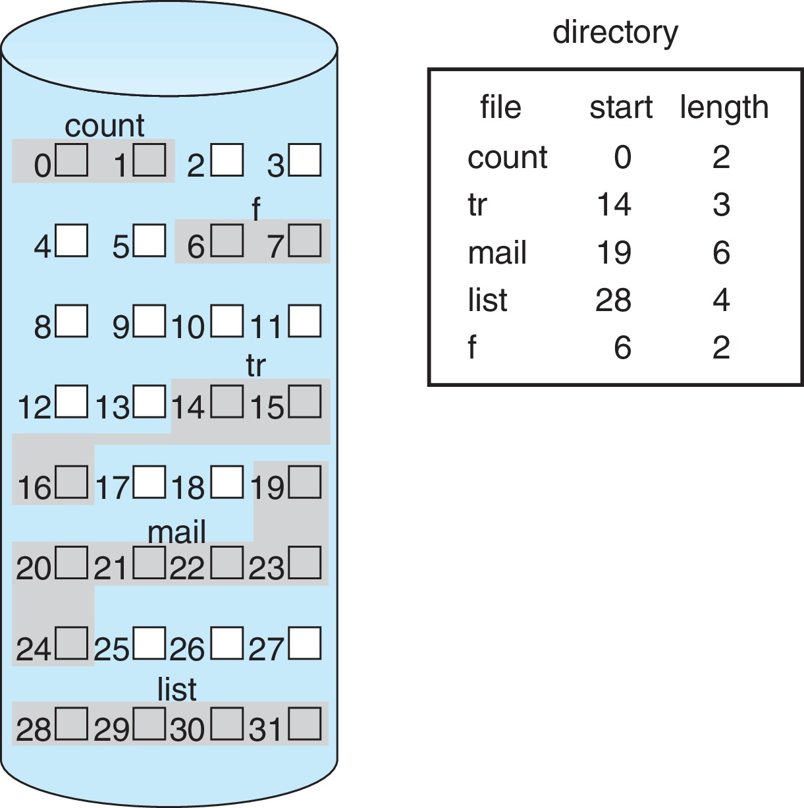
Contiguous Allocation (Cont.)

Slide 18
Extent-Based Systems
Many newer file systems (i.e., Veritas File System) use a modified contiguous allocation scheme
Extent-based file systems allocate disk blocks in extents
An extent is a contiguous block of disks
Extents are allocated for file allocation
A file consists of one or more extents
The location of a file’s blocks is then recorded as a location and a block count, plus a link to the first block of the next extent.

Slide 19
Linked Allocation
With linked allocation, each file is a linked list of storage blocks;
The blocks may be scattered anywhere on the device.
The directory contains a pointer to the first and last blocks of the file.
Each block contains pointer to next block
No compaction, external fragmentation
Free space management system called when new block needed
It can be used effectively only for sequential-access files
Improve efficiency by clustering blocks into groups but increases internal fragmentation
Reliability can be a problem
Locating a block can take many I/Os and disk seeks

Slide 20
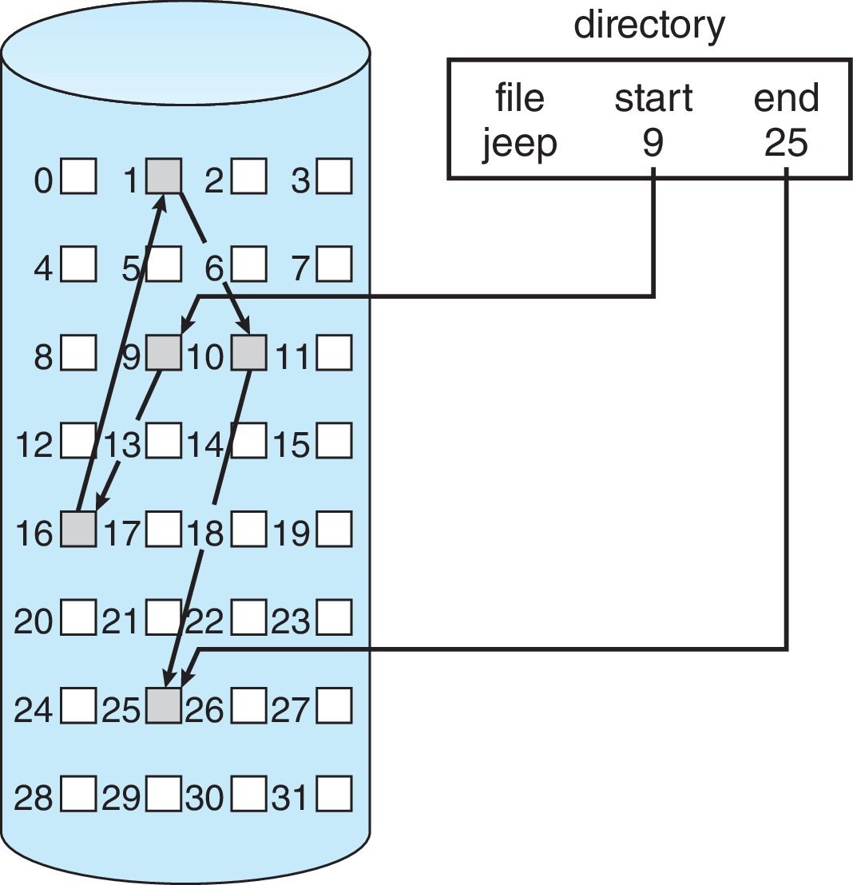
Linked Allocation Example
Each file is a linked list of disk blocks: blocks may be scattered anywhere on the disk
Scheme

Slide 21
FAT Allocation Method
A section of storage at the beginning of volume has table, indexed by block number
Much like a linked list, but faster on disk and cacheable
The directory entry contains the block number of the first block of the file.
The table entry indexed by that block number contains the block number of the next block in the file.

Slide 22
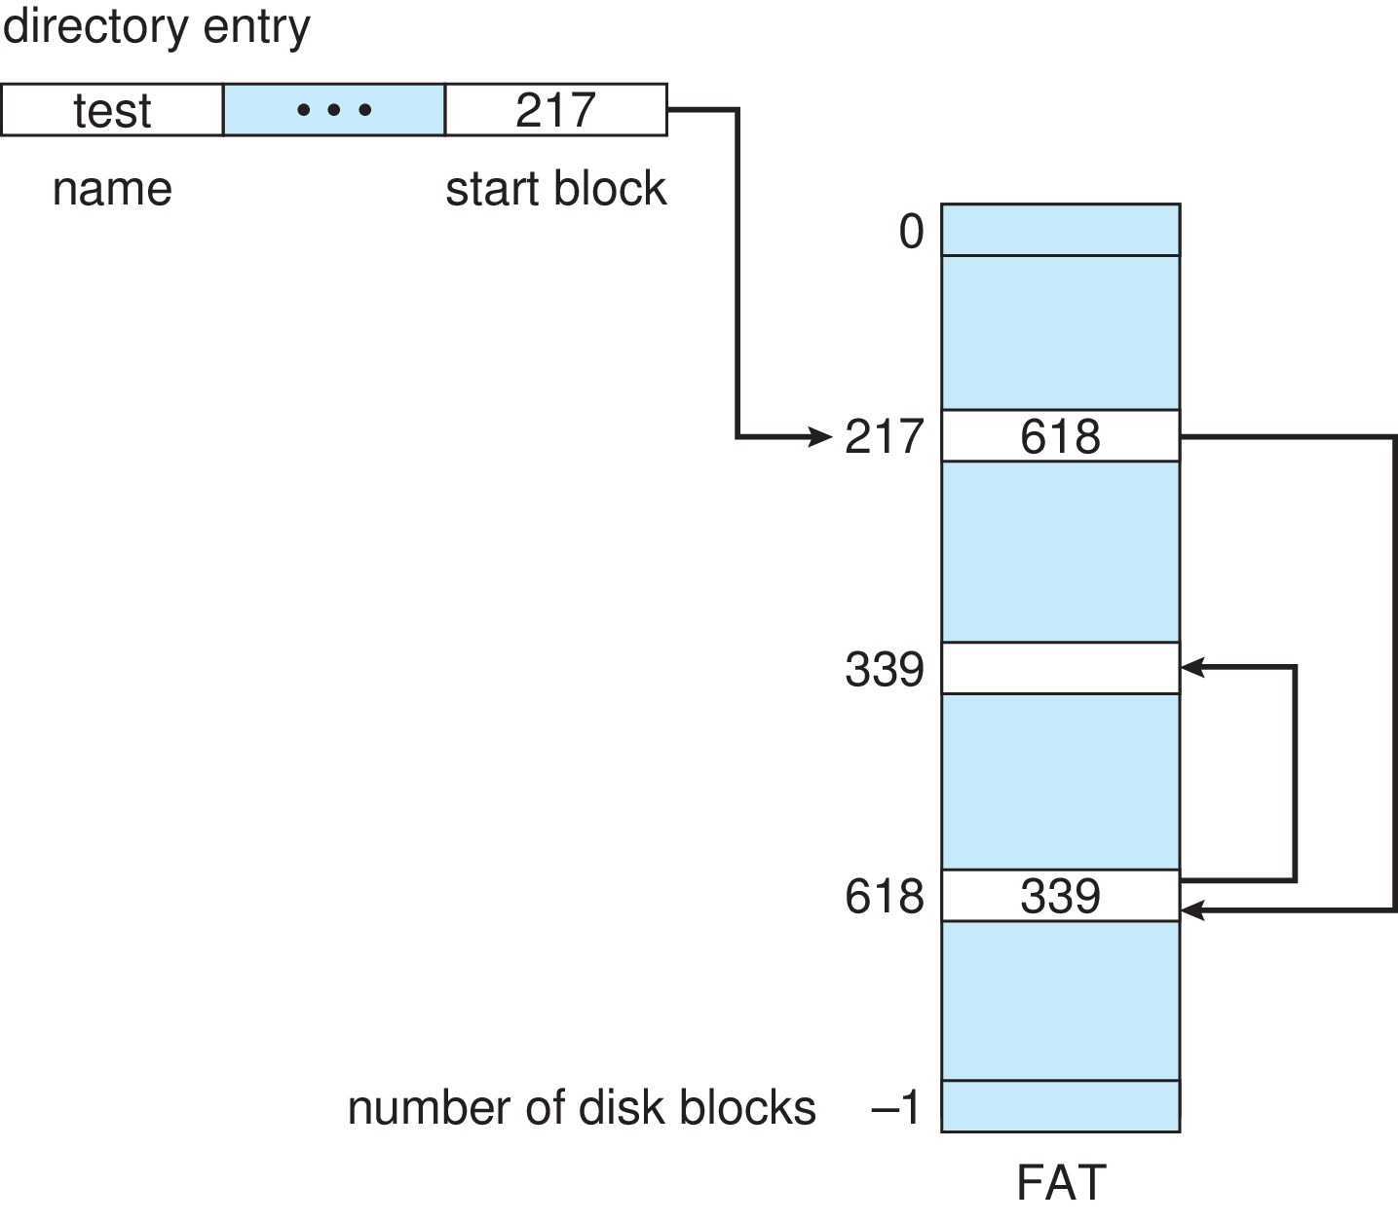
File-Allocation Table

Slide 23
Indexed Allocation Method
In the index allocation method, we have an additional block, and that block is known as the index block.
Each file has its own index block(s) of pointers to its data blocks
In the index block, the i^{th} entry holds the disk address of the i^{th} file block.
Indexed allocation supports direct access, without suffering from external fragmentation
Logical view

Slide 24
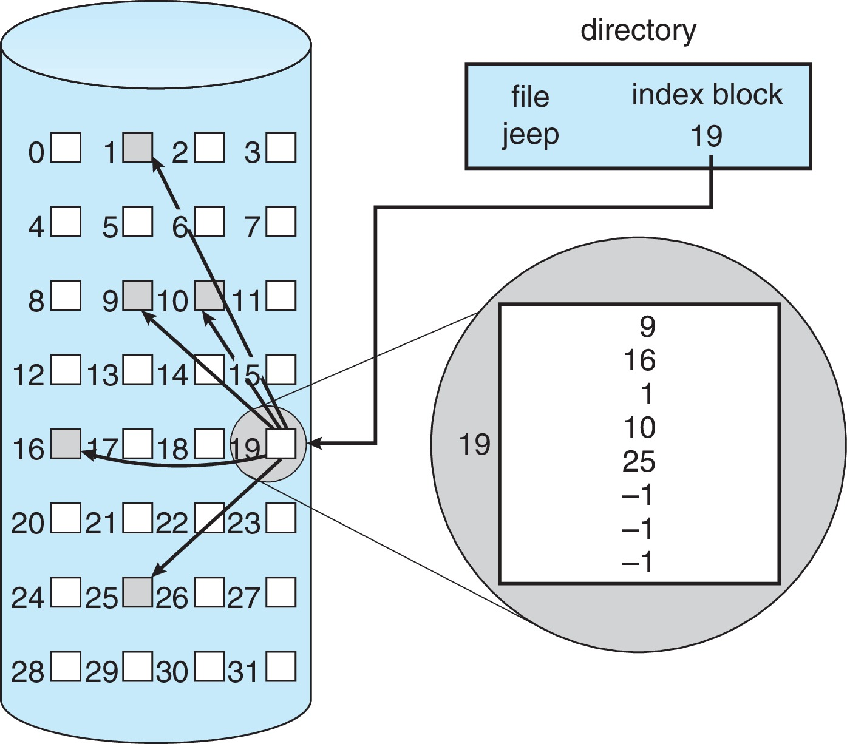
Example of Indexed Allocation

Slide 25
Indexed Allocation
Advantages of Index Allocation
The index allocation method solves the problem of external fragmentation.
Index allocation provides direct access.
Disadvantages of Index Allocation
In index allocation, pointer overhead is more.
We can lose the entire file if an index block is not correct.
It is totally a wastage to create an index for a small file.

Slide 26
Performance
Best method depends on file access type
Contiguous great for sequential and random
Linked good for sequential, not random
Declare access type at creation
Select either contiguous or linked
Indexed more complex
Single block access could require 2 index block reads then data block read
Clustering can help improve throughput, reduce CPU overhead
For NVM, no disk head so different algorithms and optimizations needed
Using old algorithm uses many CPU cycles trying to avoid non-existent head movement
Goal is to reduce CPU cycles and overall path needed for I/O

Slide 27
Free-Space Management
File system maintains free-space list to track available blocks/clusters
(Using term “block” for simplicity)
Bit vector or bit map (n blocks)
0
1
2
n-1
…
1 ⇒ block[i] free
0 ⇒ block[i] occupied
bit[i] =

Block number calculation
(number of bits per word) * (number of 0-value words) + offset of first 1 bit
CPUs have instructions to return offset within word of first “1” bit

Slide 28
Free-Space Management
Bit map requires extra space
Example:
block size = 4KB = 2¹² bytes
disk size = 2⁴⁰ bytes (1 terabyte)
n = 2⁴⁰/2¹² = 2²⁸ bits (or 32MB)
if clusters of 4 blocks -> 8MB of memory
Easy to get contiguous files

Slide 29
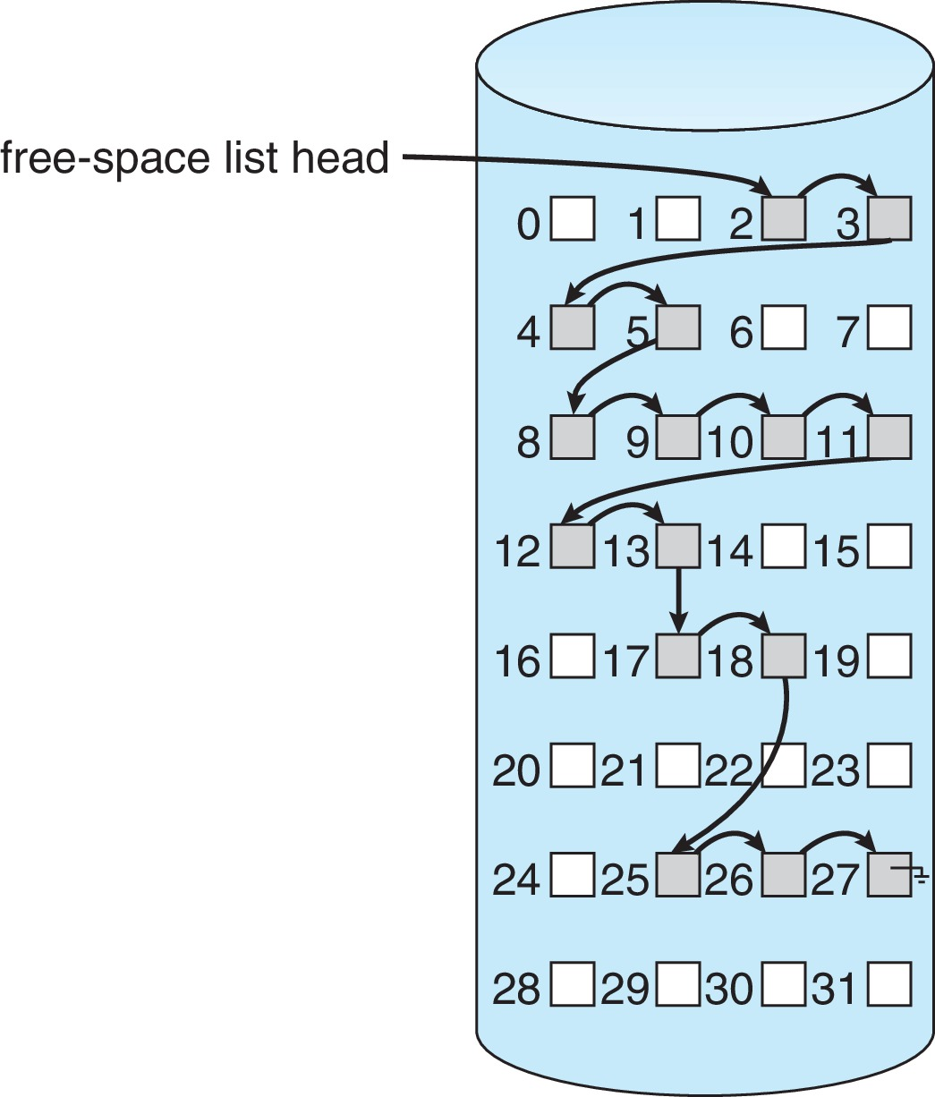
Linked Free Space List on Disk
Linked list (free list)
Cannot get contiguous space easily
No waste. Linked Free Space List on Disk of space
No need to traverse the entire list (if # free blocks recorded)

Slide 30
Free-Space Management (Cont.)
Grouping
Modify linked list to store address of next n-1 free blocks in first free block, plus a pointer to next block that contains free-block-pointers
Counting
Because space is frequently contiguously used and freed, with contiguous-allocation, extents, or clustering
Keep address of first free block and count of following free blocks
Free space list then has entries containing addresses and counts

Slide 31
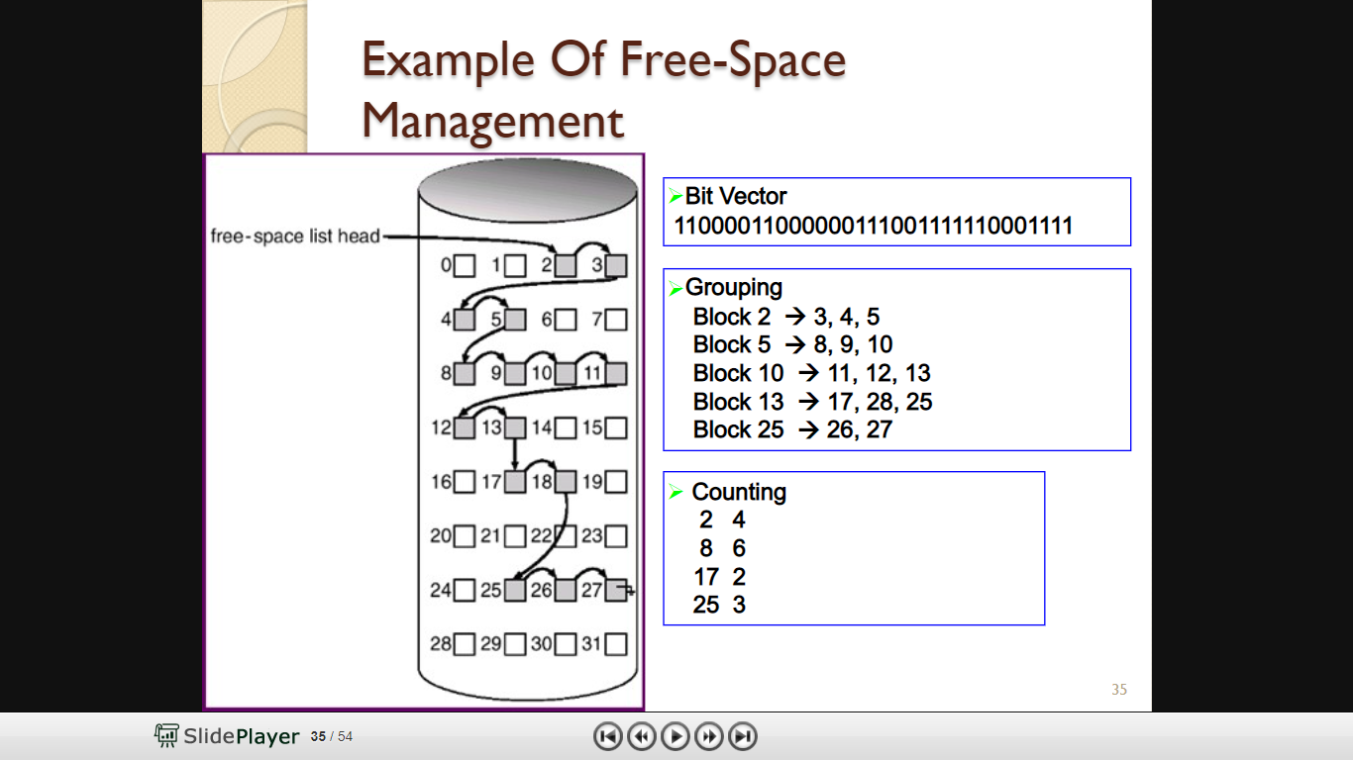
Free-Space Management (Cont.)

Slide 32
Free-Space Management (Cont.)
Space Maps
Used in ZFS (Oracle)
Consider meta-data I/O on very large file systems
Full data structures like bit maps cannot fit in memory ➔ thousands of I/Os
Divides device space into metaslab units and manages metaslabs
Given volume can contain hundreds of metaslabs
Each metaslab has associated space map
The space map is a log of all block activity (allocating and freeing), in time order, in counting format
Uses counting algorithm
But records to log file rather than file system
Log of all block activity, in time order, in counting format
Metaslab activity ➔ load space map into memory in balanced-tree structure, indexed by offset
Replay log into that structure
Combine contiguous free blocks into single entry

Slide 33
TRIMing Unused Blocks
HDDS overwrite in place so need only free list
Blocks not treated specially when freed
Keeps its data but without any file pointers to it, until overwritten
Storage devices not allowing overwrite (like NVM) suffer badly with same algorithm
Must be erased before written, erases made in large chunks (blocks, composed of pages) and are slow
TRIM is a newer mechanism for the file system to inform the NVM storage device that a page is free
Can be garbage collected or if block is free, now block can be erased

Slide 34
UNIT V
Storage Management: Mass Storage Structure: Overview – HDD Scheduling. File System: File Concept – Access Methods – Directory Structure – Protection. File System Implementation: File System Structure – File System Operations – Directory Implementation – Allocation Methods - Free Space Management – Security : The Security Problem – program Threats - Case study: Linux System.

Slide 35
The Security Problem
System secure if resources used and accessed as intended under all circumstances
Unachievable
Intruders (crackers) attempt to breach security
Threat is potential security violation
Attack is attempt to breach security
Attack can be accidental or malicious
Easier to protect against accidental than malicious misuse

Slide 36
Security Violation Categories
Breach of confidentiality
Unauthorized reading of data
Breach of integrity
Unauthorized modification of data
Breach of availability
Unauthorized destruction of data
Theft of service
Unauthorized use of resources
Denial of service (DOS)
Prevention of legitimate use

Slide 37
Security Violation Methods
Masquerading (breach authentication)
Pretending to be an authorized user to escalate privileges
Replay attack
As is or with message modification
Man-in-the-middle attack
Intruder sits in data flow, masquerading as sender to receiver and vice versa
Session hijacking
Intercept an already-established session to bypass authentication
Privilege escalation
Common attack type with access beyond what a user or resource is supposed to have

Slide 38
Security Measure Levels
Impossible to have absolute security, but make cost to perpetrator sufficiently high to deter most intruders
Security must occur at four levels to be effective:
Physical
Data centers, servers, connected terminals
Application
Benign or malicious apps can cause security problems
Operating System
Protection mechanisms, debugging
Network
Intercepted communications, interruption, DOS
Security is as weak as the weakest link in the chain
Humans a risk too via phishing and social-engineering attacks
But can too much security be a problem?

Slide 39
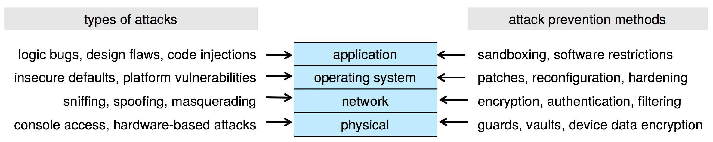
Four-layered Model of Security

Slide 40
Program Threats
Many variations, many names
Trojan Horse
Code segment that misuses its environment
Exploits mechanisms for allowing programs written by users to be executed by other users
Spyware, pop-up browser windows, covert channels
Up to 80% of spam delivered by spyware-infected systems
Trap Door
Specific user identifier or password that circumvents normal security procedures
Could be included in a compiler
How to detect them?

Slide 41
Program Threats (Cont.)
Malware - Software designed to exploit, disable, or damage computer
Trojan Horse – Program that acts in a clandestine manner
Spyware – Program frequently installed with legitimate software to display adds, capture user data
Ransomware – locks up data via encryption, demanding payment to unlock it
Others include trap doors, logic boms
All try to violate the Principle of Least Privilege
Goal frequently is to leave behind Remote Access Tool (RAT) for repeated access
Code review can help – programmers review each other’s code, looking for logic flows, programming flaws

Slide 42
Code Injection
Code-injection attack occurs when system code is not malicious but has bugs allowing executable code to be added or modified
Results from poor or insecure programming paradigms, commonly in low level languages like C or C++ which allow for direct memory access through pointers
Goal is a buffer overflow in which code is placed in a buffer and execution caused by the attack
Can be run by script kiddies – use tools written but exploit identifiers

Slide 43
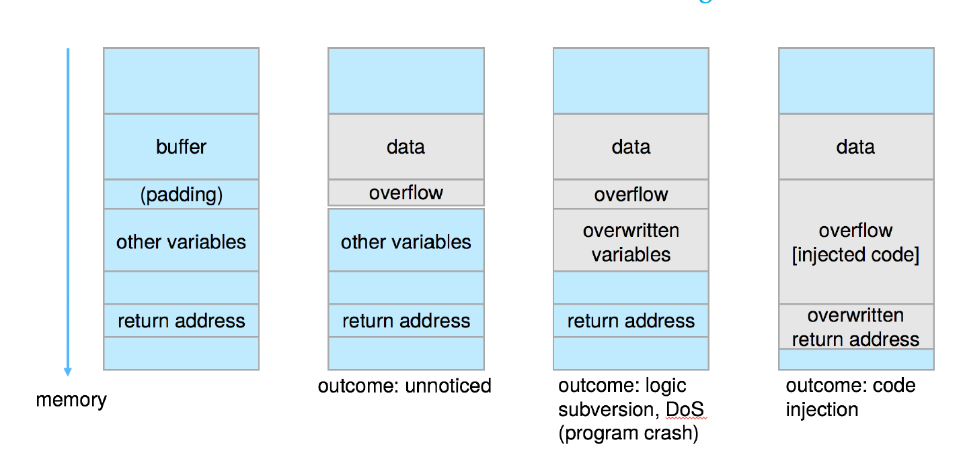
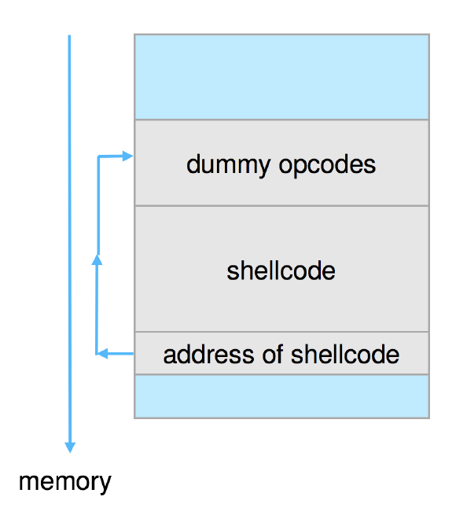
Code Injection (Cont.)
Outcomes from code injection include:
Frequently use trampoline to code execution to exploit buffer overflow:

Slide 44
Great Programming Required?
For the first step of determining the bug, and second step of writing exploit code, yes
Script kiddies can run pre-written exploit code to attack a given system
Attack code can get a shell with the processes’ owner’s permissions
Or open a network port, delete files, download a program, etc.
Depending on bug, attack can be executed across a network using allowed connections, bypassing firewalls
Buffer overflow can be disabled by disabling stack execution or adding bit to page table to indicate “non-executable” state
Available in SPARC and x86
But still have security exploits

Slide 45
Program Threats (Cont.)
Viruses
Code fragment embedded in legitimate program
Self-replicating, designed to infect other computers
Very specific to CPU architecture, operating system, applications
Usually borne via email or as a macro
Visual Basic Macro to reformat hard drive
Sub AutoOpen()
Dim oFS
Set oFS = CreateObject(’’Scripting.FileSystemObject’’)
vs = Shell(’’c:command.com /k format c:’’,vbHide)
End Sub

Slide 46
Program Threats (Cont.)
Virus dropper inserts virus onto the system
Many categories of viruses, literally many thousands of viruses
File / parasitic
Boot / memory
Macro
Source code
Polymorphic to avoid having a virus signature
Encrypted
Stealth
Tunneling
Multipartite
Armored

Slide 47
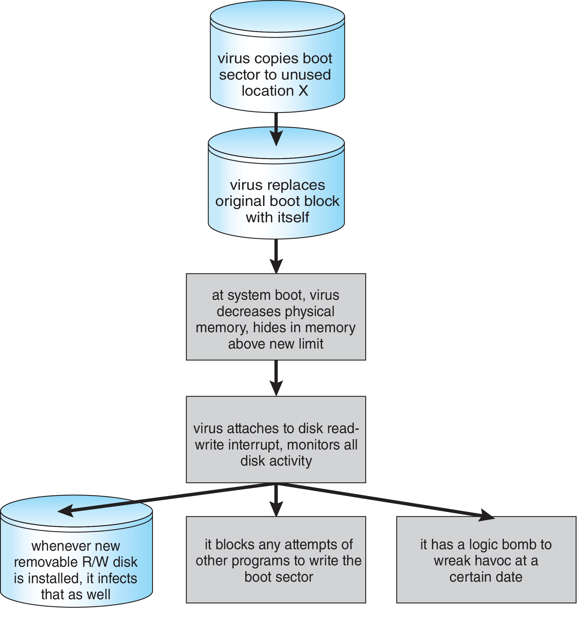
A Boot-sector Computer Virus

Slide 48
The Threat Continues
Attacks still common, still occurring
Attacks moved over time from science experiments to tools of organized crime
Targeting specific companies
Creating botnets to use as tool for spam and DDOS delivery
Keystroke logger to grab passwords, credit card numbers
Why is Windows the target for most attacks?
Most common
Everyone is an administrator
Licensing required?
Monoculture considered harmful

