Slide 1




20CSE43 – Operating Systems
UNIT II
1

Slide 2
Course Overview

Slide 3
Unit II
Process Management:: Process Concept, Process Scheduling, Operations on Processes, Interprocess Communication – IPC in Shared Memory and Message Passing Systems. CPU Scheduling: Scheduling Criteria – Scheduling Algorithms. Multithreaded Programming: Threads Overview, Multicore Programming, Multithreading Models.
CO2: make use of process management strategies for scheduling processes

Slide 4
Process Concept
An operating system executes a variety of programs that run as a process.
Process – a program in execution; process execution must progress in sequential fashion. No parallel execution of instructions of a single process
Memory layout of a process
The program code, also called text section
Data section containing global variables
Stack containing temporary data
Function parameters, return addresses, local variables
Heap containing memory dynamically allocated during run time

Slide 5
Process Concept (Cont.)
Program is passive entity stored on disk (executable file); process is active
Program becomes process when an executable file is loaded into memory
Execution of program started via GUI mouse clicks, command line entry of its name, etc.
One program can be several processes
Consider multiple users executing the same program

Slide 6
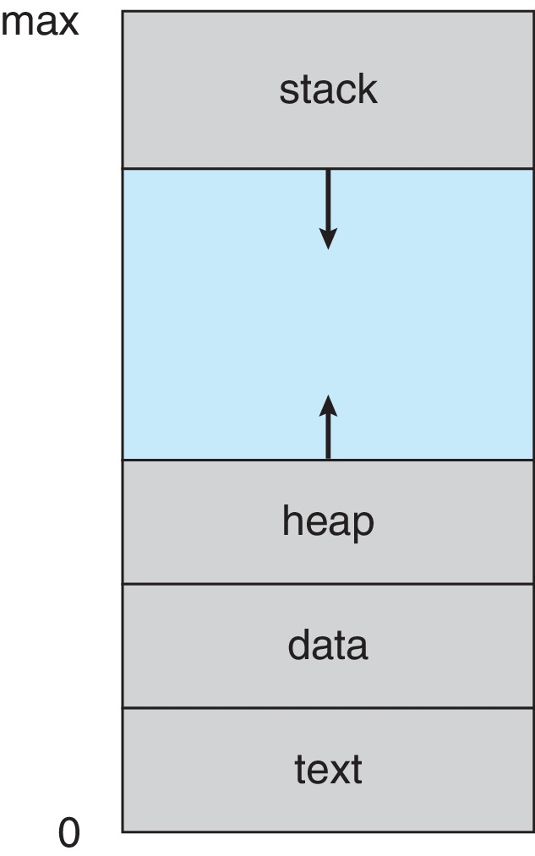
Process in Memory

Slide 7
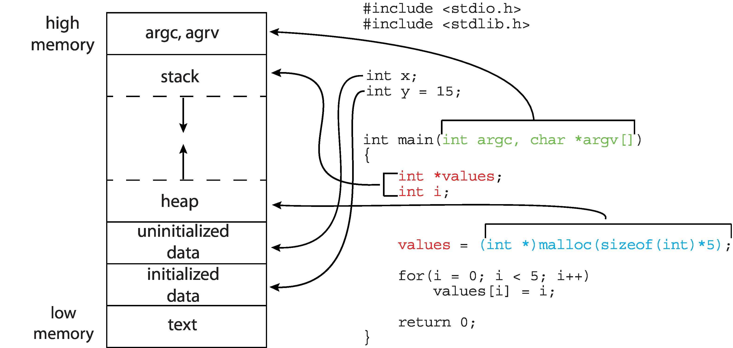
Memory Layout of a C Program

Slide 8
Process State
As a process executes, it changes state
New: The process is being created
Running: Instructions are being executed
Waiting: The process is waiting for some event to occur
Ready: The process is waiting to be assigned to a processor
Terminated: The process has finished execution

Slide 9

Diagram of Process State

Slide 10
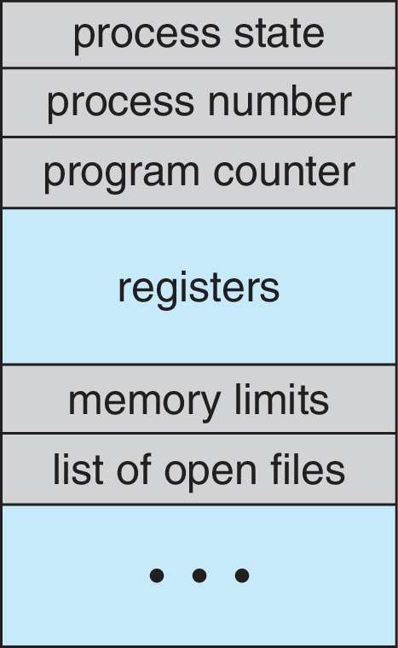
Process Control Block (PCB)
Information associated with each process(also called task control block)
Process state – running, waiting, etc.
Program counter – address of the next instruction to be executed for this process
CPU registers – contents of all process-centric registers
CPU scheduling information- priorities, scheduling queue pointers
Memory-management information – memory allocated to the process
Accounting information – CPU used, clock time elapsed since start, time limits
I/O status information – I/O devices allocated to process, list of open files

Slide 11
Threads
So far, process has a single thread of execution
Consider having multiple program counters per process
Multiple locations can execute at once
Multiple threads of control -> threads
Must then have storage for thread details, multiple program counters in PCB

Slide 12
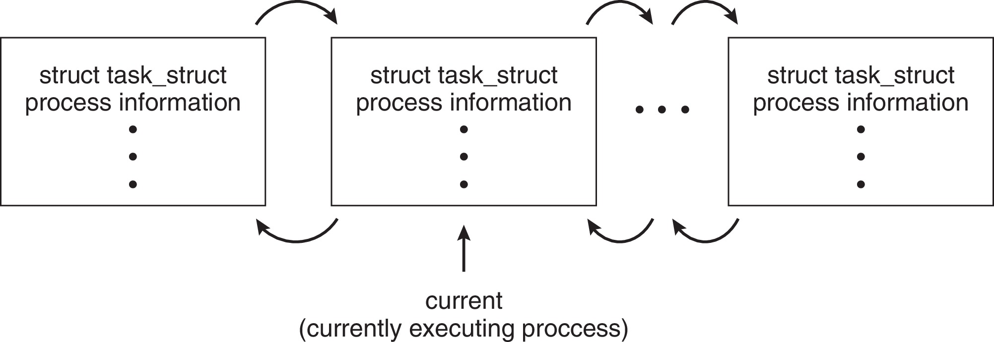
Process Representation in Linux
Represented by the C structure task_struct
pid t_pid; /* process identifier */ long state; /* state of the process */ unsigned int time_slice /* scheduling information */ struct task_struct *parent;/* this process’s parent */ struct list_head children; /* this process’s children */ struct files_struct *files;/* list of open files */ struct mm_struct *mm; /* address space of this process */

Slide 13
Process Scheduling
Process scheduler selects among available processes for next execution on CPU core
Goal -- Maximize CPU use, quickly switch processes onto CPU core
I/O bound Process, CPU bound Process
Maintains scheduling queues of processes
Ready queue – set of all processes residing in main memory, ready and waiting to execute
Wait queues – set of processes waiting for an event (i.e., I/O)
Processes migrate among the various queues

Slide 14
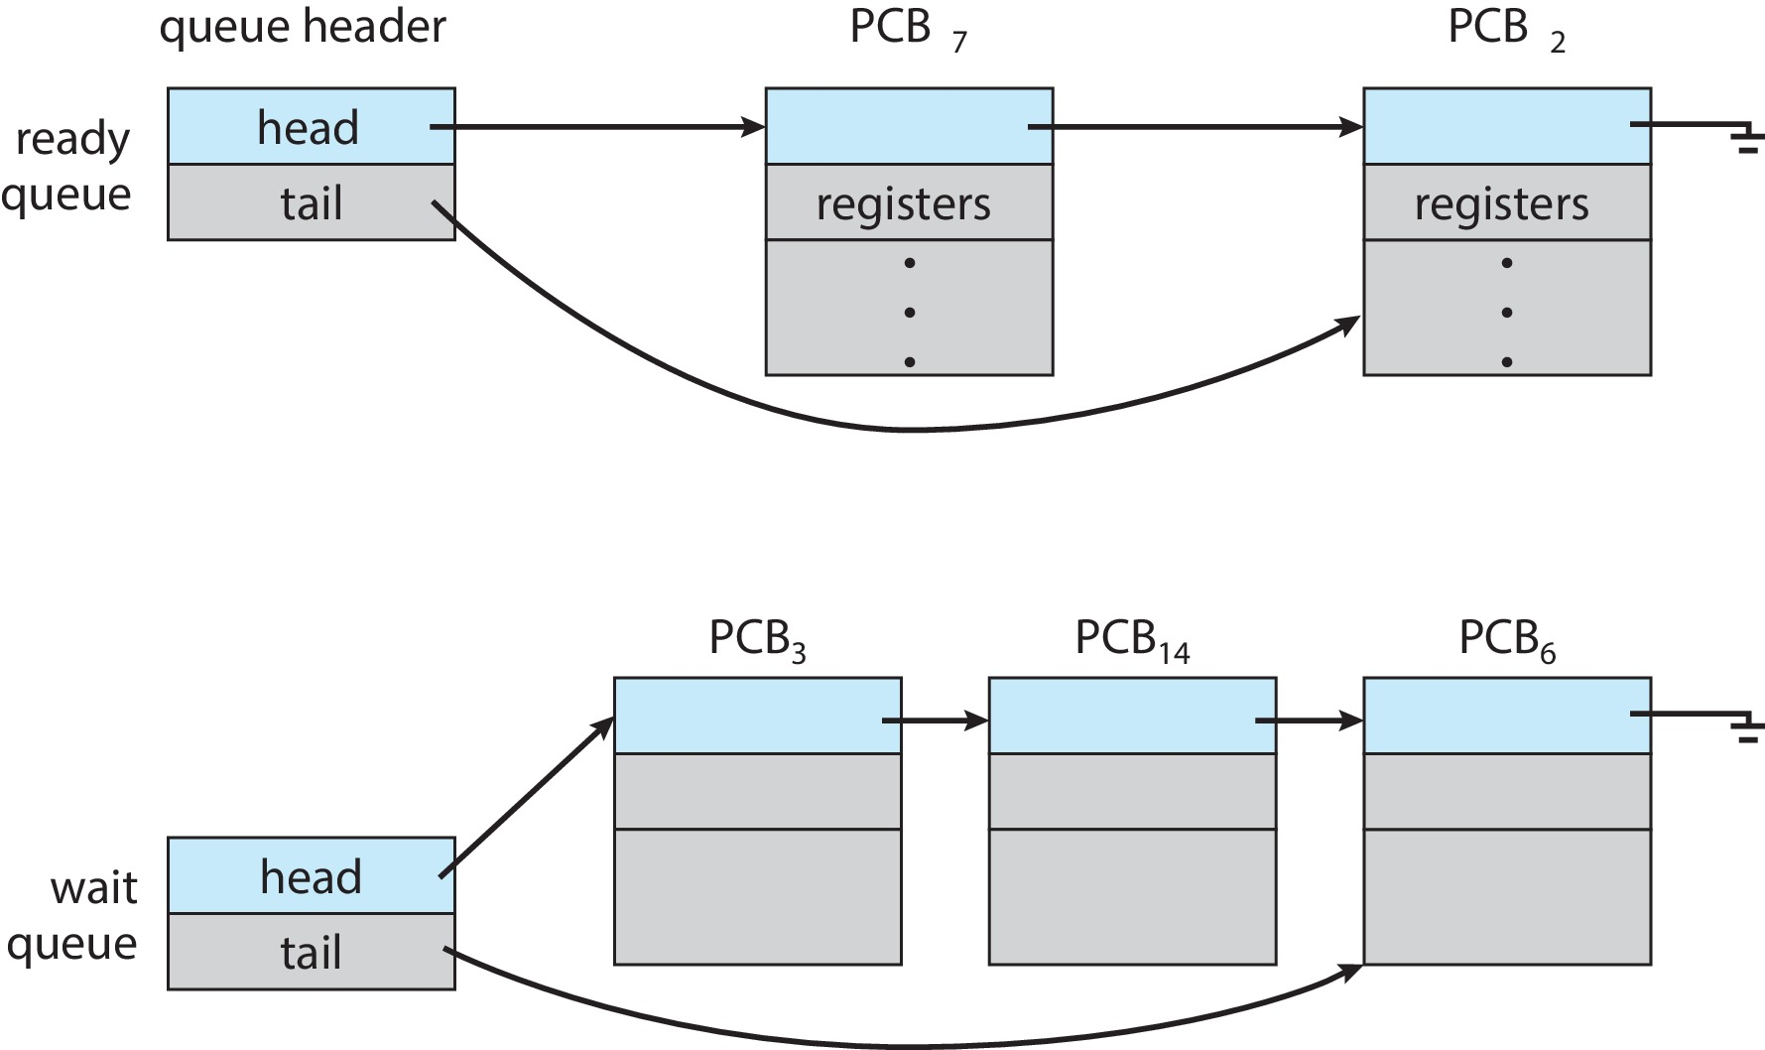
Ready and Wait Queues

Slide 15
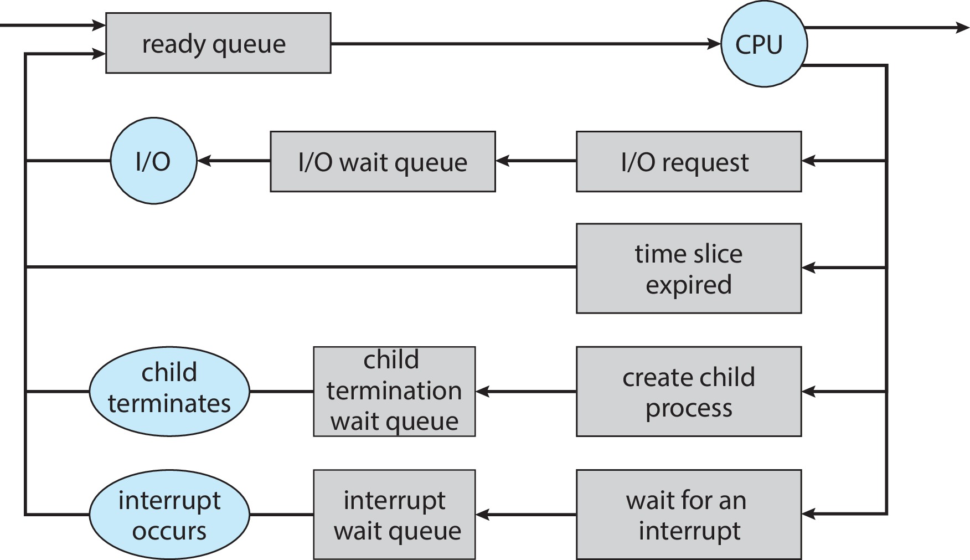
Representation of Process Scheduling

Slide 16
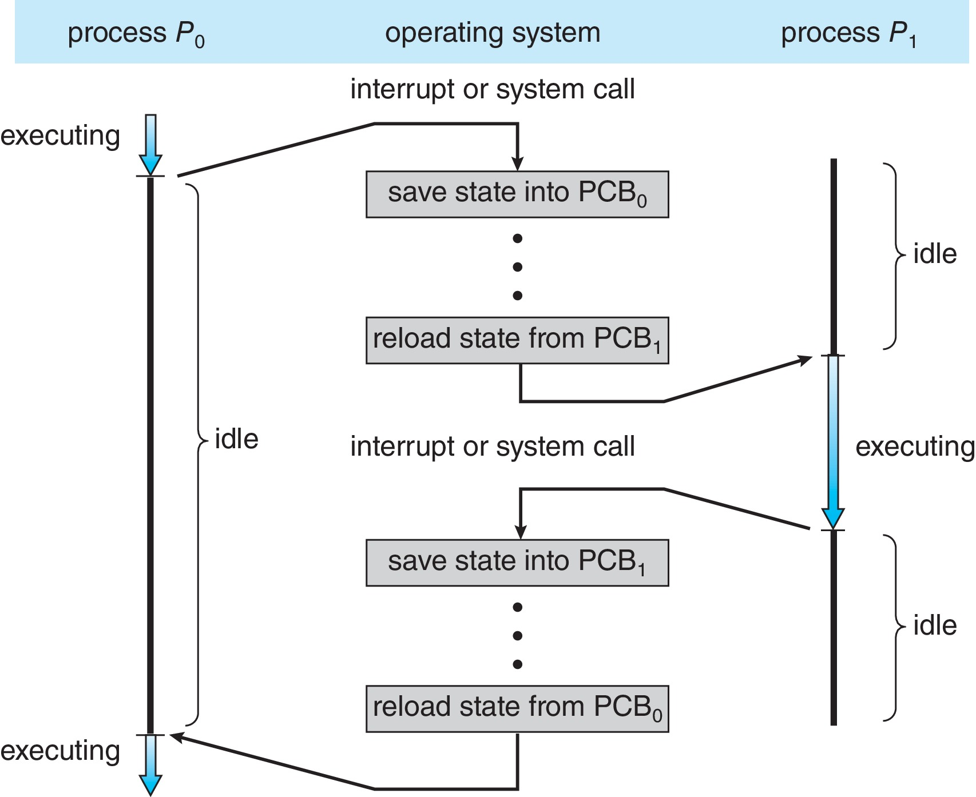
CPU Switch From Process to Process
A context switch occurs when the CPU switches from one process to another.

Slide 17
Context Switch
When CPU switches to another process, the system must save the state of the old process and load the saved state for the new process via a context switch
Context of a process represented in the PCB
Context-switch time is pure overhead; the system does no useful work while switching
The more complex the OS and the PCB ➔ the longer the context switch
Time dependent on hardware support
Some hardware provides multiple sets of registers per CPU ➔ multiple contexts loaded at once

Slide 18
Multitasking in Mobile Systems
Some mobile systems (e.g., early version of iOS) allow only one process to run, others suspended
Due to screen real estate, user interface limits iOS provides for a
Single foreground process- controlled via user interface
Multiple background processes– in memory, running, but not on the display, and with limits
Limits include single, short task, receiving notification of events, specific long-running tasks like audio playback
Android runs foreground and background, with fewer limits
Background process uses a service to perform tasks
Service can keep running even if background process is suspended
Service has no user interface, small memory use

Slide 19
Operations on Processes
System must provide mechanisms for:
Process creation
Process termination

Slide 20
Process Creation
Parent process create children processes, which, in turn create other processes, forming a tree of processes
Generally, process identified and managed via a process identifier (pid)
Process identifier (pid) – OS assigns unique identifier (integer) to each process to access attributes of a process
Resource sharing options (CPU time, memory, files, I/O devices)
Parent and children share all resources
Children share subset of parent’s resources
Parent and child share no resources
Execution options
Parent and children execute concurrently
Parent waits until children terminate

Slide 21
Process Creation (Cont.)
Address space
Child is a duplicate of parent
Child has a program loaded into it
UNIX examples
fork() system call creates new process
exec() system call used after a fork() to replace the process’ memory space with a new program
Parent process calls wait()waiting for the child to terminate

Slide 22
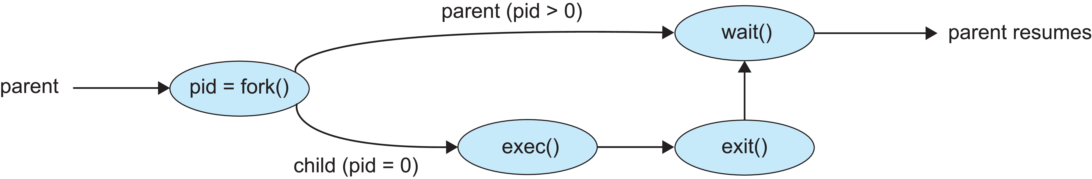
Process Creation (Cont.)
The fork() function is used to create child process
Syntax : pid = fork ( );
Fork called once, but returns twice
If pid == 0, child process
If pid> 0 , parent process
If pid < 0, error

Slide 23
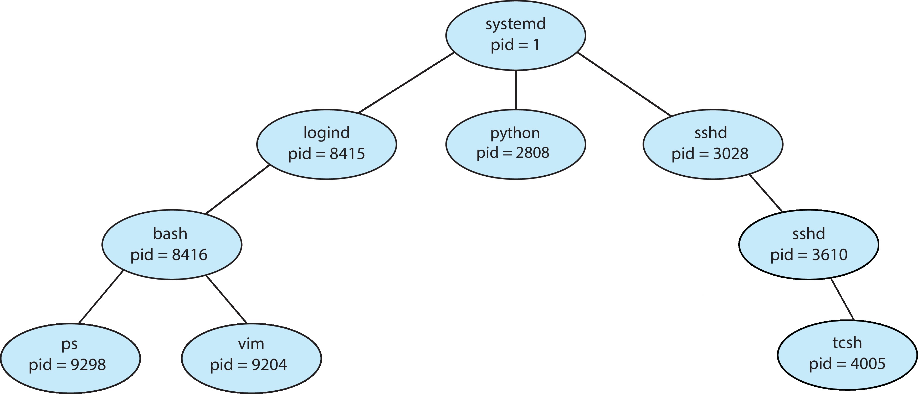
A Tree of Processes in Linux

Slide 24

C Program Forking Separate Process

Slide 25
Process Termination
Process executes last statement and then asks the operating system to delete it using the exit() system call.
Returns status data from child to parent (via wait())
Process’ resources are deallocated by operating system
Parent may terminate the execution of children processes using the abort() system call. Some reasons for doing so:
Child has exceeded allocated resources
Task assigned to child is no longer required
The parent is exiting, and the operating systems does not allow a child to continue if its parent terminates

Slide 26
Process Termination
Some operating systems do not allow child to exist if its parent has terminated. If a process terminates, then all its children must also be terminated.
cascading termination. All children, grandchildren, etc., are terminated.
The termination is initiated by the operating system.
The parent process may wait for termination of a child process by using the wait()system call. The call returns status information and the pid of the terminated process
pid = wait(&status);
When a process terminates, its resources are deallocated by the OS , but its entry in the process table must remain there until the parent calls wait - zombie process - no parent waiting (did not invoke wait()) process
If a parent did not invoke wait() and instead terminated – orphan child processes

Slide 27
Android Process Importance Hierarchy
Mobile operating systems often have to terminate processes to reclaim system resources such as memory. From most to least important:
Foreground process
Visible process
Service process
Background process
Empty process
Android will begin terminating processes that are least important.

Slide 28

Multiprocess Architecture – Chrome Browser
Many web browsers ran as single process (some still do)
If one web site causes trouble, entire browser can hang or crash
Google Chrome Browser is multiprocess with 3 different types of processes:
Browser process manages user interface, disk and network I/O
Renderer process renders web pages, deals with HTML, Javascript. A new renderer created for each website opened
Runs in sandbox restricting disk and network I/O, minimizing effect of security exploits
Plug-in process for each type of plug-in

Slide 29
Interprocess Communication
Processes within a system may be independent or cooperating
Cooperating process can affect or be affected by other processes, including sharing data
Reasons for cooperating processes:
Information sharing
Computation speedup
Modularity
Convenience
Cooperating processes need interprocess communication (IPC)
Two models of IPC
Shared memory
Message passing

Slide 30
Interprocess Communication
Processes executing concurrently in OS may be either independent processes or cooperating processes.
A process is independent if it does not share data with other processes
A process is cooperating if it can affect or be affected by the other processes. Clearly, any process that shares data with other processes is a cooperating process
Reasons for supporting cooperative process:
Information sharing : Since several applications interested in the same piece of information (for instance, copying and pasting), we must provide an environment to allow concurrent access to such information.
Computation speedup. If we want a particular task to run faster, we must break it into subtasks, each of which will be executing in parallel in multicore environment
Modularity. We may want to construct the system in a modular fashion, dividing the system functions into separate processes or threads

Slide 31
IPC models
Cooperating processes require IPC mechanism that will allow them to exchange data— that is, send data to and receive data from each other.
Two fundamental models of IPC: shared memory and message passing
Shared-memory model:
A region of memory is shared by the cooperating processes. Processes can exchange information by reading and writing data to that region.
System call is required for shared memory creation, but for doing IPC intervention of OS is not needed – fast , suitable for large amount data
Need synchronization between the cooperating processes
Message-passing model:
Communication takes place by means of messages exchanged between the cooperating processes through kernel of OS
easier to implement –no conflicts arise
Implemented using system calls – need OS intervention- slow and suitable for small amount of data

Slide 32
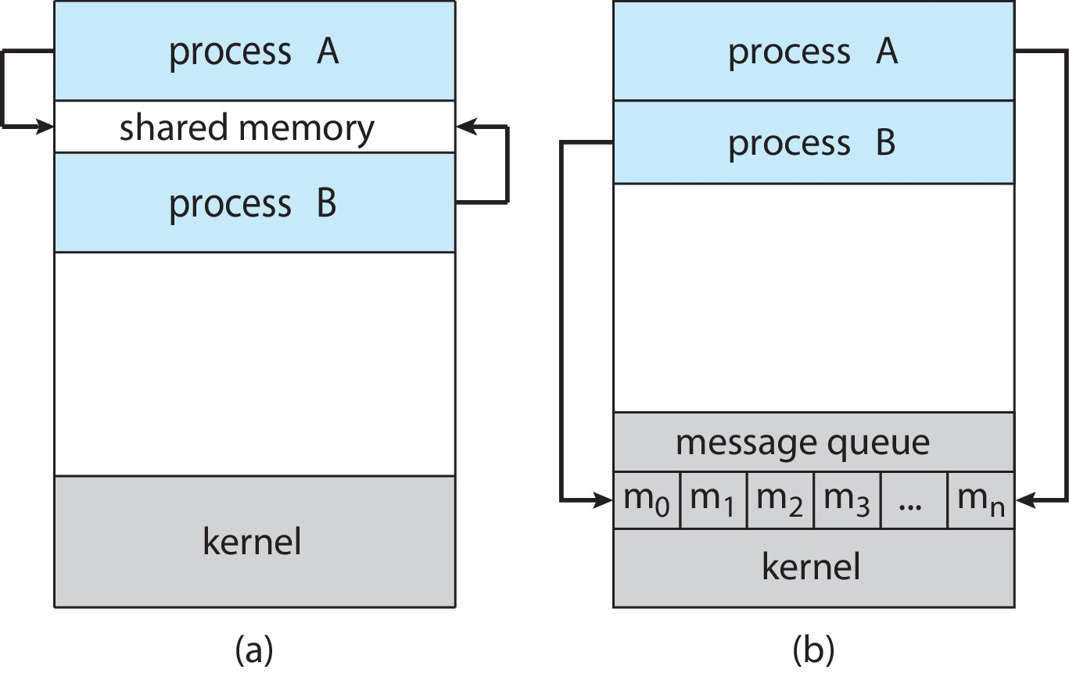
Communications Models
(a) Shared memory. (b) Message passing.

Slide 33
IPC in Shared-Memory Systems
Normally, OS prevents one process from accessing another process’s memory. Shared memory requires that two or more processes agree to remove this restriction.
Processes exchange information by reading and writing data in the shared areas. The form of the data and the location are determined by them only
The processes are responsible for ensuring that synchronization between them

Slide 34
Producer-Consumer Problem
Paradigm for cooperating processes:
producer process produces information that is consumed by a consumer process
Two variations:
unbounded-buffer places no practical limit on the size of the buffer:
Producer never waits
Consumer waits if there is no buffer to consume
bounded-buffer assumes that there is a fixed buffer size
Producer must wait if all buffers are full
Consumer waits if there is no buffer to consume

Slide 35
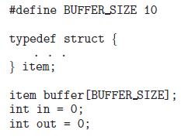
Producer Consumer Problem
Data Structure

Slide 36
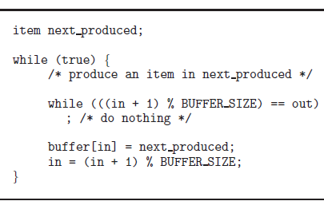
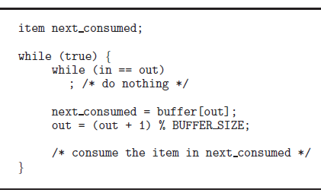
Producer Consumer Problem
Producer Consumer

Slide 37
IPC – Message Passing
Processes communicate with each other via a message-passing facility.
Useful in a distributed environment, where the communicating processes may reside on different computers connected by a network.
IPC facility provides two operations:
send(message)
receive(message)
The message size is either fixed or variable

Slide 38
Message Passing (Cont.)
If processes P and Q wish to communicate, they need to:
Establish a communication link between them
Exchange messages via send/receive
Implementation issues:
How are links established?
Can a link be associated with more than two processes?
How many links can there be between every pair of communicating processes?
What is the capacity of a link?
Is the size of a message that the link can accommodate fixed or variable?
Is a link unidirectional or bi-directional?

Slide 39
Implementation of Communication Link
Physical:
Shared memory
Hardware bus
Network
Logical:
Direct or indirect
Synchronous or asynchronous
Automatic or explicit buffering

Slide 40


IPC in Message-Passing Systems-Issues
Direct communication
Each process that wants to communicate must explicitly name the recipient or sender of the communication
Naming : Symmetry addressing
Naming : Asymmetry addressing
Disadvantage : Explicit naming , hard coding

Slide 41

IPC in Message-Passing-Issues [contd..]
1. Indirect communication : The messages are sent to and received from mailboxes(or ports). A mailbox can be viewed abstractly as an object into which messages can be placed by processes and from which messages can be removed. Each mailbox has a unique identification.
A mailbox may be owned either by a process or by the operating system
When a process owns a mailbox terminates, the mailbox disappears. Any process sends a message to this mailbox, must be notified about that.
If a mailbox is owned by an OS, it is independent of any process. It should provide mechanism for
Create a new mailbox.
Send and receive messages through the mailbox.
Delete a mailbox.

Slide 42
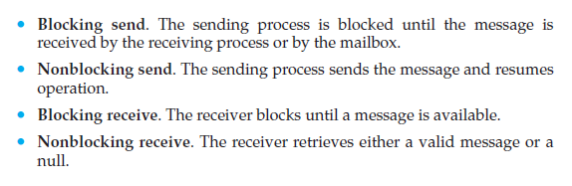
IPC in Message-Passing-Issues [contd..]
2. Synchronization :
Communication using send() and receive() can be
Synchronous (blocking mode) or
Asynchronous (Non-blocking mode)
Different combinations possible

Slide 43
IPC in Message-Passing-Issues [contd..]
3. Buffering :
Whether communication is direct or indirect, messages exchanged by communicating processes reside in a temporary queue. Basically, such queues can be
Zero capacity. The queue has a maximum length of zero; thus, the link cannot have any messages waiting in it. In this case, the sender must block until the recipient receives the message.
Bounded capacity. The queue has finite length n; If the queue is not full when a new message is sent, the message is placed in the queue, and the sender can continue execution without waiting. If the link is full, the sender must block until space is available in the queue.
Unbounded capacity. The queue’s length is potentially infinite; thus, any number of messages can wait in it. The sender never blocks.
No Buffering
Automatic Buffering

Slide 44
Unit II
Process Management:: Process Concept, Process Scheduling, Operations on Processes, Interprocess Communication – IPC in Shared Memory and Message Passing Systems. CPU Scheduling: Scheduling Criteria – Scheduling Algorithms. Multithreaded Programming: Threads Overview, Multicore Programming, Multithreading Models.

Slide 45
Motivation
Most modern applications are multithreaded
An application typically is implemented as a separate process with several threads of control
Multiple tasks with the application can be implemented by separate threads
A web browser might have one thread display images or text while another thread retrieves data from the network
A word processor may have a thread for displaying graphics, another thread for responding to keystrokes from the user, and a third thread for performing spelling and grammar checking in the background
Process creation is heavy-weight while thread creation is light-weight
Can simplify code, increase efficiency
Kernels are generally multithreaded

Slide 46
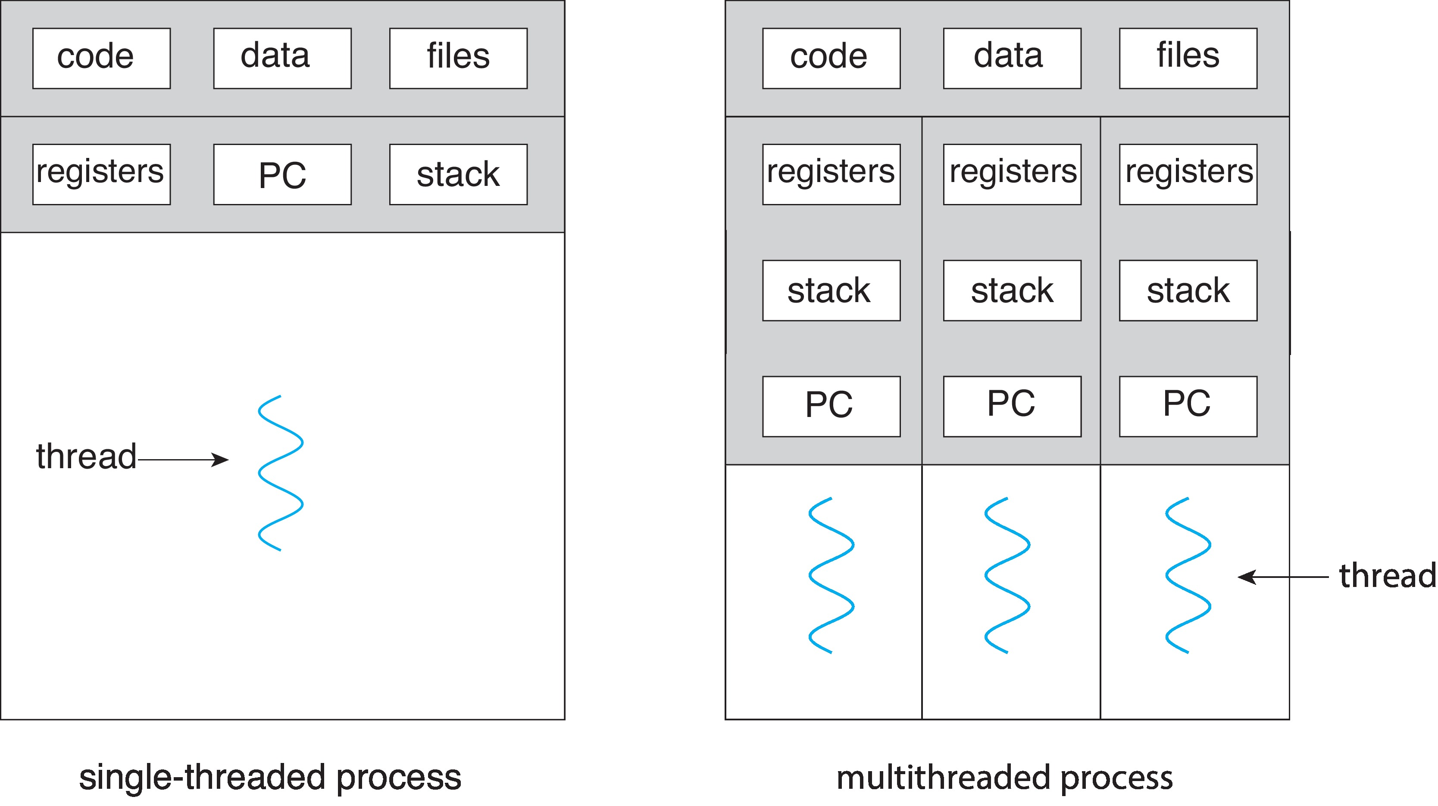
Single and Multithreaded Processes

Slide 47
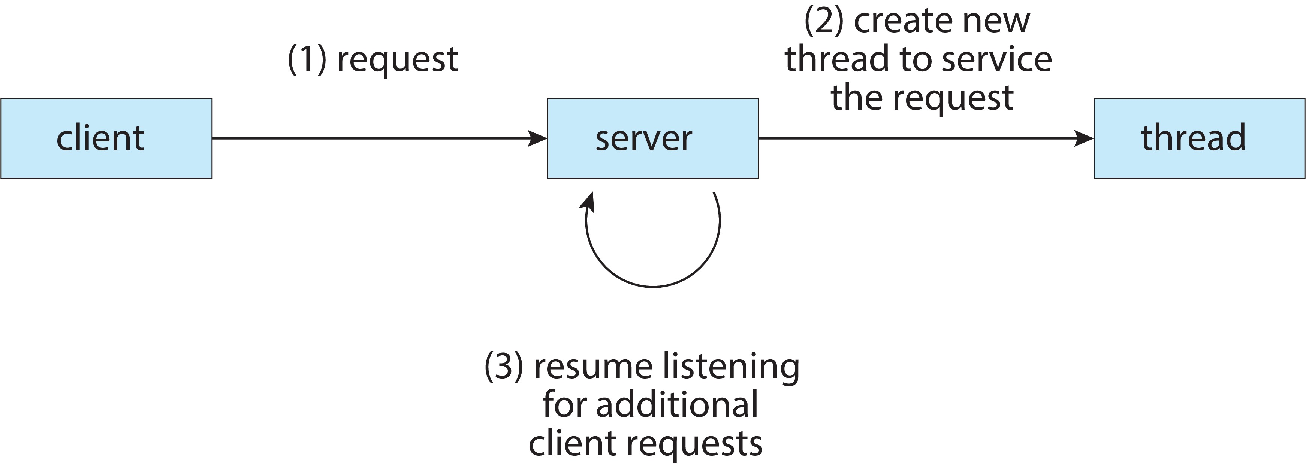
Multithreaded Server Architecture
Process creation is time consuming and resource intensive

Slide 48
Benefits
Responsiveness – may allow continued execution if part of process is blocked, especially important for user interfaces
Resource Sharing – threads share resources of process, easier than shared memory or message passing
Economy – cheaper than process creation, thread switching lower overhead than context switching
Scalability – process can take advantage of multicore architectures

Slide 49
Multicore Programming
Place multiple computing cores on a single processing chip where each core appears as a separate CPU to the operating system
Multicore or multiprocessor systems putting pressure on programmers, challenges include:
Dividing activities
Balance
Data splitting
Data dependency
Testing and debugging
Parallelism implies a system can perform more than one task simultaneously
Concurrency supports more than one task making progress
Single processor / core, scheduler providing concurrency

Slide 50

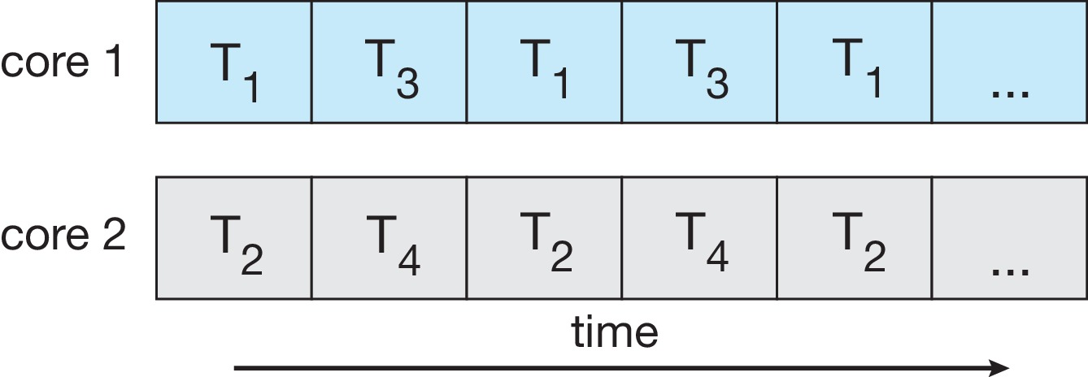
Concurrency vs. Parallelism
Concurrent execution on single-core system:
Parallelism on a multi-core system:

Slide 51
Multicore Programming
Types of parallelism
Data parallelism – distributes subsets of the same data across multiple cores, same operation on each
Task parallelism – distributing threads across cores, each thread performing unique operation

Slide 52
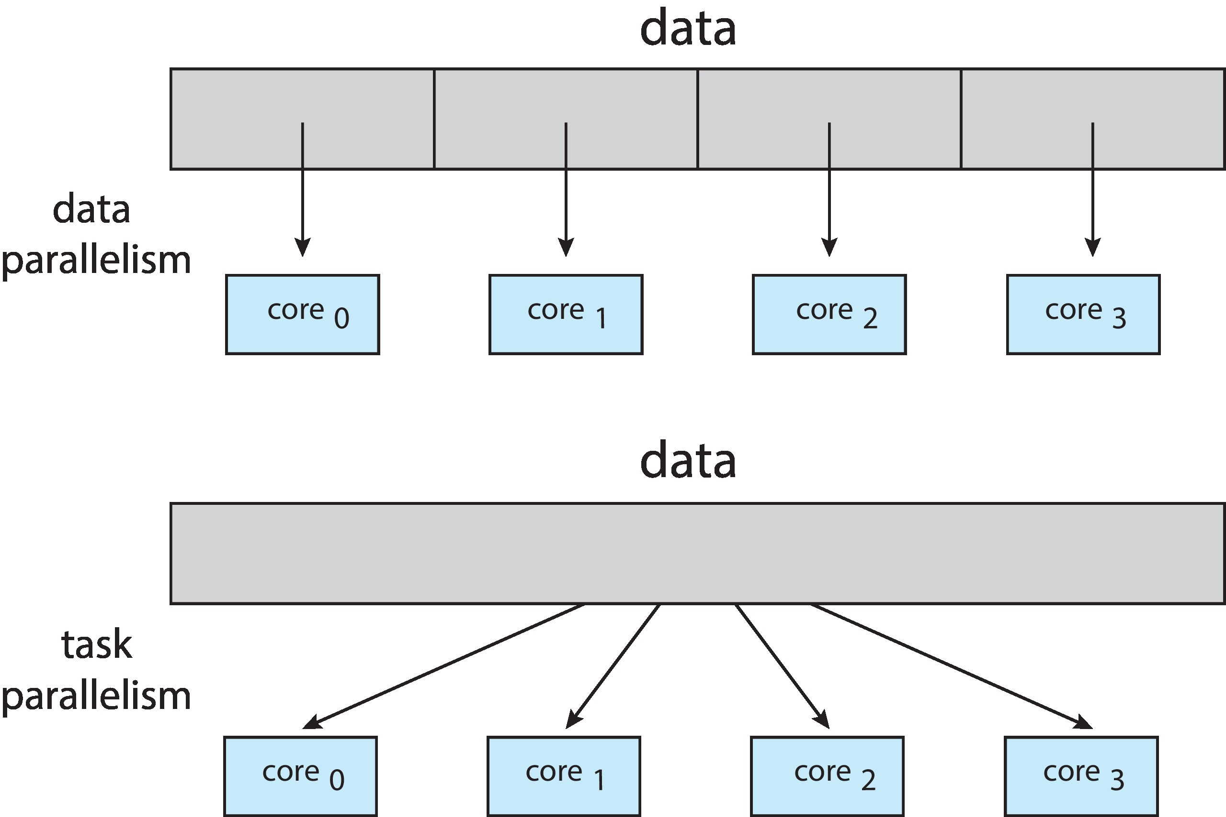
Data and Task Parallelism

Slide 53
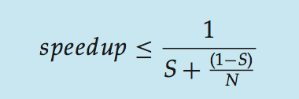
Amdahl’s Law
Identifies performance gains from adding additional cores to an application that has both serial and parallel components
S is serial portion
N processing cores
That is, if application is 75% parallel / 25% serial, moving from 1 to 2 cores results in speedup of 1.6 times
As N approaches infinity, speedup approaches 1 / S
Serial portion of an application has disproportionate effect on performance gained by adding additional cores

Slide 54
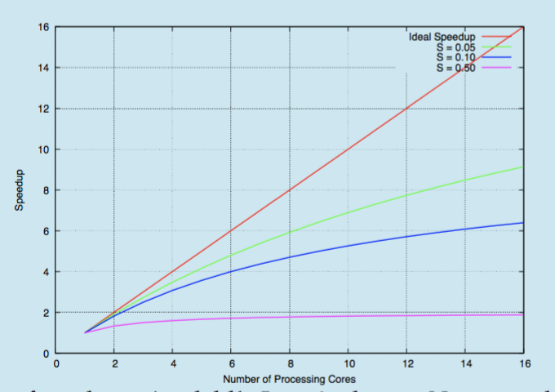
Amdahl’s Law

Slide 55
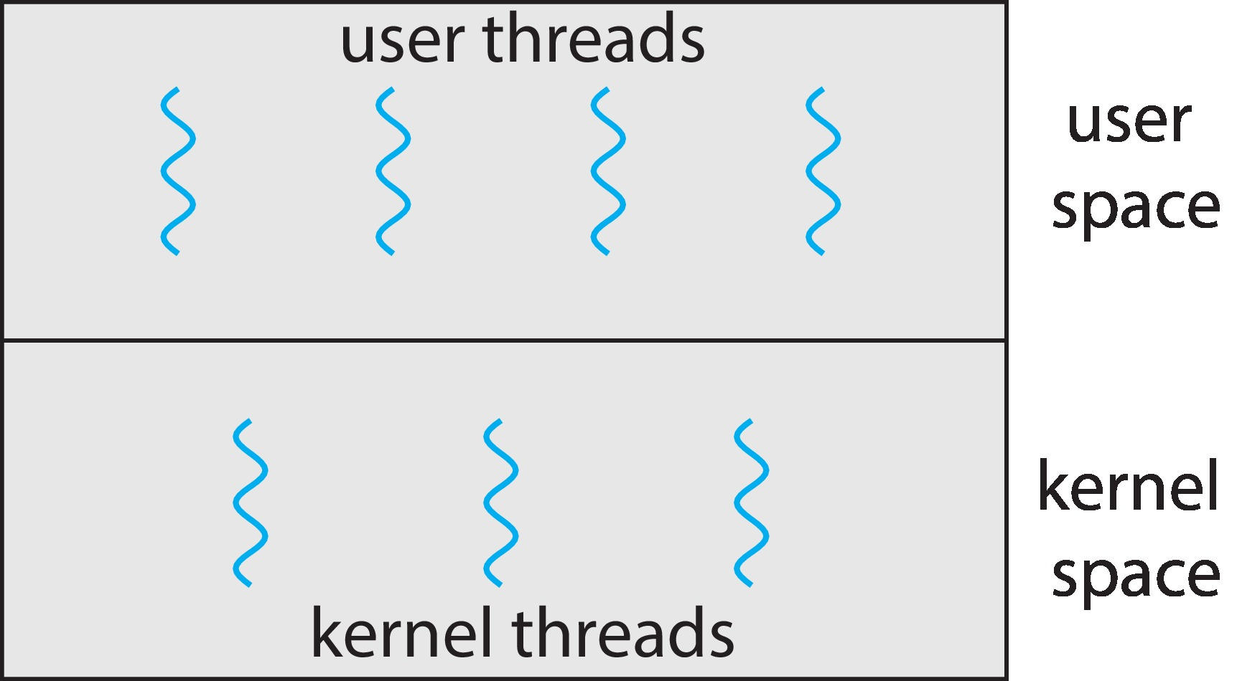
Multithreading Models
Support for threads may be provided either at the user level, for user threads, or by the kernel, for kernel threads
User threads are supported above the kernel and are managed without kernel support,
Kernel threads are supported and managed directly by the operating system.

Slide 56
Multithreading Models
Many-to-One
One-to-One
Many-to-Many

Slide 57
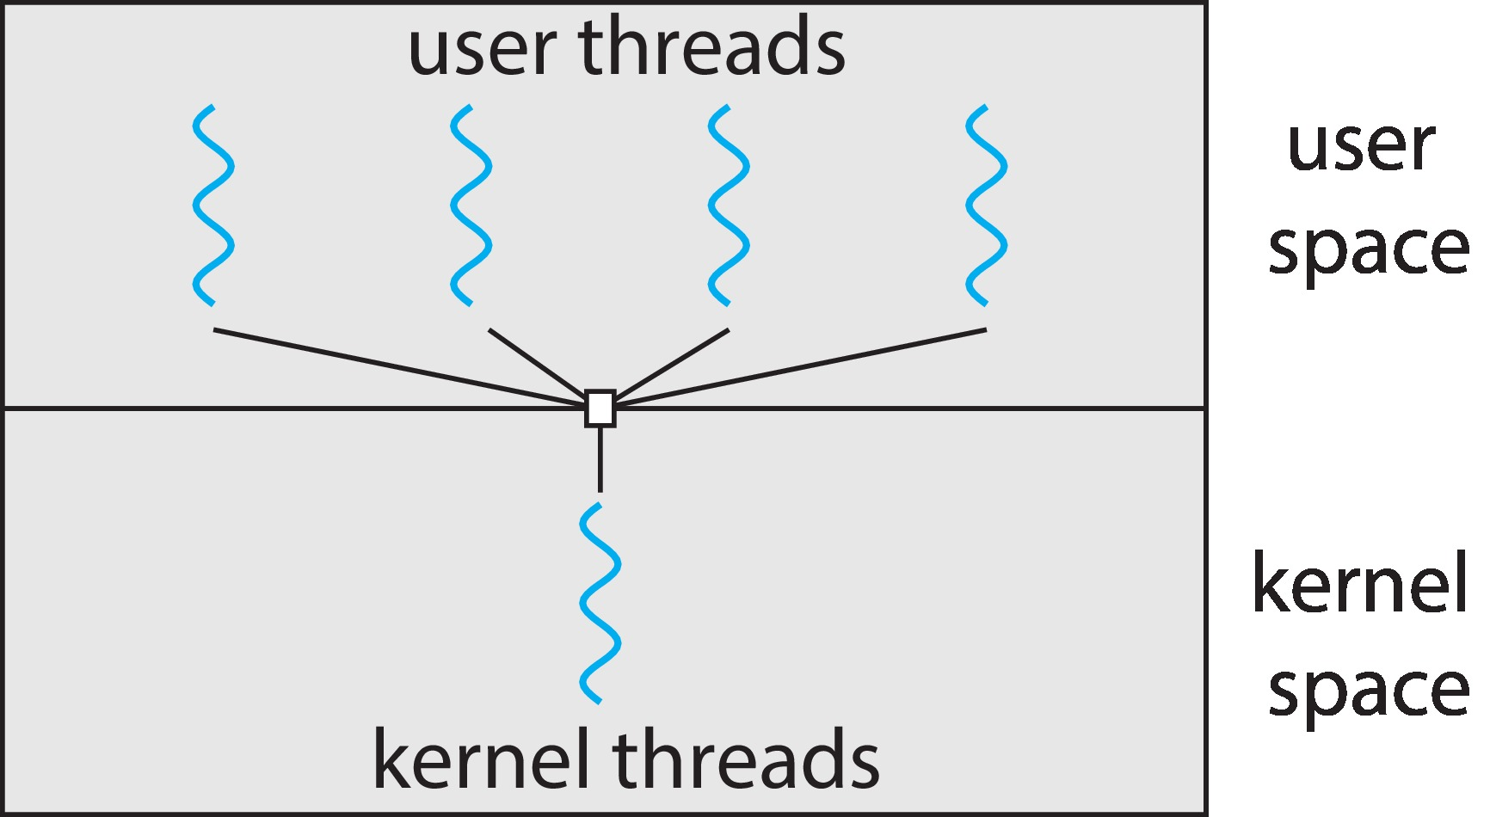
Many-to-One
Many user-level threads mapped to single kernel thread
One thread blocking causes all to block
Multiple threads may not run in parallel on muticore system because only one may be in kernel at a time
Few systems currently use this model
Examples:
Solaris Green Threads
GNU Portable Threads

Slide 58
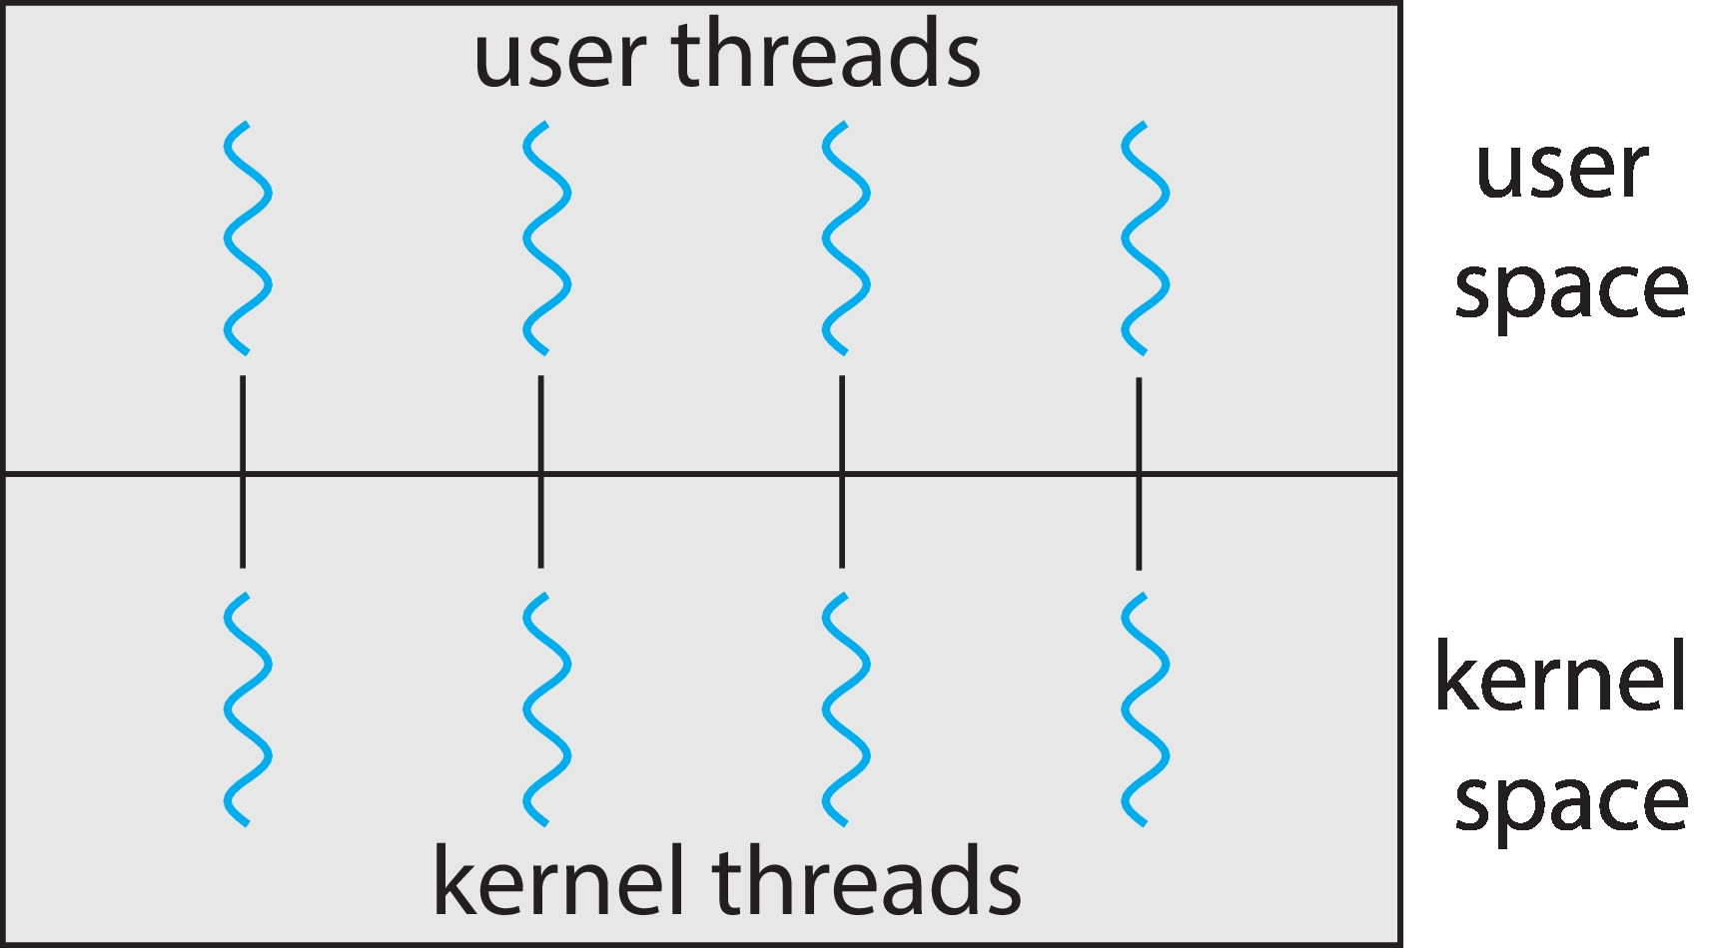
One-to-One
Each user-level thread maps to kernel thread
Creating a user-level thread creates a kernel thread
More concurrency than many-to-one
Number of threads per process sometimes restricted due to overhead
Examples
Windows
Linux

Slide 59
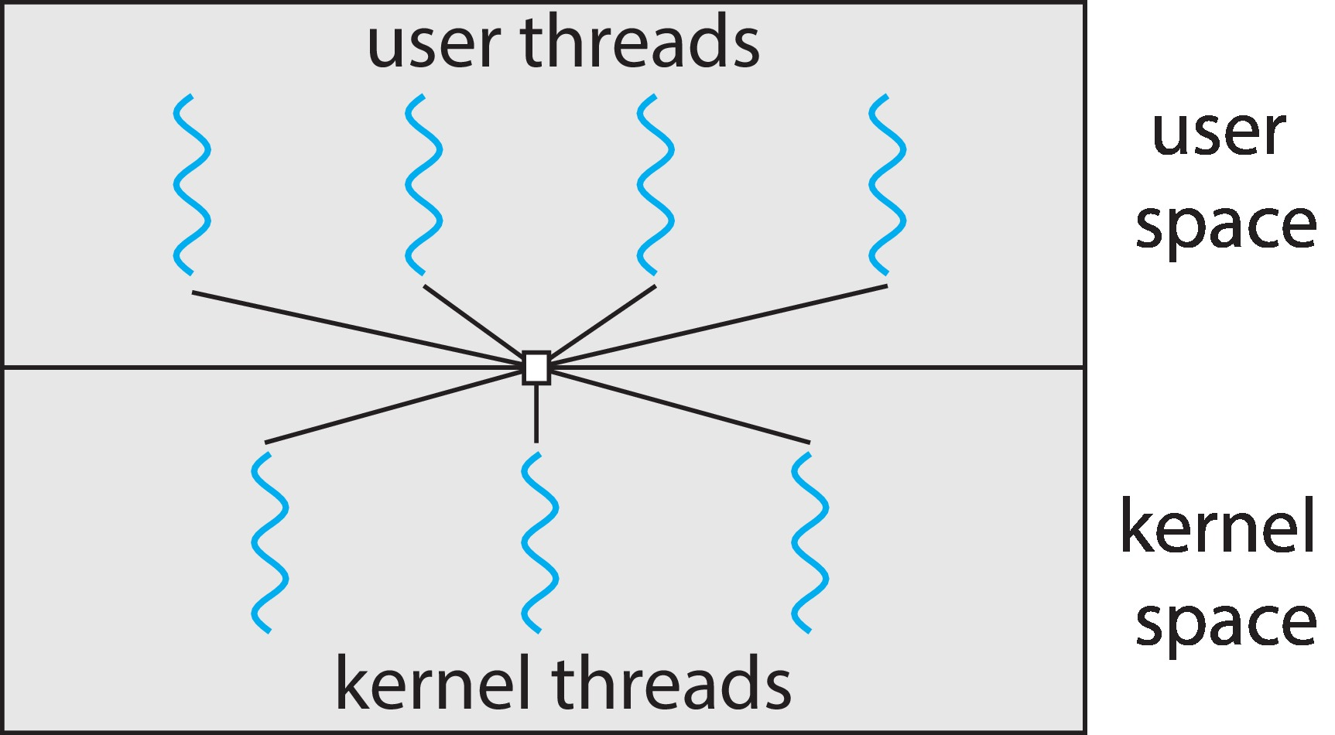
Many-to-Many Model
Allows many user level threads to be mapped to many kernel threads
Allows the operating system to create a sufficient number of kernel threads
Windows with the ThreadFiber package
Otherwise not very common

Slide 60
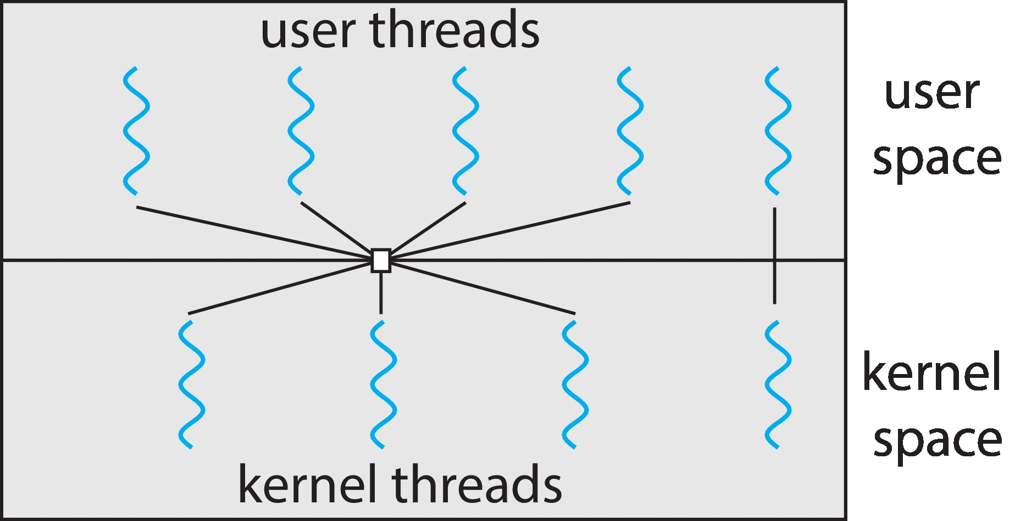
Two-level Model
Similar to M:M, except that it allows a user thread to be bound to kernel thread

Slide 61
Course Outcome
On completion of the course, the students will be able to
CO1 : outline operating system structure, services and system calls
CO2 : demonstrate various process scheduling algorithms and describe multithreading models
CO3 : apply different methods for process synchronization and for handling deadlocks
CO4 : illustrate memory management strategies and demonstrate various page replacement algorithms
CO5 : summarize the features of file systems and apply various disk scheduling algorithms

