Slide 1

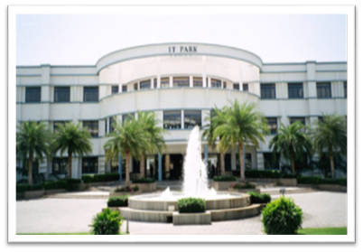

22CSE43 – Operating Systems
UNIT I
Dr.N.SHANTHI
PROFESSOR
COMPUTER SCIENCE & ENGINEERING
1

Slide 2
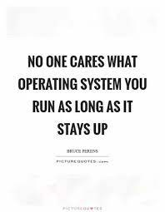
UNIT I
2

Slide 3
Course Overview
3

Slide 4
Unit I
Operating Systems Overview: Introduction – Computer System Organization – Computer System Architecture – Operations – Resource Management – Security and Protection – Virtualization – Computing Environments. Operating Systems Structures: Services – User and OS Interface – System Calls – Linkers and Loaders – Operating system Structure – Building and Booting OS.
4

Slide 5
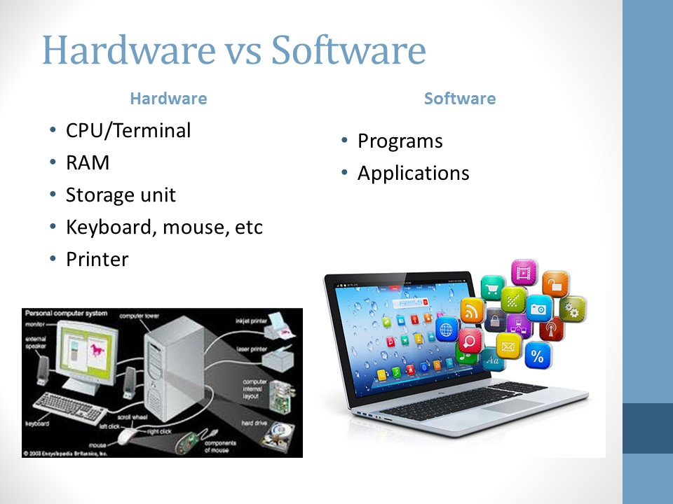
5

Slide 6
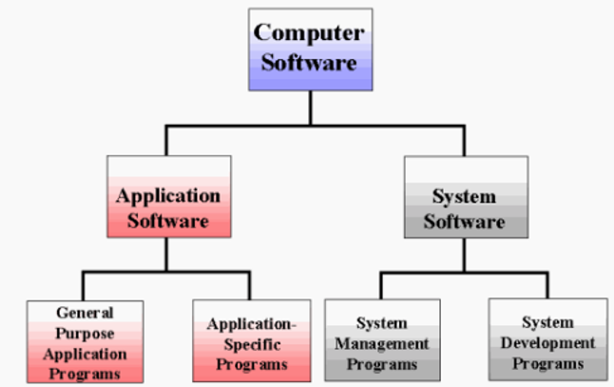
6

Slide 7
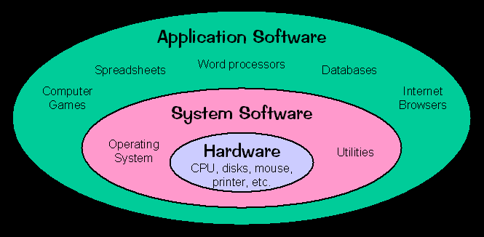
7

Slide 8
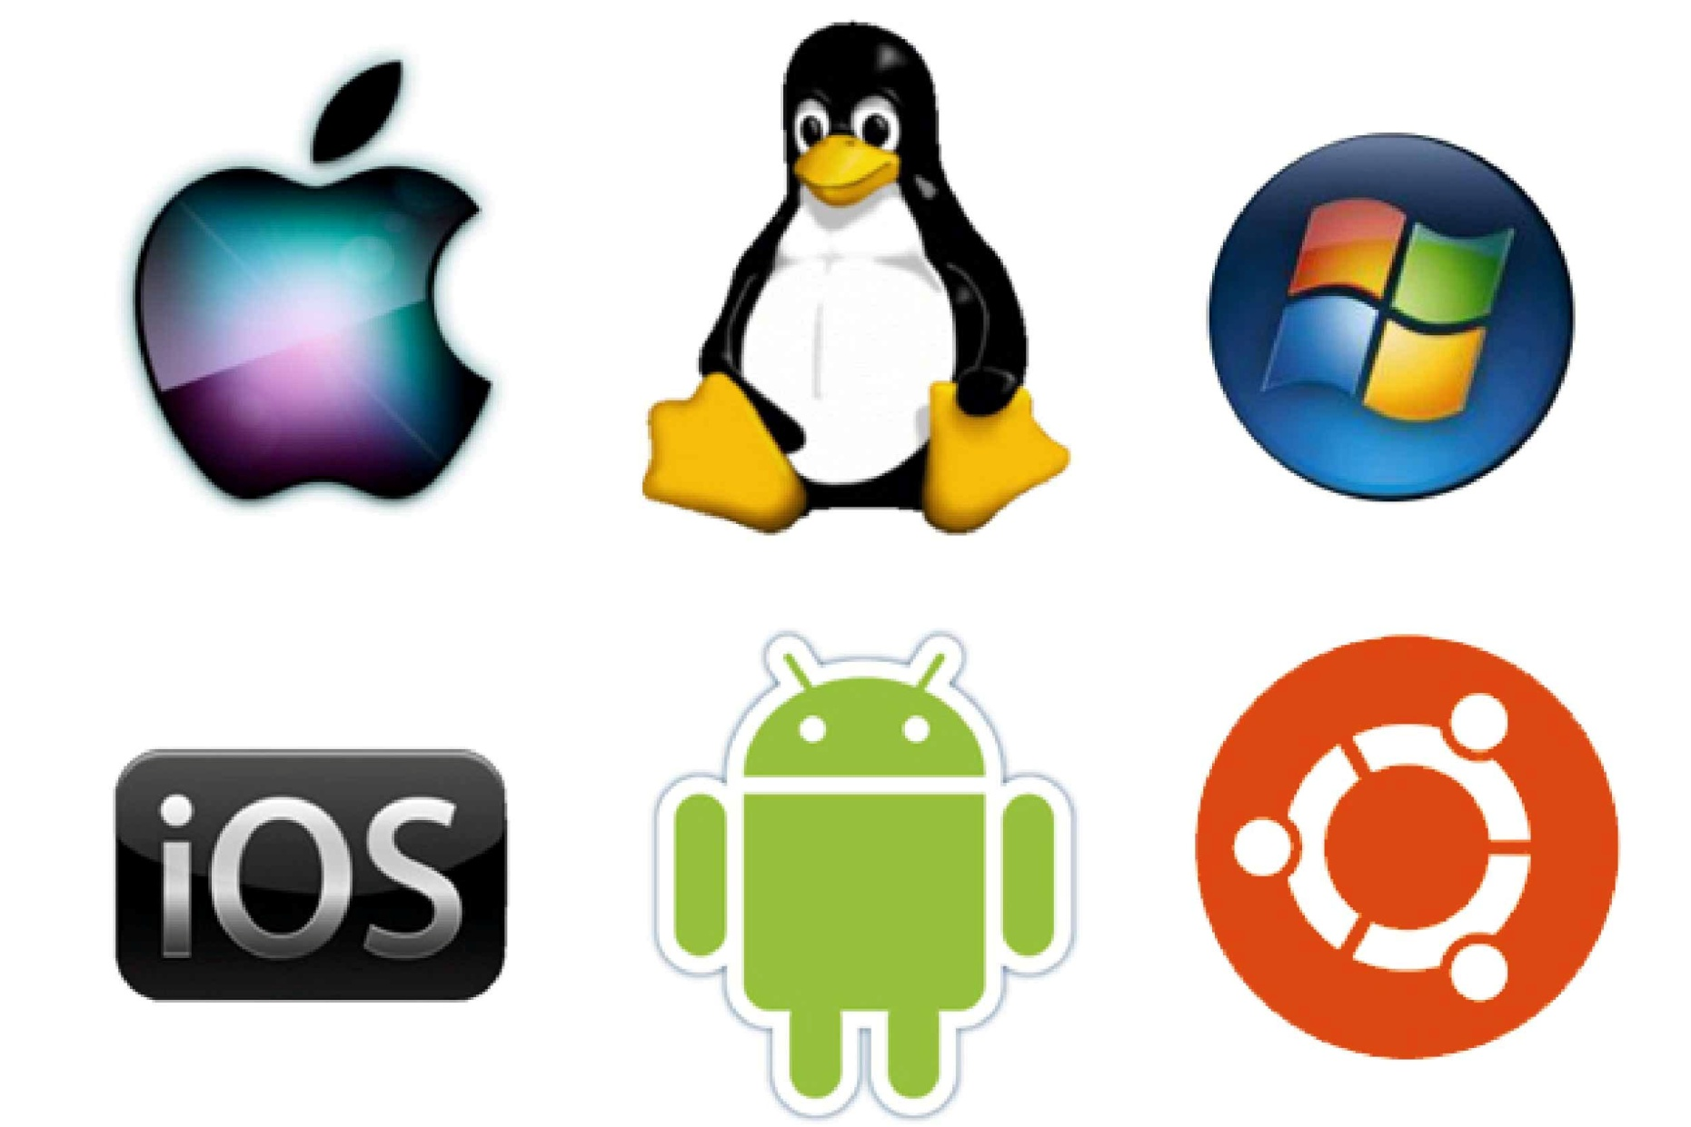
Popular Operating systems
8

Slide 9
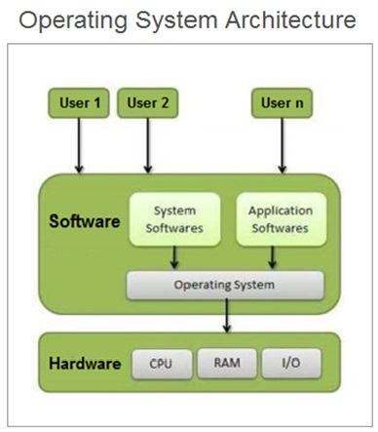
9

Slide 10
What is an Operating System?
A program that acts as an intermediary between a user of a computer and the computer hardware
Operating system goals:
Execute user programs and make solving user problems easier
Make the computer system convenient to use
Use the computer hardware in an efficient manner
10

Slide 11
Computer System Structure
Computer system can be divided into four components:
Hardware – provides basic computing resources
CPU, memory, I/O devices
Operating system
Controls and coordinates use of hardware among various applications and users
Application programs – define the ways in which the system resources are used to solve the computing problems of the users
Word processors, compilers, web browsers, database systems, video games
Users
People, machines, other computers
11

Slide 12
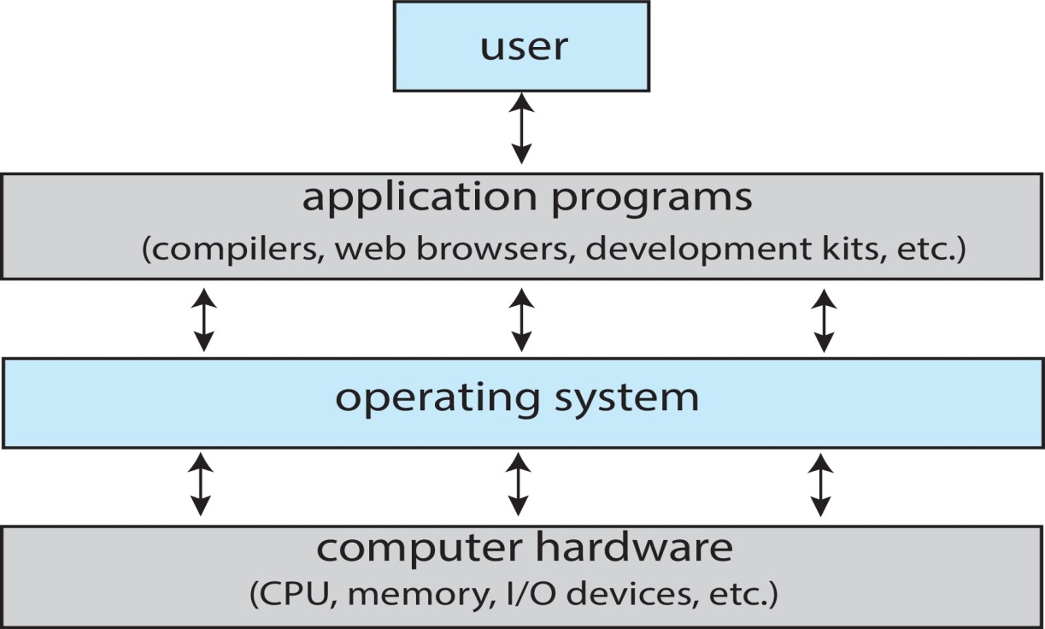
Abstract View of Components of Computer
12

Slide 13
What Operating Systems Do?
Depends on the point of view
Users want convenience, ease of use and good performance
Don’t care about resource utilization
But shared computer such as mainframe or minicomputer must keep all users happy
Operating system is a resource allocator and control program making efficient use of HW and managing execution of user programs
Users of dedicated systems such as workstations have dedicated resources but frequently use shared resources from servers
Mobile devices like smartphones and tablets are resource poor, optimized for usability and battery life
Mobile user interfaces such as touch screens, voice recognition
Some computers have little or no user interface, such as embedded computers in devices and automobiles
Run primarily without user intervention
13

Slide 14
Operating System Definition
“The one program running at all times on the computer” is the kernel, part of the operating system
Everything else is either
A system program (ships with the operating system, but not part of the kernel) , or
An application program, all programs not associated with the operating system
Today’s OSes for general purpose and mobile computing also include middleware – a set of software frameworks that provide additional services to application developers such as databases, multimedia, graphics
14

Slide 15
Unit I
Operating Systems Overview:: Introduction – Computer System Organization – Computer System Architecture – Operations – Resource Management – Security and Protection – Virtualization – Computing Environments. Operating Systems Structures: Services – User and OS Interface – System Calls – Linkers and Loaders – Operating system Structure – Building and Booting OS.
15

Slide 16
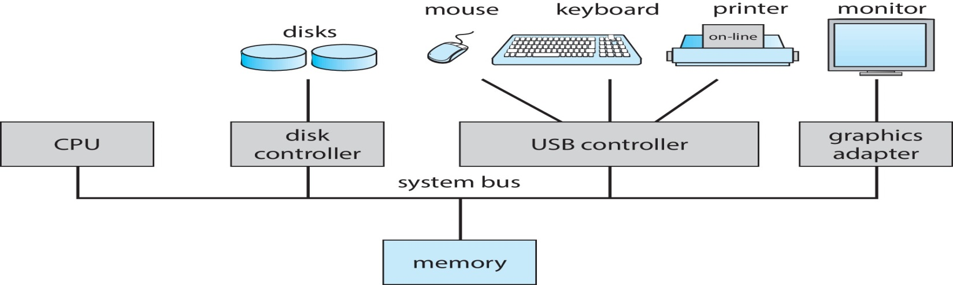
Computer System Organization
Computer-system operation
One or more CPUs, device controllers connect through common bus providing access to shared memory
Concurrent execution of CPUs and devices competing for memory cycles

Slide 17
Computer-System Operation
I/O devices and the CPU can execute concurrently
Each device controller is in charge of a particular device type
Each device controller has a local buffer
operating systems have a device driver for each device controller.
CPU moves data from/to main memory to/from local buffers
To ensure orderly access to the shared memory, a memory controller synchronizes access to the memory.
Device controller informs CPU that it has finished its operation by causing an interrupt

Slide 18
Common Functions of Interrupts
Interrupt transfers control to the interrupt service routine generally, through the interrupt vector, which contains the addresses of all the service routines
Interrupt architecture must save the address of the interrupted instruction
A trap or exception is a software-generated interrupt caused either by an error or a user request
An operating system is interrupt driven

Slide 19
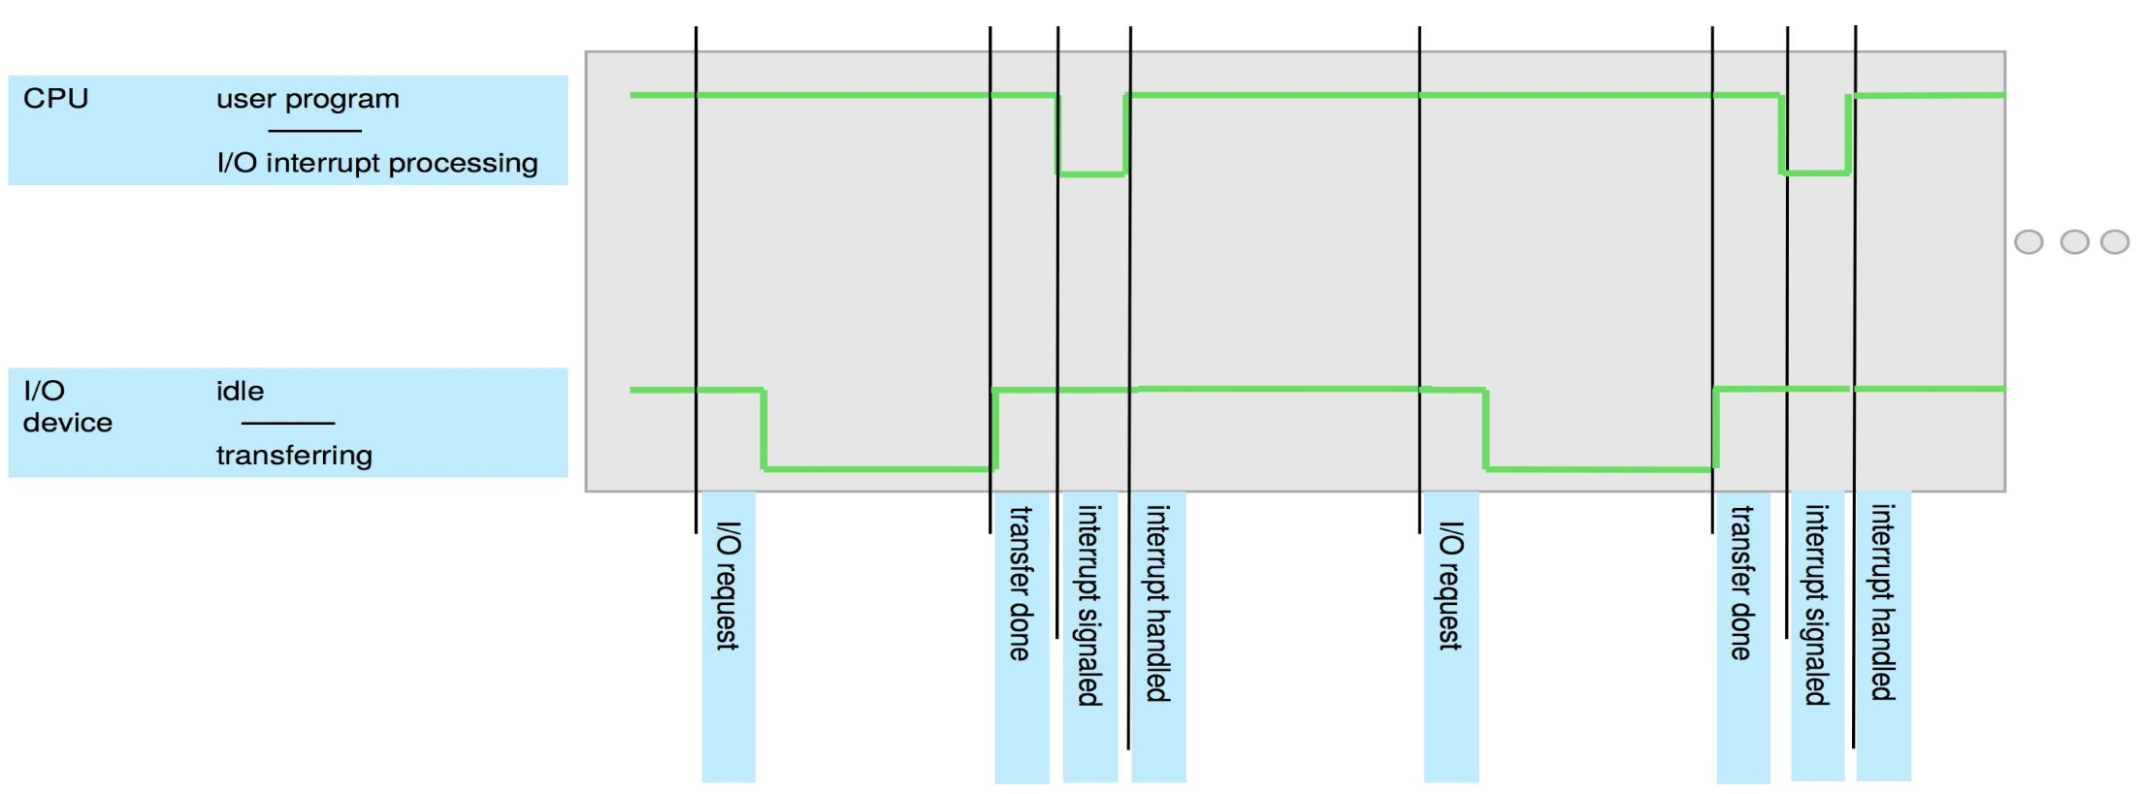
Interrupt Timeline

Slide 20
Interrupt Handling
The operating system preserves the state of the CPU by storing registers and the program counter
Determines which type of interrupt has occurred:
polling
vectored interrupt system
Separate segments of code determine what action should be taken for each type of interrupt

Slide 21
Interrupt-driven I/O Cycle

Slide 22
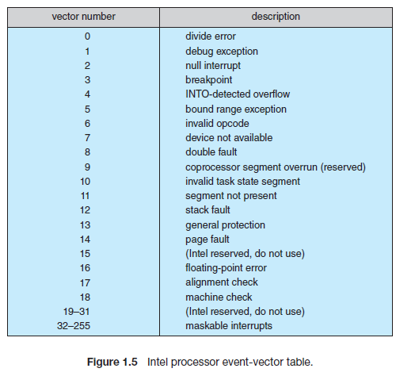
Interrupt Handling
CPUs have two interrupt request lines. Nonmaskable and Maskable
Nonmaskable interrupt - reserved for events such as unrecoverable memory errors
Maskable interrupt : can be turned off by the CPU if it executing critical instructions - used by device controllers to request service
Interrupt priority levels - to differentiate low-priority with high priority
Interrupts are used to handle asynchronous events

Slide 23
Storage Structure
Main memory – only large storage media that the CPU can access directly
Random access - Typically volatile
Secondary storage – extension of main memory that provides large nonvolatile storage capacity
Hard Disk Drives (HDD) – rigid metal or glass platters covered with magnetic recording material
Disk surface is logically divided into tracks, which are subdivided into sectors
The disk controller determines the logical interaction between the device and the computer
Non-volatile memory (NVM) devices– faster than hard disks, nonvolatile
Becoming more popular as capacity and performance increases, price drops

Slide 24
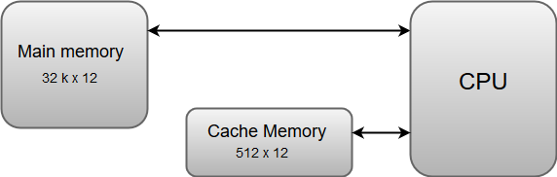
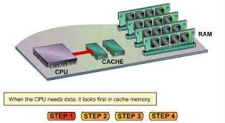
Storage Hierarchy
Storage systems organized in hierarchy
Speed
Cost
Volatility
Caching – copying information into faster storage system; main memory can be viewed as a cache for secondary storage
Device Driver for each device controller to manage I/O
Provides uniform interface between controller and kernel

Slide 25
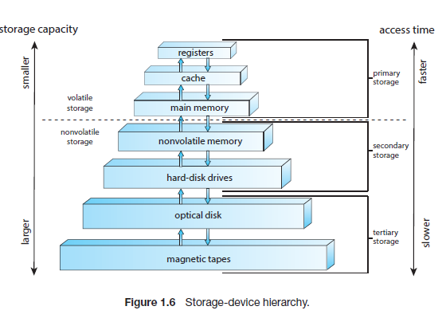
Storage-Device Hierarchy

Slide 26
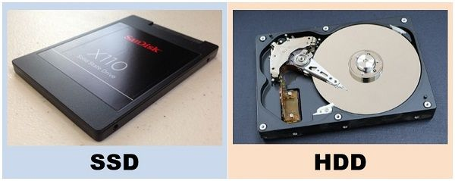
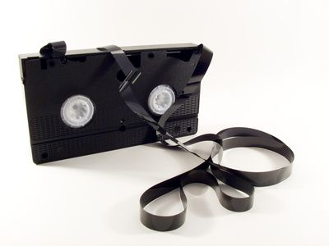
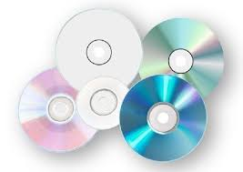
Optical disk
Magnetic tape

Slide 27
Computer Startup
Bootstrap program is loaded at power-up or reboot
Typically stored in ROM or EPROM, generally known as firmware
Initializes all aspects of system
Loads operating system kernel and starts execution

Slide 28
I/O Structure
Two methods for handling I/O
After I/O starts, control returns to user program only upon I/O completion
After I/O starts, control returns to user program without waiting for I/O completion

Slide 29
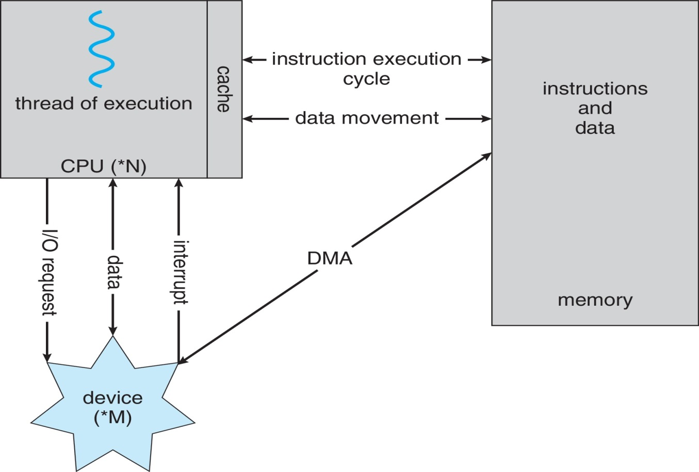
I/O structure
A von Neumann architecture

Slide 30
Direct Memory Access Structure
Used for high-speed I/O devices able to transmit information at close to memory speeds
Device controller transfers blocks of data from buffer storage directly to main memory without CPU intervention
Only one interrupt is generated per block, rather than the one interrupt per byte

Slide 31
Unit I
Operating Systems Overview:: Introduction – Computer System Organization – Computer System Architecture – Operations – Resource Management – Security and Protection – Virtualization – Computing Environments. Operating Systems Structures: Services – User and OS Interface – System Calls – Linkers and Loaders – Operating system Structure – Building and Booting OS.

Slide 32
Computer-System Architecture
A computer system can be organized in a number of different ways.
Based on the number of general-purpose processors used
Single-Processor Systems
Multiprocessor Systems
Clustered Systems

Slide 33
Single-Processor Systems
single processor containing one CPU with a single processing core
The core is the component that executes instructions and registers for storing data locally.
The one main CPU with its core is capable of executing a general-purpose instruction set, including instructions from processes

Slide 34
Multiprocessor Systems
Multiprocessor systems growing in use and importance (sharing the computer bus and sometimes the clock, memory, and peripheral devices. )
Also known as parallel systems, tightly-coupled systems(shared memory.)
Advantages include:
Increased throughput
Economy of scale
Increased reliability
Multicore systems, in which multiple computing cores reside on a single chip
Multicore systems can be more efficient than multiple chips with single cores because on-chip communication is faster than between-chip communication

Slide 35
Symmetric multiprocessing architecture

Slide 36
A dual-core design with two cores on the same chip

Slide 37
NUMA multiprocessing architecture

Slide 38
Clustered Systems
They are composed of two or more individual systems—or nodes—joined together; each node is typically a multicore system.
Such systems are considered loosely coupled
provide high-availability service
Increased reliability – graceful degradation or fault tolerance
Clustering can be structured asymmetrically or symmetrically.
In asymmetric clustering, one machine is in hot-standby mode while the other is running the applications.
In symmetric clustering, two or more hosts are running applications and are monitoring each other
Some clusters are for high-performance computing (HPC)
Applications must be written to use parallelization (which divides a program into separate components that run in parallel on individual computers in the cluster. )

Slide 39
Structure of a Clustered System

Slide 40
Unit I
Operating Systems Overview:: Introduction – Computer System Organization – Computer System Architecture – Operations – Resource Management – Security and Protection – Virtualization – Computing Environments. Operating Systems Structures: Services – User and OS Interface – System Calls – Linkers and Loaders – Operating system Structure – Building and Booting OS.

Slide 41
Operating System Operations
Bootstrap program – simple code to initialize the system, load the kernel
Kernel loads
Starts system daemons (services provided outside of the kernel)
Kernel interrupt driven (hardware and software)
Hardware interrupt by one of the devices
Software interrupt (exception or trap):
Software error (e.g., division by zero)
Request for operating system service – system call
Other process problems include infinite loop, processes modifying each other or the operating system

Slide 42
Multiprogramming
Single user cannot always keep CPU and I/O devices busy
OS supports to run multiple programs to keep either the CPU or the I/O devices busy at all times.
In a multiprogrammed system, a program in execution is termed as process.
Multiprogramming organizes jobs (code and data) so CPU always has one to execute
General principle :
A subset of total jobs in system is kept in memory
One job selected and run via job scheduling
When job has to wait (for I/O for example), OS switches to another job

Slide 43
Multitasking (Timesharing)
A logical extension of Multiprogramming systems– the CPU switches jobs so frequently providing the user with a fast response time.
Response time should be < 1 second
Each user has at least one program executing in memory  process
If several jobs ready to run at the same time  CPU scheduling
If processes don’t fit in memory, swapping moves them in and out to run
Virtual memory allows execution of processes not completely in memory

Slide 44
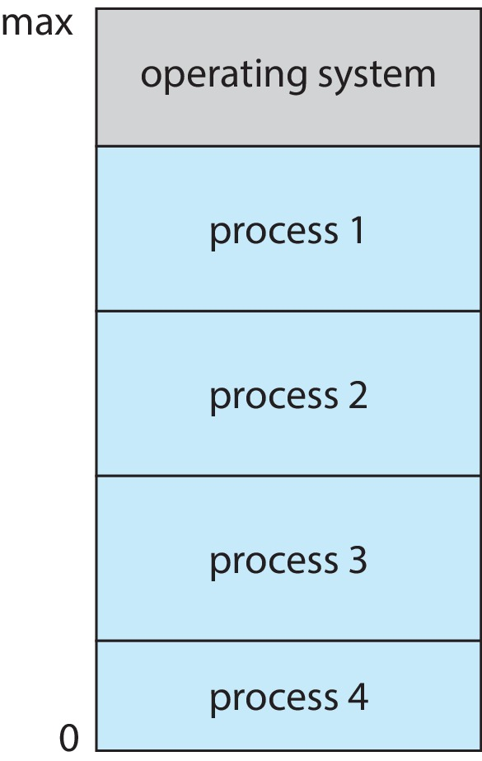
Memory Layout for Multiprogrammed System

Slide 45
Dual-mode Operation
In order to ensure the proper execution of the operating system, we must be able to distinguish between the execution of operating-system code and user defined code - done by an hardware
Dual-mode operation allows OS to protect itself and other system components
User mode and kernel mode
Mode bit provided by hardware (0 – kernel and 1- user mode)
Provides ability to distinguish when system is running user code or kernel code.
When a user is running  mode bit is “user”
When kernel code is executing  mode bit is “kernel”
How do we guarantee that user does not explicitly set the mode bit to “kernel”?
System call changes mode to kernel, return from call resets it to user
Some instructions designated as privileged, only executable in kernel mode
The instruction to switch to kernel mode is an example of a privileged instruction
Increasingly CPUs support multi-mode operations
i.e. virtual machine manager (VMM) mode for guest VMs

Slide 46
Dual-mode Operation
At system boot time, the hardware starts in kernel mode.
The operating system is then loaded and starts user applications in user mode.
Whenever a trap or interrupt occurs, the hardware switches from user mode to kernel mode
Thus, whenever the operating system gains control of the computer, it is in kernel mode.
The system always switches to user mode before passing control to a user program.
The dual mode of operation provides us with the means for protecting the operating system from errant users—and errant users from one another.

Slide 47
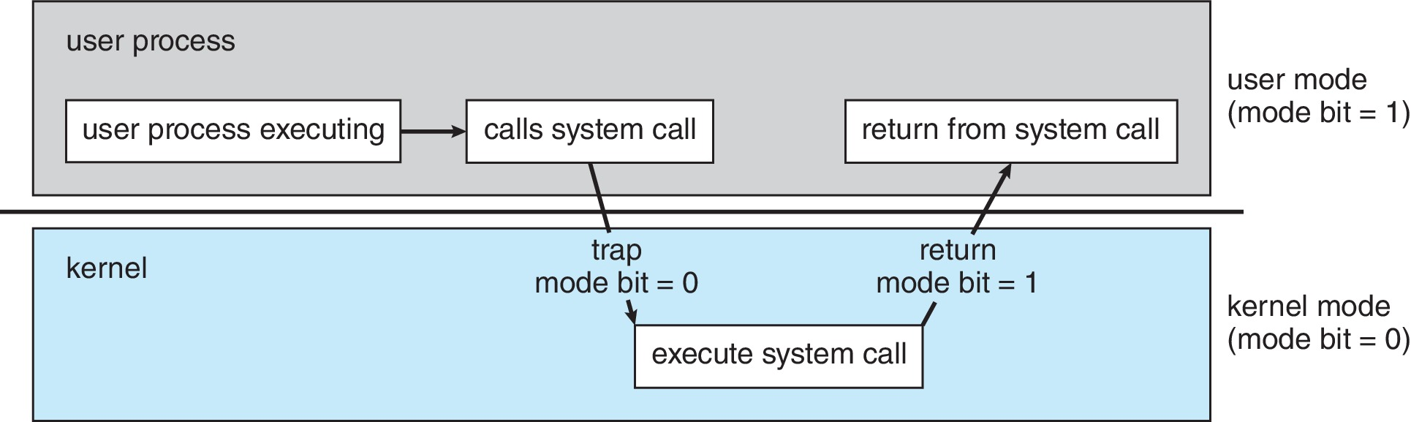
Transition from User to Kernel Mode

Slide 48
Timer
Timer to prevent infinite loop (or process hogging resources)
Timer is set to interrupt the computer after some time period
Keep a counter that is decremented by the physical clock
Operating system set the counter (privileged instruction) , when counter zero generate an interrupt
Set up before scheduling process to regain control or terminate program that exceeds allotted time

Slide 49
Unit I
Operating Systems Overview:: Introduction – Computer System Organization – Computer System Architecture – Operations – Resource Management – Security and Protection – Virtualization – Computing Environments. Operating Systems Structures: Services – User and OS Interface – System Calls – Linkers and Loaders – Operating system Structure – Building and Booting OS.

Slide 50
Process Management
A program can do nothing unless its instructions are executed by a CPU.
process is a program in execution. It is a unit of work within the system. Program is a passive entity; process is an active entity.
Process needs resources to accomplish its task
CPU, memory, I/O, files
Initialization data
Process termination requires reclaim of any reusable resources
Single-threaded process has one program counter specifying location of next instruction to execute
Process executes instructions sequentially, one at a time, until completion
Multi-threaded process has one program counter per thread
Typically system has many processes, some user, some operating system running concurrently on one or more CPUs

Slide 51
Process Management Activities
The operating system is responsible for the following activities in connection with process management:
Creating and deleting both user and system processes
Suspending and resuming processes
Providing mechanisms for process synchronization
Providing mechanisms for process communication
Providing mechanisms for deadlock handling

Slide 52
Memory Management
To execute a program all (or part) of the instructions must be in memory
All (or part) of the data that is needed by the program must be in memory
Memory management determines what is in memory and when
Optimizing CPU utilization and computer response to users
Memory management activities
Keeping track of which parts of memory are currently being used and by whom
Deciding which processes (or parts thereof) and data to move into and out of memory
Allocating and deallocating memory space as needed

Slide 53
File-system Management
OS provides uniform, logical view of information storage
Abstracts physical properties to logical storage unit - file
Each medium is controlled by device (i.e., disk drive, tape drive)
Varying properties include access speed, capacity, data-transfer rate, access method (sequential or random)
File-System management
Files usually organized into directories
Access control on most systems to determine who can access what
OS activities include
Creating and deleting files and directories
Primitives to manipulate files and directories
Mapping files onto secondary storage
Backup files onto stable (non-volatile) storage media

Slide 54
Mass-Storage Management
Usually disks used to store data that does not fit in main memory or data that must be kept for a “long” period of time
Proper management is of central importance
Entire speed of computer operation hinges on disk subsystem and its algorithms
OS activities
Mounting and unmounting
Free-space management
Storage allocation
Disk scheduling
Partitioning
Protection

Slide 55
Caching
Important principle, performed at many levels in a computer (not only in hardware but also in operating system -software)
Information in use copied from slower to faster storage temporarily
Faster storage (cache) checked first to determine if information is there
If it is, information used directly from the cache (fast)
If not, data copied to cache and used there
Cache smaller than storage being cached
Cache management important design problem
Cache size and replacement policy

Slide 56
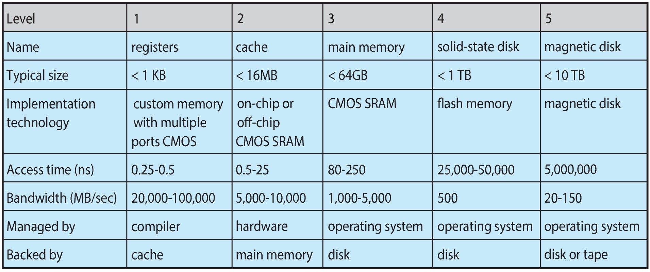
Characteristics of Various Types of Storage
Movement between levels of storage hierarchy can be explicit or implicit

Slide 57
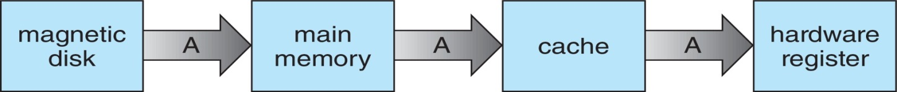
Migration of data “A” from Disk to Register
Multitasking environments must be careful to use most recent value, no matter where it is stored in the storage hierarchy
Multiprocessor environment must provide cache coherency in hardware such that all CPUs have the most recent value in their cache

Slide 58
I/O Subsystem
One purpose of OS is to hide peculiarities of hardware devices from the user
I/O subsystem responsible for
Memory management of I/O including buffering (storing data temporarily while it is being transferred), caching (storing parts of data in faster storage for performance), spooling (the overlapping of output of one job with input of other jobs)
General device-driver interface
Drivers for specific hardware devices

Slide 59
Unit I
Operating Systems Overview:: Introduction – Computer System Organization – Computer System Architecture – Operations – Resource Management – Security and Protection – Virtualization – Computing Environments. Operating Systems Structures: Services – User and OS Interface – System Calls – Linkers and Loaders – Operating system Structure – Building and Booting OS.

Slide 60
Protection and Security
Protection – any mechanism for controlling access of processes or users to resources defined by the OS
Security – defense of the system against internal and external attacks
Huge range, including denial-of-service, worms, viruses, identity theft, theft of service
Systems generally first distinguish among users, to determine who can do what
User identities (user IDs, security IDs) include name and associated number, one per user
User ID then associated with all files, processes of that user to determine access control
Group identifier (group ID) allows set of users to be defined and controls managed, then also associated with each process, file
Privilege escalation allows user to change to effective ID with more rights

Slide 61
Unit I
Operating Systems Overview:: Introduction – Computer System Organization – Computer System Architecture – Operations – Resource Management – Security and Protection – Virtualization – Computing Environments. Operating Systems Structures: Services – User and OS Interface – System Calls – Linkers and Loaders – Operating system Structure – Building and Booting OS.

Slide 62
Virtualization
Virtualization is a technology that allows us to abstract the hardware of a single computer (the CPU, memory, disk drives, network interface cards, and so forth) into several different execution environments
Allows operating systems to run applications within other OSes
Vast and growing industry
Emulation used when source CPU type different from target type (i.e. PowerPC to Intel x86)
Generally slowest method
Every machine-level instruction that runs natively on the source system must be translated to the equivalent function on the target system
Virtualization – OS natively compiled for CPU, running guest OSes also natively compiled
Consider VMware running WinXP guests, each running applications, all on native WinXP host OS
VMM (virtual machine Manager) provides virtualization services

Slide 63
Virtualization (cont.)
Use cases involve laptops and desktops running multiple OSes for exploration or compatibility
Apple laptop running Mac OS X host, Windows as a guest
Developing apps for multiple OSes without having multiple systems
Quality assurance testing applications without having multiple systems
Executing and managing compute environments within data centers
VMM can run natively, in which case they are also the host
There is no general-purpose host then (VMware ESX and Citrix XenServer)

Slide 64
Computing Environments - Virtualization

Slide 65
Unit I
Operating Systems Overview:: Introduction – Computer System Organization – Computer System Architecture – Operations – Resource Management – Security and Protection – Virtualization – Computing Environments. Operating Systems Structures: Services – User and OS Interface – System Calls – Linkers and Loaders – Operating system Structure – Building and Booting OS.

Slide 66
Computing Environments
Traditional
Mobile
Client Server
Peer-to-Peer
Cloud computing
Real-time Embedded

Slide 67
Traditional Computing
Stand-alone general-purpose machines
In recent days, this environment have blurred as most systems interconnect with others (i.e., the Internet)
Recent days , many organizations have portals that provide web access to internal systems
Mobile computers can synchronize with PCs to allow very portable use of company information.
Mobile devices can also interconnect via wireless networks
Networking becoming ubiquitous – even home systems use firewalls to protect home computers from Internet attacks

Slide 68
Mobile Computing
refers to computing on handheld smartphones and tablet computers
rich features support than traditional laptops… like e-mail , browsing , playing music and video, reading digital books, taking photos, and recording and editing high-definition video, GPS chips, accelerometers, and gyroscopes
A gyroscope is a device used for measuring or maintaining orientation and angular velocity- used for inertial guidance systems installed in space launch vehicles, ballistic missiles, and orbiting satellites
Accelerometers can be used to measure vibration on cars, machines, buildings, process control systems and safety installations.
augmented-reality applications…especially for mobile devices
Two operating systems currently dominate mobile computing:
Apple iOS and
Google Android.

Slide 69
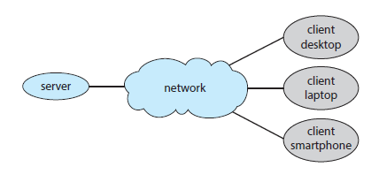
Client Server
Client- generates request and Server - service the request
Distributed environment
Two categories :
Compute-server system provides an interface to client to request services (i.e., database)
File-server system provides interface for clients to store and retrieve files
General architecture

Slide 70
Peer-to-Peer Computing
Another type of distributed system
P2P does not distinguish clients and servers - all nodes are considered peers
Each host act as client or server or both
Operation :
Node must join P2P network
Registers its service with central lookup service on network, or
Broadcast request for service and respond to requests for service via discovery protocol
Voice over IP (VoIP) such as Skype
Hybrid approach
centralized login server, decentralized peers and allows two peers to communicate

Slide 71
Cloud Computing
Supports computing, storage, applications as a service through network
Logical extension of virtualization
Amazon EC2(Amazon Elastic Compute Cloud) has thousands of servers, millions of VMs, huge storage available across the Internet, pay based on usage
Types of clouds
Public cloud – available via Internet to anyone willing to pay
Private cloud – run by a company for the company’s own use
Hybrid cloud – includes both public and private cloud components
Types of services
Software as a Service (SaaS) – applications available via Internet (Google suite)
Platform as a Service (PaaS) – software stack ready for application use via the Internet (i.e., a database server)
Infrastructure as a Service (IaaS) – servers or storage available over Internet (i.e., storage available for backup)

Slide 72
Real-Time Embedded Systems
Real-time embedded systems most common form of computers – available in car engines, robots, and microwave ovens.
special purpose, limited purpose OS, real-time OS , limited user interaction
Some have OS, some perform tasks without an OS
Real-time OS has well-defined fixed time constraints
Processing must be done within constraint
Correct operation only if constraints met ,
Otherwise they get fail..

Slide 73
Unit I
Operating Systems Overview:: Introduction – Computer System Organization – Computer System Architecture – Operations – Resource Management – Security and Protection – Virtualization – Computing Environments. Operating Systems Structures: Services – User and OS Interface – System Calls – Linkers and Loaders – Operating system Structure – Building and Booting OS.

Slide 74
Operating System Services
Provides environment for execution of programs and services to programs and users
Set of services helpful to the user:
User interface - Varies between Command-Line (CLI), Graphics User Interface (GUI), touch-screen
Program execution - able to load a program into memory and to run that program, end execution, either normally or abnormally (indicating error)
I/O operations - A running program may require I/O either for a file or an I/O device
File-system manipulation - Programs need to read and write files and directories, create and delete them, search them, list file Information, permission management.
Communications – Processes may exchange information, on the same computer or between computers over a network
Error detection – OS needs to be constantly aware of possible errors -For each error, OS take appropriate action to ensure correct and consistent computing. Errors may occur in the CPU and memory hardware, in I/O devices (a connection failure on a network, or lack of paper in the printer), and in the user program (such as an arithmetic overflow or an attempt to access an illegal memory location).

Slide 75
Operating System Services…
Another set of services for efficient operation of the system itself via resource sharing
Resource allocation - When multiple users or multiple jobs running concurrently, resources must be allocated to each of them
Logging - To keep track of which users use how much and what kinds of computer resources
Protection and security - The owners of information stored in a multiuser or networked computer system may want to control use of that information, concurrent processes should not interfere with each other
Protection involves ensuring that all access to system resources is controlled
Security of the system from outsiders requires user authentication, extends to defending external I/O devices from invalid access attempts

Slide 76
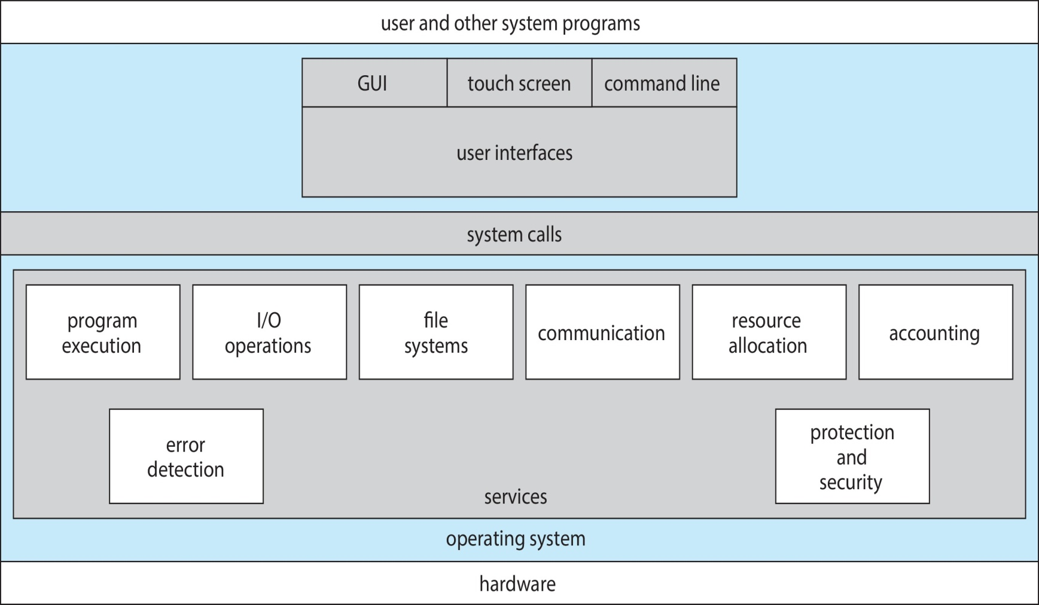
A View of Operating System Services

Slide 77
Unit I
Operating Systems Overview:: Introduction – Computer System Organization – Computer System Architecture – Operations – Resource Management – Security and Protection – Virtualization – Computing Environments. Operating Systems Structures: Services – User and OS Interface – System Calls – Linkers and Loaders – Operating system Structure – Building and Booting OS.

Slide 78
User and OS Interface
Command Line interpreter (CLI)
Primarily user interacts with a command to OS
Linux, UNIX, and Windows – special program runs when we login in interactive systems
multiple CLIs called as shells – In Linux - C shell, Bourne-Again shell, Korn shell etc
Sometimes commands built-in, sometimes just names of programs (Linux)
Ex. Microsoft – MS-DOS, traditional Unix
Graphical User Interface (GUI)
mouse-based window-and-menu system characterized by a desktop metaphor
Use of mouse to position its pointer on images, or icons, on the screen (the desktop)
Windows 1.0 and further versions, and Linux with KDE / GNOME environment
Touch-Screen Interface
Smart phones and handheld tablet computers typically use a touch-screen interface
users interact by making gestures on the touch screen (pressing / swiping )

Slide 79
Unit I
Operating Systems Overview:: Introduction – Computer System Organization – Computer System Architecture – Operations – Resource Management – Security and Protection – Virtualization – Computing Environments. Operating Systems Structures: Services – User and OS Interface – System Calls – Linkers and Loaders – Operating system Structure – Building and Booting OS.

Slide 80
System Calls
System calls provide an interface to the services made available by an operating system.
available as functions written in C and C++, or assembly-language ( low-level tasks – direct hardware access)
Mostly accessed by programs via a high-level Application Programming Interface (API) rather than direct use
Three most common APIs
Win32 API for Windows,
POSIX API for POSIX-based systems ( UNIX, Linux, and Mac OS X)
Java API for the Java virtual machine (JVM)

Slide 81
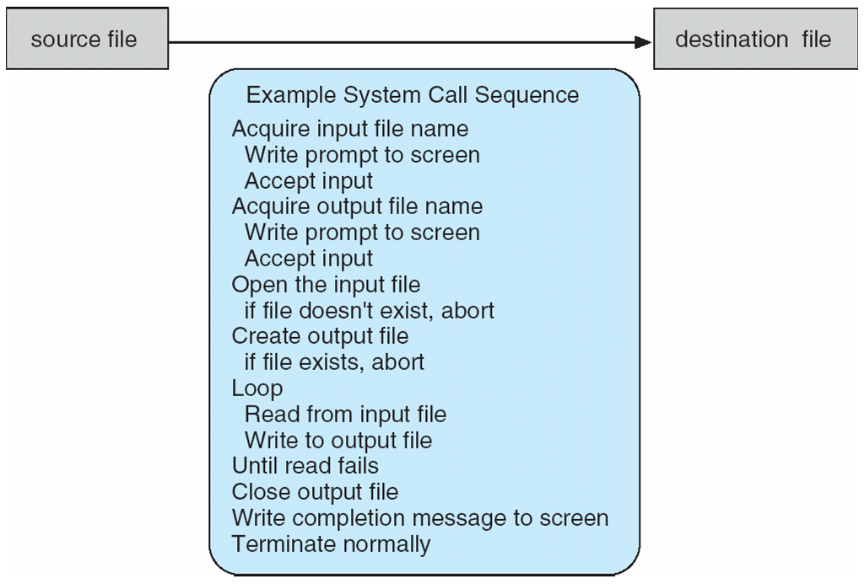
Example of System Calls
System call sequence to copy the contents of one file to another file [cp source.txt dest.txt]

Slide 82
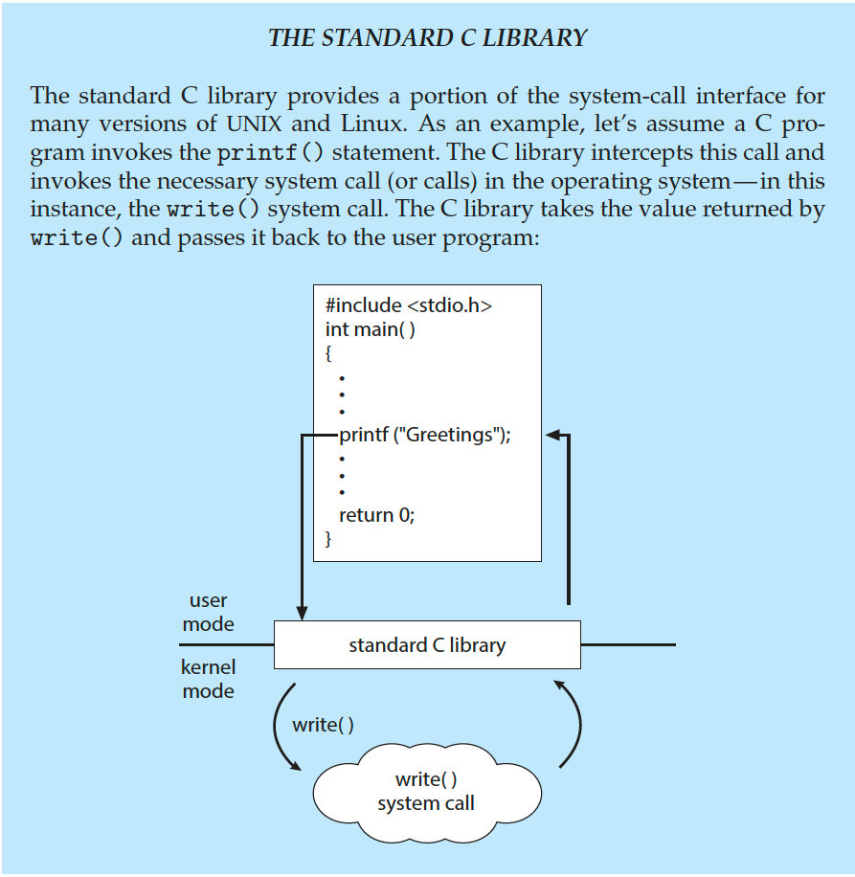
Standard C library – System Call –relationship

Slide 83
Handling of a user application invoking the open() system call

Slide 84
Passing of parameters as a table

Slide 85
Types of System Calls
Process control
File management
Device management
Information maintenance
Communication
Protection

Slide 86
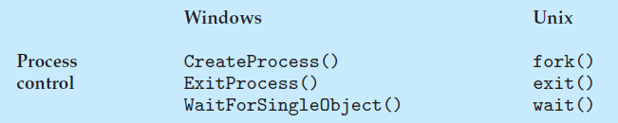
System calls …Process control
create process, terminate process
end, abort
load, execute
get process attributes, set process attributes
wait for time
wait event, signal event
allocate and free memory , Dump memory if error
Debugger for determining bugs, single step execution
Locks for managing access to shared data between processes

Slide 87
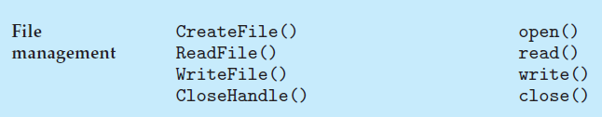
System calls … File management
create file, delete file
open, close file
read, write, reposition
get and set file attributes
Windows Unix

Slide 88

System calls … Device management
request device, release device
read, write, reposition
get device attributes, set device attributes
logically attach or detach devices
Windows Unix

Slide 89

System calls …Information maintenance
get time or date, set time or date
get system data, set system data
get and set process, file, or device attributes
Windows Unix

Slide 90
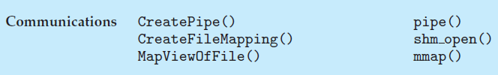
System calls …Communication
create, delete communication connection
send, receive messages
transfer status information
attach and detach remote devices
Windows Unix

Slide 91

Protection
Get and set permissions
Allow and deny user access
Windows Unix

Slide 92
Unit I
Operating Systems Overview:: Introduction – Computer System Organization – Computer System Architecture – Operations – Resource Management – Security and Protection – Virtualization – Computing Environments. Operating Systems Structures: Services – User and OS Interface – System Calls – Linkers and Loaders – Operating system Structure – Building and Booting OS.

Slide 93
Linkers and Loaders
To run a program, object file must be brought into main memory
object files that are designed to be loaded into any physical memory location known as an relocatable object file
A linker combines several object files or libraries into a single binary executable file
A loader is used to load the binary executable file into memory, where it is eligible to run on a CPU core
An activity associated with linking and loading is relocation, which assigns final addresses to the program parts and adjusts code and data in the program to match those addresses
In reality, most systems allow a program to dynamically link libraries as the program is loaded - Dynamically Linked Libraries (DLLs) - linking and loading libraries that are in need

Slide 94
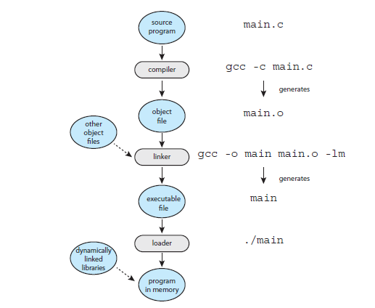
Role of linker and loader

Slide 95
Unit I
Operating Systems Overview:: Introduction – Computer System Organization – Computer System Architecture – Operations – Resource Management – Security and Protection – Virtualization – Computing Environments. Operating Systems Structures: Services – User and OS Interface – System Calls – Linkers and Loaders – Operating system Structure – Building and Booting OS.

Slide 96
Operating-System Structure
General-purpose OS is very large program
A common approach is to partition the task into small components, or modules, rather than have one single system.
Various ways to structure OS design
Monolithic Structure
Layered Approach
Microkernel
Modules
Hybrid

Slide 97
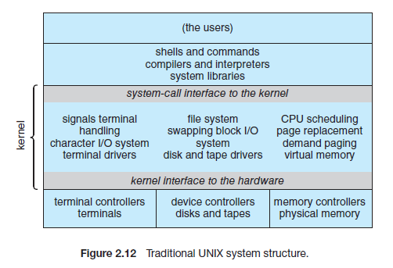
Monolithic
no structure at all - place all of the functionality of the kernel into a single, static binary file that runs in a single address space.
common technique for designing operating systems
E.g. original UNIX with 2 parts - kernel and system programs
Adv
simplest
Less overhead in the system-call interface, and communication within the kernel is fast
Disadv
Difficult to implement and extend.

Slide 98
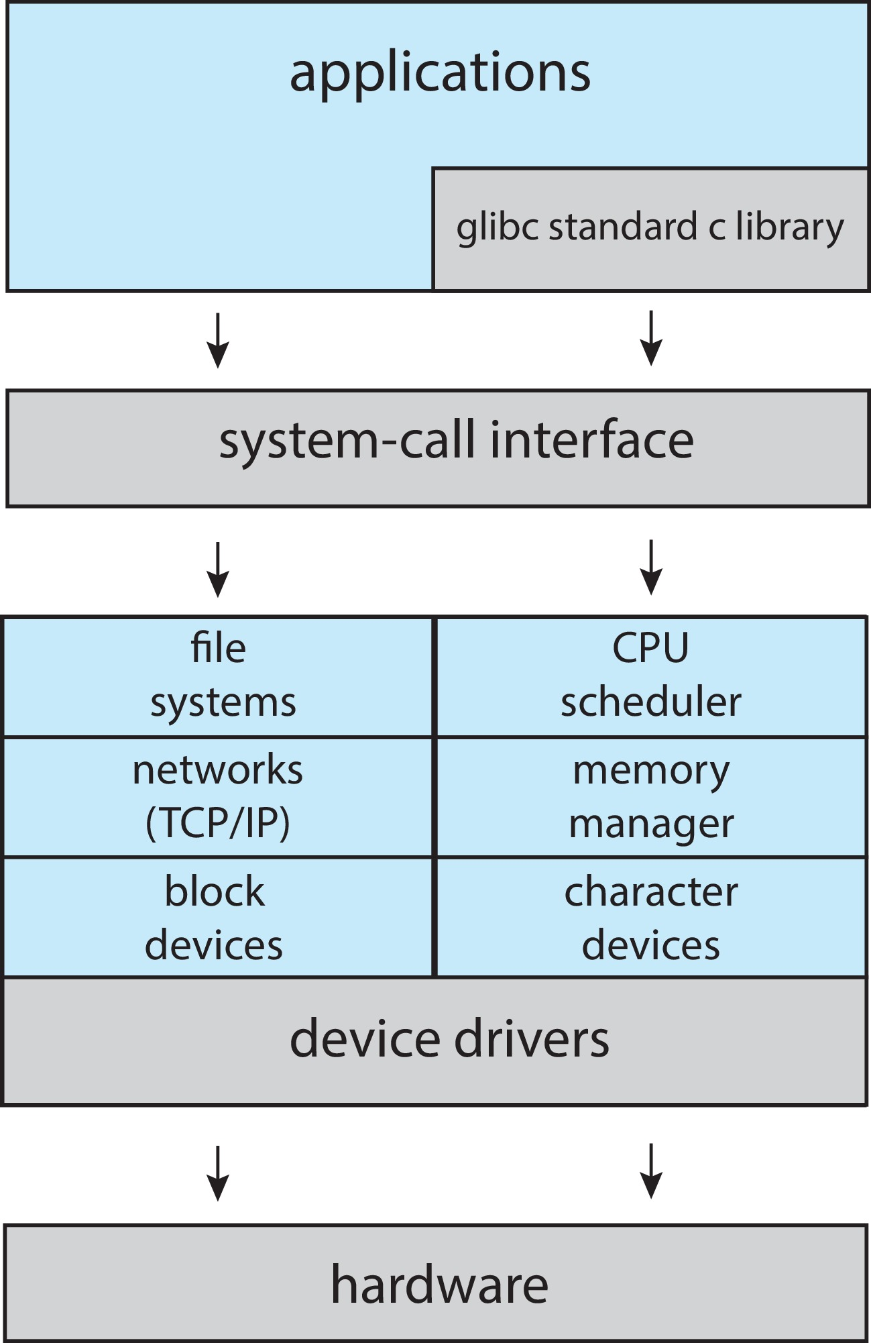
Linux System Structure
Monolithic plus modular design

Slide 99
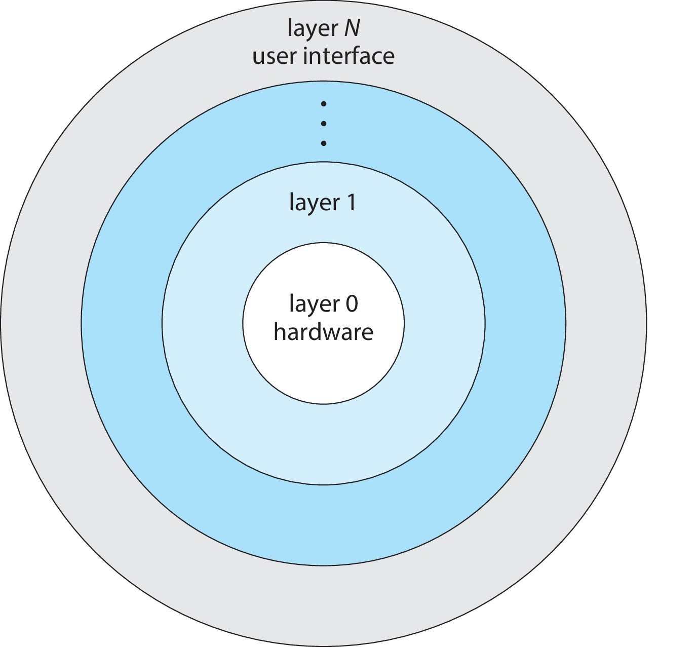
Layered Approach
Tightly coupled vs Loosely coupled
The operating system is divided into a number of layers (levels), each built on top of lower layers. The bottom layer (layer 0), is the hardware; the highest (layer N) is the user interface.
Debugging the lower level layers
With modularity, layers are selected such that each uses functions (operations) and services of only lower-level layers

Slide 100
Microkernels
Moves as much from the kernel into user space
Mach is an example of microkernel
Mac OS X kernel (Darwin) partly based on Mach
Communication takes place between user modules using message passing
Benefits:
Easier to extend a microkernel
Easier to port the operating system to new architectures
More reliable (less code is running in kernel mode)
More secure
Detriments:
Performance overhead of user space to kernel space communication

Slide 101
Microkernel System Structure

Slide 102
Modules
Many modern operating systems implement loadable kernel modules (LKMs)
Uses object-oriented approach
Each core component is separate
Each talks to the others over known interfaces
Each is loadable as needed within the kernel
Overall, similar to layers but with more flexible
Linux, Solaris, etc.

Slide 103
Hybrid Systems
Most modern operating systems are not one pure model
Hybrid combines multiple approaches to address performance, security, usability needs
Linux and Solaris kernels in kernel address space, so monolithic, plus modular for dynamic loading of functionality
Windows mostly monolithic, plus microkernel for different subsystem personalities

Slide 104
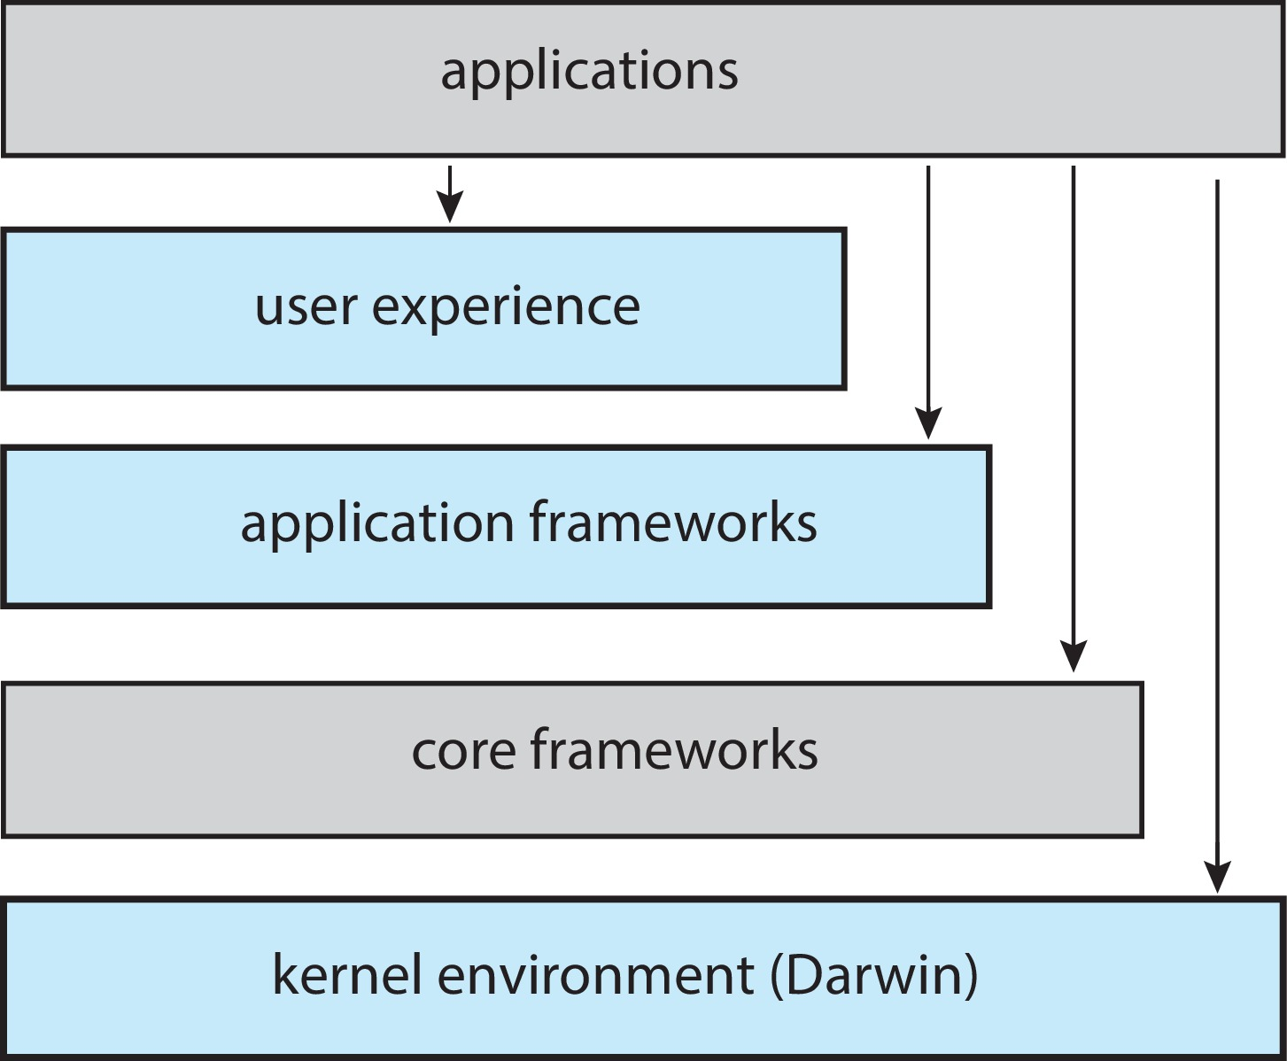
macOS and iOS Structure
AQUA / SPRINGBOARD User interface
Cocoa and Cocoa Touch frameworks
support graphics and media including, Quicktime and OpenGL

Slide 105
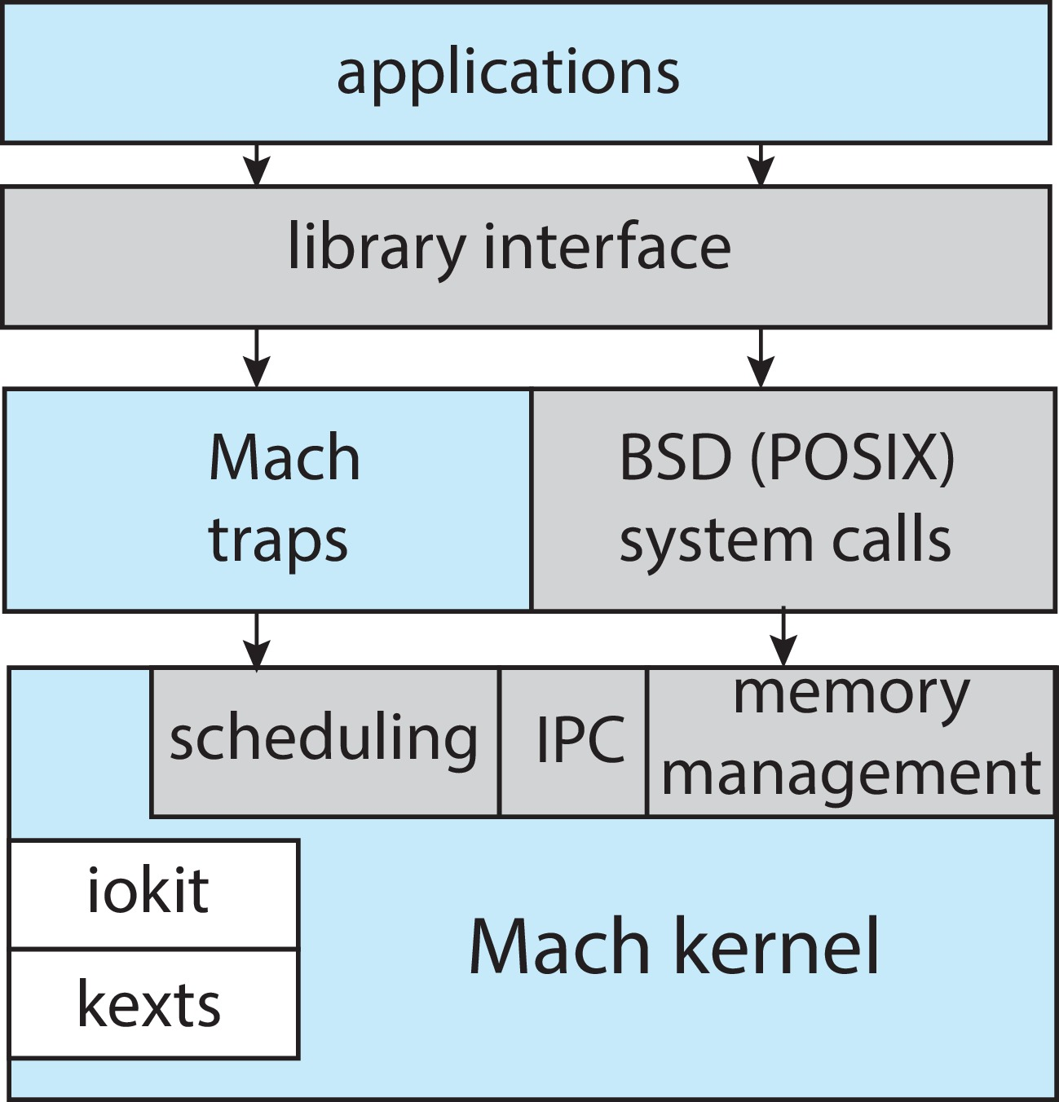
Darwin

Slide 106
Android
Developed by Open Handset Alliance (mostly Google)
Open Source
Similar stack to iOS
Based on Linux kernel but modified
Provides process, memory, device-driver management
Adds power management
Runtime environment includes core set of libraries and Dalvik virtual machine
Apps developed in Java plus Android API
Java class files compiled to Java bytecode then translated to executable then runs in Dalvik VM
Libraries include frameworks for web browser (webkit), database (SQLite), multimedia, smaller libc

Slide 107
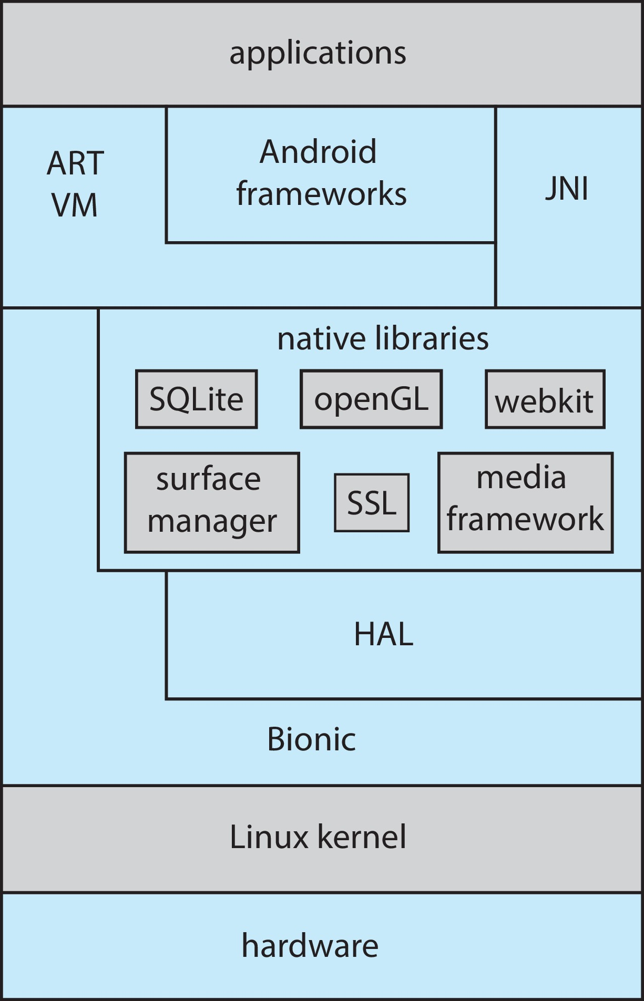
Android Architecture

Slide 108
Unit I
Operating Systems Overview:: Introduction – Computer System Organization – Computer System Architecture – Operations – Resource Management – Security and Protection – Virtualization – Computing Environments. Operating Systems Structures: Services – User and OS Interface – System Calls – Linkers and Loaders – Operating system Structure – Building and Booting OS.

Slide 109
Building and Booting an Operating System
Operating systems generally designed to run on a class of systems with variety of peripherals
Commonly, operating system already installed on purchased computer
But can build and install some other operating systems
If generating an operating system from scratch
Write the operating system source code
Configure the operating system for the system on which it will run
Compile the operating system
Install the operating system
Boot the computer and its new operating system

Slide 110
Building and Booting Linux
Download Linux source code (http://www.kernel.org)
Configure kernel via “make menuconfig”
Compile the kernel using “make”
Produces vmlinuz, the kernel image
Compile kernel modules via “make modules”
Install kernel modules into vmlinuz via “make modules_install”
Install new kernel on the system via “make install”

Slide 111
System Boot
The process of starting a computer by loading the kernel is known as booting the system
When power initialized on system, execution starts at a fixed memory location
Operating system must be made available to hardware so hardware can start it
Small piece of code – bootstrap loader, BIOS, stored in ROM or EEPROM locates the kernel, loads it into memory, and starts it
Sometimes two-step process where boot block at fixed location loaded by ROM code, which loads bootstrap loader from disk
Modern systems replace BIOS with Unified Extensible Firmware Interface (UEFI)
Common bootstrap loader, GRUB, allows selection of kernel from multiple disks, versions, kernel options
Kernel loads and system is then running
Boot loaders frequently allow various boot states, such as single user mode

Slide 112
Course Outcome
On completion of the course, the students will be able to
CO1 : explain operating system structure, services and system calls and identify appropriate system calls for a given service
CO2 : make use of process management strategies for scheduling processes
CO3 : apply different methods for process synchronization and deadlock handling
CO4 : make use of memory management strategies and apply page replacement policies to address demand paging
CO5 : apply various disk scheduling algorithms and elaborate file systems concepts

