Slide 1

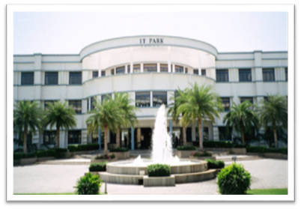


20CST43 - OPERATING SYSTEMS
UNIT V
1

Slide 2
UNIT V
Storage Management: Mass Storage Structure: Overview – HDD Scheduling. File System: File Concept – Access Methods – Directory Structure – Protection. File System Implementation: File System Structure – File System Operations – Directory Implementation – Allocation Methods - Free Space Management. – Security : The Security Problem – program Threats - Case study: Linux System.

Slide 3
Overview of Mass Storage Structure
Bulk of secondary storage for modern computers is hard disk drives (HDDs) and nonvolatile memory (NVM) devices
HDDs spin platters of magnetically-coated material under moving read-write heads
Drives rotate at 60 to 250 times per second
Transfer rate is rate at which data flow between drive and computer
Positioning time (random-access time) is time to move disk arm to desired cylinder (seek time) and time for desired sector to rotate under the disk head (rotational latency)
Head crash results from disk head making contact with the disk surface -- That’s bad
Disks can be removable

Slide 4
Moving-head Disk Mechanism
https://animagraffs.com/hard-disk-drive/

Slide 5
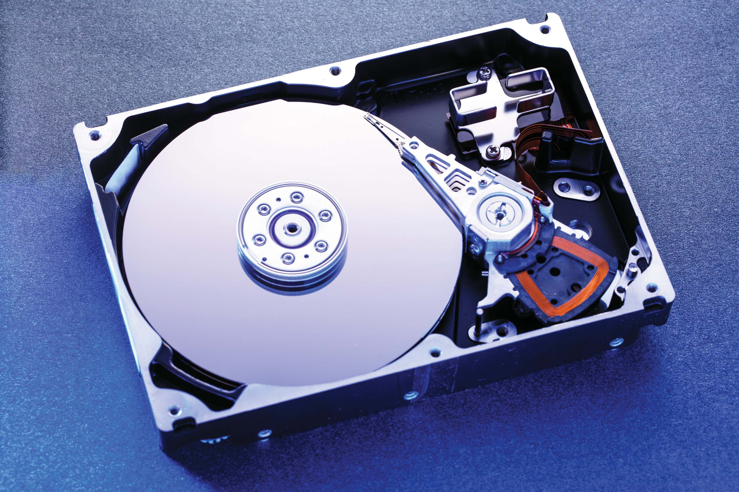
Hard Disk Drives
Platters range from .85” to 14” (historically)
Commonly 3.5”, 2.5”, and 1.8”
Range from 30GB to 3TB per drive
Performance
Transfer Rate – theoretical – 6 Gb/sec
Effective Transfer Rate – real – 1Gb/sec
Seek time from 3ms to 12ms – 9ms common for desktop drives
Latency based on spindle speed

Slide 6
Hard Disk Performance
Access Latency = Average access time = average seek time + average latency
For fastest disk 3ms + 2ms = 5ms
For slow disk 9ms + 5.56ms = 14.56ms
Average I/O time = average access time + (amount to transfer / transfer rate) + controller overhead
For example to transfer a 4KB block on a 7200 RPM disk with a 5ms average seek time, 1Gb/sec transfer rate with a .1ms controller overhead =
5ms + 4.17ms + 0.1ms + transfer time =
Transfer time = 4KB / 1Gb/s * 8Gb / GB * 1GB / 1024²KB = 32 / (1024²) = 0.031 ms
Average I/O time for 4KB block = 9.27ms + .031ms = 9.301ms

Slide 7
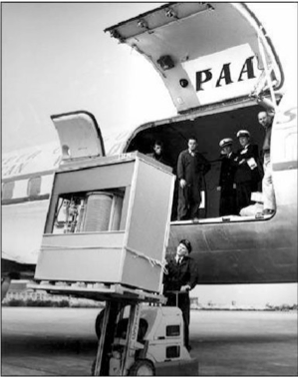
The First Commercial Disk Drive
1956
IBM RAMDAC computer included the IBM Model 350 disk storage system
5M (7 bit) characters
50 x 24” platters
Access time = < 1 second

Slide 8
Nonvolatile Memory Devices
Flash-memory-based NVM is frequently used in a disk-drive-like container is called a solid-state disks (SSDs)
Other forms include USB drives (thumb drive, flash drive), DRAM disk replacements, surface-mounted on motherboards, and main storage in devices like smartphones
Can be more reliable than HDDs
More expensive per MB
May have shorter life span – need careful management
Less capacity
But much faster
No moving parts, so no seek time or rotational latency

Slide 9
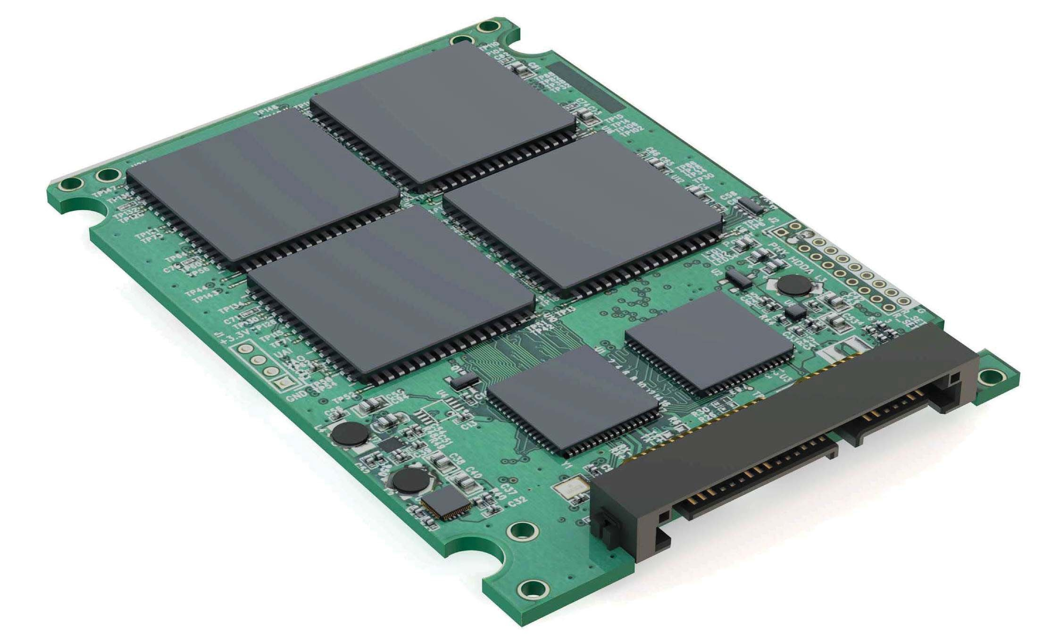
Nonvolatile Memory Devices
Have characteristics that present challenges
Read and written in “page” increments (think sector) but can’t overwrite in place
Must first be erased, and erases happen in larger ”block” increments
Can only be erased a limited number of times before worn out – ~ 100,000
Life span measured in drive writes per day (DWPD)
A 1TB NAND drive with rating of 5DWPD is expected to have 5TB per day written within warrantee period without failing

Slide 10
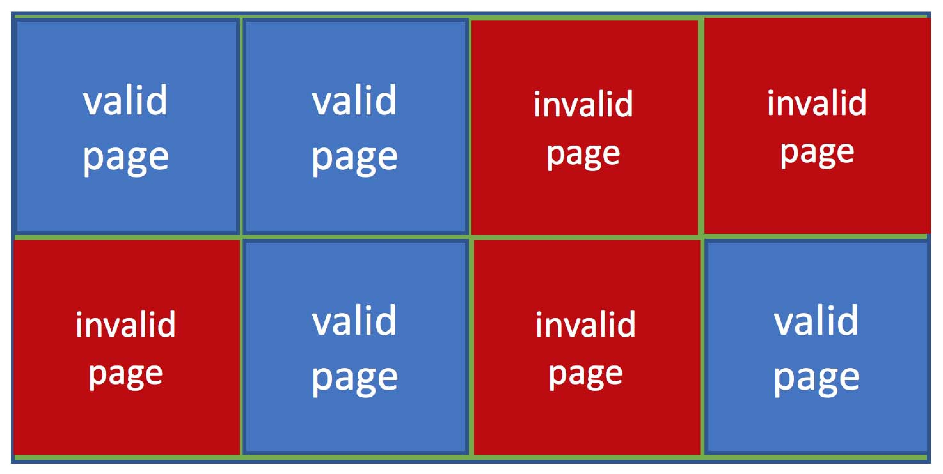
NAND Flash Controller Algorithms
With no overwrite, pages end up with mix of valid and invalid data
To track which logical blocks are valid, controller maintains flash translation layer (FTL) table
Also implements garbage collection to free invalid page space
Allocates overprovisioning to provide working space for GC
Each cell has lifespan, so wear leveling needed to write equally to all cells
NAND block with valid and invalid pages

Slide 11
Volatile Memory
DRAM frequently used as mass-storage device
Not technically secondary storage because volatile, but can have file systems, be used like very fast secondary storage
RAM drives (with many names, including RAM disks) present as raw block devices, commonly file system formatted
Computers have buffering, caching via RAM, so why RAM drives?
Caches / buffers allocated / managed by programmer, operating system, hardware
RAM drives under user control
Found in all major operating systems
Linux /dev/ram, macOS diskutil to create them, Linux /tmp of file system type tmpfs
Used as high speed temporary storage
Programs could share bulk data, quickly, by reading/writing to RAM drive

Slide 12
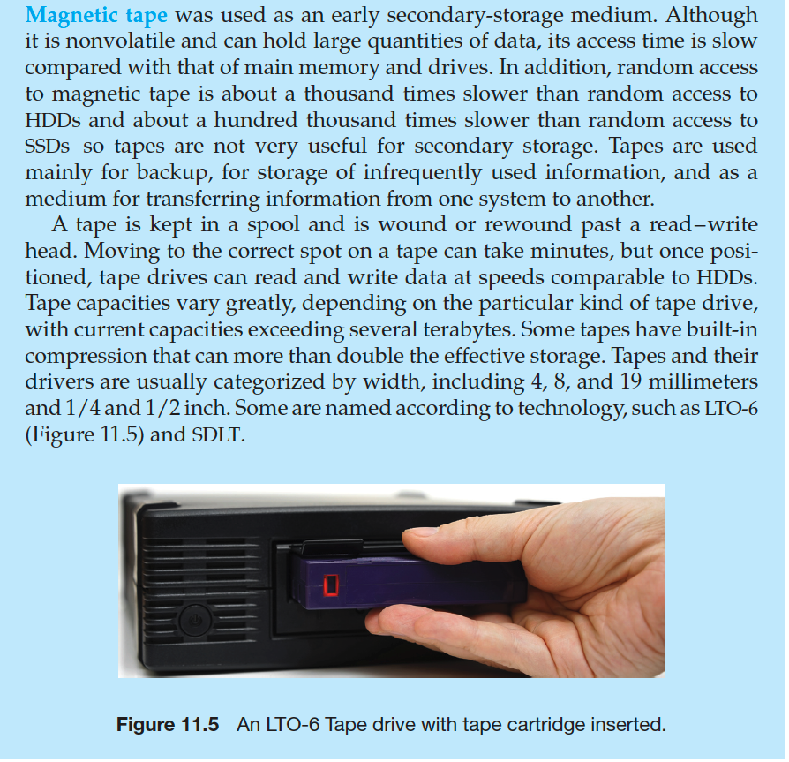
Magnetic Tape

Slide 13
Disk Attachment
Host-attached storage accessed through I/O ports talking to I/O busses
Several busses available, including advanced technology attachment (ATA), serial ATA (SATA), eSATA, serial attached SCSI (SAS), universal serial bus (USB), and fibre channel (FC).
Most common is SATA
Because NVM much faster than HDD, new fast interface for NVM called NVM express (NVMe), connecting directly to PCI bus
Data transfers on a bus carried out by special electronic processors called controllers (or host-bus adapters, HBAs)
Host controller on the computer end of the bus, device controller on device end
Computer places command on host controller, using memory-mapped I/O ports
Host controller sends messages to device controller
Data transferred via DMA between device and computer DRAM

Slide 14
Address Mapping
Disk drives are addressed as large 1-dimensional arrays of logical blocks, where the logical block is the smallest unit of transfer
Low-level formatting creates logical blocks on physical media
The 1-dimensional array of logical blocks is mapped into the sectors of the disk sequentially
Sector 0 is the first sector of the first track on the outermost cylinder
Mapping proceeds in order through that track, then the rest of the tracks in that cylinder, and then through the rest of the cylinders from outermost to innermost
Logical to physical address should be easy
Except for bad sectors
Non-constant # of sectors per track via constant angular velocity

Slide 15
HDD Scheduling
The operating system is responsible for using hardware efficiently — for the disk drives, this means having a fast access time and disk bandwidth
Minimize seek time
Seek time ≈ seek distance
Disk bandwidth is the total number of bytes transferred, divided by the total time between the first request for service and the completion of the last transfer

Slide 16
Disk Scheduling (Cont.)
There are many sources of disk I/O request
OS
System processes
Users processes
I/O request includes input or output mode, disk address, memory address, number of sectors to transfer
OS maintains queue of requests, per disk or device
Idle disk can immediately work on I/O request, busy disk means work must queue
Optimization algorithms only make sense when a queue exists
In the past, operating system responsible for queue management, disk drive head scheduling
Now, built into the storage devices, controllers
Just provide LBAs, handle sorting of requests
Some of the algorithms they use described next

Slide 17
Disk Scheduling (Cont.)
Note that drive controllers have small buffers and can manage a queue of I/O requests (of varying “depth”)
Several algorithms exist to schedule the servicing of disk I/O requests
The analysis is true for one or many platters
We illustrate scheduling algorithms with a request queue (0-199)
98, 183, 41, 122, 14, 124, 65, 67
Head pointer 53

Slide 18
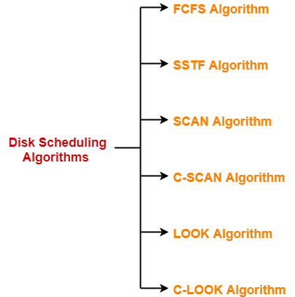
Disk Scheduling Algorithms

Slide 19
FCFS Scheduling
Simplest, perform operations in order requested
no reordering of work queue
no starvation: every request is serviced
Doesn’t provide fastest service
Advantages-
It is simple, easy to understand and implement.
It does not cause starvation to any request.
Disadvantages-
It results in increased total seek time.
It is inefficient.

Slide 20
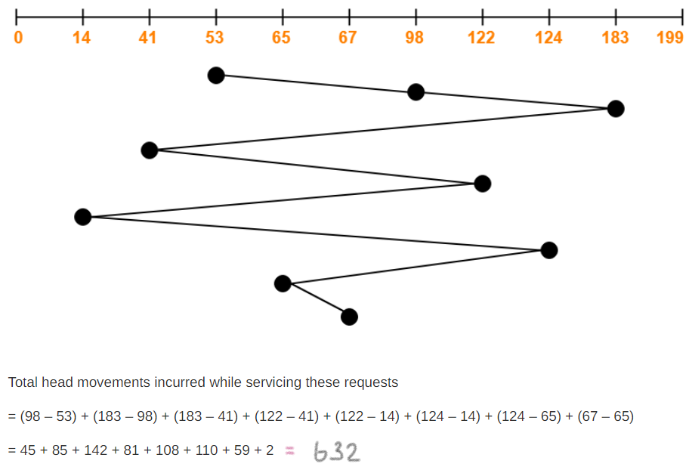
Problem Consider a disk queue with requests for I/O to blocks on cylinders 98, 183, 41, 122, 14, 124, 65, 67. The FCFS scheduling algorithm is used. The head is now at cylinder number 53 and previously at 50. The cylinders are numbered from 0 to 199. The total head movement (in number of cylinders) incurred while servicing these requests is _______.

Slide 21
SSTF Scheduling
SSTF stands for Shortest Seek Time First.
This algorithm services that request next which requires least number of head movements from its current position regardless of the direction.
It breaks the tie in the direction of head movement.
Advantages
It reduces the total seek time as compared to FCFS.
It provides increased throughput.
It provides less average response time and waiting time.
Disadvantages
starvation is possible; stay in one area of the disk if very busy
switching directions slows things down
Not the most optimal

Slide 22
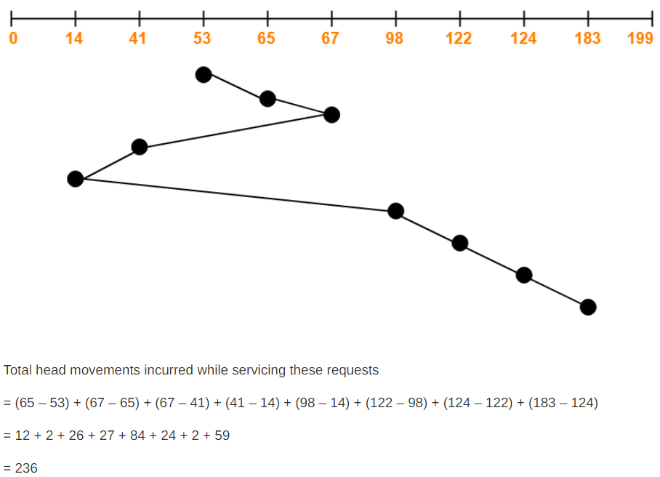
Problem Consider a disk queue with requests for I/O to blocks on cylinders 98, 183, 41, 122, 14, 124, 65, 67. The SSTF scheduling algorithm is used. The head is initially at cylinder number 53 moving towards larger cylinder numbers on its servicing pass. The cylinders are numbered from 0 to 199. The total head movement (in number of cylinders) incurred while servicing these requests is _______.

Slide 23
Problem
Consider a disk system with 100 cylinders. The requests to access the cylinders occur in following sequence- 4, 34, 10, 7, 19, 73, 2, 15, 6, 20
Assuming that the head is currently at cylinder 50, what is the time taken to satisfy all requests if it takes 1 ms to move from one cylinder to adjacent one and shortest seek time first policy is used?

Slide 24
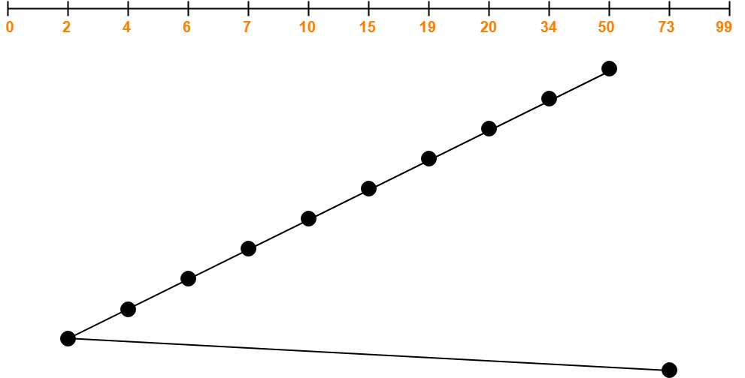
4, 34, 10, 7, 19, 73, 2, 15, 6, 20
Total head movements incurred while servicing these requests
= (50 – 34) + (34 – 20) + (20 – 19) + (19 – 15) + (15 – 10) + (10 – 7) + (7 – 6) + (6 – 4) + (4 – 2) + (73 – 2)
= 16 + 14 + 1 + 4 + 5 + 3 + 1 + 2 + 2 + 71
= 119

Slide 25
SCAN or Elevator Algorithm
As the name suggests, this algorithm scans all the cylinders of the disk back and forth.
Head starts from one end of the disk and move towards the other end servicing all the requests in between.
After reaching the other end, head reverses its direction and move towards the starting end servicing all the requests in between.
SCAN called as Elevator Algorithm - its working resembles the working of an elevator.
Advantages-
It is simple, easy to understand and implement.
It does not lead to starvation.
It provides low variance in response time and waiting time.
Disadvantages-
It causes long waiting time for the cylinders just visited by the head.
It causes the head to move till the end of the disk even if there are no requests to be serviced.

Slide 26
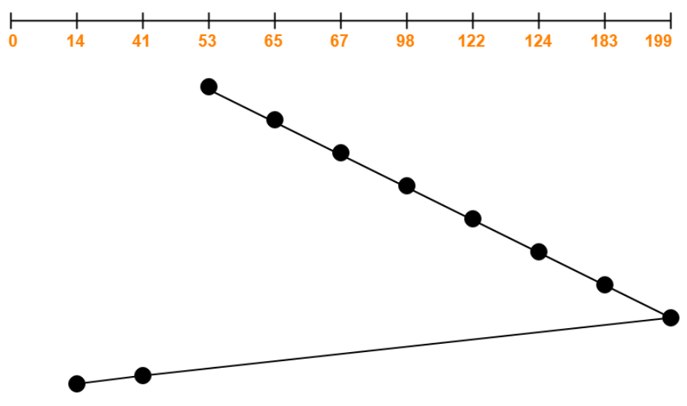
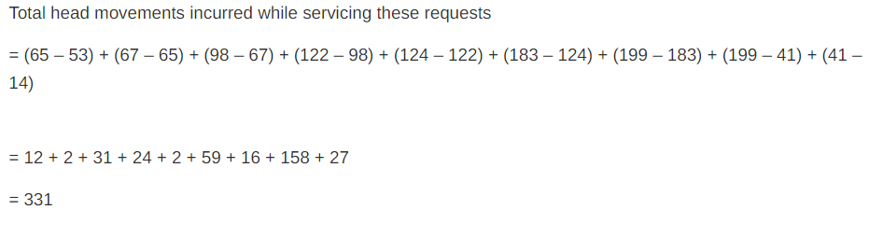
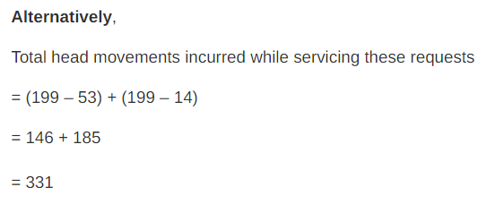
Problem Consider a disk queue with requests for I/O to blocks on cylinders 98, 183, 41, 122, 14, 124, 65, 67. The SCAN scheduling algorithm is used. The head is initially at cylinder number 53 moving towards larger cylinder numbers on its servicing pass. The cylinders are numbered from 0 to 199. The total head movement (in number of cylinders) incurred while servicing these requests is _______.

Slide 27
Circular-SCAN [C-SCAN]
An improved version of the SCAN Algorithm.
Head starts from one end of the disk and move towards the other end servicing all the requests in between.
After reaching the other end, head reverses its direction.
It then returns to the starting end without servicing any request in between.
The same process repeats.
Advantages
Few requests are in front of the head, since these cylinders have recently been serviced. Hence provides a more uniform wait time.
Disadvantages
It causes more seek movements as compared to SCAN Algorithm.
It causes the head to move till the end of the disk even if there are no requests to be serviced.

Slide 28
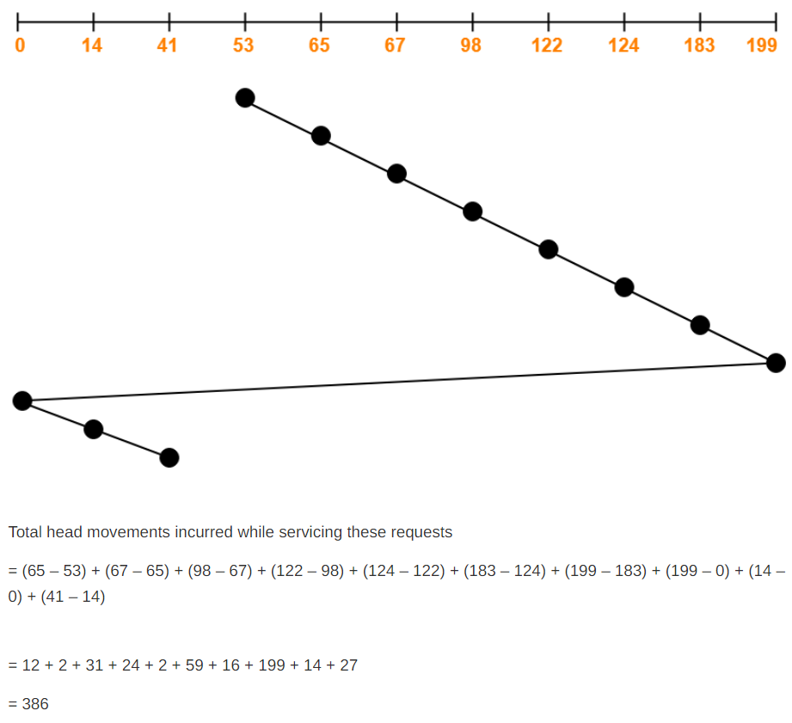
Problem Consider a disk queue with requests for I/O to blocks on cylinders 98, 183, 41, 122, 14, 124, 65, 67. The C-SCAN scheduling algorithm is used. The head is initially at cylinder number 53 moving towards larger cylinder numbers on its servicing pass. The cylinders are numbered from 0 to 199. The total head movement (in number of cylinders) incurred while servicing these requests is _______.

Slide 29
LOOK
like SCAN but stops moving inwards (or outwards) when no more requests in that direction exist
SCAN vs LOOK
SCAN Algorithm scans all the cylinders of the disk starting from one end to the other end even if there are no requests at the ends.
LOOK Algorithm scans all the cylinders of the disk starting from the first request at one end to the last request at the other end.
Advantages
It provides better performance as compared to SCAN Algorithm.
It does not lead to starvation.
Disadvantages
There is an overhead of finding the end requests.

Slide 30
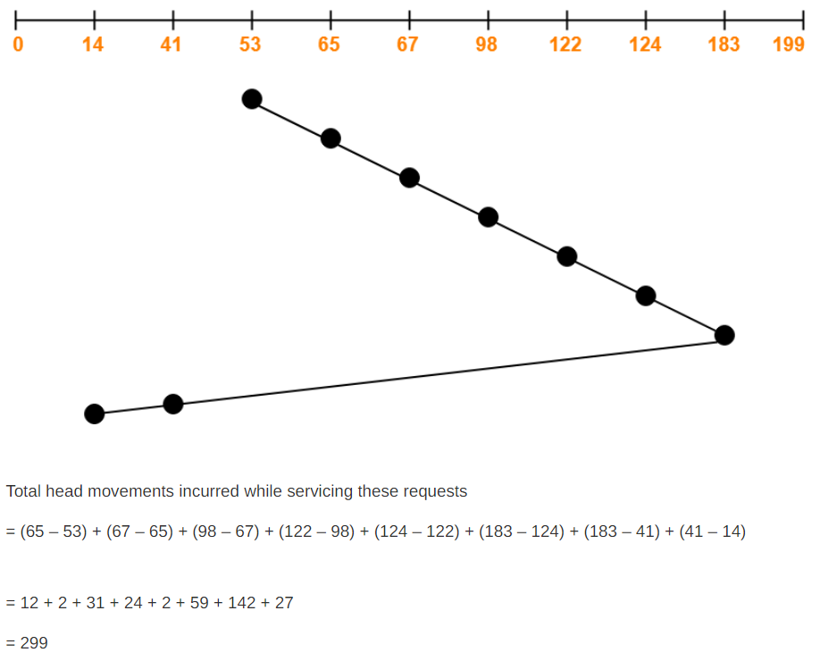
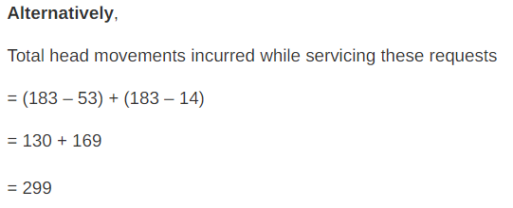
Problem Consider a disk queue with requests for I/O to blocks on cylinders 98, 183, 41, 122, 14, 124, 65, 67. The LOOK scheduling algorithm is used. The head is initially at cylinder number 53 moving towards larger cylinder numbers on its servicing pass. The cylinders are numbered from 0 to 199. The total head movement (in number of cylinders) incurred while servicing these requests is _______.

Slide 31
Circular LOOK [ C-LOOK ]
Circular-LOOK Algorithm is an improved version of the LOOK Algorithm.
Head starts from the first request at one end of the disk and moves towards the last request at the other end servicing all the requests in between.
After reaching the last request at the other end, head reverses its direction.
Advantages
It does not causes the head to move till the ends of the disk when there are no requests to be serviced.
It provides better performance as compared to LOOK Algorithm.
It does not lead to starvation.
Disadvantages
There is an overhead of finding the end requests.

Slide 32
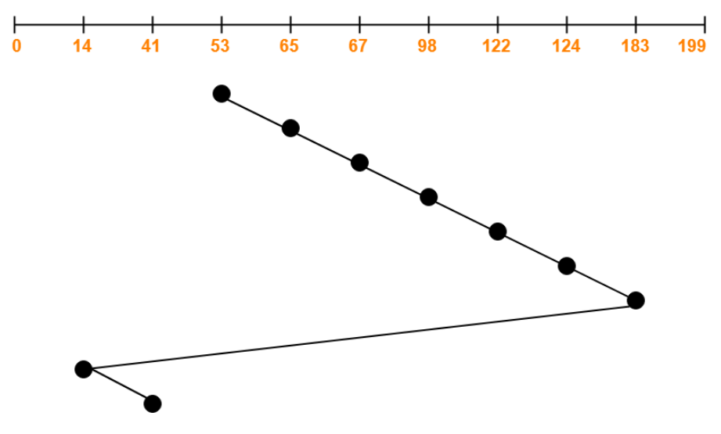
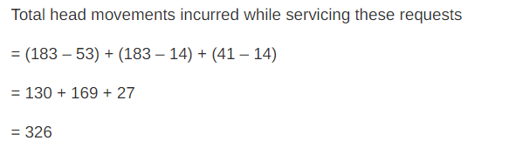
Problem Consider a disk queue with requests for I/O to blocks on cylinders 98, 183, 41, 122, 14, 124, 65, 67. The C-LOOK scheduling algorithm is used. The head is initially at cylinder number 53 moving towards larger cylinder numbers on its servicing pass. The cylinders are numbered from 0 to 199. The total head movement (in number of cylinders) incurred while servicing these requests is _______.

Slide 33
Suppose that a disk drive has 5,000 cylinders, numbered 0 to 4,999. The drive is currently serving a request at cylinder 2,150, and the previous request was at cylinder 1,805. The queue of pending requests, in FIFO order, is: 2,069; 1,212; 2,296; 2,800; 544; 1,618; 356; 1,523; 4,965; 3,681 Starting from the current head position, what is the total distance (in cylinders) that the disk arm moves to satisfy all the pending requests for each of the following disk-scheduling algorithms?
FCFS
SSTF
SCAN
C-SCAN
LOOK
C-LOOK

Slide 34
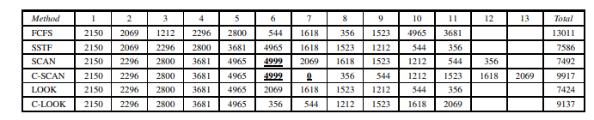

Slide 35
Which one to choose?
Performance depends on number and type of requests.
SSTF over FCFS.
SCAN, C-SCAN for systems that place a heavy load on the disk, as they are less likely to cause starvation.
Default algorithms, SSTF or LOOK

Slide 36
UNIT V
Storage Management: Mass Storage Structure: Overview – HDD Scheduling. File System: File Concept – Access Methods – Directory Structure – Protection. File System Implementation: File System Structure – File System Operations – Directory Implementation – Allocation Methods - Free Space Management. – Security : The Security Problem – program Threats - Case study: Linux System.

Slide 37
File Concept
A file is a named collection of related information that is recorded on secondary storage
Contiguous logical address space
data cannot be written to secondary storage unless they are within a file
Types:
Data
Numeric
Character
Binary
Program
Contents defined by file’s creator
Many types
text file,
source file,
executable file

Slide 38
File Attributes
Name – only information kept in human-readable form
Identifier – unique tag (number) identifies file within file system
Type – needed for systems that support different types
Location – pointer to file location on device
Size – current file size
Protection – controls who can do reading, writing, executing
Time, date, and user identification – data for protection, security, and usage monitoring
Information about files are kept in the directory structure, which is maintained on the disk
Many variations, including extended file attributes such as file checksum

Slide 39
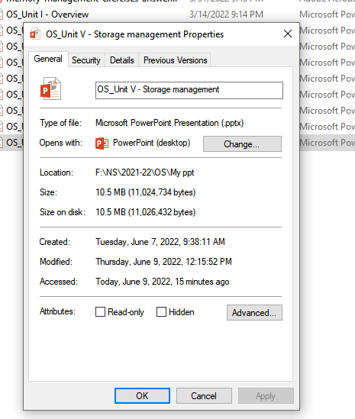
File info Window

Slide 40
Directory Structure
A collection of nodes containing information about all files
Both the directory structure and the files reside on disk

Slide 41
File Operations
Create
Write – at write pointer location
Read – at read pointer location
Reposition within file - seek
Delete
Truncate
Open (F_{i}) – search the directory structure on disk for entry F_{i}, and move the content of entry to memory
Close (F_{i}) – move the content of entry F_{i} in memory to directory structure on disk

Slide 42
Open Files
Several pieces of data are needed to manage open files:
Open-file table: tracks open files
File pointer: pointer to last read/write location, per process that has the file open
File-open count: counter of number of times a file is open – to allow removal of data from open-file table when last processes closes it
Disk location of the file: cache of data access information
Access rights: per-process access mode information

Slide 43
File Locking
Provided by some operating systems and file systems
Similar to reader-writer locks
Shared lock similar to reader lock – several processes can acquire concurrently
Exclusive lock similar to writer lock
Mandatory or advisory:
Mandatory – access is denied depending on locks held and requested
Advisory – processes can find status of locks and decide what to do

Slide 44
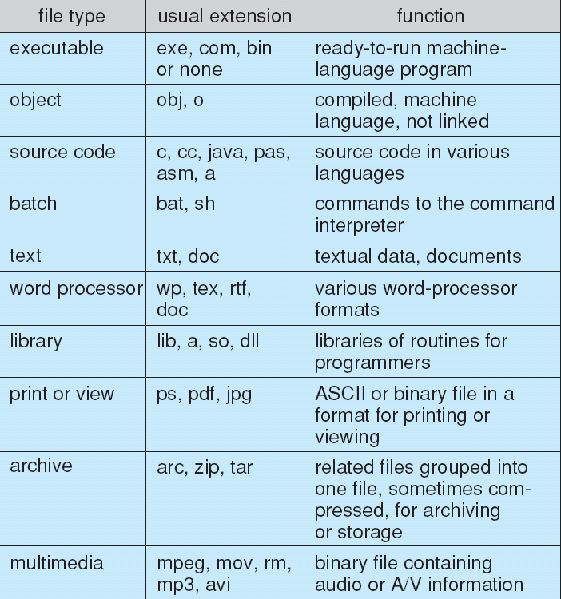
File Types – Name, Extension

Slide 45
File Structure
None - sequence of words, bytes
Simple record structure
Lines
Fixed length
Variable length
Complex Structures
Formatted document
Relocatable load file
Who decides:
Operating system
Program

Slide 46
Access Methods
A file is fixed length logical records
Sequential Access
Direct Access
Other Access Methods

Slide 47
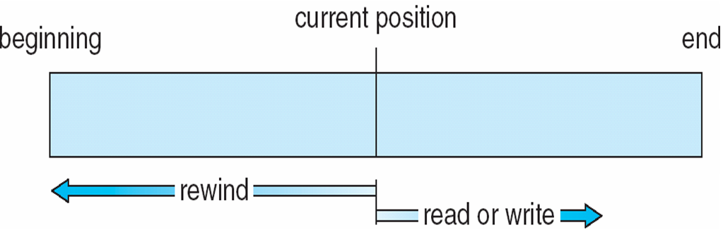
Sequential Access
Operations
read next
write next
Reset
Figure

Slide 48
Direct Access
Operations
read n
write n
position to n
read next
write next
rewrite n
n = relative block number
Relative block numbers allow OS to decide where file should be placed

Slide 49
Other Access Methods
Can be other access methods built on top of base methods
General involve creation of an index for the file
Keep index in memory for fast determination of location of data to be operated on (consider Universal Produce Code (UPC code) plus record of data about that item)
If the index is too large, create an in-memory index, which an index of a disk index
IBM indexed sequential-access method (ISAM)
Small master index, points to disk blocks of secondary index
File kept sorted on a defined key
All done by the OS
VMS operating system provides index and relative files as another example (see next slide)

Slide 50
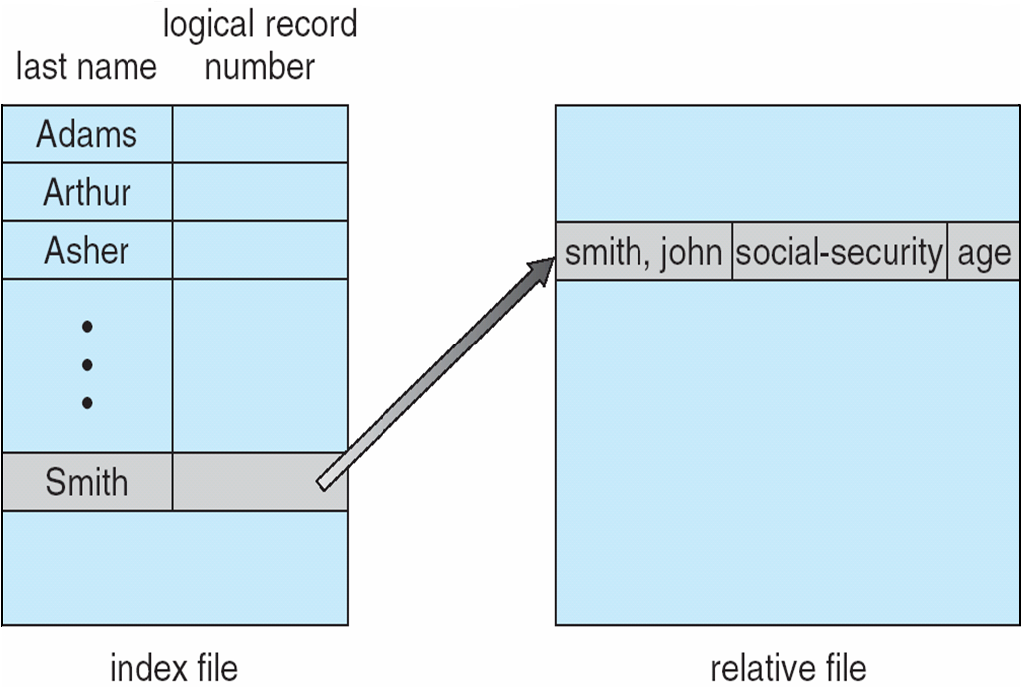
Example of Index and Relative Files

Slide 51
Directory Structure
A collection of nodes containing information about all files
Both the directory structure and the files reside on disk

Slide 52
Operations Performed on Directory
Search for a file
Create a file
Delete a file
List a directory
Rename a file
Traverse the file system

Slide 53
Directory Organization
The directory is organized logically to obtain
Efficiency – locating a file quickly
Naming – convenient to users
Two users can have same name for different files
The same file can have several different names
Grouping – logical grouping of files by properties, (e.g., all Java programs, all games, …)

Slide 54
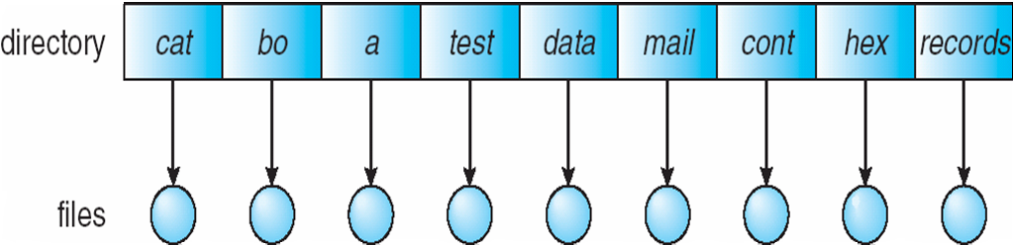
Single-Level Directory
A single directory for all users
Naming problem
Grouping problem

Slide 55
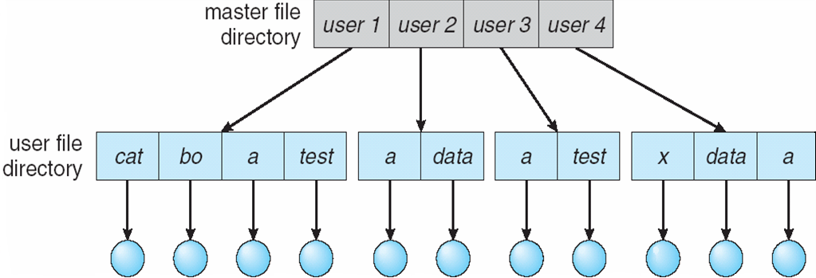
Two-Level Directory
Separate directory for each user
Path name
Can have the same file name for different user
Efficient searching
No grouping capability

Slide 56
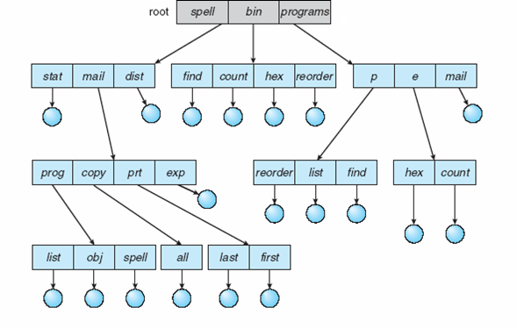
Tree-Structured Directories

Slide 57
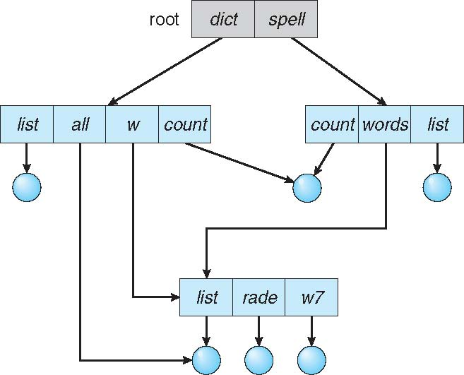
Acyclic-Graph Directories
Have shared subdirectories and files
An acyclic graph—that is, a graph with no cycles—allows directories to share subdirectories and files
Example

Slide 58
Acyclic-Graph Directories (Cont.)
Two different names (aliasing)
If dict deletes w/list ⇒ dangling pointer
Solutions:
Backpointers, so we can delete all pointers.
Variable size records a problem
Backpointers using a daisy chain organization
Entry-hold-count solution
New directory entry type
Link – another name (pointer) to an existing file
Resolve the link – follow pointer to locate the file

Slide 59
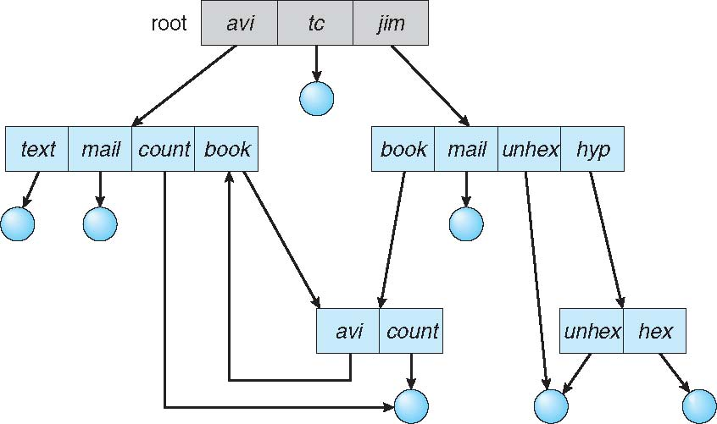
General Graph Directory

Slide 60
General Graph Directory (Cont.)
How do we guarantee no cycles?
Allow only links to files not subdirectories
Garbage collection
Every time a new link is added use a cycle detection algorithm to determine whether it is OK

Slide 61
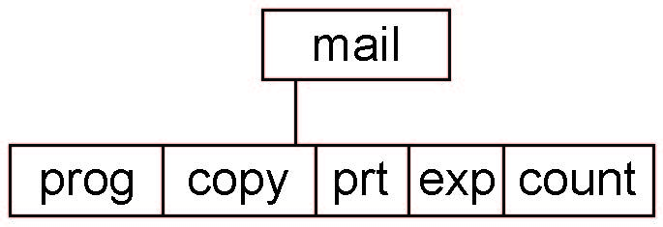
Current Directory
Can designate one of the directories as the current (working) directory
cd /spell/mail/prog
type list
Creating and deleting a file is done in current directory
Example of creating a new file
If in current directory is /mail
The command
mkdir <dir-name>
Results in:
Deleting “mail” ⇒ deleting the entire subtree rooted by “mail”

Slide 62
Protection
File owner/creator should be able to control:
What can be done
By whom
Types of access
Read
Write
Execute
Append
Delete
List

Slide 63
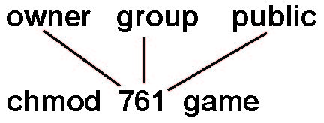
Access Lists and Groups in Unix
Mode of access: read, write, execute
Three classes of users on Unix / Linux
RWX
a) owner access 7 ⇒ 1 1 1 RWX
b) group access 6 ⇒ 1 1 0
RWX
c) public access 1 ⇒ 0 0 1
Ask manager to create a group (unique name), say G, and add some users to the group.
For a file (say game) or subdirectory, define an appropriate access.
Attach a group to a file
chgrp G game

Slide 64
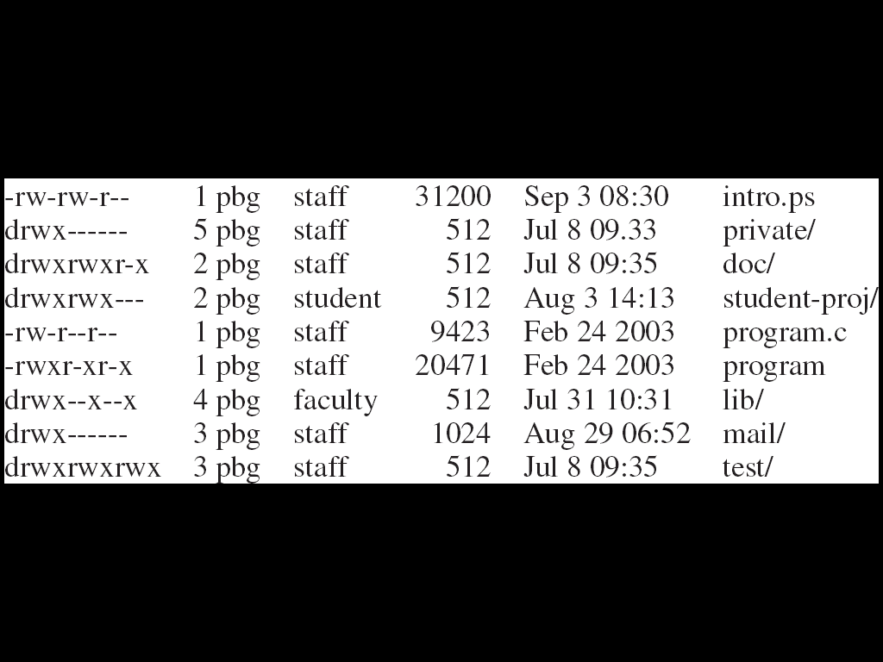
A Sample UNIX Directory Listing

Slide 65
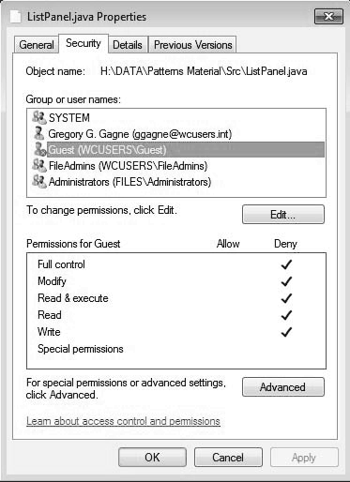
Windows 7 Access-Control List Management

