Slide 1
Module 2: Data Cleaning and Featurizing
Ben Afflerbach
5/11/2020

Slide 2
A Basic Materials Design Workflow
Identify Materials Properties
Train Model of Properties
Predict Properties For New Chemical Compositions
Synthesize and Verify Predictions
Training Details
Generate Training Data
Data Cleaning
Feature Generation and Engineering
Model Assessment
Model Optimization
Predictions
Notes:
Throughout these materials we’ll be calling back to our over-arching example of performing materials design
Now we’ll dive into the first three steps in the training workflow
These encompass things that need to be done before we can start fitting models

Slide 3
Workflow Step 1: Generating Materials Science Data
Performing Experiments
Existing Databases
Notes:
Generally requires large upfront investment of time and money
High throughput experiments and computations can be very beneficial
Can be specifically targeted to areas of interest
Examples:
High throughput computational simulations to calculate a specific property
Automatic synthesis and characterization of compounds
Notes:
Many are freely available for download
May require significant data cleaning to get in a useable state
Examples:
ASM databases – Alloys
Materials Project – Computationally Calculated Properties
Pub Chem – Chemical Information
Citrine – Integrated ML workflow with existing datasets
Notes:
Materials data can come from many different places
In most real research problems obtaining data is the most time-consuming step of the process of building a machine learning model
Leveraging existing data is one way to shortcut the process of having to spend time generating your own data

Slide 4
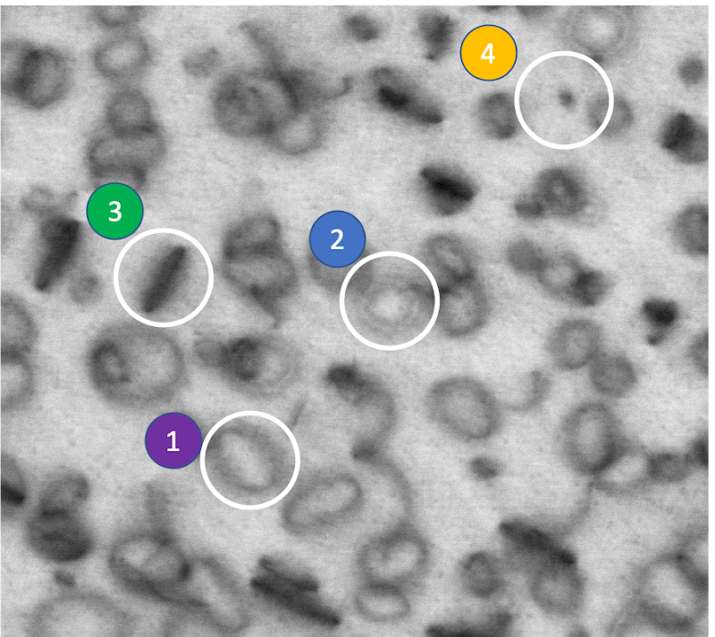
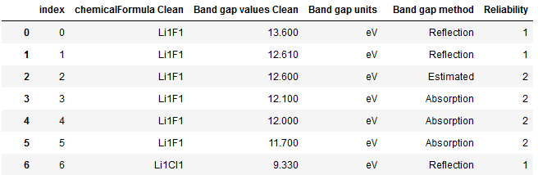
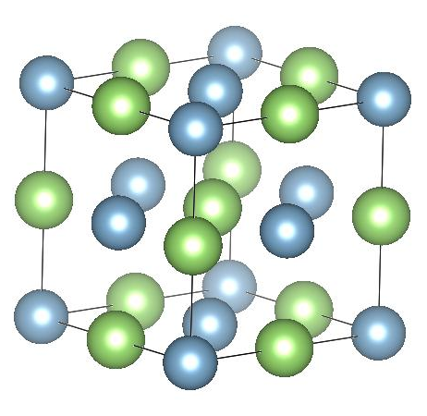
A Few Examples of Materials Science Data
Defects in materials
Bandgaps of Semiconductors
Crystal Structures
Notes:
Previously we gave one example of what materials data looks like in in the example of bandgap data, but this isn’t what data has to look like
On the left we show an example where images are the data, and a model might be used to analyze and identify defects in those images
On the top right is data similar to the example shown previously. Band gap values for semiconductors
And Finally it could be something like the crystal structures of materials. The data in this case would be atomic coordinates of the structure

Slide 5
Example: Band Gap Data for Semiconductors
Composition: In this example this is the fundamental input used by the model
Target: The thing that is predicted. May also be called labels in classification applications
Meta Data: Information that helps understand the data, but isn’t used directly by models
Note: In total dataset has ~1400 rows, showing top few here
Data Source: W.H. Strehlow, E.L. Cook, Compilation of Energy Band Gaps in Elemental and Binary Compound Semiconductors and Insulators, J. Phys. Chem. Ref. Data. 2 (1973) 163–200. doi:10.1063/1.3253115.
Digitized: https://citrination.com/datasets/1160/show_files
Notes:
We’ll look in more detail at the bandgap example from the previous slide, and we’ll continue to reference this dataset throughout the slides
Each row is an individual measurement as well as associated information
Notice that we don’t have any features yet in the data! But we do know the chemical formula

Slide 6
Workflow Step 2: Data Cleaning
Dataset
Missing
Corrupt
Mislabeled
Remove/Combine Duplicates
Assess Different Sources
Dataset
Specific
Cleaning
Remove
“Bad Data”
Notes:
So once we’ve generated or found data we need to make sure it’s accurate. Never trust data that is handed to you!
There are often errors in constructing datasets and things like missing, corrupt, or mislabeled points can occur
It’s hard to give a complete list of thing that may need to occur at this stage, but the goal is to make sure each data point is accurate to the best of your knowledge
This is often where domain expertise can be very useful. For example continuing from our band gap problem. What if we noticed that a bunch of our band gaps were negative?
This should immediately raise a red flag that we need to look at those points in more detail as those values aren’t possible.

Slide 7
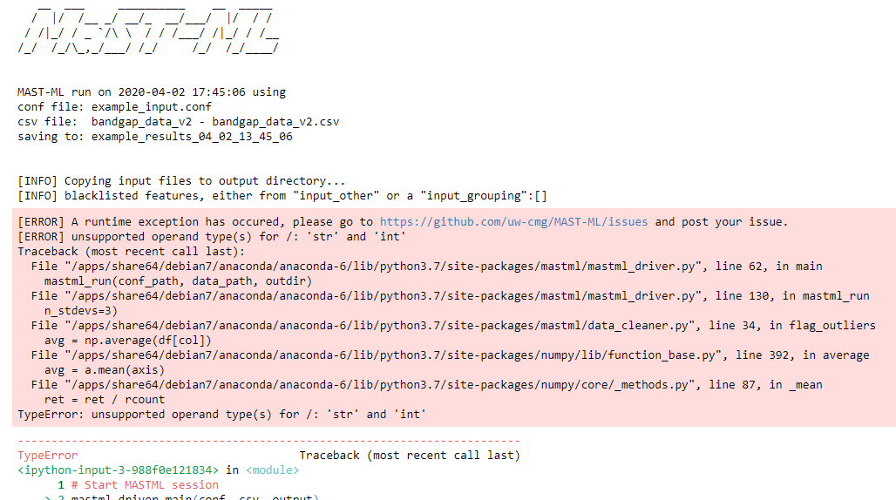
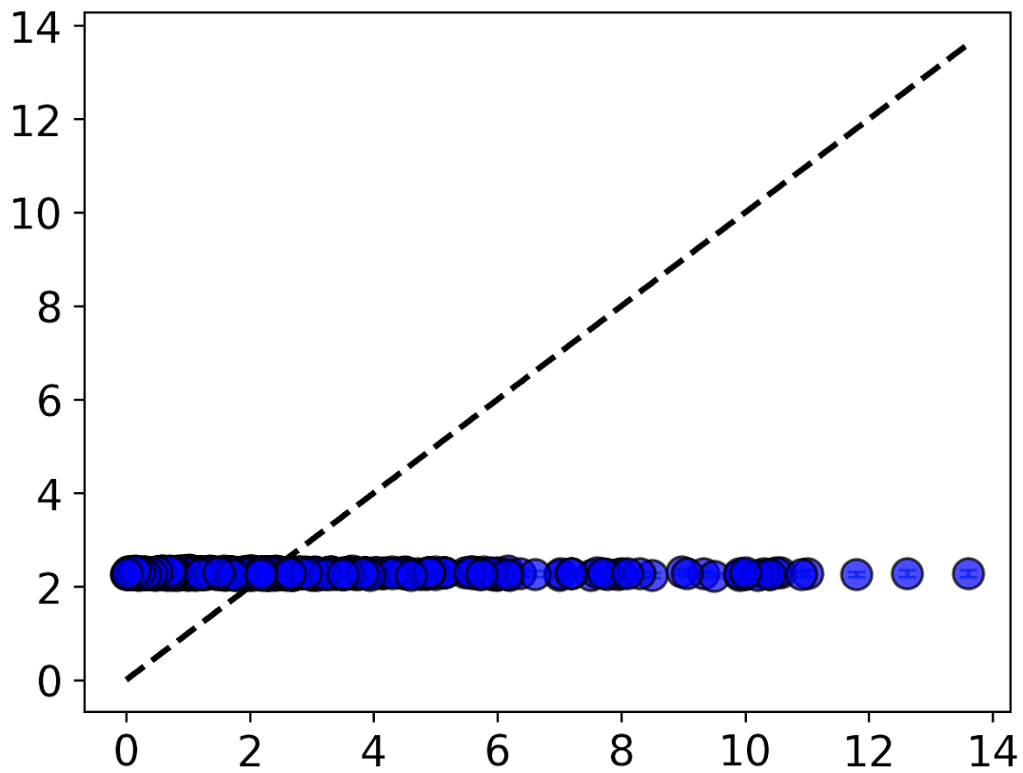
What can go wrong?
Code Errors
Unreliable Models
All predictions are the same: model hasn’t learned anything
Predicted Property
True Property
Notes:
If we don’t perform data clearning correctly, or skip the cleaning step we’ll often run into bad errors down the road.
Code’s will often crash if data isn’t cleaned, or the model will give unphysical results.
On the right this model is just predicting the same values every time! It wasn’t able to learn anything

Slide 8
Example: Cleaning Band Gap Data
Average Duplicate Compositions: Multiple values for each formula could lead to more noise in the model. Averaging across multiple experiments for a formula can give one unique value for each
Filter Data on Reliability: With an estimate of the reliability of experiments we can choose to only use the most reliable points. Labelled with 1
Data Source: W.H. Strehlow, E.L. Cook, Compilation of Energy Band Gaps in Elemental and Binary Compound Semiconductors and Insulators, J. Phys. Chem. Ref. Data. 2 (1973) 163–200. doi:10.1063/1.3253115.
Digitized: https://citrination.com/datasets/1160/show_files
Notes:
- Here’s a few steps we might take for our band gap example, averaging duplicating and filtering for reliable data

Slide 9
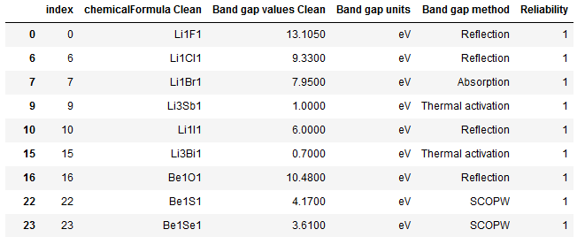
Example: Band Gap Data After Cleaning
Average Duplicate Compositions: Multiple values for each formula could lead to more noise in the model. Averaging across multiple experiments for a formula can give one unique value for each
Filter Data on Reliability: With an estimate of the reliability of experiments we can choose to only use the most reliable points. Labeled with 1
Data Source: W.H. Strehlow, E.L. Cook, Compilation of Energy Band Gaps in Elemental and Binary Compound Semiconductors and Insulators, J. Phys. Chem. Ref. Data. 2 (1973) 163–200. doi:10.1063/1.3253115.
Digitized: https://citrination.com/datasets/1160/show_files
Notes:
- Notice now we only have one unique band gap for each formula
- Note: not to expect to have reliability handed to you. This something the research who put together this dataset had to spend a lot of time on

Slide 10
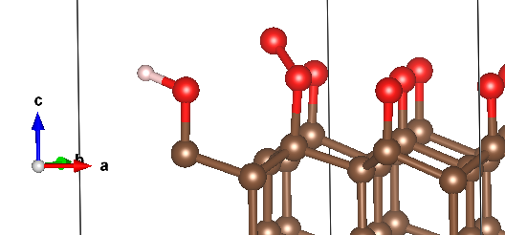
Workflow Step 3: Feature Generation / Engineering
Human Formatted Data
ML Formatted Data = Vector
Intensities in images
Elemental properties values from input compositions
Structural properties values from input structures
Experimental data values from each material
Al₂O₃
Notes:
Feature generation/Engineering is the step where we generate the actually inputs to the machine learning model
As mentioned before data often comes in the form of a chemical formula, an image, or a structure of a material
To be understood by the model we have to translate this information into something a computer can understand

Slide 11
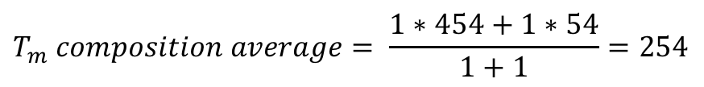
Example: Build Elemental Property Features
Identify Elements
Lookup Properties of Each Element
Find Composition Weighted Average
Add New Feature to the Dataset
Li Melting Temperature: 454 K
F Melting Temperature: 54 K
$$T_{m} composition average= \frac{1∗454+1∗54}{1+1}=254$$
Property Source: https://ptable.com/#Property/MeltingPoint
Notes:
Here’s again a specific example from our band gap dataset
We want to generate features from the composition and to do that we can use elemental properties
Each of these features will be added to the dataset as a new column so that the model can use them

Slide 12
Example: Min/Max Feature Scaling
Raw Values
Normalized Values
Magnitude is different
Range is different
Magnitude is similar
Range is similar
Values
Rescaled Values
Melting Temperature (K)
Number of Valence Electrons
Melting Temperature (K)
Number of Valence Electrons
Notes:
Features can come in many different shapes and sizes
Normalization is a common practice to make them work better together
Some models can be very sensitive to the absolute value of features so putting them on the same scale reduces bias towards certain features
Think about melting temperature as a feature vs number of valence electrons.
Bars show range of values across a dataset

Slide 13
Summary
There is a lot of work in finding a dataset and getting it into shape to be used in building machine learning models
Putting in the effort early sets up the models to perform well later
Generate Training Data
Data Cleaning
Feature Generation and Engineering
Model Assessment
Model Optimization
Predictions
Notes:
Remind students of again the two key takeaways
In the next set of slides we’ll talk through in more details about the second half of the workflow

