Slide 1
Module 4: Challenges in Materials Science Machine Learning
Ben Afflerbach
5/11/2020

Slide 2
A Basic Materials Design Workflow
Identify Materials Properties
Train Model of Properties
Predict Properties For New Chemical Compositions
Synthesize and Verify Predictions
Training Details
Generate Training Data
Data Cleaning
Feature Generation and Engineering
Model Assessment
Model Optimization
Predictions
Notes:
Throughout these materials we’ll be calling back to our over-arching example of performing materials design
We’ve talked through the overall process and now we’ll discuss things to keep in mind during these steps that can lead to problems

Slide 3
Reminder: Decision Tree Setup
Input Data
Features
Labels
Index | X₁ | X₂ | Y
Mat 1 | 0.25 | True | 0
Mat 2 | 0.75 | False | 0.12
Mat 3 | 0.1 | False | 0.7
Root
Individual Data points
Leaf
Decision
Decision
Leaf
Leaf
Leaf
Single Value
Y=0.15
Predictions
Notes:
- Call back to original setup for decision trees

Slide 4
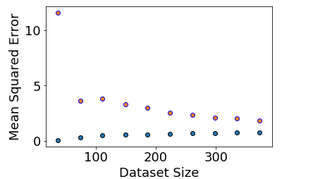
Challenge 1: Dataset Size
Band Gap Errors
Model Errors generally decrease with more data
Material Science data is generally expensive and time consuming to generate
Mean Squared Error (eV)
Test Error
Train Error
Notes:
As mentioned in dataset generation size of dataset is often a limiting factor
It’s important to know how model performance is changing with number of data points because sometimes the easiest way to improve performance is just to do more experiments

Slide 5
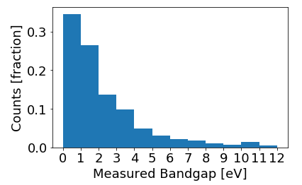
Challenge 2: Biased Target (Y) Data
Data is often heavily grouped around certain values that have had a lot of research interest
A lack of “negative” data can bias predictions even if the total number of data points is large
Notes:
Negative data here means values that aren’t really of interest to the primary research goal.

Slide 6
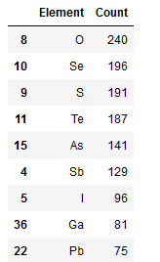
Challenge 3: Compositionally Grouped Data
Data is also often grouped heavily around certain elements and compositions
Again this may bias the model towards those elements
Physics may shift dramatically from element to element. We can’t predict what we haven’t learned a pattern for!
Notes:
- Just the key points in text on slide

Slide 7
Challenge 4: Making appropriate Predictions
Models should be more accurate around training data
Error metrics are usually setup to give errors in this same range

Slide 8
Summary
There are some unique challenges to working with materials science data
Keeping them in mind will lead to better models
Identify Materials Properties
Train Model of Properties
Predict Properties For New Chemical Compositions
Synthesize and Verify Predictions

