Slide 1

🏥
SehatAI
Rural Health Risk & Triage Copilot
AI-assisted screening • Patient education • Human review
PakAngels GenAI & Agentic AI Training — Cohort 11 | Mid-Hackathon Submission
Team
Jahangeer Ali
Kheem Pakrnash Dharmani
Maria Talib
Team Lead · AI Engineer
AI Engineer
Civil Engineer
Huda Tahir
Hajra Arshad
Saira Lateef
IT Expert
Web Developer
IT Expert
SehatAI — Rural Health Risk & Triage Copilot
1

Slide 2
The Problem We're Solving
Millions of people in rural and under-served communities cannot get a quick, affordable first opinion about their health.
👨‍⚕️
Scarce specialists
📄
Unreadable reports
Doctors and diagnostic labs are concentrated in cities, far from rural clinics and villages.
Patients receive lab reports full of numbers and jargon they cannot interpret on their own.
⏳
Late detection
🗣️
Language barriers
Diabetes and heart disease often go unnoticed until symptoms are already severe.
Most digital health tools are English-only, excluding Urdu-speaking and low-literacy users.
SehatAI — Rural Health Risk & Triage Copilot
2

Slide 3
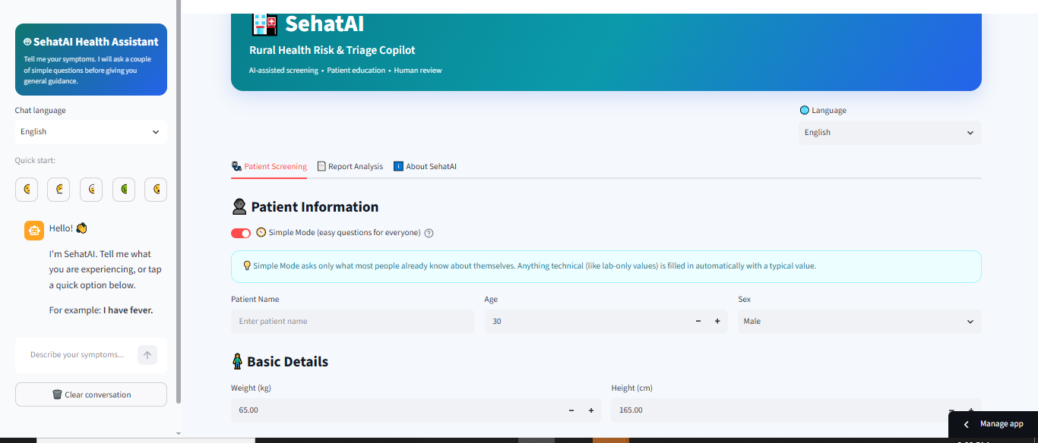
Our Solution: SehatAI
A bilingual, AI-assisted triage web app that turns patient-entered vitals, free-text symptoms and uploaded lab reports into a plain-language screening summary — with a human doctor always kept in the loop.
🧭
Simple Mode for everyone
Plain-language questions (weight, height, "120/80" blood pressure) so low-literacy users can complete a screening on their own.
Two trained risk models
SehatAI running in Simple Mode
🩺
Random Forest models trained on the Pima Diabetes and UCI Heart Disease datasets estimate diabetes and cardiovascular risk.
Not a diagnosis — a first, friendly screening step that points patients toward the right next step of care.
📄
Smart report analyzer
OCR + regex read PDF/image lab reports, feed detected values into the ML models, and explain results in everyday language.
💬
Conversational assistant
A Groq-powered chatbot asks short follow-up questions before giving safe, non-diagnostic guidance — in English, Urdu, or Roman Urdu.
SehatAI — Rural Health Risk & Triage Copilot
3

Slide 4
Technology Stack
🖥️
🤖
🧠
Interface
Machine Learning
Conversational AI
Streamlit (Python), custom CSS theming, bilingual UI
scikit-learn Random Forest, XGBoost, joblib, SHAP explainability
Groq API — free-tier "openai/gpt-oss-20b" language model
🔍
📊
☁️
Report Reading
Data
Deployment
pypdf (PDF text), pytesseract + Pillow (image OCR), regex value extraction
pandas, numpy — Pima Indians Diabetes & UCI Heart Disease datasets
GitHub for version control, Streamlit Community Cloud for hosting
SehatAI — Rural Health Risk & Triage Copilot
4

Slide 5
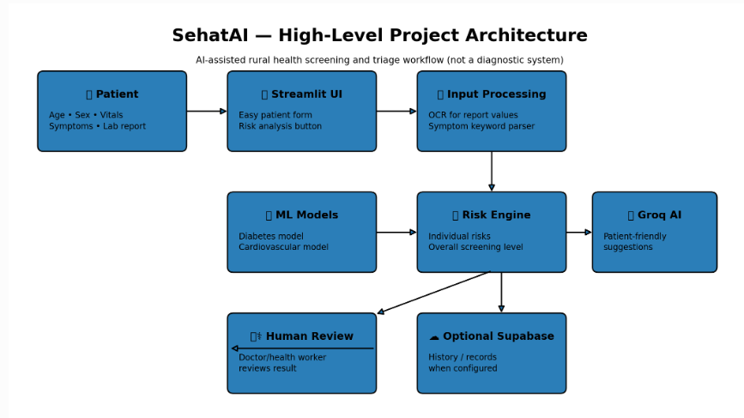
High-Level System Architecture
How patient input flows through SehatAI, from the form to a human-reviewed result.
SehatAI — Rural Health Risk & Triage Copilot
5

Slide 6
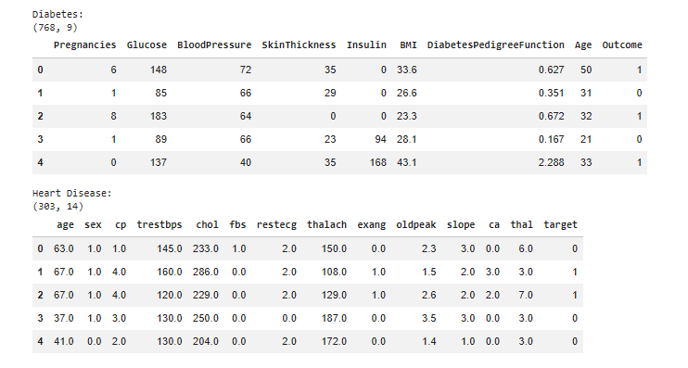
Datasets & Model Training
🩸
Diabetes
Pima Indians Diabetes Dataset — 768 rows × 9 columns (8 clinical features + Outcome label).
❤️
Heart Disease
UCI Heart Disease Dataset — 303 rows × 14 columns, cleaned to 297 complete records.
🧹
Preprocessing
Biologically-impossible zeros (Glucose, BP, Skin, Insulin, BMI) treated as missing and filled with the column median; incomplete heart-disease rows dropped.
⚖️
Model comparison
Both a Random Forest and an XGBoost classifier were trained on an 80/20 split and compared on Accuracy, ROC-AUC and F1-score.
First rows of the two training datasets
🔎
Explainability
SHAP (TreeExplainer) surfaces the top features behind each individual prediction.
SehatAI — Rural Health Risk & Triage Copilot
6

Slide 7
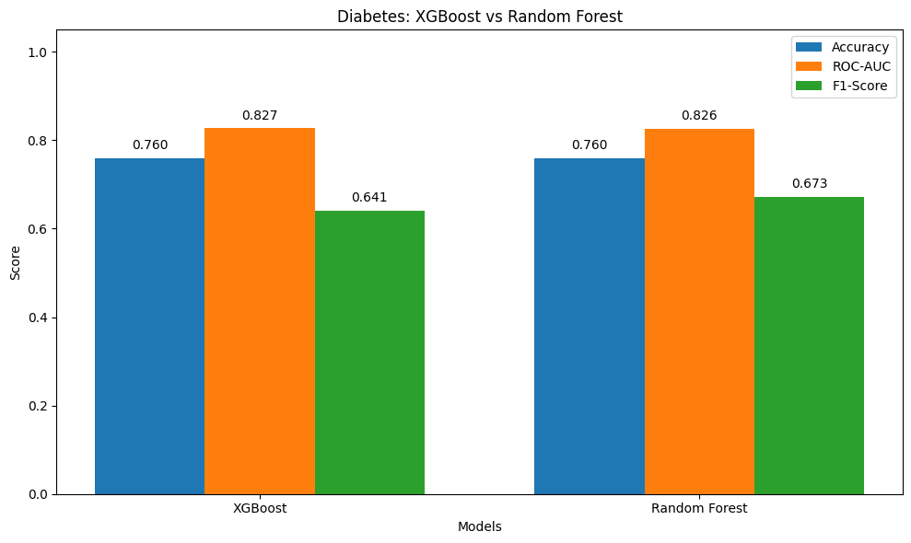
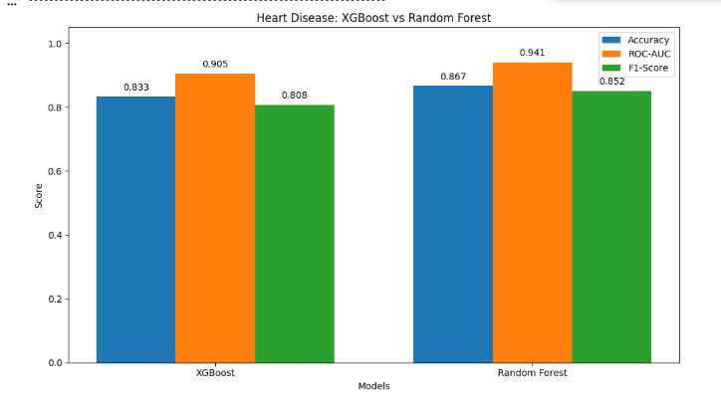
Results — Model Evaluation
Test-set performance
Dataset | Model | Accuracy | ROC-AUC | F1-Score
Diabetes | XGBoost | 0.760 | 0.827 | 0.641
Diabetes | Random Forest ✓ | 0.760 | 0.826 | 0.673
Heart Disease | XGBoost | 0.833 | 0.905 | 0.808
Heart Disease | Random Forest ✓ | 0.867 | 0.941 | 0.852
✓ Random Forest was selected as the deployed model for both diseases — the best overall balance of accuracy, ROC-AUC and F1-score.
Heart-disease model comparison
These are screening-level estimates from statistical models trained on public benchmark datasets — not a medical diagnosis.
SehatAI — Rural Health Risk & Triage Copilot
7

Slide 8
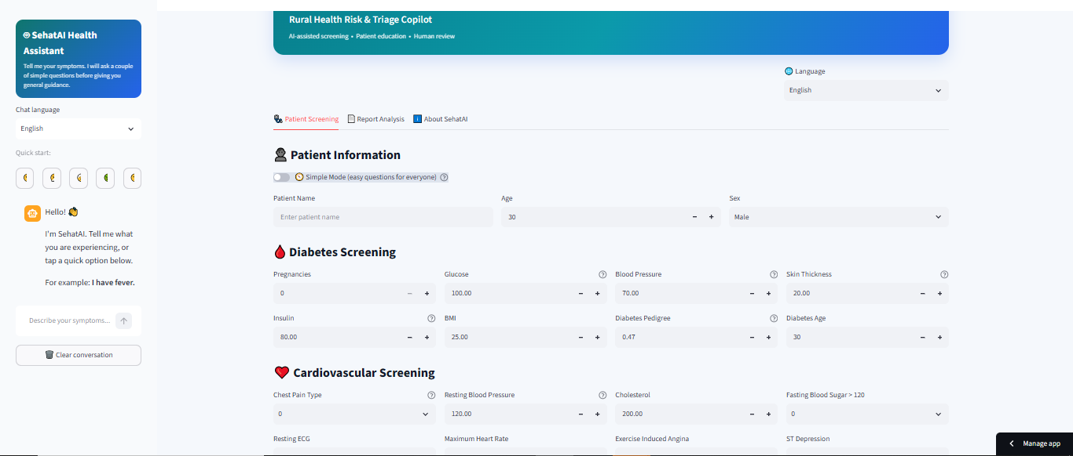
Live Demo — The Application
Simple Mode — plain-language screening for everyone
Advanced Mode — full clinical form for health workers with lab results
SehatAI — Rural Health Risk & Triage Copilot
8

Slide 9
Impact & What's Next
Why it matters
Roadmap
Gives patients a friendly, private first step before visiting a clinic.
Native Android/iOS app for offline-friendly rural use.
Works with as little information as a person's weight, height and rough BP.
Vision-capable OCR model for messier, handwritten reports.
Explains medical reports in plain English, Urdu, or Roman Urdu.
More screening models: anemia, hypertension, malnutrition.
Keeps a human doctor in the loop for every important decision — never replaces one.
Clinician dashboard with patient history via Supabase.
SehatAI is a decision-support prototype, not a certified medical device. Every screening result is explicitly labelled as an estimate, and the app consistently directs patients toward a qualified healthcare professional for confirmation and care.
SehatAI — Rural Health Risk & Triage Copilot
9

Slide 10
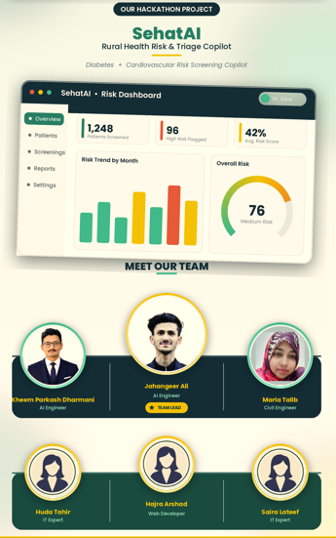

Thank You
Meet Team SehatAI
👤
Jahangeer Ali
Team Lead · AI Engineer
👤
Kheem Pakrnash Dharmani
AI Engineer
👤
Maria Talib
Civil Engineer
👤
Huda Tahir
IT Expert
👤
Hajra Arshad
Web Developer
👤
Saira Lateef
IT Expert
PakAngels GenAI & Agentic AI Training — Cohort 11, with iCodeGuru & ASPIRE Pakistan
SehatAI — Rural Health Risk & Triage Copilot
10

