Slide 1
Arduino sketch
Setup blink
Blink loop
Start
Turn built-in LED on
setup
Set pin for built-in LED to output
Delay 1 second
loop
Turn built-in LED off
Delay 1 second

Slide 2
Basic counter setup
Basic counter loop
Loop with decision
initialize counter
PORTC = counter
PORTC = counter
Set bits 0-5 of PORTC to outputs
Increment counter
Increment counter
PORTC = 0
Delay 1 second
Delay 1 second
Counter>
59?
N
Y
Reset counter

Slide 3
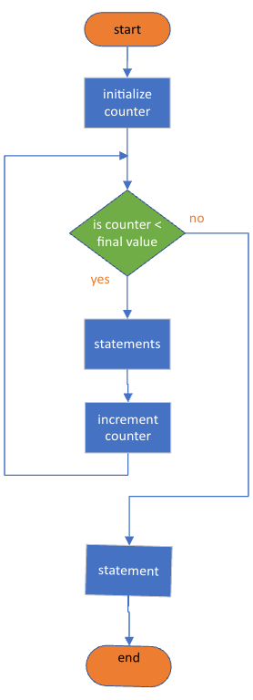
For loop:
for(initialize; test; increment) {}
Note the position of the initialize, test, increment statements in the flow chart.

Slide 4
Lab 2
PORTC = counter
initialize counters
PIND && 0b00000100 != 0
N
Set bits 0-5 of PORTB and PORTC to outputs
Increment counter
Make bit 2 of Port D an input
Y
Delay 1 second
a) Setup Subprocess
b) Setup Subprocess

Slide 5
Lab 3
Read ADCVAL
ADCval >= 854
N
ADCval >= 684
N
N
ADCval >= 171
N
ADCval >=1
N
Some decisions omitted for clarity.
Each step is 170 less than the previous
Y
Y
Y
Y
Set PORTC to
0b00111111
Set PORTC to
0b00011111
Set PORTC to
0b00000011
Set PORTC to
0b00000001
Loop Subprocess

