Slide 1

UPI FRAUD DETECTION USING MACHINE LEARNING
by
S. Jaheda
Roll No. 214G1A3229
G. Afra Tahaseen
Roll No. 214G1A3202
K. Divya Madhuri
Roll No. 214G1A3219
P. Mohammad Arshad
Roll No. 214G1A3253
Under the guidance of
Ms. P. Sirisha _{M. Tech.}
Assistant Professor
Department of Computer Science and Engineering (Data Science)
Srinivasa Ramanujan Institute of Technology
(Affiliated to JNTUA & Approved by AICTE) (Accredited by NAAC with ‘A’ Grade & Accredited by NBA (EEE, ECE & CSE)
Rotarypuram Village, B K Samudram Mandal, Ananthapuramu – 515701.
2024 - 2025

Slide 2

Contents
Abstract
Problem Statement
Objectives
Introduction
Literature survey
Existing System
Proposed System

Slide 3
Contents
Requriments
Data Flow Diagram
UML Diagram
Data Processing Techniques
References
GitHub Link
Queries

Slide 4
Abstract
The rapid adoption of Unified Payments Interface (UPI) for digital transactions, the risk of fraudulent activities has also increased significantly. To address this challenge, we propose a novel approach to detect UPI fraud by analyzing transaction details such as the bank book name, transaction ID, and transaction amount. Our method employs three machine learning algorithms: Random Forest, K-Nearest Neighbors (KNN), and Decision Tree. The Random Forest classifier is known for its accuracy and resilience against overfitting, making it a robust choice for this application. It processes the provided transaction details to classify the transaction outcome as either "Transaction Failed: Incorrect Details Entered" or "Transaction Successful: Details Verified and Processed."In addition to Random Forest, the KNN algorithm provides a straightforward approach to classification based on the similarity of transaction details with previously labeled data. The Decision Tree algorithm, with its intuitive structure, offers clear decision-making pathways, enhancing interpretability.
Keywords: UPI Digital Payments, Random Forest Algorithm, K-Nearest Neighbors, Decision Tree, Machine Learning.

Slide 5
Problem Statement
With the rapid adoption of the Unified Payments Interface (UPI) for digital transactions, the increasing incidence of fraudulent activities poses a significant challenge to financial security. The complexity of transaction details, such as bank book names, transaction IDs, and amounts, creates opportunities for unauthorized transactions. To mitigate this risk, we propose a novel approach for detecting UPI fraud by leveraging machine learning techniques. Our system employs a combination of Random Forest, K-Nearest Neighbors (KNN), and Decision Tree classifiers to analyze transaction data. These algorithms are known for their effectiveness in classification tasks. enabling the system to accurately identify whether a transaction is "Transaction Failed: Incorrect Details Entered" or "Transaction Successful: Details Verified and Processed."

Slide 6
Objectives of Project
Development of Fraud Detection System: The project focuses on creating a robust fraud detection system specifically for Unified Payments Interface (UPI) transactions, analyzing critical details like bank book name, transaction ID, and transaction amount.
Machine Learning Algorithms: We aim to implement a framework using machine learning algorithms, including Random Forest, K-Nearest Neighbors (KNN), and Decision Tree, to effectively classify transactions as either fraudulent or successful.
Accuracy and Minimized False Positives: The goal is to enhance the accuracy of fraud detection while minimizing false positives, ensuring that legitimate transactions are not incorrectly flagged.
Integration into Financial Systems: Ultimately, the proposed model will be integrated into real-world financial systems, providing users with increased protection against unauthorized transactions and fostering confidence in digital payment processes.

Slide 7
Literature Survey
s.no | Title | Author | Journal Name &year | Methodology adapted | Key findings | gaps
1. | UPI fraud detection using machine learning Algorithms | Jallapuram sindhu, Ms.Vijaya sree Swarupa | International journal of Engineering research and science and technology, 2023 | Machine Learning Techniques | Hidden Markov Models (HMM),Neural network | Limited to small volume of data.
2. | A review of credit card fraud detection using machine learning techniques | Nadia Boutaher, Amia elomri ,noreddine abghour,khalid Moussaid | IEEE,2020 | Machine Learning Techniques | Logistic Regression | Limited data

Slide 8
Literature Survey
No | Title | Author | Journal Name & Year | Methodology Adapted | Key Findings | Gaps
3. | Fraud Detection in UPI Transactions Using Machine Learning | J. Kavitha, G. Indira, A. Anil kumar , A. Shrinita , D. Bappan | EPRA International Journal of Research and Development (IJRD),April -2024 | Machine Learning Techniques | machine learning (ML) techniques like SVM | Limited availability of diverse, real-world datasets and scalability for high transaction volumes
4. | UPI fraud Detection using Machine Learning | Yash Patil, Amar Shinde, Yash Parthe, Sameer Sayyad | International Research Journal of Modernization in Engineering Technology and Science , September-2024 | Machine Learning Techniques | Multi-Model Approaches Hidden Markov Models (HMM), K-means Clustering | Limited Dataset Generalization

Slide 9
Introduction
With the rapid adoption of the Unified Payments Interface (UPI) for digital transactions, the risk of fraudulent activities has surged significantly. To address this challenge, we propose a robust approach to detect UPI fraud by analyzing key transaction details, including the bank book name, transaction ID, and transaction amount. Our approach employs three machine learning algorithms: Random Forest, K-Nearest Neighbors (KNN), and Decision Tree. Random Forest is valued for its accuracy and resistance to overfitting, making it ideal for distinguishing legitimate transactions from fraudulent ones. KNN provides intuitive, distance-based classification, while the Decision Tree offers a clear and interpretable decision-making model. This ensemble approach classifies transactions as either "Is Fraud" or "Fraud."

Slide 10
Existing System
Logistic Regression is an already existing method used for UPI fraud detection. It classifies transactions as fraudulent or legitimate based on historical data, using features such as transaction amount, frequency, and user behavior.
If the probability of fraud exceeds a certain threshold, the transaction is flagged as suspicious. While this method is simple, interpretable, and effective for basic classification tasks, it has several limitations.
It assumes linear relationships between features, which makes it less effective in detecting complex or evolving fraud patterns. Additionally, it may struggle with large datasets and is prone to overfitting if not properly tuned.

Slide 11
Proposed System
This proposed system for UPI fraud detection presents a clear and structured approach to enhancing digital payment.
Data-driven Approach:
By using historical transaction data, the system can detect fraud based on actual patterns, improving its accuracy.
Versatile Model Selection:
The inclusion of multiple algorithms (Decision Tree, Random Forest, and KNN) allows for flexibility and optimization, ensuring the best-performing model is chosen.
Real-time Monitoring:
The integration of the system with real-time transaction data means that fraud detection is immediate, which is crucial for minimizing losses.User Feedback: The feedback loop enables the system to evolve continuously, improving its predictions and adapting to new fraud tactics.

Slide 12
Proposed System
User Feedback:
The feedback loop enables the system to evolve continuously, improving its predictions and adapting to new fraud tactics.
Performance Metrics:
Evaluating the system using various performance metrics will help to fine-tune the model and ensure that it balances accuracy and detection capability.

Slide 13
Requirements
Functional requirements
Transaction monitoring
Fraud predictions model
Real time alerts
Fraud pattern updates
Non functional requirement
Scalability
Accuracy
Maintainability

Slide 14
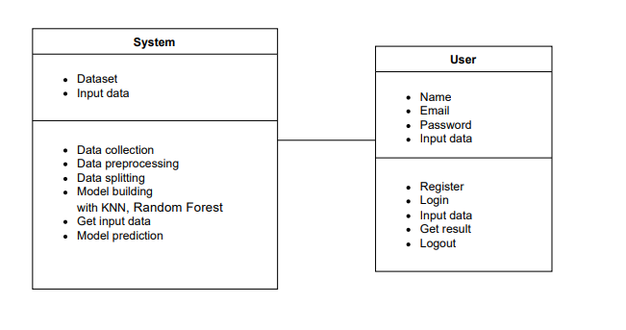
UML Diagrams
Class Diagram:
Class diagram in the Unified Modeling Language (UML) is a type of static structure diagram that describes the structure of a system by showing the system's classes, their attributes, operations (or methods), and the relationships among the classes. It explains which class contains information.

Slide 15
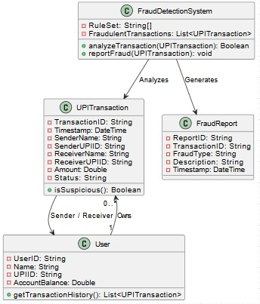
UML Diagrams

Slide 16
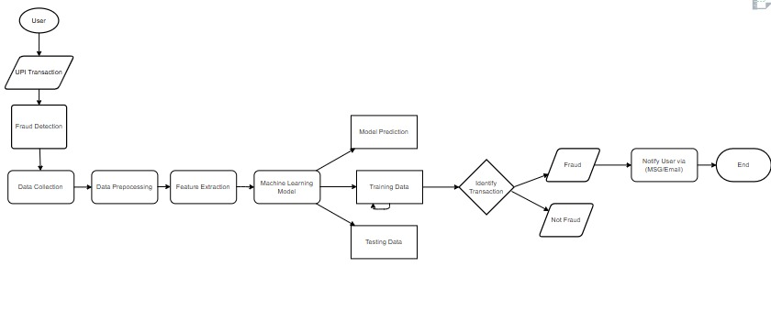
Data Flow Diagram

Slide 17
Data Preprocessing Techniques
Data Cleaning
Feature Selection
Data Transformation
Encoding Categorical Data
Data Splitting
Feature Engineering

Slide 18
Reference
[1]. Nadia Boutaher,Amia elomri,noreddine abghour,khalid Moussaid, A review of credit card fraud detection
using machine learning techniques
[2]. J. Kavitha, G. Indira, A. Anil kumar , A. Shrinita , D. Bappan, Fraud Detection in UPI Transactions Using Machine Learning. EPRA International Journal of Research and Development (IJRD),April -2024
[3]. Sahin M (2017) Understanding Telephony Fraud as an Essential Step to Better Fight it [Thesis]. École Doctorale Informatique, Télécommunication et Électronique, Paris
[4]. Jallapuram sindhu,Ms.Vijaya sree Swarupa, UPI fraud detection using machine learning Algorithms.
International journal of Engineering research and science and technology,2023
[5]. Yash Patil, Amar Shinde, Yash Parthe, Sameer Sayyad, UPI fraud Detection using Machine Learning. International Research Journal of Modernization in Engineering Technology and Science , September-2024

Slide 19
Review-0 Queries
Are there any specific datasets already available for this task?
Are there additional features beyond transaction details that need to be considered?
Where can this be applied?
How many attributes are required and used in this?
What is overfitting?

Slide 20
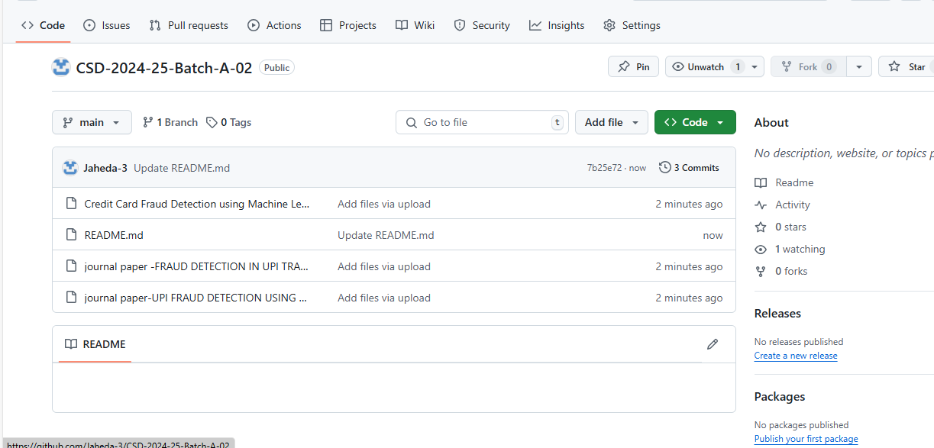
GITHUB LINK

Slide 21
Any Queries?

Slide 22
Thank You!!!

