Slide 1

UPI FRAUD DETECTION USING MACHINE LEARNING
by
S. Jaheda
Roll No. 214G1A3229
G. Afra Tahaseen
Roll No. 214G1A3202
K. Divya Madhuri
Roll No. 214G1A3219
P. Mohammad Arshad
Roll No. 214G1A3253
Under the guidance of
Ms. P. Sirisha _{M. Tech.}
Assistant Professor
Department of Computer Science and Engineering (Data Science)
Srinivasa Ramanujan Institute of Technology
(Affiliated to JNTUA & Approved by AICTE) (Accredited by NAAC with ‘A’ Grade & Accredited by NBA (EEE, ECE & CSE)
Rotarypuram Village, B K Samudram Mandal, Ananthapuramu – 515701.
2024 - 2025

Slide 2
Review-1 Queries
Are there any specific datasets already available for this task?
Are there additional features beyond transaction details that need to be considered?
Where can this be applied?
How many attributes are required and used in this?
What is overfitting?

Slide 3

Contents
Abstract
Problem Statement
Objectives
Introduction
Literature survey
Existing System
Proposed System

Slide 4
Contents
Requriments
Data Flow Diagram
Implementation
Data Processing Techniques
References
GitHub Link
Queries

Slide 5
Abstract
The rapid adoption of Unified Payments Interface (UPI) for digital transactions, the risk of fraudulent activities has also increased significantly. To address this challenge, we propose a novel approach to detect UPI fraud by analyzing transaction details such as the bank book name, transaction ID, and transaction amount. Our method employs four machine learning algorithms: Random Forest, XGBClassifier, GBM and Decision Tree. It processes the provided transaction details to classify the transaction outcome as either "Transaction Failed: Incorrect Details Entered" or "Transaction Successful: Details Verified and Processed". Random Forest improves accuracy and resilience, effectively detecting fraud. XGBClassifier is a powerful gradient boosting algorithm for classification tasks. It is fast, handles missing values, prevents overfitting .The Decision Tree algorithm, with its intuitive structure, offers clear decision-making pathways, enhancing interpretability.
Keywords: UPI Digital Payments, Fraud Detection, Random Forest Algorithm, Decision Tree, XGBClassifier, GBM’s, Machine Learning.

Slide 6
Problem Statement
With the rapid adoption of the Unified Payments Interface (UPI) for digital transactions, the increasing incidence of fraudulent activities poses a significant challenge to financial security.
The complexity of transaction details, such as bank book names, transaction IDs, and amounts, creates opportunities for unauthorized transactions. To mitigate this risk, we propose a novel approach for detecting UPI fraud by leveraging machine learning techniques.
Our system employs a combination of XGBClassifier, GBM’s, Random Forest, and Decision Tree classifiers to analyze transaction data.
These algorithms are known for their effectiveness in classification tasks. enabling the system to accurately identify whether a transaction is "Transaction Failed: Incorrect Details Entered" or "Transaction Successful: Details Verified and Processed."

Slide 7
Introduction
With the rapid adoption of the Unified Payments Interface (UPI) for digital transactions, the risk of fraudulent activities has surged significantly. To address this challenge, we propose a robust approach to detect UPI fraud by analyzing key transaction details, including the bank book name, transaction ID, and transaction amount.
Our approach employs four machine learning algorithms: XGBClassifier, GBM’s, K-Nearest Neighbors (KNN), and Decision Tree.
Random Forest is valued for its accuracy and resistance to overfitting, making it ideal for distinguishing legitimate transactions from fraudulent ones. KNN provides intuitive, distance-based classification, while the Decision Tree offers a clear and interpretable decision-making model. This ensemble approach classifies transactions as either "Is Fraud" or "Fraud."

Slide 8
Objectives of Project
Development of Fraud Detection System: The project focuses on creating a robust fraud detection system specifically for Unified Payments Interface (UPI) transactions, analyzing critical details like bank book name, transaction ID, and transaction amount.
Machine Learning Algorithms: We aim to implement a framework using machine learning algorithms, including Random Forest, XGBClassifier, Gradeient Boosting and Decision Tree, to effectively classify transactions as either fraudulent or successful.
Accuracy and Minimized False Positives: The goal is to enhance the accuracy of fraud detection while minimizing false positives, ensuring that legitimate transactions are not incorrectly flagged.
Integration into Financial Systems: Ultimately, the proposed model will be integrated into real-world financial systems, providing users with increased protection against unauthorized transactions and fostering confidence in digital payment processes.

Slide 9
Literature Survey
s.no | Title | Author | Journal Name &year | Methodology adapted | Key findings | gaps
1. | UPI fraud detection using machine learning Algorithms | Jallapuram sindhu, Ms.Vijaya sree Swarupa | International journal of Engineering research and science and technology, 2023 | Machine Learning Techniques | Hidden Markov Models (HMM),Neural network | Limited to volume of data.
2. | A review of credit card fraud detection using machine learning techniques | Nadia Boutaher, Amia elomri ,noreddine abghour,khalid Moussaid | IEEE,2020 | Machine Learning Techniques |  | Limited data

Slide 10
Literature Survey
No | Title | Author | Journal Name & Year | Methodology Adapted | Key Findings | Gaps
3. | Fraud Detection in UPI Transactions Using Machine Learning | J. Kavitha, G. Indira, A. Anil kumar , A. Shrinita , D. Bappan | EPRA International Journal of Research and Development (IJRD),April -2024 | Machine Learning Techniques | machine learning (ML) techniques like SVM | Limited availability of diverse, real-world datasets and scalability for high transaction volumes
4. | UPI fraud Detection using Machine Learning | Yash Patil, Amar Shinde, Yash Parthe, Sameer Sayyad | International Research Journal of Modernization in Engineering Technology and Science , September-2024 | Machine Learning Techniques | Multi-Model Approaches Hidden Markov Models (HMM), K-means Clustering | Limited Dataset Generalization

Slide 11
Proposed Work
Methods to be Followed for the Proposed System
Data Collection and Preparation
Feature Engineering
Data Partitioning
Model Implementation
Addressing Class Imbalance
Performance Evaluation
Deployment and Integration
Feedback and Continuous Improvement

Slide 12
Existing System
The existing systems for fraud detection in digital transactions often rely on traditional machine learning algorithms. However, many of these systems suffer from scalability issues and poor generalization due to their reliance on models that are sensitive to noisy or irrelevant features.
Additionally, algorithms such as Decision Trees, k-Nearest Neighbors (KNN), and other simpler models can become computationally expensive with large datasets, resulting in inefficiencies, especially in real-time applications.
KNN, in particular, faces challenges in fraud detection due to its high computational cost during inference, as it requires calculating distances to all training samples. KNN is sensitive to irrelevant or redundant features, making it less effective when dealing with high-dimensional or noisy data.

Slide 13
Proposed System
Data-driven Approach: By using historical transaction data, the system can detect fraud based on actual patterns, improving its accuracy.
Versatile Model Selection: The inclusion of multiple algorithms (Decision Tree, Random Forest, and XGBClassifier, Gradient Boosting) allows for flexibility and optimization, ensuring the best-performing model is chosen.
Real time Monitoring: The integration of the system with real-time transaction data means that fraud detection is immediate, which is crucial for minimizing losses.
Performance Metrics: Evaluating the system using various performance metrics will help to fine-tune the model and ensure that it balances accuracy and detection capability.

Slide 14
Requirements
Functional requirements :
Transaction monitoring
Fraud predictions model
Real time alerts
Fraud pattern updates
Non functional requirements :
Scalability
Accuracy
Maintainability

Slide 15
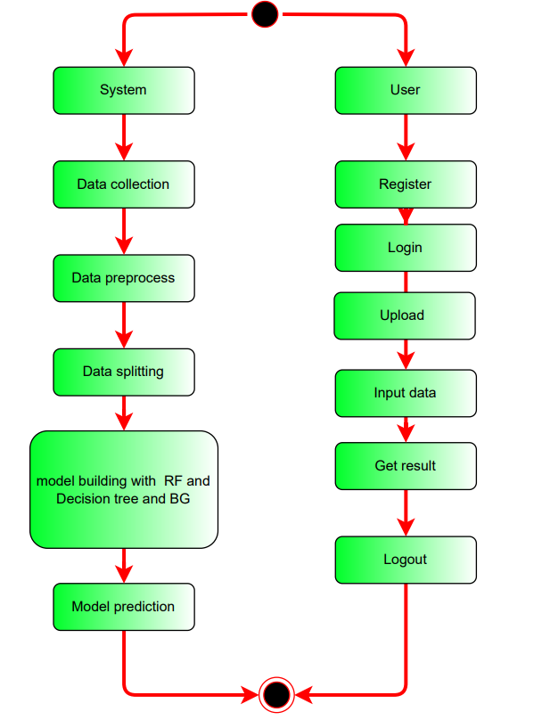
Implementation

Slide 16
Implementation
Take the Dataset: The system accepts and processes the dataset provided by the user. This dataset forms the foundation for building the predictive model.
Preprocessing: Before training a predictive model, the system preprocesses the dataset. This includes handling missing data, data cleaning, and feature extraction. Preprocessing ensures that the data is in a suitable format for modeling.
Training: The system uses machine learning techniques and Python modules to train a model based on the preprocessed dataset. The model learns patterns and relationships within the data, allowing it to make predictions.
Generate Results: Once the model is trained, the system can generate results based on user input values. These results typically indicate whether the input data corresponds to a specific condition, event, or prediction, such as Medical Insurance Cost.

Slide 17
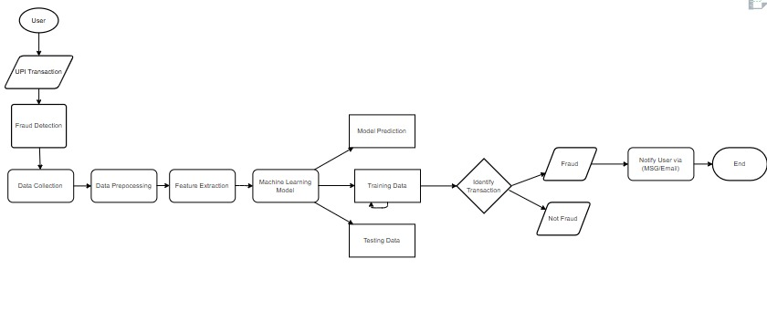
Data Flow Diagram

Slide 18
Data Preprocessing Techniques
Data Cleaning
Feature Selection
Data Transformation
Encoding Categorical Data
Data Splitting
Feature Engineering

Slide 19
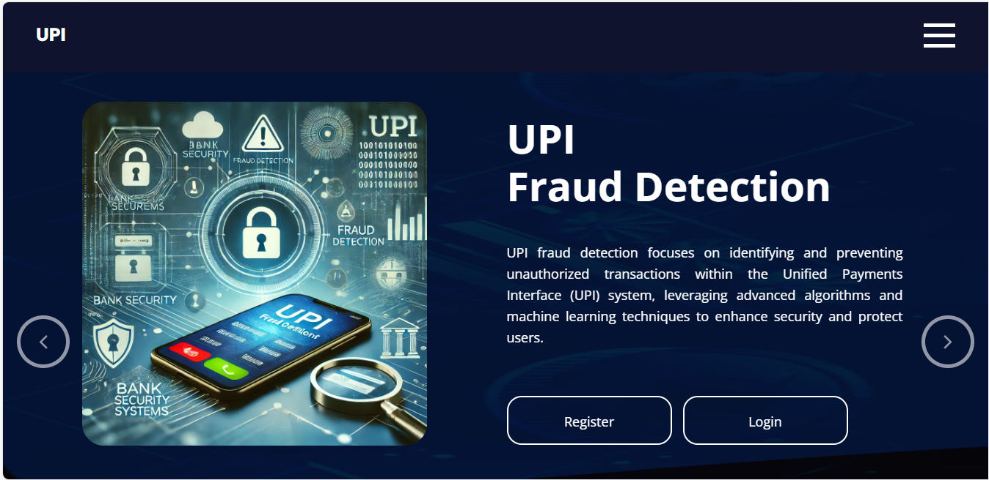
Output

Slide 20
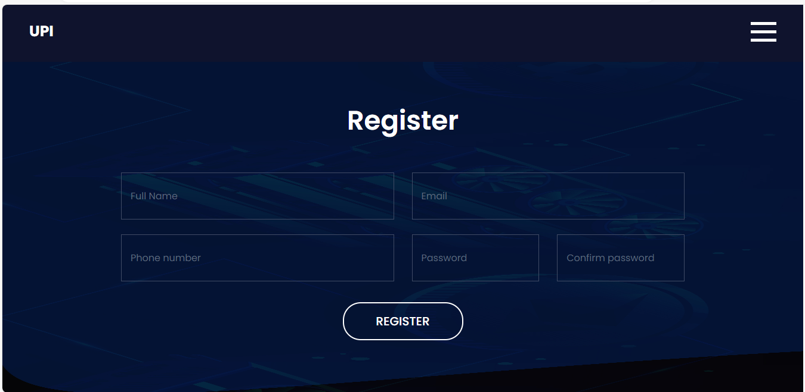

Slide 21
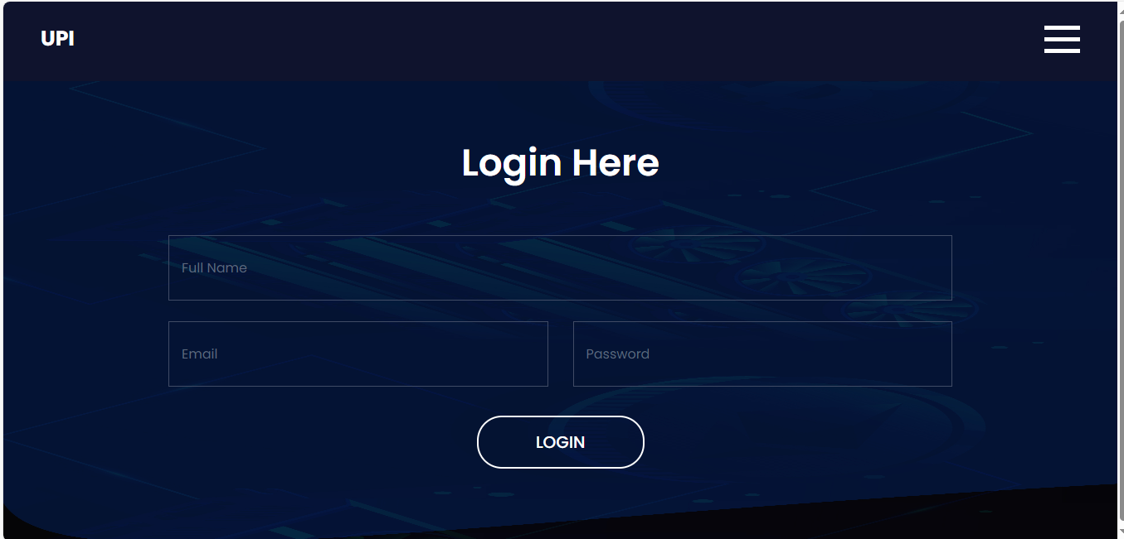

Slide 22
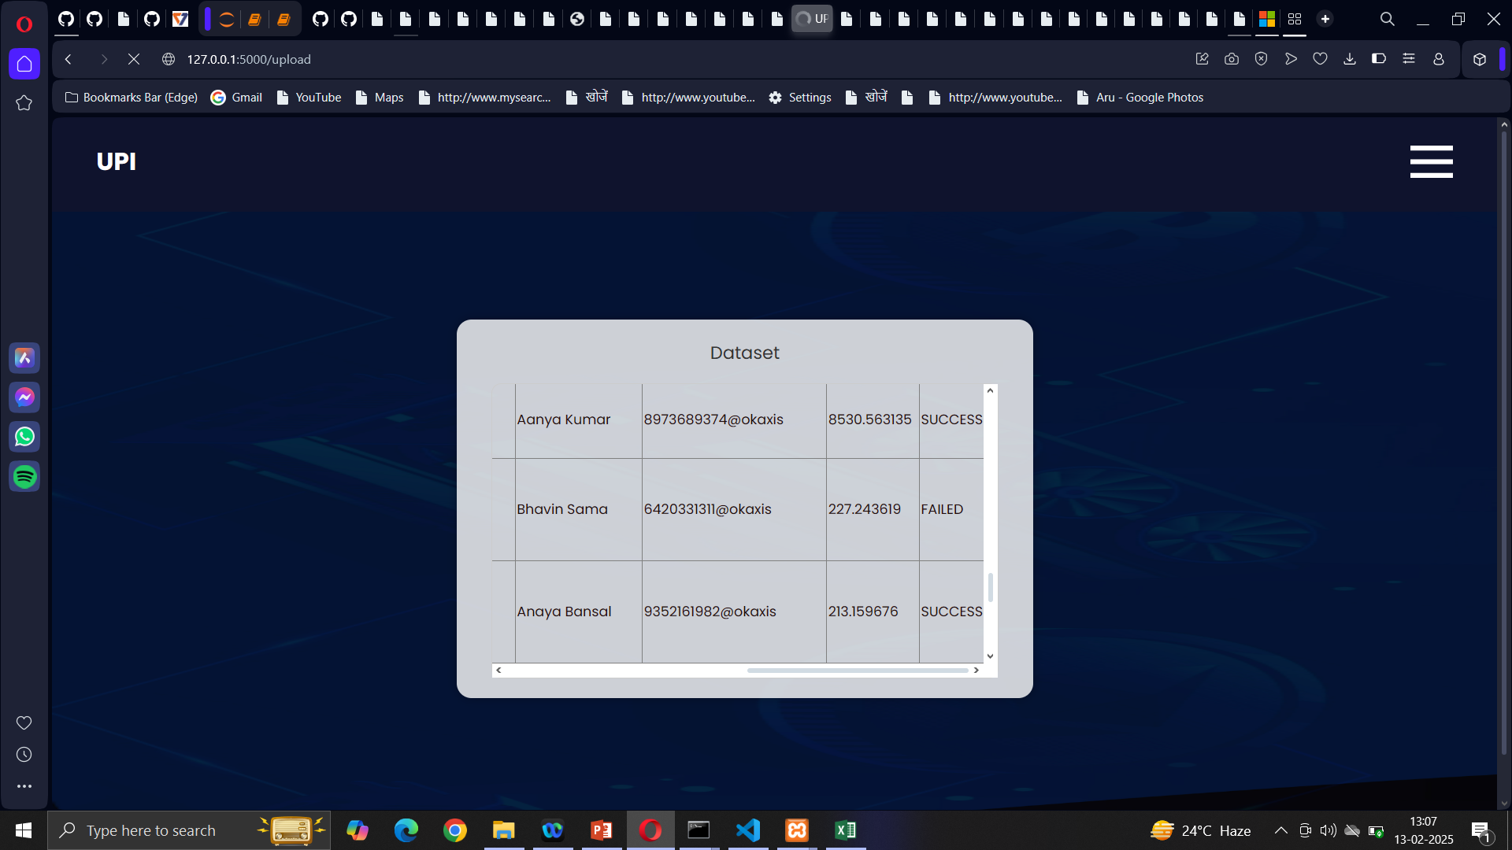
Output

Slide 23
Reference
[1]. Rupa Rani, Adnan Alam, Abdul Javed, “Secure UPI: Machine Learning-Driven Fraud Detection System for UPI Transactions”, IEEE | April 2024 .
[2]. Abdallah A, Maarof MA, Zainal A (2016) Fraud detection system: A survey. J Netw Comput Appl 68:90–113
[3]. Sahin M (2017) Understanding Telephony Fraud as an Essential Step to Better Fight it [Thesis]. École Doctorale Informatique, Télécommunication et Électronique, Paris
[4]. BOLTON RJ, HAND DJ (2001) Unsupervised profiling methods for fraud detection. In Conference on Credit Scoring and Credit Control 7, Edinburgh, UK, 5–7 Sept
[5]. Phua C, Lee V, Smith K, Gayler R (2010) A comprehensive survey of data mining-based fraud detection research. https://doi.org/10.48550/ARXIV.1009.6119

Slide 24
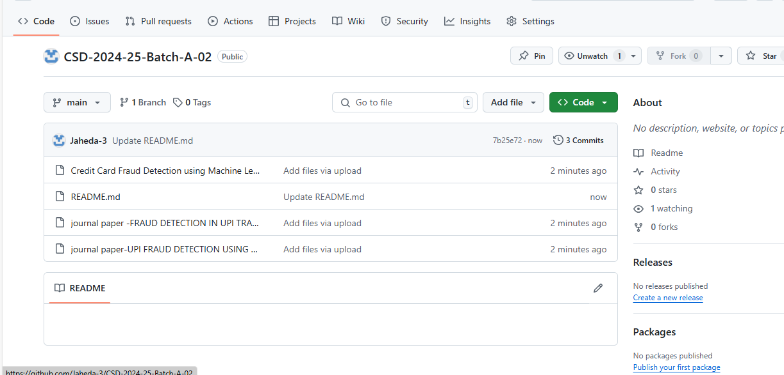
GITHUB LINK

Slide 25
Any Queries?

Slide 26
Thank You!!!

