Slide 1
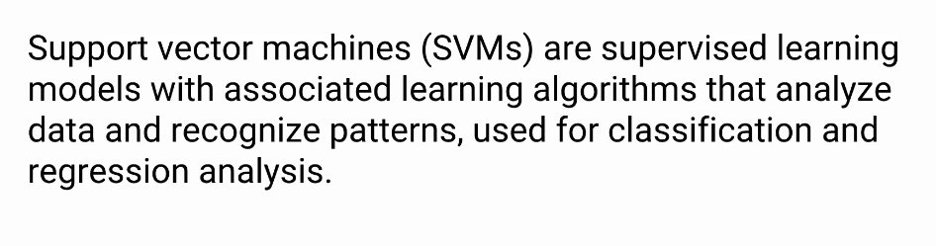
Support Vector Machine (SVM)
Name: Md Jahedul Kader Forman
ID: C151097

Slide 2
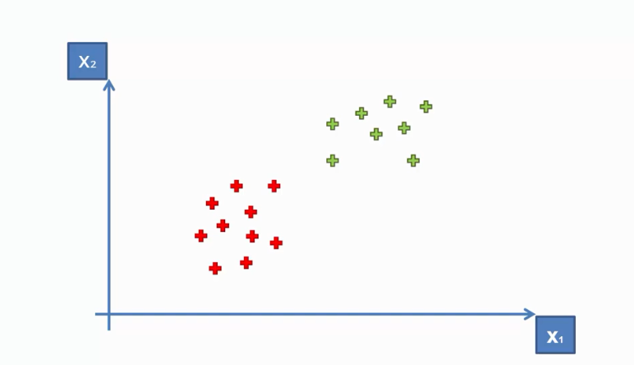
How can we separate these points?

Slide 3
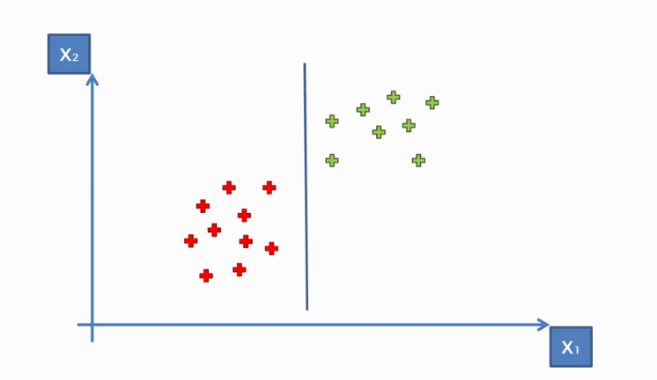
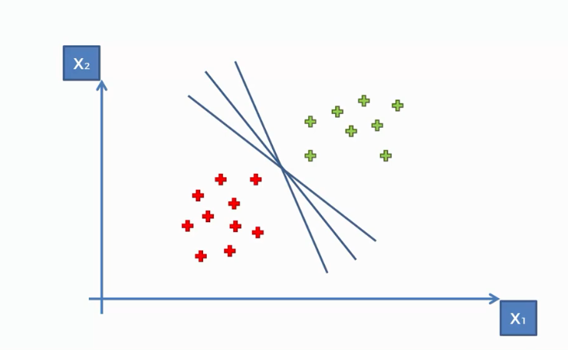
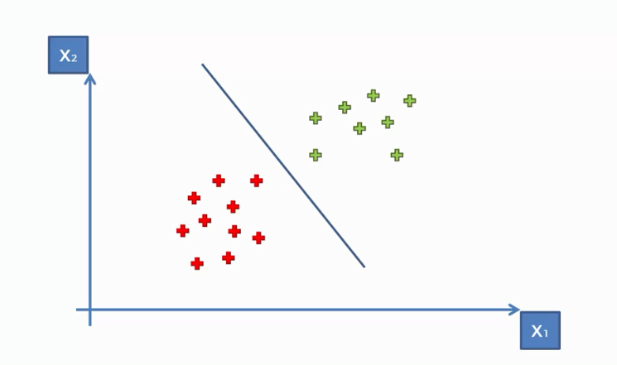
Which is the best separating line?

Slide 4
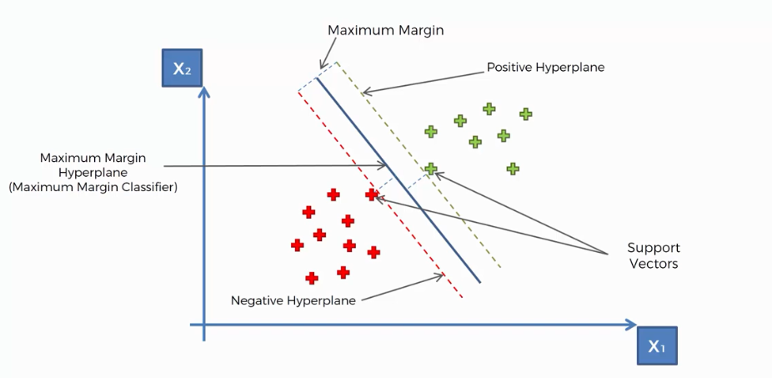
Maximum Margin and Support Vectors
Solution is Here
Optimal hyper plane reduces the generalization error the most.
Correctly classify the new added data.

Slide 5
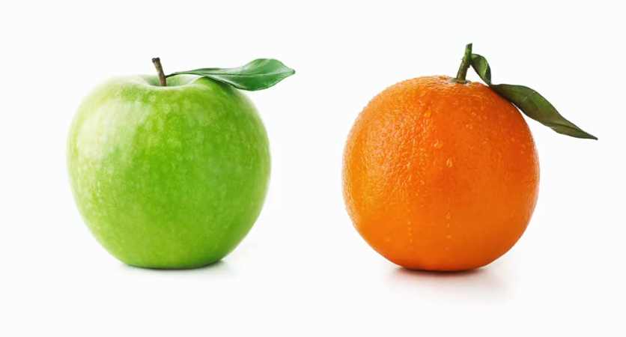
What’s So Special About SVMs?

Slide 6
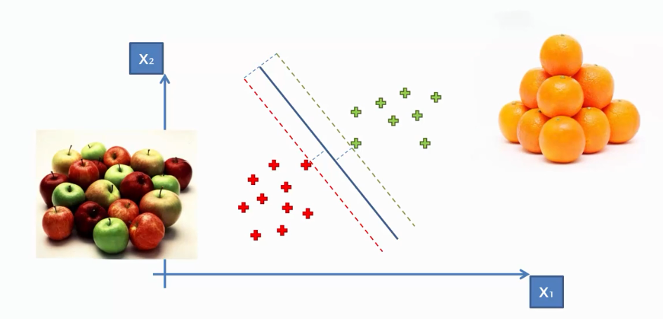
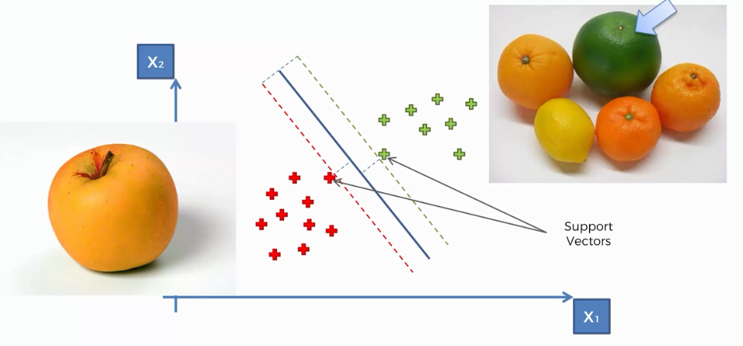
Most of the Machine Learning Algorithms look at the apples standard common type of apples :
SVMs look at the apples that very much Like an orange :

Slide 7
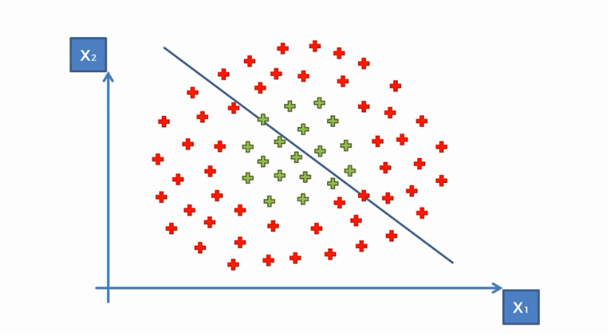
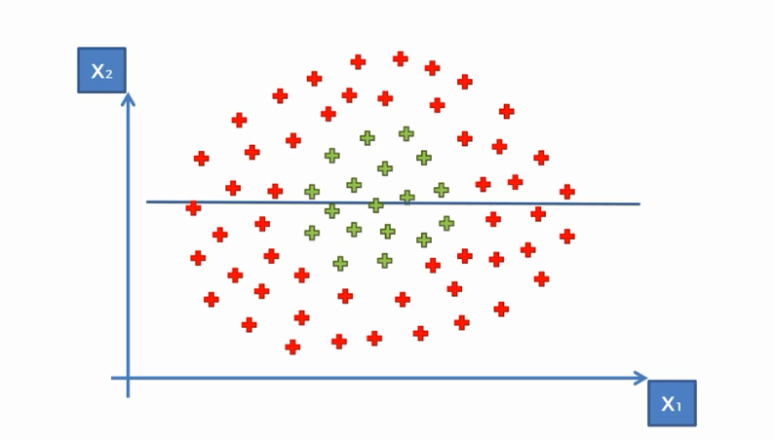
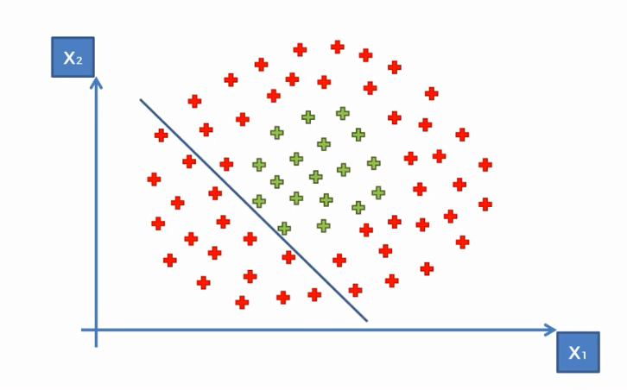
Non-Linear SVM

Slide 8
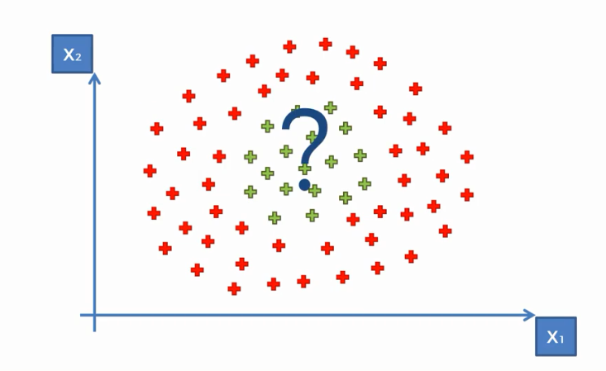
How Can separate non-linear data point?

Slide 9
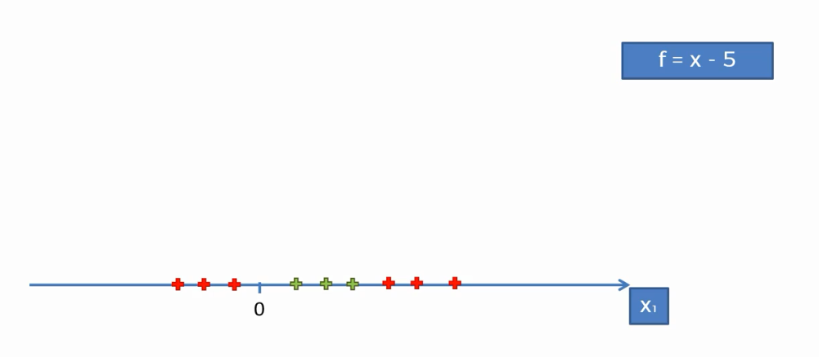
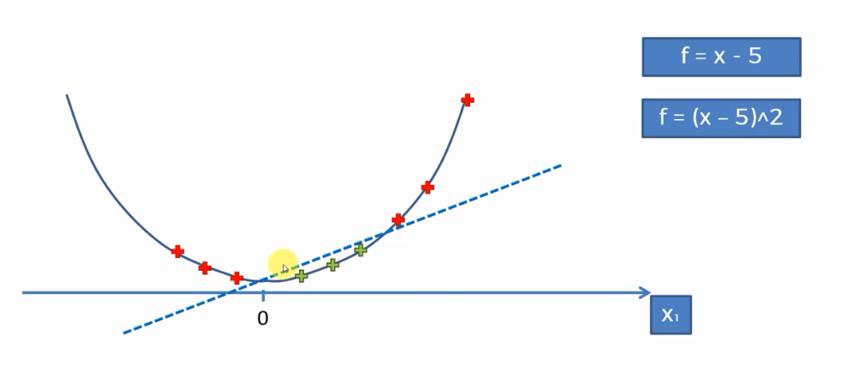
Solution
Kernel Trick

Slide 10
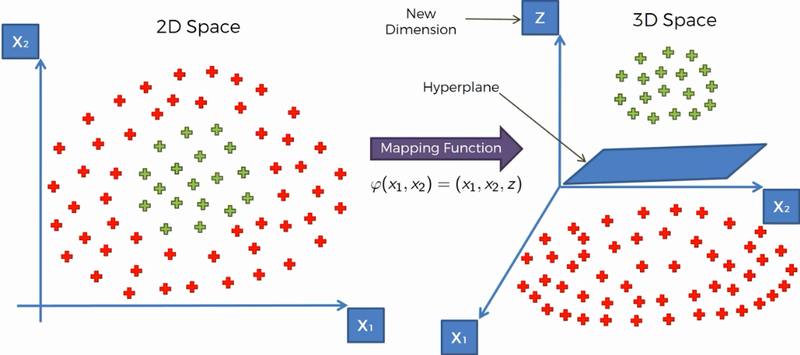
Kernel Trick

Slide 11
Pros associated with SVM
It works really well with clear margin of separation
It is effective in high dimensional spaces.
It is effective in cases where number of dimensions is greater than the number of samples.
It uses a subset of training points in the decision function (called support vectors), so it is also memory efficient.

Slide 12
Cons associated with SVM
It doesn’t perform well, when we have large data set because the required training time is higher
It also doesn’t perform very well, when the data set has more noise i.e. target classes are overlapping
SVM doesn’t directly provide probability estimates, these are calculated using an expensive five-fold cross-validation. It is related SVC method of Python scikit-learn library.

Slide 13
Thank You

