Slide 1



UC13 · ENTERPRISE DATA ENGINEERING
Enterprise Procurement Data Platform
Sprint 1 — Data Discovery & Ingestion
5 formats
8
100%
CSV, Excel, JSON, XML, SQL ingested
Core datasets landed in staging
Records reconciled with audit logs
ABC Global Manufacturing Ltd. · Sprint Presentation

Slide 2





Sprint 1: Purpose
PURPOSE
Building the Procurement Raw Data Landing Zone
Discover and document enterprise source systems
Define datasets, columns, data types, keys, and business meanings
Ingest heterogeneous data using Pentaho
Load raw data into PostgreSQL staging tables
Add basic logging, exception handling, and Git commits
Enterprise Procurement Data Platform · ABC Global Manufacturing Ltd.

Slide 3
Source Systems
SOURCES
Where procurement data originates
Source system | Example data
Procurement Management System | Purchase orders, procurement transactions
Purchase Requisition System | Requests, departments, required dates
ERP | Supplier, product, financial and purchasing master data
Vendor Portal | Supplier details, confirmations, delivery information
WMS / Inventory | Receipts, stock, warehouses, capacity
Accounts Payable | Invoices, payments, due dates
Contract Management | Contracts, terms, values, validity
Supplier Performance Database | Delivery, quality, ratings
Enterprise Procurement Data Platform · ABC Global Manufacturing Ltd.

Slide 4

Heterogeneous Data Ingestion
FORMATS
Demonstrating different source formats
Format | Possible dataset | Pentaho input
CSV | Suppliers, contracts | CSV File Input
Excel | Purchase orders | Mircrosoft Excel Input
JSON | Inventory ,warehouse | JSON Input
XML | Invoices or AP data | Get Data from XML
Mixing formats deliberately proves the pipeline can handle real enterprise heterogeneity, not just one clean file type.
Enterprise Procurement Data Platform · ABC Global Manufacturing Ltd.

Slide 5
Dataset Inventory
DATASETS
Core datasets for the landing zone
Domain | Dataset | Key examples
Procurement | Purchase orders / transactions | PO_ID, Supplier_ID, Product_ID, Quantity, Amount
Procurement | Purchase requisitions | Requisition_ID, Department_ID, Required_Date
Suppliers | Suppliers | Supplier_ID, Name, Country, Rating, Status
Suppliers | Supplier performance | Supplier_ID, PO_ID, Quality, Delivery
Products | Products | Product_ID, Category, Cost, Reorder_Level
Inventory | Inventory / warehouse | Product_ID, Warehouse_ID, Stock_Quantity
Finance | Invoices | Invoice_ID, PO_ID, Amount, Payment_Status
Contracts | Contracts | Contract_ID, Supplier_ID, Start_Date, End_Date
Enterprise Procurement Data Platform · ABC Global Manufacturing Ltd.

Slide 6

Data Dictionary
DATA DICTIONARY
What must be documented for every dataset
Field | Example
Dataset / table | suppliers
Column name | Supplier_ID
Data type | VARCHAR(50)
Nullable | No
Key type | Primary key
Business definition | Unique supplier identifier
Source system / file | Vendor Portal / suppliers.csv
Transformation notes | Trim whitespace; standardize format
Enterprise Procurement Data Platform · ABC Global Manufacturing Ltd.

Slide 7

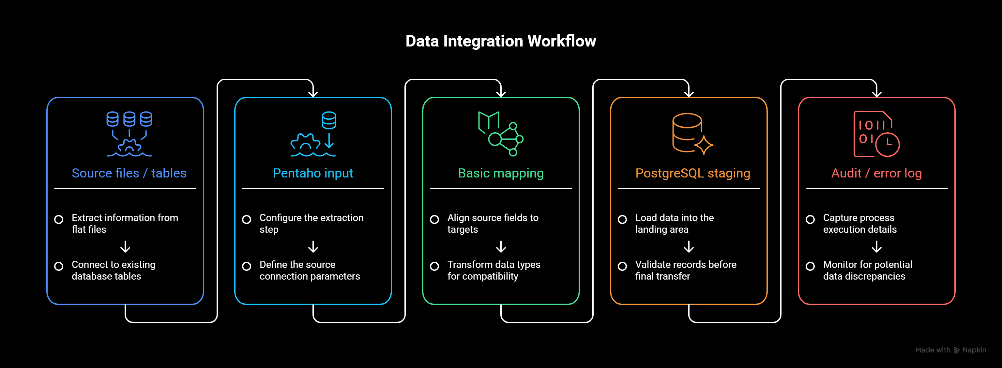
Sprint 1 Architecture
ARCHITECTURE
The raw-data ingestion flow
At Sprint 1, the focus is reliable ingestion and raw landing — not final analytics.
Enterprise Procurement Data Platform · ABC Global Manufacturing Ltd.

Slide 8


Bronze and Staging
BRONZE
What happens to raw data
Preserve, don’t transform
Bronze keeps source data in its original form for traceability and reprocessing.
Controlled landing area
Staging tables give each source domain its own controlled PostgreSQL landing zone.
Example tables
supplier_staging, procurement_staging, inventory_staging, invoice_staging.
No heavy logic yet
Avoid applying business rules before the raw data is safely captured.
Enterprise Procurement Data Platform · ABC Global Manufacturing Ltd.

Slide 9
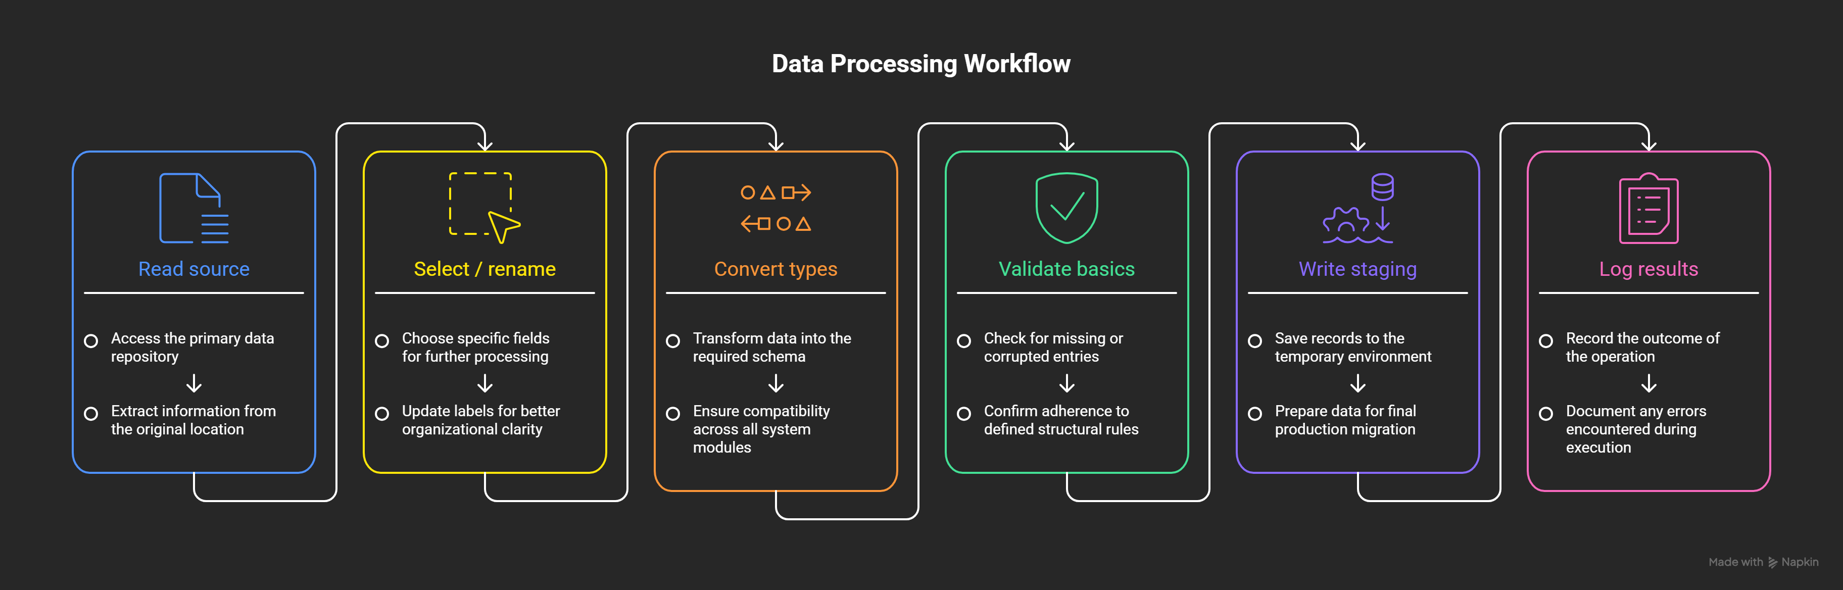
Pentaho Transformation Flow
ETL FLOW
How one ingestion pipeline works
Typical components: CSV / Excel / JSON / XML / Table Input, Select Values, String Operations, Filter Rows, Data Validator, and Table Output.
Enterprise Procurement Data Platform · ABC Global Manufacturing Ltd.

Slide 10


Basic Ingestion Rules
RULES
Checks performed during Sprint 1
Required fields are identified and mapped
Column names and data types are standardized for staging
Dates, quantities, prices, and identifiers are parsed consistently
Source file names and ingestion timestamps are retained
Unreadable files and malformed records are captured as exceptions
Enterprise Procurement Data Platform · ABC Global Manufacturing Ltd.

Slide 11

Logging and Exception Handling
LOGGING
Make ingestion observable and recoverable
Log field | Purpose
Job_ID | Identify one execution
Source_File / Source_System | Trace origin
Start_Time / End_Time | Measure execution
Records_Read | Count input records
Records_Loaded | Count successful staging rows
Records_Rejected | Count failures
Status / Error_Message | Explain outcome
Enterprise Procurement Data Platform · ABC Global Manufacturing Ltd.

Slide 12


Reconciliation
RECONCILIATION
Proving that records are accounted for
Input records
Loaded records
Rejected records
Reconciliation check
5,000 read = 4,975 loaded + 25 rejected
Rejected records should never simply disappear — store the reason and source reference for investigation, so every input record is accounted for.
Enterprise Procurement Data Platform · ABC Global Manufacturing Ltd.

Slide 13
Git Collaboration
GIT
How Sprint 1 work is recorded
Create branch
Build pipeline
Test ingestion
Commit changes
Push to GitHub
Review / merge
Commit Pentaho transformations, SQL scripts, Python utilities, documentation, and sample configuration — never passwords or database credentials.
Enterprise Procurement Data Platform · ABC Global Manufacturing Ltd.

Slide 14

Sprint 1 Deliverables
DELIVERABLES
What must be submitted
Source Inventory
Data Dictionary
Pentaho ETL pipelines for the selected formats
PostgreSQL staging database and table scripts
Basic ingestion logs and exception-handling evidence
Git commit history and updated repository
Enterprise Procurement Data Platform · ABC Global Manufacturing Ltd.

Slide 15
Sprint 1 Success Criteria
SUCCESS CRITERIA
When can Sprint 1 be considered complete?
Every selected source dataset has a documented owner, format, schema, and purpose
Each selected format can be read successfully through Pentaho
Raw records are loaded into the correct PostgreSQL staging tables
Record counts can be reconciled
Failures are logged with meaningful error messages
All artifacts are committed to GitHub and ready for Sprint 2 profiling
Enterprise Procurement Data Platform · ABC Global Manufacturing Ltd.

Slide 16


SPRINT 1 · CONCLUSION
From unknown source data to a controlled landing zone
Sprint 0 defined the business problem and target architecture
Sprint 1 discovers the source data and establishes the ingestion foundation
Sprint 2 will profile, clean, validate, and model the data warehouse
Sprint 3 will add lineage, governance, orchestration, and Power BI analytics
Sprint 2 begins with data profiling in Python and star-schema design in PostgreSQL.
Enterprise Procurement Data Platform · ABC Global Manufacturing Ltd.

