Slide 1
Firewalls
Dola Das
Assistant Professor, Dept. of CSE,
KUET

Slide 2
Firewall
A firewall is a network security device placed at the perimeter of the corporate network
all the packets entering and leaving the network go through the firewall first
appropriate actions are taken based on the network rules configured by the organization

Slide 3
Firewall
Major factors that come into consideration for architecting a firewall:
  Organization‘s ability to implement and develop the architecture
  The budget allotted by the organization
  Objectives of the network

Slide 4
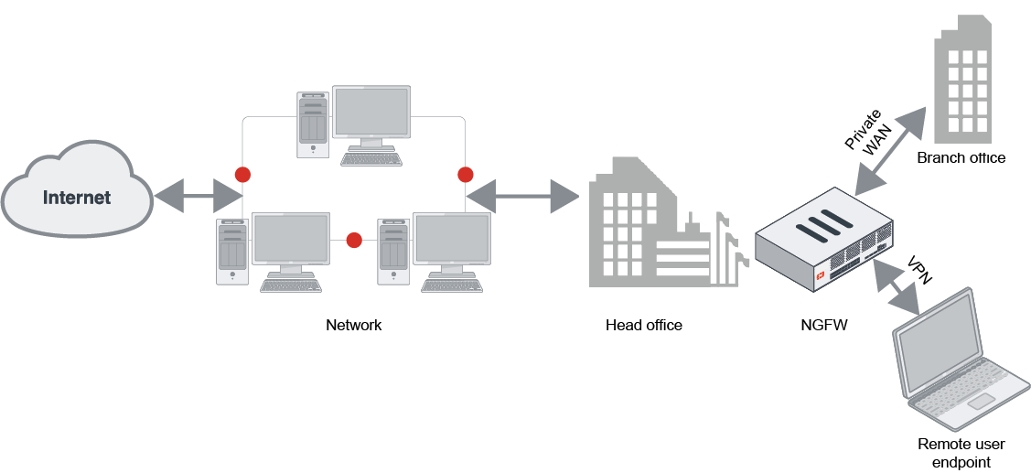
Firewall architecture

Slide 5
Firewall architecture
There are four common architectural implementations of firewalls widely in use:
  packet filtering routers,
  screened host firewalls,
  dual-homed firewalls and
  screened subnet firewalls

Slide 6
Firewall architecture
packet filtering routers:
  placed at the perimeter between the organization‘s internal networks and the internet service provider.
  can be configured to accept or reject the packets as per the rule of the organization.
  one of the simple and effective ways to lower down the organization‘s risk from the internet.
Drawbacks
  The length and the complexity of the rule sets implemented to filter the packets can grow and degrade network performance.
  suffers from a lack of auditing and strong authentication mechanisms.

Slide 7
Stateful Inspection Firewalls
also referred to as dynamic packet filtering.
monitors the state of active connections and uses the information to permit the network packets.
filters data packets supported by state and context.
well suited with Transmission Control Protocol (TCP) and similar protocols. Also with UDP.

Slide 8
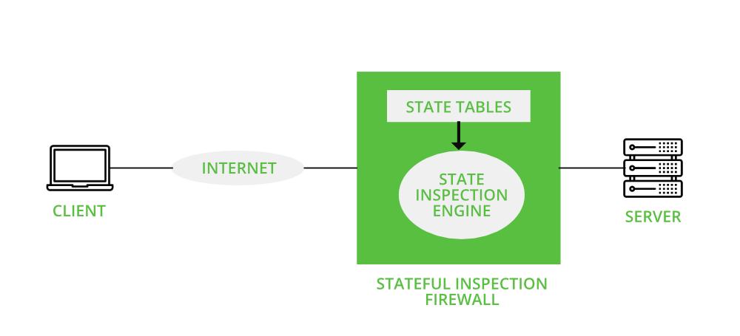
Stateful Inspection Firewalls

Slide 9
Stateful Inspection Firewalls
Advantages:
  aware of the state of a connection.
  can detect when illicit data is being used to infiltrate the network
  has the power to log and store important aspects of network connections
  do not have to open up a large range of ports to allow communication
Disadvantages:
  can be complex to configure.
  cannot prevent application-layer attacks
  do not carry user authentication of connections
  Not all protocols contain state information

Slide 10
Application-proxy Gateway Firewalls
contain a proxy agent that acts as an intermediary between two hosts that wish to communicate with each other.
never allows a direct connection between two hosts.
Each successful connection attempt actually results in the creation of two separate connections.
external hosts only communicate with the proxy agent, internal IP addresses are not visible to the outside world.
proxy agent interfaces directly with the firewall ruleset.

Slide 11
Application-proxy Gateway Firewalls
Advantages:
  can offer a higher level of security for some applications.
  inspects traffic content to identify policy violations.
  some have the ability to decrypt packets (e.g., SSL-protected payloads), examine them, and re-encrypt them before sending them on to the destination host.
Disadvantages:
  spends much more time reading and interpreting each packet.
  poorly suited to high-bandwidth or real-time applications.
  tend to be limited in terms of support for new network applications and protocols.

Slide 12
Dedicated Proxy Servers
usually have much more limited firewalling capabilities.
differ from application-proxy gateways.
application-specific, some actually perform analysis and validation of common application protocols such as HTTP.

Slide 13
Dedicated Proxy Servers
Many organizations enable caching of frequently used web pages on the proxy to reduce network traffic and improve response times.

Slide 14
Hybrid Firewall
consist of multiple firewalls, each providing a specified set of functions.
For instance, you can use one firewall to execute packet filtering while another firewall acts as a proxy.
can tweak the performance of the security system, taking advantage of the diverse range of capabilities the different firewalls offer.

Slide 15
Hybrid Firewall
Advantages:
  can add a new firewall to an existing security system without having to remove or replace your current firewall.
  can allow you to set up a distributed firewall which enables to establish security rules that control access between two separate networks.
  Granular control of the protection of the network.
  Easier threat isolation.
Disadvantages:
  may unnecessarily complicate your network without providing much tangible benefit.
  Some organizations have neither the extra time nor people power to deal with multiple firewall setups.
  A relatively simple configuration error can result in a costly breach.

Slide 16
Hybrid Firewall
Before committing to a hybrid firewall solution, it is best to keep the following considerations in mind:
  Can you accomplish what you aim to do with a hybrid solution using just a single firewall?
  How will a hybrid firewall setup impact network throughput?
  How can you get the most from your hybrid firewall?

Slide 17
Network address translation (NAT)
a method of mapping an IP address space into another.
A unique public IP address was assigned to each device on the network. These all are at the LAN(Local Area Network) side of the default gateway.
Assign the IP address of the ISP(Internet Service Provider) to the WAN(Wide Area Network) side of the default gateway.
Every computer knows the default gateway’s IP address.

Slide 18
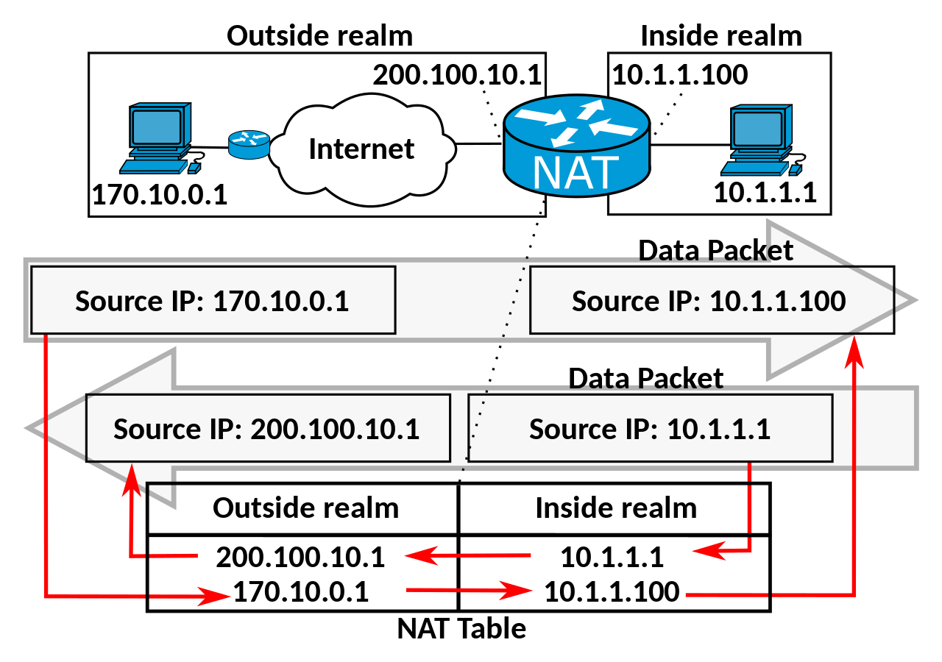
Network address translation (NAT)
Establishing two-way communication:

Slide 19
Network address translation (NAT)
Applications:
  Routing
  Load balancing

Slide 20
Network address translation (NAT)
Dynamic NAT (DNAT):
  mapping of an internal private IP address into the router’s public IP is dynamic
  also called IP masquerading
  outgoing traffic carries “a” public IP of the router
  When data comes in, it is looked upon in the NAT table for its destination address.
  more secure as hackers can’t get the host address straight away
  But still expensive.

Slide 21
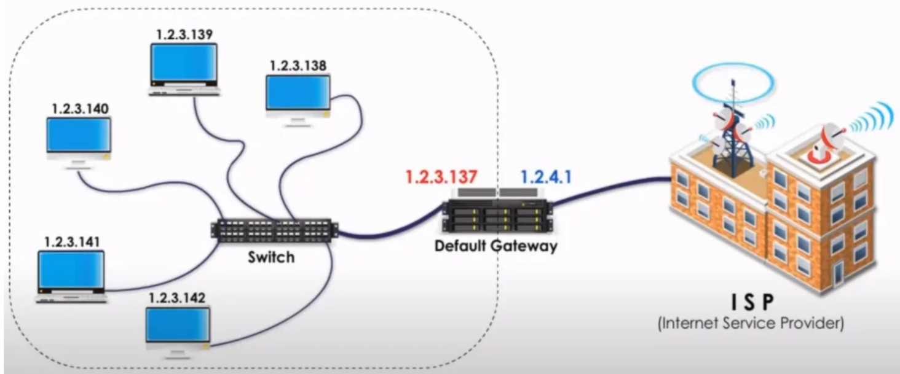
Network address translation (NAT)
DNAT:

Slide 22
Network address translation (NAT)
Static NAT (SNAT):
  one private address is mapped with one public IP address
  These IP addresses never change

Slide 23
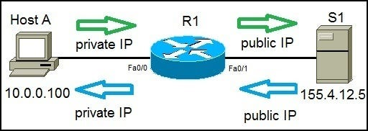
Network address translation (NAT)
SNAT:

Slide 24
Port address translation (PAT)
most common form of NAT.
Each host on a LAN has its IP address translated into the router’s WAN side IP with a different port number.
makes each session unique.

Slide 25
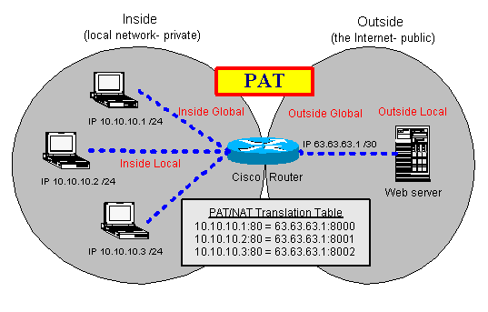
Port address translation (PAT)

Slide 26
Demilitarized Zone(DMZ)
a perimeter network.
protects and adds an extra layer of security to an organization’s internal LAN from untrusted traffic.
goal is to allow an organization to access untrusted networks.
store external-facing services and resources, as well as servers.
makes it more difficult for a hacker to gain direct access.
A company can minimize the vulnerabilities of its Local Area Network.
can communicate efficiently and share information directly via a safe connection.

Slide 27
How Does a DMZ Network Work?
DMZ network provides a buffer between the internet and an organization’s private network
DMZ is isolated by a security gateway, such as a firewall
The default DMZ server is protected by another security gateway that filters traffic coming in from external networks.
It is ideally located between two firewalls
even if a sophisticated attacker is able to get past the first firewall, they must also access the hardened services in the DMZ before they can do damage to a business.

Slide 28
Benefits of Using a DMZ
Enabling access control
Preventing network reconnaissance
Blocking Internet Protocol (IP) spoofing
DMZ Design and Architecture
  Single firewall
  Dual firewall

Slide 29
Virtual Private Networking (VPN)
to encrypt and decrypt specific network traffic flows between the protected network and external networks.
use additional protocols to encrypt traffic and provide user authentication and integrity checking.
are most often used to provide secure network communications across untrusted networks.

Slide 30
Virtual Private Networking
two most common VPN architectures are:
  gateway-to-gateway- connect multiple fixed sites over public lines through the use of VPN gateways.
  host-to-gateway- provides a secure connection to the network for individual users, usually called remote users.

Slide 31
Intrusion Detection System (IDS)
monitors network traffic and searches for known threats and suspicious or malicious activity.
sends alerts to IT and security teams
some can block malicious or suspicious traffic.
are software applications.
runs on organizations’ hardware or as a network security solution.

Slide 32
Intrusion in Cybersecurity
Address spoofing
Fragmentation
Pattern evasion
Coordinated attack

Slide 33
IDS Types
Network intrusion detection system (NIDS)
Host intrusion detection system (HIDS)
Signature-based intrusion detection system (SIDS)
Anomaly-based intrusion detection system (AIDS)
Perimeter intrusion detection system (PIDS)
Virtual machine-based intrusion detection system (VMIDS)
Stack-based intrusion detection system (SBIDS)
So, What is the Use and benifits of an Intrusion Detection System (IDS)?

Slide 34
Intrusion Detection System (IDS) Challenges
False alarms
False negatives

Slide 35
Intrusion Prevention Systems (IPS)
is also an intrusion detection prevention system (IDPS)
proactively detects and prevents harm from malicious traffic
protection identifies potential threats by monitoring network traffic in real time by using network behavior analysis
includes anti-virus/anti-malware software, firewall, anti-spoofing software, and network traffic monitoring

Slide 36
How does IPS Work?
Signature-based Detection
Statistical Anomaly-based Detection

Slide 37
Potential Attacks Detected and Prevented By IPS
Address Resolution Protocol (ARP) Spoofing
Buffer Overflow
Distributed Denial of Service (DDoS)
Operating System (OS) Fingerprinting
Etc.

Slide 38
Types of IPS
Network-based intrusion prevention system (NIPS)
Wireless intrusion prevention system (WIPS)
Host-based intrusion prevention system (HIPS)
Network behavior analysis (NBA)

Slide 39
IDS vs. IPS
An IDS solution is typically limited to the monitoring and detection of known attacks and activity that deviates from a baseline normal prescribed by an organization.
An intrusion prevention system (IPS) goes beyond this by blocking or preventing security risks. An IPS can both monitor for malicious events and take action to prevent an attack from taking place.

Slide 40
Firewall Administration
Administrators can configure, manage, and monitor networks firewalls
One can customize role-based administrative access to the management interfaces to delegate specific tasks or permissions to certain administrators
Improper firewall configuration can result in attackers gaining unauthorized access

Slide 41
Firewall Administration
Secure the Firewall
Establish Firewall Zones and an IP Address Structure
Configure Access Control Lists (ACLs)
Test the Firewall Configuration
etc.

Slide 42
Firewall Positioning Policies
A firewall policy dictates how firewalls should handle network traffic for specific IP addresses and address ranges, protocols, applications, and content types based on the organization’s information security policies.
Types:
    Policies Based on IP Addresses and Protocols
    Policies Based on Applications
    Policies Based on User Identity
    Policies Based on Network Activity

Slide 43
References
https://resources.infosecinstitute.com/topic/firewall-types-and-architecture/
https://www.geeksforgeeks.org/what-is-stateful-inspection/
https://www.fortinet.com/resources/cyberglossary/hybrid-firewall-advantages-disadvantages#:~:text=What%20Is%20a%20Hybrid%20Firewall%3F%20Hybrid%20firewalls%20consist,filtering%20while%20another%20firewall%20acts%20as%20a%20proxy.
https://medium.com/networks-security/nat-snat-dnat-pat-port-forwarding-b7982fab02cd
https://www.fortinet.com/resources/cyberglossary/what-is-dmz
https://www.fortinet.com/resources/cyberglossary/intrusion-detection-system#:~:text=What%20is%20an%20Intrusion%20Detection%20System%20%28IDS%29%3F%20An,when%20it%20detects%20any%20security%20risks%20and%20threats.
https://www.fortinet.com/resources/cyberglossary/what-is-an-ips
https://www.fortinet.com/resources/cyberglossary/firewall-configuration

Slide 44
Thank you

