Slide 1
COMPUTER SECURITY · FINAL UPDATE · PROJECT FORUM
Phishing Email Detection Using Large Language Models
A leakage-aware, cross-corpus and cost-aware benchmark of small open LLMs
Jahid Ibna Sinha (011221376)
Md. Jakaria Alam Saimon (011221002)
Nowshin Anjum Faria (011221372)
United International University
Group 18
Notes:
15 sec. Names and title. Say: in the proposal we promised a table that did not exist. Today we show it filled in.

Slide 2
WHERE WE STARTED
Sinha
From a suspicion to a measured result
15 JUL
Literature review
5 papers, all 97 to 99%. Every one tests inside one dataset. None reports cost.
21 JUL
Preliminary run
Train on one corpus, test on another: F1 0.99 fell to 0.30.
11 AUG
Overlap check
Kaggle already contains two thirds of SpamAssassin.
5 SEP
Proposal talk
Six objectives, one table to fill.
18 SEP
Final experiments
9 sources, 9 models, 164,871 emails checked for overlap.
What changed since the proposal
Prior work found
E-PhishGen (AISec 2025) already tested classical models across corpora. Our claim is now leakage removal plus cost, and we cite them.
Nazario is test-only
Enron became a full corpus, so pairing Nazario with Enron mail would leak. Nazario now measures phishing recall only.
Numbers rebuilt
The 74.4% / 4,282 / 48 on our proposal slides came from an unsaved run. Every number today comes from code in the repo.
Question: if we remove leaked emails and always test on a corpus the model has never seen, how good are cheap detectors, and what do they cost?
2
Notes:
45 sec. Walk the timeline in one breath. Then the three changes, be open about the old numbers. Land on the question in the blue box.

Slide 3
OBJECTIVES
Sinha
Six objectives from the proposal
# | Objective | What we delivered | Status
1 | Decontaminated benchmark | 9 sources, overlap measured at 3 levels, near duplicates removed | Done
2 | Leave-one-corpus-out | 6 folds, each run with raw and cleaned training data | Done
3 | One protocol, all families | 2 classical, DistilBERT, 6 small LLMs, 2 few-shot. Phishsense-1B not run | Mostly
4 | Cost in dollars | Real cost of every one of 19,200 LLM calls, from OpenRouter | Done
5 | AI-written phishing | E-PhishLLM (GPT-4o-mini emails) as a held-out shift test | Done
6 | One honest table | F1 on unseen corpora with 95% bootstrap intervals, next to cost | Done
Phishsense-1B needs a HuggingFace access token. It is the first item for the next two weeks.
3
Notes:
30 sec. Do not read every row. Say: five of six fully done, one mostly, and say why Phishsense is missing.

Slide 4
METHODOLOGY
Sinha
Six steps, one script each, all on a laptop
1 Collect
9 public sources, subject + body, 10k cap per corpus
2 Overlap
exact, normalized, MinHash near duplicate
3 Decontaminate
train on 5 corpora, drop copies of the 6th
4 Models
TF-IDF, DistilBERT, 6 small LLMs
5 Shift test
E-PhishLLM, Nazario, Nigerian
6 Report
F1 + 95% CI + USD per 1,000
→
→
→
→
→
Leave-one-corpus-out
For each corpus T, train on the other five and test on all of T. Run twice: raw training data, and with every near duplicate of T removed. The gap is the inflation caused by leaked emails.
Same emails for everyone
A fixed 300-email subset per test set. Every model, local or paid, is scored on exactly those emails, so the numbers are comparable.
4
Notes:
45 sec. Point at steps 2 and 3, those are ours. Explain raw vs clean in one sentence. Then hand over to Saimon.

Slide 5
EXPERIMENTAL CORE DETAILS (FROM THE NOTEBOOK)
Saimon
What exactly we ran
Source | Role | Cleaned | Used | Eval
spamassassin | train+test | 5,803 | 5,803 | 300
ceas08 | train+test | 39,091 | 10,000 | 300
trec07 | train+test | 53,638 | 10,000 | 300
ling | train+test | 2,858 | 2,858 | 300
enron | train+test | 29,604 | 10,000 | 300
kaggle | train+test | 17,505 | 10,000 | 300
nazario | test only | 1,554 | 1,554 | 150
nigerian | test only | 3,316 | 3,316 | 150
ephishllm | test only | 11,502 | 10,000 | 300
Classical
TF-IDF 1-2 grams, 50k features, LogReg / Naive Bayes, CPU 0.25 s per 1,000 emails
DistilBERT
1 epoch, 128 tokens, batch 16, lr 5e-5, 1,000 emails per corpus, laptop CPU
6 LLMs via OpenRouter
Llama 1B/3B/8B, Qwen 7B, Gemma 12B, Phi-4 14B. Temperature 0, 5 output tokens, 1,500 chars. Few-shot: 4 examples from other corpora
Reproducible
Seed 42 everywhere. 8 GB MacBook. Total API spend $0.52
5
Notes:
50 sec. This is the notebook slide. Mention: all numbers on later slides are produced by these scripts, the notebook re-creates every table.

Slide 6
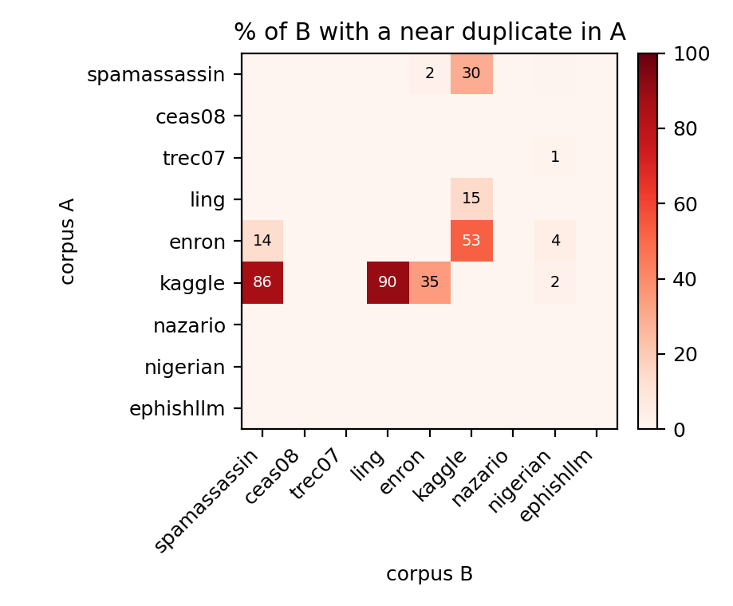
RESULT 1 · OVERLAP BETWEEN CORPORA
Saimon
The standard check finds almost none of it
SpamAssassin emails that also sit inside the Kaggle set
EXACT TEXT
2
0.03%
NO WHITESPACE
3,850
66.34%
NEAR DUPLICATE
5,009
86.32%
Kaggle also holds 90% of Ling and 35% of Enron. More than half of Kaggle is Enron.
Why exact matching fails: Kaggle deletes line breaks and glues words ("cream?Isn't"). We checked 400 of them by brute force: the matches are real.
6
Notes:
55 sec. Say the three numbers slowly: two, three thousand eight hundred, five thousand. The exact check is what most people would run and it finds two.

Slide 7
RESULT 2 · LEAKAGE INFLATES SCORES
Saimon
Remove the copies and the good transfer disappears
KAGGLE → SPAMASSASSIN, TF-IDF + LOGREG
0.966 → 0.666
F1 with leaked emails, then after removing them
Held-out | Raw | Clean | Drop | Removed
spamassassin | 0.947 | 0.847 | 10.0 | 3,165
ling | 0.962 | 0.847 | 11.5 | 1,444
enron | 0.972 | 0.919 | 5.4 | 6,091
kaggle | 0.976 | 0.928 | 4.8 | 11,018
ceas08 | 0.833 | 0.832 | 0.1 | 13
trec07 | 0.871 | 0.871 | 0.0 | 7
CEAS and TREC share almost nothing with the rest, and their scores do not move. That is the control.
7
Notes:
55 sec. Kaggle to SpamAssassin was the suspicious 0.97 from July. Now it is measured. Point at CEAS and TREC: no overlap, no change. Hand over to Faria.

Slide 8
RESULT 3 · THE TABLE FROM THE PROPOSAL, FILLED IN
Faria
Unseen corpora, AI phishing and cost in one place
Model | Unseen-corpus F1 (95% CI) | Worst corpus | False alarms | AI phishing F1 | Nazario recall | $ / 1,000
Qwen-2.5-7B few-shot | 0.937 (0.925-0.948) | 0.844 | 5% | 0.598 | 0.847 | $0.074
Qwen-2.5-7B | 0.928 (0.915-0.940) | 0.850 | 3% | 0.819 | 0.940 | $0.031
TF-IDF + LogReg | 0.901 (0.886-0.916) | 0.807 | 9% | 0.640 | 0.713 | local
Llama-3.2-3B few-shot | 0.901 (0.885-0.915) | 0.848 | 3% | 0.438 | 0.680 | $0.037
TF-IDF + NB | 0.895 (0.879-0.909) | 0.773 | 7% | 0.631 | 0.600 | local
DistilBERT | 0.891 (0.875-0.906) | 0.838 | 6% | 0.493 | 0.760 | local
Gemma-3-12B | 0.882 (0.866-0.896) | 0.768 | 25% | 0.955 | 0.980 | $0.016
Llama-3.1-8B | 0.881 (0.865-0.896) | 0.779 | 21% | 0.817 | 0.973 | $0.011
Llama-3.2-3B | 0.850 (0.832-0.868) | 0.799 | 5% | 0.507 | 0.827 | $0.016
Phi-4-14B | 0.727 (0.702-0.749) | 0.621 | 28% | 0.759 | 0.660 | $0.021
Llama-3.2-1B | 0.623 (0.597-0.647) | 0.359 | 60% | 0.474 | 0.760 | $0.009
All scores on the same held-out emails. Trained models use decontaminated data. LLMs never saw any of our data. False alarms = share of legitimate mail flagged.
8
Notes:
60 sec. Read the highlighted Qwen row, then Gemma (best on AI phishing, but 25% false alarms), then DistilBERT (best in-corpus, worst on AI phishing). Point at the cost column.

Slide 9
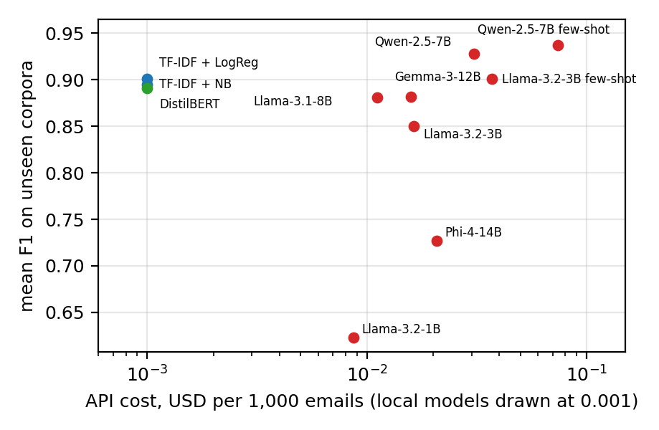
RESULT 4 · WHAT IT MEANS
Faria
No single winner: pick the trade-off you can live with
1. Best balance: Qwen-2.5-7B zero-shot
0.928 F1 on unseen corpora, 3% false alarms, 0.819 on AI phishing, $0.031 per 1,000 emails.
2. Gemma-3-12B catches more, flags more
0.955 on AI phishing, but 25% of legitimate mail flagged. Good for review queues, not for blocking.
3. Few-shot helps old mail, hurts AI phishing
Qwen on AI phishing: 0.819 to 0.598 with 4 old examples. They anchor it to old spam.
4. The usual metric picks the wrong model
DistilBERT: best in-corpus F1 (0.975), weakest trained model on AI phishing (0.493).
9
Notes:
60 sec. Four points, one sentence each. Spend the time on 2 and 3. Mention Phi-4 only if asked: it ignored the one-word format in a third of emails.

Slide 10
LIMITATIONS
Faria
What this study does not show
Labels are mixed
Four corpora count ordinary spam as positive. We keep the published labels and report phishing-only recall separately.
Small evaluation sets
300 emails per test set keeps the cost low. The 95% intervals are about ±0.01 to ±0.03.
LLM training data is unknown
Old public corpora may be in the LLMs' pre-training data. E-PhishLLM is newer, but we cannot rule it out.
Text only, English only
No headers, URLs or attachments. The Italian and German part of E-PhishLLM is unused.
Light DistilBERT training
1,000 emails per corpus and one epoch, to fit an 8 GB laptop.
One prompt, one run
No prompt search. Providers can change a model behind the same name.
10
Notes:
40 sec. Say the first three clearly. The teacher will ask about LLM pre-training contamination, so name it before they do.

Slide 11
SCOPE OF IMPROVEMENTS WITHIN 2 WEEKS
Faria
What we can finish before the final paper
DAYS 1 TO 3
Phishsense-1B
Get a HuggingFace token, run it locally on the same 2,400 emails. It is the model that fell from 97.5% to 70%.
DAYS 4 TO 6
Phishing-only labels
Relabel spam vs phishing on a sample and rerun, to close the label gap.
DAYS 7 TO 9
Bigger test sets
1,000 emails per set for the top 3 models. Under $0.50 more.
DAYS 10 TO 14
Multilingual + write-up
Italian and German E-PhishLLM, stronger DistilBERT, final paper.
Each item reuses the existing scripts. The budget left is well over one dollar.
11
Notes:
30 sec. Four blocks, left to right. Stress that each one is small because the pipeline already exists.

Slide 12
SOURCE CODE
Faria
Everything is public and re-runnable
GITHUB
github.com/Jahid15/phishing-llm-cross-corpus
code, results, paper, research log
COLAB NOTEBOOK
notebooks/phishing_llm_cross_corpus.ipynb
loads every result in seconds, or re-runs all six steps
High accuracy on one dataset is easy. Honest evaluation is the hard part.
Thank you. Questions?
12
Notes:
20 sec. Read the links, then the closing line slowly, then stop.

