Slide 1

Notes:
15 sec. In the proposal we showed an empty table. Today it is filled in, and we also found things we did not expect.

Slide 2
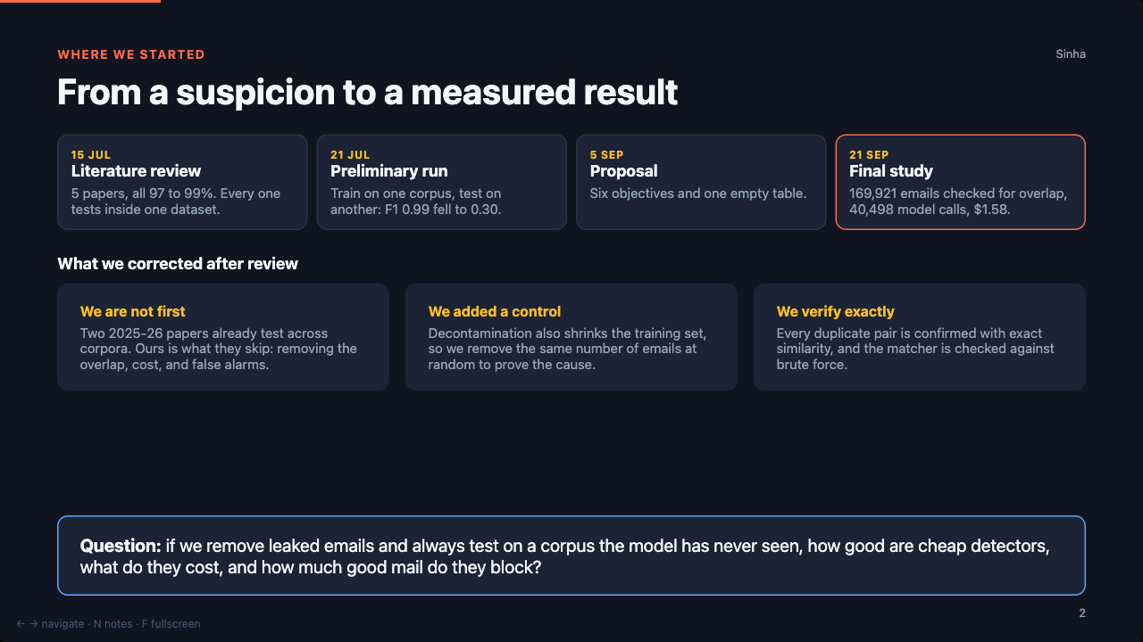
Notes:
35 sec. Timeline in one breath, then the three corrections. Be open that we are not the first to test across corpora.

Slide 3
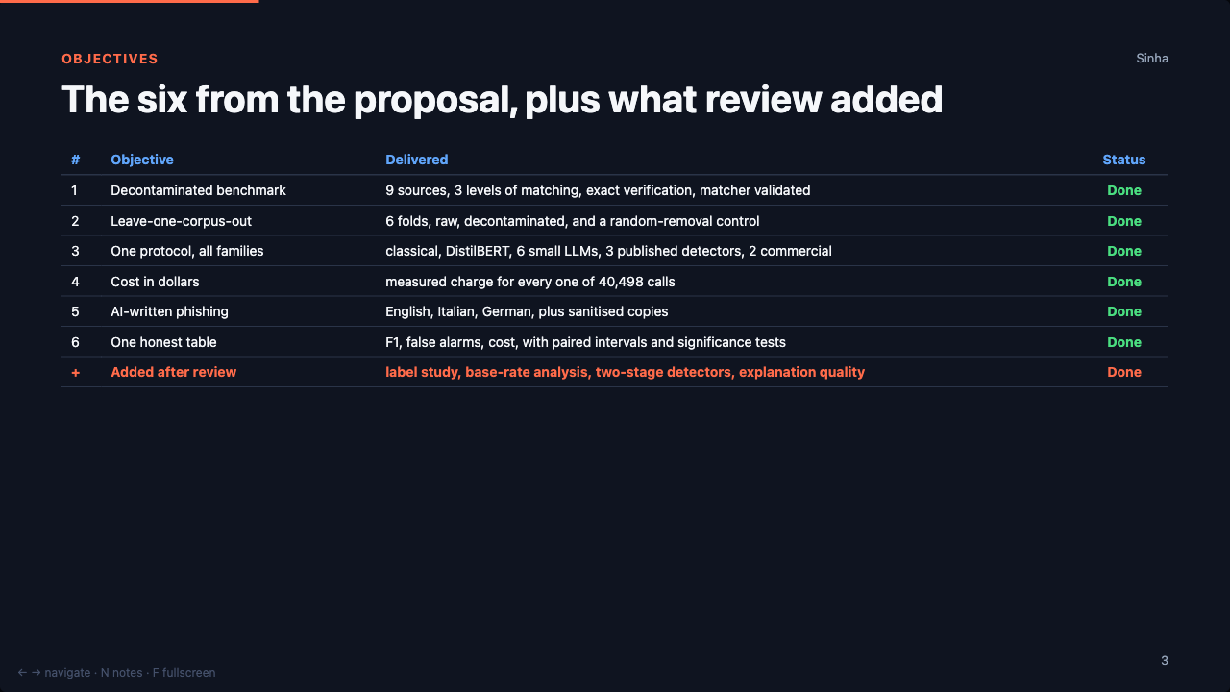
Notes:
35 sec. All six done. Point at the last row: review made the project bigger, not smaller.

Slide 4
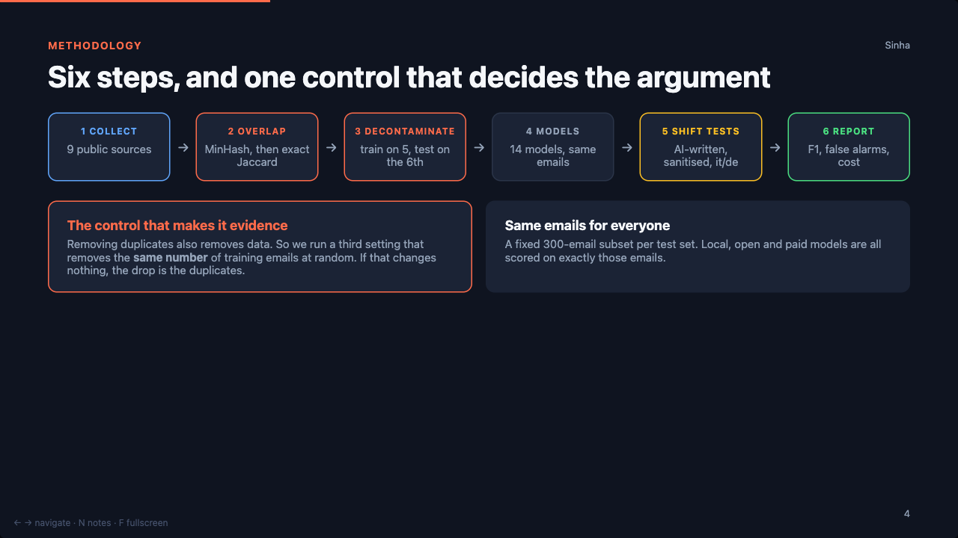
Notes:
40 sec. Spend the time on the control box. That is the answer to the first question any examiner asks.

Slide 5
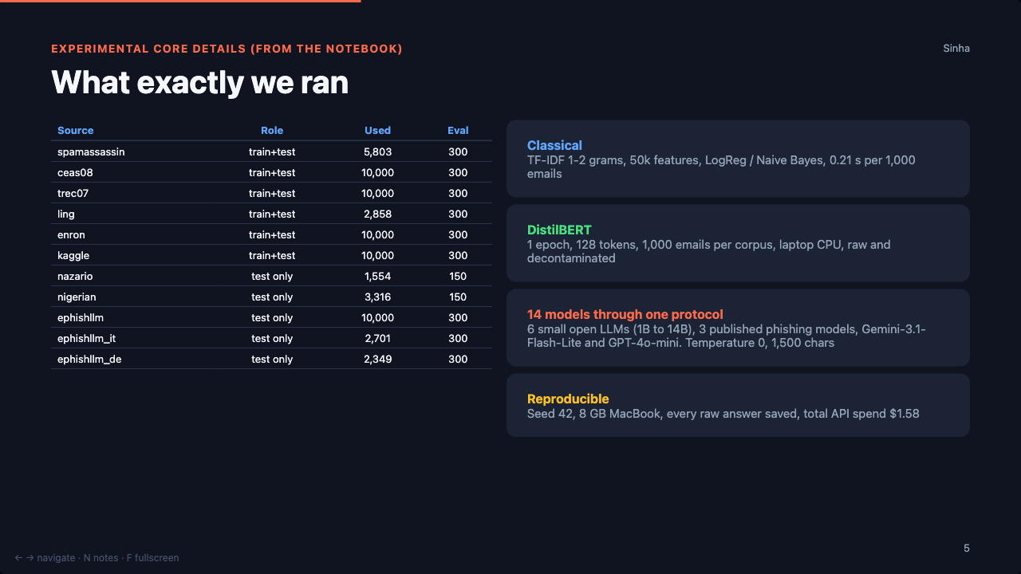
Notes:
45 sec. This is the notebook slide. Say: every table that follows is produced by these scripts from these files.

Slide 6
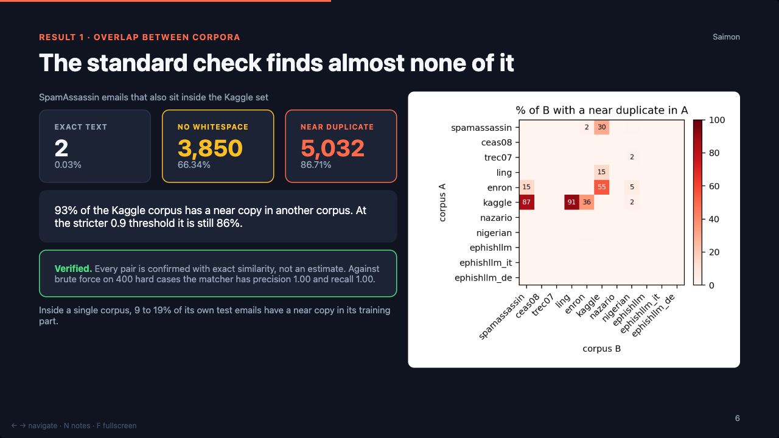
Notes:
55 sec. Say the three numbers slowly. Then the verification line: this is the part a reviewer attacks, and we checked it.

Slide 7
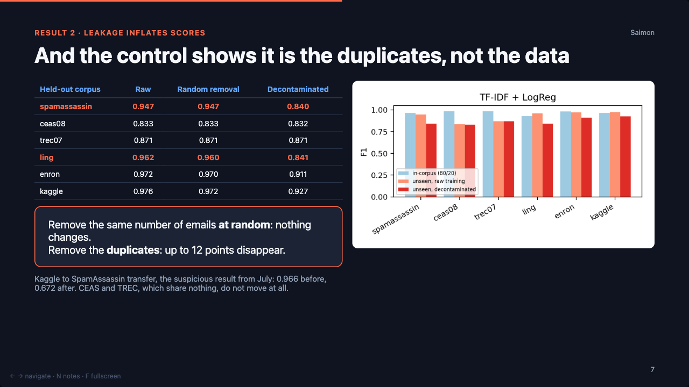
Notes:
60 sec. This is the strongest slide. Read the three columns across one row, then the red box. Then hand to Faria.

Slide 8
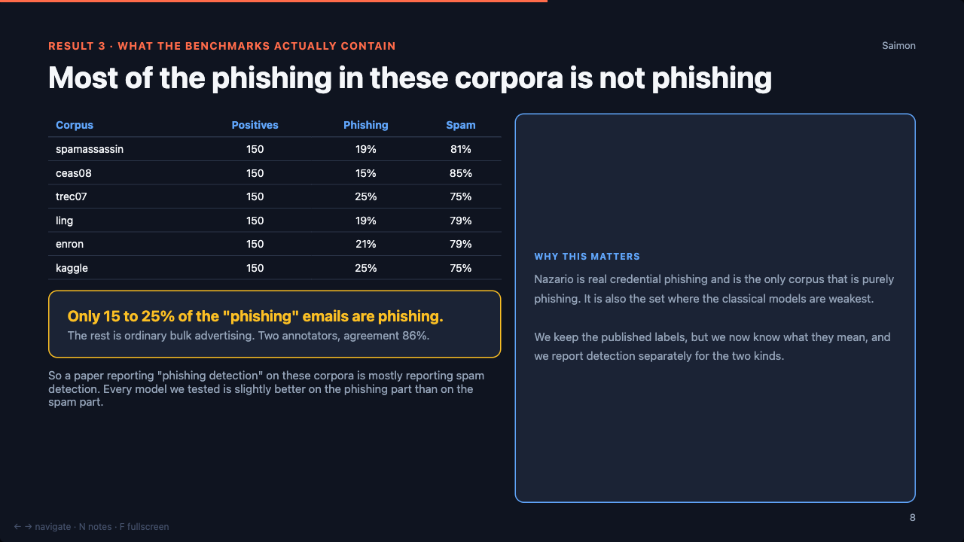
Notes:
45 sec. This surprises people. Say the headline number, then that we used two annotators rather than trusting one model.

Slide 9
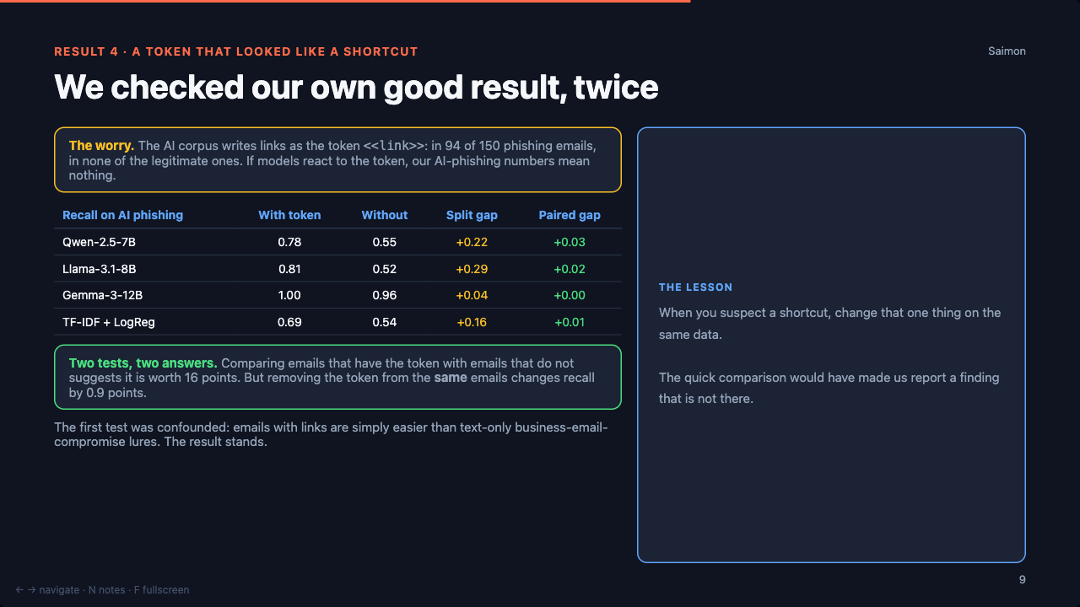
Notes:
40 sec. Tell it as a story: we suspected our own good number, ran the obvious test, it said we were right to worry, then the proper paired test said otherwise. Report both.

Slide 10
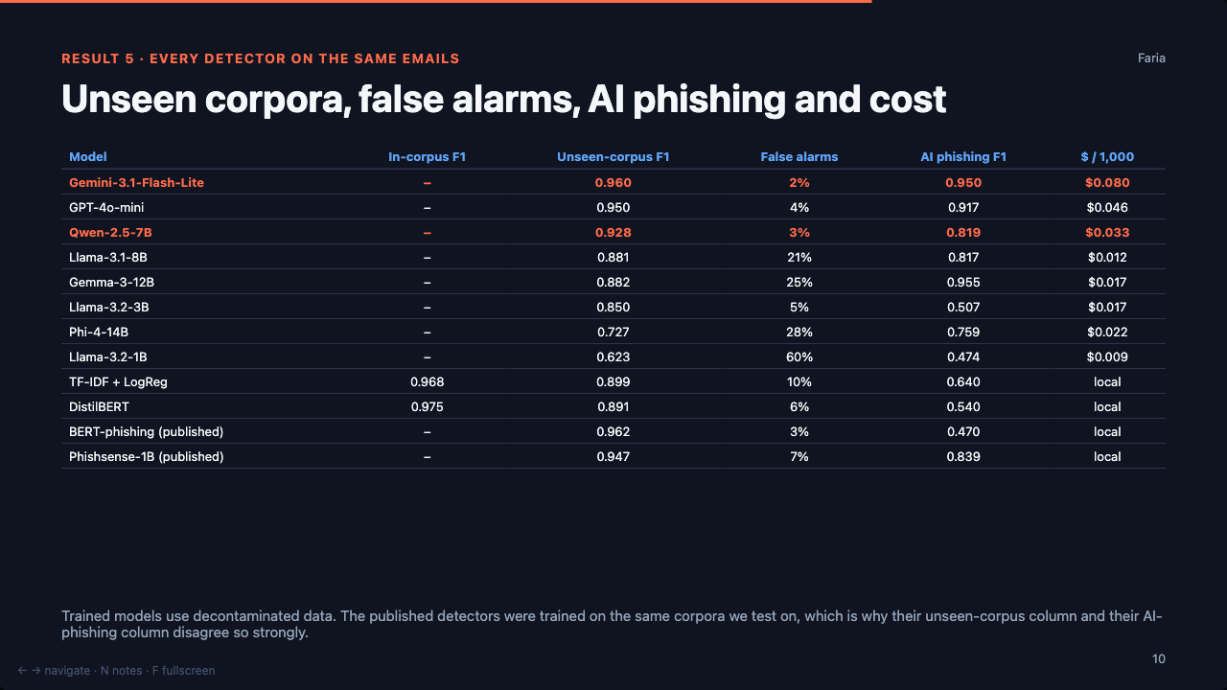
Notes:
55 sec. Three rows only: Gemini (best, paid), Qwen (best open), and a published detector (high on our corpora, low on AI mail).

Slide 11
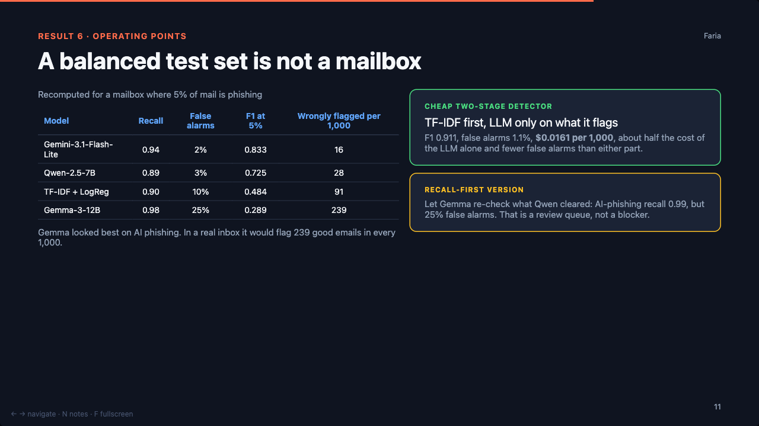
Notes:
50 sec. The point: the ranking changes with the base rate, and combining two cheap models beats either one.

Slide 12
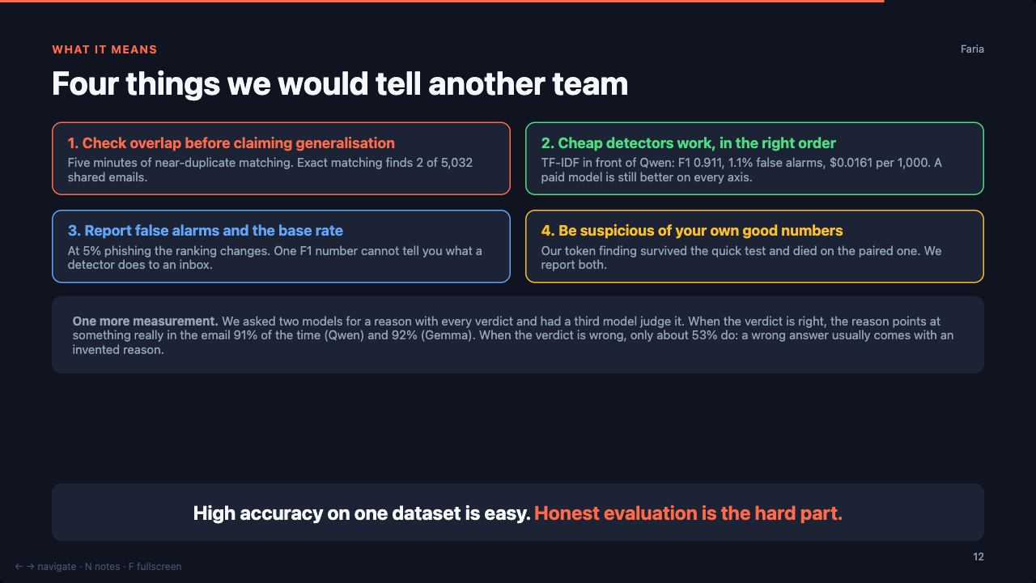
Notes:
40 sec. One sentence per card. Read the explanation box quickly, then the closing line, then go on to limitations.

Slide 13
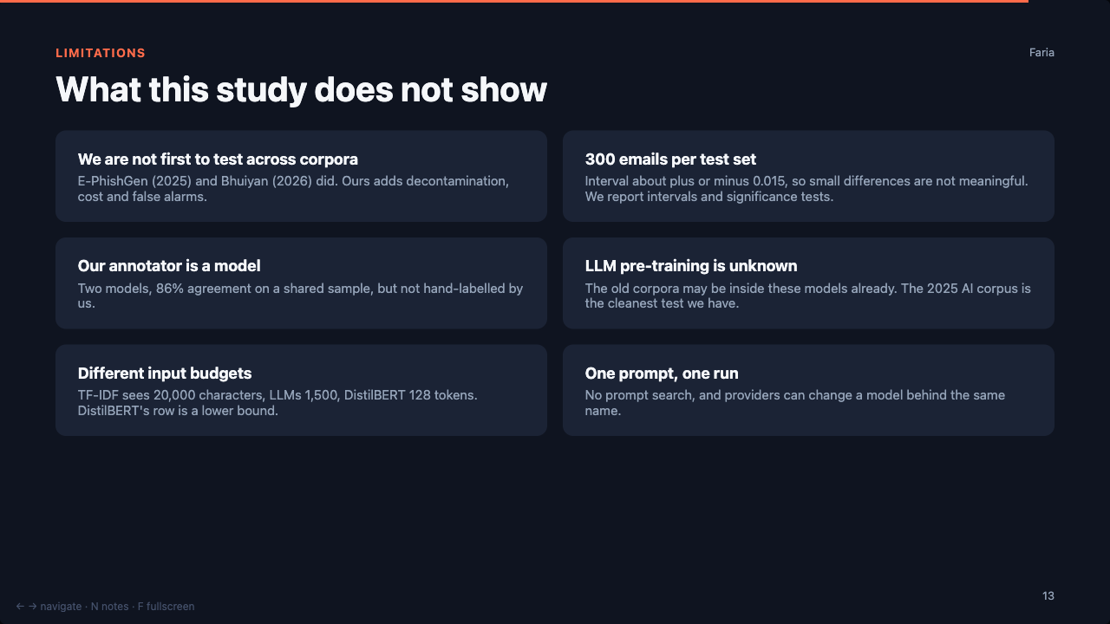
Notes:
35 sec. Say the first three clearly. Owning these is what makes the rest believable.

Slide 14
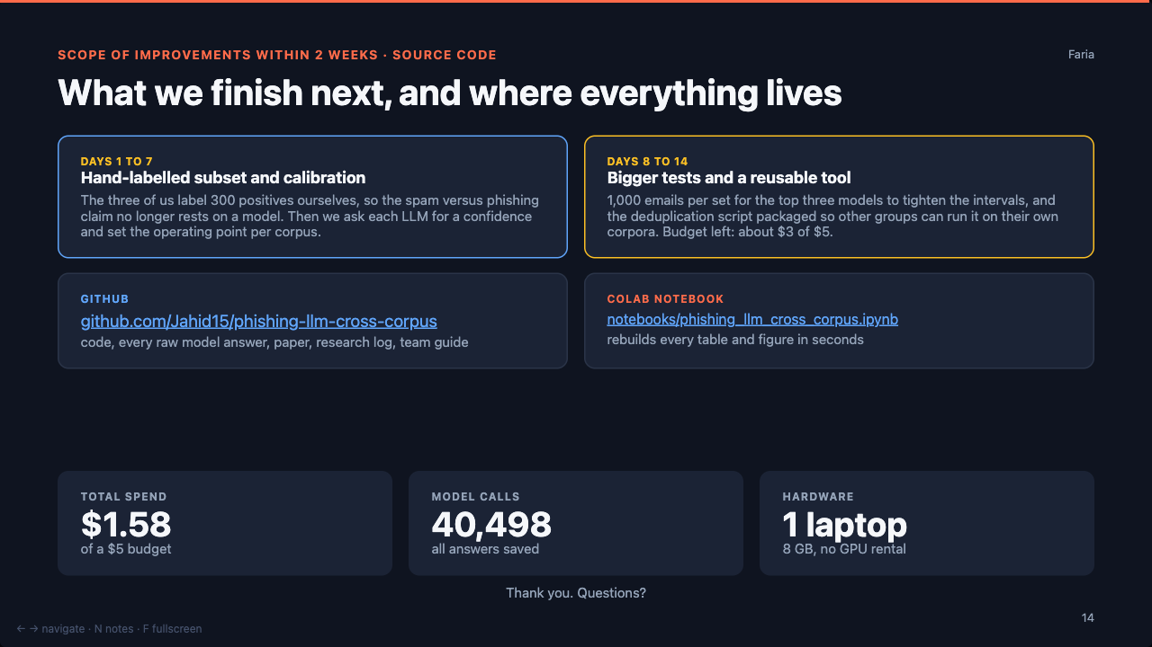
Notes:
35 sec. Two blocks of plan, then the links, then the three numbers. Stop after "thank you".

