Slide 1
CSE-201
Data Structure & Algorithm
Lecture - 1
Data Structure & Algorithm

Slide 2
Introduction to Data Structures
Data Structures
The logical or mathematical model of a particular organization of data is called a data
structure.
Types of Data Structure
1. Linear Data Structure
Example: Arrays, Linked Lists, Stacks, Queues
2. Nonlinear Data Structure
Example: Trees, Graphs
A
Array
A
B
C
D
E
F
Tree
B
C
D
E
F
Figure: Linear and nonlinear structures
Data Structure & Algorithm

Slide 3
Choice of Data Structures
The choice of data structures depends on two considerations:
It must be rich enough in structure to mirror the actual relationships of data in the real world.
The structure should be simple enough that one can effectively process data when necessary.
10
10
20
30
40
20
30
50
60
70
40
50
60
70
80
Figure 2: Array with 8 items
Figure 3: Tree with 8 nodes
Data Structure & Algorithm

Slide 4
Data Structure Operations
Traversing: Accessing each record exactly once so that certain items in the record may be processed.
2. Searching: Finding the location of the record with a given key value.
3. Inserting: Adding a new record to the structure.
4. Deleting: Removing a record from the structure.
5. Sorting: Arranging the records in some logical order.
6. Merging: Combing the records in two different sorted files into a single sorted file.
Data Structure & Algorithm

Slide 5
Algorithms
It is a well-defined set of instructions used to solve a particular problem.
Example:
Write an algorithm for finding the location of the largest element of an array Data.
Largest-Item (Data, N, Loc)
1. set k:=1, Loc:=1 and Max:=Data[1]
2. while k<=N repeat steps 3, 4
3. If Max < Data[k] then Set Loc:=k and Max:=Data[k]
4. Set k:=k+1
5. write: Max and Loc
6. exit
Data Structure & Algorithm

Slide 6
Complexity of Algorithms
The complexity of an algorithm M is the function f(n) which gives the running time and/or storage space requirement of the algorithm in terms of the size n of the input data.
Two types of complexity
1. Time Complexity
2. Space Complexity
Sometimes the choice of data structures involves a time-space tradeoff. By increasing the amount of space for storing the data, it is possible to reduce the time needed for processing the data, or vice versa.
Data Structure & Algorithm

Slide 7
Analyzing Algorithms
Predict the amount of resources required:
  memory: how much space is needed?
  computational time: how fast the algorithm runs?
FACT: running time grows with the size of the input
Input size (number of elements in the input)
  Size of an array, polynomial degree, # of elements in a matrix, # of bits in the binary representation of the input, vertices and edges in a graph
Def: Running time = the number of primitive operations (steps) executed before termination
  Arithmetic operations (+, -, *), data movement, control, decision making (if, while), comparison
Data Structure & Algorithm

Slide 8
Algorithm Analysis: Example
Alg.: MIN (a[1], …, a[n])
  m ← a[1];
  for i ← 2 to n
  if a[i] < m
  then m ← a[i];
Running time:
  the number of primitive operations (steps) executed before termination
  T(n) =1 [first step] + (n) [for loop] + (n-1) [if condition] +
  (n-1) [the assignment in then] = 3n - 1
Order (rate) of growth:
  The leading term of the formula
  Expresses the asymptotic behavior of the algorithm
Data Structure & Algorithm

Slide 9
Typical Running Time Functions
1 (constant running time):
  Instructions are executed once or a few times
logN (logarithmic)
  A big problem is solved by cutting the original problem in smaller sizes, by a constant fraction at each step
N (linear)
  A small amount of processing is done on each input element
N logN
  A problem is solved by dividing it into smaller problems, solving them independently and combining the solution
Data Structure & Algorithm

Slide 10
Typical Running Time Functions
N² (quadratic)
  Typical for algorithms that process all pairs of data items (double nested loops)
N³ (cubic)
  Processing of triples of data (triple nested loops)
N^{K} (polynomial)
2^{N} (exponential)
  Few exponential algorithms are appropriate for practical use
Data Structure & Algorithm

Slide 11
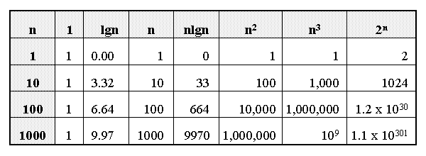
Growth of Functions
Data Structure & Algorithm

Slide 12
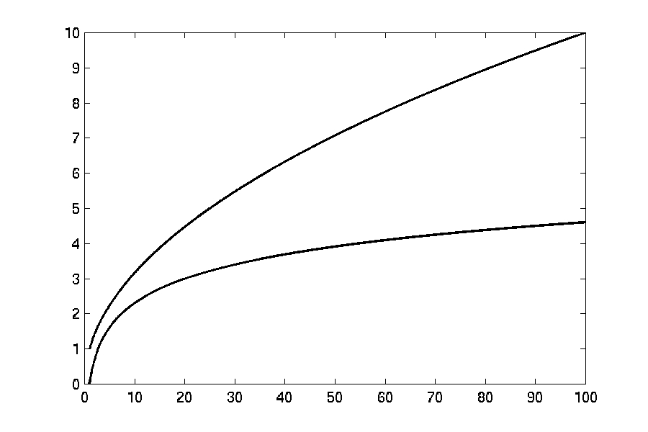

Complexity Graphs
log(n)
Data Structure & Algorithm

Slide 13
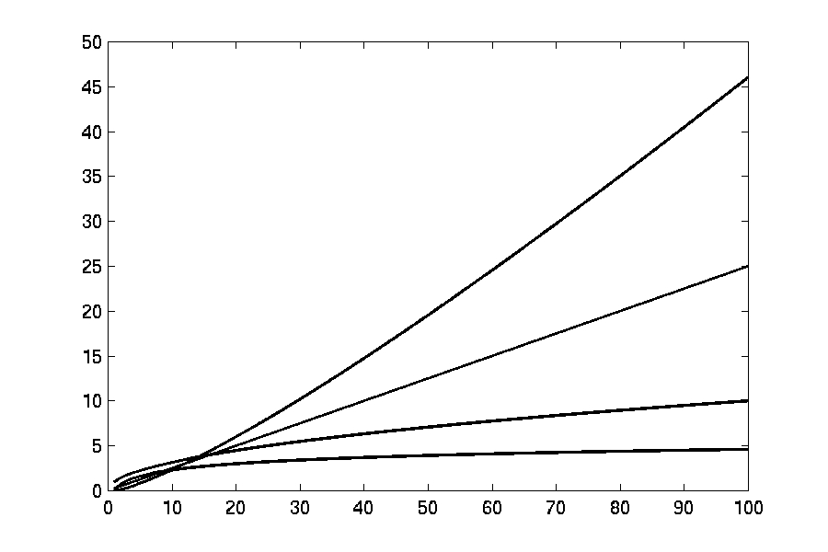
Complexity Graphs
n log(n)
n
log(n)
Data Structure & Algorithm

Slide 14
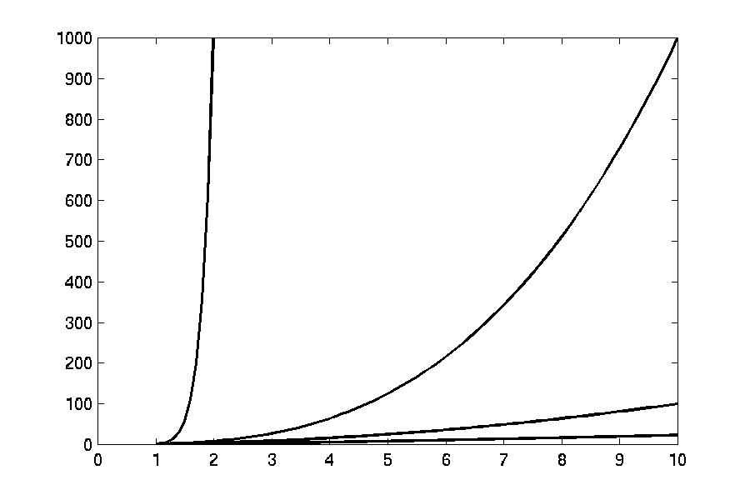
Complexity Graphs
n¹⁰
n³
n²
n log(n)
Data Structure & Algorithm

Slide 15
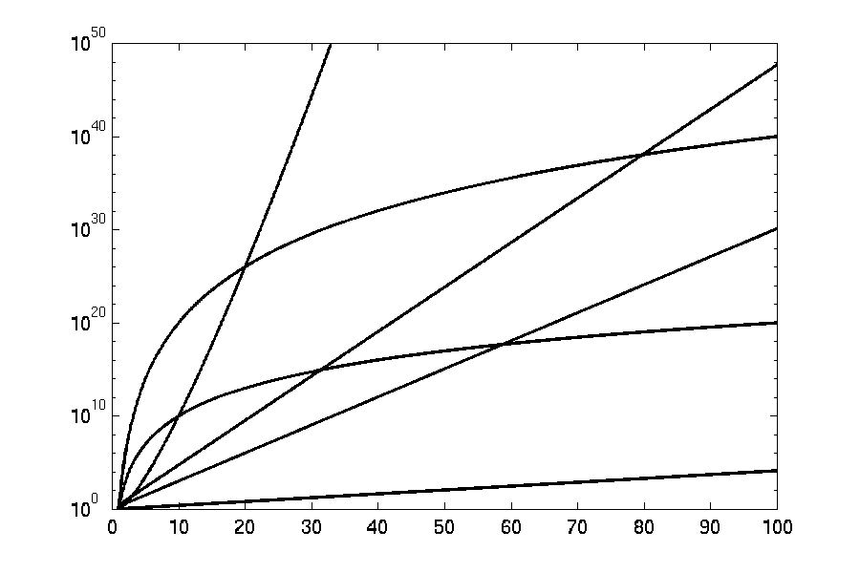
Complexity Graphs (log scale)
3^{n}
n^{n}
n²⁰
2^{n}
n¹⁰
1.1^{n}
Data Structure & Algorithm

Slide 16
Algorithm Complexity
Worst Case Complexity:
  the function defined by the maximum number of steps taken on any instance of size n
Best Case Complexity:
  the function defined by the minimum number of steps taken on any instance of size n
Average Case Complexity:
  the function defined by the average number of steps taken on any instance of size n
Data Structure & Algorithm

Slide 17
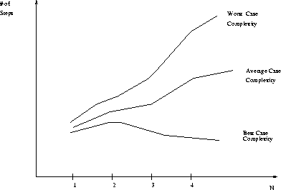
Best, Worst, and Average Case Complexity
Number of steps
Worst Case Complexity
Average Case Complexity
Best Case Complexity
N
(input size)
Data Structure & Algorithm

Slide 18
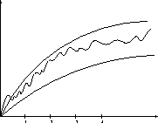
Doing the Analysis
It’s hard to estimate the running time exactly
  Best case depends on the input
  Average case is difficult to compute
  So we usually focus on worst case analysis
    Easier to compute
    Usually close to the actual running time
Strategy: find a function (an equation) that, for large n, is an upper bound to the actual function (actual number of steps, memory usage, etc.)
Upper bound
Actual function
Lower bound
Data Structure & Algorithm

Slide 19
Motivation for Asymptotic Analysis
An exact computation of worst-case running time can be difficult
  Function may have many terms:
    4n² - 3n log n + 17.5 n - 43 n^{⅔} + 75
An exact computation of worst-case running time is unnecessary
  Remember that we are already approximating running time by using RAM model
Data Structure & Algorithm

Slide 20
Classifying functions by their
Asymptotic Growth Rates (1/2)
asymptotic growth rate, asymptotic order, or
order of functions
  Comparing and classifying functions that ignores
    constant factors and
    small inputs.
The Sets big oh O(g), big theta Θ(g), big omega Ω(g)
Data Structure & Algorithm

Slide 21
Classifying functions by their
Asymptotic Growth Rates (2/2)
O(g(n)), Big-Oh of g of n, the Asymptotic Upper Bound;
Θ(g(n)), Theta of g of n, the Asymptotic Tight Bound; and
Ω(g(n)), Omega of g of n, the Asymptotic Lower Bound.
Data Structure & Algorithm

Slide 22
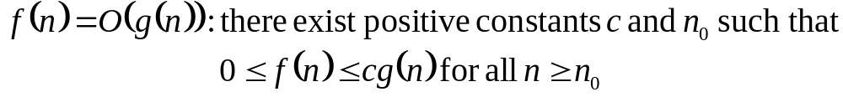
Big-O
What does it mean?
  If f(n) = O(n²), then:
    f(n) can be larger than n² sometimes, but…
    We can choose some constant c and some value n₀ such that for every value of n larger than n₀ : f(n) < cn²
    That is, for values larger than n₀, f(n) is never more than a constant multiplier greater than n²
    Or, in other words, f(n) does not grow more than a constant factor faster than n².
Data Structure & Algorithm

Slide 23
Visualization of O(g(n))
cg(n)
f(n)
n₀
Data Structure & Algorithm

Slide 24
Examples
  2n² = O(n³):
  n² = O(n²):
  1000n²+1000n = O(n²):
  n = O(n²):
2n² ≤ cn³ ⇒ 2 ≤ cn ⇒ c = 1 and n₀= 2
n² ≤ cn² ⇒ c ≥ 1 ⇒ c = 1 and n₀= 1
1000n²+1000n ≤ cn² ≤ cn²+ 1000n ⇒ c=1001 and n₀ = 1
n ≤ cn² ⇒ cn ≥ 1 ⇒ c = 1 and n₀= 1
Data Structure & Algorithm

Slide 25
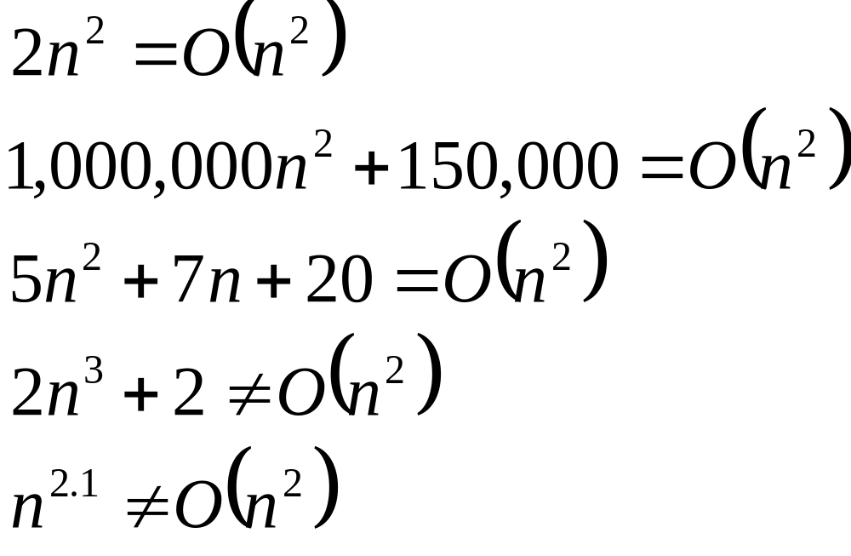
Big-O
Data Structure & Algorithm

Slide 26
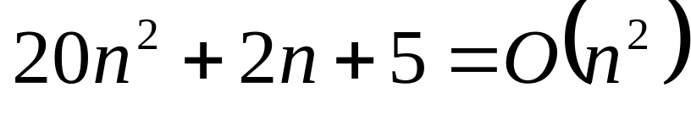
More Big-O
Prove that:
Let c = 21 and n₀ = 4
21n² > 20n² + 2n + 5 for all n > 4
n² > 2n + 5 for all n > 4
TRUE
Data Structure & Algorithm

Slide 27
Tight bounds
We generally want the tightest bound we can find.
While it is true that n² + 7n is in O(n³), it is more interesting to say that it is in O(n²)
Data Structure & Algorithm

Slide 28

Big Omega – Notation
Ω() – A lower bound
  n² = Ω(n)
  Let c = 1, n₀ = 2
  For all n ≥ 2, n² > 1 × n
Data Structure & Algorithm

Slide 29
Visualization of Ω(g(n))
f(n)
cg(n)
n₀
Data Structure & Algorithm

Slide 30
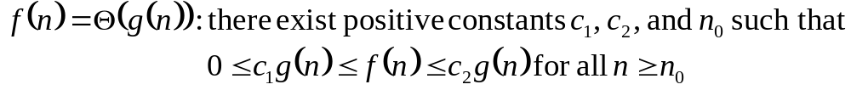
Θ-notation
Big-O is not a tight upper bound. In other words n = O(n²)
Θ provides a tight bound
In other words,
Data Structure & Algorithm

Slide 31
Visualization of Θ(g(n))
c₂g(n)
f(n)
c₁g(n)
n₀
Data Structure & Algorithm

Slide 32
A Few More Examples
n = O(n²) ≠ Θ(n²)
200n² = O(n²) = Θ(n²)
n^{2.5} ≠ O(n²) ≠ Θ(n²)
Data Structure & Algorithm

Slide 33
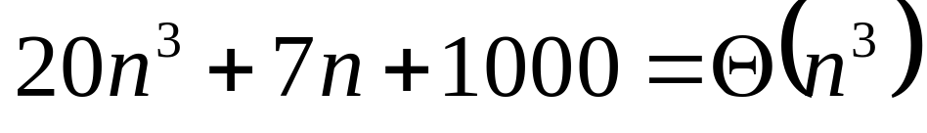
Example 2
Prove that:
Let c = 21 and n₀ = 10
21n³ > 20n³ + 7n + 1000 for all n > 10
n³ > 7n + 5 for all n > 10
TRUE, but we also need…
Let c = 20 and n₀ = 1
20n³ < 20n³ + 7n + 1000 for all n ≥ 1
TRUE
Data Structure & Algorithm

Slide 34
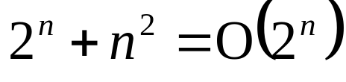
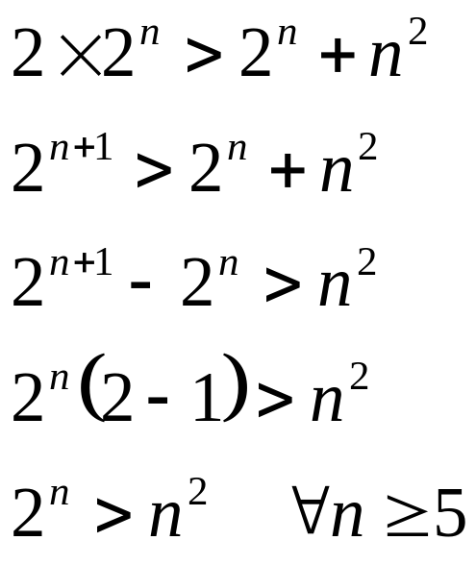
Example 3
Show that
Let c = 2 and n₀ = 5
✓
Data Structure & Algorithm

Slide 35
Asymptotic Notations - Examples
Θ notation
  n²/2 – n/2
  (6n³ + 1)lgn/(n + 1)
  n vs. n²
Ω notation
  n³ vs. n²
  n vs. logn
  n vs. n²
= Θ(n²)
= Θ(n²lgn)
n ≠ Θ(n²)
O notation
  2n² vs. n³
  n² vs. n²
  n³ vs. nlogn
n³ = Ω(n²)
2n² = O(n³)
n = Ω(logn)
n² = O(n²)
n ≠ Ω(n²)
n³ ≠ O(nlgn)
Data Structure & Algorithm

Slide 36
Asymptotic Notations - Examples
For each of the following pairs of functions, either f(n) is O(g(n)), f(n) is Ω(g(n)), or f(n) = Θ(g(n)). Determine which relationship is correct.
  f(n) = log n²; g(n) = log n + 5
  f(n) = n; g(n) = log n²
  f(n) = log log n; g(n) = log n
  f(n) = n; g(n) = log² n
  f(n) = n log n + n; g(n) = log n
  f(n) = 10; g(n) = log 10
  f(n) = 2^{n}; g(n) = 10n²
  f(n) = 2^{n}; g(n) = 3^{n}
f(n) = Θ (g(n))
f(n) = Ω(g(n))
f(n) = O(g(n))
f(n) = Ω(g(n))
f(n) = Ω(g(n))
f(n) = Θ(g(n))
f(n) = Ω(g(n))
f(n) = O(g(n))
Data Structure & Algorithm

Slide 37
Simplifying Assumptions
1. If f(n) = O(g(n)) and g(n) = O(h(n)), then f(n) = O(h(n))
2. If f(n) = O(kg(n)) for any k > 0, then f(n) = O(g(n))
3. If f₁(n) = O(g₁(n)) and f₂(n) = O(g₂(n)),
then f₁(n) + f₂(n) = O(max (g₁(n), g₂(n)))
4. If f₁(n) = O(g₁(n)) and f₂(n) = O(g₂(n)),
then f₁(n) * f₂(n) = O(g₁(n) * g₂(n))
Data Structure & Algorithm

Slide 38
Example
Code:
a = b;
Complexity:
Data Structure & Algorithm
Notes:
constant

Slide 39
Example
Code:
sum = 0;
for (i=1; i <=n; i++)
sum += n;
Complexity:
Data Structure & Algorithm
Notes:
linear

Slide 40
Example
Code:
sum = 0;
for (j=1; j<=n; j++)
for (i=1; i<=j; i++)
sum++;
for (k=0; k<n; k++)
A[k] = k;
Complexity:
Data Structure & Algorithm
Notes:
N squared == 1 + 2 + … + N

Slide 41
Example
Code:
sum1 = 0;
for (i=1; i<=n; i++)
for (j=1; j<=n; j++)
sum1++;
Complexity:
Data Structure & Algorithm
Notes:
Obviousy n squared

Slide 42
Example
Code:
sum2 = 0;
for (i=1; i<=n; i++)
for (j=1; j<=i; j++)
sum2++;
Complexity:
Data Structure & Algorithm

Slide 43
Example
Code:
sum1 = 0;
for (k=1; k<=n; k*=2)
for (j=1; j<=n; j++)
sum1++;
Complexity:
Data Structure & Algorithm
Notes:
outer loop O(lg N), inner loop (N) == O (N lg N) by product rule

Slide 44
Example
Code:
sum2 = 0;
for (k=1; k<=n; k*=2)
for (j=1; j<=k; j++)
sum2++;
Complexity:
Data Structure & Algorithm
Notes:
outer O (lg N) inner = sum of powers of 2 which is linear since
The sum of powers of 2 dividing into N is 2N so its O (N lg N) by product rule

Slide 45
Recurrences
Def.: Recurrence = an equation or inequality that describes a function in terms of its value on smaller inputs, and one or more base cases
E.g.: T(n) = T(n-1) + n
Useful for analyzing recurrent algorithms
Methods for solving recurrences
  Substitution method
  Recursion tree method
  Master method
  Iteration method
Data Structure & Algorithm

