Slide 1
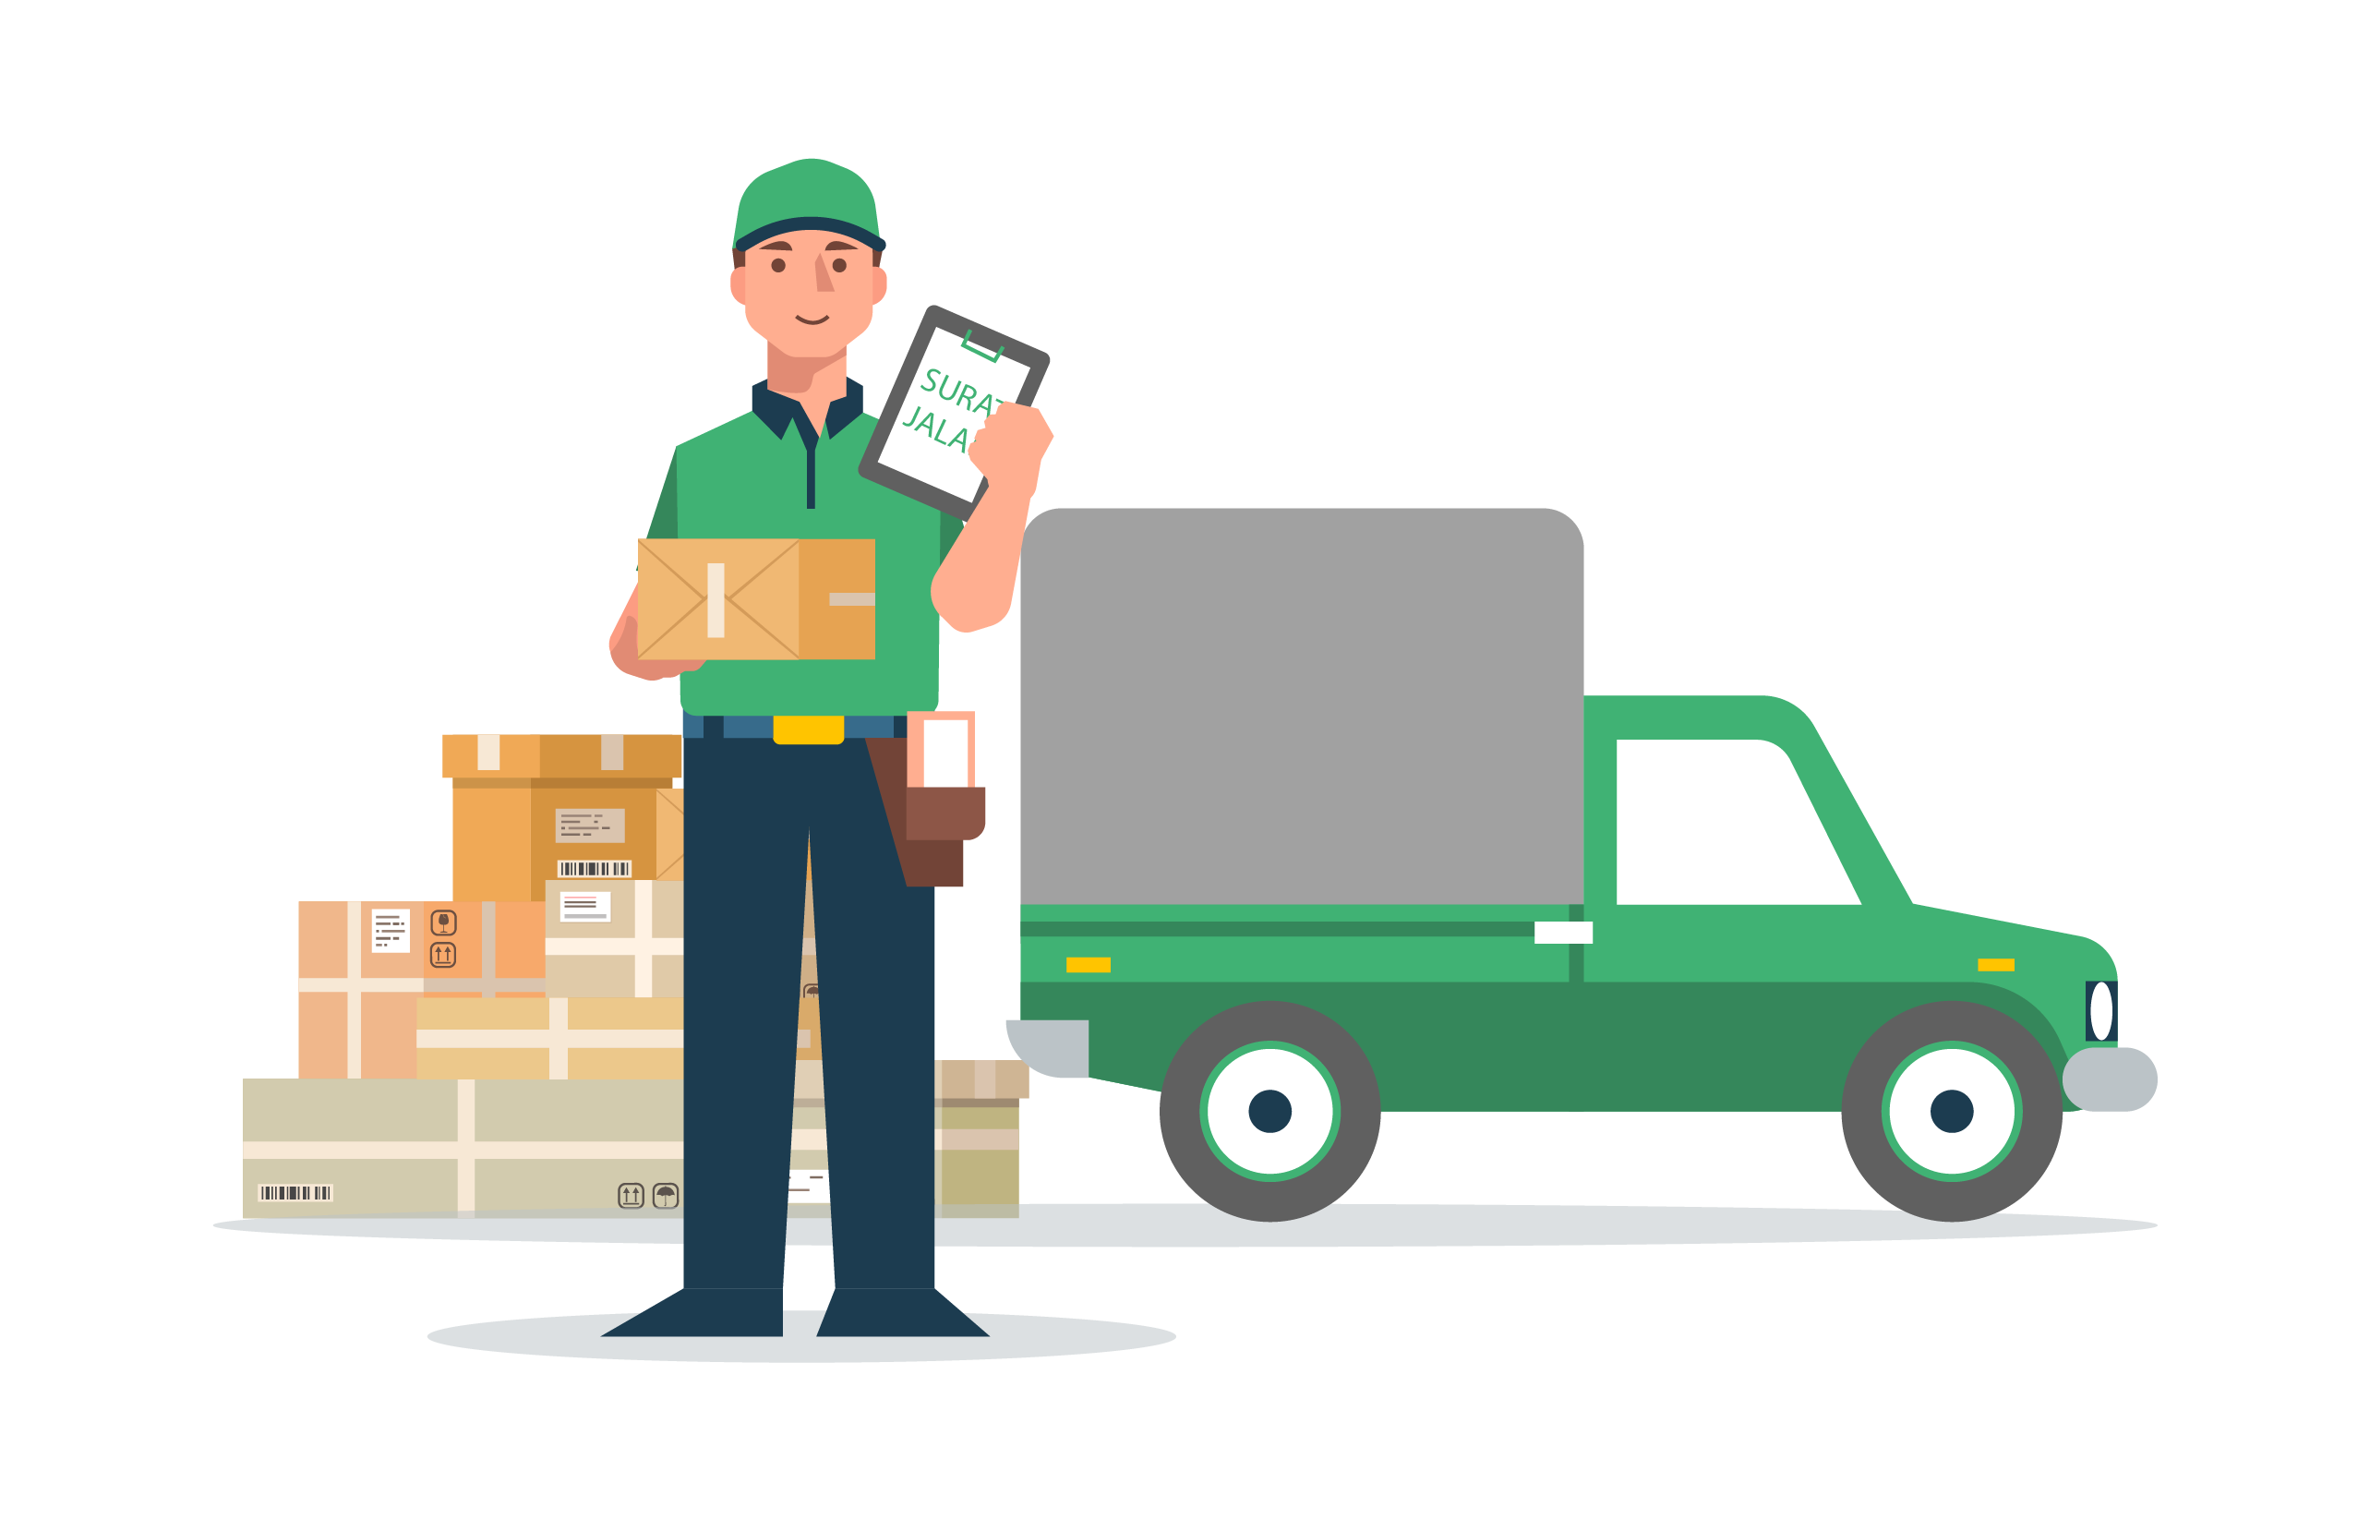
InstaDel
Crowd Sourced Delivery Network for Local Service

Slide 2


Presented By
.
Md Jahid Hasan Pintu
ID: 201002001
Parvez Mosaraf
ID: 201002095
Rukiya Afroze
ID: 201002180
Supervised By:
Sadia Afroze Assistant Professor Dept. of Computer Science and Engineering

Slide 3
Contents
INTRODUCTION
MOTIVATION
OBJECTIVES
LITERATURE REVIEW
PROBLEM STATEMENT
METHODOLOGY
ENGINEERING AND TECHNICAL ASPECTS
PROJECT MANAGEMENT AND FINANCE
CONCLUSION

Slide 4
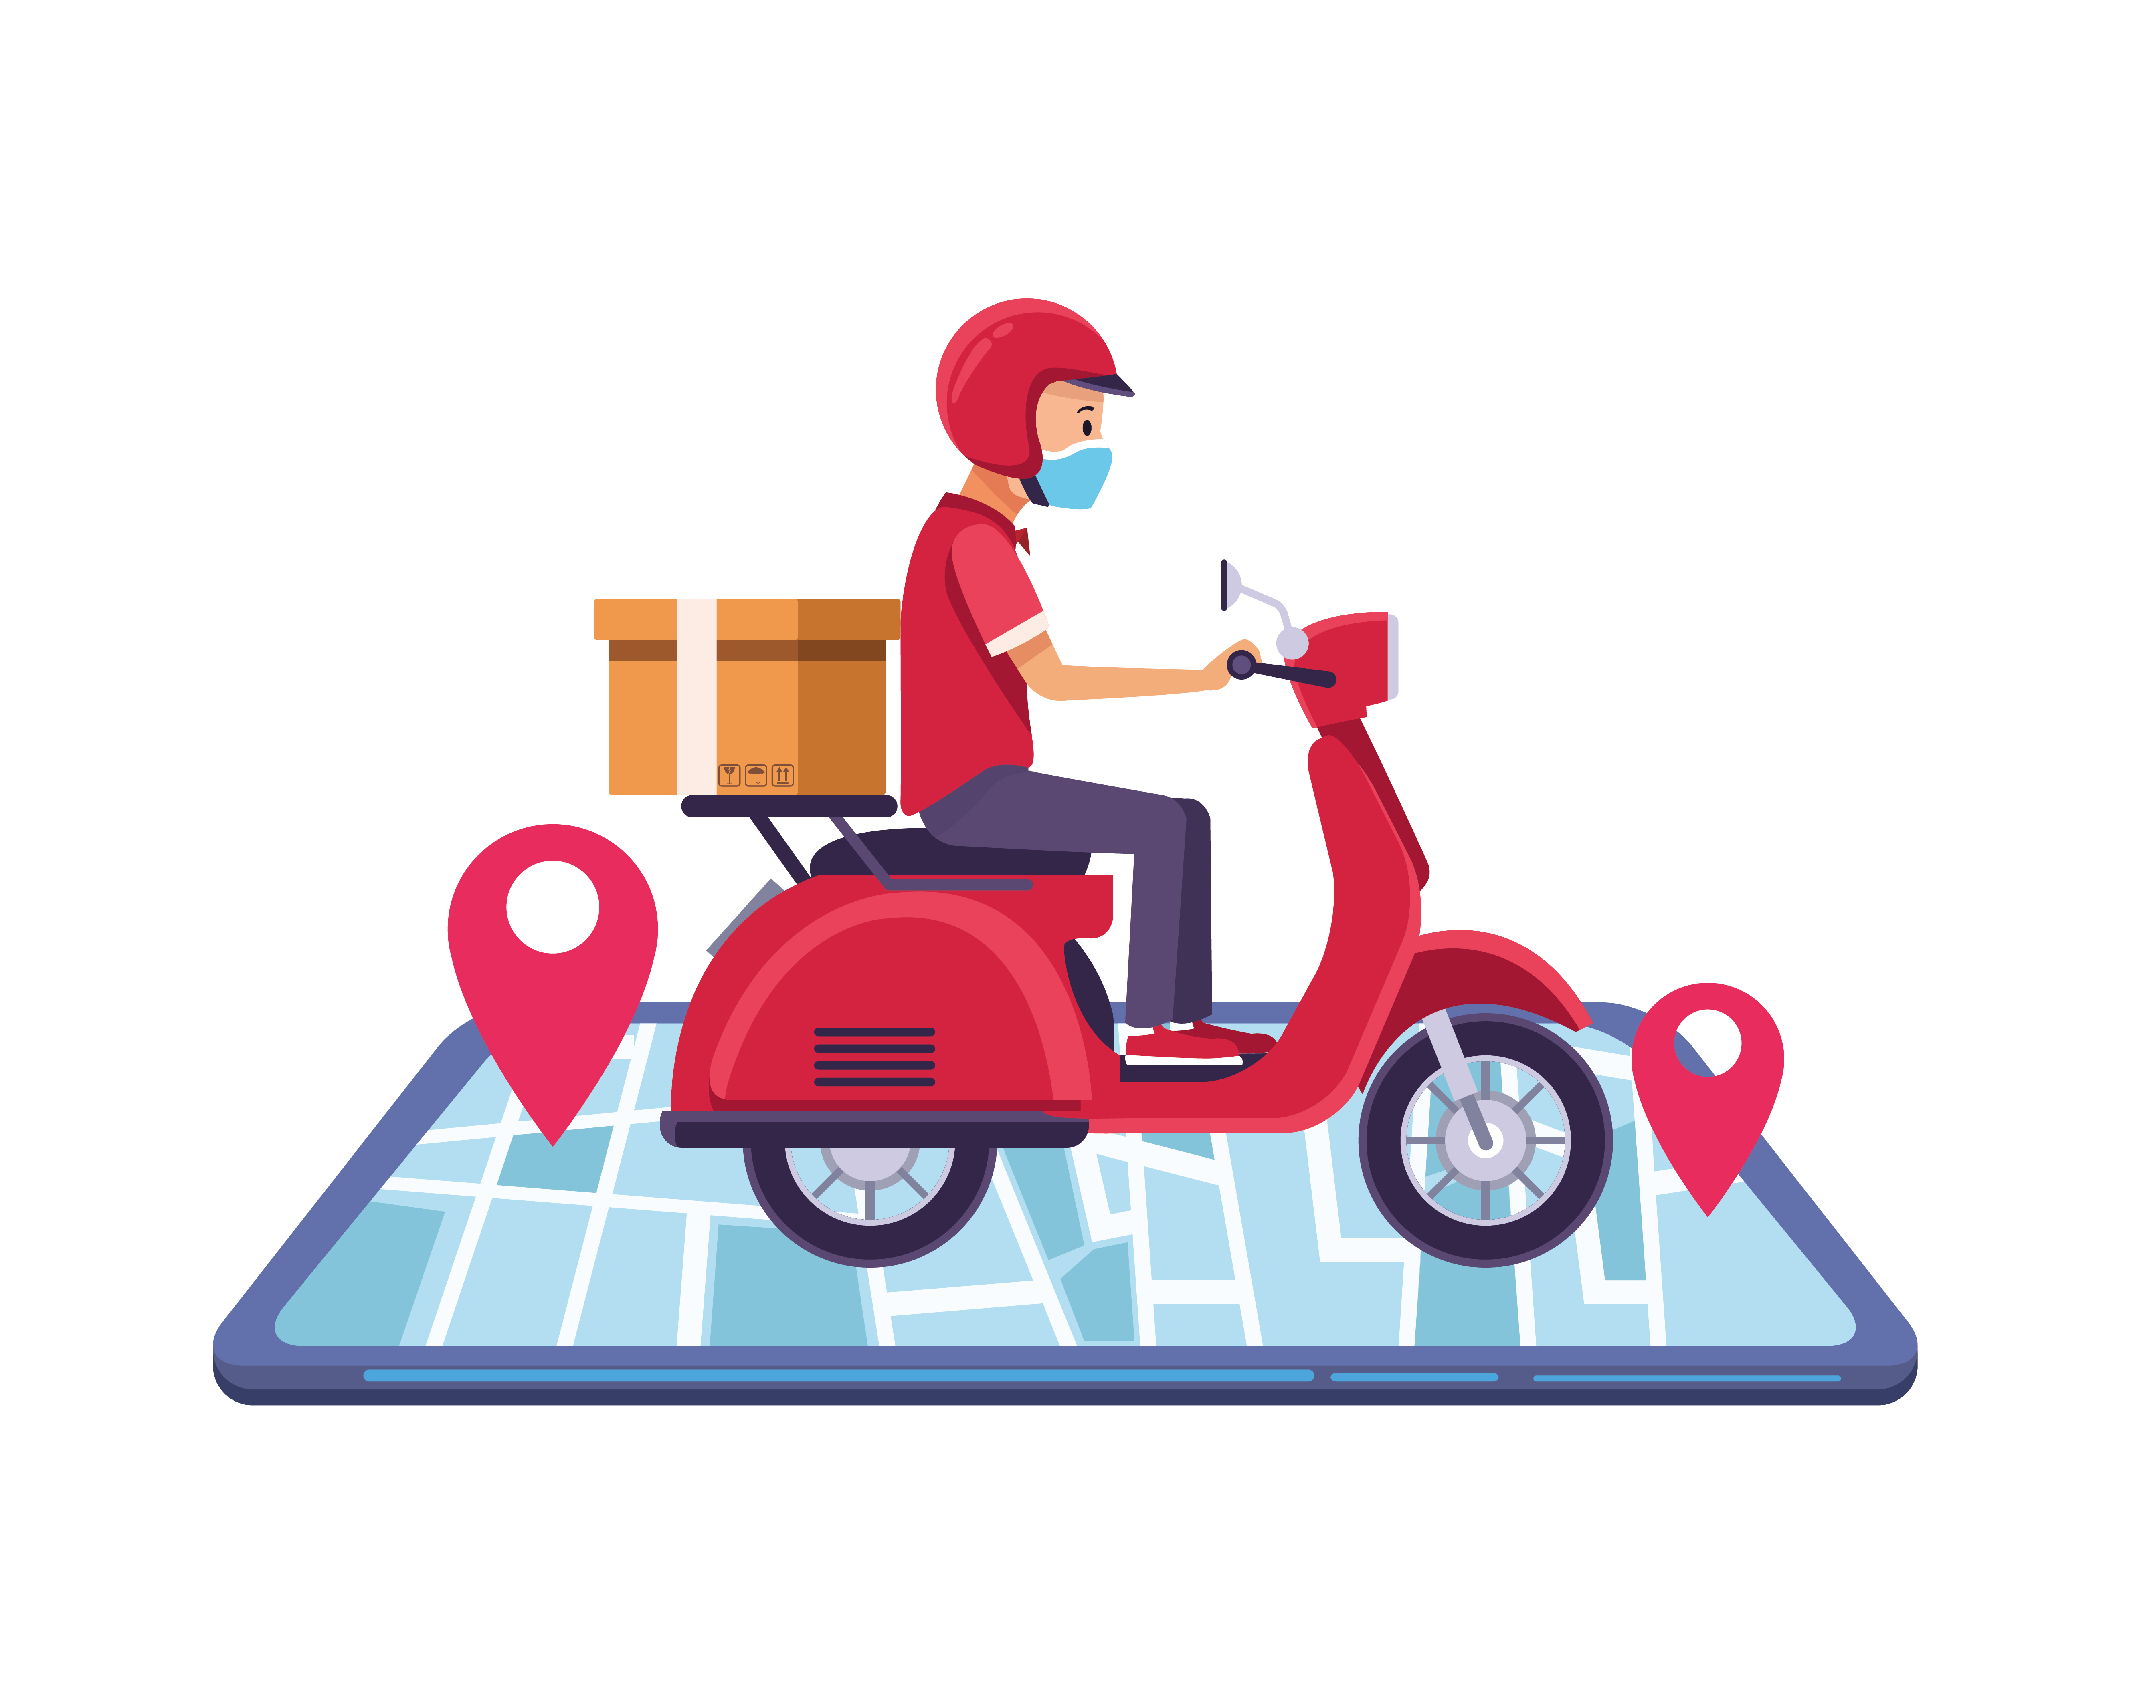
Introduction
Crowd-Sourced Delivery Network
Empowering Individuals:
Enhanced Convenience
Boosting Local Businesses:

Slide 5
Motivation
Long Delivery Times
Inefficiency in Rural Areas
High Costs
Customer Dissatisfaction
Growing E-commerce Demand

Slide 6
Objectives
Develop a Seamless and Efficient Delivery Network
01
Enhance Delivery Speed and Convenience
02
Foster Economic Opportunities
03
Ensure Real-Time Tracking and Security
04
Support Local Businesses
05

Slide 7
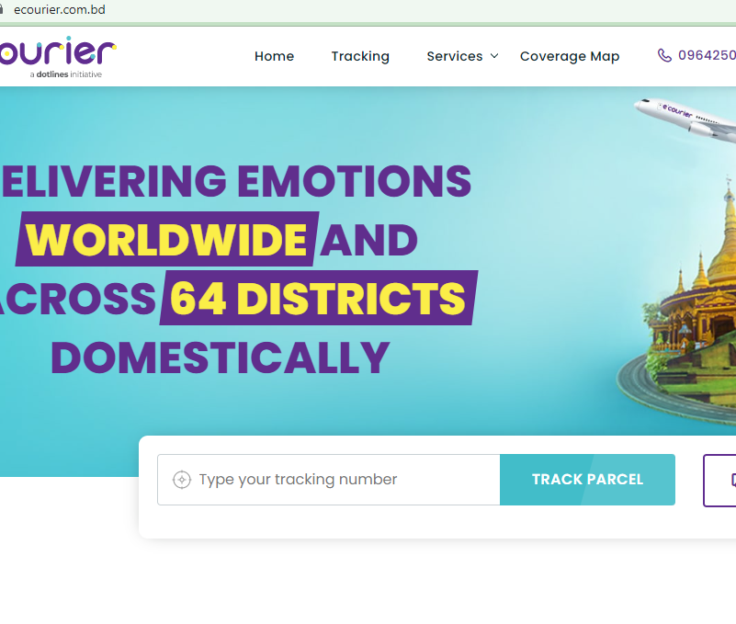
Literature Review
Ecourier is a new courier Service in Dhaka
Deliver only Dhaka City within one day
It takes long time for outside Dhaka

Slide 8
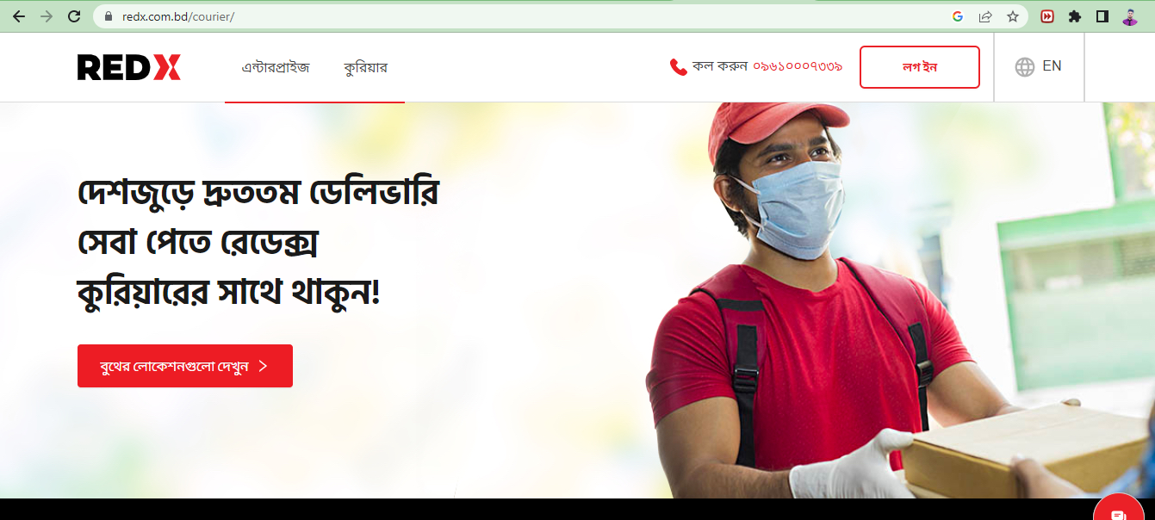
Literature Review cont..

Slide 9
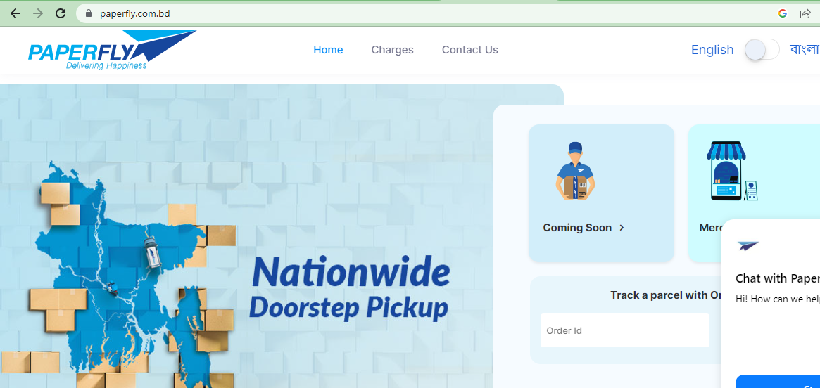
Literature Review cont..

Slide 10
Problem Statement
Limited Availability of Reliable Delivery Services
Inadequate Infrastructure for Rural Deliveries
Costly and Inefficient Delivery Options
Customer Dissatisfaction and Negative Impact on Businesses
Growing E-commerce Sector and Increased Demand

Slide 11
Methodology
/
Data Collection
Requirements Analysis
System Design
Technology Selection
Development and Testing
User Feedback and Iteration

Slide 12

Engineering and Technical Aspects
Mobile Application
Multiple point Tracking System
GPS based location tracking system
Scalability and Reliability

Slide 13
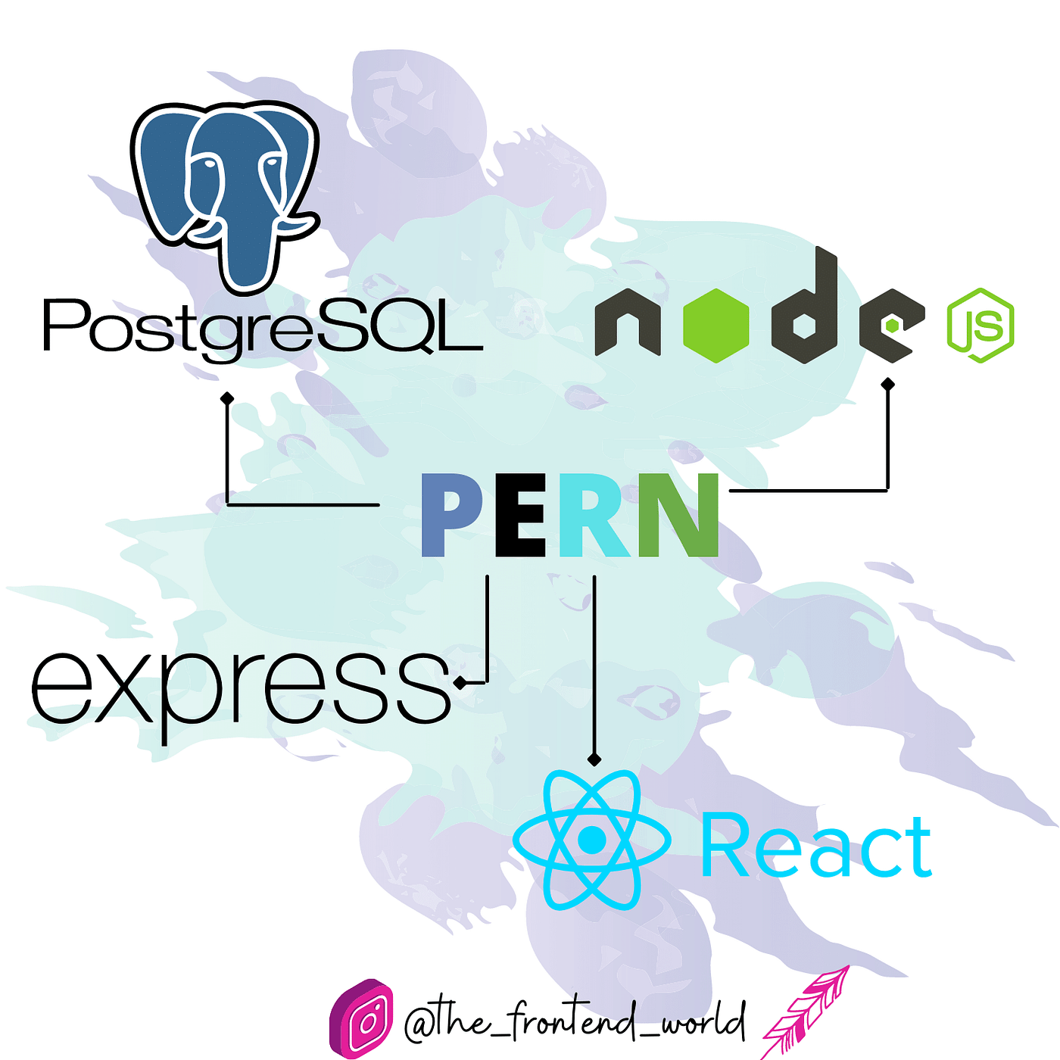
Technology will be used
Operating System:
Windows 10
IDE:
Visual Studio Code
Client Side:
HTML, CSS
Java Script, React Js
React Native
Server Side:
Node Js, Express Js
Database:
PostgreSQL

Slide 14
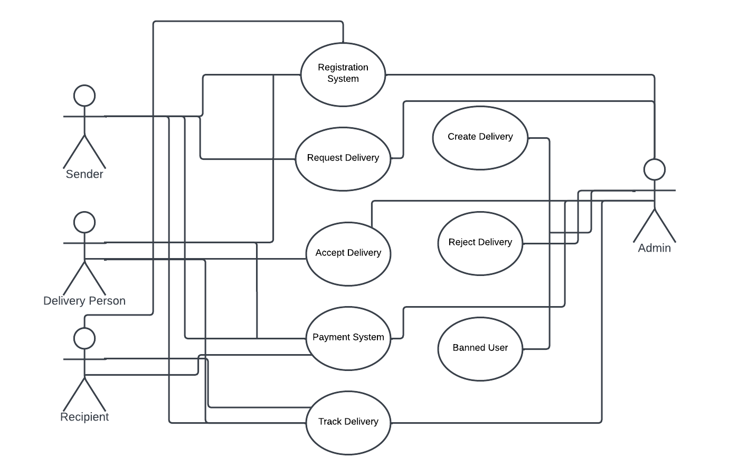
Use Case Diagram
Fig: Insta Del Use Case

Slide 15
Gantt Chart
Activity | April | May | June | July | August | September | October | November | December
Planning | ✓
Requirement |  | ✓
Design
Coding
Testing
Delivery

Slide 16
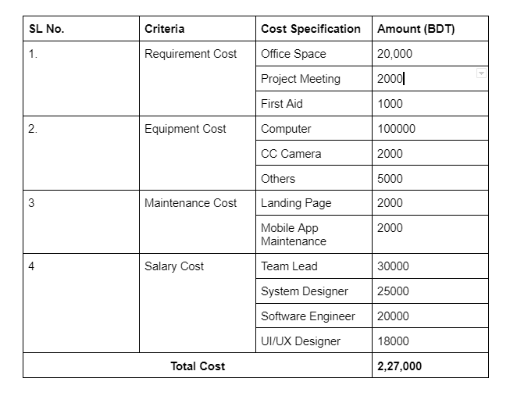
Budget Details

Slide 17
Conclusion
InstaDel has revolutionized the way we send and receive packages.
Providing an opportunity for them to earn additional income while utilizing their routine trips.
Enhancing customer satisfaction.
Create a vibrant and efficient delivery ecosystem.

Slide 18
Any Question ?

Slide 19
Thank you

