Slide 1
Arduino Based Home Automation System
Md. RASHEDUL ISLAM ID: 2017-2-60-044 (15)
Nazmul Hasan Khan id: 2017-2-60-055(18)
BM. Jahidul Haque id: 2017-2-60-133(22)

Slide 2
What is home automation system ?
A home automation is such a system that monitors and/or controls home attributes such as lighting and appliances etc.
Utilizing home automation could lead to more efficient and intelligent energy saving techniques.

Slide 3
Aim of the project
To eliminate the problem of well-known cable or wire.
The basic aim of Home automation is also to control or monitor signals from different appliances, or basic services. A smart phone or web browser can be used to control or monitor the home automation system also.
Objective of the project
To explore the main reasons of Home Automation for better security, provide comfort and energy efficiency.
To make a house to become intelligent and automated.

Slide 4
Project materials(H\W)
Hardware: Arduino UNO, Bluetooth HC-05 module, 1N4007 rectifier diode, 12V Relay circuits, Resistors, LED's, Fans, Diplay.

Slide 5
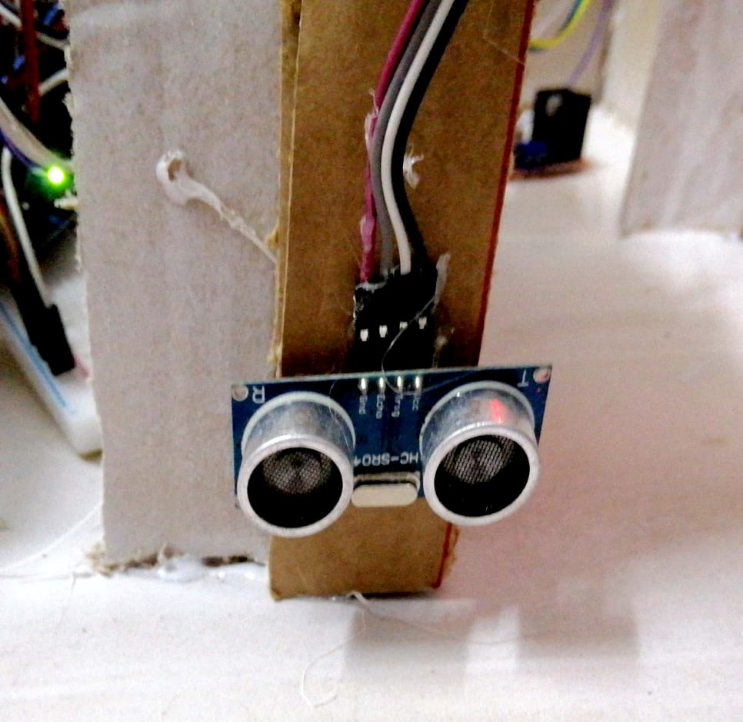
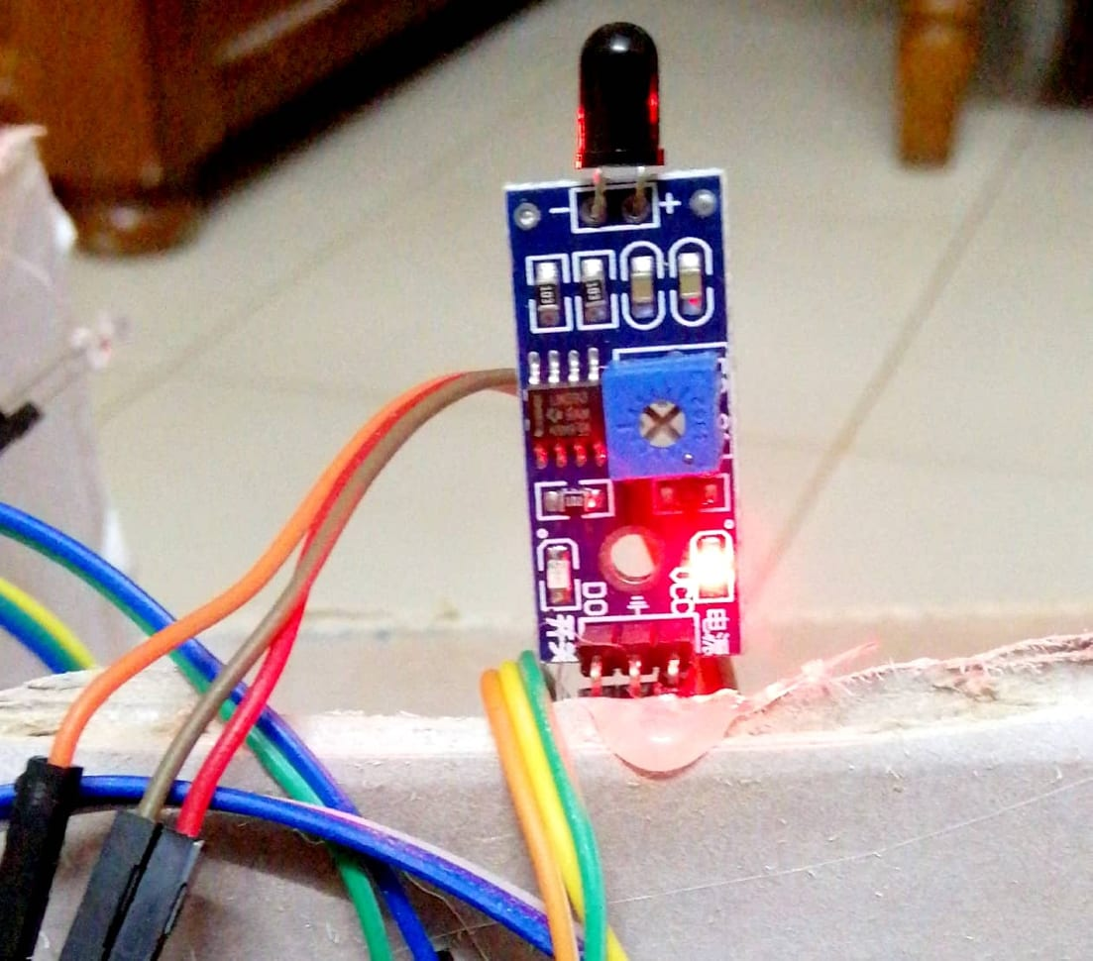
Sensor
Ultrasonic Sensor
Flame sensor

Slide 6
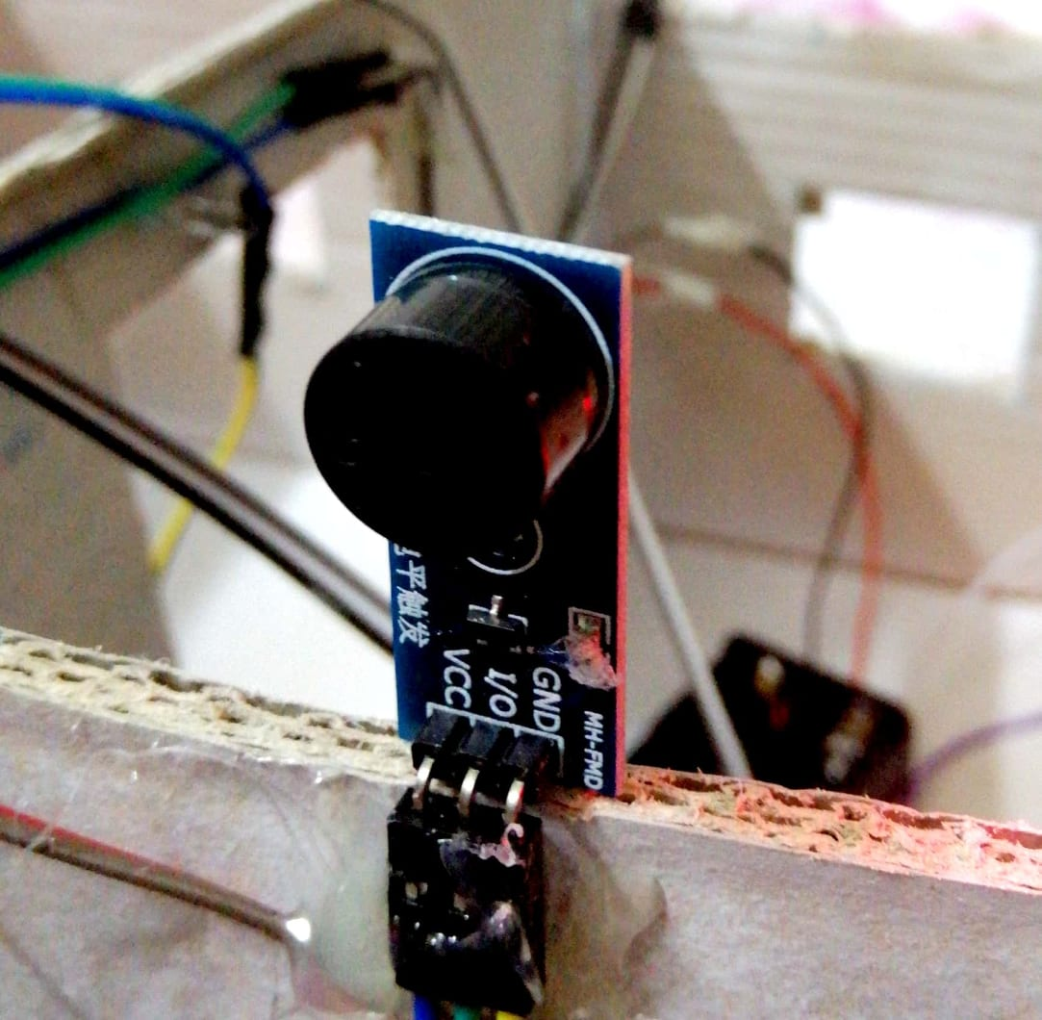
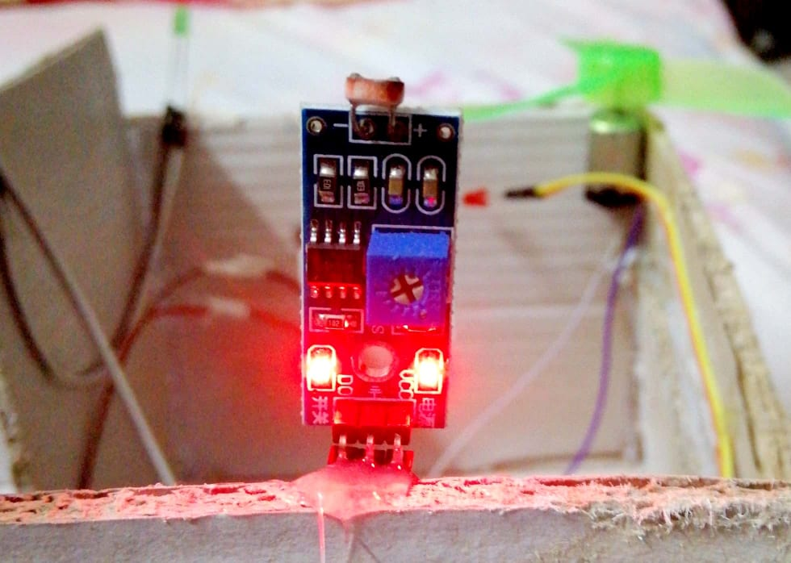
Sensor
LDR sensor
Buzzer Module

Slide 7
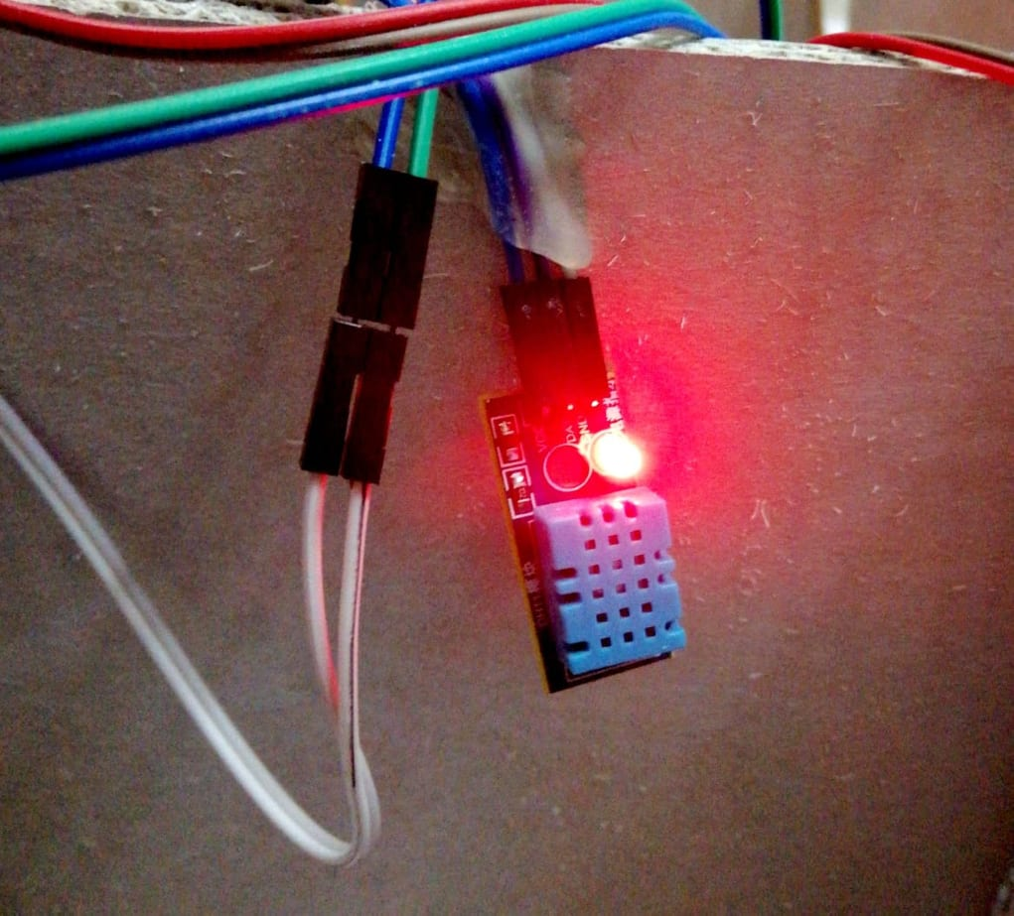
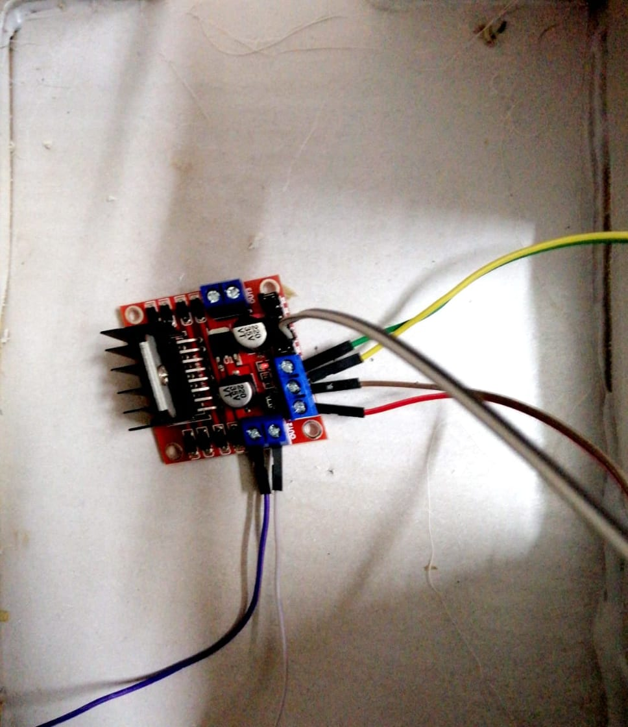
Sensors
Thermal Sensor
L298 Dual Full Bridge Driber

Slide 8
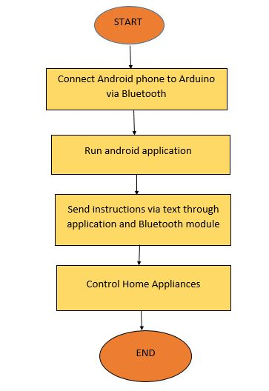
Design of proposed work

Slide 9
Advantages
Smart home technology
It is a robust and easy to use system.
Design is efficient and low cost.
Controlling electrical devices wirelessly.
Complexity is less as only a single mobile is used to control multiple aplliances.

Slide 10
Limitations
System is incapable of showing any feedback status.
Number of appliances that can be controlled is limited.
Range is limited.

Slide 11
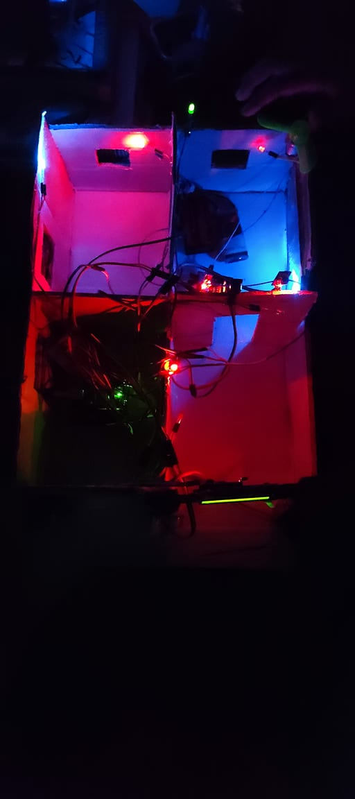
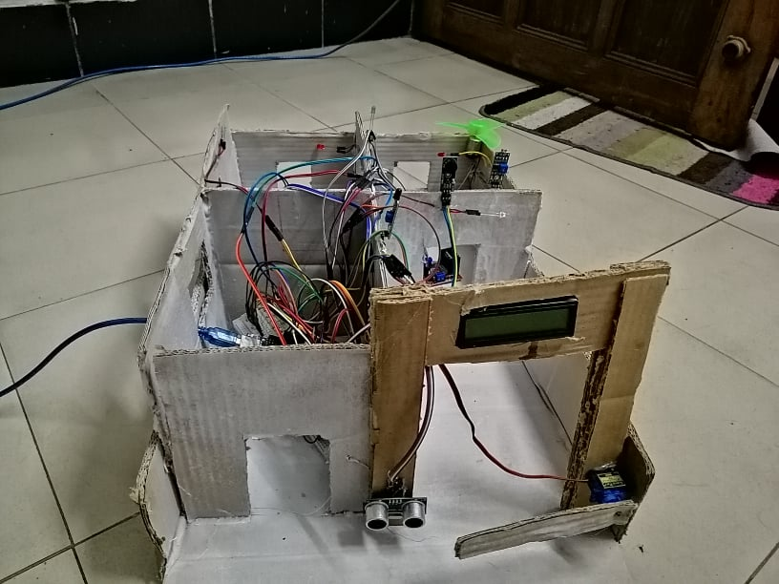
Project

Slide 12
THANK YOU !!!

