Slide 1
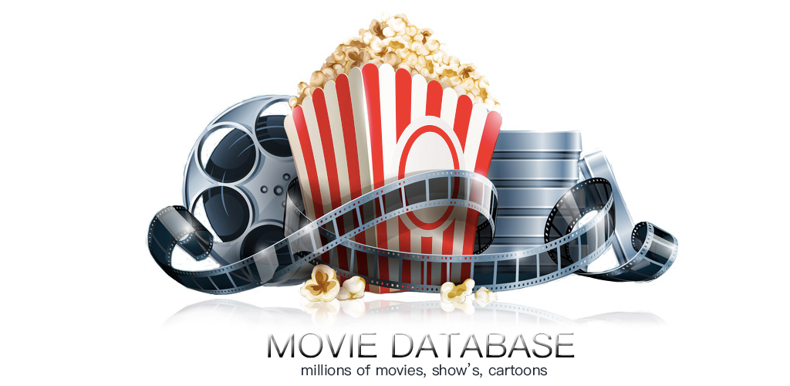

Slide 2

Introduction:A movie database management system is a specialized software application designed to efficiently organize, store, retrieve, and manage information related to films and their associated data. It serves as a comprehensive repository for details about movies, including cast and crew information, release dates, genres, ratings, reviews, and more.

Slide 3

Purpose: creating a movie database serves the overarching purpose of improving the management, accessibility, and utilization of information within the film industry. It benefits various stakeholders, including filmmakers, distributors, audiences, and researchers, contributing to the overall growth and efficiency of the industry.

Slide 4
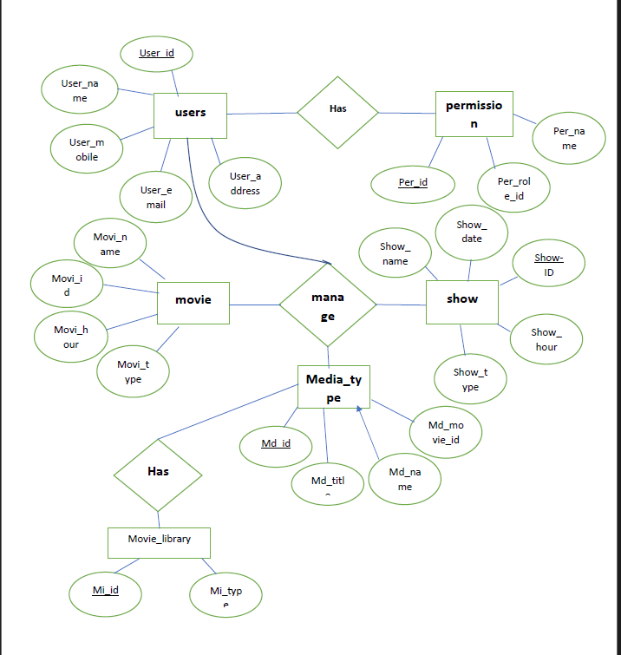
ER diagram:

Slide 5
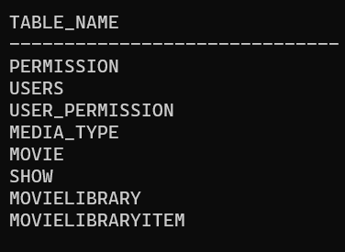
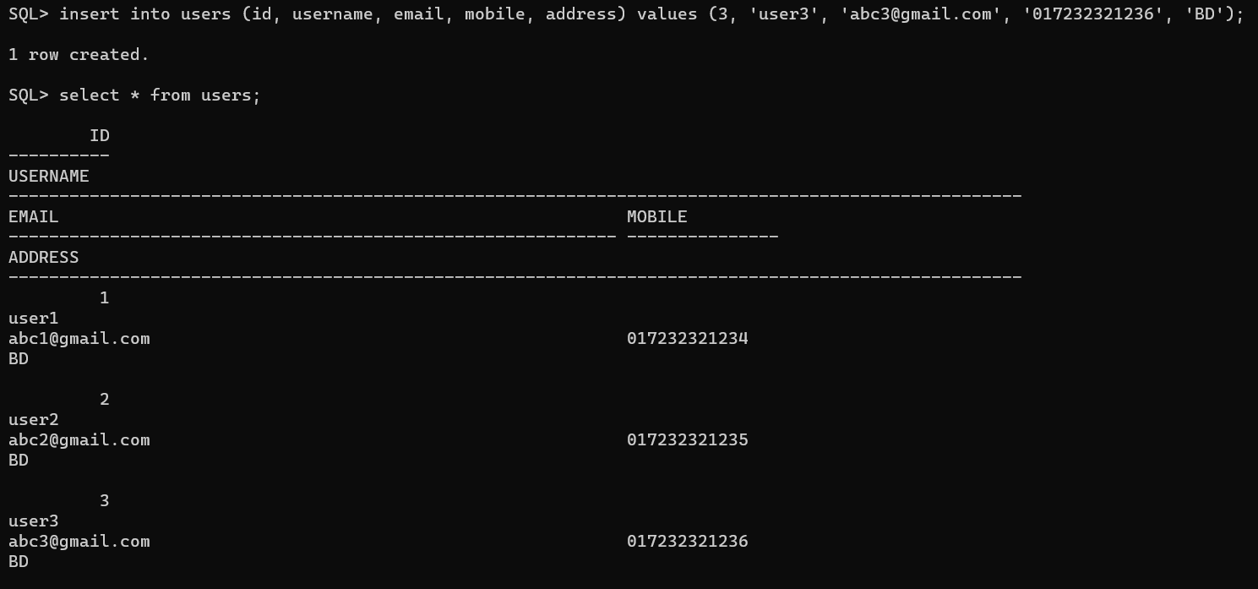
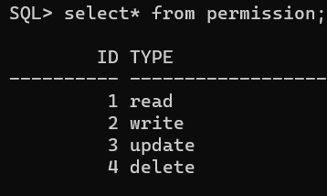
Tables: users: permission table:

Slide 6
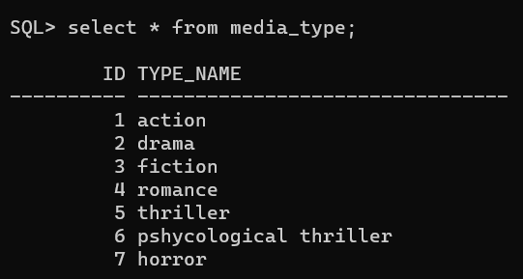
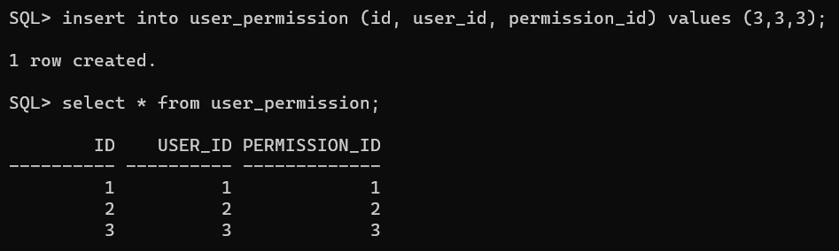
Media type: user_permission:

Slide 7
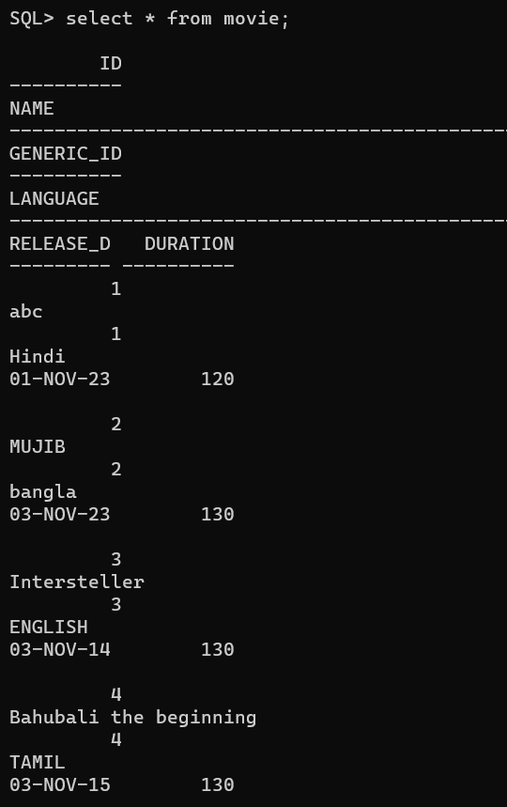
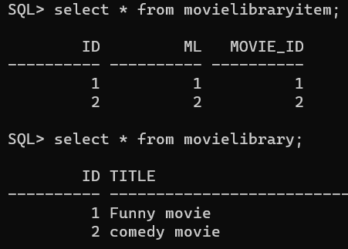

Movie: movie library:

Slide 8

Conclusion: In conclusion, a movie database is a crucial tool that plays a pivotal role in the efficient functioning of the film industry. By serving as a comprehensive repository for a wealth of information about movies, it addresses the complex and dynamic nature of the filmmaking process. The creation of a movie database is driven by the need for streamlined data management, decision-making support, and improved collaboration among stakeholders.

