Slide 1

BANGLADESH UNIVERSITY OF BUSINESS AND TECHNOLOGY
CSE-301 : Technical Writing and Presentation
Submitted to:
Jahid Tanvir
Lecturer
Department of CSE
Submmited By:
Name | ID | Intake | Section
MD.Monirul Islam | 20234103338 | 52 | 09
MD.Jahidul Islam Shihab | 20234103347 | 52 | 09
MD. Al Nasir Uddin Siam | 20234103349 | 52 | 09
Yeasir Ibna Hasibur Rahman | 20234103358 | 52 | 09

Slide 2

Presentation On
Software-Defined Networking (SDN)
Architectures, Comparative Analysis, and Future Directions

Slide 3
Presentation Outline
Introduction: Concept & Market Relevance
Core Architecture: Layers & Components
Literature Review: Comparative Studies
Methodology: Models & Simulation Tools
Result Analysis: Controller Performance
Limitations: Challenges & Gaps
Future Work: AI Integration & 6G
Conclusion
Refernces

Slide 4

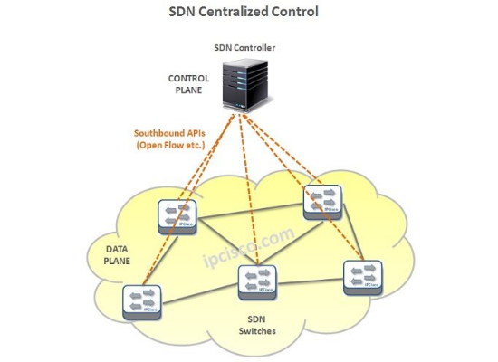
Introduction: What is SDN?
Decoupling Brain from Muscle
Traditional networking tightly couples the control plane (decision making) with the data plane (forwarding) on individual devices [1].
SDN Paradigm Shift [1,4]:
Centralized Control: A global view of the network.
Programmability: Network behavior configured via software/APIs.
Agility: Rapid adaptation to changing traffic demands.

Slide 5

Market Relevance & Growth

Slide 6
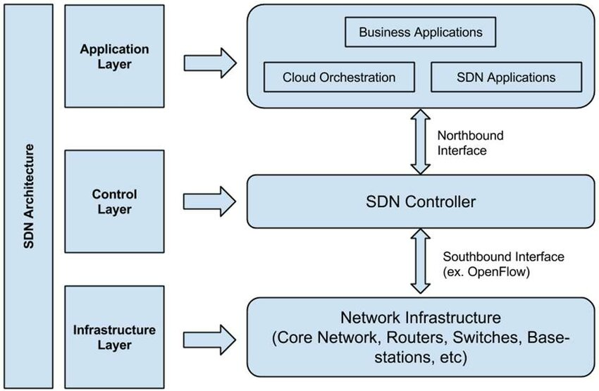
SDN Layered Architecture
Three Key Planes [1 ,2]
Application Plane: Business applications (Firewalls, Load Balancers) that communicate requirements [2].
Data Plane: The "Muscle" (Switches/Routers) that forwards packets based on rules [1,2].
Control Plane: The "Brain" (SDN Controller) that translates requirements into rules [2].

Slide 7
Literature Review: Comparative Matrix
Study/Paper | Focus Area | Key Finding
Salman et al. (2025)[1] | Controller Performance | Excels in latency; ODL leads in throughput for dense networks.
Govindarajan et al.[2] | SDN vs Traditional | SDN enables superior load balancing but introduces Single Point of Failure risks.
MDPI Survey (2024)[5] | Security Issues | Centralized control plane is a prime target for DDoS attacks; distributed consensus is needed.
Comparison Study (2024)[3] | Topology Impact | Linear topologies favor Ryu; Tree topologies favor ODL for scalability.

Slide 8






Controller Landscape
OpenDaylight (ODL)
ONOS
Ryu
Java-based, modular, and backed by the Linux Foundation. Known for high throughput and industry adoption.
Carrier-grade, distributed architecture. Best for Service Providers requiring high availability.
Python-based, component-oriented. Highly favored in research for its simplicity and fast prototyping.

Slide 9
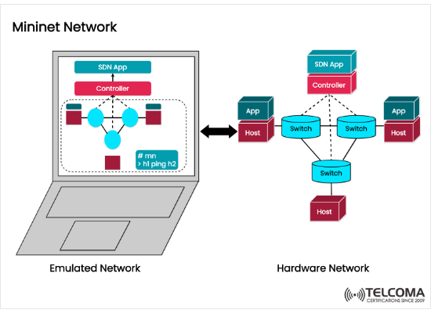
Methodology: Experimental Model
Simulation Environment: Experiments are typically conducted using Mininet, the standard emulator for rapid prototyping.
Traffic Generation: Tools like Iperf (bandwidth) and Cbench (controller benchmarking) generate synthetic loads.
Topology Design: Testing across Linear, Tree, and Mesh topologies to evaluate path finding algorithms.

Slide 10
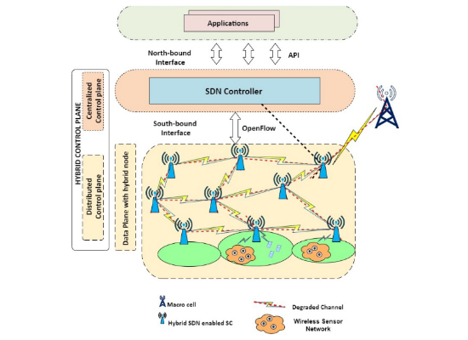

Methodology: Hybrid Network Scenarios
Bridging Legacy and Future
Pure SDN deployment is rare in brownfield environments. Methodologies often involve a Hybrid SDN model:
Legacy Nodes: Traditional routers running OSPF/BGP.
SDN Nodes: OpenFlow switches managed by a central controller.
Goal: Evaluate interoperability and progressive migration strategies.

Slide 11
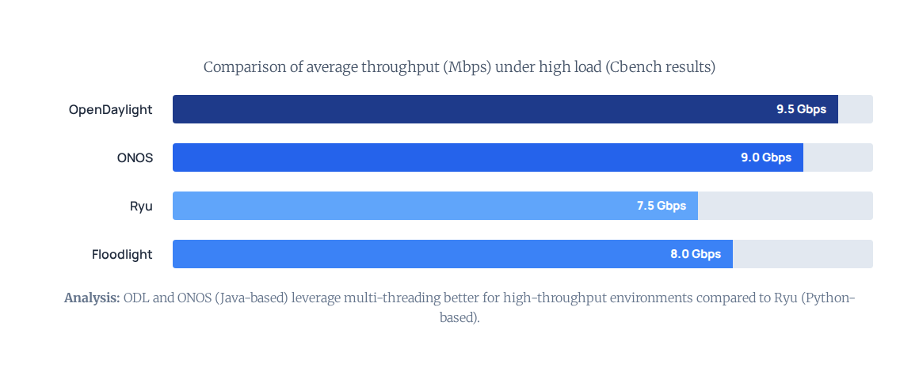
Result Analysis: Controller Throughput

Slide 12
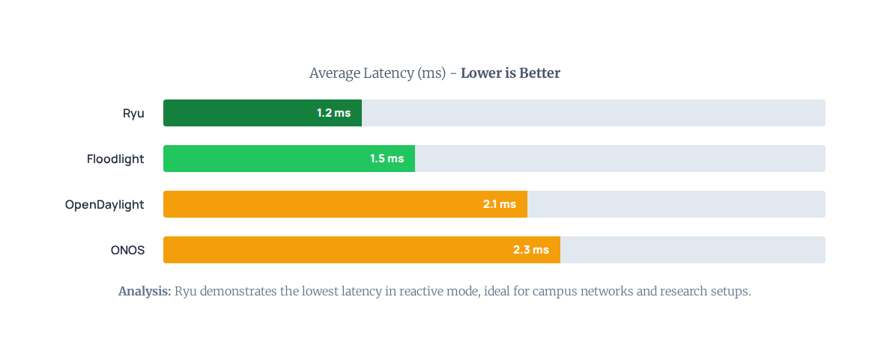
Result Analysis: Latency Comparison

Slide 13





Which Approach is Best?
Research & Prototyping
Enterprise Data Centers
Service Providers (WAN)
Winner: Ryu
Due to its simplicity, Python support, and low latency in small topologies.
Winner: OpenDaylight
Due to massive ecosystem support, legacy protocol integration, and high throughput.
Winner: ONOS
Due to native clustering, high availability, and carrier-grade scalability features.

Slide 14

Limitations & Challenges
Single Point of Failure (SPOF): A centralized controller failure can bring down the entire network if redundancy isn't configured.
Scalability Bottlenecks: As flow requests increase, the controller-switch link can become saturated.
Security Vulnerabilities
Consistency vs. Availability: Distributed controllers (like ONOS) face CAP theorem trade-offs during network partitions.

Slide 15



Identified Research Gaps
Distributed Security
Real-time AI Adaptation
Legacy Interoperability
Lack of robust, standardized security protocols for east-west communication between distributed controllers.
Limited research on controllers that can self-heal using Reinforcement Learning in < 1ms response times.
Seamless, automated translation between OpenFlow rules and complex vendor-specific legacy CLI commands.

Slide 16

Future Work: AI & 6G
Intent-Based Networking (IBN): Moving from "how" to configure (rules) to "what" is needed (business intent).
AI-Driven SDN: Using Machine Learning to predict traffic spikes and pre-install rules to reduce latency.
SDN in 6G: Dynamic slicing of network resources for ultra-low latency applications (IoT, Autonomous Driving).

Slide 17
Conclusion
"SDN has fundamentally transformed networking from static hardware configuration to dynamic software orchestration. While challenges in security and scalability remain, the integration of AI and distributed architectures points to a future of fully autonomous, self-driving networks."

Slide 18






Image Sources
https://ipcisco.com/wp-content/uploads/SDN-centralized-control-1-458x492.jpg
Source: ipcisco.com
https://sdn.ieee.org/images/files/newsletter/201709-haleplidis-figure1.jpg
Source: ieee.org
https://uploads.teachablecdn.com/attachments/kIdtT9WLQ82xjO9qwRHQ_2-14+Mininet+Network.drawio.png
Source: www.telcomaglobal.com
https://www.mdpi.com/jsan/jsan-10-00057/article_deploy/html/images/jsan-10-00057-g001.png
Source: www.mdpi.com
https://thegreeleyvoice.com/wp-content/uploads/2025/02/neural-networks.png
Source: thegreeleyvoice.com

Slide 19
References
[1] D. Kreutz, F. Ramos, P. Esteves Verissimo, C. Esteve Rothenberg, S. Azodolmolky and S. Uhlig, “Software-Defined Networking: A Comprehensive Survey,” Proceedings of the IEEE, vol. 103, no. 1, pp. 14–76, Jan. 2015.
[2] N. McKeown et al., “OpenFlow: Enabling Innovation in Campus Networks,” in Proc. ACM
SIGCOMM, pp. 69–74, 2008.
[3] S. Jain et al., “B4: Experience with a Globally-Deployed Software Defined WAN,” in Proc. ACM SIGCOMM, pp. 3–14, 2013.
[4] A. Lara, A. Kolasani and B. Ramamurthy, “Network Innovation Using OpenFlow: A Survey,” IEEE Communications Surveys & Tutorials, vol. 16, no. 1, pp. 493–512, 2014.
[5] S. Scott-Hayward, G. O’Callaghan and S. Sezer, “SDN Security: A Survey,” IEEE Communications Surveys & Tutorials, vol. 18, no. 1, pp. 623–654, 2016.

Slide 20
Questions?
Thank you for your attention.

