Slide 1


Bank of Baroda Hackathon - 2022
Technology Partner
Your Team Name :Primers
Your team bio : Jahir Mashal
Imtiyaz Khan
Shubham Saroj
Date :14/08/2022

Slide 2
Problem Statement?
Why did you decide to solve this Problem statement?
Problem-solving enables us to identify and exploit opportunities in the environment and exert control over the future. Problem solving skills and the problem-solving process are a critical part of daily life both as individuals and organizations.
To stop bad things from happening/ To secure money & Properties and also Preventing from thieving

Slide 3
User Segment & Pain Points
Which user /advertiser segment would be early adopter of your product & why?
Security Department will adopt early.
Because its made for the purpose of securing the eniviornment in financial sector like banks.

Slide 4
Pre-Requisite
What are the alternatives/competitive products for the problem you are solving?
This is in making for this problem and the once that are already present are costly to afford.

Slide 5
Azure tools or resources
Azure tools or resources which are likely to be used by you for the prototype, if your idea gets selected Azure Virtual Machine Azure SQL Database Azure Blob Storage

Slide 6
Any Supporting Functional Documents
Present your solution, talk about methodology, architecture & scalability
1.Camera at entrance will scan the face of the person entering and count the numbers of people , and check the details of person’s data in database . behave There will already be an inquiry table for the new account opener on the entrance.
2. Person can’t exit outside on the same way he entered.there will be another way for the exit.
3. In the main hall there will be 2 cameras in the corner facing each other it will capture all the hall in 180 degree .
4.Cameras will sense the facial expression and behavoureal changes .
5. On cash counter there will also be a camera which will identify the persons account in the bank and will show account details to the emplyore and also identify how he behave on cash counter .
6. Camera at exit will scan the face of the person going towards exit and count the numbers of people going out .

Slide 7
Key Differentiators & Adoption Plan
How is your solution better than alternatives and how do you plan to build adoption?
The solution we are building is adoptable by the environment of its surroundings and does not feel uncomfortable for the customer’s and it a high security system for the verification purposes.
We are using high quality cams and system which connect with bank database with this all this will be handled by the security cabin 24/7.

Slide 8
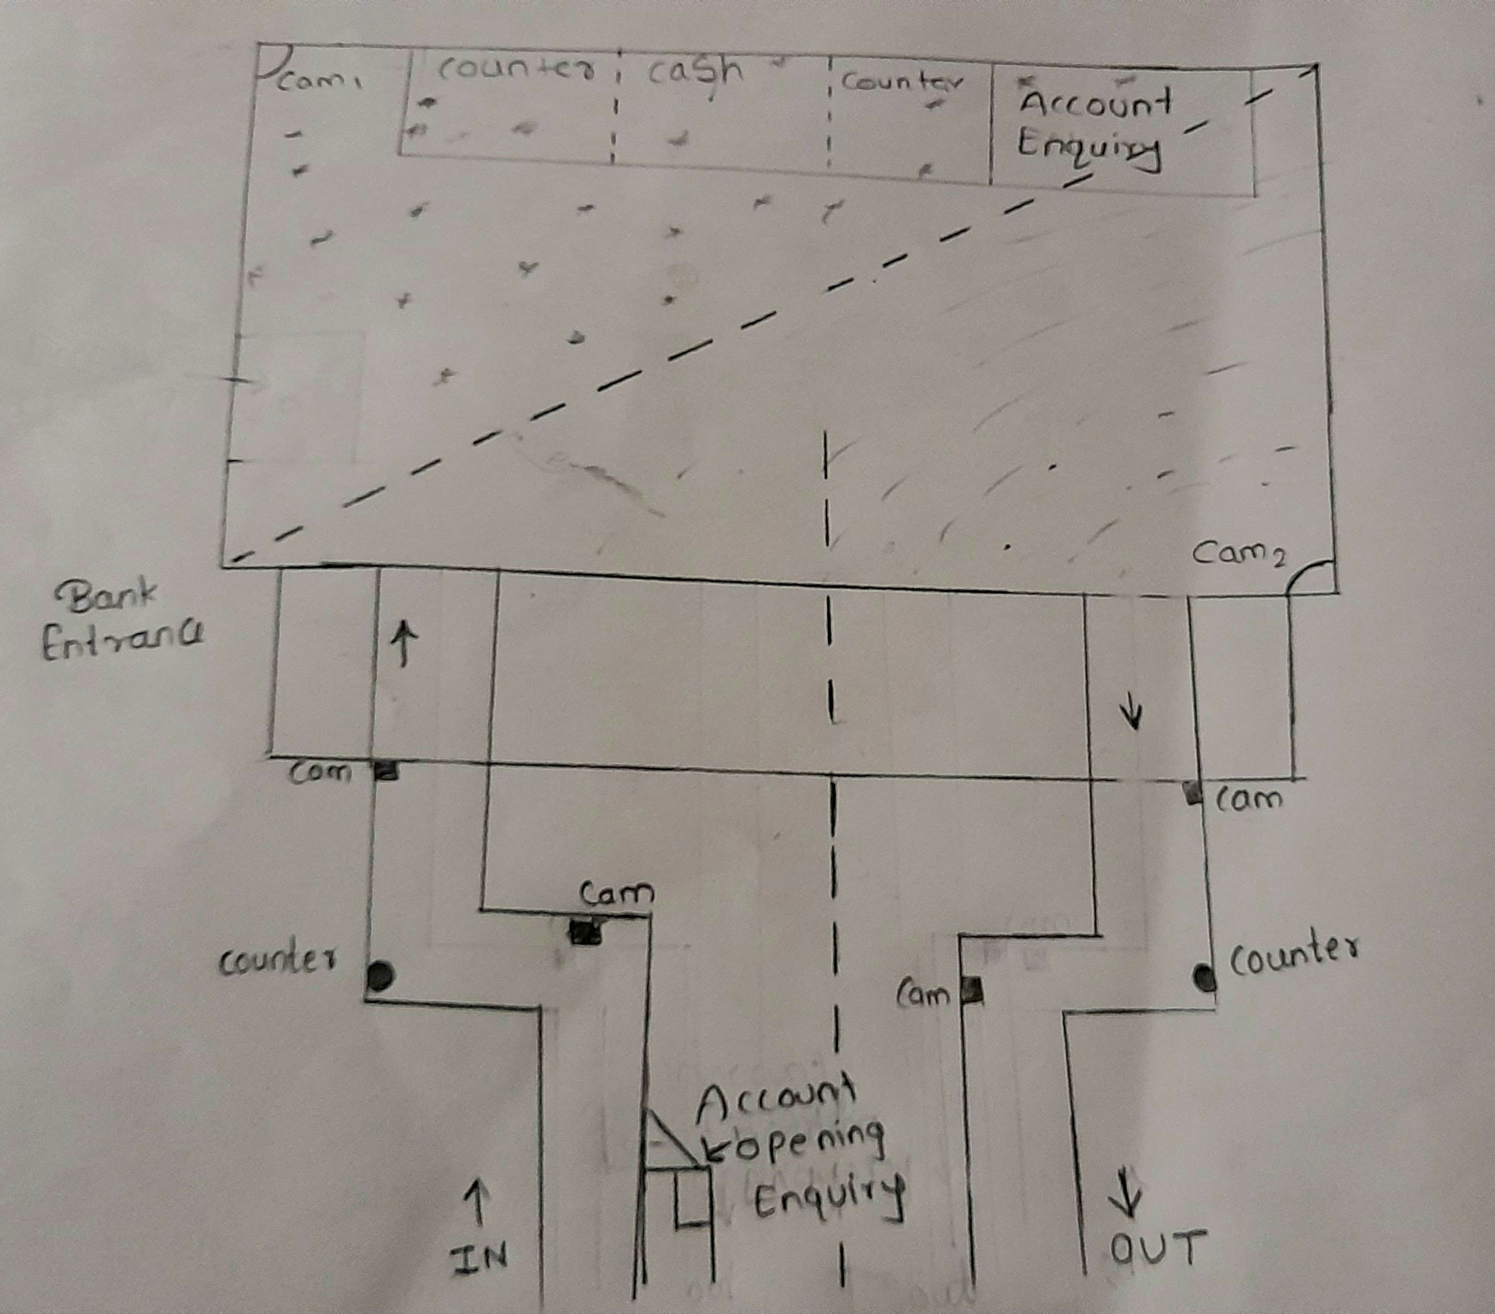
GitHub Repository Link & supporting diagrams, screenshots, if any
How far it can go?

Slide 9
Thank You
Team member names
JahirMashal
Imtiyaz Khan
Shubham Saroj

