Slide 1


The superexchange interaction in overdoped manganites
L.E. Gonchar
Ural State University of Railway Transport
Ural Federal University named after First President of Russia B.N. Yeltsin,
Yekaterinburg, Russia

Slide 2
Model of the JT magnetic crystal
Crystalline structure,
charge ordering (experimental data from papers)
Tuning of model*
Linear vibronic interaction
Orbital ordering
Magnetic structure
Orbitally-dependent superexchange interaction & SIA
*If necessary, the non-linear and non-local parts could be added to the model. These part are not used in current investigation,

Slide 3
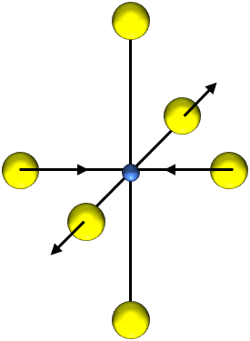
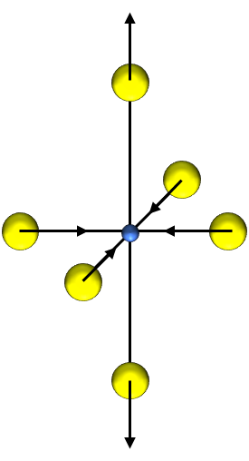
Orbital subsystem model
Mn³⁺ −d⁴, in the crystal field of octahedron ⁵E, eigenfunctions: |θ⟩~2z²-x²-y², |ε⟩~x²-y²
e_{g}
d⁴
t_{2g}
H_{JT}=V_{e}(Q_{θ}X_{θ}+Q_{ε}X_{ε})
V_{e}= –1,29 эВ/Å*
⁵E
Q_{ε}
Q_{θ}
Θ−angle parameter characterizing the orbital state of Mn³⁺ - the main in the work
* | A.E. Nikiforov, S.E. Popov Appl. Phys. A 74, S1743 (2002)

Slide 4
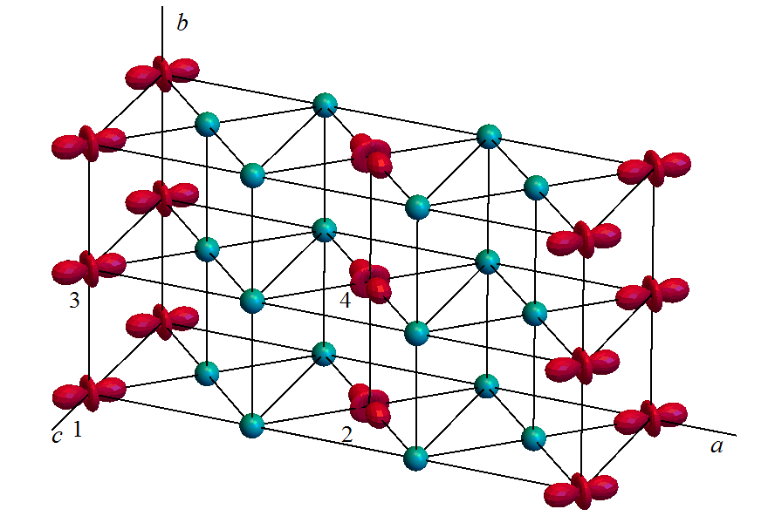
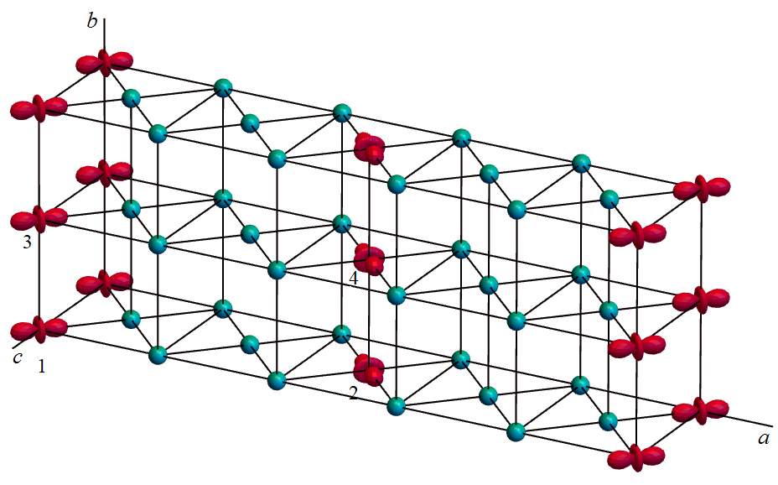
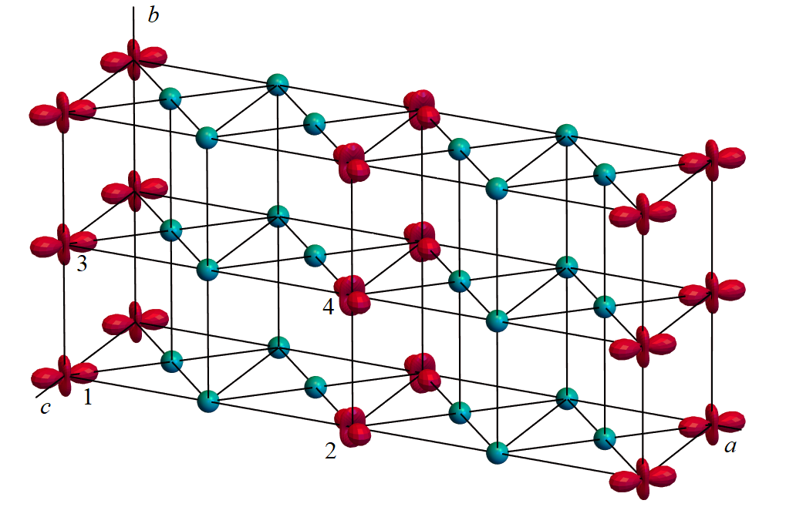
Symmetrized e_{g}-distortions and orbital structures
Mn³⁺−⁵E
La_{1/3}Ca_{2/3}MnO₃, Pnma×3
structure from Radaelli P.G. et al. PRB 59,14440 (1999)
Θ₁=Θ₃≈2π−Θ₂=2π−Θ₄=Θ
Mn⁴⁺ −⁴A₂
Bi_{1/5}Ca_{4/5}MnO₃, Pnma×5
La_{1/4}Ca_{3/4}MnO₃, P2₁/m
structure from S. Grenier et al. PRB 75 085101 (2007)
structure from M. Pissas et al. PRB 72, 064426 (2005)

Slide 5
Magnetic subsystem model
+ transformation of the reference frame from local axes of octahedron to general system

Slide 6
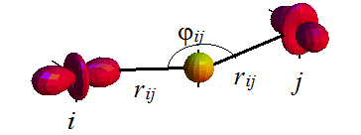
Orbitally-dependent exchange interaction
Mn³⁺ – Mn³⁺ (x, y, z)
Mn³⁺ – Mn⁴⁺ (x, y, z)
Mn⁴⁺ – Mn⁴+
Mn³⁺
Mn³⁺
O²⁻

Slide 7
Parameters of interactions
Compound | Parameters, meV
La_{1/3}Ca_{2/3}MnO₃ (Θ=5π/3) | J₃^{ac}=1.0, J₂^{ac,1}=2.2, J₂^{ac,2}= −9.1, J₃^{b}=1.3, J₁^{b}=2.4 D=0.15, E=±0.15
La_{1/4}Ca_{3/4}MnO₃ (Θ=1.58π) | J₃^{ac}=1.0, J₂^{ac,1}=2.6, J₂^{ac,2}= −9.7, J₃^{b}=1.3, J₁^{b}=1.4 D=0.08, E=±0.17
Bi_{1/5}Ca_{4/5}MnO₃ (Θ=1.66π) | J₃^{ac}=1.2, J₂^{ac,1}=3.4, J₂^{ac,2}= −9.0, J₃^{b}=1.3, J₁^{b}=1.3 D=0.14, E=±0.15

Slide 8
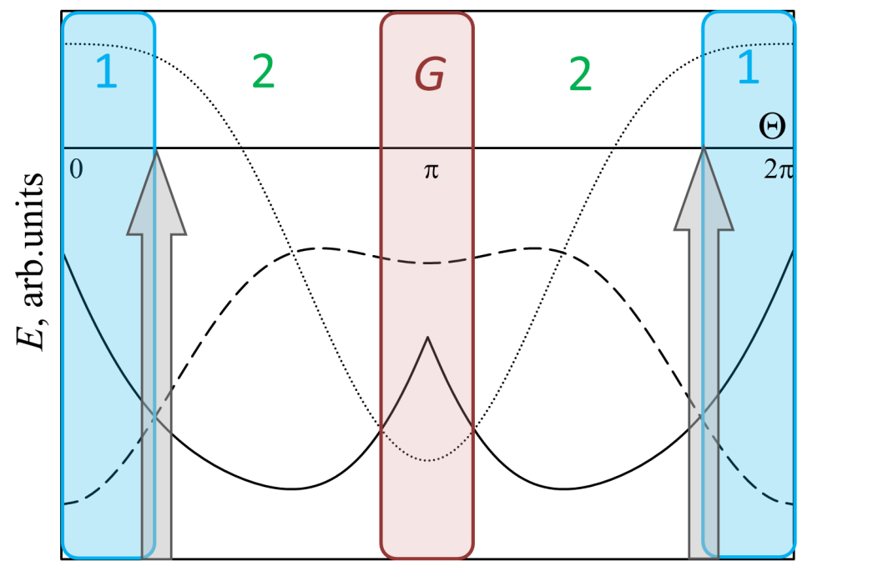
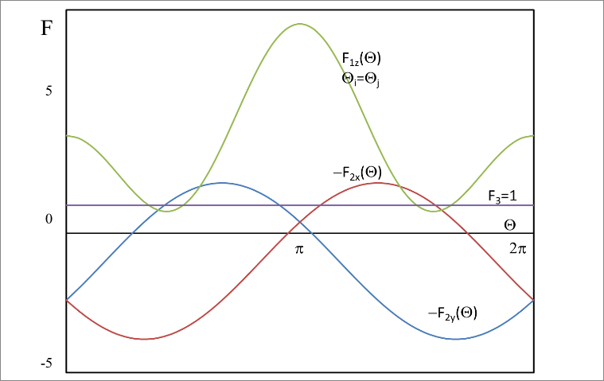
Orbital dependence of superxchange interaction and exchange energy
z
Wide arrows show the orbital mixture angles of the experimental structures [Radaelli P.G. et al. PRB 59,14440 (1999), M. Pissas et al. PRB 72, 064426 (2005), S. Grenier et al. PRB 75 085101 (2007)]
Magnetic structures of types 1 and 2 are complicated. They are drawn in slide 9.

Slide 9
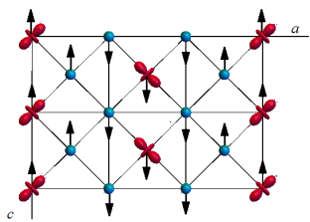
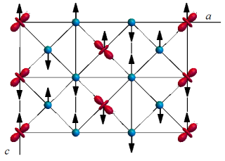
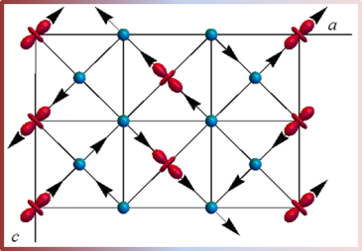
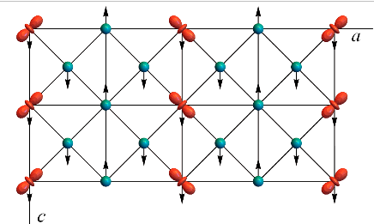
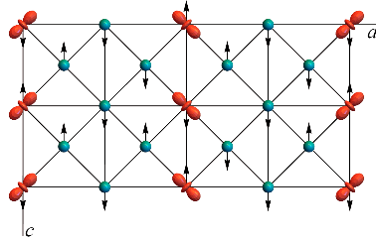
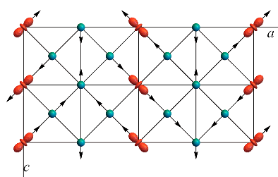
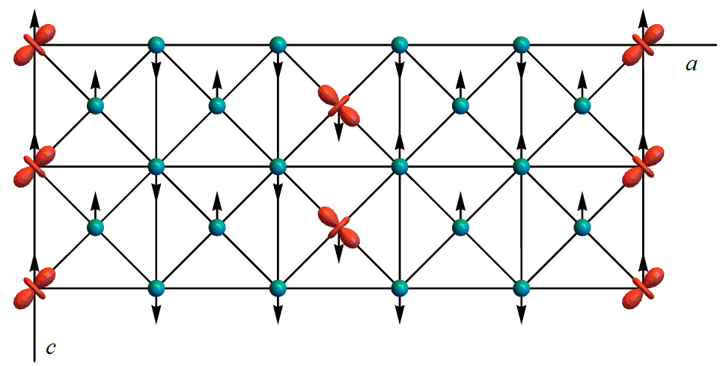
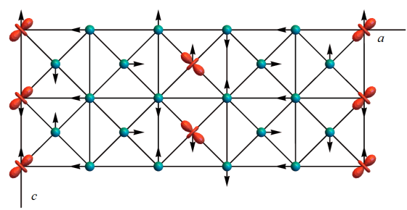
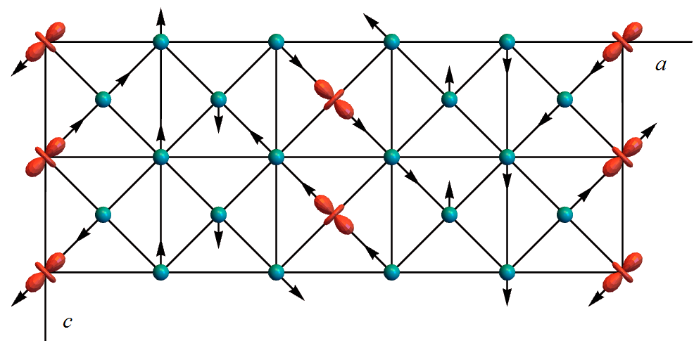
Magnetic structures (next pane –opposite directions)
Compound | 1- k_{c}=0 || | 2 - k_{c}={0,0,1/2} || ⊥
La_{1/3}Ca_{2/3}MnO₃ FM trimers
La_{1/4}Ca_{3/4}MnO₃ FM trimers FM stripes (AFM stripes) |  | and some others
Bi_{1/5}Ca_{4/5}MnO₃ FM trimers AFM stripes |  | and some others

Slide 10
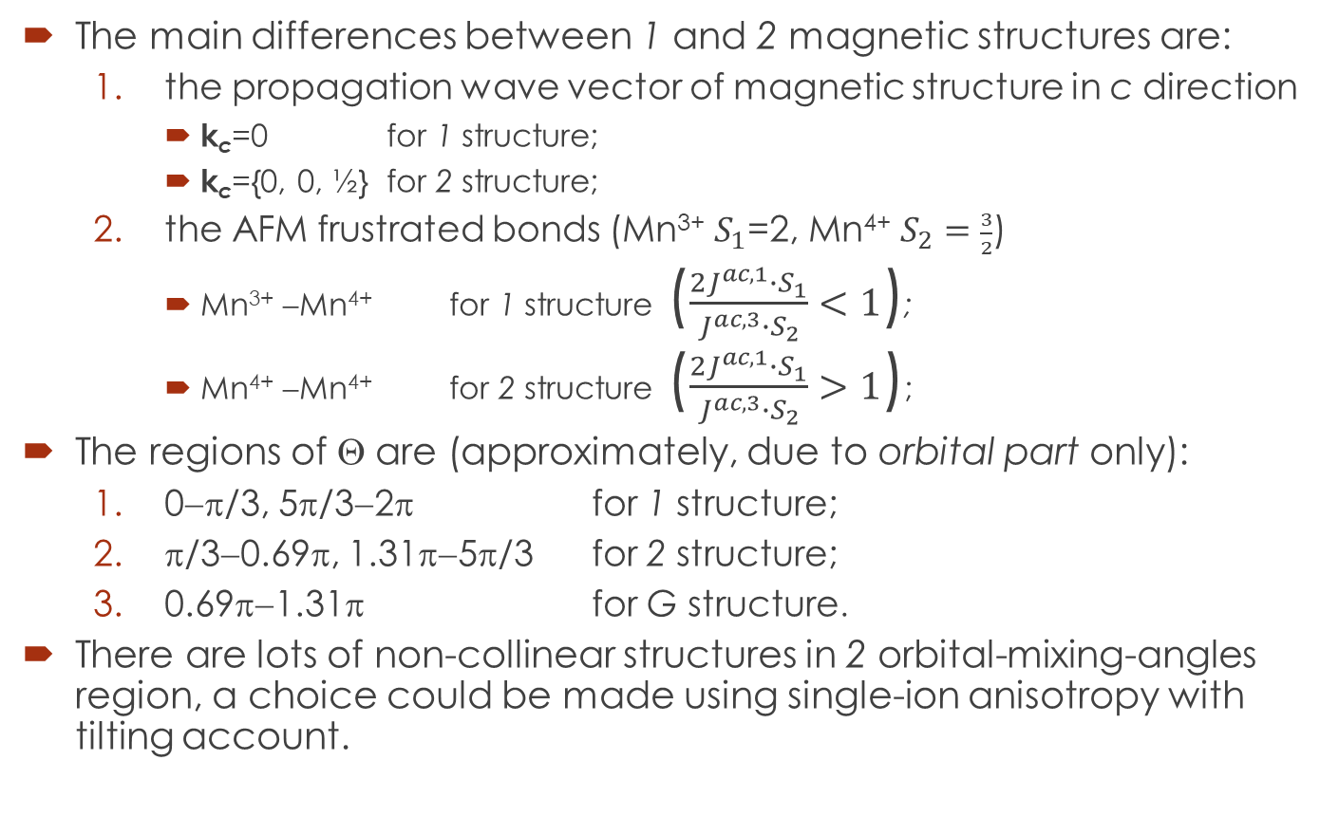
Magnetic structure: comments
The main differences between 1 and 2 magnetic structures are:
the propagation wave vector of magnetic structure in c direction
k_{c}=0 for 1 structure;
k_{c}={0, 0, ½} for 2 structure;
the AFM frustrated bonds (Mn³⁺ $S_{1}$=2, Mn⁴⁺ $S_{2}=\frac{3}{2}$)
Mn³⁺ −Mn⁴⁺ for 1 structure ($\frac{2J^{ac,1}∙S_{1}}{J^{ac,3}∙S_{2}}<1$);
Mn⁴⁺ −Mn⁴⁺ for 2 structure ($\frac{2J^{ac,1}∙S_{1}}{J^{ac,3}∙S_{2}}>1$);
The regions of Θ are (approximately, due to orbital part only):
0−π/3, 5π/3−2π for 1 structure;
π/3−0.69π, 1.31π−5π/3 for 2 structure;
0.69π−1.31π for G structure.
There are lots of non-collinear structures in 2 orbital-mixing-angles region, a choice could be made using single-ion anisotropy with tilting account.

Slide 11
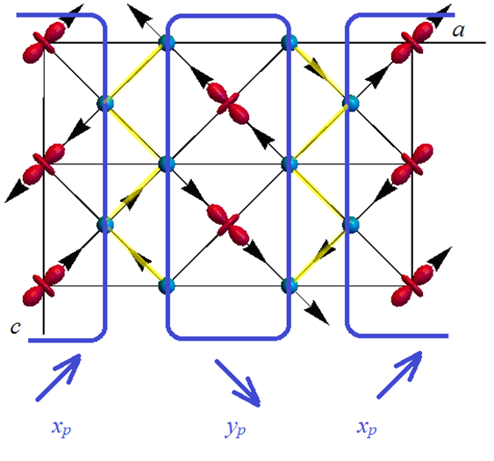
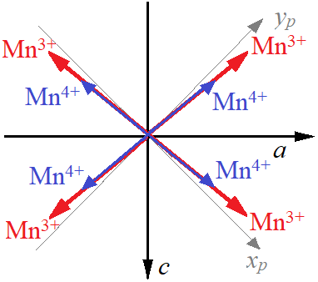
Magnetic structure: La_{1/3}Ca_{2/3}MnO₃
Comparing with experiments (Radaelli, PRB59 14440, Fernández-Díaz, PRB59 1277(1999)) :
Wave vector of MS
Magnetic trimers, angle between trimers 80⁰ (56^{о} –Radaelli, 80^{о}- Fernández-Díaz)

Slide 12
Conclusions
Model describes various magnetic structures of JT insulating manganites
Magnetic subsystem is dependent upon orbital one
Orbital dependence afford to describe both general ordering and non-collinear components of magnetic structure
The main feature of magnetic structure: FM trimers with Mn⁴⁺ - Mn⁴⁺ planar bond frustration
NO C-structure

Slide 13
Thank you for attention!
Liudmila E. Gonchar, Yekaterinburg, Russia
l.e.gonchar@yandex.ru
https://www.researchgate.net/profile/L-Gonchar-2

Slide 14
Model is published in…
J.Magn.Magn.Mater. 465, 661 (2018)
Physics of the Solid State 61, 728 (2019)
J.Magn.Magn.Mater. 513, 167248 (2020)
Low Temp.Phys. 48, 37 (2022)
Phys. Met. Met. 123, 268 (2022)
Appl Magn. Reson. 54, 503–511 (2023)

