Slide 1

The Role of Nonadiabatic Couplings
in Spectroscopic Calculations of Aromatic Molecules
Soumya Mukherjee¹, Saikat Hazra¹, Satyam Ravi^{1,2},
Subhankar Sardar^{1,3} and Satrajit Adhikari^{1,*}
¹School of Chemical Sciences, Indian Association for the Cultivation of Science,
Jadavpur, Kolkata - 700 032, West Bengal, India;
²School of Advance Science and Languages, VIT Bhopal University, Bhopal – 466114, India
³Department of Chemistry, Bhatter College, Paschim Midnapore, West Bengal, India
*Email: pcsa@iacs.res.in
Poster Presenter’s Email: pcsm5@iacs.res.in, soumyamukherjee093@gmail.com

Slide 2
Objective and key features of my work
Born-Oppenheimer (BO) approximation^{1,2} : No coupling between fast-moving electrons and slow-moving nuclei (huge differences in masses).
At degenerate points, nonadiabatic coupling terms (NACTs) (electron-nuclei coupling) become infinite (Hellmann-Feynman theorem)^{3,4}. At other points also, NACT may have non-negligible value due to substantial coupling between electronic and nuclear motion.
A paradigm shift from adiabatic to diabatic framework is needed.
In diabatic representation, electron-nuclear couplings appear in form of diabatic couplings which are smooth, continuous as well as single-valued.
Diabatic wavefunctions are formed by orthogonal rotation of the adiabatic wavefunction. The elements of such rotation matrix are obtained by employing the Adiabatic-to-Diabatic Transformation (ADT) condition^{5,6}.
Finally, diabatic potential energy is calculated using the similarity transformation of adiabatic potential energy matrix by the rotation (ADT) matrix.
We have developed a generalized code, ‘ADT’ to formulate analytic expressions of ADT quantities and compute their numerical values.⁷
Born M. and Oppenheimer J. R., Ann. Phys. 1927, 84, 457.
Born M. and Huang K., Dynamical Theory of Crystal Lattices, Oxford University Press: Oxford, U.K., (1954)
Hellmann, H. Einfuhrang in die Quantenchemie; Franz Duetiche: Leipzig, Germany, 1937.
Feynman, R. Forces in Molecules. Phys. Rev. 1939, 56, 340−343.
Baer, M. Phys. Rep. 2002, 358, 75−142.
Sarkar, B.; Adhikari, S. J. Chem. Phys. 2006, 124, 074101.
Naskar K., Mukherjee S., Mukherjee B., Ravi S., Mukherjee S., Sardar S. and Adhikari S. J. Chem. Theory Comput. 2020, 16, 1666.

Slide 3
Origination of NACT
BO expansion :
where, molecular wavefunction
electronic wavefunctions
nuclear wavefunctions
Total time-independent Schrödinger equation :
sum of nuclear kinetic energy operator and electronic Hamiltonian
where,
nuclear kinetic energy operator
Electronic Schrödinger equation :
[u_{i} s are adiabatic potential energy]

Slide 4
Substituting the wavefunction and projecting this equation with ,
where U adiabatic potential energy matrix (diagonal matrix)
τ nonadiabatic coupling matrix (NACM). (skew-symmetric
for real wavefunctions)
Here, NACT :
In BO approximation this is considered as 0 (i.e. no electron-nuclear coupling) and the above Schrödinger equation becomes,

Slide 5
Diabatic Representation
Adiabatic wavefunctions :
where, A rotation matrix (orthogonal)
diabatic nuclear wavefunction matrix.
Adiabatic to Diabatic Transformation (ADT) Condition :
Modified Schrödinger equation :
where,
Here W is diabatic potential energy matrix (off diagonal terms are diabatic couplings and they are not singular)

Slide 6
Example: Diabatization for six state sub-Hilbert space ^{[1]}
One of the rotation matrix :
One of the ADT equations :
Mukherjee S., Ravi S., Dutta J., Sardar S. and Adhikari S. Phys. Chem. Chem. Phys., 2022, 22, 2185.

Slide 7
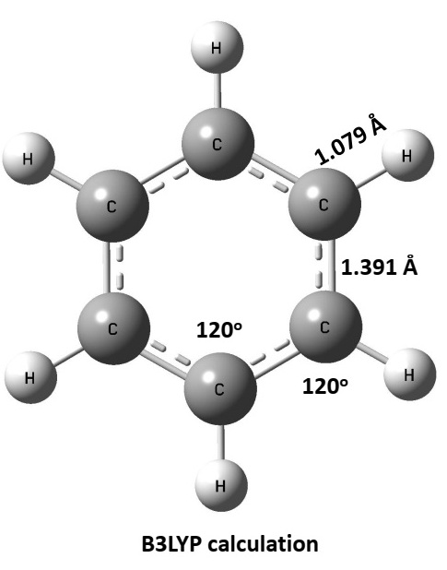
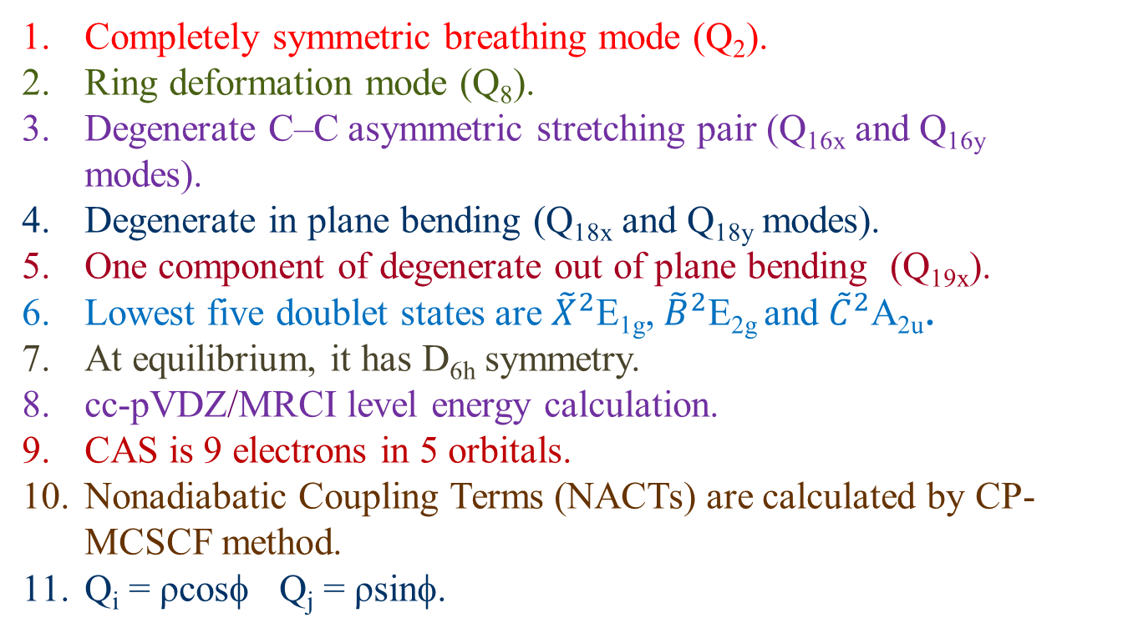
BBO Treatment for C₆H₆⁺
Ab Initio Calculations :
Completely symmetric breathing mode (Q₂).
Ring deformation mode (Q₈).
Degenerate C–C asymmetric stretching pair (Q_{16x} and Q_{16y} modes).
Degenerate in plane bending (Q_{18x} and Q_{18y} modes).
One component of degenerate out of plane bending (Q_{19x}).
Lowest five doublet states are ${\tilde{X}}^{2}$E_{1g}, ${\tilde{B}}^{2}$E_{2g} and ${\tilde{C}}^{2}$A_{2u}.
At equilibrium, it has D_{6h} symmetry.
cc-pVDZ/MRCI level energy calculation.
CAS is 9 electrons in 5 orbitals.
Nonadiabatic Coupling Terms (NACTs) are calculated by CP-MCSCF method.
Q_{i} = ρcosφ Q_{j} = ρsinφ.
Mukherjee S., Ravi S., Naskar K., Sardar S. and Adhikari S. J. Chem. Phys., 2021, 154, 094306.

Slide 8
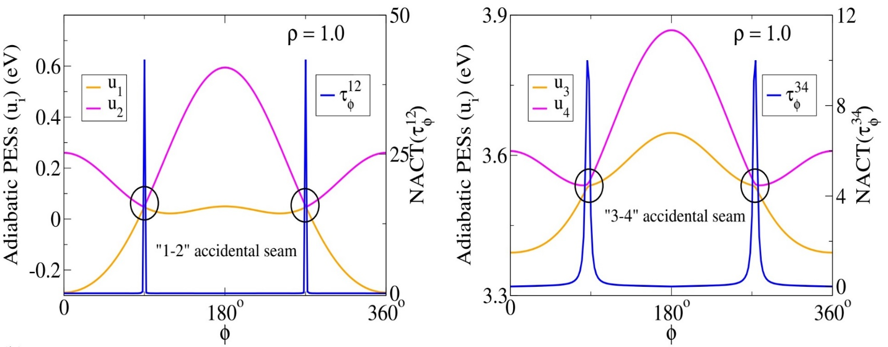
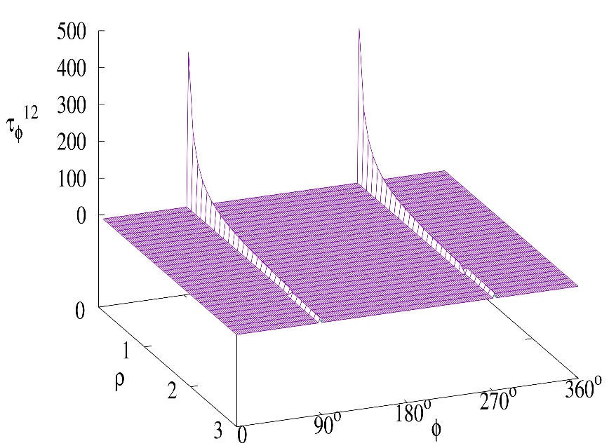
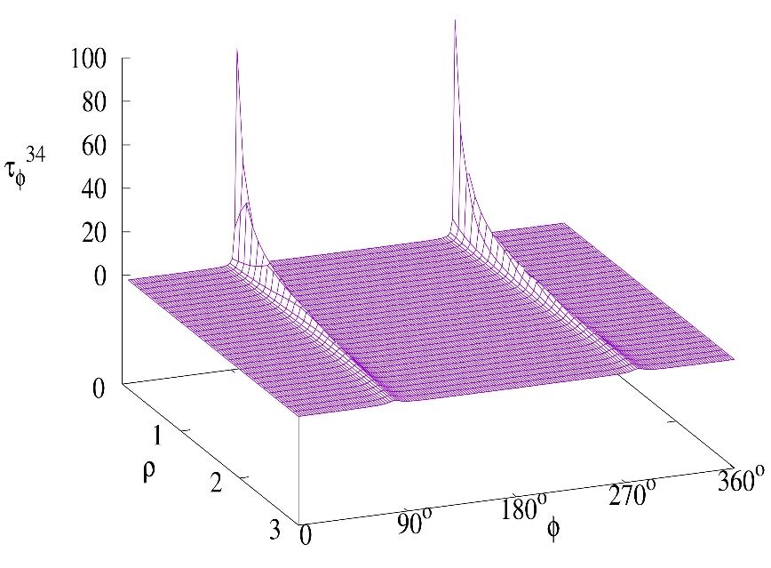
Q_{18x}-Q_{19y} Pair: Adiabatic Energies and NACTs
Mukherjee S., Ravi S., Naskar K., Sardar S. and Adhikari S. J. Chem. Phys., 2021, 154, 094306.

Slide 9
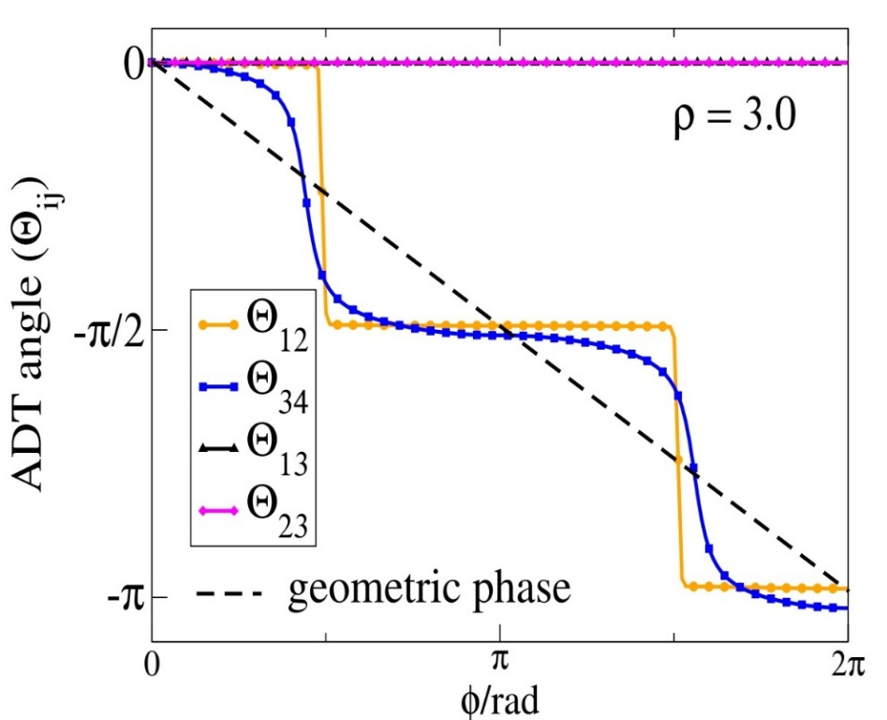
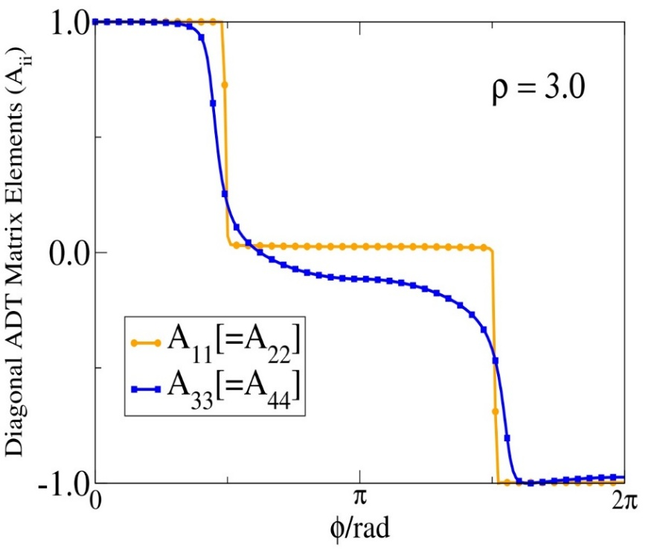
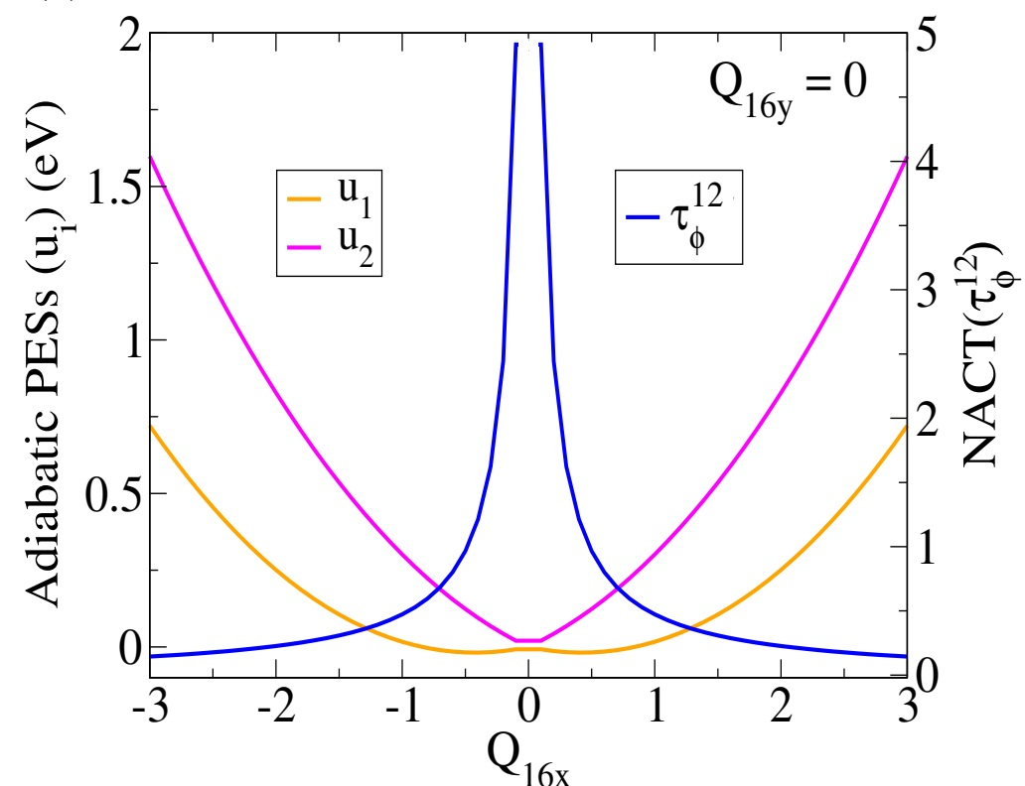
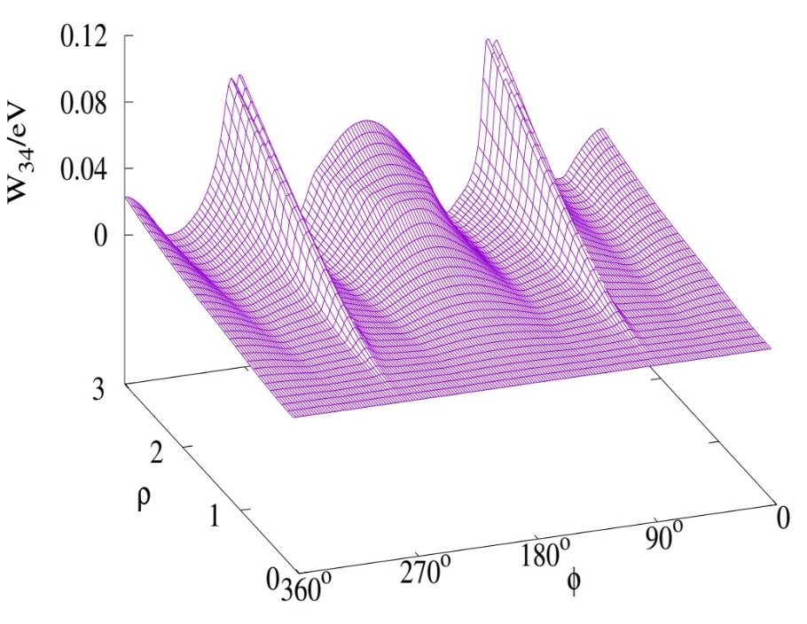
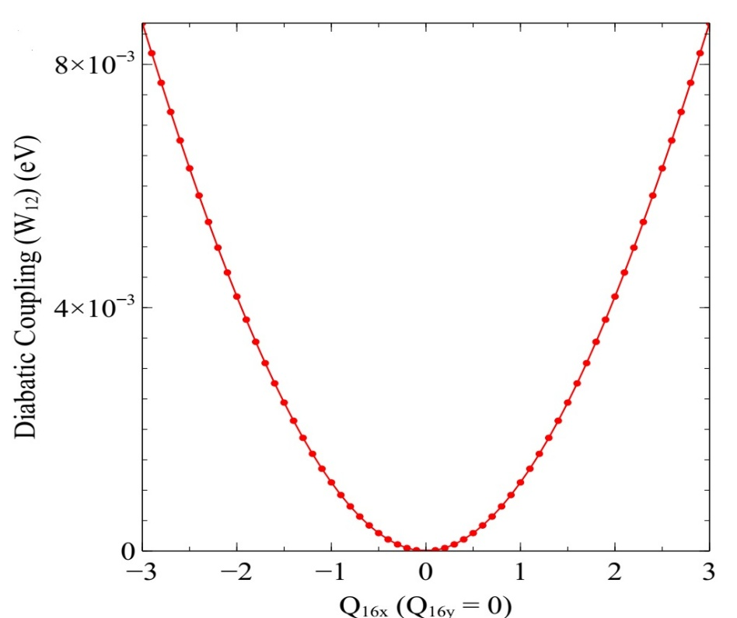
Q_{18x}-Q_{19y} Pair: ADT Quantities
Non-Traditional JT Model
Mukherjee S., Ravi S., Naskar K., Sardar S. and Adhikari S. J. Chem. Phys., 2021, 154, 094306.

Slide 10
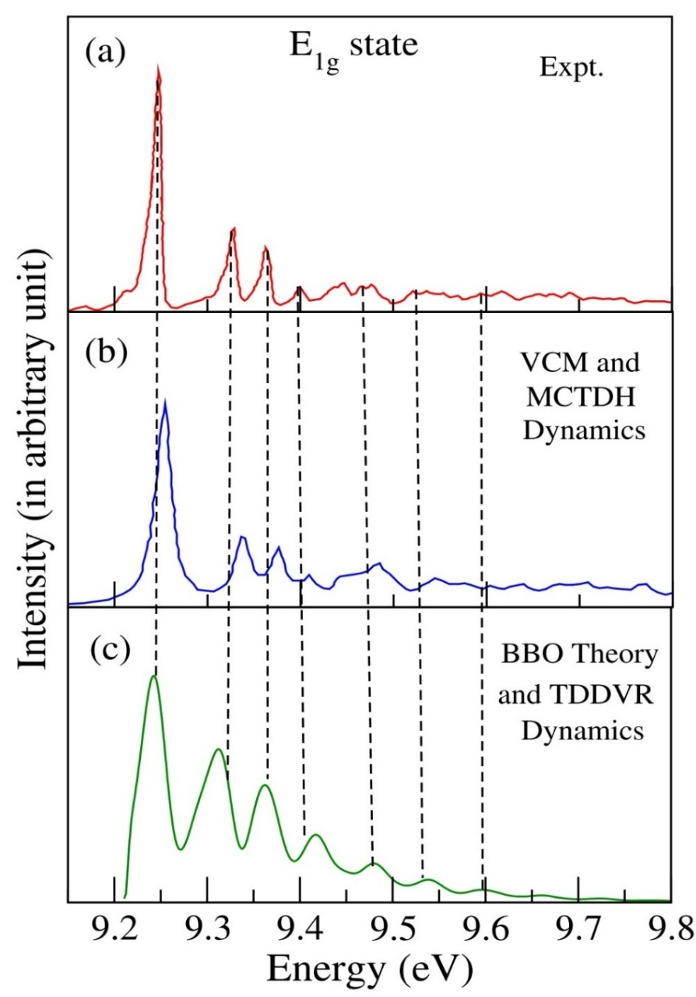
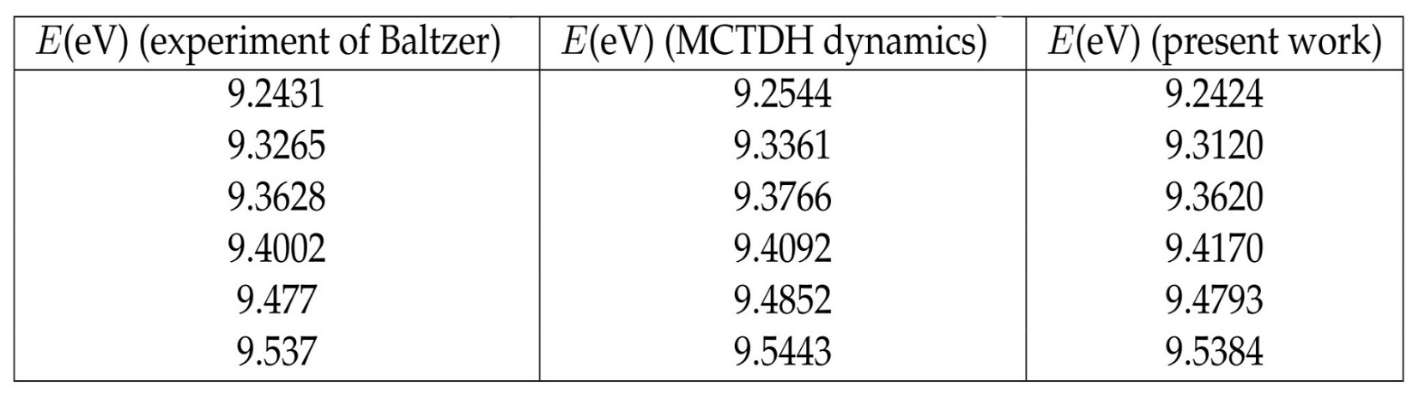
Photoelectron Spectra
*
*
*
*
Baltzer P. et al. Chem. Phys. 1997, 224, 95.
Köppel H., Bâldea I., and Szalay P. G., Adv. Quantum Chem. 2003, 44, 199.
Mukherjee S., Ravi S., Naskar K., Sardar S. and Adhikari S. J. Chem. Phys., 2021, 154, 094306.

Slide 11
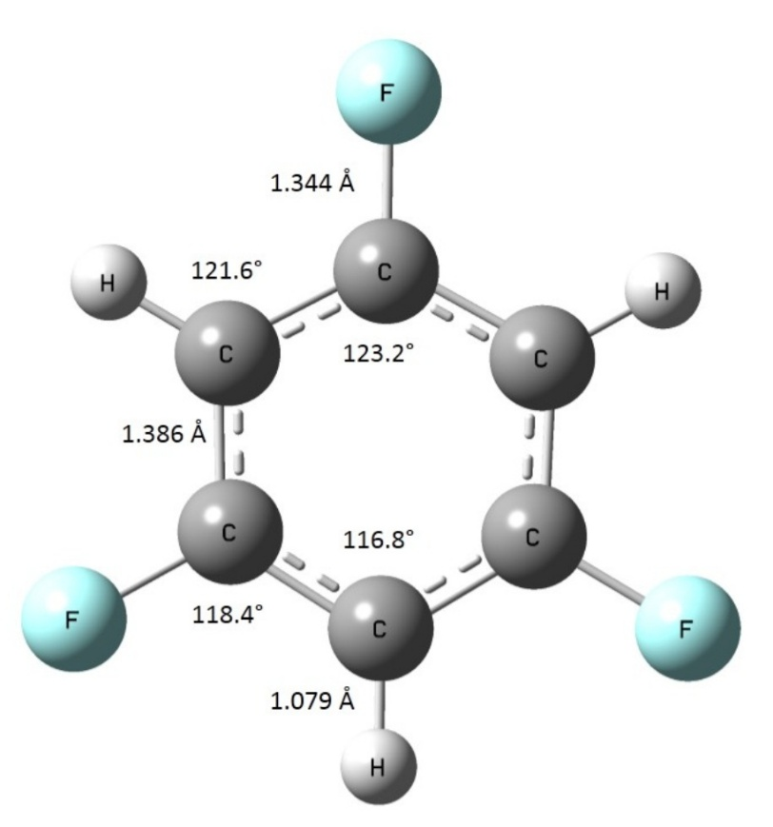
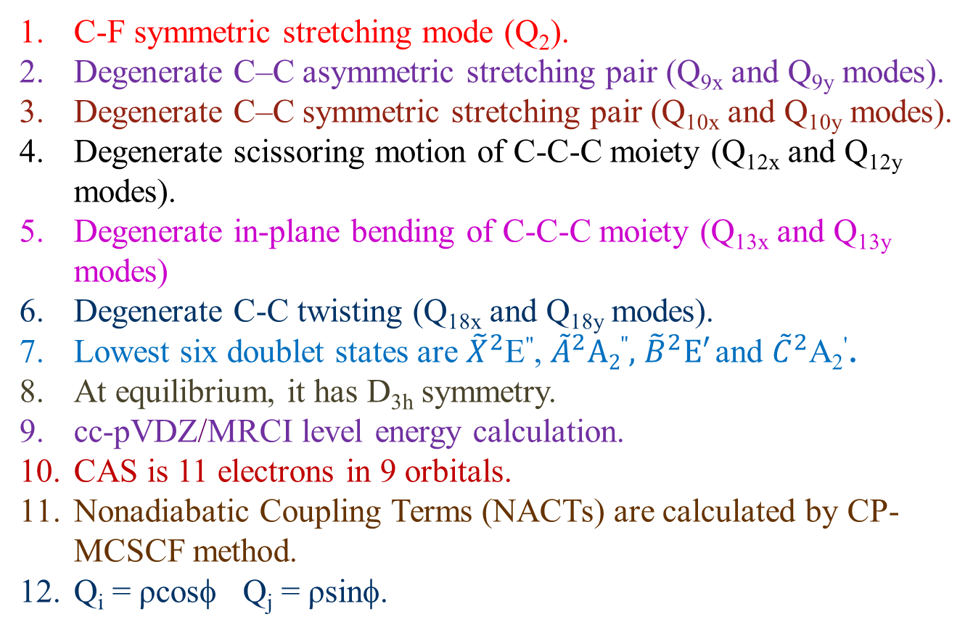
BBO Treatment for 1,3,5-C₆H₃F₃⁺
Ab Initio Calculations :
C-F symmetric stretching mode (Q₂).
Degenerate C–C asymmetric stretching pair (Q_{9x} and Q_{9y} modes).
Degenerate C–C symmetric stretching pair (Q_{10x} and Q_{10y} modes).
Degenerate scissoring motion of C-C-C moiety (Q_{12x} and Q_{12y} modes).
Degenerate in-plane bending of C-C-C moiety (Q_{13x} and Q_{13y} modes)
Degenerate C-C twisting (Q_{18x} and Q_{18y} modes).
Lowest six doublet states are ${\tilde{X}}^{2}$E", ${\tilde{A}}^{2}A2",$ ${\tilde{B}}^{2}E′$ and ${\tilde{C}}^{2}$A₂'.
At equilibrium, it has D_{3h} symmetry.
cc-pVDZ/MRCI level energy calculation.
CAS is 11 electrons in 9 orbitals.
Nonadiabatic Coupling Terms (NACTs) are calculated by CP-MCSCF method.
Q_{i} = ρcosφ Q_{j} = ρsinφ.
Mukherjee S., Ravi S., Dutta J., Sardar S. and Adhikari S. Phys. Chem. Chem. Phys., 2022, 22, 2185.

Slide 12
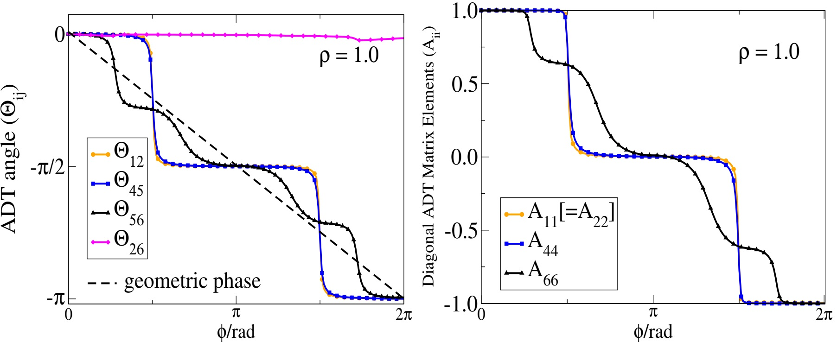
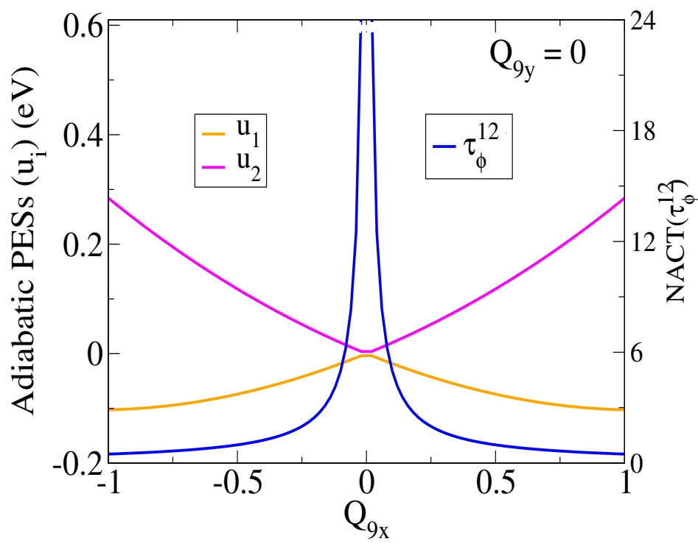
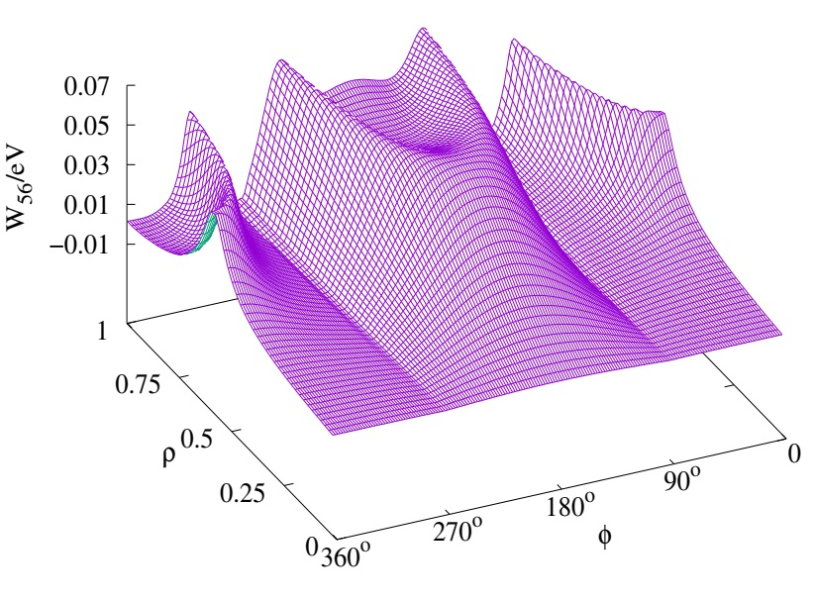
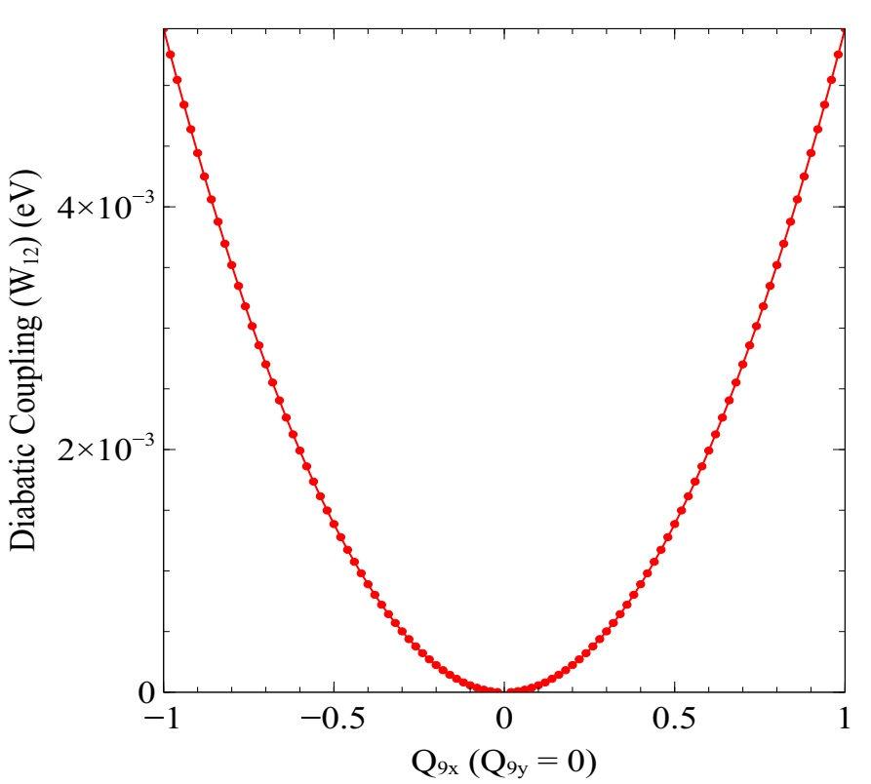
Q_{9y}-Q_{18y} Pair: ADT Quantities
Non-Traditional JT Model
Mukherjee S., Ravi S., Dutta J., Sardar S. and Adhikari S. Phys. Chem. Chem. Phys., 2022, 22, 2185.

Slide 13
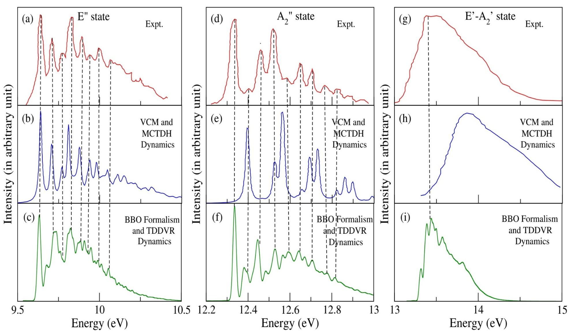
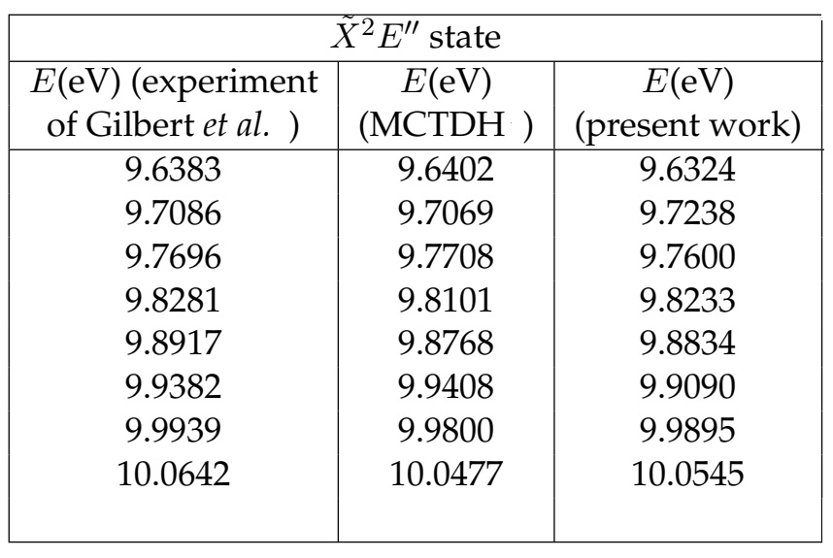
Photoelectron Spectra
*
*
*
*
*
Q_{13x}, Q_{13y}, Q_{18x}, Q_{18y}, Q₂, Q_{9x} and Q_{9y}
normal modes are used
Gilbert, R.; Sauvageau, P.; Sandorfy, C. Chem. Phys. Lett. 1972, 17, 465-470.
Mondal, T.; Mahapatra, S.; Phys. Chem. Chem. Phys. 2009, 11, 10867-10880.
Mukherjee S., Ravi S., Dutta J., Sardar S. and Adhikari S. Phys. Chem. Chem. Phys., 2022, 22, 2185.

Slide 14
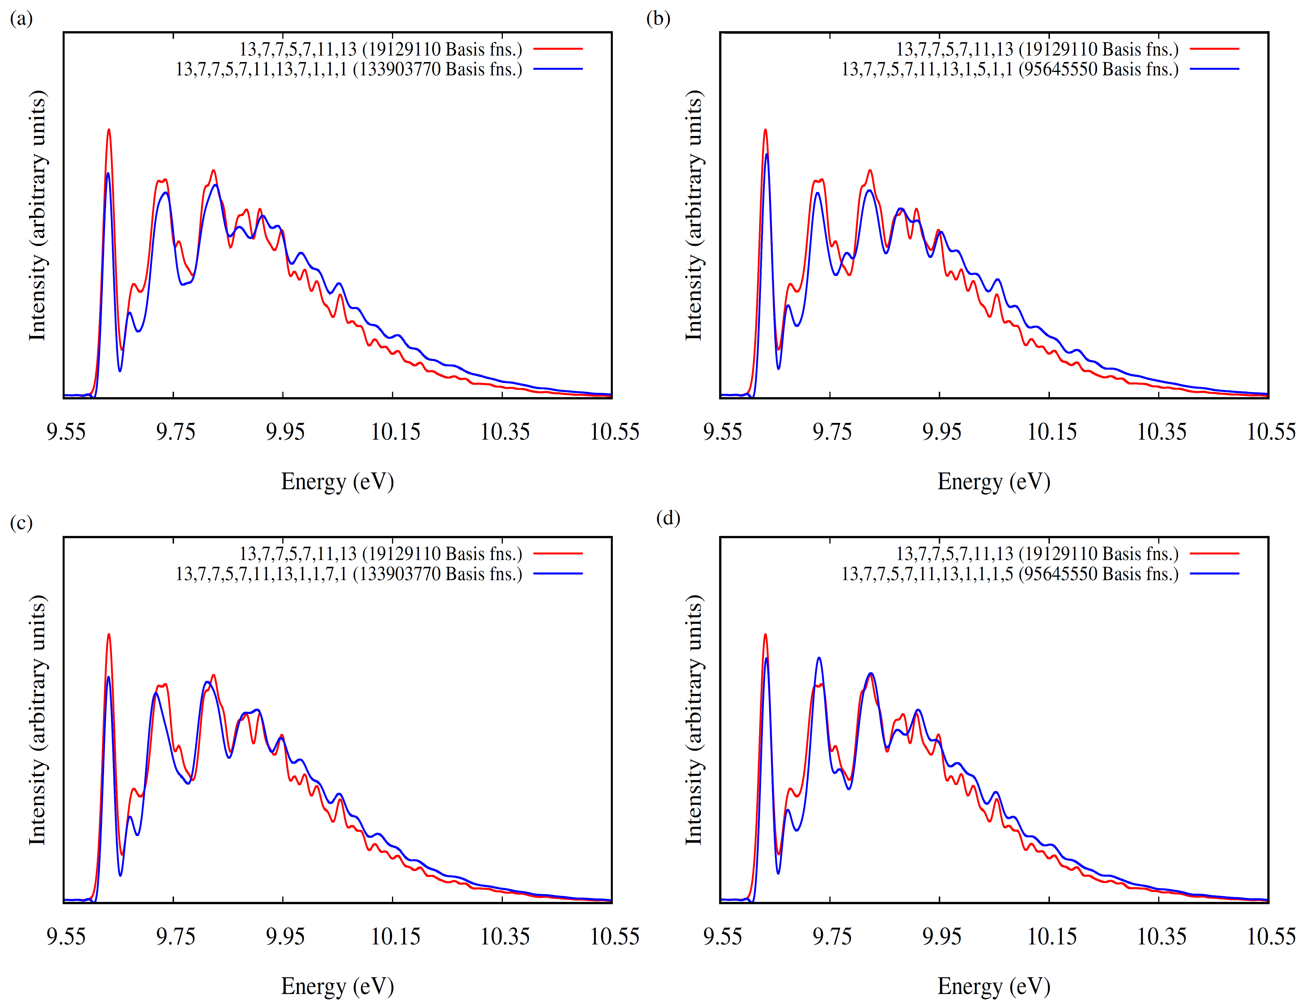
Including Q_{10x}, Q_{10y},
Q_{12x}, Q_{12y} normal modes
Mukherjee S., Ravi S., Dutta J., Sardar S. and Adhikari S. Phys. Chem. Chem. Phys., 2022, 22, 2185.

Slide 15
Future Plans
Investigation of non-adiabatic interactions of o-diflurobenzene and pyridine cations by scanning the pairs of normal modes.
Calculation of theoretical photoabsoprtion spectra of the neutral counterparts by TDDVR dynamics.
Acknowledgements
Soumya Mukherjee (File No: SPM-07/080(0250)/2016-EMR-I) acknowledges CSIR India and IACS for research fellowship. Saikat Hazra and Satyam Ravi thank IACS for research fellowship. Subhankar Sardar acknowledges Principal, Bhatter College, Dantan for providing research facility in his institution. Satrajit Adhikari acknowledges DST, India, through project no. File No. CRG/2019/000793 for the research funding. Satrajit Adhikari also acknowledges IACS for CRAY supercomputing facility.
Thank You

