Slide 1
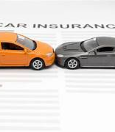


CAR INSURANCE CLAIM PREDICTION GROUP - 12
Jahnani Nagarajan Sivakumar
Kirthika Kulandaivel Senthilkumar
Krishna Apurva
Manusha Medarametla

Slide 2


Project Overview
Introduction
Dataset Description
Exploratory Data Analysis
Decision Tree Analysis
Random Forest Analysis
Logistic Regression Analysis
Neural Network Analysis
Model Evaluation
Conclusion

Slide 3
Introduction
Aims to predict if policyholders will file a claim in the next six months by analyzing a comprehensive dataset.
Helps insurance companies refine their risk assessment and pricing strategies.
Revolutionize managing risk in the car insurance industry using Advanced analytics and Machine learning.
Goal:
The project aims to develop an accurate predictive model using policyholder attributes for data-informed decision-making.

Slide 4
Dataset description
Data Source: Kaggle
97656 instances and 44 attributes.
Describes policyholder’s details like policy tenure, age of the car, age of the car owner, the population density of the city, make and model of the vehicle, power, engine type, etc.,
Target variable indicating whether the policyholder files a claim in the next six months.
Split for the training and testing with a ratio of 60:40

Slide 5
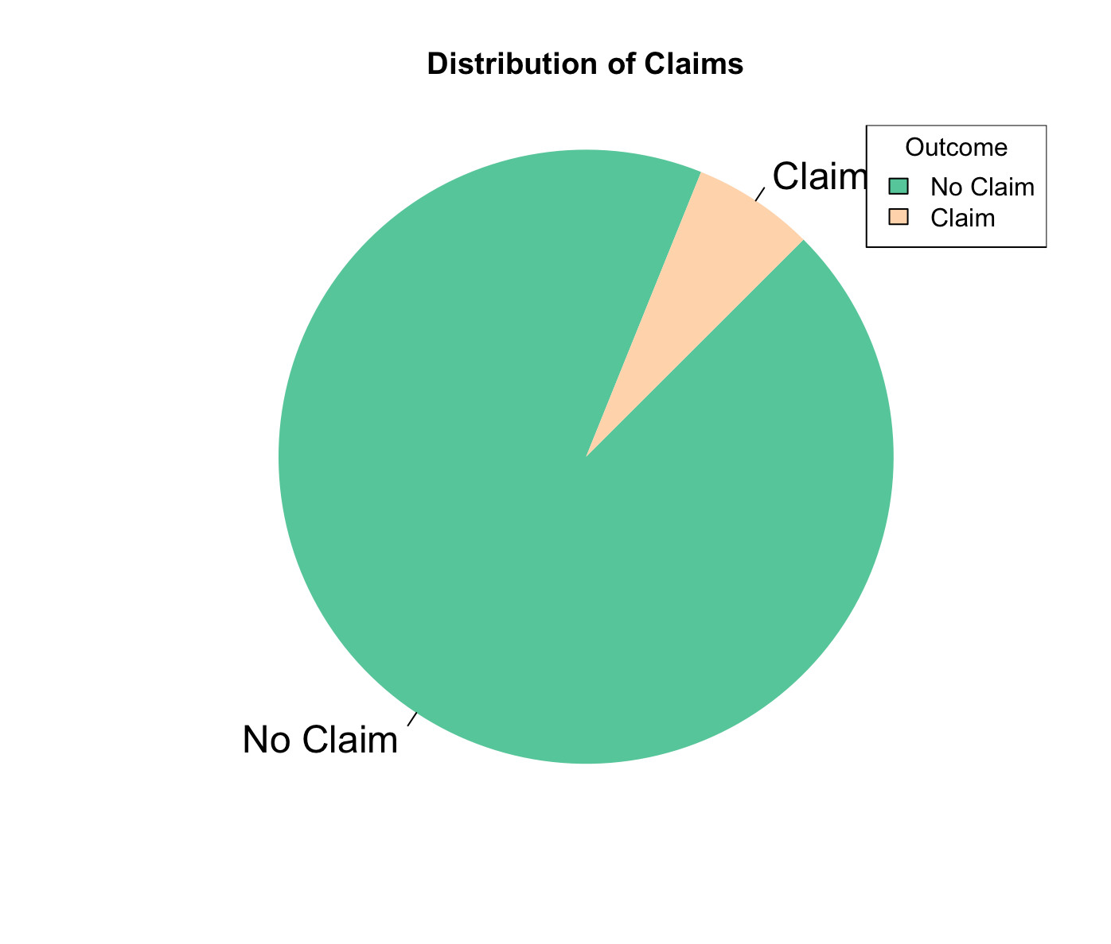
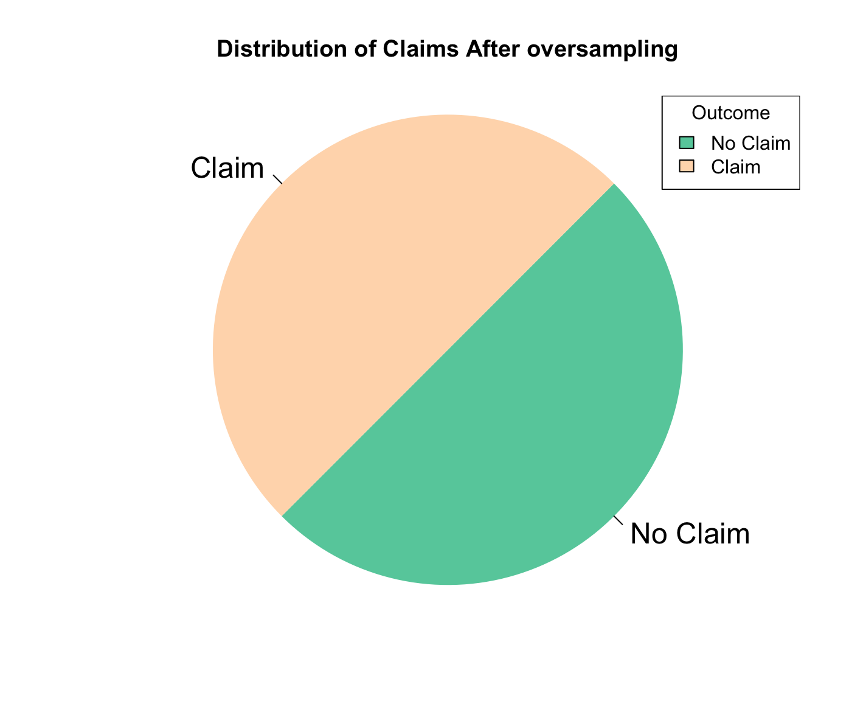
Exploratory Data Analysis
An imbalance in the target data distribution occurs
Oversampled to balance data

Slide 6
Pre-processing procedures
Identification of null values present, if any
Dropping attributes that are not required for Classification Analysis
Mutated ‘0’ and ‘1’ instead of ‘No’ and ‘Yes’ in the dataset
Grouped categorical and numerical attributes
Extracted numerical values from Max torque and Max power to estimate ratio with RPM values
Added new columns to the dataset by splitting the categorical data

Slide 7
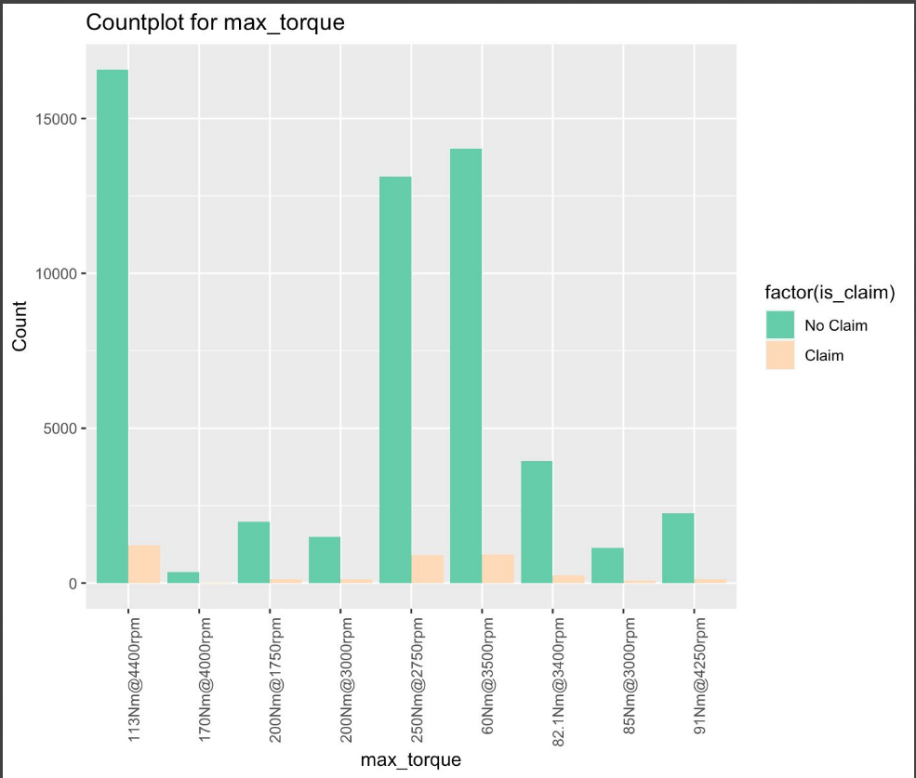
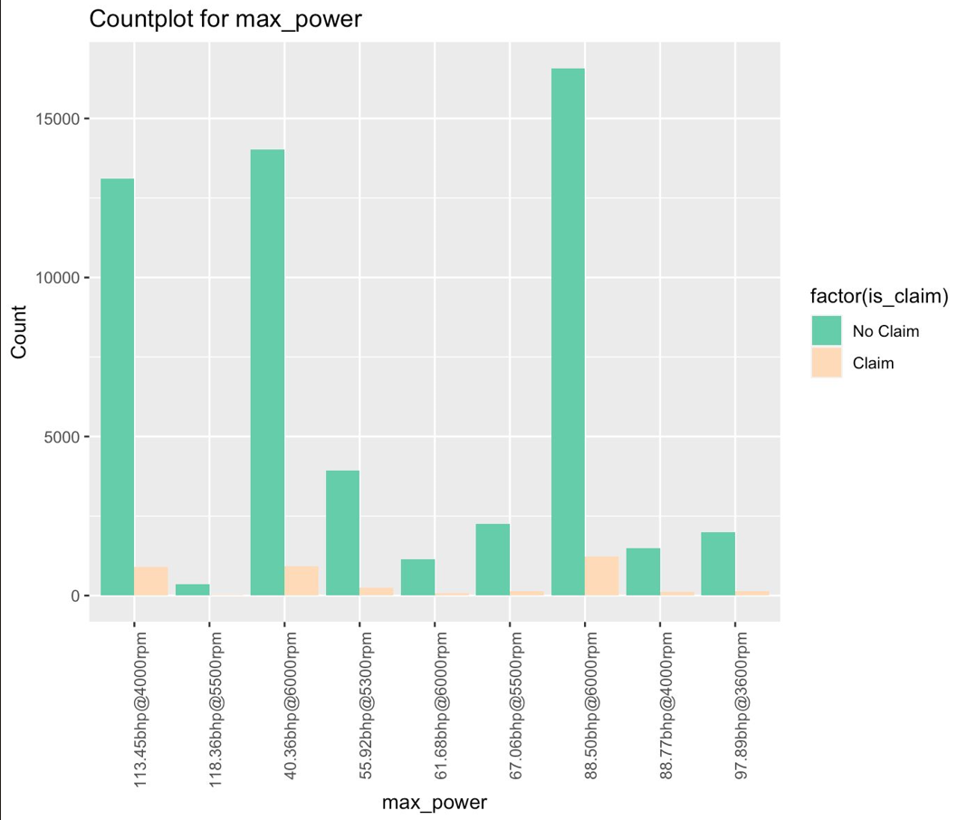
Data distribution Analysis
Max-torque Max-power

Slide 8
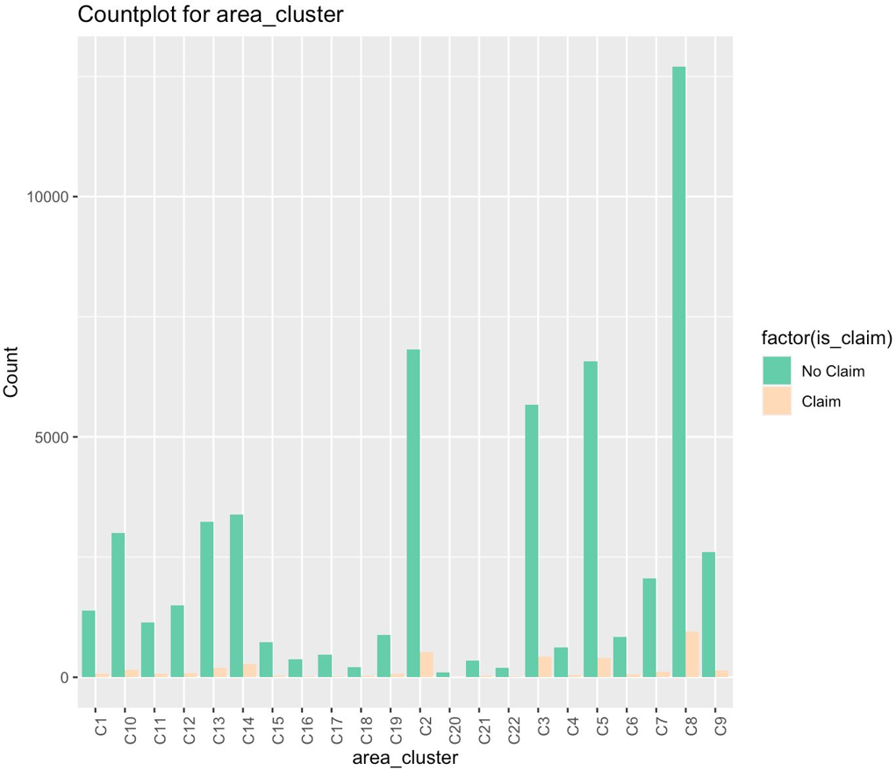
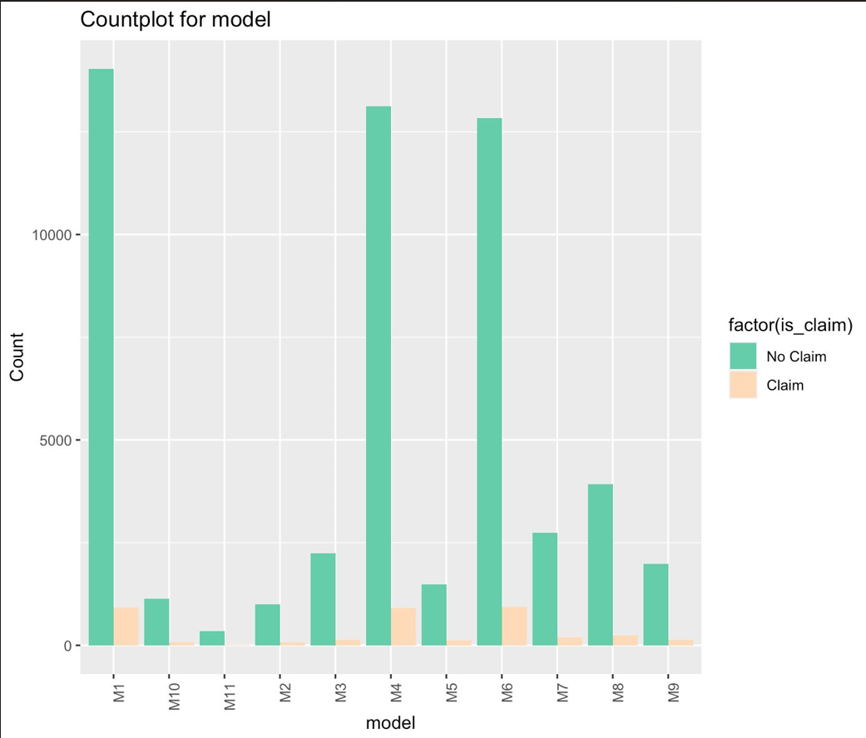
Area and Model vs claim

Slide 9
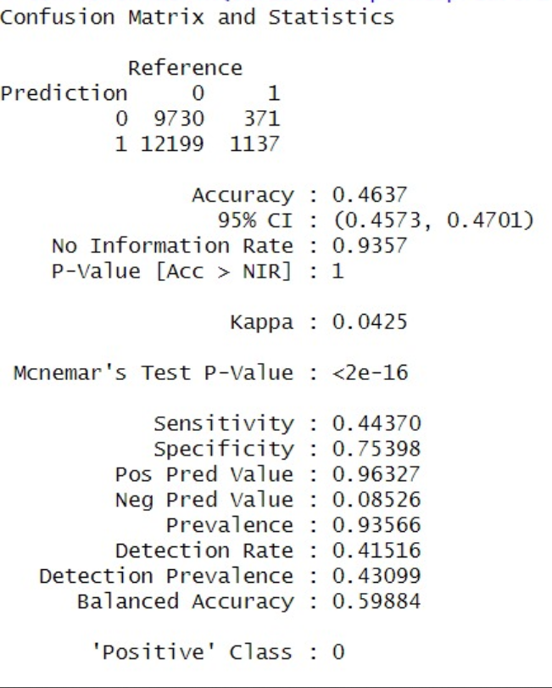
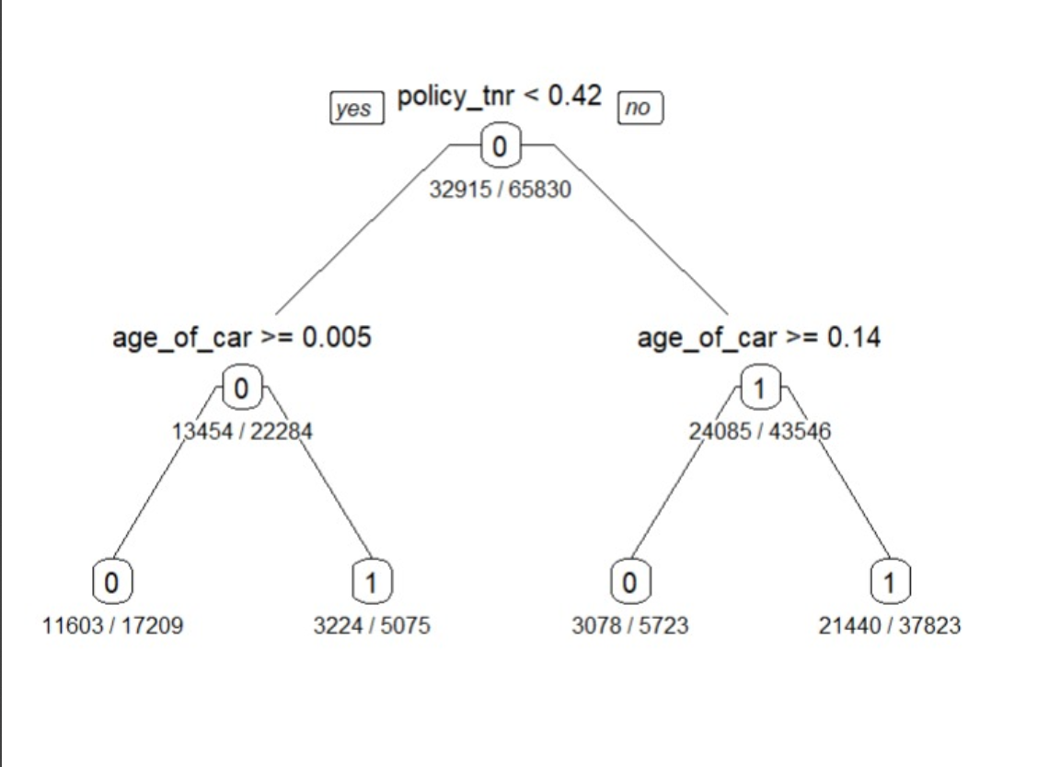
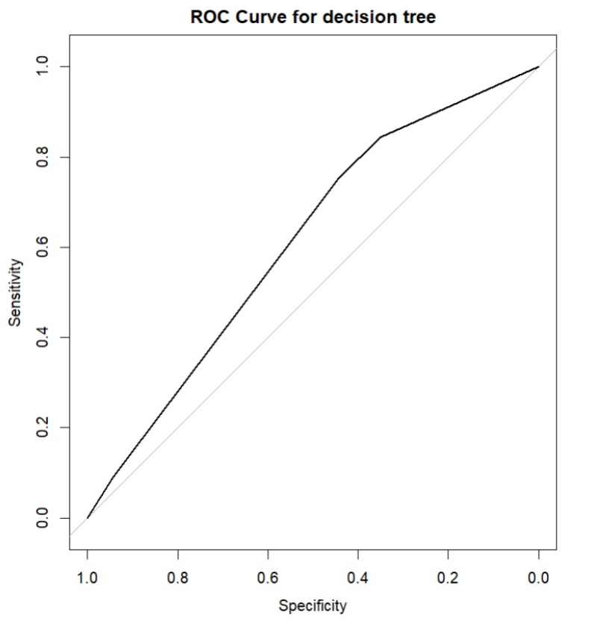
Decision tree Analysis

Slide 10
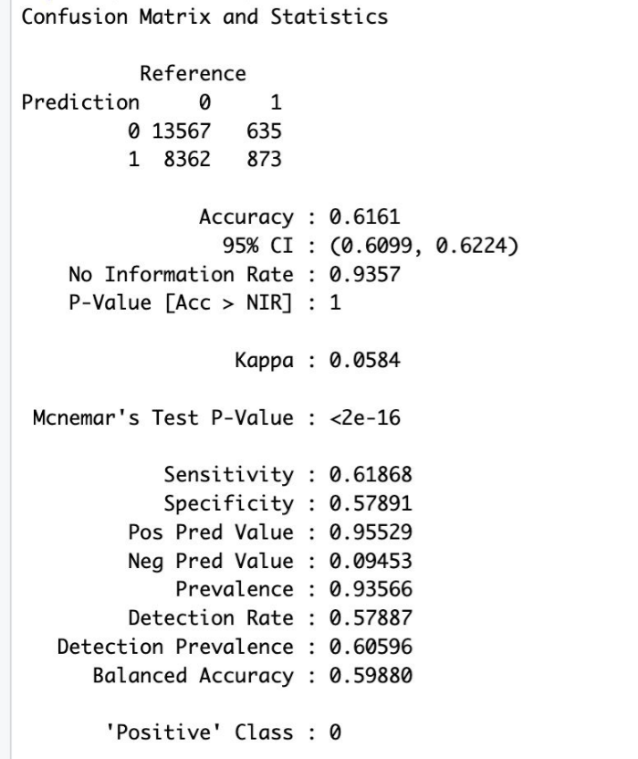
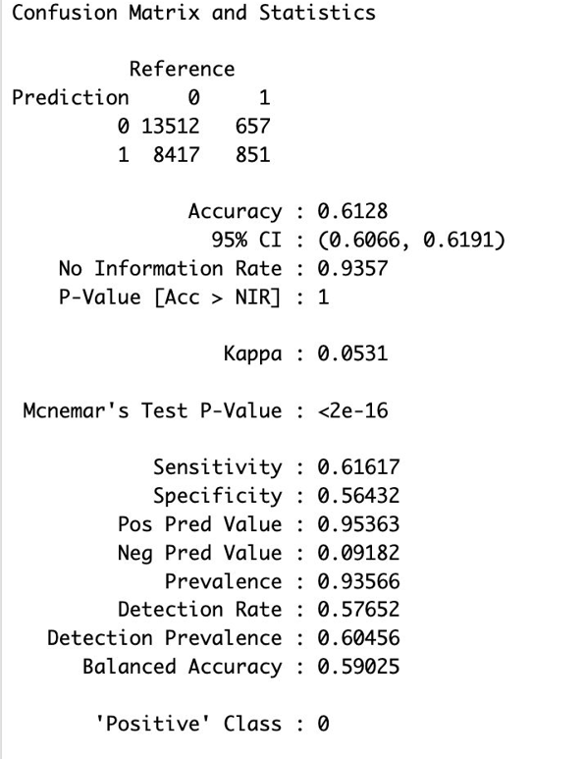
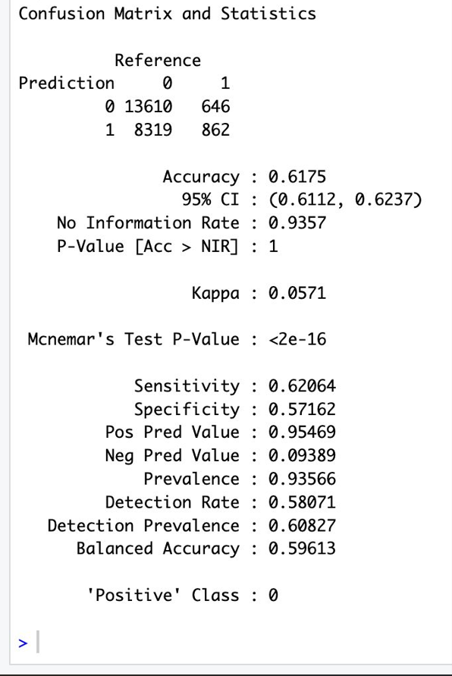
Random forest analysis
10 TREES CONFUSION MATRIX 100 TREES CONFUSION MATRIX 500 TREES CONFUSION MATRIX

Slide 11
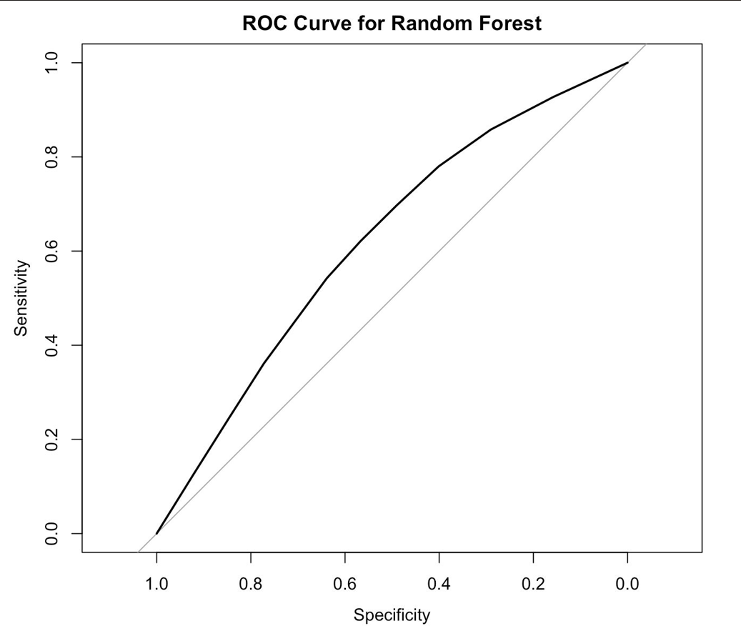


RANDOM FOREST ANALYSIS (CONT..)
10 TREES ROC CURVE
500 TREES ROC CURVE
100 TREES ROC CURVE

Slide 12
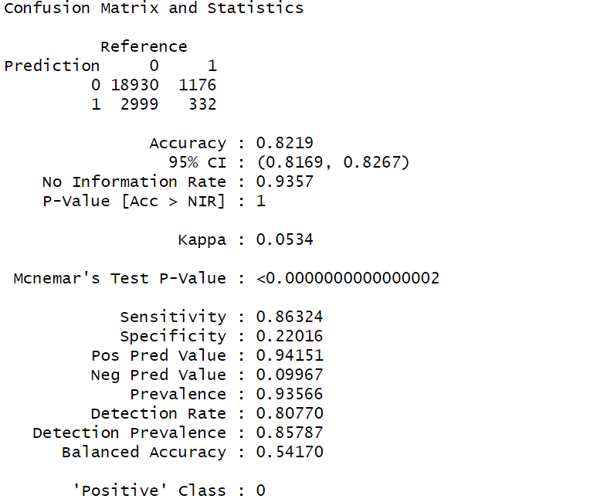
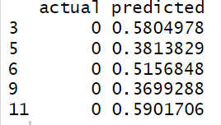
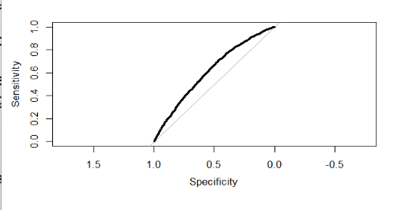
Logistic regression analysis
Area under the curve: 0.6128

Slide 13
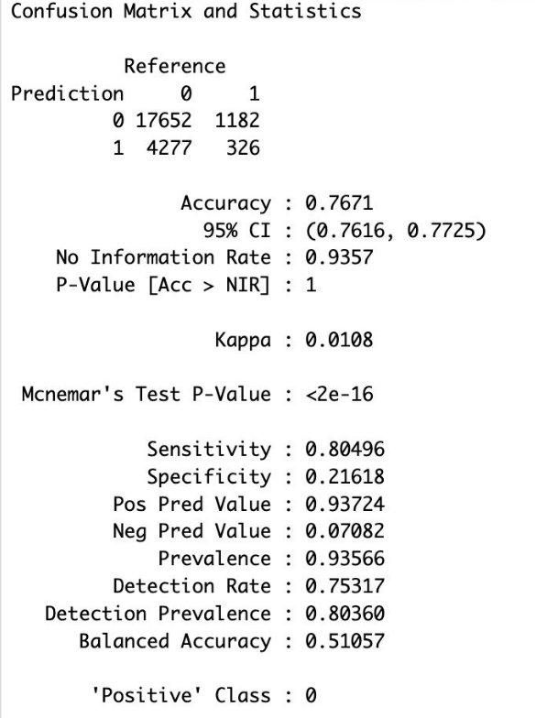
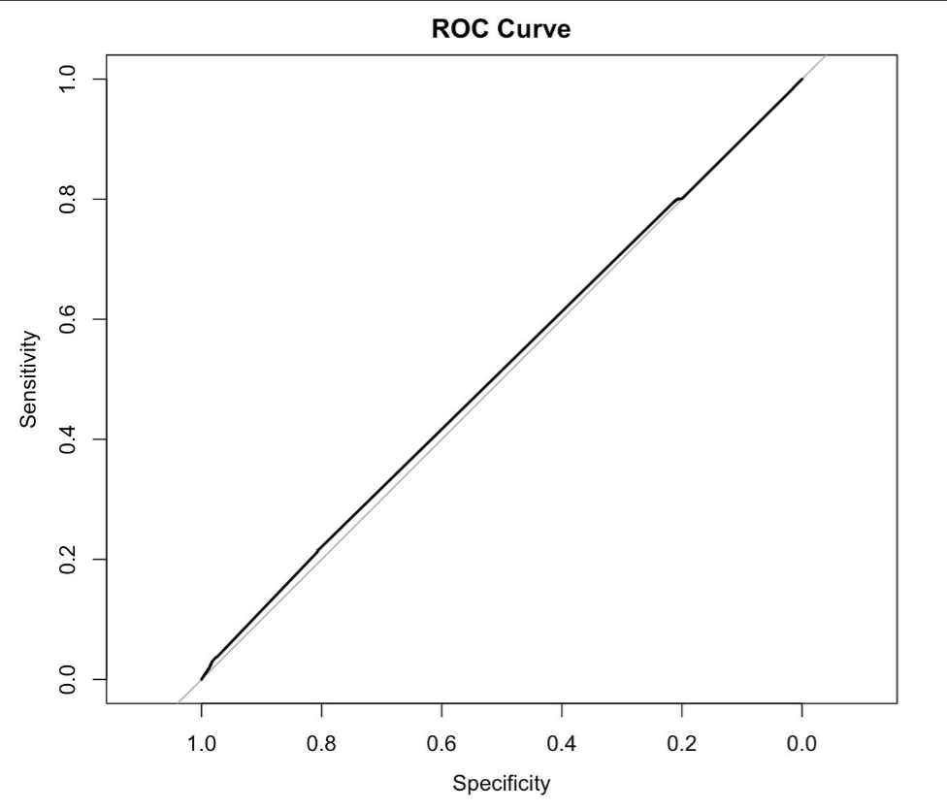
Neural network analysis

Slide 14
overview
 | Accuracy | Area Under Curve (ROC)
Decision Tree | 46.37% | 0.6109
Random Forest | 61.62% | 0.6316
Logistic Regression | 82.19% | 0.6128
Neural Network | 76.71% | 0.5118

Slide 15
SUMMARY
Logistic regression has the highest accuracy among the models.
Low AUC may suggest that its ability to discriminate between classes is not as strong as Random Forest
Random Forest accuracy is lower than logistic regression
Higher AUC indicates better discrimination between positive and negative cases.
Random forests are less interpretable than logistic regression.
Decision trees are prone to overfitting and might have struggled with generalization to new data

Slide 16
Conclusion
Based on the business objective, interpretability is crucial to determine what factors influence the policyholder to claim. Therefore, logistic regression clearly explains the attributes that can make a policyholder claim a policy. For example, policy tenure, age of the car, and area have a higher influence on claim prediction than any other attribute.
The insurance company can use this prediction model to charge the policyholder with a premium or higher-cost policy.

Slide 17
Thank you
Acknowledgement:
Prof. Zhang’s R scripts and Notes

