Slide 1
FUNDAMENTALS OF COMPUTERS

Slide 2
UNIT-III Computer Software
Introduction to Computer Software
Classification of Computer Software
System Software, Application software
Graphics Software
Multimedia Software
Database Management Software
Firmware, Middleware
Procuring Computer Software

Slide 3
Introduction to Computer Software
Computer Software is a collection of instructions, data, or computer programs that are used to run machines and carry out particular activities.
It is a collection of programs, procedures, and documentation that performs different tasks on a computer system. It actually tells the computer what to do and how to do it.
Computer software is programming code executed on a computer processor. The code can be machine-level code, or code written for an operating system.
In a computer system, the software is basically a set of instructions or commands that tell a computer what to do. In other words, the software is a computer program that provides a set of instructions to execute a user’s commands and tell the computer what to do.
.

Slide 4
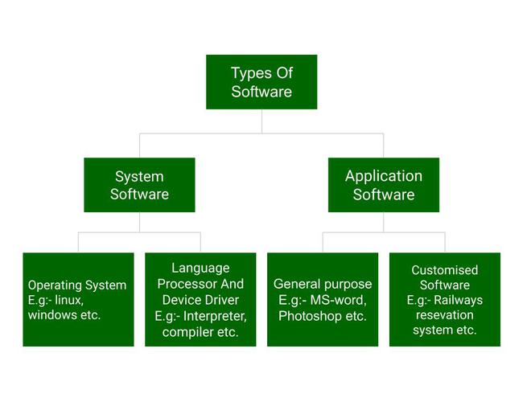
Classification of Computer Software

Slide 5
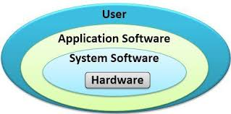
System software:
System software is software that directly operates the computer hardware and provides the basic functionality to the users as well as to the other software to operate smoothly. Or in other words, system software basically controls a computer’s internal functioning and also controls hardware devices such as monitors, printers, and storage devices, etc.
It is like an interface between hardware and user applications, it helps them to communicate with each other because hardware understands machine language(i.e. 1 or 0) whereas user applications are work in human-readable languages like English, Hindi, etc. so system software converts the human-readable language into machine language and vice versa.

Slide 6
Types of System Software
Operating System: It is the main program of a computer system. When the computer system ON it is the first software that loads into the computer’s memory. Basically, it manages all the resources such as computer memory, CPU, printer, hard disk, etc., and provides an interface to the user, which helps the user to interact with the computer system. It also provides various services to other computer software. Examples of operating systems are Linux, Apple macOS, Microsoft Windows, etc.
Language Processor: As we know that system software converts the human-readable language into a machine language and vice versa. So, the conversion is done by the language processor. It converts programs written in high-level programming languages like Java, C, C++, Python, etc(known as source code), into sets of instructions that are easily readable by machines(known as object code or machine code).
Device Driver: A device driver is a program or software that controls a device and helps that device to perform its functions. Every device like a printer, mouse, modem, etc. needs a driver to connect with the computer system eternally. So, when you connect a new device with your computer system, first you need to install the driver of that device so that your operating system knows how to control or manage that device.

Slide 7
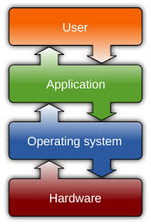
Application Software :
Application software that performs special functions or provides functions that are much more than the basic operation of the computer is known as application software. Or in other words, application software is designed to perform a specific task for end-users.
It is a product or a program that is designed only to fulfill end-users’ requirements. It includes word processors, spreadsheets, database management, inventory, payroll programs, etc.

Slide 8
Types of Application Software
General Purpose Software: This type of application software is used for a variety of tasks and it is not limited to performing a specific task only. For example, MS-Word, MS-Excel, PowerPoint, etc.
Customized Software: This type of application software is used or designed to perform specific tasks or functions or designed for specific organizations. For example, railway reservation system, airline reservation system, invoice management system, etc.
Utility Software: This type of application software is used to support the computer infrastructure. It is designed to analyze, configure, optimize and maintains the system, and take care of its requirements as well. For example, antivirus, disk fragmenter, memory tester, disk repair, disk cleaners, registry cleaners, disk space analyzer, etc.

Slide 9
Graphics software
Graphics software is a type of computer program that is used to create and edit images.
There is a wide range of graphics software available on the market, ranging from simple programs that allow users to create and edit basic images, to complex tools that can be used to create detailed 3D models and animations.
Some of the most popular graphics software programs include Adobe Photoshop, Corel Painter, and Autodesk Maya.

Slide 10
Characteristics:
A graphics software program is a computer application used to create digital images.
Graphics software programs can be used to create both vector and raster images.
Common features of graphics software programs include the ability to create, edit, and save images in a variety of formats.
Some graphics software programs also offer features such as the ability to create animations or 3D models.
Popular examples of graphics software programs include Adobe Photoshop, GIMP, and Inkscape.

Slide 11
Examples:
Some popular graphics software programs are Adobe Photoshop, Adobe Illustrator, and CorelDRAW. These programs can be used to create and edit digital images, illustrations, and logos. They offer a variety of features and tools that allow users to manipulate photos and graphics to create custom designs.
Adobe Photoshop is a popular graphics software used by photographers and graphic designers.
Adobe Illustrator is another popular graphics software used by graphic designers, especially for creating vector illustrations.
CorelDRAW is a graphics software used by both professionals and hobbyists.
GIMP is a free and open source graphics software with capabilities similar to Photoshop.
Inkscape is a free and open source vector graphics software used by graphic designers and illustrators.

Slide 12
Multimedia Software
Multimedia software is defined as the combination of text, audio, images, animation, or video to produce interactive content.
Media Players:Software applications like VLC, Windows Media Player, or QuickTime for playing audio and video files.
Graphics Software:Tools like Adobe Photoshop, GIMP, or CorelDRAW for creating and editing images.
Video Editing Software:Applications such as Adobe Premiere, Final Cut Pro, or DaVinci Resolve for editing and producing videos.
Audio Editing Software:Tools like Audacity, Adobe Audition, or GarageBand for editing and producing audio content.
Web Browsers:Browsers like Google Chrome, Mozilla Firefox, or Safari that support multimedia content on the web.
Multimedia Authoring Tools:Software like Adobe Animate, Unity, or Blender for creating interactive multimedia content.
3D Modeling and Animation Software:Applications such as Autodesk Maya, Blender, or Cinema 4D for creating 3D multimedia content.
Presentation Software:Tools like Microsoft PowerPoint or Prezi for creating multimedia-rich presentations.

Slide 13
Database Management Software
Database management software or DBMS is a collection of programs which helps users to store, edit, and extract data from a database.
A database management system (DBMS) is a software system for creating and managing databases. A DBMS enables end users to create, protect, read, update and delete data in a database.
Database administrators use Database Management Software, or DBMS, for storing, changing, and managing data in a database environment. It enables users to design personalized data storage to meet their analytics and reporting needs.

Slide 14
Database software design also supports creating, implementing, and maintaining an organization-wide data management system.
Database management software (DBMS) is essential for organizing, storing, and retrieving data.
Examples of Database Management Softwares are MySQL, DB2, Microsoft Access, Microsoft SQL Server, Oracle Database.

Slide 15
Firmware
Firmware is a type of software that is embedded into hardware devices to control their functionality. Unlike traditional software, firmware is not designed to be modified or updated frequently, and it is typically stored in non-volatile memory. It serves as a bridge between the hardware and software layers of a system, allowing the hardware to interact with the operating system and applications.
Firmware is a software program permenantly etached into hardware devices such as a keyboard, Hard disk drive, BIOS or Video cards.It is programmed to give permanent instructions to communicate with other devices and perform functioning like basic input/output task.Firmware is typically stored in the ROM of a hardware device.
Firmware is software that provides basic machine instructions that allow the hardware to function and communicate with other software running on a device.
Types of firmwares:
1. Low level 2. High level 3. Subsystem

Slide 16
Low-level firmware: Low-level firmware is considered an intrinsic part of a device's hardware. It is often stored on non-volatile, read-only chips like ROM and therefore cannot be rewritten or updated. Devices containing low-level firmware have one-time programmable memory.
High-level firmware: High level firmware does allow updates and is generally more complex than low-level firmware. In a computer, high-level firmware resides on flash memory chips.
Subsystem firmware: Subsystem firmware often comes as part of an embedded system. It is comparable to high-level firmware in that it can be updated and is more complex than low-level firmware. One example is a server's power subsystem, which is a piece of server hardware that functions semi-independently from the server.

Slide 17
Middleware
Middleware is software that lies between an operating system and the applications running on it. Essentially functioning as hidden translation layer, middleware enables communication and data management for distributed applications.
Middleware is a type of software that glues together two already existing separate applications. It mediates between two different types of applications and provides services that are otherwise not provided by the underlying operating system.
Middleware is a set of data and tools which enables different applications to use the resources and services in a networked system.

Slide 18
The main difference between firmware and middleware is that the firmware is a type of software that allows controlling the device's hardware while the middleware is a software that provides services to software applications beyond those available from the operating system.
USB drives, hard drives and other portable storage devices contain basic firmware that enable them to function with a computer. Mobile devices. Mobile phones, tablets, laptops and other mobile devices all contain firmware that let the hardware work with various software.

Slide 19
Procuring Computer Software
When we buy a computer, we are just purchasing the hardware.
The absence of the required software the computer is just a useless machine.
Hence, to make the computer functional and useful, we need to acquire software.
The software procurement process is the strategic acquisition of software solutions to meet operational needs and drive business objectives.
Softwares can be acquired in three ways:
1. Buying pre-written software
2. Having customized software
3. Downloading public domain software

Slide 20
Key steps in the software procurement process include:
Identifying software needs
Evaluating options based on functionality and suitability
Selecting vendors
Negotiating favorable contracts
Ensuring seamless integration
Continuous monitoring and evaluation of software performance

