Slide 1
Sensor Fusion

Slide 2
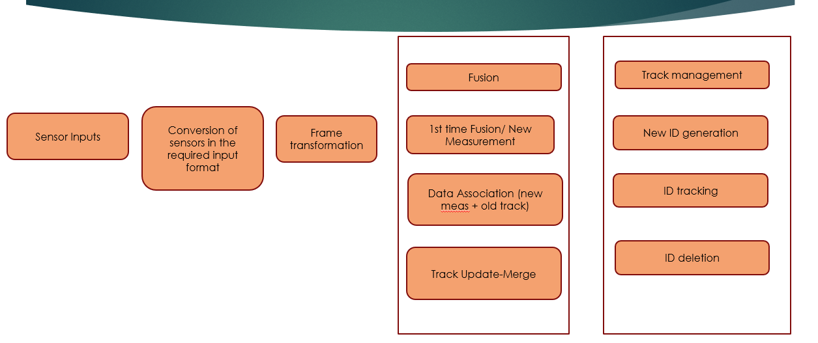

Slide 3
Sensor fusion:
Ability to bring together inputs from multiple radars, lidars, and cameras to form a single model or image of environment around a vehicle.
Resulting model is more accurate because it balances the strengths of different sensors.
Types/Techniques of sensor fusion:
1.Sensor Fusion by Abstraction Level:
The most common types of fusion is by abstraction level. In this case, we're asking the question " When should we do the fusion?“
1)Low-Level
2)Mid-Level
3)High-Level

Slide 4
1)Low-Level Fusion:
It is about fusing raw data coming from multiple sensors.
Eg: We fuse point clouds(set of data points in space) coming from lidars and pixels from cameras.
Pros: It considers all the data
Cons: Early fusion(Low-level) was very hard to do until few years ago, as processing required is huge. At each millisec, we can fuse hundreds of points with hundreds of pixels.
2)Mid-Level Fusion:
Mid-Level sensor fusion is about fusing the objects detected independently on sensor data.
If a camera detects an obstacle, and a radar detects it, we'll fuse these results to have the best estimate of the position, class, and velocity of the obstacle.
Kalman filter is generally the approach used.

Slide 5
Pros: Easy to understand and contains several existing implementations.
Cons: It relays heavily on detectors. If one fails whole fusion can fail.
3)High-Level fusion:
It is about fusing both object and their trajectories. We don’t relay only on detections but also on predictions and traking.
Pros: This process is one level higher, and thus benefits the same simplicity advantage.
Cons: we might lose too much information. If our tracking is wrong whole thing is wrong.

Slide 6
2.Centralization Level:
The second way to classify a Fusion algorithm is by centralization level. Here, we're asking the question " Where is the fusion happening?". The main computer can do it, or each sensor can do its own detection and fusion. Some approaches even use satellites architecture to do.
1)Centralized - One central unit deals with the fusion.
2)Decentralized - Each sensor fuses data and forward it to the next one.
3)Distributed - Each sensor processes the data locally and send it to the next unit.
Aptiv has developed an architecture they call the satellite architecture. Plug many sensors fuse them together to one central unit it handles the intelligence called active safety domain controller.

Slide 7
3. Competitive Fusion:
In Competition Level, we're asking "What should the fusion do?“
1)Competitive Fusion
Competitive Fusion is when sensors are meant for the same purpose. For example, when we use both a RADAR and a LIDAR to detect the presence of pedestrian. Here, the data fusion process happening is called redundancy, thus the "competitive" term.
2) Complementary Fusion
Complementary fusion is about using different sensors looking at different scenes to get something we couldn't have obtained otherwise.
For example, when building a panorama with multiple cameras. Since these sensors complete each other, we use the term "complementary".
3) Coordinated Fusion
Finally, coordinated fusion is about using two or more sensors to produce a new scene, but this time looking at the same object.

Slide 8
