Slide 1
Introduction to CEM

Slide 2
Levels Of Autonomous Vehicles
In 2014, the SAE International, previously known as the Society of Automotive Engineers (SAE) introduced the J3016(standard used to define different levels of automation in a vehicle) “Levels of Driving Automation” standard for consumers. The J3016 standard defines the six distinct levels of driving automation, starting from SAE level 0 where the driver is in full control of the vehicle, to SAE level 5 where vehicles can control all aspects of the dynamic driving tasks without human intervention.

Slide 3
1. SAE Level 0:
No Automation:
The Human Driver Performs all driving aspects of driving tasks
Ex: steering, acceleration
2. SAE Level 1:
Driver Assistance:
The vehicle features a single automated system for driver assistance, such as steering or acceleration/deceleration and with the anticipation that human driver performs all remaining aspects of driving tool.
3. SAE Level 2:
Partial Automation:
The vehicle can perform steering and acceleration/deceleration. However, the human driver required to monitor the driving environment and can take control at any time.

Slide 4
4. SAE Level 3:
Conditional Automation:
The vehicle can detect obstrucles in driving environment and can perform most driving tasks. Thought, human override is still required.
5. SAE Level 4:
High Automation:
The vehicle can perform all aspects of dynamic driving task under specific scenarios. Human overriding is still an option.
6. SAE Level 5:
Full Automation:
The vehicle performs all driving tasks under all conditions and scenarios without human intervention.

Slide 5
Types of sensor fusion:
Sensor Fusion by Abstraction Level:
The most common types of fusion is by abstraction level. In this case, we're asking
the question " When should we do the fusion?“
1.Low Level Fusion - Fusing the RAW DATA
Low Level Sensor Fusion is about fusing the raw data coming from multiple
sensors.
2.Mid Level Fusion - Fusing the DETECTIONS
Mid-Level sensor fusion is about fusing the objects detected independently
on sensor data.
If a camera detects an obstacle, and a radar detects it, we'll fuse these results
to have the best estimate of the position, class, and velocity of the obstacle.
3.High Level Fusion - Fusing the TRACKS
Finally, high level sensor fusion is about fusing both objects and their trajectories.

Slide 6
Sensor Fusion by Centralization Level
The second way to classify a Fusion algorithm is by centralization level. Here,
we're asking the question " Where is the fusion happening?". The main
computer can do it, or each sensor can do its own detection and fusion.
1.Centralized - One central unit deals with the fusion.
2.Decentralized - Each sensor fuses data and forward it to the next one.
3.Distributed - Each sensor processes the data locally and send it to the next unit.
Sensor Fusion by Competition Level
In Competition Level, we're asking "What should the fusion do?“
1.Competitive Fusion
Competitive Fusion is when sensors are meant for the same purpose. For
example, when we use both a RADAR and a LIDAR to detect the presence of
pedestrian. Here, the data fusion process happening is called redundancy,
thus the "competitive" term.

Slide 7
2. Complementary Fusion
Complementary fusion is about using different sensors looking at different
scenes to get something we couldn't have obtained otherwise.
For example, when building a panorama with multiple cameras. Since these sensors complete each other, we use the term "complementary".
3. Coordinated Fusion
Finally, coordinated fusion is about using two or more sensors to produce a
new scene, but this time looking at the same object.

Slide 8
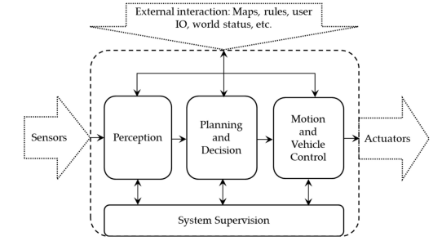
Architecture Of Autonomous Driving System:

Slide 9
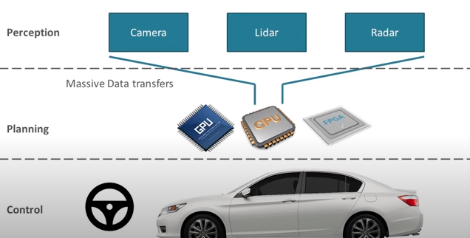
A functional perspective that describes the four main functional blocks and flow of information.

Slide 10
Adaptive Cruise Control
Adaptive cruise control (ACC) is a system designed to help vehicles maintain a safe following distance and stay within the speed limit. This system adjusts a car's speed automatically so drivers don't have to.
ACC functions by sensory technology installed within vehicles such as cameras, lasers, and radar equipment, which creates an idea of how close one car is to another, or other objects on the roadway.
Radar-based systems use the Doppler effect(The Doppler effect, or Doppler shift, describes the changes in frequency of any kind of sound or light wave produced by a moving source with respect to an observer) to detect objects with a relative speed distance within a certain angle – usually 65 degrees – from the sensor. They can identify other objects up to a distance of about 1,000 feet.

Slide 11
Laser-based systems aren’t quite as innocuous(not harmful) as radars. Radar systems can usually be hidden in a small box or compartment near the front of the car, whereas lasers must have their sensors exposed to detect anything. Lasers also don’t work as well in rain or fog and have trouble sensing vehicles that are dirty
Automakers offer ACC in three different types:
Full-speed range
Stop & Go, and
Partial cruise control
Full speed range can bring the car to a full stop but must be re-activated by
tapping the gas pedal. Stop & Go will stop the car completely and accelerate
again slowly. Partial cruise control turns off below a set minimum speed.

Slide 12
Collision avoidance system
A collision avoidance system, also known as a driver assistance system, is a safety system designed to prevent a collision or decrease its severity in the few seconds before it occurs.
Collision avoidance systems use a variety of technologies and sensors, such as radar, lasers, cameras, GPS, and artificial intelligence. Not all collision avoidance systems are created equally—some warn or alert, while others override the driver to assist them in avoiding collisions and mitigating risk.
Types:
Forward collision warning system (FCW): An FCW system is an advanced safety technology that monitors a vehicle's speed, the speed of the vehicle in front of it, and the distance between the vehicles. If vehicles get too close due to the speed of the rear vehicle, the FCW system will warn that driver of an crash.

Slide 13
Lane departure warning system: This type of collision avoidance system is designed to alert drivers if their vehicle begins to drift out of their lane, and can be particularly useful for aiding with blind spot detection in real time.
Pedestrian detection system: Pedestrians and cyclists can be some of the most vulnerable targets for vehicles, with pedestrians accounting for nearly a quarter of all fatalities(an occurrence of death by accident) on the road. A pedestrian detection system uses sensors to identify human movement on the road—like cyclists—in an attempt to help drivers see a moving object before it’s too late.
Automatic braking system: An AEB is a technology that automatically activates the vehicle’s braking system when it senses an oncoming object. Certain automatic emergency braking (AEB) systems will only apply a portion of the braking power to allow the driver more time to step in, while other systems will pump the brakes until the vehicle comes to a full stop.

Slide 14
THANK YOU

