Slide 1
Sentiment Analysis of COVID-19 Tweets – Visualization Dashboard

Slide 2

Team Details
Team Size – 1
Team Leader/Member – Jahnavi Jonnalagadda
Ownership/Responsibilities - End-to-End design and implementation using IBM Cloud Tech Stack
Jahnavi Jonnalagadda
LinkedIn - https://www.linkedin.com/in/jahnavijonnalagadda/
GitHub - https://github.com/Jahnavi-Jonnalagadda
Chaitanya Bharathi Institute of Technology
Hyderabad, India

Slide 3
Overview
Perform Twitter Sentiment Analysis and understand the public sentiment towards the announcement of lockdown extension.
Develop a visualization dashboard from the obtained results.
This solution, primarily using IBM Cloud, Watson Natural Language Understanding, Watson Language Translator, Watson Language Identify, IBM Cloudant and Node-RED, derives the sentiment analysis of the twitter feeds and provides a visualization dashboard for analysis.
The proposed solution looks into the factors that affect mental health of people due to social distancing, tackling of fake news, etc., and arrives at a score and a dashboard visualization which can be used for further analysis like taking the key decisions to improve the economy or restart any business.

Slide 4
Technologies Used
1. IBM Cloud
2. Watson Natural Language Understanding
3. IBM Cloudant
4. Watson Language Translator
5. Watson Language Identify
6. Node-RED

Slide 5
Existing Process
Inadequate accuracy and performance.
Unable to deal with complex sentences and analyze.
Analyzing data only in specific time interval.
Complex code for live visualization dashboards.
Proposed Solution
Reduces complexity of the solution and leads to easy development.
Watson NLU and sentiment node gives us sentiment scores instantly instead of writing huge codes.
Node-RED develops live and dynamic visualization dashboard.

Slide 6
Workflow
1. Extract tweets on #lockdownextension.
2. Perform sentiment analysis, store the tweets and their respective sentiment scores in Cloudant database.
3. Use Watson Language Identify and Watson Language Translator to identify and translate tweets respectively, which are of languages not accepted by Watson NLU.
4. Extract tweet emotions using Watson Natural Language Understanding.
5. Node-RED to build dashboards of the analysis obtained.

Slide 7
Flow Chart

Slide 8
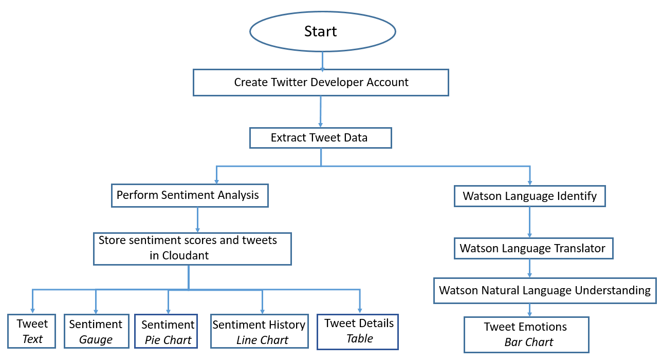
Block Diagram

Slide 9
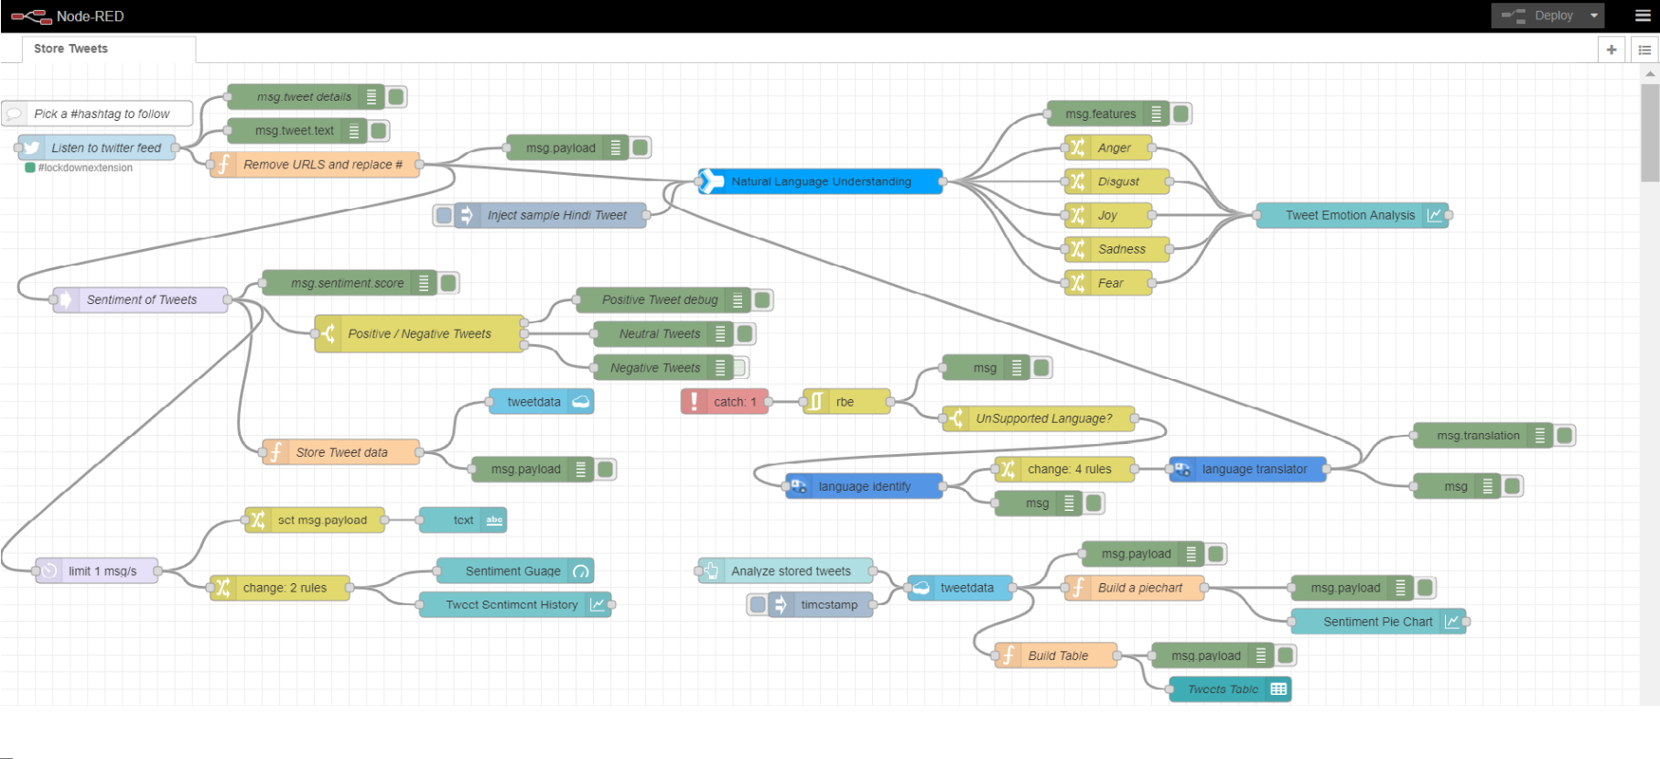
Model Flow

Slide 10
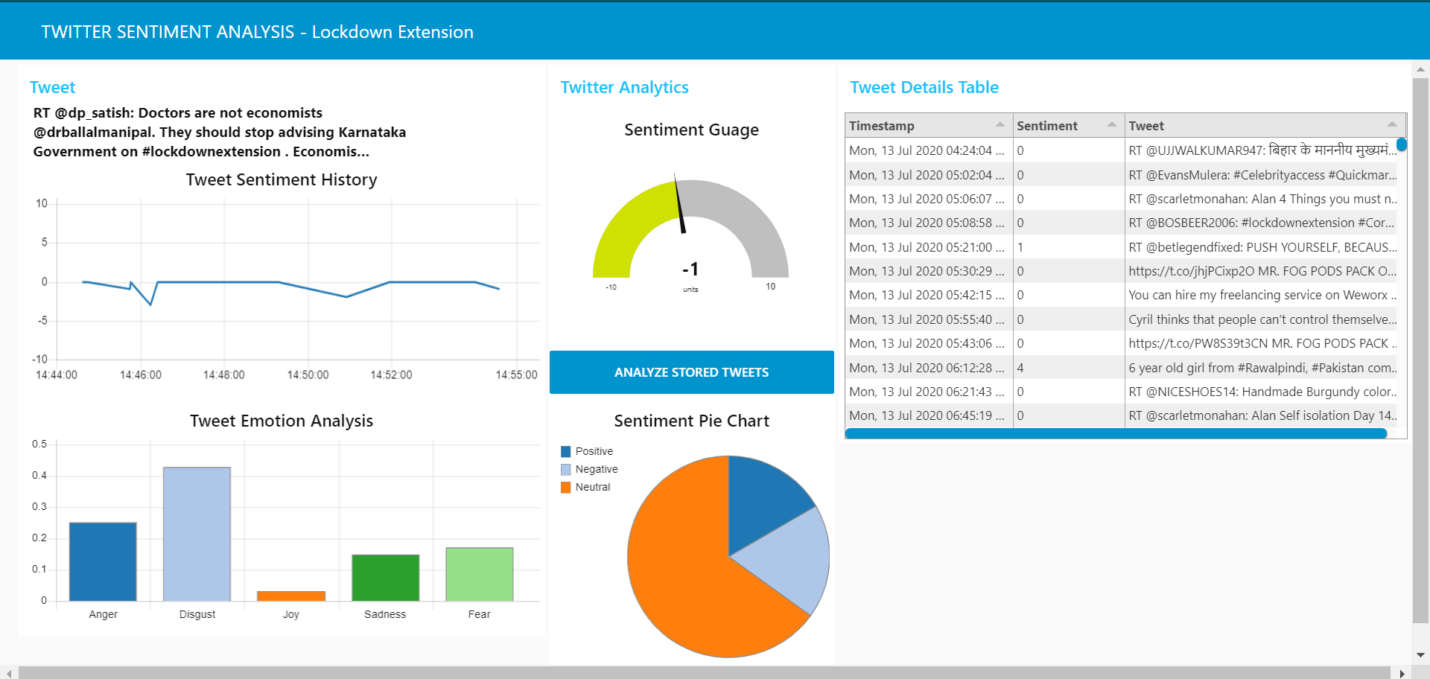
Model Dashboard

