Slide 1
ACADEMIC MAJOR PROJECT DEFENSE | B.TECH CSE (AI/ML)
BuyWise: Think Before You Spend
An AI-Powered Personal Finance & Purchasing Decision Assistant for College Students
Deterministic Capacity Engine | Scikit-Learn ML Categorization | Isolation Forest Anomaly Detection | Vite/React SPA

Slide 2
BUYWISE | AI FOR PERSONAL FINANCE
The Student Financial Crisis: Frictionless Spending, High Friction Survival
Frictionless UPI Payments
• Instant QR code scanning removes psychological friction of cash.
• Micro-expenses (₹40 to ₹250) occur multiple times daily.
• Canteen snacks, chai, and food delivery bleed allowances without visibility.
• Compounding effect exhausts monthly stipend within 10–12 days.
Lumpy Academic Deadlines
• Semester college fees (₹3,000–₹10,000) fall due on fixed dates.
• Hostel room rent and exam fees cannot be negotiated or postponed.
• Students face embarrassing fee defaults or emergency family loans.
• Lack of milestone visibility blinds students to impending deadlines.
Savings Confusion & Guilt
• Students lack distinction between untouchable reserves and monthly targets.
• Saved money is accidentally spent or double-counted.
• Absence of proactive gating: traditional apps only record after money is gone.
• Constant anxiety: 'Can I afford these headphones today?' remains unanswered.

Slide 3
BUYWISE | AI FOR PERSONAL FINANCE
Why Traditional Expense Trackers Fall Short for Students
Traditional Trackers (Spendee, Walnut, MoneyManager)
• Retroactive Accounting: Only tells you where money went after it left.
• Zero Decision Support: No answer to 'Should I buy this item right now?'
• Ignores College Fees: Treats ₹3,500 semester exam fee identically to shopping.
• Conflates Reserves & Goals: Double-counts savings goals against depleted cash.
• Complex for Students: Designed for salaried corporate tax accountants.
• No Alternative Gating: Does not suggest wait periods or budget cutbacks.
BuyWise Preemptive Decision Paradigm
• Forward-Looking Gating: Evaluates candidate purchases before checkout.
• Clear Actionable Verdict: Explains BUY NOW, WAIT, or RECONSIDER.
• Protects Academic Fees: Locks upcoming semester obligations upfront.
• Mathematically Invariant: Zero double-counting across internal transfers.
• Student-Centric UX: Designed around weekly/monthly parental allowances.
• Dynamic What-If Sandbox: Compares postponing vs. cheaper alternatives.

Slide 4
BUYWISE | AI FOR PERSONAL FINANCE
The BuyWise Solution: Think Before You Spend
1. Deterministic Engine
• Guaranteed mathematical capacity invariance.
• Evaluates liquid cash against untouchable emergency reserve.
• Protects dynamic remaining monthly savings target.
• 100% explainable calculation; zero black-box LLM hallucinations.
2. Machine Learning Core
• TF-IDF + Logistic Regression categorizes messy UPI text strings in <3ms.
• Isolation Forest identifies unusual spending outliers without labels.
• OLS Linear Regression forecasts 30-day burn rate trajectories.
• Resilient keyword and Z-score fallbacks if ML service is offline.
3. Interactive Fintech UI
• React 18 & Vite 6 single-page web app with sub-second hot reload.
• Warm off-white, muted lavender, and sage green aesthetic.
• Chronological visual balance trajectory across fee due dates.
• 1-click pre-seeded Demo Student Workspace for immediate testing.

Slide 5
BUYWISE | AI FOR PERSONAL FINANCE
Six Integrated Modules Supporting Student Decisions
Module 1: Purchase Decision Analyzer
• Evaluates candidate price, category & priority.
• Outputs BUY NOW, WAIT, or RECONSIDER.
• Reveals projected balance & reasons.
Module 2: Daily Spending Evaluator
• Evaluates micro-purchases (e.g. ₹250 meal).
• Checks today's spend against safe daily pace.
• Protects upcoming 7-day bill commitments.
Module 3: Financial Profile & Timeline
• Tracks liquid balance, cushion & savings target.
• Chronological trajectory across fee due dates.
• Cycle rollover resets active actual savings.
Module 4: What-If Purchase Simulator
• Dynamic comparative decision sandbox.
• Compares Buy Now vs Wait for Allowance.
• Quantifies cheaper options & skip annual impact.
Module 5: Spending Intelligence
• Category distribution via interactive Recharts.
• Detects repeated micro-leaks (<= ₹300).
• Isolation Forest highlights severe spending outliers.
Module 6: Personalized Advisor
• Behavioral coaching on emergency cushion health.
• Detects food dining velocity spikes (>35%).
• Paces progress toward monthly savings goals.

Slide 6
BUYWISE | AI FOR PERSONAL FINANCE
Decision Engine Workflow: Transparent 5-Branch Evaluation
1. Input Gating & Reserves
• Liquid Cash = Current Available Balance.
• RST = max(0, Target - ActualSavings).
• TPR = EmergencyReserve + RST.
• SafeDiscretionary = max(0, Balance - TPR).
• PendingObligations = Filtered over 30 days.
2. Constraint Evaluations
• Branch A: Balance - Price < 0 (Overdraft).
• Branch B: Balance - Price < EmergencyReserve (Untouchable cushion breached).
• Branch C: Balance - Price < TPR (Encroaches on remaining savings target).
• Branch D: BufferAfterBills < TPR (Jeopardizes semester tuition fee/rent).
3. Verdict & Income Check
• If future income arrives before purchase date AND restores buffer -> WAIT (Safe to buy after income).
• If purchase is essential -> WAIT / trim other spend.
• If constraint cannot be resolved -> RECONSIDER.
• If all reserves & bills satisfied -> BUY NOW.

Slide 7
BUYWISE | AI FOR PERSONAL FINANCE
Mathematical Proof: Invariance & Zero Double-Counting
State 1: Initial Baseline Setup
• Liquid Spending Balance: ₹3,500
• Untouchable Emergency Cushion: ₹700
• Monthly Savings Target: ₹1,000
• Actual Savings Achieved: ₹0
• Remaining Savings Target: max(0, 1000 - 0) = ₹1,000
• Total Protected Reserves: 700 + 1000 = ₹1,700
• Safe Discretionary Spending: 3500 - 1700 = ₹1,800
• Verdict for ₹1,800 purchase: BUY NOW (leaves exactly ₹1,700 reserves).
State 2: Transfer ₹400 into Savings Account
• Spending Account Debited: 3500 - 400 = ₹3,100
• Actual Savings Incremented: 0 + 400 = ₹400
• Remaining Savings Target: max(0, 1000 - 400) = ₹600
• Total Protected Reserves: 700 + 600 = ₹1,300
• Safe Discretionary Spending: 3100 - 1300 = ₹1,800 (INVARIANT!)
• No Double-Counting: Remaining target dropped dynamically from 1000 to 600.
• Protected from Overspend: Spending ₹2,000 leaves ₹1,100 < ₹1,300 -> RECONSIDER.

Slide 8
BUYWISE | AI FOR PERSONAL FINANCE
System Architecture: Decoupled Multi-Service Topology
Frontend Single Page App
• Port: 5173 (Vite 6 Dev & Preview).
• React 18 functional components & hooks.
• Tailwind CSS responsive design system.
• Lucide React iconset & Recharts visualizations.
• Zero-config demo workspace launcher.
Node.js Express API Server
• Port: 5000 (Express REST API).
• JWT authentication & bcrypt password hashing.
• Mongoose models with strict multi-tenant isolation.
• In-memory MongoDB engine with Atlas URI support.
• Deterministic Financial Decision Engine.
FastAPI Python ML Engine
• Port: 8000 (Uvicorn ASGI).
• TF-IDF + Logistic Regression categorizer (<3ms).
• Isolation Forest anomaly detector.
• OLS Linear Regression spending forecaster.
• Resilient keyword & Z-score statistical fallbacks.

Slide 9
BUYWISE | AI FOR PERSONAL FINANCE
AI/ML Implementation: Light, Local & Highly Explainable
TF-IDF + Logistic Regression
• Converts unstructured UPI notes to n-gram vectors.
• Softmax multiclass probability across 9 expense types.
• Trained with balanced class weighting (C=5.0).
• 100% accuracy on campus test cases in <2.4ms.
• Replaces bulky, slow LLM APIs.
Isolation Forest Outlier Detection
• Unsupervised tree ensemble (100 iTrees).
• Isolates spending anomalies based on path length.
• Flags irregular spikes (e.g. ₹4,500 coat on ₹150 avg).
• Contamination factor: 0.08.
• Statistical Z-score fallback for history < 5.
OLS Linear Regression Forecaster
• Fits daily cumulative expenditure trajectory.
• Calculates slope beta1 to detect burn velocity.
• Categorizes accelerating vs decelerating burn rates.
• 30-day projection bounds for end-of-month planning.
• Moving average fallback for sparse data.

Slide 10
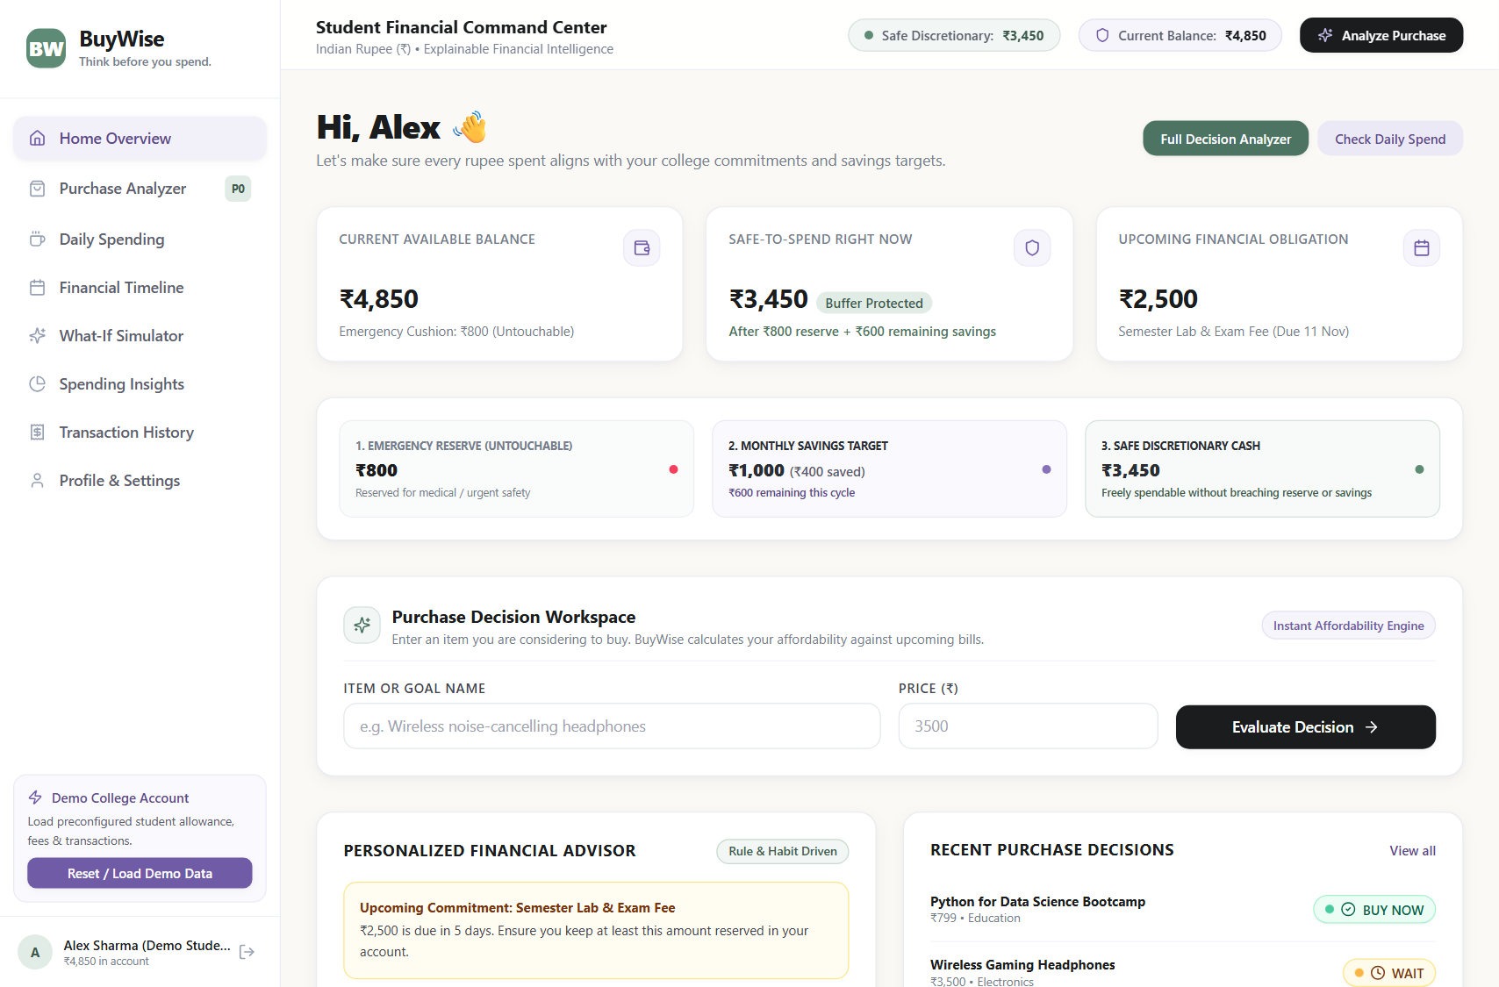
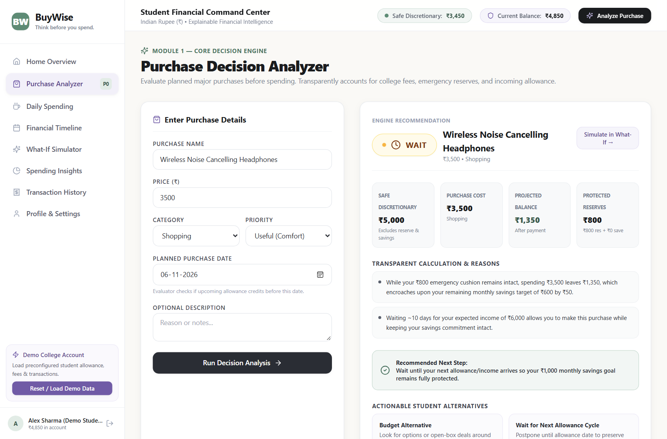
BUYWISE | AI FOR PERSONAL FINANCE
Application Visuals: Real Screenshots from Running System
Executive Home Dashboard: Real-time safe discretionary spending (₹3,450), untouchable cushion (₹800), and remaining savings target (₹600).
Purchase Decision Analyzer: Transparent financial breakdown for candidate purchase (₹3,500 headphones) displaying WAIT verdict & days to income.

Slide 11
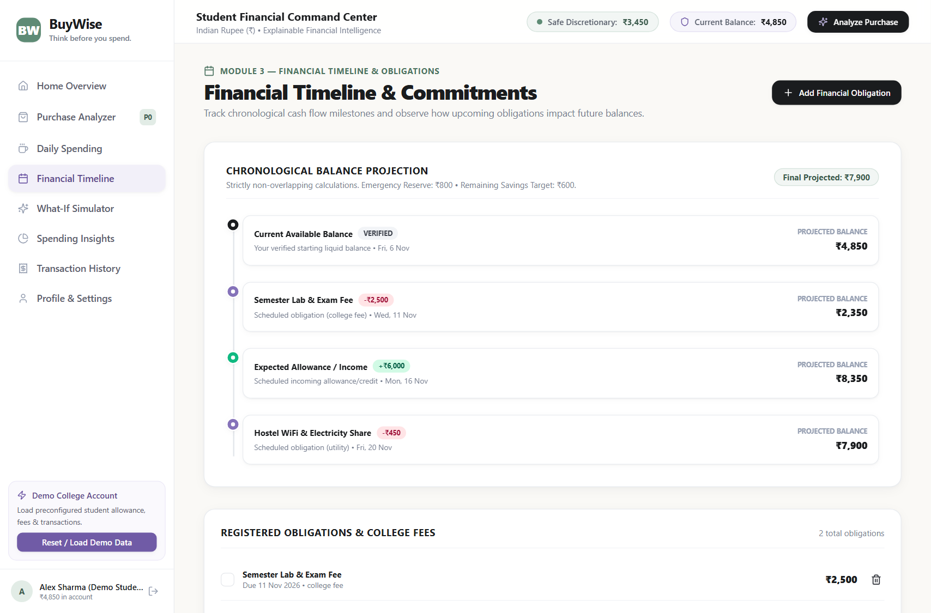
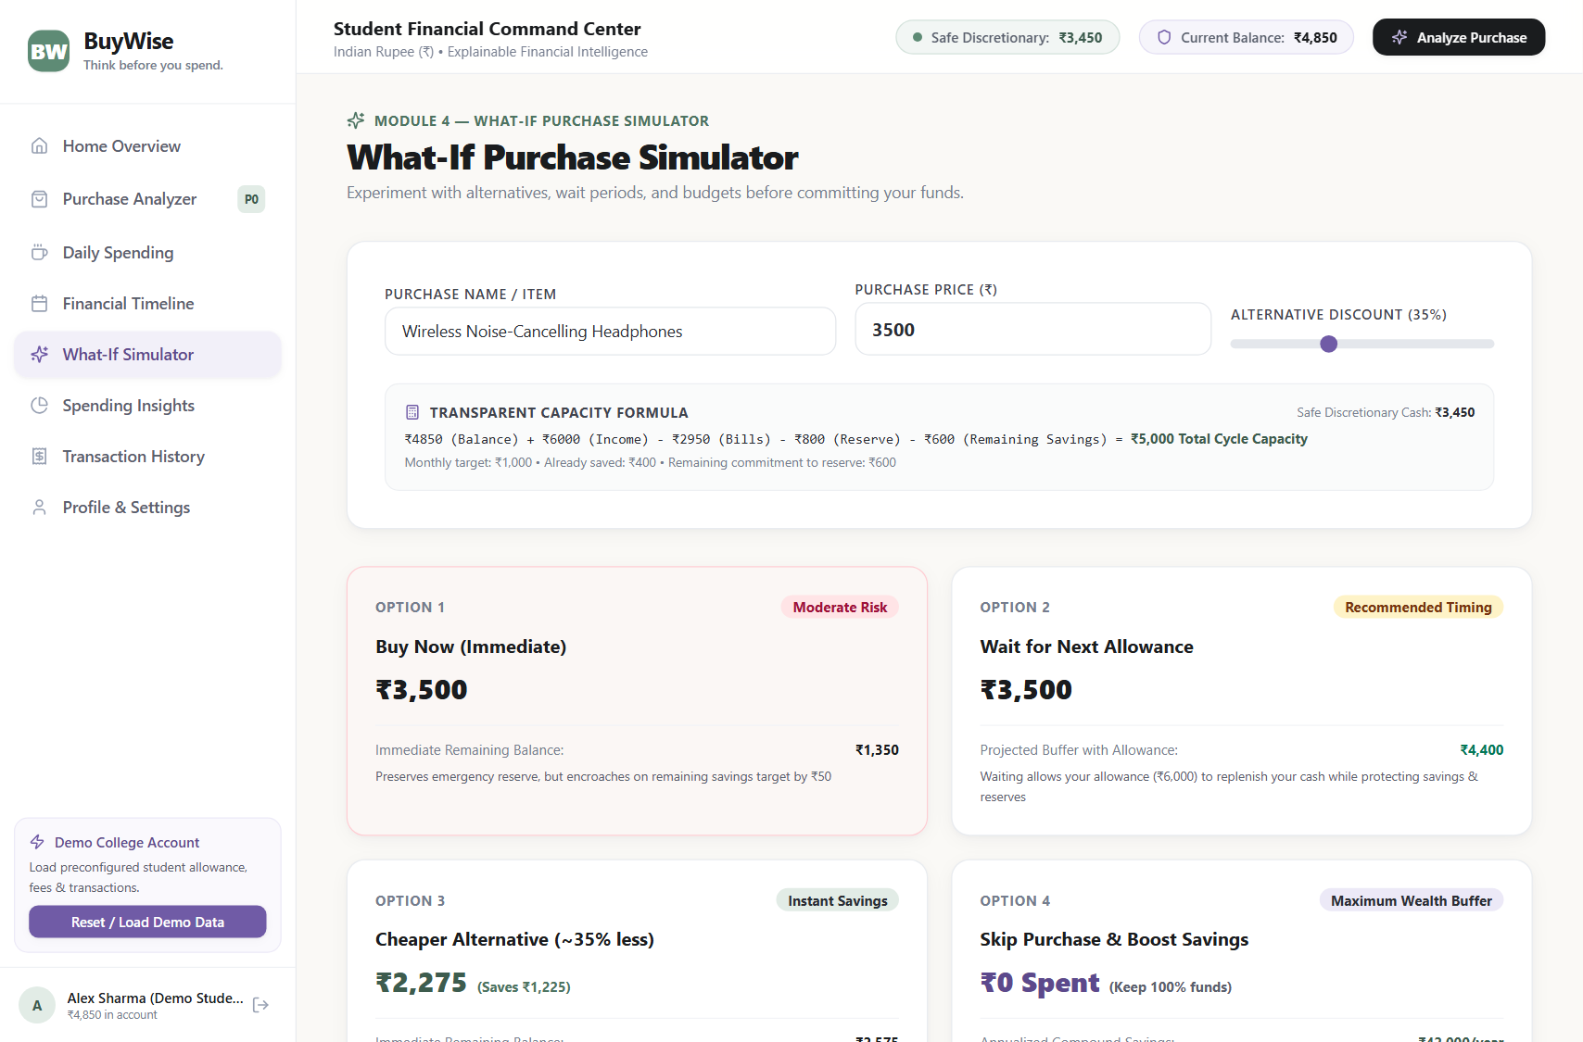
BUYWISE | AI FOR PERSONAL FINANCE
Application Visuals: Timeline & What-If Purchase Simulator
Chronological Financial Timeline: Milestone projection tracking upcoming tuition fees (₹2,500 due in 5 days) and scheduled allowance credit.
What-If Simulator: Side-by-side comparative modeling for Buy Now vs Wait for Allowance vs Cheaper Alternative vs Annual Skip Savings.

Slide 12
BUYWISE | AI FOR PERSONAL FINANCE
Verification & Audit: 100% Pass Rate Across All Suites
Master E2E Audit (28/28)
• Express <-> FastAPI <-> Mongo live communication.
• Auth token enforcement & duplicate rejection.
• Strict User A vs User B data isolation.
• Accounting invariance on transfer (₹1,800).
• Decision analyzer 9 boundary cases.
• Daily spending pace & timeline milestones.
• All 28 live HTTP tests passed.
Backend & Logic Suite (21/21)
• Engine critical cases 1 through 10.
• Reserve protection & upcoming fees checks.
• Dynamic savings target pacing tests.
• Cycle rollover & cumulative savings tests.
• Database models CRUD & status mutations.
• Centralized error handling & validation.
• All 21 backend unit tests passed.
ML & Frontend Build (100%)
• ML Suite: 8/8 categorizer test cases passed.
• Isolation Forest outlier detection passed.
• Linear Regression trajectory prediction passed.
• Sparse data fallback triggers verified.
• Vite 6 Production Build: 1,604 modules compiled.
• 0 build warnings, 0 runtime console errors.
• Total assertions: 53/53 PASSED (100%).

Slide 13
BUYWISE | AI FOR PERSONAL FINANCE
System Limitations & Future Enhancements
Current Limitations
• Default In-Memory Database: Embedded MongoMemoryServer resets data on process restart unless configured with MONGODB_URI.
• Manual Receipt Entry: Does not yet extract line items from camera photos or PDF bank statements via OCR.
• Short History Warm-up: Isolation Forest requires at least 5 transactions for stable tree construction (handled via Z-score fallback).
• Single Currency: Currently calibrated specifically for Indian Rupees (₹) and Indian campus expense profiles.
Future Scope & Roadmap
• Account Aggregator (RBI AA) Integration: Direct read-only synchronization with student bank accounts & UPI apps.
• Local On-Device OCR: Lightweight vision models parsing canteen chits and paper grocery bills.
• Shared Flat Expense Splitting: Multi-student hostel mess bill splitting with automatic obligation generation.
• Multi-Currency Calibration: Support for international students studying abroad with real-time FX hedging.

Slide 14
CONCLUSION & SUMMARY
BuyWise: Transforming Student Financial Decision-Making
• Traditional trackers tell you where your money went; BuyWise tells you whether to spend it in the first place.
• Mathematical guarantees prevent catastrophic college fee defaults, protect emergency reserves, and eliminate double-counting.
• Machine learning provides sub-millisecond semantic classification and anomaly detection without relying on costly external APIs.
• Comprehensive verification: 53/53 assertions passed across live E2E integration, unit, and ML test suites.
• A production-ready, academically rigorous, and student-centered financial decision assistant.
Thank You! Questions & Discussion Welcomed.

