Slide 1

Ecommerce Data Analysis
Presented By
JAHNAVI.KADA

Slide 2

INTRODUCTION :
Ecommerce, or electronic commerce, refers to the buying and selling of goods and services over the internet. It encompasses a wide range of online business activities, including retail, wholesale, and services.
E-commerce retail data analysis plays a crucial role in understanding customer behavior and trends, particularly through the use of point of sale (POS) data.​
This analysis enables retailers to optimize their marketing strategies, improve customer experiences, and drive sales growth.

Slide 3
OBJECTIVES :
1.Identify Sales Patterns:
Analyze sales data to uncover trends and patterns over time, including seasonal fluctuations and peak sales periods.
2.Customer Behavior Analysis:
Understand customer purchasing behavior, including frequency of purchases, average order value, and customer demographics.
3.Product Performance:
Evaluate the performance of different products or categories, identifying bestsellers and underperforming items.
4.Revenue Analysis:
Calculate total revenue, profit margins, and other key financial metrics to assess the overall financial health of the e-commerce business.
5.Market Segmentation:
Segment the customer base into different groups based on purchasing habits, geographic location, and other relevant criteria to tailor marketing efforts.

Slide 4
OBJECTIVES :
6.Return Analysis:
Analyze the reasons and frequency of product returns to identify potential issues with products or customer expectations.
7.Channel Performance:
Compare the effectiveness of different sales channels (e.g., online store, mobile app) to understand where customers prefer to shop.
8.Customer Retention:
Measure customer retention rates and identify strategies to improve customer loyalty and repeat purchases.
9.Logistics and Delivery:
Evaluate the efficiency of the supply chain and delivery processes, including shipping times and costs, to optimize logistics.

Slide 5
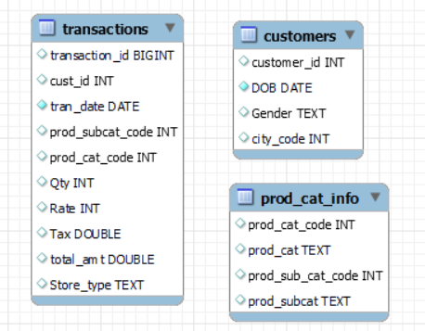
DATA MODEL DIAGRAMS :

Slide 6
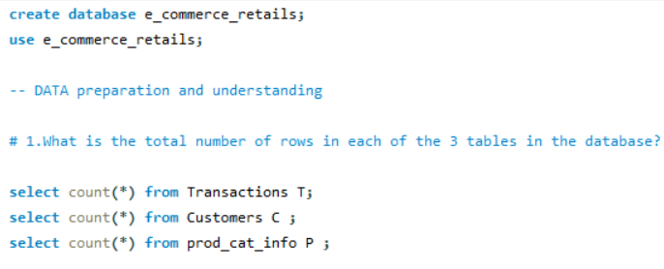



DATA preparation and understanding
1.What is the total number of rows in each of the 3 tables in the database?
OUTPUT:

Slide 7
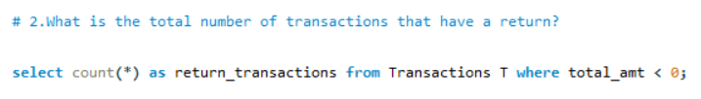

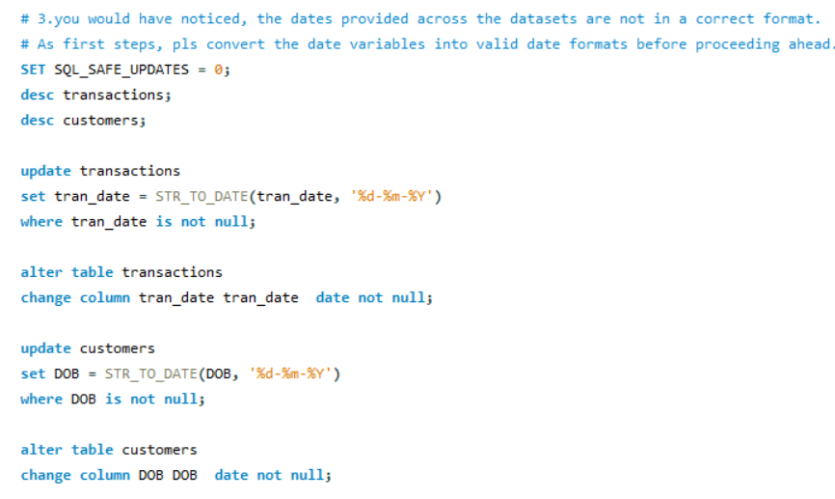
2.What is the total number of transactions that have a return?
3. Convert the date variables into valid date formats before proceeding ahead.

Slide 8
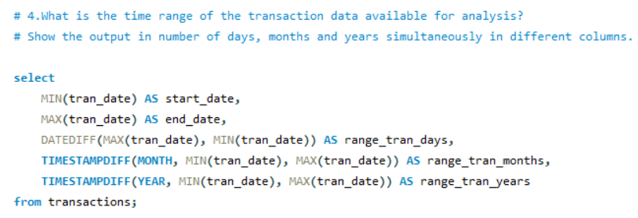



4.What is the time range of the transaction data available for analysis?
5.Which product category does the sub-category "DIY" belong to?

Slide 9
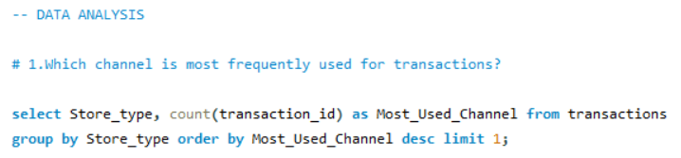

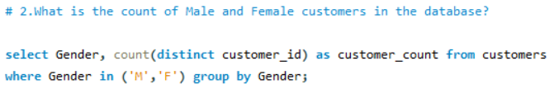

DATA ANALYSIS
1.Which channel is most frequently used for transactions?
2.What is the count of Male and Female customers in the database?

Slide 10
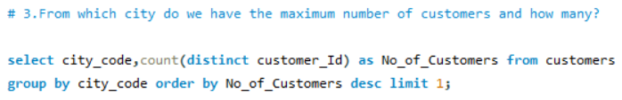

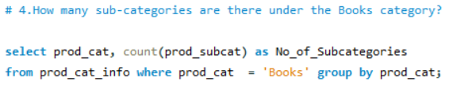



3.From which city do we have the maximum number of customers and how many?
4.How many sub-categories are there under the Books category?
5.What is the maximum quantity of products ever ordered?

Slide 11
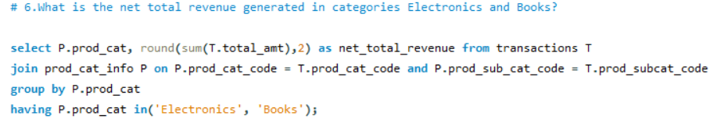

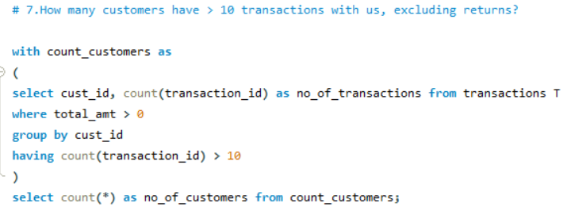

6.What is the net total revenue generated in categories Electronics and Books?
7.How many customers have > 10 transactions with us, excluding returns?

Slide 12
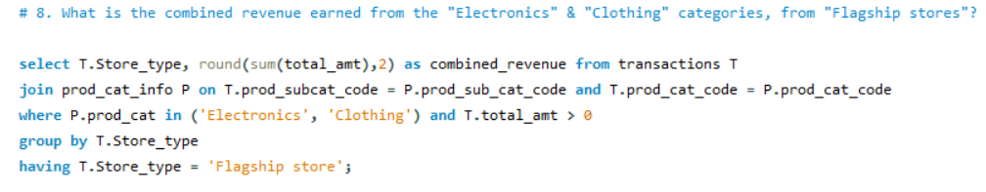

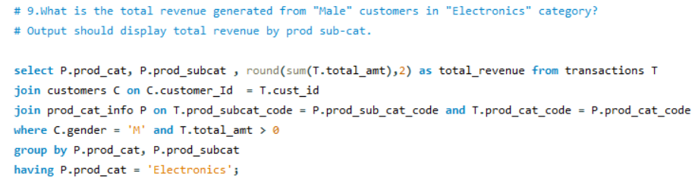
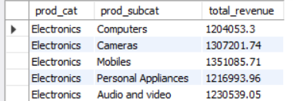
8. What is the combined revenue earned from "Electronics" & "Clothing" categories from "Flagship stores"?
9.What is the total revenue generated from "Male" customers in "Electronics" category?

Slide 13
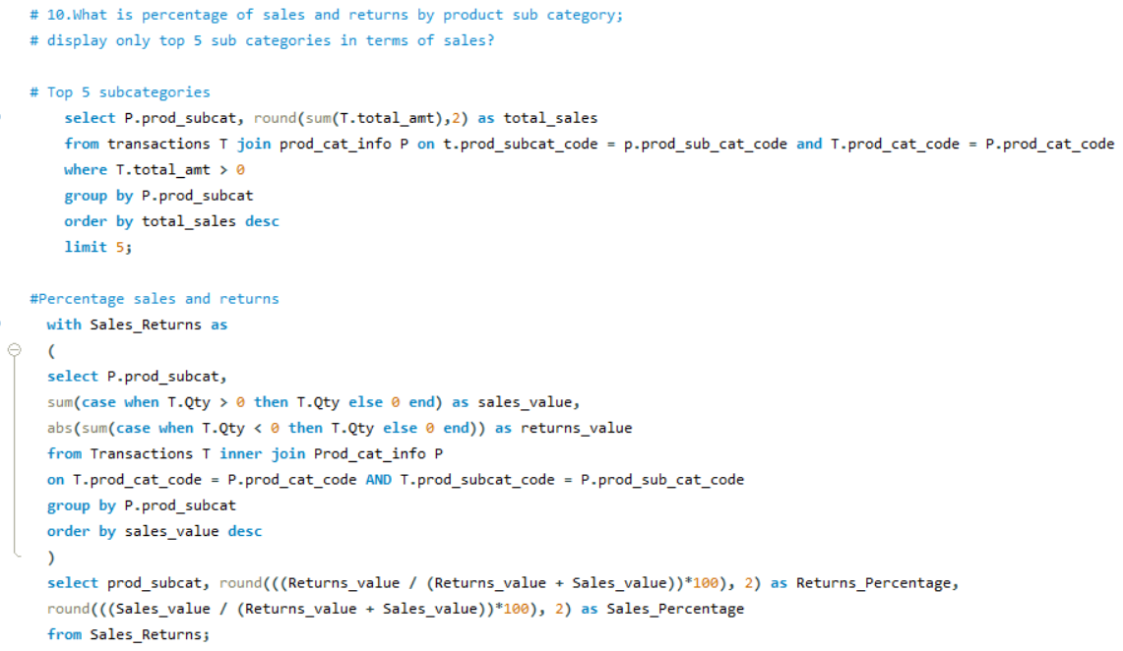
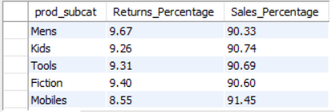
10.What is percentage of sales and returns by product sub category.

Slide 14
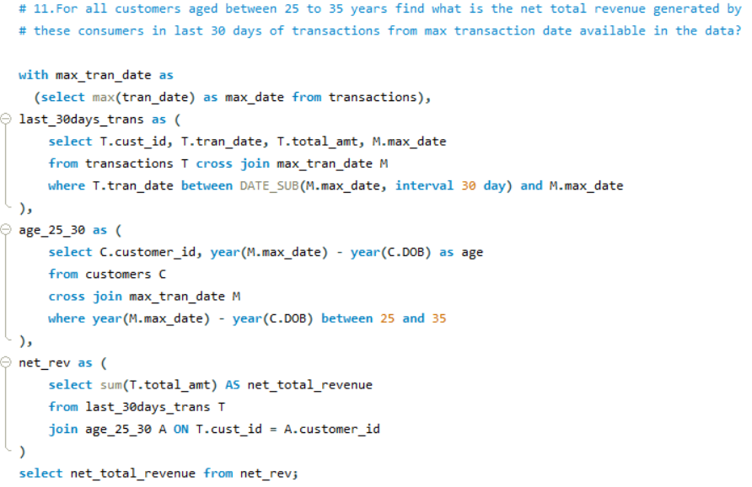

11.For all customers aged between 25 to 35 years find what is the net total revenue generated by these consumers in last 30 days of transactions from max transaction date available in the data?

Slide 15
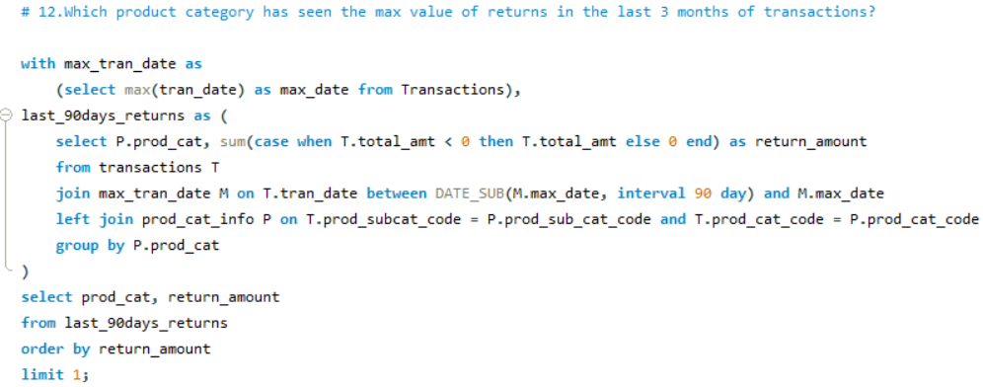

12.Which product category has seen the max value of returns in the last 3 months of transactions?

Slide 16
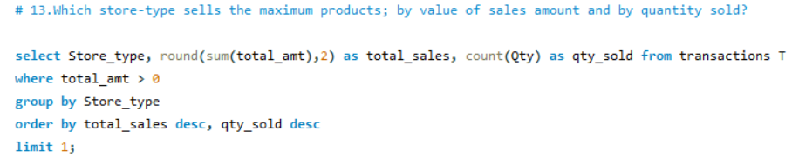

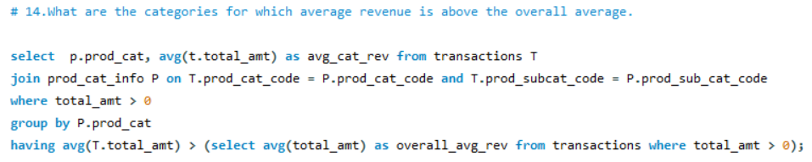
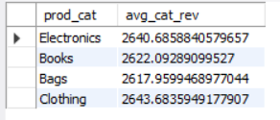
13.Which store-type sells the maximum products by value of sales amount and by quantity sold?
14.What are the categories for which average revenue is above the overall average.

Slide 17
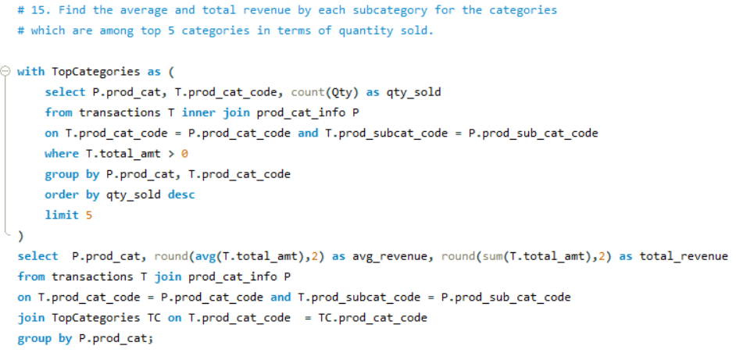
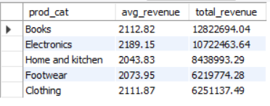
15. Find the average and total revenue by each subcategory for the categories which are among top 5 categories in terms of quantity sold.

Slide 18
CONCLUSION:
The conclusion for an e-commerce retail data analysis project typically summarizes the insights gained, the effectiveness of the methodologies used, and potential recommendations for the business. Here are some key points often found in such conclusions:
Insight Generation: The analysis usually identifies key patterns and trends in the data, such as peak sales periods, high-performing product categories, and customer demographics that drive the most revenue. For example, analyzing the sales data can reveal which marketing campaigns were the most successful and which customer segments are the most valuable.
Performance Measurement: It often involves evaluating the effectiveness of various marketing channels, website performance, and new product launches. This includes metrics like conversion rates, return on investment for marketing campaigns, and customer acquisition costs.
Optimization Opportunities: The conclusion may highlight areas where the business can optimize its operations, such as improving website user experience, targeting marketing efforts more effectively, or refining inventory management based on sales patterns.
Future Recommendations: Based on the findings, the analysis may offer recommendations for future actions. These can include strategies for boosting sales during off-peak periods, enhancing customer retention through personalized marketing, or leveraging data analytics for more informed decision-making.

Slide 19
THANK YOU

