Slide 1

EXPLORATORY DATA ANALYSIS FOR ECOMMERCE

Slide 2

INTRODUCTION :
Ecommerce, or electronic commerce, refers to the buying and selling of goods and services over the internet. It encompasses a wide range of online business activities, including retail, wholesale, and services.
E-commerce retail data analysis plays a crucial role in understanding customer behavior and trends, particularly through the use of point of sale (POS) data.​
This analysis enables retailers to optimize their marketing strategies, improve customer experiences, and drive sales growth.

Slide 3
OBJECTIVES :
1.Identify Sales Patterns:
Analyze sales data to uncover trends and patterns over time, including seasonal fluctuations and peak sales periods.
2.Customer Behavior Analysis:
Understand customer purchasing behavior, including frequency of purchases, average order value, and customer demographics.
3.Product Performance:
Evaluate the performance of different products or categories, identifying bestsellers and underperforming items.
4.Revenue Analysis:
Calculate total revenue, profit margins, and other key financial metrics to assess the overall financial health of the e-commerce business.
5.Market Segmentation:
Segment the customer base into different groups based on purchasing habits, geographic location, and other relevant criteria to tailor marketing efforts.

Slide 4
OBJECTIVES :
6.Return Analysis:
Analyze the reasons and frequency of product returns to identify potential issues with products or customer expectations.
7.Channel Performance:
Compare the effectiveness of different sales channels (e.g., online store, mobile app) to understand where customers prefer to shop.
8.Customer Retention:
Measure customer retention rates and identify strategies to improve customer loyalty and repeat purchases.
9.Logistics and Delivery:
Evaluate the efficiency of the supply chain and delivery processes, including shipping times and costs, to optimize logistics.

Slide 5
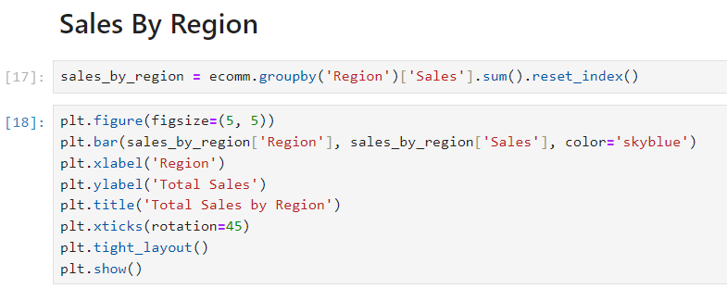
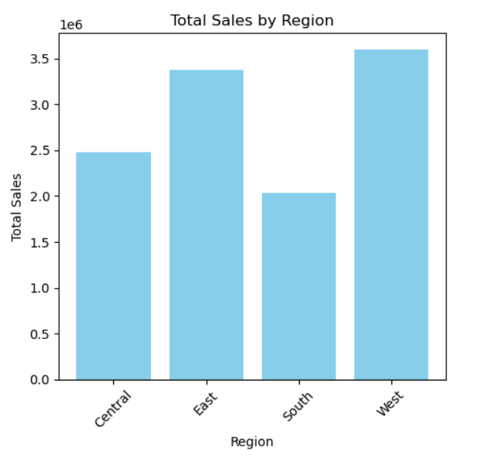
BAR GRAPHS

Slide 6
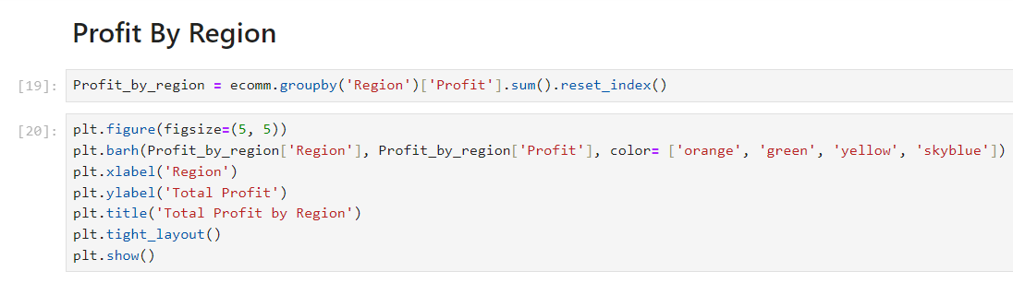
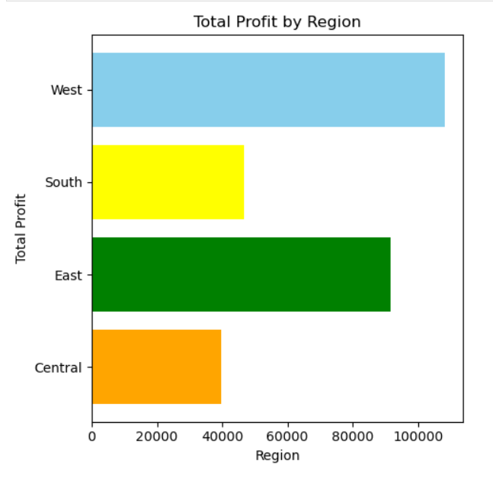

Slide 7
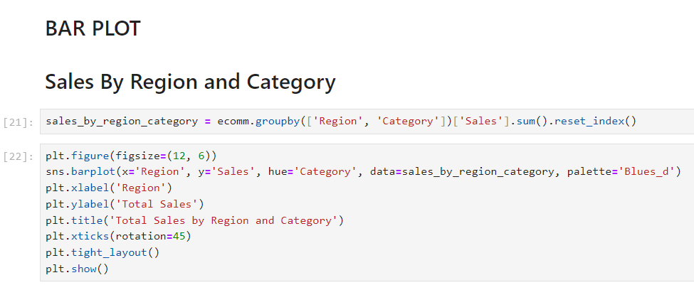
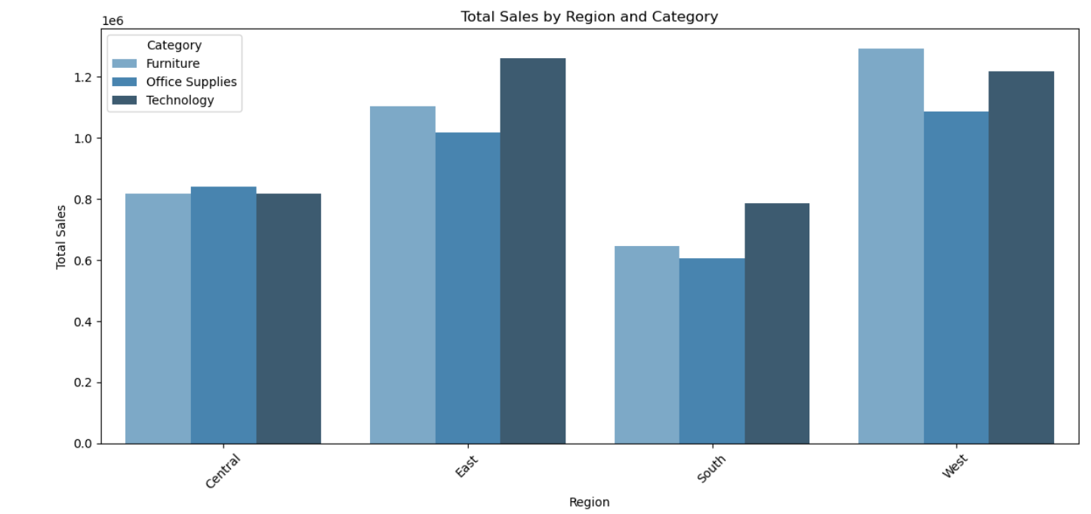

Slide 8
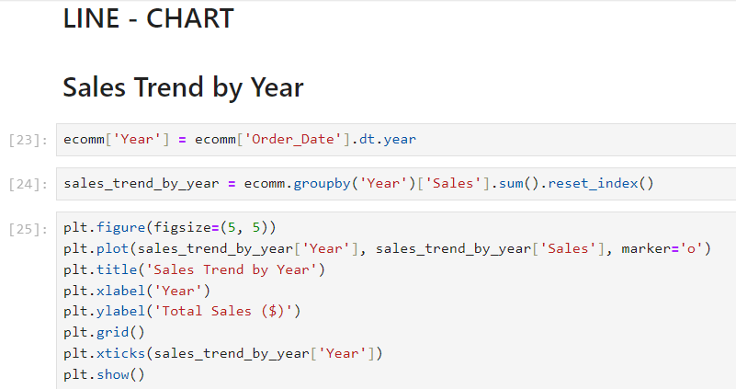
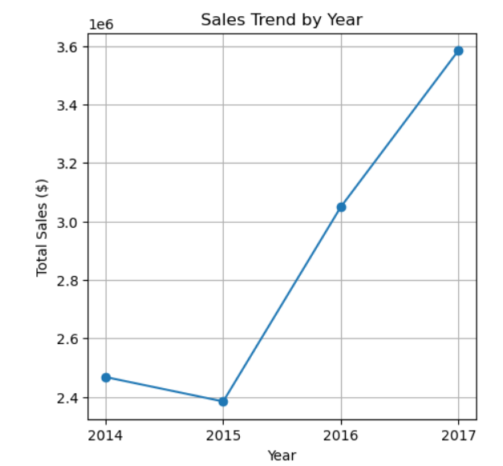
LINE CHART

Slide 9
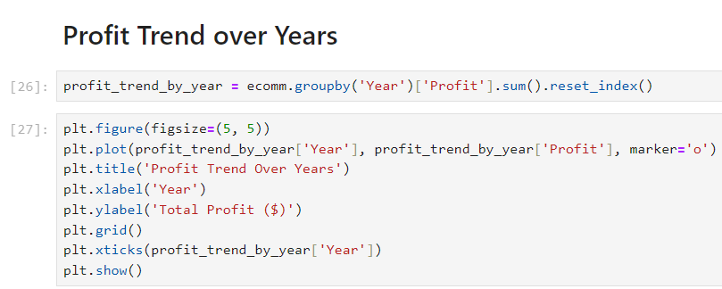
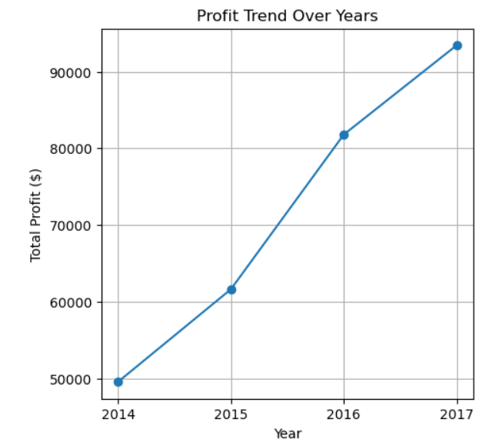

Slide 10
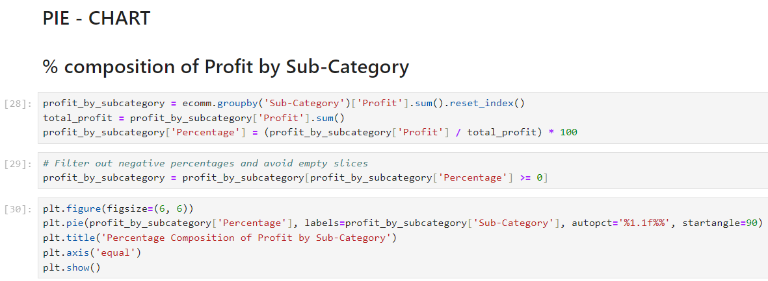
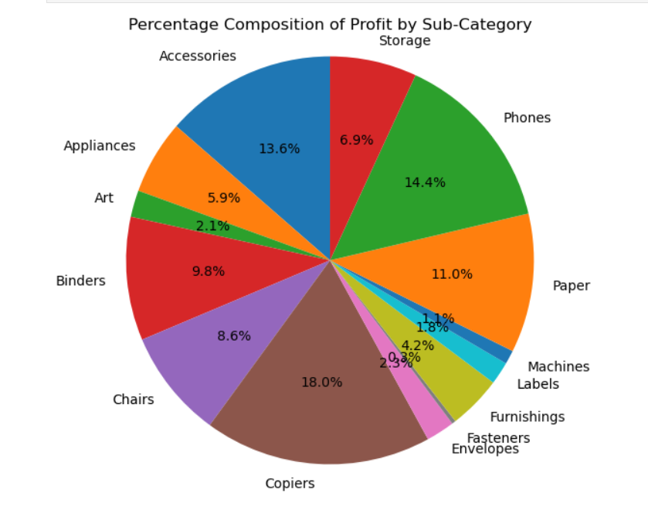
PIE CHART

Slide 11
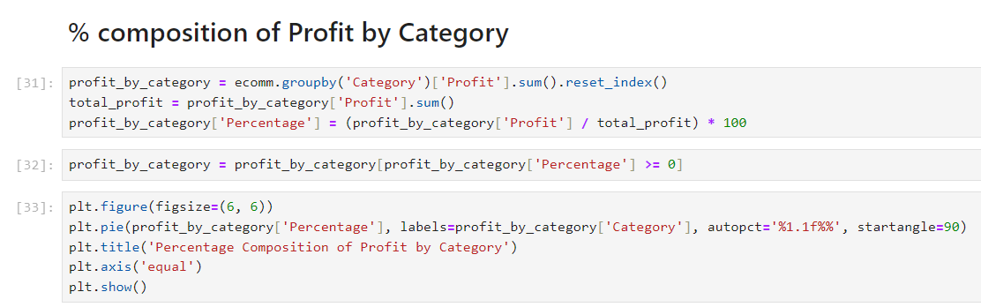
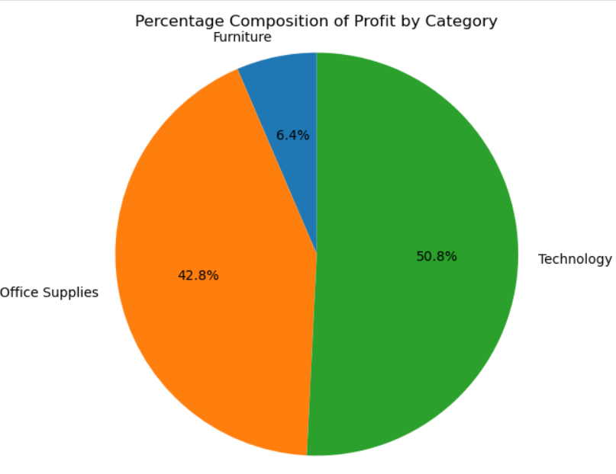

Slide 12

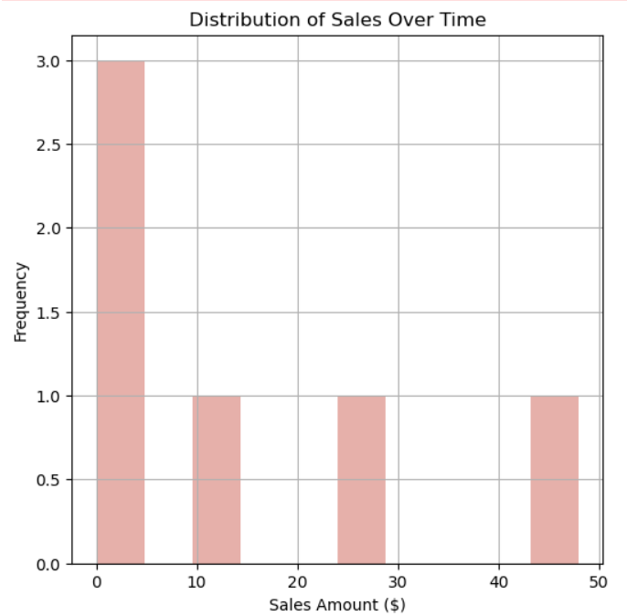
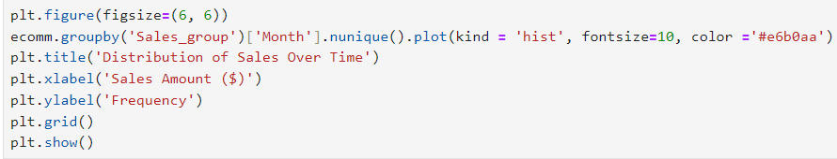
HISTOGRAMS

Slide 13

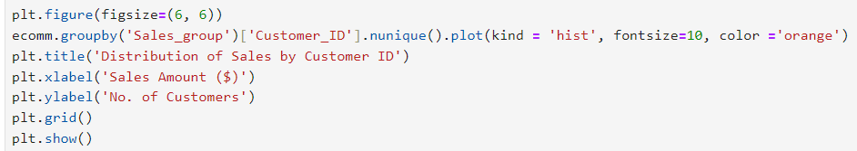
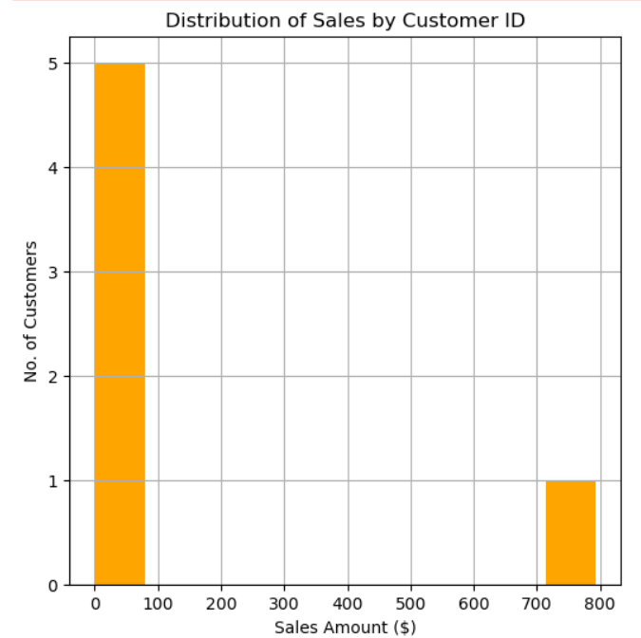

Slide 14
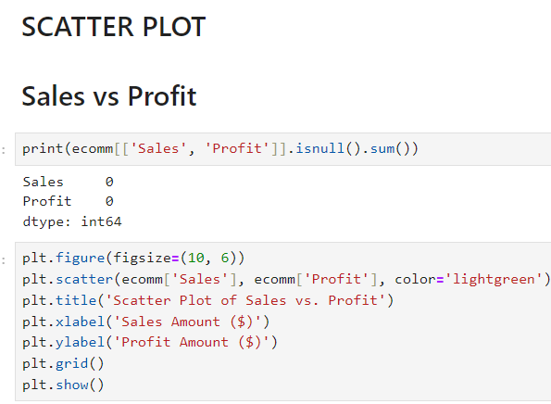
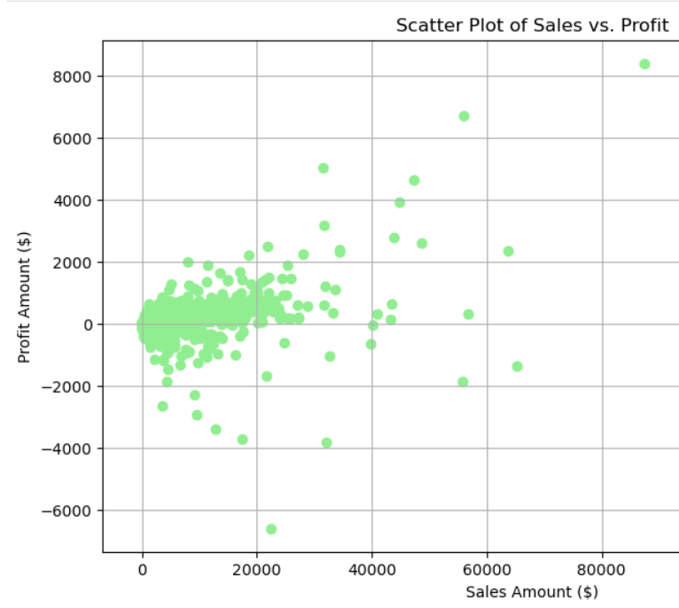
SCATTER PLOT

Slide 15
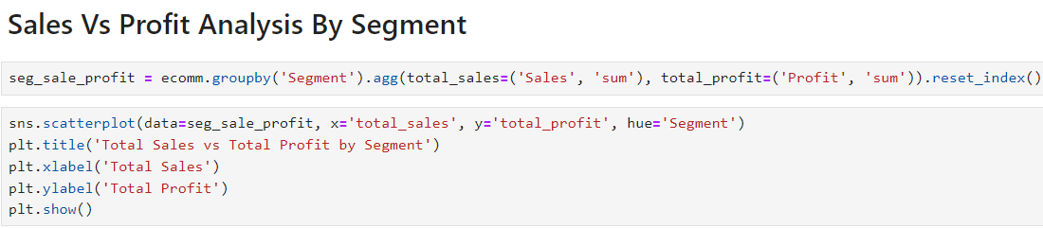
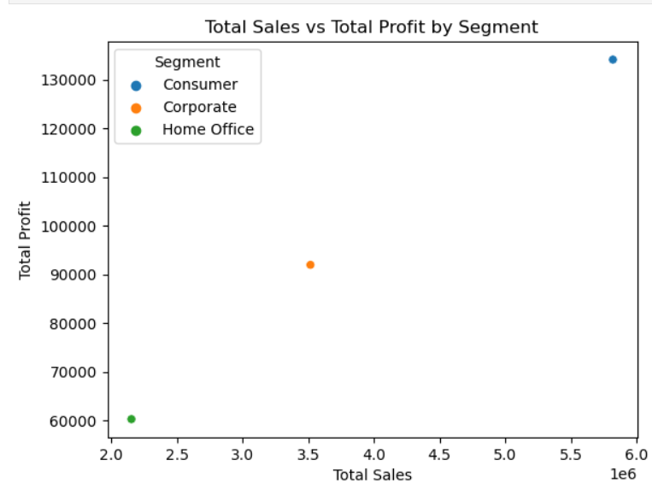

Slide 16
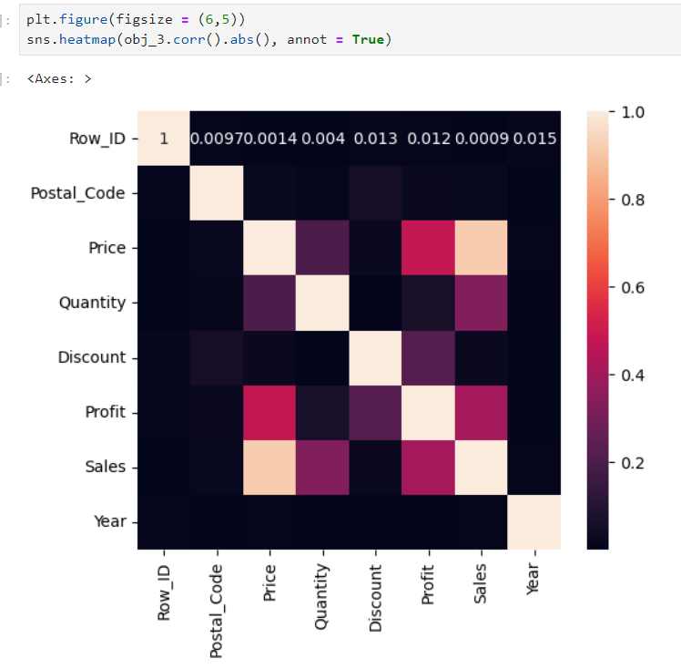
CORRELATION USING
HEAT MAPS

Slide 17
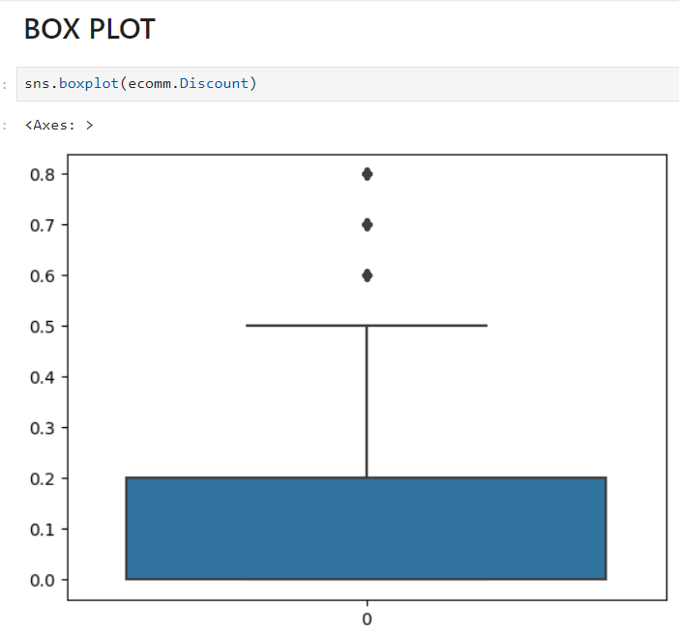
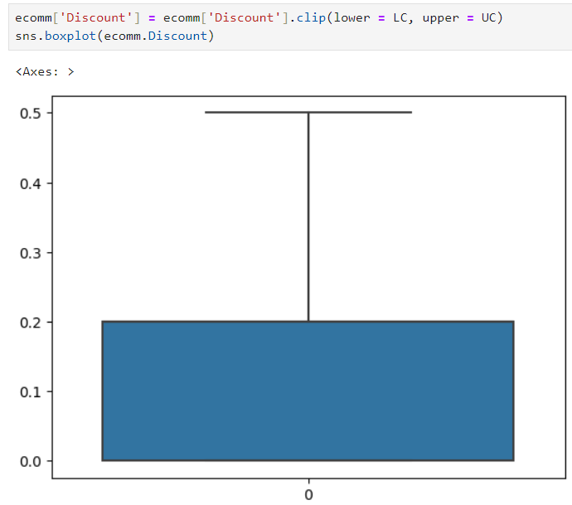
BOX PLOT

Slide 18
CONCLUSION
The conclusion for an e-commerce retail data analysis project typically summarizes the insights gained, the effectiveness of the methodologies used, and potential recommendations for the business. Here are some key points often found in such conclusions:
Insight Generation: The analysis usually identifies key patterns and trends in the data, such as peak sales periods, high-performing product categories, and customer demographics that drive the most revenue. For example, analyzing the sales data can reveal which marketing campaigns were the most successful and which customer segments are the most valuable.
Performance Measurement: It often involves evaluating the effectiveness of various marketing channels, website performance, and new product launches. This includes metrics like conversion rates, return on investment for marketing campaigns, and customer acquisition costs.
Optimization Opportunities: The conclusion may highlight areas where the business can optimize its operations, such as improving website user experience, targeting marketing efforts more effectively, or refining inventory management based on sales patterns.
Future Recommendations: Based on the findings, the analysis may offer recommendations for future actions. These can include strategies for boosting sales during off-peak periods, enhancing customer retention through personalized marketing, or leveraging data analytics for more informed decision-making.

Slide 19
THANK YOU

