Slide 1

Exploratory Data Analysis for Credit Card
PRESENTED BY:
JAHNAVI KADA

Slide 2

INTRODUCTION :
Credit card data analysis plays a fundamental role in understanding consumer behavior, managing risks, and optimizing business strategies within the financial sector. By thoroughly examining credit card transactions, organizations can derive insights that are essential for enhancing service offerings and mitigating risks associated with fraud and credit defaults1. The analysis encompasses a wide array of aspects including transaction trends, spending patterns, and demographic influences, crucial for creating tailored financial products that resonate with diverse customer needs2. This exploratory approach to analyzing credit card data not only aids in identifying fraud but also enhances customer engagement through personalized marketing efforts

Slide 3
OBJECTIVES :
The main objectives of credit card data analysis can be outlined as follows:
Fraud Detection: To identify and mitigate potentially fraudulent activities by analyzing transaction patterns and anomalies common in credit card misuse1.
Customer Behavior Insight: To gain a comprehensive understanding of consumer spending habits across different demographics, allowing for refined targeting in marketing strategies.
Risk Management: To evaluate risks associated with credit card usage, particularly in assessing creditworthiness and default probability among borrowers.
Business Strategy Optimization: To inform businesses about spending trends and consumer preferences, enabling them to develop more effective marketing campaigns and improve service delivery.
Predictive Analytics: To deploy machine learning algorithms for predictive modeling that aids in forecasting credit card usage trends and potential defaults.

Slide 4

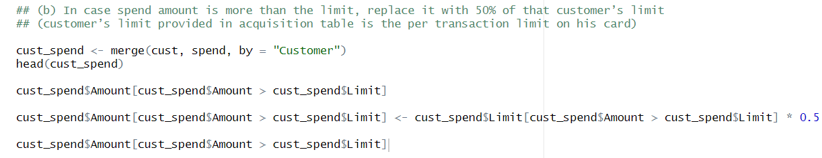
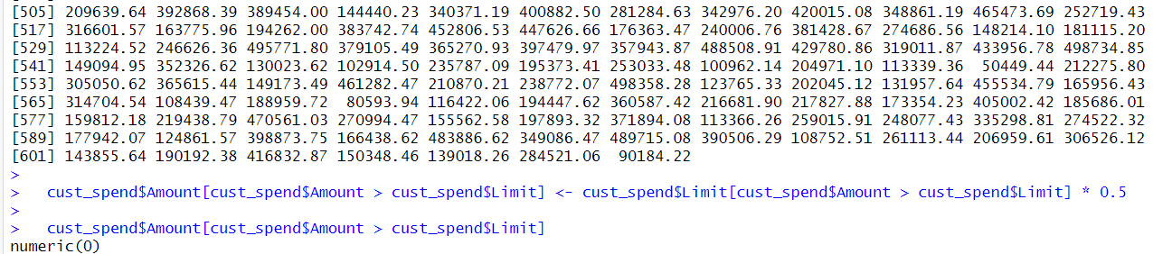
(1) In the above dataset
(a) In case age is less than 18, replace it with mean of age values
(b) In case spend amount is more than the limit, replace it with 50% of that customer’s limit (customer’s limit provided in acquisition table is the per transaction limit on his card)

Slide 5
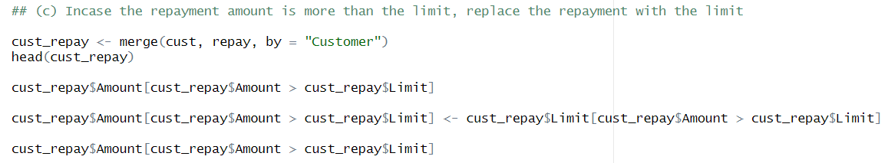
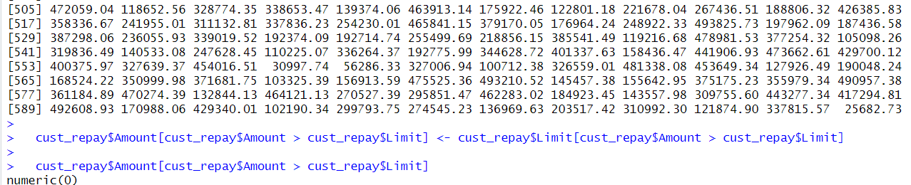
(c) Incase the repayment amount is more than the limit, replace the repayment with the limit

Slide 6
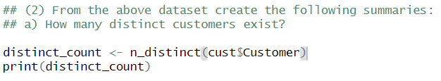



(2) From the above dataset create the following summaries:
a) How many distinct customers exist?
b) How many distinct categories exist?

Slide 7
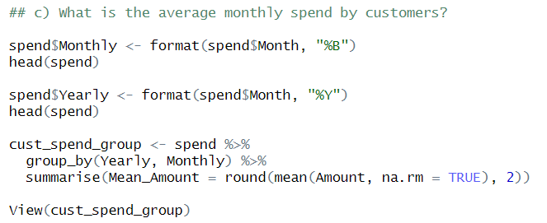
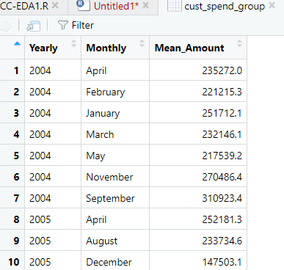
c) What is the average monthly spend by customers?

Slide 8
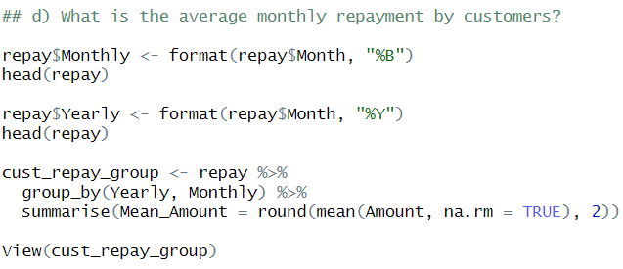
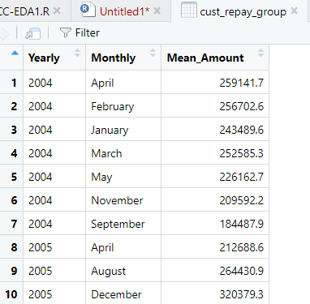
d) What is the average monthly repayment by customers?

Slide 9
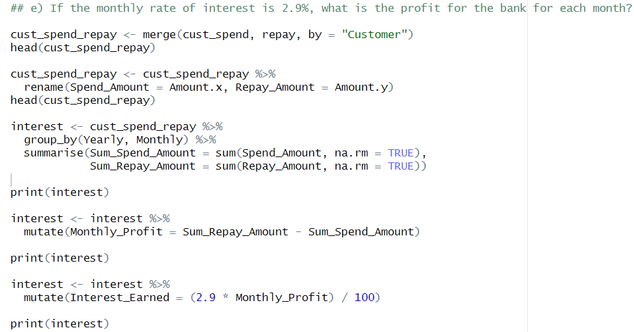
e) If the monthly rate of interest is 2.9%, what is the profit for the bank for each month?

Slide 10
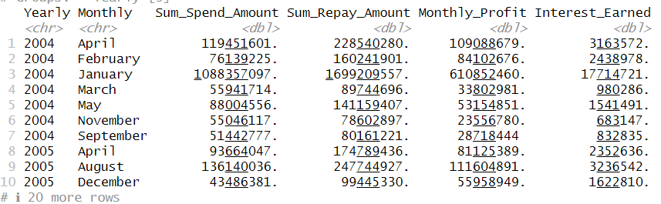

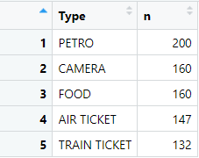
f) What are the top 5 product types?

Slide 11
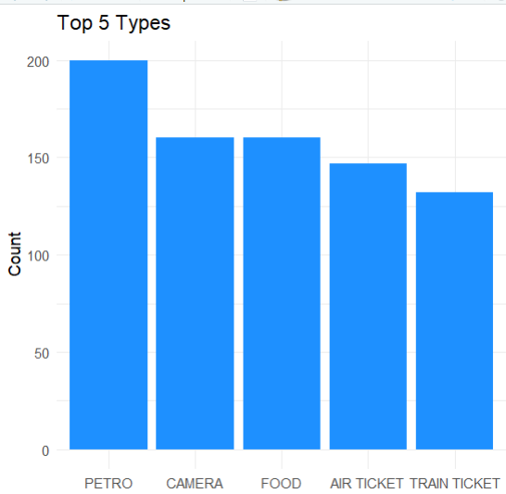

Slide 12
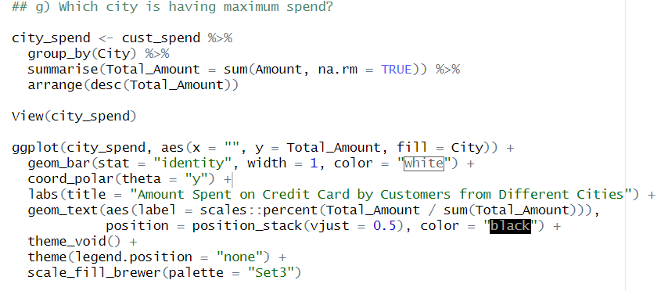
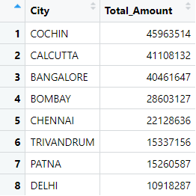
g) Which city is having maximum spend?

Slide 13
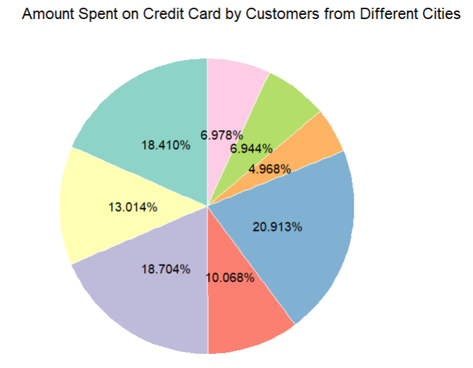

Slide 14
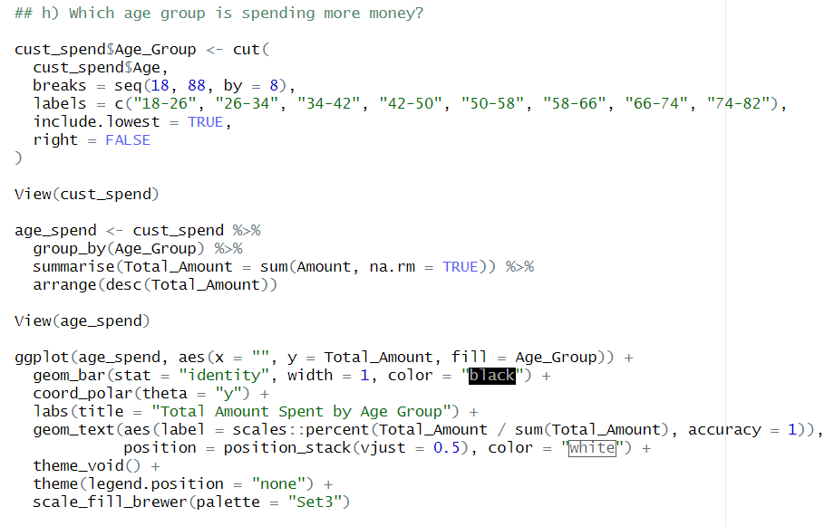
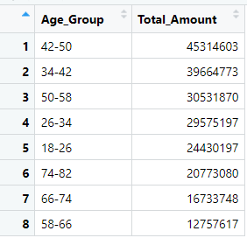
h) Which age group is spending more money?

Slide 15
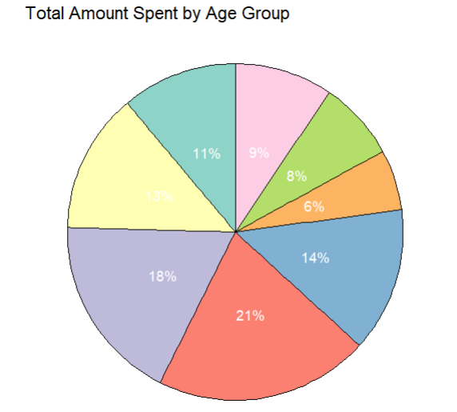

Slide 16
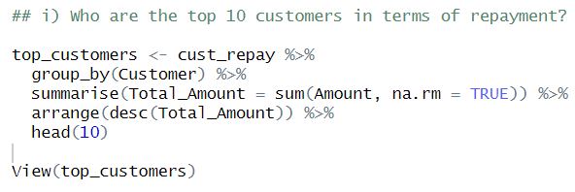
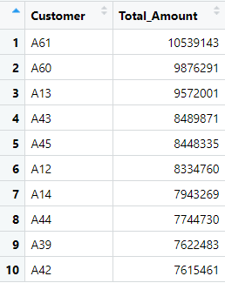
i) Who are the top 10 customers in terms of repayment?

Slide 17
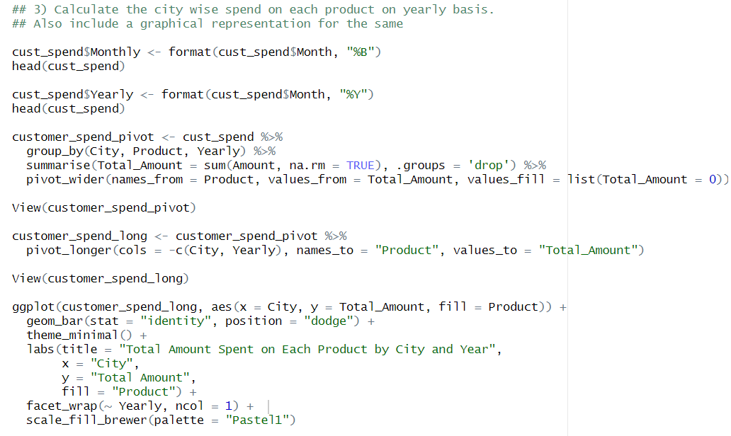
3) Calculate the city wise spend on each product on yearly basis. Also include a graphical representation for the same

Slide 18
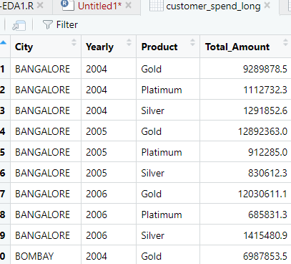
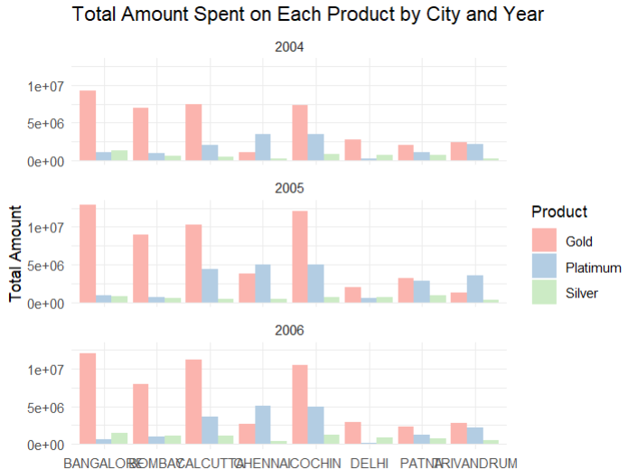

Slide 19
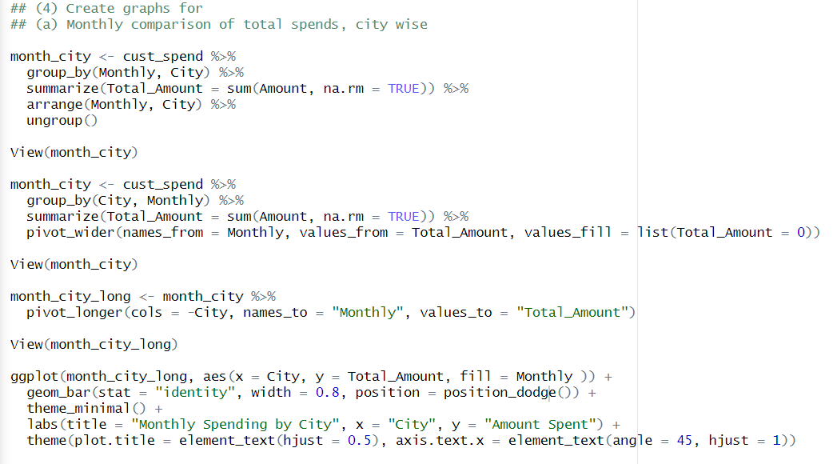
(4) Create graphs for
a) Monthly comparison of total spends, city wise

Slide 20
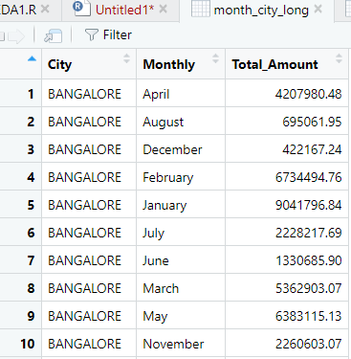
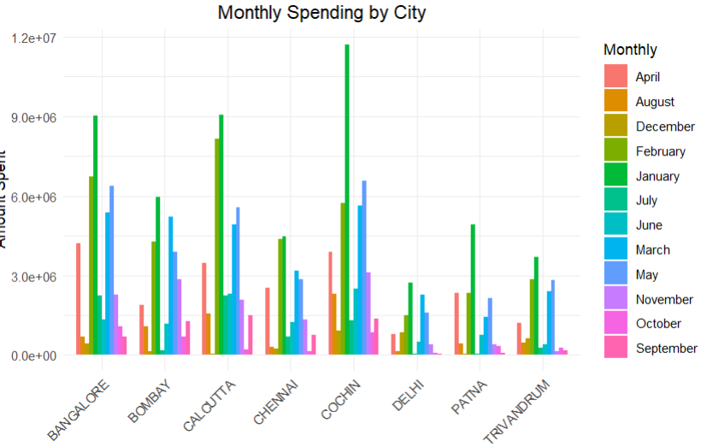

Slide 21
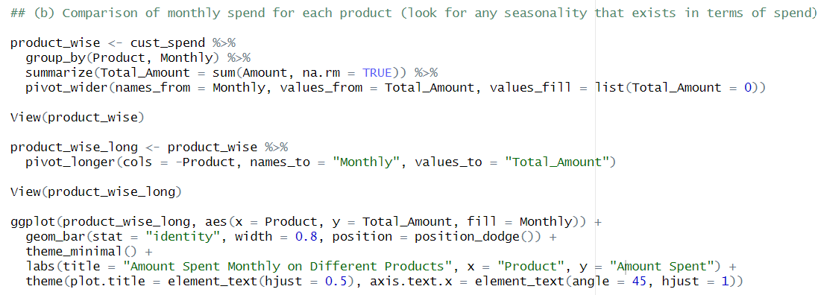
(b) Comparison of monthly spend for each product (look for any seasonality that exists in terms of spend)

Slide 22
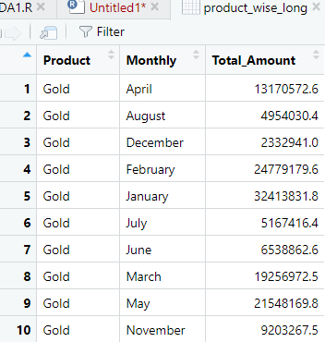
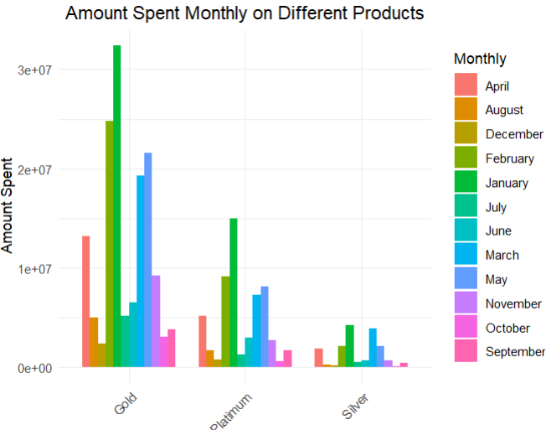

Slide 23
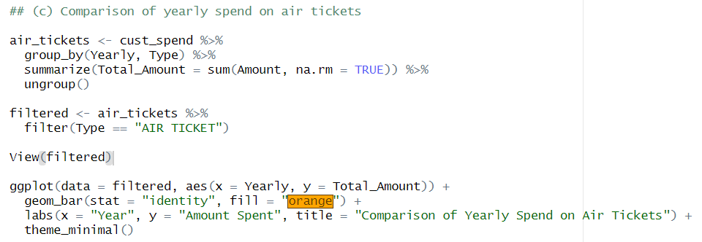
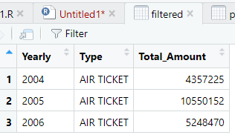
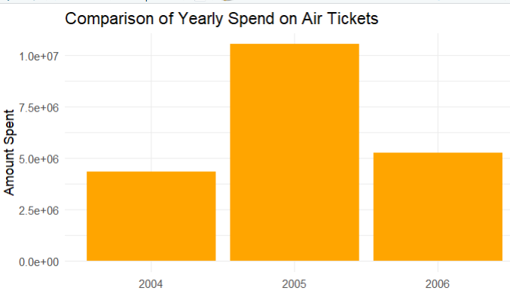
(c) Comparison of yearly spend on air tickets

Slide 24
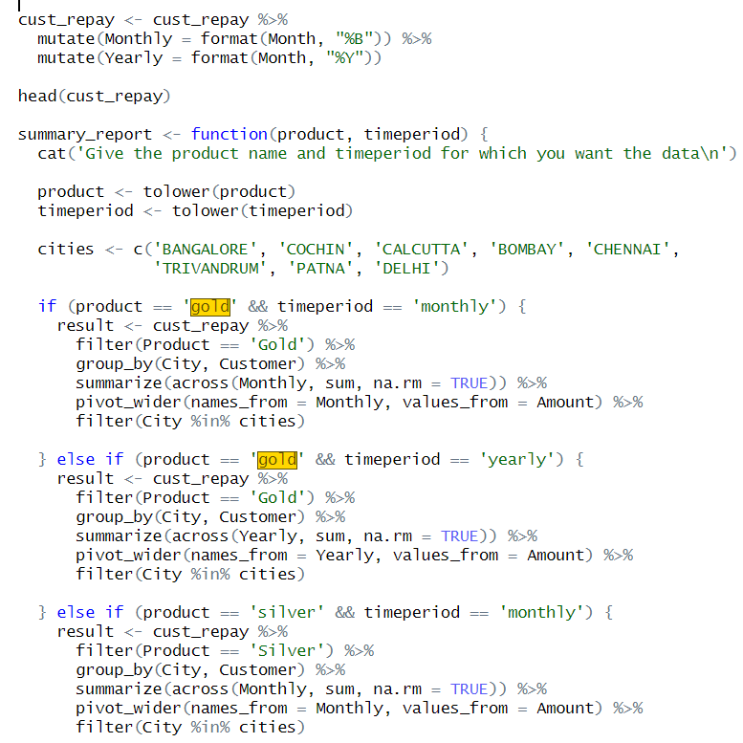
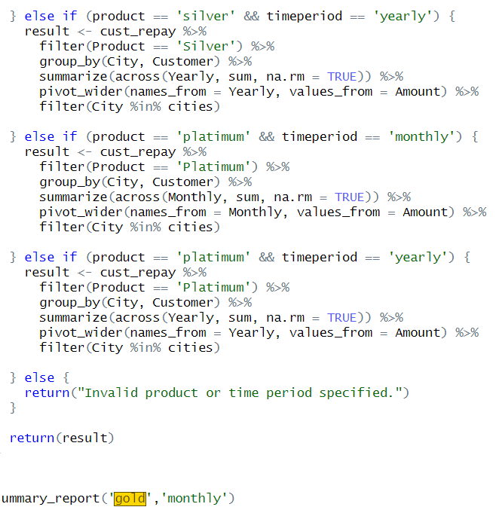
(5) You need to find top 10 customers for each city in terms of their repayment amount by different products and by different time periods i.e. year or month. The user should be able to specify the product (Gold/Silver/Platinum) and time period (yearly or monthly) and the function should automatically take these inputs while identifying the top 10 customers

Slide 25
Conclusion:
​In conclusion, analysing credit card data is crucial for various stakeholders, including banks, businesses, and consumers.​ It provides valuable insights that can enhance fraud detection, improve customer service, and aid in strategic decision-making. Understanding consumer behaviour concerning credit card usage not only aids in tailoring marketing strategies but also helps in risk management and financial stability for institutions. As more data continues to be generated, leveraging data analysis tools and techniques will be vital in maintaining a competitive edge in the financial landscape.

Slide 26
THANK YOU

