Slide 1


JIRA
Jahnavi Moka(T1826)
A Quest Global Company

Slide 2

WHAT IS JIRA
JIRA is a software development tool used for project
management and issue tracking. It is a popular tool among
software development teams to plan, track, and release software
projects.
➢ JIRA provides a centralized platform for managing tasks, bugs,
and other types of issues and it helps teams to organize and
prioritize their work.
➢ The tool integrates with other software development tools and
has a variety of customizable features and workflows that allow
teams to adapt it to their specific needs.
➢ Additionally, JIRA also provides various reporting and
dashboard features that help teams stay on top of their work and
make data-driven decisions

Slide 3
What Is the history of Jira?
Jira was originally created by Atlassian as a bug-tracking tool for their own software development projects. The first public release of Jira was in 2002. Since then, Jira has become one of the most widely used issue-tracking and project-management tools in the world.
How does Jira work?
Jira is designed to help teams track and manage issues within a project. Jira can be used to track bugs, stories, epics, tasks, and anything else that needs to be tracked within a project. Jira's issue-tracking features enable teams to quickly identify and resolve issues. Jira's project management features help teams plan, track, and release software projects.

Slide 4
WHAT IS THE USE OF JIRA SOFTWARE
JIRA provides a centralized platform for managing tasks, bugs, and other types of issues, and it helps teams organize and prioritize their work. JIRA is designed for agile software development teams, and it supports multiple methodologies such as Scrum, Kanban, and custom workflows.
JIRA is used for:
Project Management: JIRA provides a centralized platform for managing software development projects, with support for multiple projects and workflows.
Task Management: Teams can create, assign, and track tasks, bugs, and other types of issues.
Agile Planning: JIRA supports agile methodologies such as Scrum and Kanban and provides tools for planning and tracking sprints, backlogs, and releases.
Reporting and Dashboards: JIRA provides various reports and dashboards that help teams get a real-time view of their work and make data-driven decisions.
Collaboration: JIRA allows teams to collaborate and communicate effectively, with features such as comments,
notifications, and alerts.

Slide 5
FEATURES OF JIRA
Easy Issue Creation : Creating tasks, bug reports, and feature requests is simple. You can fill out a form on the web or send an email to set up issues, eliminating the need for manual data entry.
Real-Time Information : JIRA delivers real-time updates, allowing teams and management to see project status and progress clearly.
Scrum and Kanban Boards : JIRA supports boards that give an instant view of the project's progress, helping teams track individual tasks and customize workflows as needed.
Task Management : Each task has its own details, such as status, comments, attachments, and due dates, all stored inone place for easy tracking.
Integration : Seamlessly connect test cases in TestRail with issues in JIRA, allowing teams to track test progress and related bugs

Slide 6
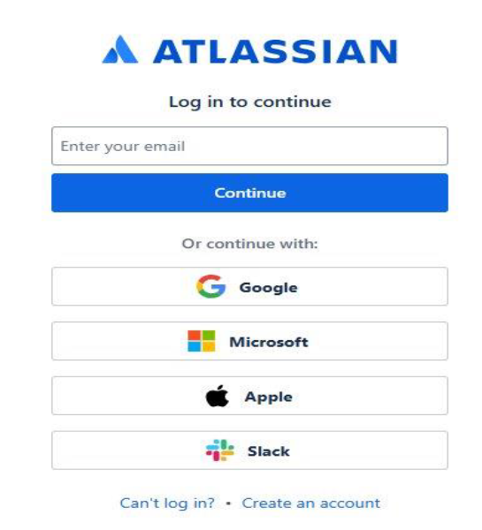
STEP BY STEP PROCEDURE FOR JIRA
1. Log in to JIRA : Access your JIRA account and go to the relevant project.

Slide 7
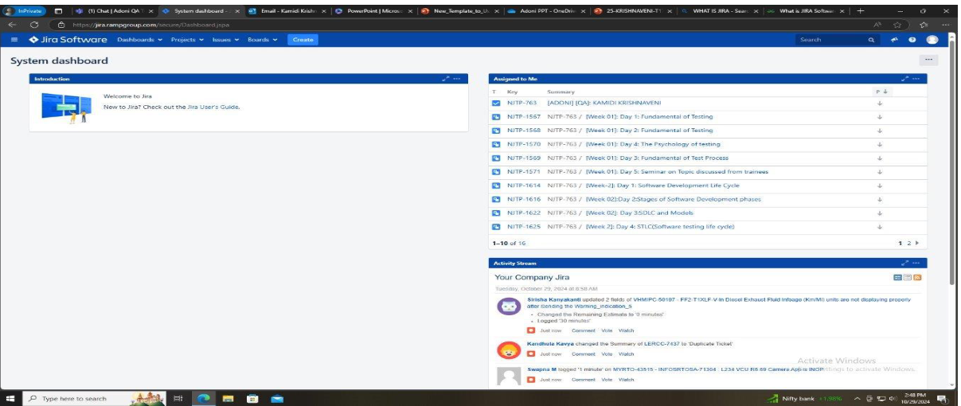
HOW TO CREATE A BUG
2. Click on "Create " : Find and click the "Create" button at the top of the screen.

Slide 8
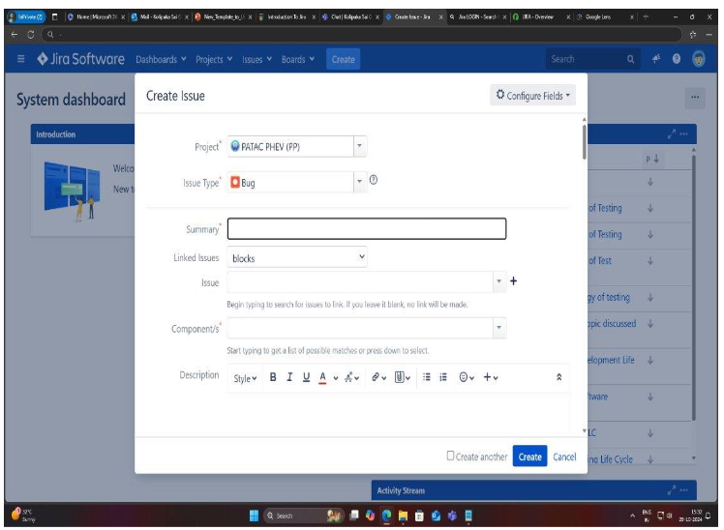
.
3. Fill Out the Bug Details:
Issue Type : Select "Bug."
Summary : Provide a brief title for the bug.
Description : Describe the bug in detail,including steps to reproduce it.
Assign and Set Priority : Choose assignee and priority level as needed.

Slide 9
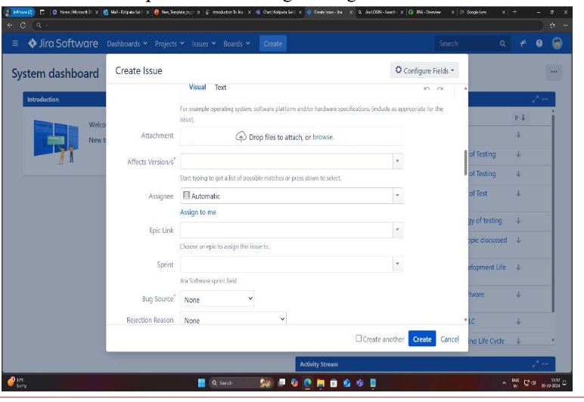
.
4. Attach Files (if necessary) : Upload any relevant screenshots or documents.
5. Assignee: Select the team member responsible for fixing the bug.

Slide 10
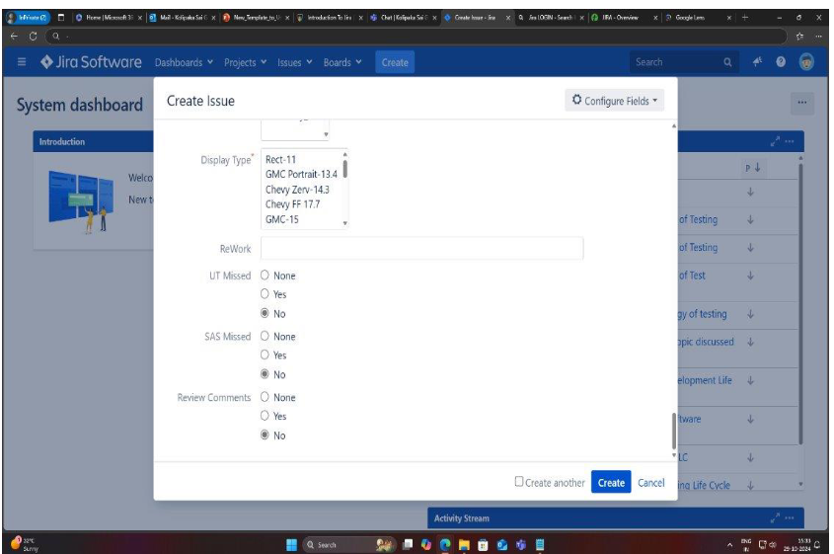
.
6. Click "Create" : Once all details are filled in, click the "Create" button to submit the bug report.

Slide 11

.

