Slide 1

Serverless Customer Feedback Analysis System Using Aws Comprehend And Quicksight
S.JAHNAVI(2210030485)
Under the esteemed guidance of
Ms. P. Sree Lakshmi
Assistant Professor,
Department of Computer Science and Engineering

Slide 2
Project Overview
1.Problem / Opportunity
Manual feedback analysis is time-consuming and error-prone
Lack of real-time insights delays decision-making
Need for an automated, low-cost, serverless feedback analysis solution
2.Objective
Build a serverless system to analyze customer feedback using Amazon Comprehend
Visualize insights like sentiment and key topics using Amazon QuickSight
3.Real-World Relevance
Enhances business intelligence through real-time customer insight
Enables data-driven decisions to improve product/service quality
Reduces operational costs and eliminates the need for infrastructure maintenance

Slide 3
Services Used
1. Amazon Comprehend
Extracts sentiment (Positive, Negative, Neutral, Mixed) from text
Identifies key phrases and entities in customer feedback
Fully managed NLP service—no ML expertise required
2. AWS Lambda
Executes backend logic for feedback processing
Triggered when new feedback is uploaded to S
Calls Comprehend and stores enriched results automatically
3. Amazon QuickSight
Visualizes customer insights through interactive dashboards
Integrates directly with S3
Enables real-time sentiment tracking and topic trend analysis

Slide 4
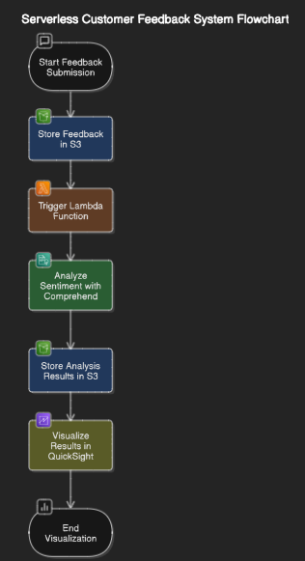
Flow Diagram

Slide 5
Implementation Process
1. Setup Feedback Collection
Create a simple feedback form
On submission, store raw feedback data in an S3 bucket
2. Trigger AWS Lambda Function
Configure S3 to trigger Lambda when new feedback is uploaded
Lambda reads the file, parses text content
3. Analyze Using Amazon Comprehend
Lambda invokes Comprehend to detect sentiment and key phrases
Comprehend returns structured NLP output
4. Visualize in QuickSight
Connect Amazon QuickSight to S3
Build dashboards to view customer sentiment trends, keyword frequency, and other insights

Slide 6
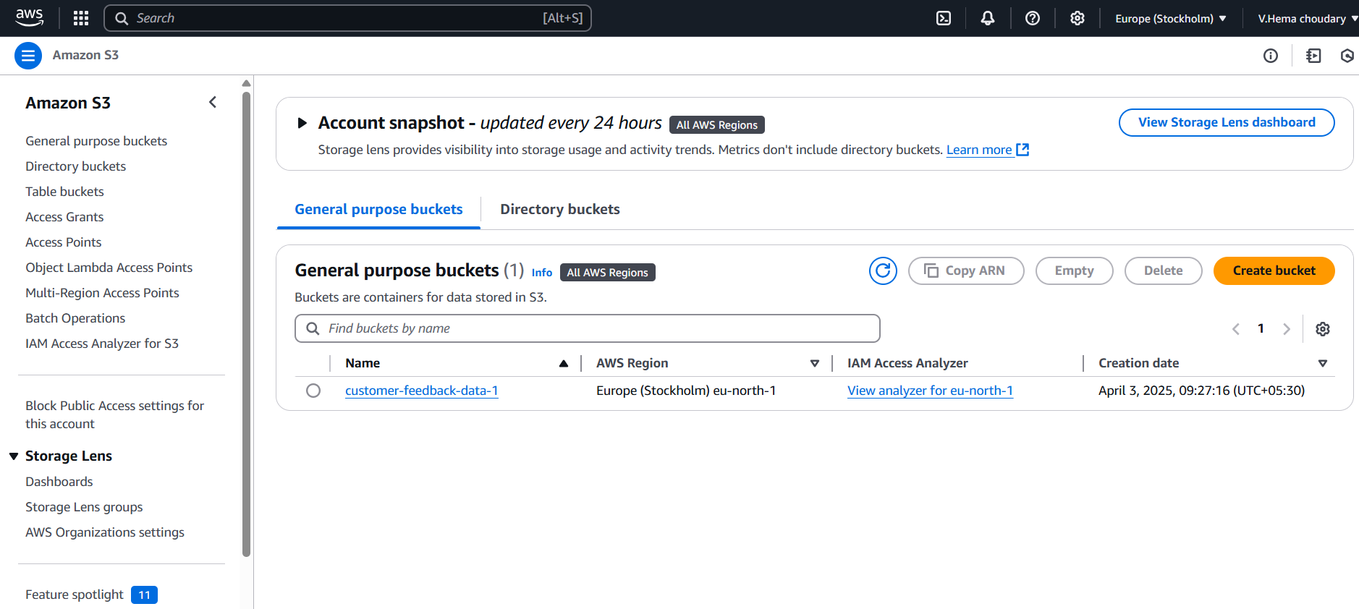
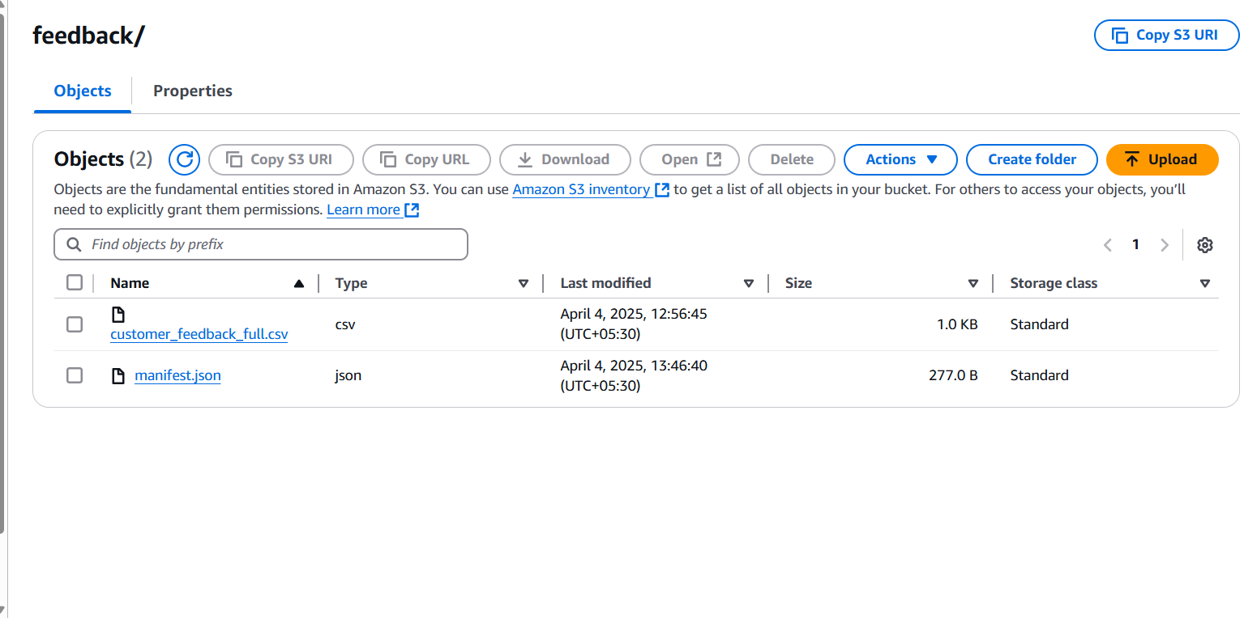
Implementation Process

Slide 7
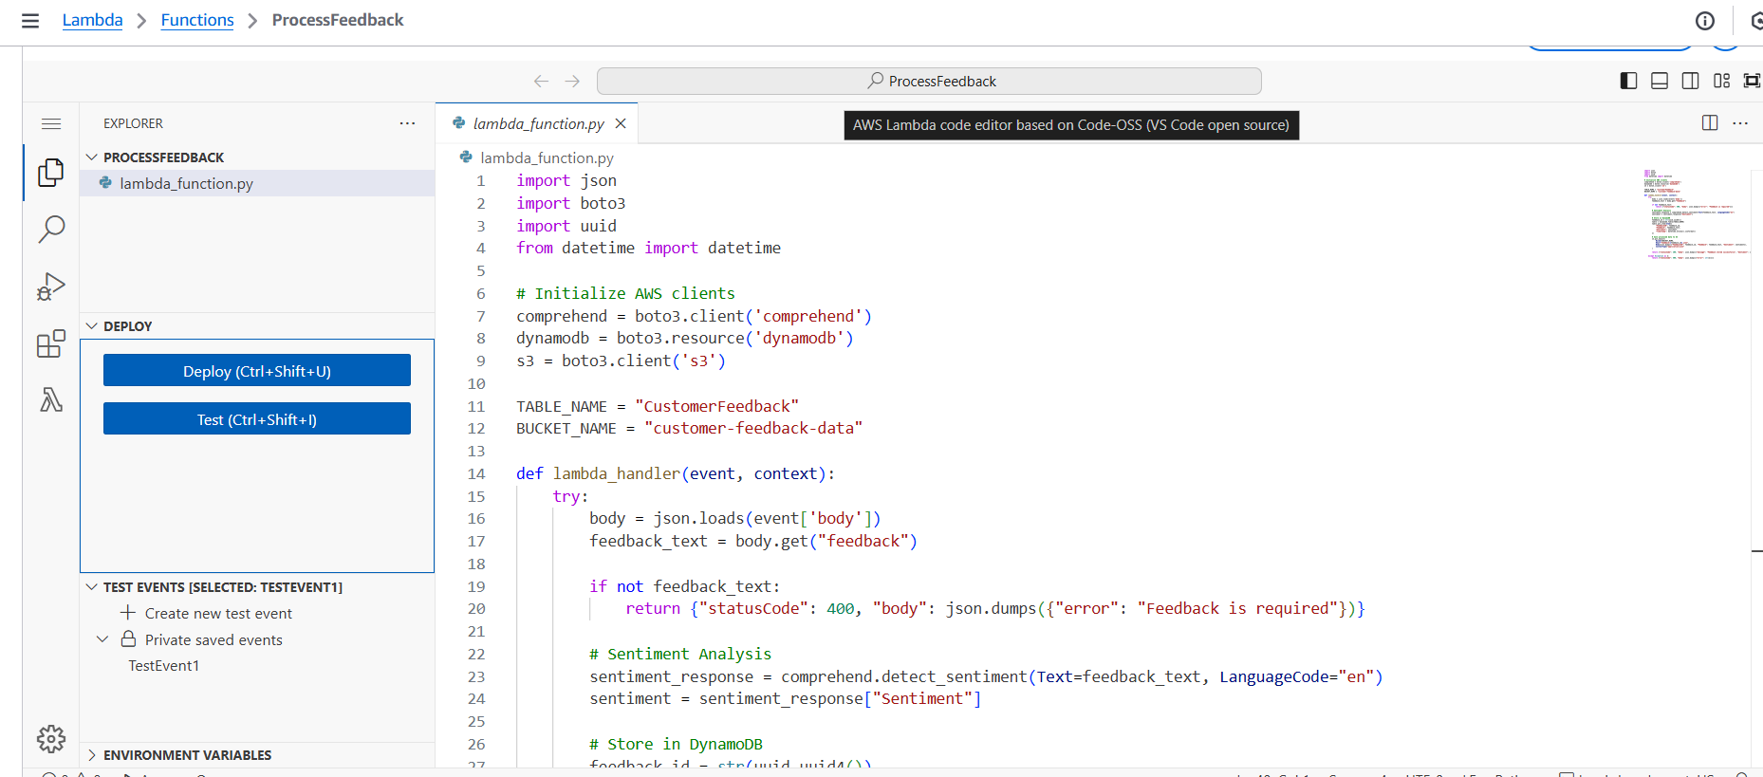
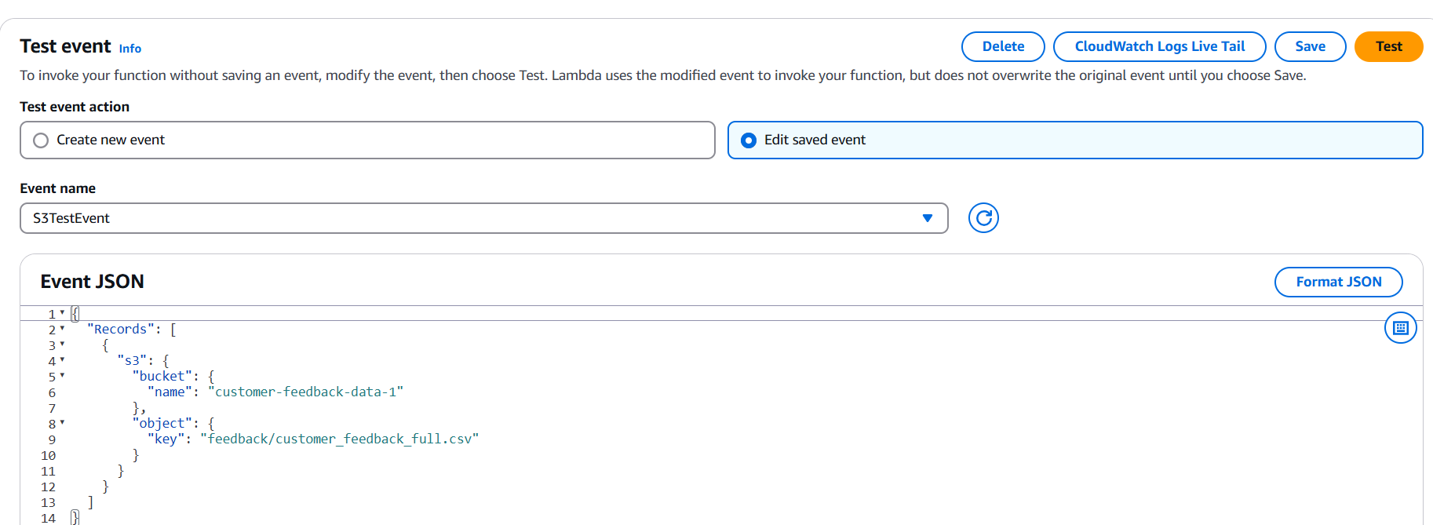
Implementation Process

Slide 8
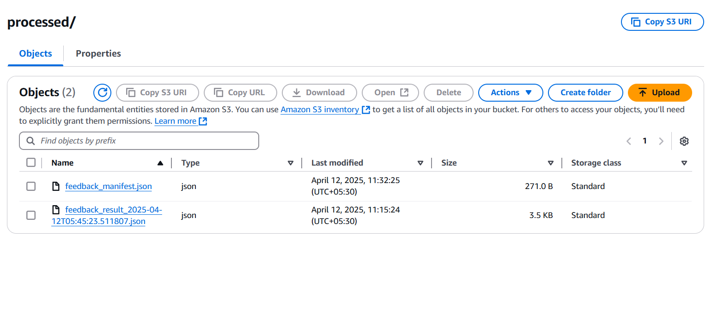
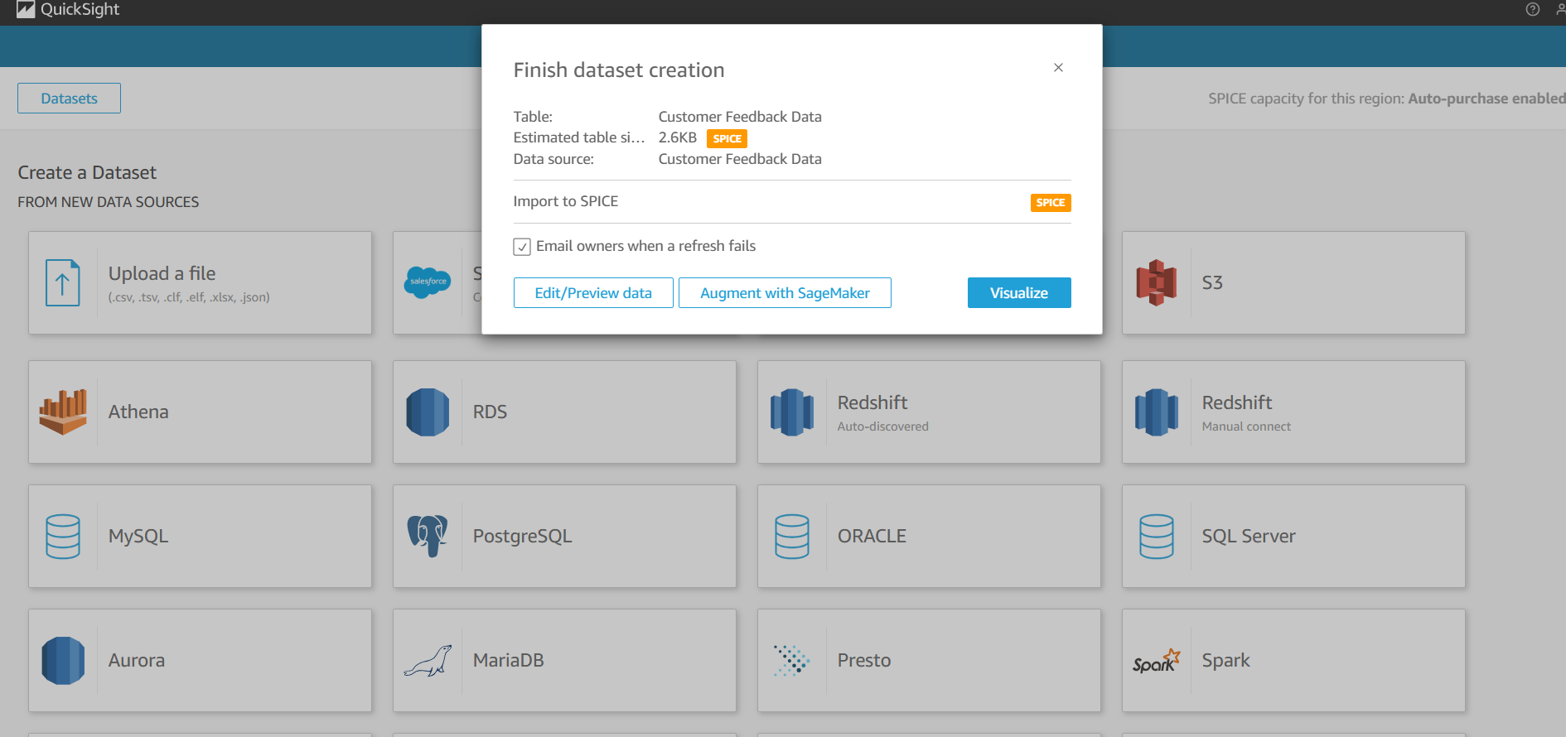
Implementation Process

Slide 9
Key Features and Functionality
1.Key Functionalities Implemented
Automatic Sentiment Analysis of feedback
Key Phrase Extraction from textual feedback
Seamless Data Pipeline using S3, Lambda, and Comprehend
Interactive Dashboards in QuickSight for insights
2.End-User Perspective
Businesses get real-time insights from customer feedback
Feedback is analyzed automatically—no manual effort
Visual dashboards help in quick decision-making
Cost-effective, serverless and scalable system
3. AWS Services Integrated
Amazon Comprehend – Natural Language Processing (sentiment, phrases)
AWS Lambda – Serverless logic for processing feedback
Amazon S3 – Raw and processed feedback storage

Slide 10
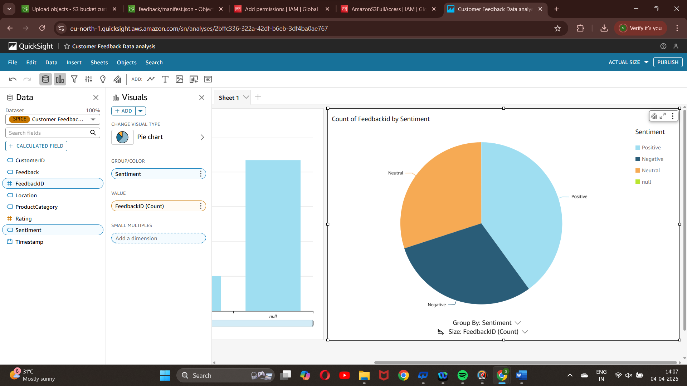
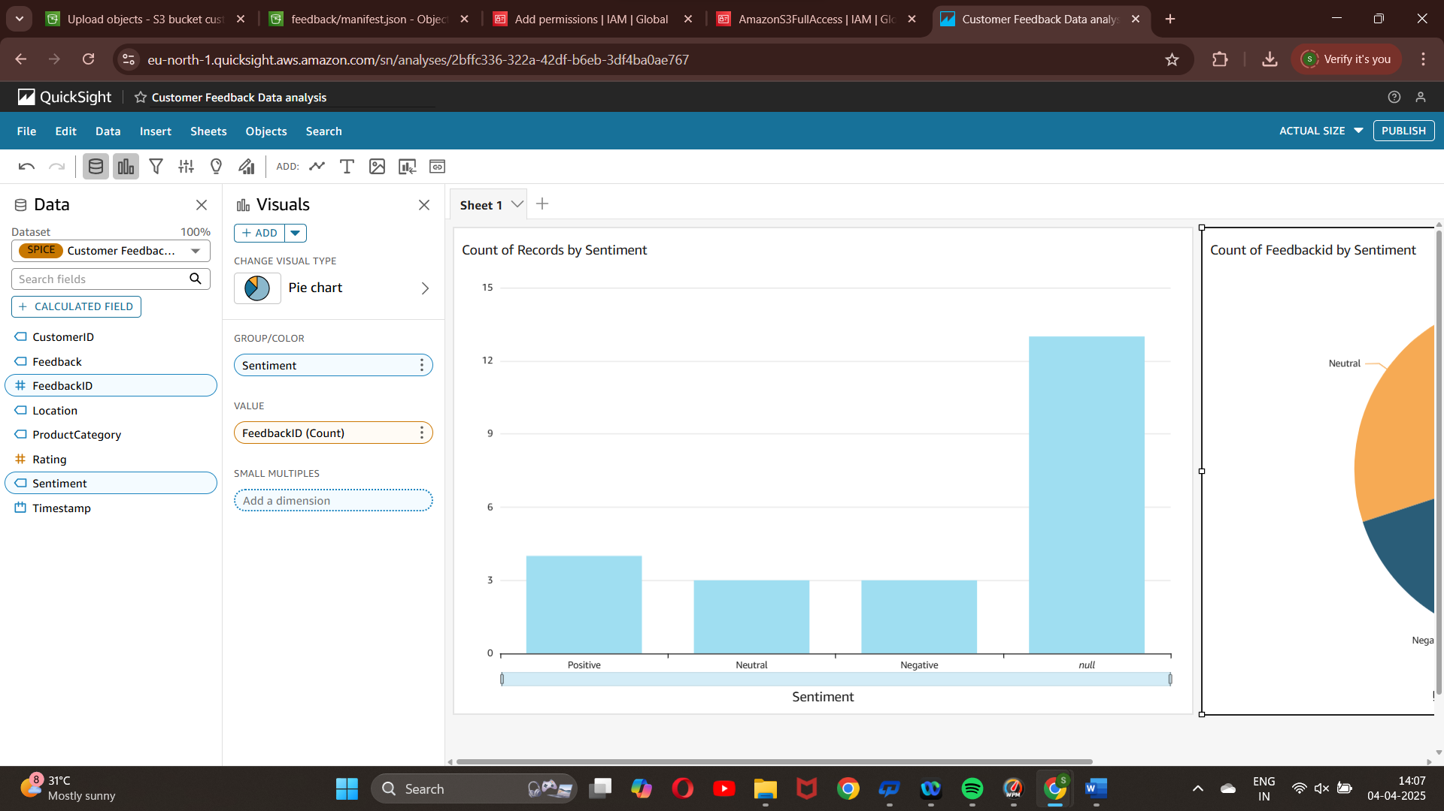
Results and Outputs

Slide 11
Challenges and Solutions
1.Challenges & Resolutions
Automated Analysis Timing: Triggering Comprehend reliably upon each feedback submission
Data Mapping: Structuring raw vs. processed feedback for QuickSight compatibility
Dashboard Freshness: Keeping QuickSight visualizations up-to-date with new data
2. How Challenges Were Resolved
Event-Driven Workflow: Used S3 trigger to automate Lambda execution
Data Structuring: Stored enriched feedback in structured JSON/CSV format
Scheduled Refresh: Configured QuickSight to auto-refresh visuals periodically
3. Debugging Tools/Strategies
Lambda Logs: Used CloudWatch to monitor and debug Lambda executions
Comprehend Console: Validated sentiment and key phrase extraction manually
QuickSight Preview Mode: Ensured correct data mapping and field selection before dashboard publishing

Slide 12
Learnings & Takeaways
1.Technical Skills
Amazon Comprehend: Natural Language Processing (sentiment, key phrases)
AWS Lambda: Serverless functions for automated feedback processing
Amazon QuickSight: Building interactive dashboards and visualizations
Amazon S3: Cloud storage integration and event-based triggering
2.Soft Skills
Teamwork: Collaborative problem-solving and development
Project Planning: Task delegation and timeline management
3. Certifications
Working towards AWS Certified Developer – Associate

Slide 13
Future Scope
1.Possible Extensions/Improvements
Multi-language Support for analyzing feedback in regional languages
Real-Time Alerts for spikes in negative sentiment
Mobile Dashboard Support via QuickSight mobile app
2. Real-Time Deployment Considerations
Scalability: Utilize S3 and Lambda’s auto-scaling capabilities for high feedback volume
High Availability: Deploy across multiple AWS regions to ensure reliable feedback processing.
3.Cost Optimization/Scaling Ideas
Use AWS Free Tier: All services (S3, Lambda, Comprehend, QuickSight) have free tier options
On-Demand Usage: Pay only for what you use with Lambda and Comprehend

Slide 14
References
[1] Amazon Web Services. Getting Started with Amazon Comprehend. Available at: https://docs.aws.amazon.com/comprehend/latest/dg/get-started.html
[2] Amazon Web Services. Using AWS Lambda with Other Services. Available at: https://docs.aws.amazon.com/lambda/latest/dg/lambda-services.html
[3] Amazon Web Services. Storing and Retrieving Data in Amazon S3. Available at: https://docs.aws.amazon.com/AmazonS3/latest/userguide/Welcome.html
[4] Amazon Web Services. Visualizing Data with Amazon QuickSight. Available at: https://docs.aws.amazon.com/quicksight/latest/user/welcome.html
[5] Amazon Web Services. Working with AWS Glue Crawlers. Available at: https://docs.aws.amazon.com/glue/latest/dg/add-crawler.html

Slide 15
THANK YOU

