Slide 1


House Insurance Customer Retention

Slide 2

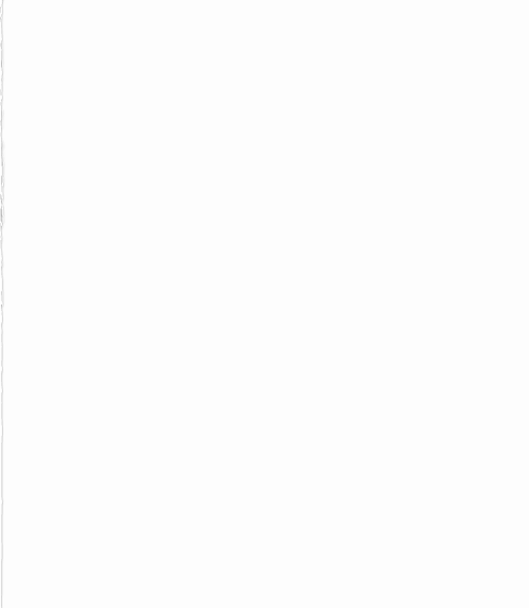
Agenda
Introduction and Background
Data Description
Data Pre-Processing
Data Exploration
Data Preparation
Modeling Techniques
Conclusions
Recommendations
References

Slide 3
Introduction and Background

Slide 4
Problem statement
Kangaroo is a House Insurance American Company that is concerned about the company’s retention rates and wants to know what is causing policy cancellation and also retain existing customers. The aim of this project is to create a retention model to identify policies that will be renewed or canceled before the end of the term and understand what variables are most influential in causing a policy cancellation.
The Kangaroo data set is based on 4 years of property insurance policies from 2013 to 2017. There are almost 30,000 policies in our dataset.

Slide 5
Business Case
Homeowners Insurance is a valuable policy option that provides coverage for not just the house but also its contents and the owner's liability. Approximately 85% of homeowners have home insurance policies, according to data from the National Association of Insurance Commissioners (NAIC).
The average annual cost of homeowners insurance in the U.S. is $1,445, according to Value Penguin's 2021 analysis using a sample policy in each state. The average money spent on homeowners’ insurance coverage has risen in the past several years, across all forms of policy, based on the NAIC's survey of premiums spent. This increase in premium may be attributed to the early cancellation of claims. To understand this better, we chose to work on this project. The goal of this project is to understand the factors that are driving the customer to continue or cancel the existing policy.

Slide 6
Metric
Our criteria to access the model is to reduce the number of customers who have been misclassified as not canceled. Because of this, the company is not able to get a clear picture of how many customers are there with the company.

Slide 7
Data Description

Slide 8
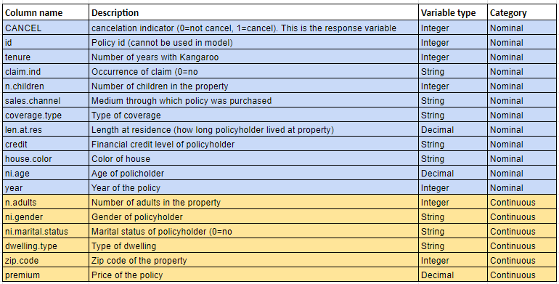
Feature Description
Input variables considered are as below:
Target variable – CANCEL

Slide 9
Data Pre-Processing

Slide 10
Pre-processing
1) Excluding Variables
ID
2) Missing Values
Omitted records (420)
3) Feature Engineering
ZipCode
FamilySize
4) Outliers Exploration
Ni.age
Skew Correction
Ni.age, family_size, len.at.res

Slide 11
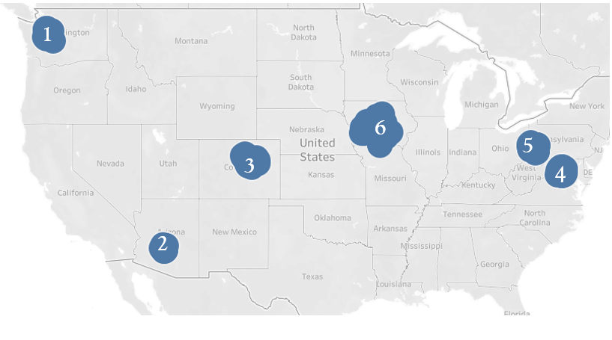



Feature Engineering
Zipcode encoding into Zones
Washington
Arizona
Colorado
Virginia
Pennsylvania
Iowa
1
6
5
3
4
2
Ni.adults
Ni.children
Family size

Slide 12
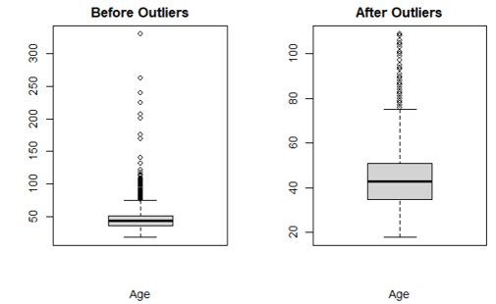
Outliers in Ni.Age
1
6
5
3
4
2

Slide 13
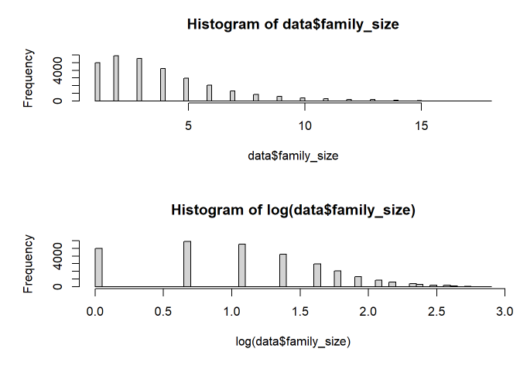
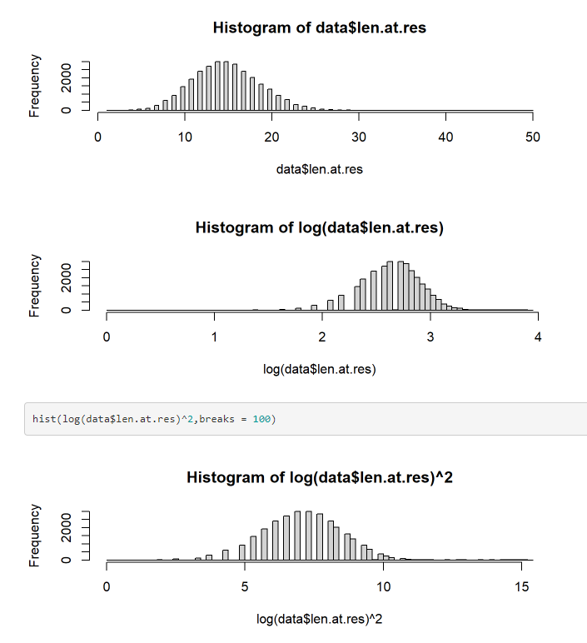
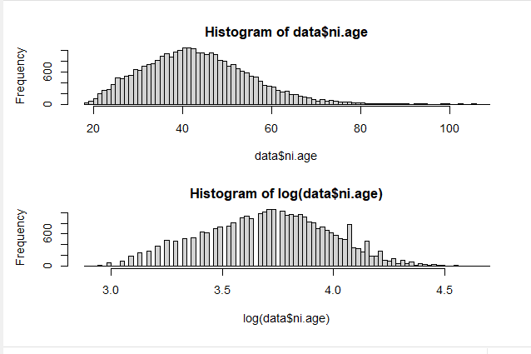
Skew Correction
family_size
ni.age
len.at.res

Slide 14
Data Exploration

Slide 15
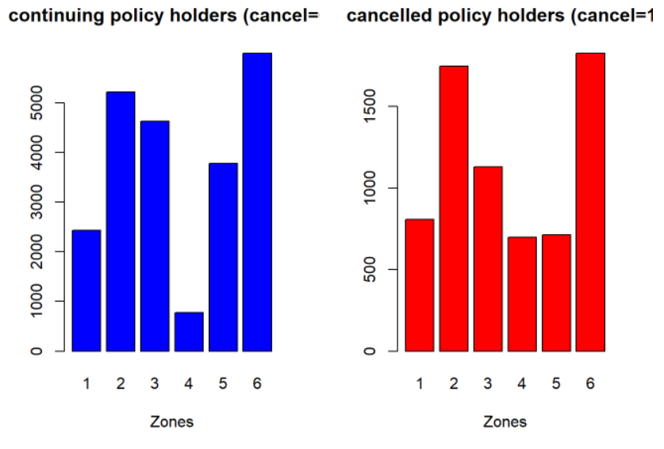
Zone vs Cancel
0)
For kangaroo company, the number of canceled policyholders are coming from 2,6 i.e., Arizona and Iowa, whereas the least cancellations are coming from Virginia and Pennsylvania.
Washington
Arizona
Colorado
Virginia
Pennsylvania
Iowa

Slide 16
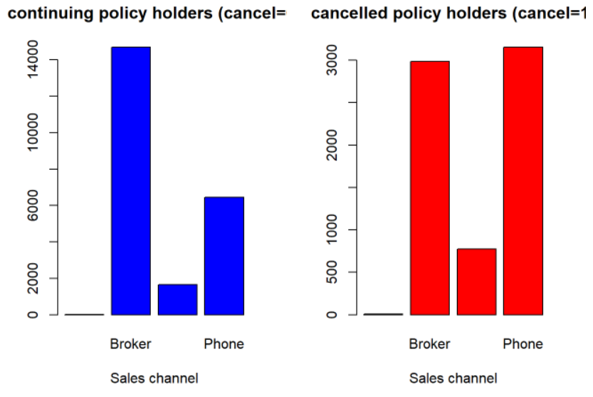
Sales Channel vs Cancel
0)
For the majority of continuing policies, the preferred sales channel is via a broker, whereas for canceled policies, it is via phone and broker

Slide 17
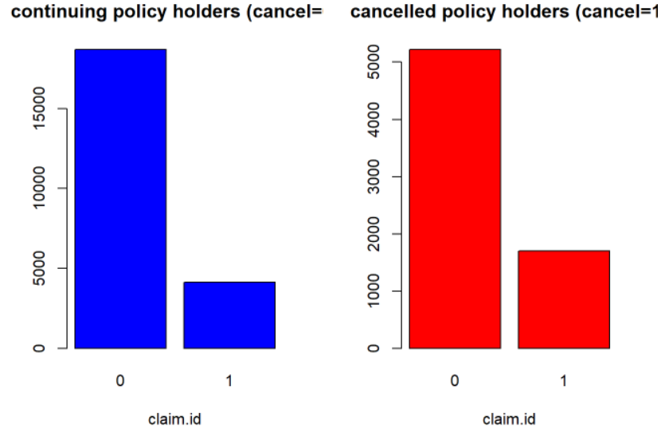
Claim.id vs Cancel
0)
Cancelled policies tend to show high claim rate compared to continuing policies

Slide 18
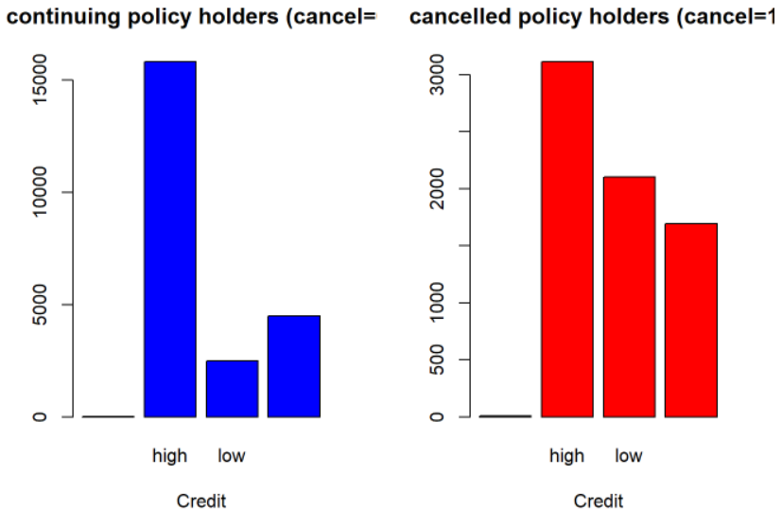
Credit vs Cancel
0)
It seems like continuing policyholders are having a high credit scores, but the reverse is not true, high credit customers don’t mean they will continue the policy

Slide 19
Data Preparation

Slide 20
Data Preparation
1) Dummy Variable
For Categorical Variables
2) Normalization
Continuous variables
Z Norm=
(X-mu)/sigma
3) Imbalanced Class
Oversampling
Under sampling
4) Data Split
Training-70
Test-30

Slide 21

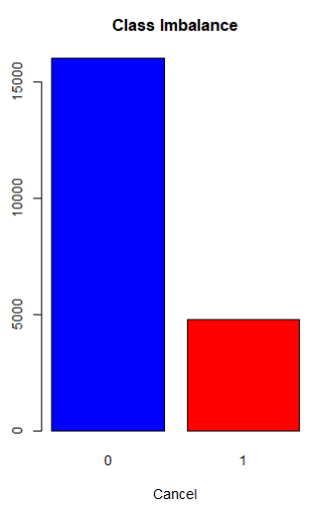
Handling Imbalanced classes (Train)
Under Sampling
Keeps all the data in the minority class and reduces the size of the majority class.
Over Sampling
Samples from the minority class with replacement and supplementing the training data with multiple copies of the instance.
Caret package, ovum.sample function

Slide 22
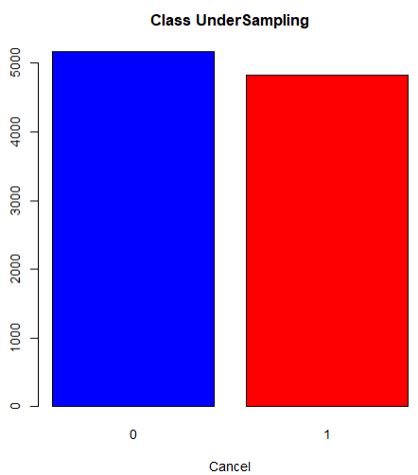
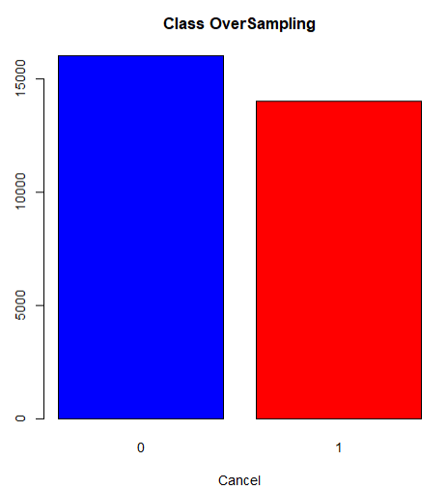
Data Split

Slide 23
Modeling Techniques

Slide 24
Logistic Regression with ALL features
Logistic Regression with Statistically Significant features
XGBoost Tree
Decision Tree
Random Forest Tree
Majority voting

Slide 25
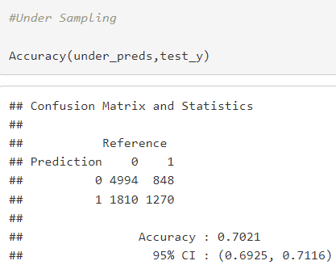
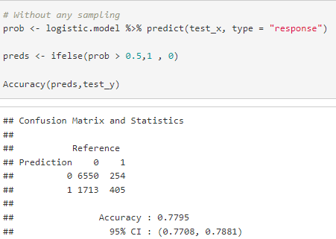
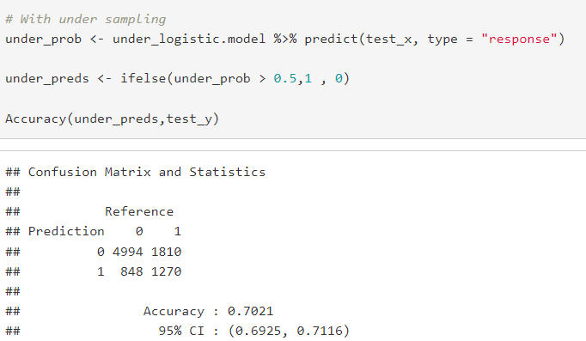
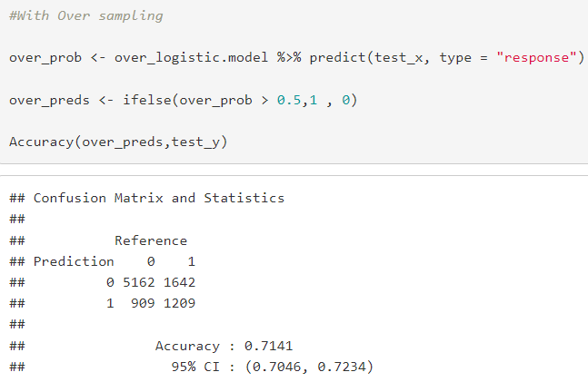
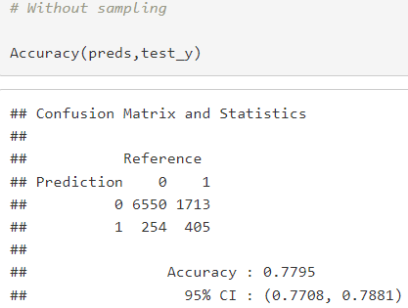
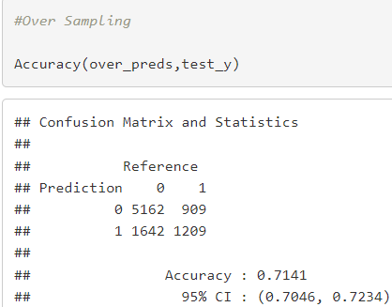
Models – Logistic with All Features
Metric | No Sampling | Under Sampling | Over Sampling
Accuracy | 77.95 | 70.21 | 71.41
TPs | 405 | 1270 | 1209
We observe that with sampling, the misclassification of not canceled policies has reduced.
Under sampling is performing better in terms of correctly classifying the canceled policies, however, we chose oversampled dataset as it gave higher accuracy.

Slide 26
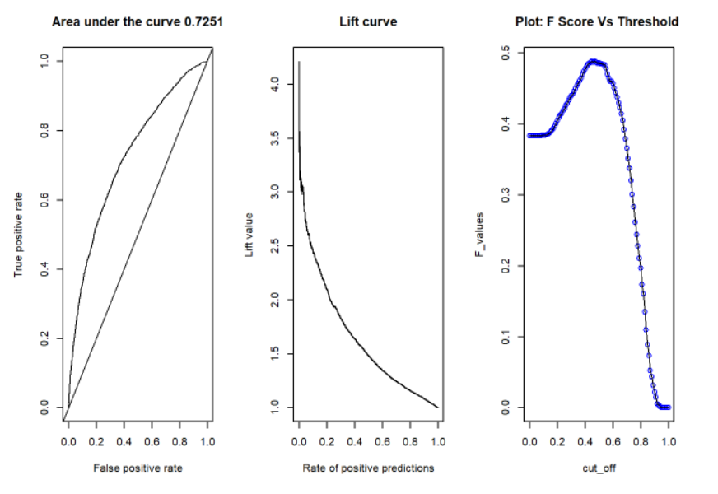
ROC, Lift and F curve

Slide 27
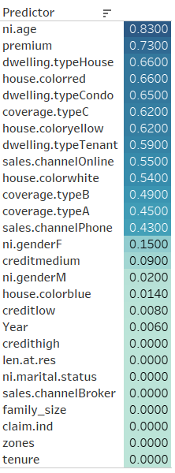
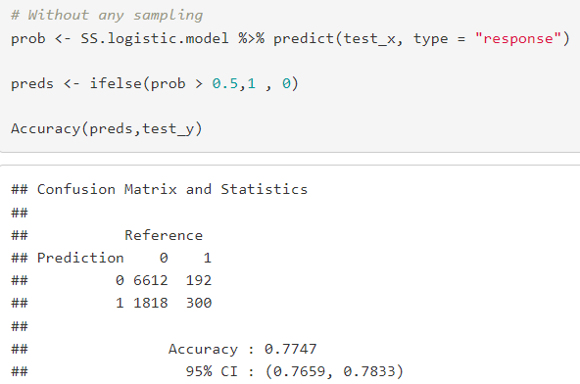
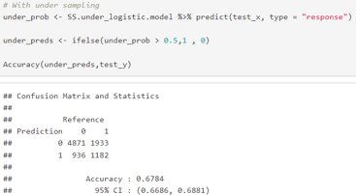
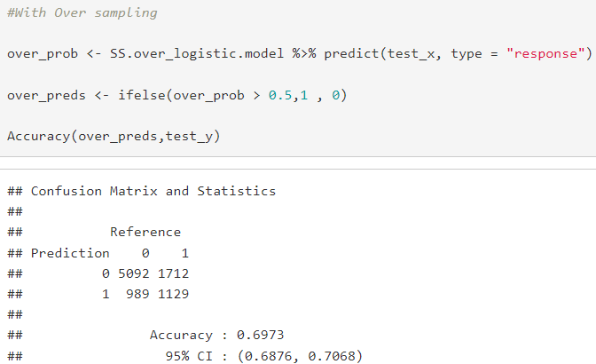
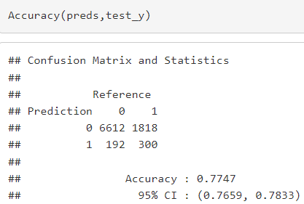
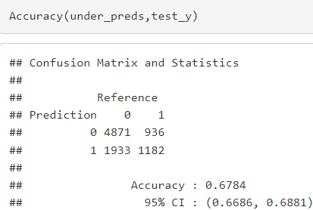
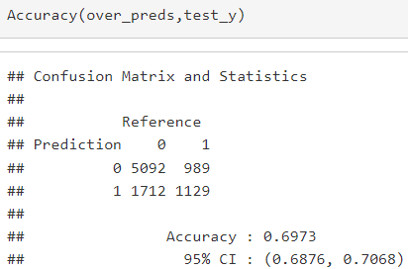
Logistic With Statistically Significant features
Metric | No Sampling | Under Sampling | Over Sampling
Accuracy | 77.47 | 67.84 | 69.73
TPs | 300 | 1182 | 1129
We chose a CI of 0.05, On using statistically significant predictors, we reduced the complexity of the model at the cost of accuracy.
Also with sampling, the misclassification of un-canceled policies (FN) have been reduced.
We chose oversampled dataset as it gave higher accuracy.

Slide 28
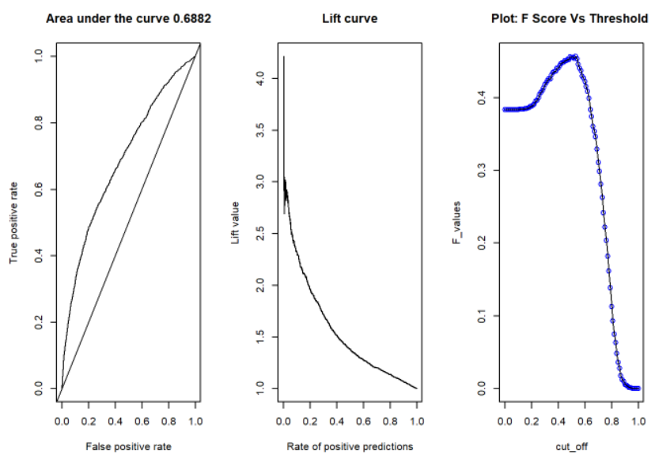
ROC, Lift curve and F curve

Slide 29
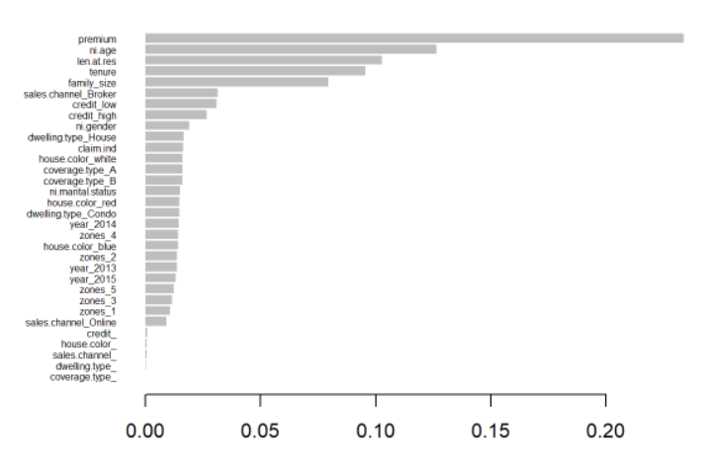
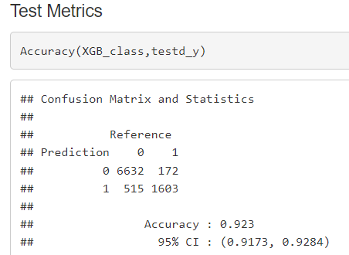
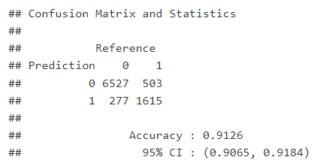
XGBoost Tree
Accuracy is 91.26%
True Positive Count is 1615

Slide 30
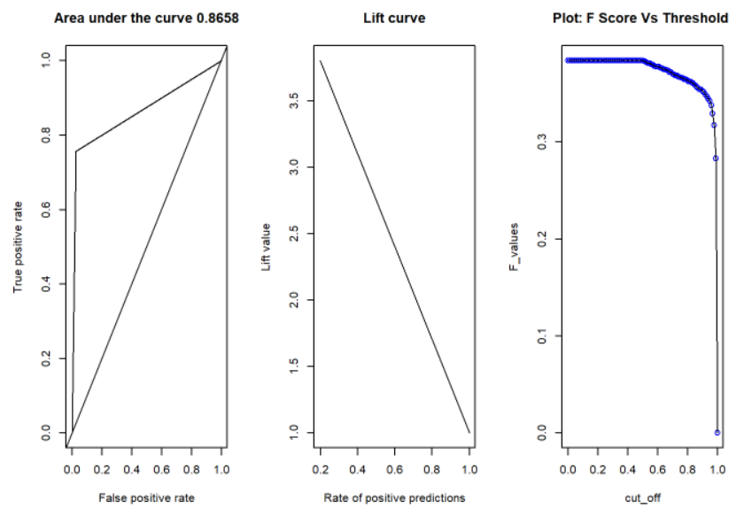
ROC, Lift curve and F curve

Slide 31
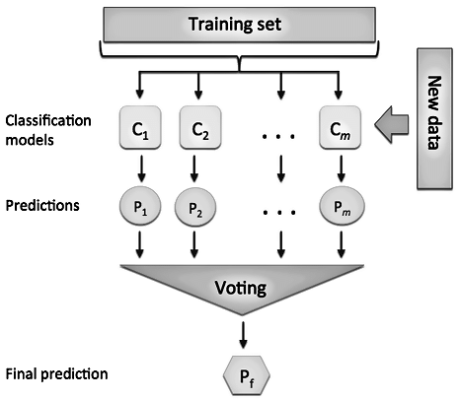
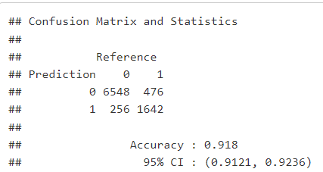
Majority Voting
Accuracy is 91.8%
True Positive Count is 1642

Slide 32
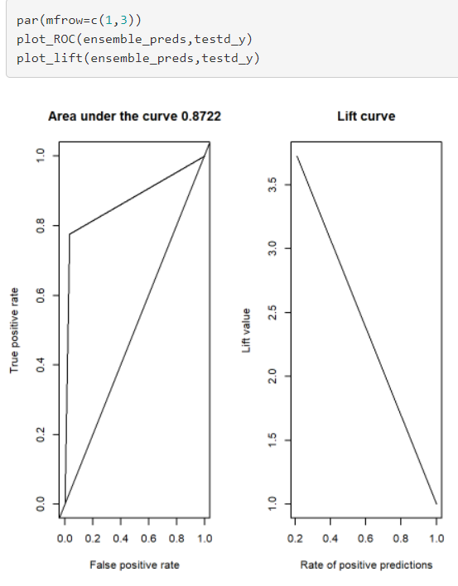
ROC, Lift curve - Majority Voting

Slide 33
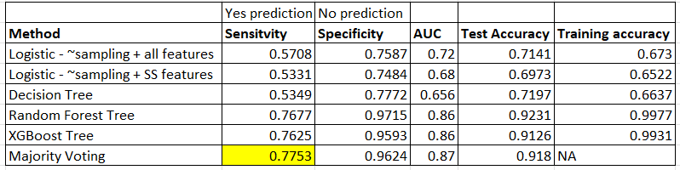
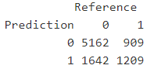
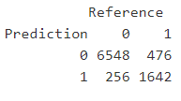
Model Comparison Metrics-Evaluation Criteria
Our criteria to access the model is to reduce the number of customers who have been misclassified as canceled (FP). Considering this, Majority Voting gave the best result in terms of sensitivity.
According to that best Model we chose is Majority Voting–which has the least False Positives. This is because the business intends on finding policyholders who are canceling their membership.
Logistic
Majority Voting

Slide 34
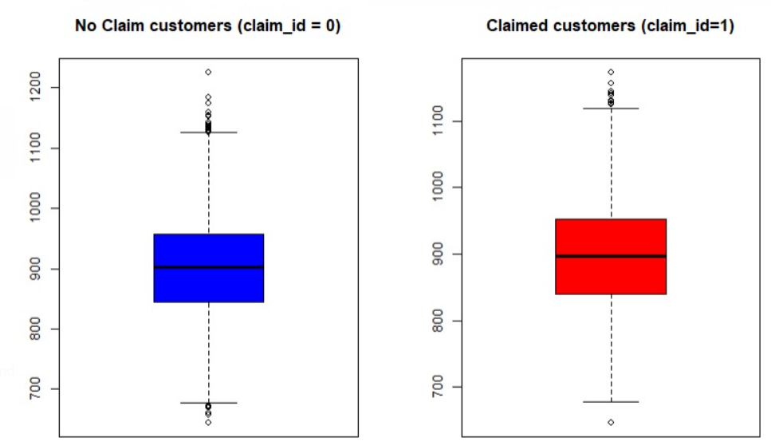
Based on our analysis, the recommendations would be :
To concentrate on the zones of Arizona and Iowa states by rolling out offers, because there is a rise on customers canceling their membership in these areas.
To focus on customers who are claiming benefits- offering a nominal subsidy on their next premium, which might retain their membership with the business
Recommendations for Kangaroo Company

Slide 35
Recommendations for Kangaroo Company
0)
We want to advise the company to give preference to customers with high credit scores, as we can infer low, and medium is included to cancel the plan.
Offering reasonable premiums for customers with low/medium credit scores would retain the customers with the company

Slide 36
Future work
We will incorporate our best model on Kaggle, so our predictions might help home insurance companies to focus on their specific parameters to retain their customers

Slide 37
References
https://www.kaggle.com/competitions/trv-ness-hackathon-2022
https://www.valuepenguin.com/home-insurance-statistics
Textbook-Michael J. Crawley - Statistics, 2nd Edition_ An Introduction Using R-Wiley (2014)

Slide 38
Appendix

Slide 39
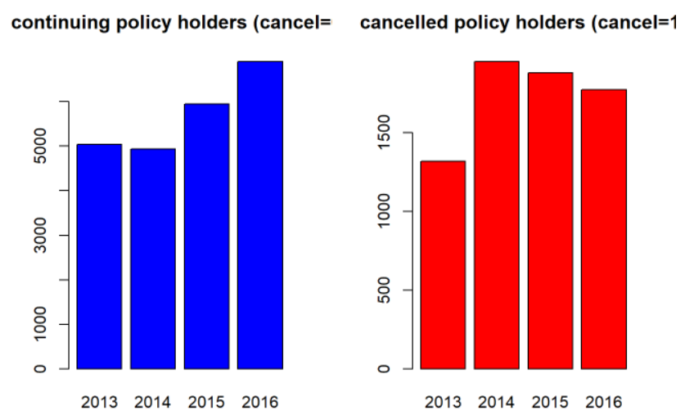
Year Vs Cancel
0)
For kangaroo company, Annually we can observe the maximum policy cancellations are in the year 2014, whereas it is following a declining trend till the year 2016, whereas the continuing policies are continuing to increase across the years.

Slide 40
Recommendations for Kangaroo Company
0)
As clearly seen in the bar graph, the policies are renewed when there is human interaction (for ex: broker) in driving the customer to continue their relationship with the company rather than a phone call.
We suggest Kangaroo Company to hire more sales representatives.

Slide 41
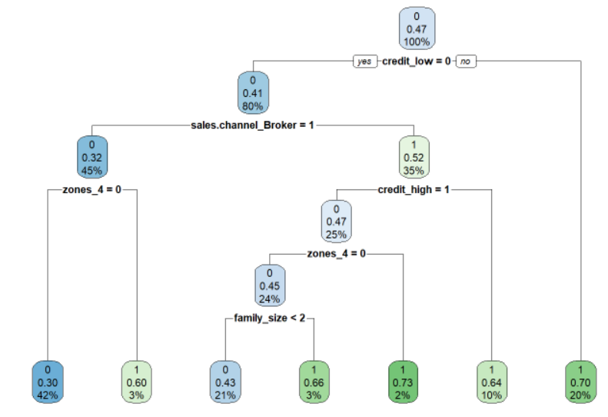
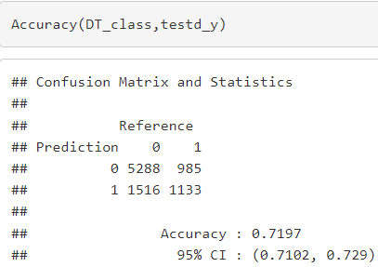
Decision Tree
Accuracy is 71.97%
True Positive Count is 1133

Slide 42
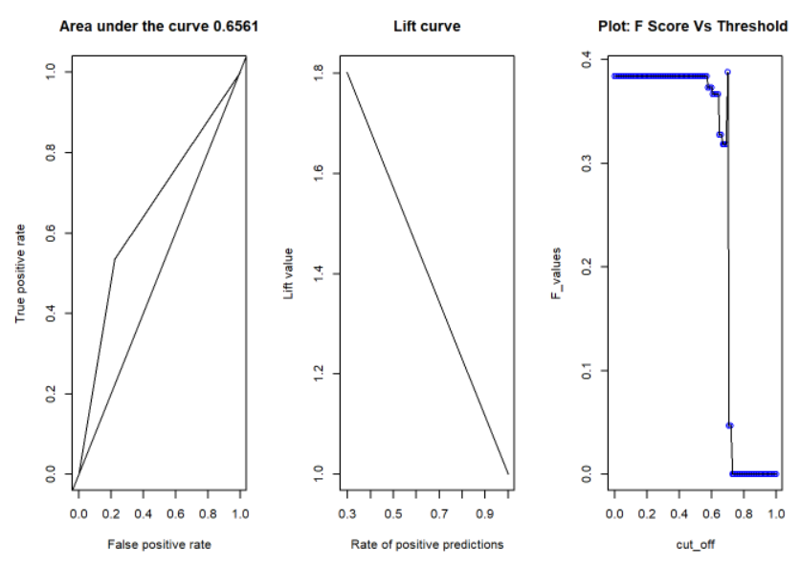
ROC, Lift curve and F curve

Slide 43
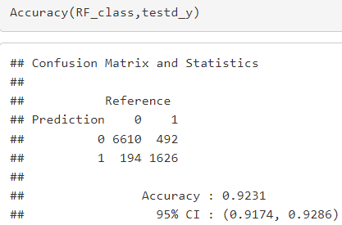
Random Forest Classifier
Accuracy is 92.31%
True Positive Count is 1626

Slide 44
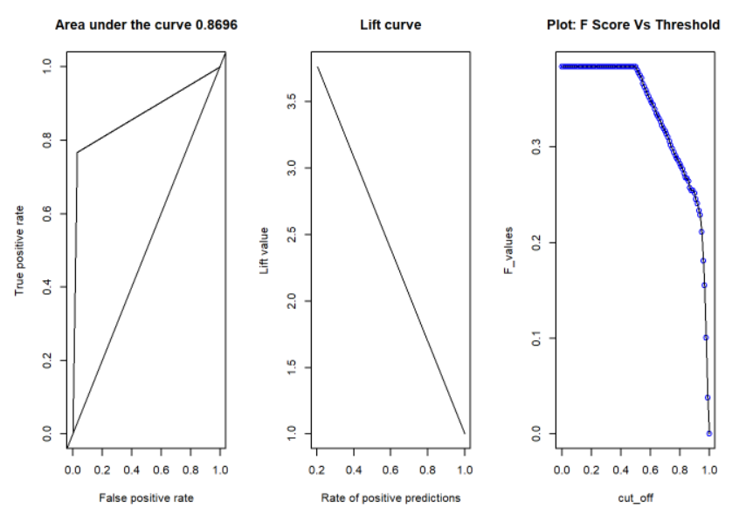
ROC, Lift curve and F curve

Slide 45
Thank You
Any Queries?

