Slide 1

P2P Lending Data
OPIM 5604 | Team 1 Vishwa Srivastava Jahnavi Adabala Karthik Lalisetti Nicholas Lopilato Praneetha VC

Slide 2
Agenda
Business Brief
Scope Definition
Overall Approach
Data Sampling
Data Exploration – Observations and Trends
Data Exploration - PCA
Models – Comparison Summary Slide
Best Model – Performance Analysis
Model of Choice
Recommendation and justifications
Appendix – Include details of other models
Speaker: Praneetha VC
Speaker: Karthik L
Speaker: Nicholas L
Speaker: Jahnavi A
Speaker: Vishwa S
Speaker: Praneetha VC

Slide 3
Business Brief | Peer 2 Peer lending
What is P2P lending?
Alternative means of raising debt for individuals
Gaining prominence in economies (developing countries) with low financial inclusion
Intermediaries assess credit worthiness of borrowers and provide data points to individual borrowers to make lending decision
Key Stakeholders
Borrowers: Raise money at an agreed interest rate
Lenders: Lend money to borrowers at an agreed interest rate AND bear the risk of default
Intermediary: Makes money from the borrower-lender interest rate spread
What’s important for a P2P lending companies?
Ability to predict default intent of the borrowers
Borrower default rates impacts the P2P lender’s ability to attract lenders; lower the default rates higher the lender interest
Business Problem Statement: Build a model to predict loan defaulters using Bondora’s lending data
Speaker: Praneetha VC

Slide 4
Scope Definition
The data set is Bondora’s P2P lending/borrowing information for the individuals in Estonia.
Available Information | Borrowers | Lenders/Intermediary
Personal | Age, Education, Dependents, etc. | NA
Financial | Credit score, previous loan history, applied amount, house ownership type, income, etc. | Amount committed, loan_id, portfolio manager id, meta data, etc.
Data Attributes | Description
Source: | Kaggle
URL: | https://www.kaggle.com/datasets/sid321axn/bondora-peer-to-peer-lending-loan-data
Data Time Frame | Default and Non Default Loans data from 2009 to 2021
Scope: Any borrower that missed the scheduled date of payment of interest is considered defaulter
Speaker: Praneetha VC

Slide 5
Overall Approach
112 Predictor Variables
91 predictor variables
Step 1: Remove columns with >50% missing values (county, city, employment position) for e.g. meta data (application date, report generated date, loan_id, language_code, etc.), inapplicable columns
57 predictor variables
Step 2: Remove columns that has data outside scope (restructured loan, penalty on outstanding interest, penalty on outstanding balance, write offs, expected loss, grace period start date, etc.)
38 predictor variables
Step 3: Remove columns that are correlated with other columns AND have significant proportion of missing values , for e.g. age and work experience were highly correlated. But many values for work ex. were missing, total income and income from principal employer had very high correlation
32
Step 4: Dimensionality reduction through principal components, new formula columns, derived Columns
22 variables
Speaker: Karthik L

Slide 6
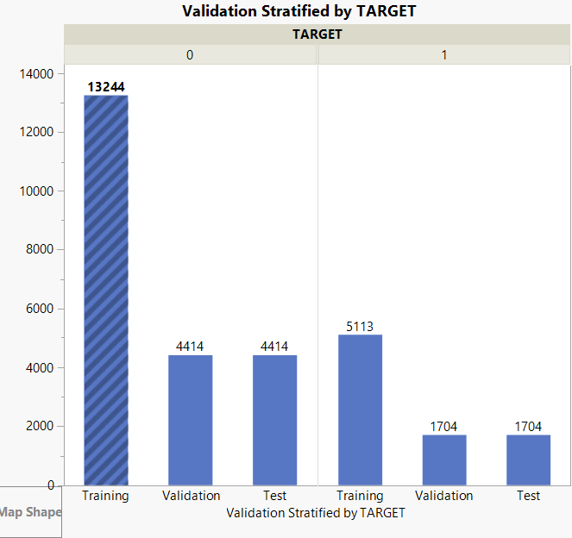
Data Sampling
Properties | Initial Raw Data | Final Processed Data
Number of Rows | 179235 | 30591
Number of columns | 112 | 23 (PCA(13)+Categorical(8) +1 (Target) + Validation (1))
Validation | Training | Test
60% Data | 20% Data | 20% Data
18357 | 6118 | 6118
Speaker: Karthik L

Slide 7
Data Exploration | Observations
The maximum interest rate accepted in the loan applications is 71.3% while the mean is 25.20% and median is 23.7%
$91 monthly repayments are made on an average by borrowers belonging to age group of 26 to 50 years.
Even a high credit score won't justify someone’s credibility of paying back one’s loan. For instance, in our dataset someone having the best credit score of 1000 has existing liabilities greater than 18 loans/debts/liabilities. 35 percent of these people are defaulters.
The borrowers with ‘Basic education’ whose principal balance range is <$750 belongs to the category of good borrowers where as defaulters in these conditions have much larger principal balance that needs to be paid.
People with higher education are more leveraged with Interest and Penalty balance up to a maximum of $54,000 whereas borrowers of lower education level have less leverage with maximum value of $31,626
Speaker: Karthik L

Slide 8

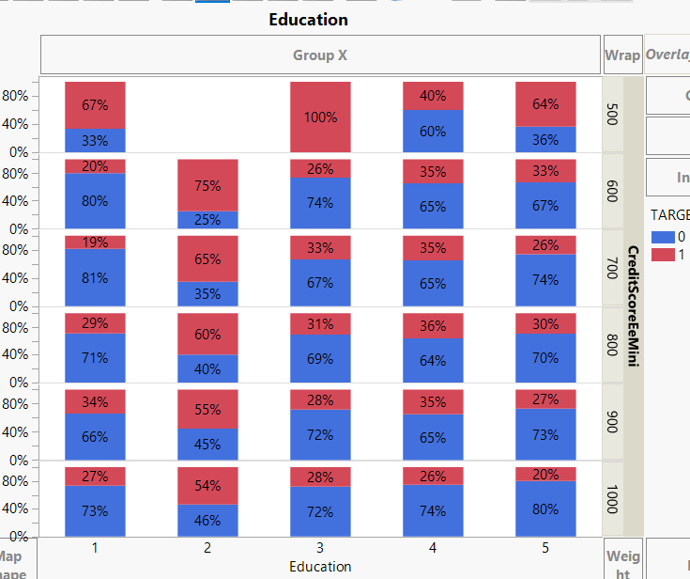
Data Exploration | Trends & Relationships
Less Educated
More Educated
Although the defaulters are randomly distributed across different education level. The majority of defaulters have the highest level of education as secondary education.
Out of total 8521 defaulters in our dataset of 30591 records, 46% (3967) of the defaulters have secondary education
Most good borrowers have credit score > 700 (box bottom right)
Credit Score
More educated borrowers (3,4,5) have lower default rates than less educated borrowers (1,2)
27% of borrowers in segment 3,4 and 5 are defaulters
34% of borrowers in segment 1,2 are defaulters
Good Borrowers Defaulters
1 – Primary education, 2 – Basic Education, 3–Vocational Education, 4 – Secondary Education, 5 – Higher Education
Speaker: Karthik L

Slide 9
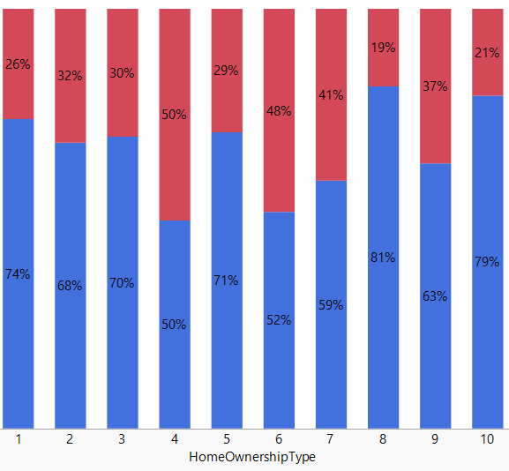
Data Exploration | Trends & Relationships
Every other tenant that rents unfurnished property is likely to default on their loan
Home owners (cat 1) are generally good borrowers; 44% (9694) of non-defaulters own a house (cat 1).
81% borrowers having an existing mortgage (cat 8) are non-defaulters.
Good Borrowers Defaulters
1 –Owner, 2 – Living with parents, 3 – Tenant, pre-furnished property, 4 – Tenant, unfurnished property, 5 – Council house, 6 – Joint tenant, 7.- Joint ownership, 8 – Mortgage , 9 –Owner with encumbrance, 10 – Other
Speaker: Karthik L

Slide 10
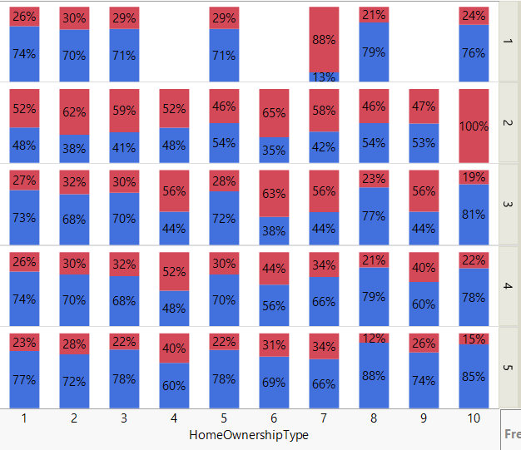
Data Exploration | Trends & Relationships
Of the total (13152) home owners (cat 1)that borrow
25.5% of more educated (cat 3,4,5) home owner are defaulters
31.6% of less educated (cat 1,2) home owner are defaulters
Less Educated
Education Type
More Educated
Irrespective of the home ownership type, 56% of borrowers with basic education are likely to default
Good Borrowers Defaulters
1 –Owner, 2 – Living with parents, 3 – Tenant, pre-furnished property, 4 – Tenant, unfurnished property, 5 – Council house, 6 – Joint tenant, 7.- Joint ownership, 8 – Mortgage , 9 –Owner with encumbrance, 10 – Other
1 – Primary education, 2 – Basic Education, 3–Vocational Education, 4 – Secondary Education, 5 – Higher Education
Speaker: Karthik L

Slide 11
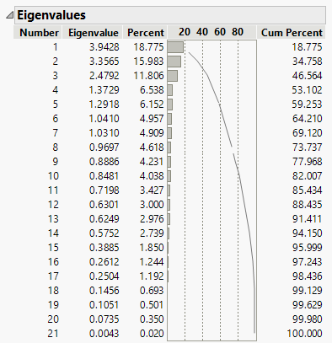
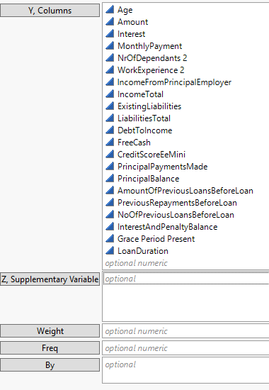
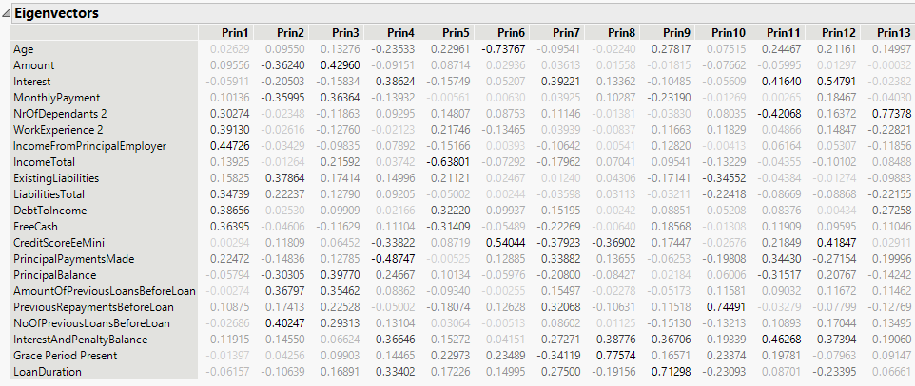
Data Exploration | PCA
Eigen Values - Final
Top 6 PCs account for 60% of the explainability of our continuous variables.
INPUTS
Eigen Values - Initial
Eigen Vectors
For the busines case on P2P lending, we have decided to capture ~90% variability in the data while doing PCA.
Speaker: Nicholas L

Slide 12
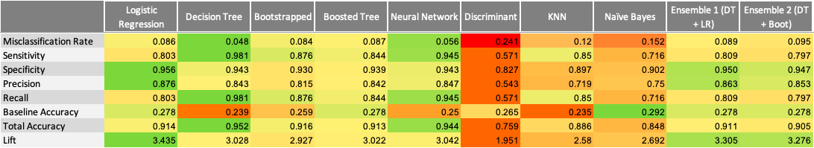
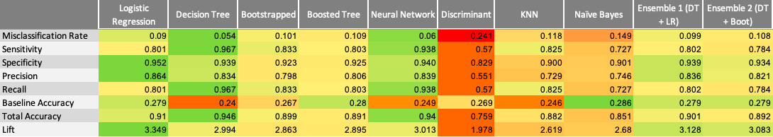
Model Comparison – Overview
Model of choice
Worst Model
Training
Validation
Best Performing Models
Speaker: Nicholas L
Best Model

Slide 13
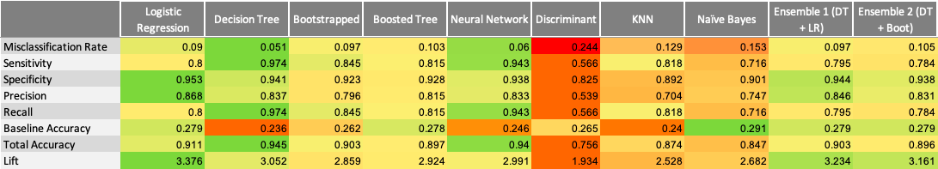
Model Comparison – Overview
Model of choice
Worst Model
Test
Best Performing Models
Best Model
Insights
Given every other parameter constant, sensitivity of the model will have direct impact on the profitability and reputation of a lending company
Purely from performance perspective - Decision trees and Neural Networks are the two best models with best misclassification rate & sensitivity
Our model of choice, however, is Logistic Regression Model – this is due to lower hindsight bias in this model when compared to other models
Discriminant model is the worst performing model; understandably it doesn’t consider categorical input variables in predictions
Speaker: Nicholas L

Slide 14
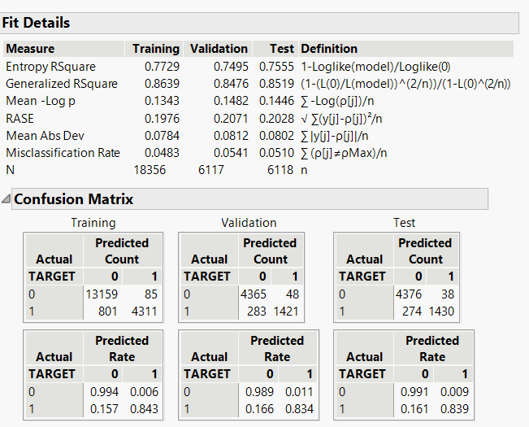
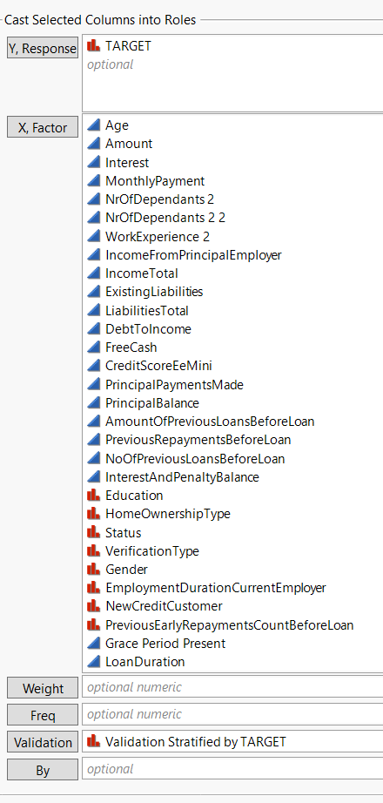
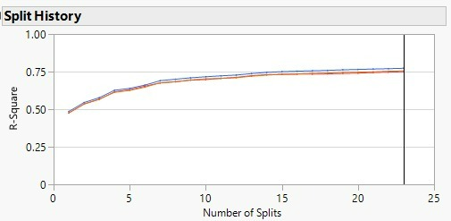
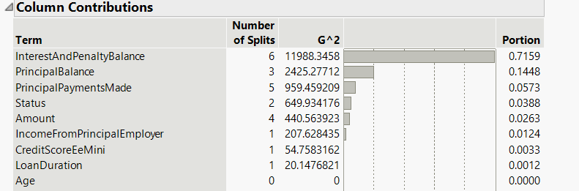
Decision Tree – Model Analysis & Rejection
Inputs
Split History
Fit Details
Confusion Matrix
Column Contributions
- This model has the lowest misclassification rate in validation & test data among ALL models analyzed
Hindsight Bias: The top predictor variables (column contributions) for default in our model are interest and penalty balance, principal balance, status – when a fresh loan application is made, these fields would be absent for ALL borrowers. As this model predicts the defaulters basis the presence of above fields AFTER the loan is issued, this model is not usable
Speaker: Jahnavi A

Slide 15
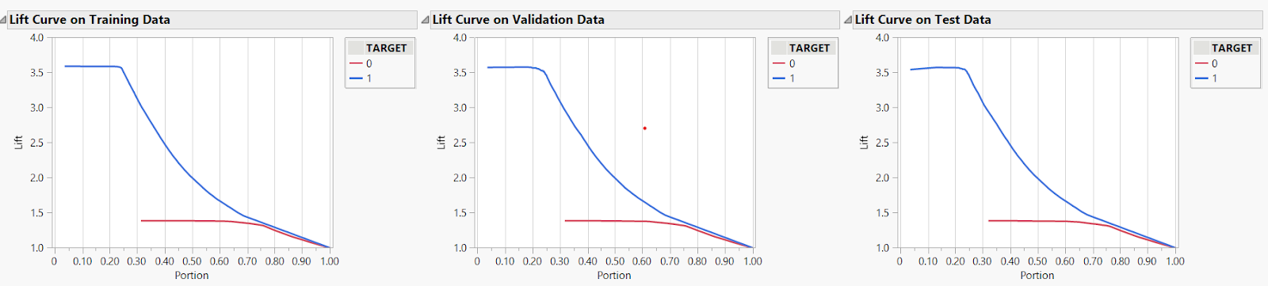
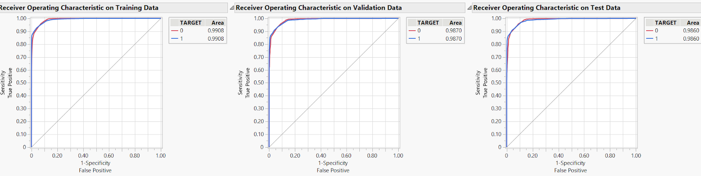
Decision Tree
Line Curve
Borrowers
The models’ accuracy goes up by 3.5X for the top 25% probable good borrowers.
As we go lower in the probability of the applicant to be a “good borrower”, the lift decreases exponentially
Defaulters
For top 32% most-probable defaulters, however, there is no lift in model performance
For defaulters, the lift is only 1.3X at best
Between top 32% and top 70%, the lift in model performance to correctly identify defaulters stays constant
ROC
Training
Validation
Test
Good Borrowers Defaulters
Speaker: Jahnavi A

Slide 16
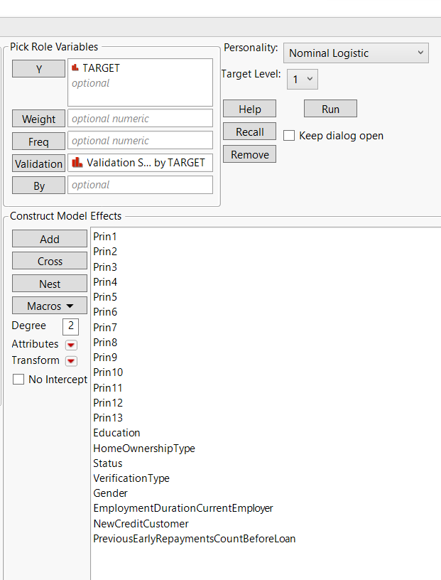
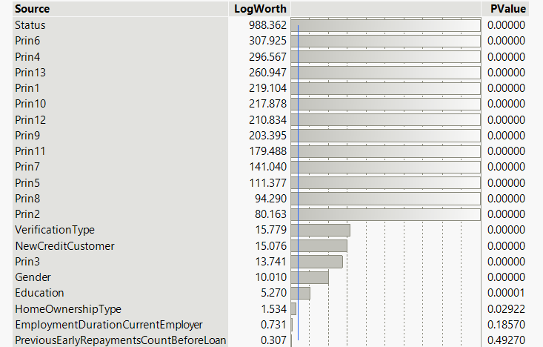
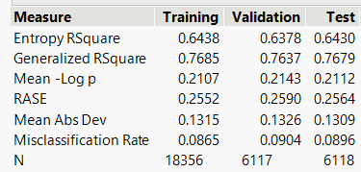
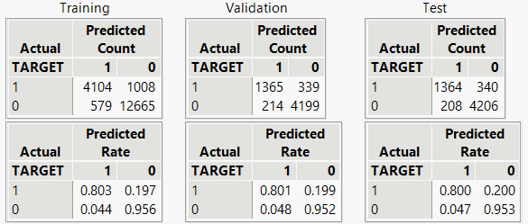
Logistic Regression – Model of Choice
INPUTS
Effect Summary
The LogWorth contribution of continuous variables (PCs) towards model performance is more than categorical variables (except status)
PC6,PC4,PC13,PC1 are the biggest contributors to model performance
The variables that make up the largest variance in these respective PCs are:
PC6 : credit, (-ve) age PC4: interest, (-ve) principal payments made
PC13: dependents
PC1: work ex, income from employer
Removed
Fit Details
Confusion Matrix
Compared to decision tree, we see lower sensitivity and higher misclassification rate However, the variables critical to identify defaulters can be captured upfront during loan application
Speaker: Vishwa

Slide 17
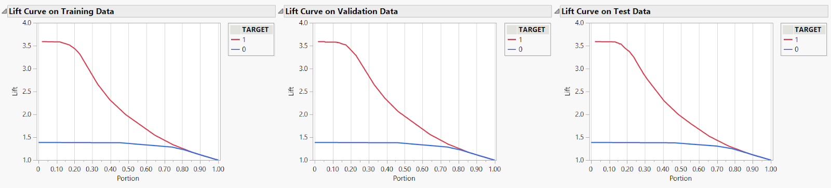
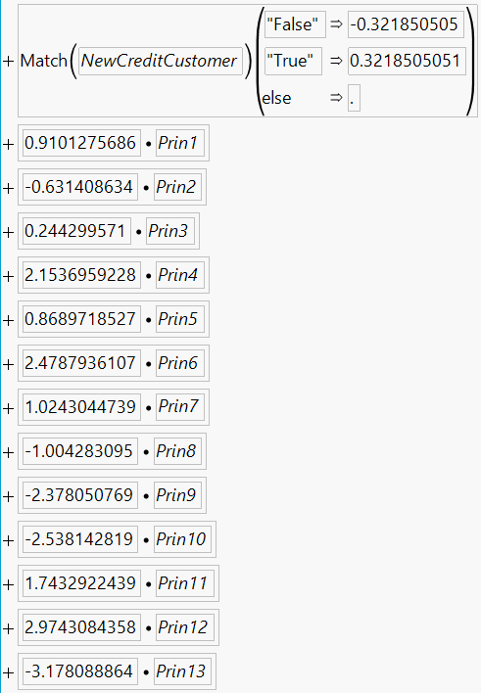
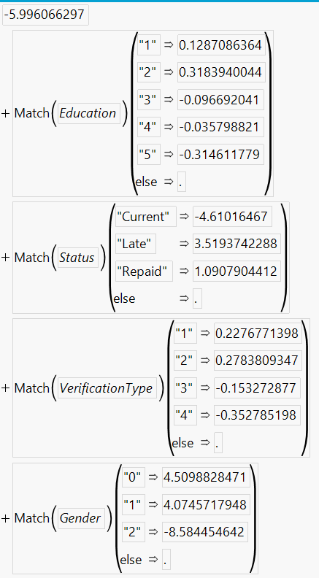
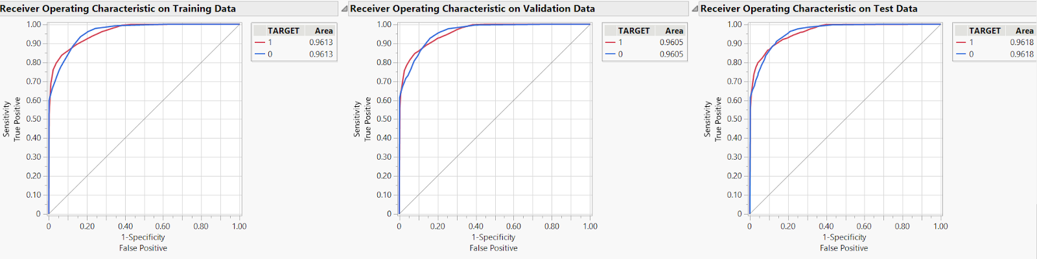
Logistic Regression
Line Curve
Formula
For top 15% most likely defaulter applicants, we see 3.6X lift in model accuracy
For non-defaulters, there is 1.4x lift for top 50% applicants
ROC
Training
Validation
Test
Good Borrowers Defaulters
Speaker: Vishwa

Slide 18
Business Recommendation & Trade Offs
Recommendations
Justifications
Bondora should perform additional due diligence and/or charge higher interest rates to accommodate for additional risk for borrowers that have dependents.
More than 50% of defaulters having 1 or more dependents have defaulted on their loans
Bondora should review the level of education of younger borrowers (age 20-40) to further scrutinize the application and assess the risk of default.
64% of borrowers between 20-40 defaulted on their loans.
More educated (cat 3,4,5) borrowers have 6% lower default rate than less educated (cat 1,2)
Borrowers with existing mortgages, at time of application, should be positively considered for loan applications. These borrowers are vetted from other financial institutions and this creates a safety net for the next lending institution (Bondora) to lend money
1. 80% of non-defaulters have an existing mortgage
Bondora should scrutinize the loan applications and even consider charging higher interest rates in which the borrowers have minimal to negative free cash on hand.
1. 75% of defaulters have <$25 free cash available vs Median of $58 for all borrowers (including defaulters)
Speaker: Vishwa

Slide 19
Annexures
Speaker: Vishwa

Slide 20
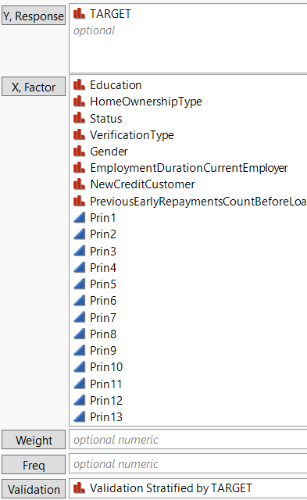
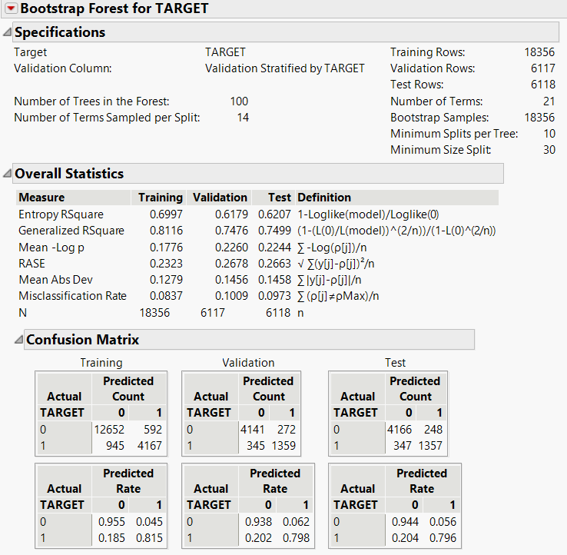
Bootstrapped Forest
INPUTS
Specifications
Overall Statistics
Confusion Matrix
Speaker: Vishwa

Slide 21
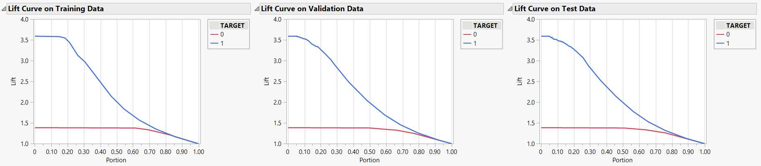
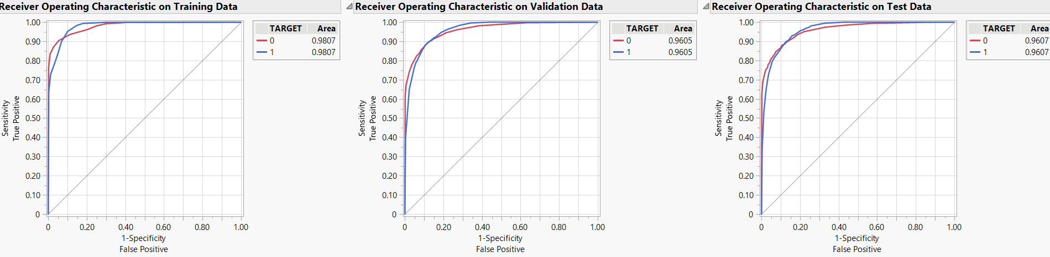
Bootstrapped Forest
Lift Curve
ROC
Training
Validation
Test
Good Borrowers Defaulters
Speaker: Vishwa

Slide 22
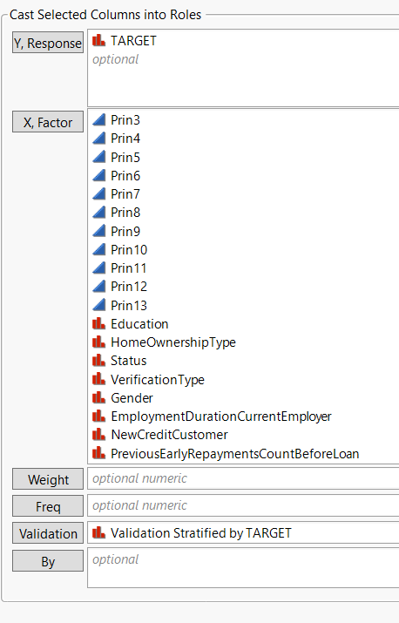
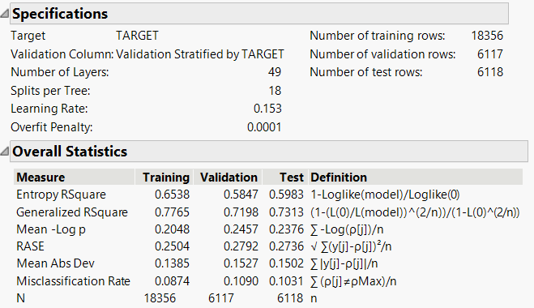
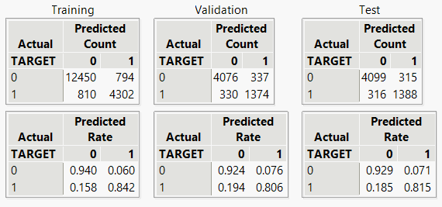
Boosted Tree
INPUTS
Confusion Matrix
Speaker: Vishwa

Slide 23
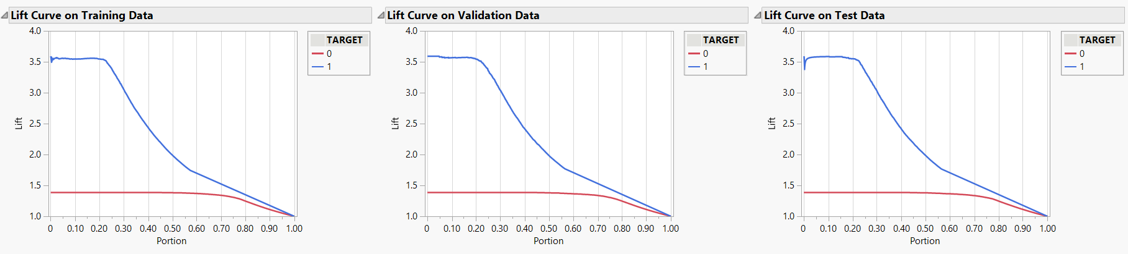
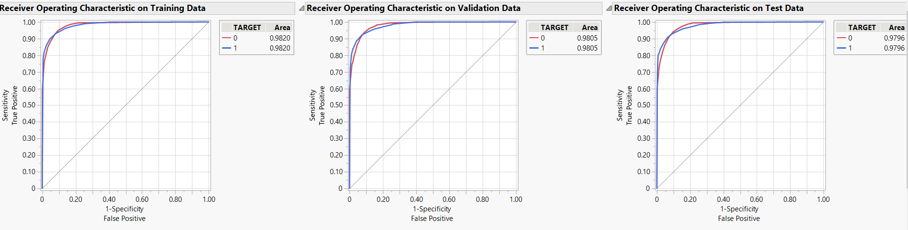
Boosted Tree
Lift Curve
ROC
Training
Validation
Test
Good Borrowers Defaulters
Speaker: Vishwa

Slide 24
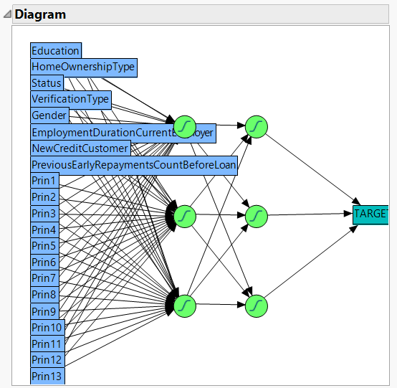
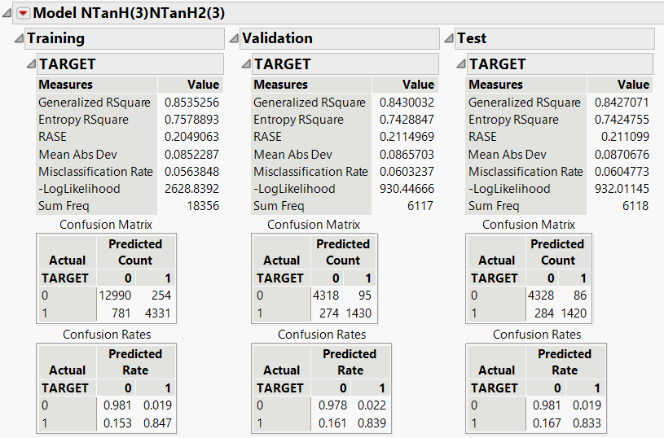
Neural Network
INPUTS
DIAGRAM
Model NTanH(3)NTanH2(3)
Speaker: Vishwa

Slide 25
Neural Network
Lift Curve
ROC
Training
Validation
Test
Good Borrowers Defaulters
Speaker: Vishwa

Slide 26
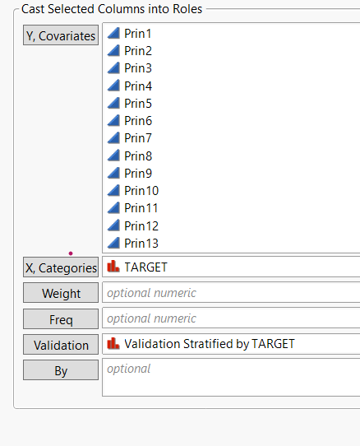
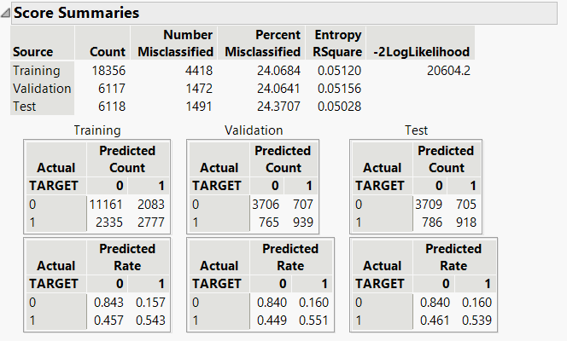
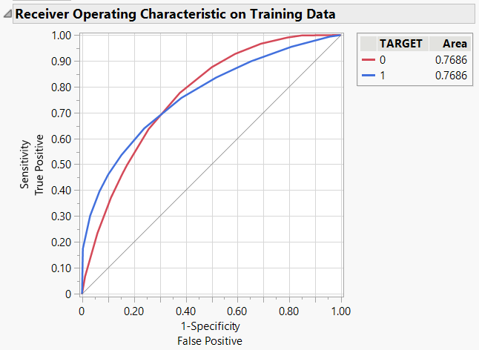
Discriminant
INPUTS
Confusion Matrix
ROC Curve
Speaker: Vishwa

Slide 27
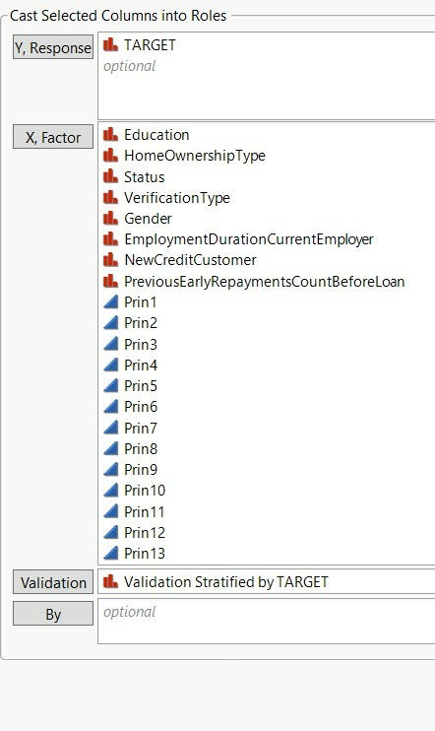
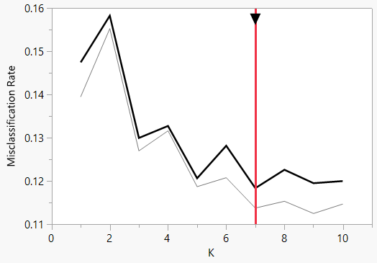
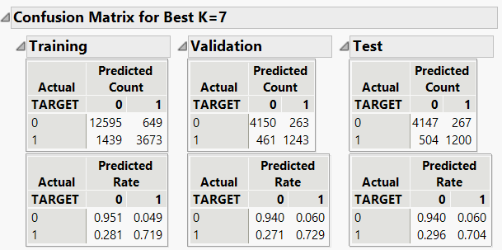
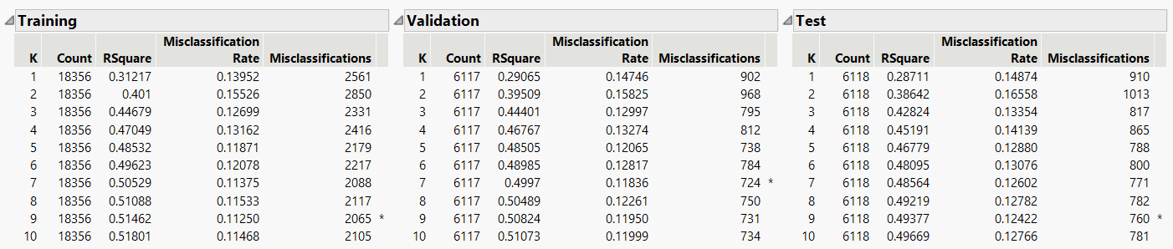
K Nearest Neighbor
INPUTS
Best K Graph
Confusion matrix
Fit Details
Speaker: Vishwa

Slide 28
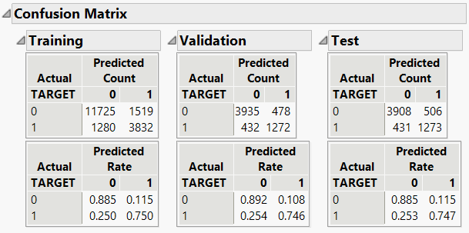

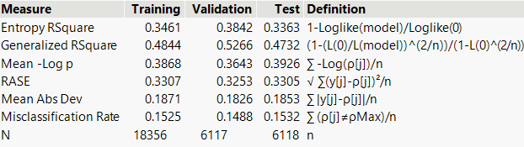
Naïve Bayes
Confusion Matrix
INPUTS
Fit Details
Speaker: Vishwa

Slide 29
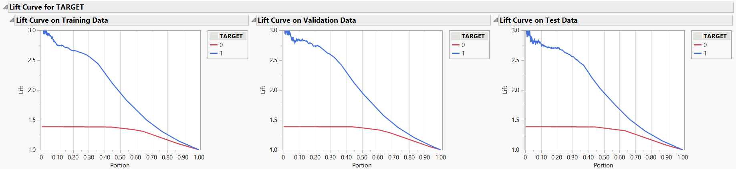
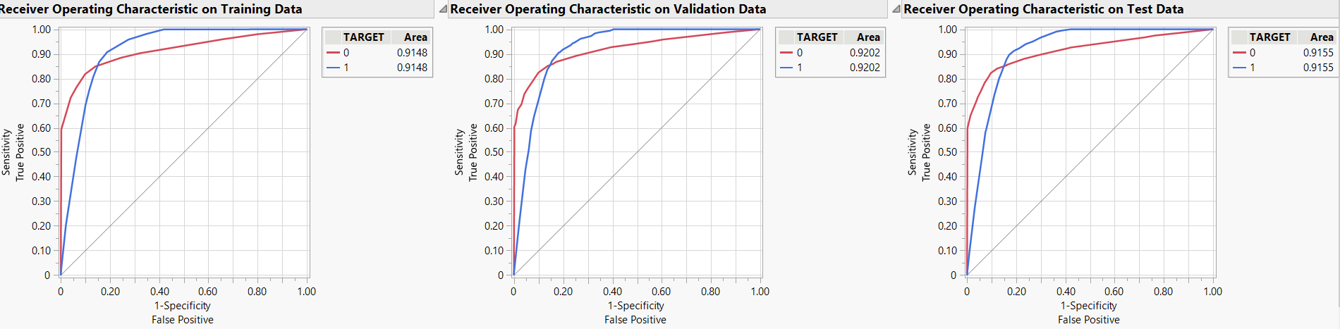
Naive Bayes
Lift Curve
ROC
Training
Validation
Test
Good Borrowers Defaulters
Speaker: Vishwa

