Slide 1

P810-High Cloud airlines
Group -2
Pujari Hemalatha
Godila Keerthika
Hemalatha Kalepu
Jahnavi Vanjari
V.Vijaya Chandana
Gokul Deshmukh
Lakshya Soni

Slide 2

Introduction
✈️ About High Cloud Airlines
High Cloud Airlines is a well-established airline that operates both domestic and international flights. It focuses on passenger and cargo transportation, aiming to provide efficient and reliable services.
Project Objective :
This project uses data analytics and business intelligence to help High Cloud Airlines:
Understand passenger trends and revenue growth.
Analyze flight delays, route efficiency, and seasonal demand.
Improve scheduling, pricing, and customer experience using data insights.

Slide 3
Dataset Overview
📊 Data Overview – High Cloud Airlines
1️⃣ Dataset Size & Source
Contains 11 lakh rows of airline operational data.
Source: High Cloud Airlines flight records.
2️⃣ Key Columns & Metrics
Flight Details: Carrier Name, Flight Number, Route, Distance Group, Departure & Arrival Times.
Passenger & Capacity Metrics: Transported Passengers, Available Seats, Load Factor %.
Date Information: Year, Month, Day, Financial Quarter, Weekday/Weekend.
3️⃣ Data Cleaning & Optimization
Load Factor Calculation: (Transported Passengers / Available Seats) * 100.
Error Handling: Replaced invalid Load Factor values with 0% (ensures accurate aggregation), after removing null values and Duplicates.
SQL Optimization: Used indexing to improve query performance.

Slide 4
Tools Used & Key Insights
Tools Used :
We have used four powerful tools to analyze airline operations:
Excel – Cleaning and organizing data for initial analysis.
SQL – Extracting useful insights from large databases.
Power BI & Tableau – Interactive dashboards and data visualization.
Key Insights
Busiest Flight Routes – Identified the most traveled routes.
Seasonal Trends – Found peak and off-peak travel periods.
Seat Utilization – Optimized load factor for better occupancy.
Weekday vs. Weekend Travel – Analyzed passenger flow patterns.
Revenue & Cost Analysis – Explored pricing, expenses, and profitability.

Slide 5
Excel Analysis - Data Cleaning & Insights
Data Cleaning & Preparation – Removed duplicates, handled NULL values, and structured raw data for analysis.
Data Transformation – Applied formulas and functions to standardize and organize data.
Pivot Tables & Charts – Created pivot tables for summarizing key trends.
Trend Analysis – Used conditional formatting to highlight insights like peak travel times and seat utilization.
Data Validation & Standardization – Ensured data consistency using drop-down lists, text functions, and error handling.

Slide 6
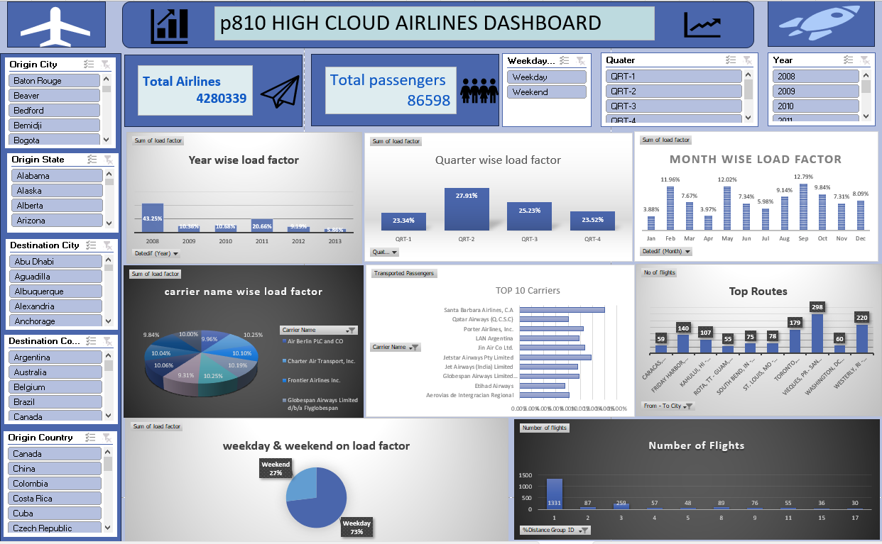
Excel Dashboard Overview

Slide 7
Power BI - Insights
Data Modeling – Established relationships between tables to ensure smooth interaction in reports.
DAX Functions & Measures – Used SUM, AVERAGE,CALCULATE, Calenderauto functions to derive key metrics.
Interactive Dashboards – Created dynamic visuals such as bar charts, pie charts, maps, and KPIs to track airline performance.
Filters & Slicers – Enabled user-driven insights by allowing selection of time periods, routes, and other key filters.
Key Business Insights – Identified top-performing routes, seasonal demand trends, revenue drivers, and customer segmentation to help decision-making.

Slide 8
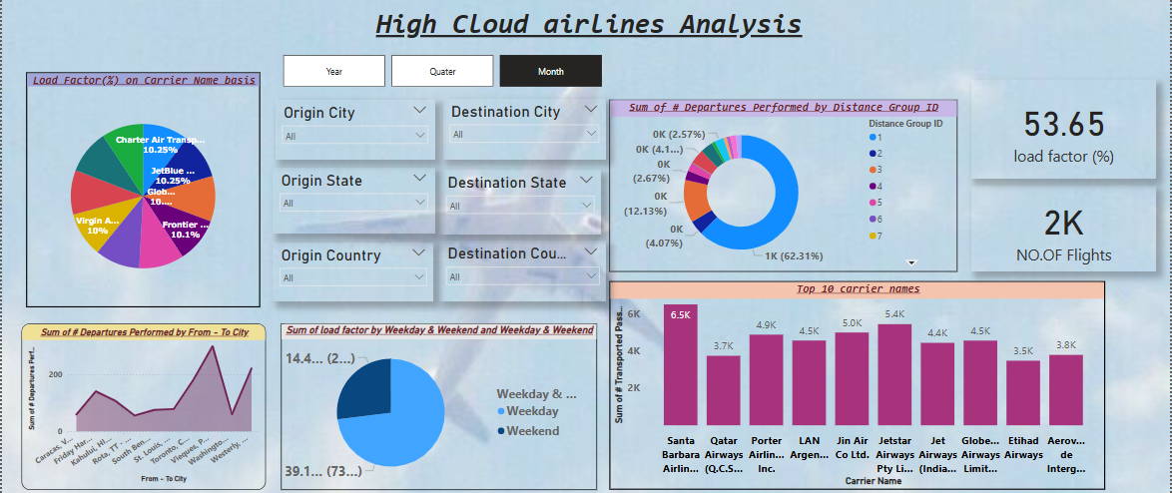
Powerbi Dashboard Overview

Slide 9
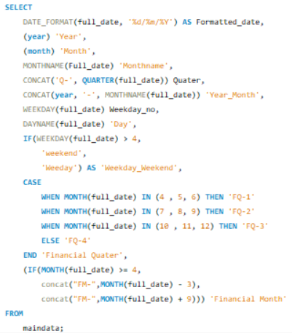
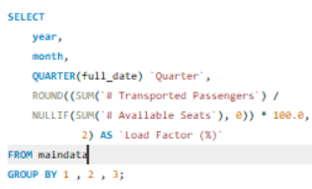
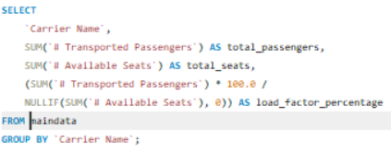
SQL Query Insights & Results
KPI :1
KPI 2
KPI 3

Slide 10
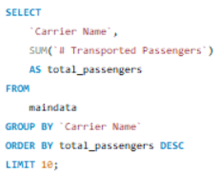
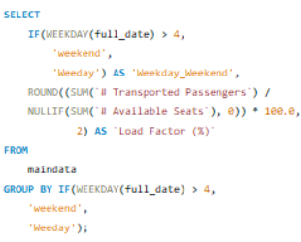

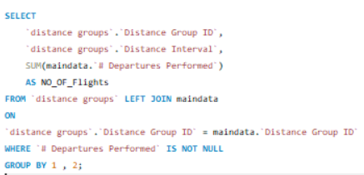
SQL Query Insights & Results
KPI : 4
KPI : 6
KPI : 5
KPI : 7

Slide 11
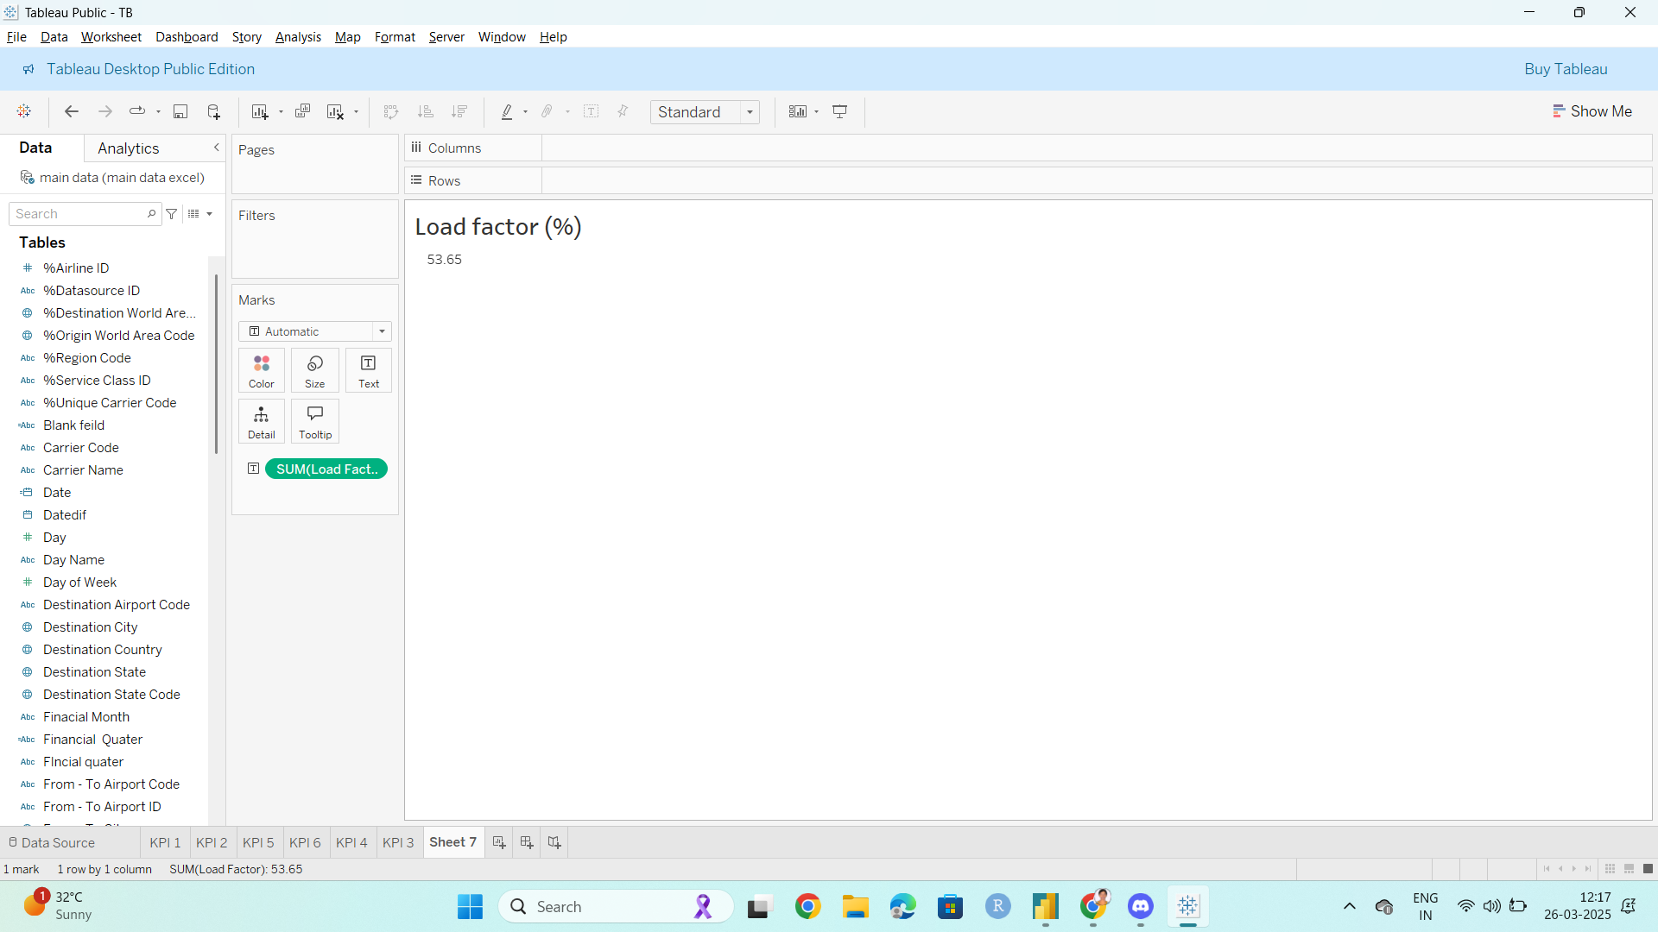
Tableau - Key Insights & Visualizations
Data Connection & Preparation – Connected to Excel data, cleaned and structured it for visualization.
Data Modeling – Built relationships between tables for seamless data integration.
Interactive Dashboards – Designed visually appealing dashboards with filters, slicers, and drill-downs for better insights.
Advanced Visualizations – Used Bar charts, bubble chart, and pie chart for deep analysis.
Key Business Insights – Identified top-performing routes, passenger demographics, peak seasons, and revenue trends for strategic decision-making.

Slide 12
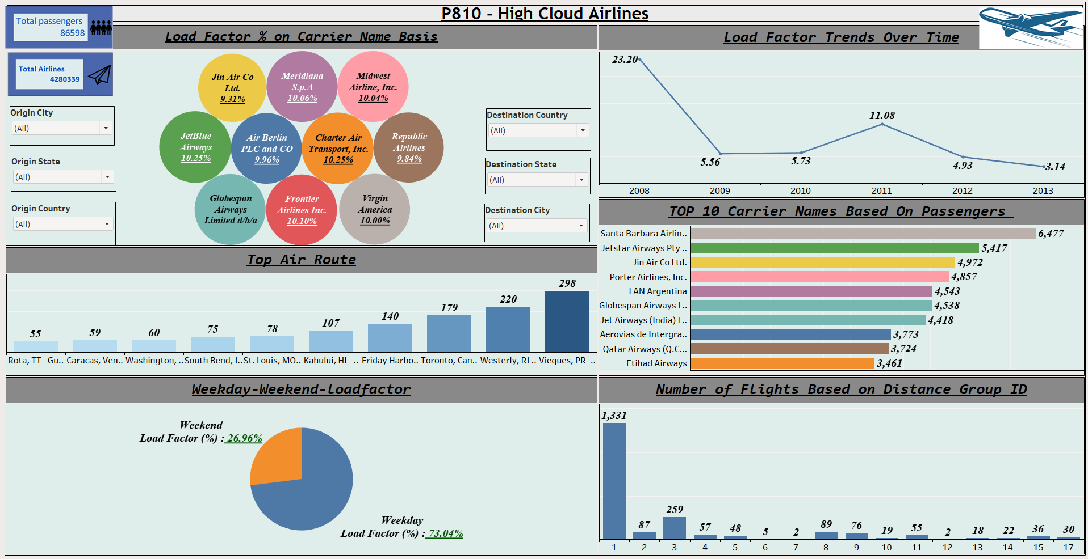
Tableau Dashboard Overview

Slide 13
Aviation Load Factor & Flight Performance Analysis
1. Load Factor Analysis by Carrier Name :-
The analysis of airline performance based on load factor percentage reveals that Charter Transport Inc and JetBlue have the highest load factor percentages among all carriers. This indicates , these airlines effectively utilize their seat capacity, ensuring minimal empty seats and better revenue optimization.
On the other hand, carriers such as Santa Barbara (6.5K passengers), Qatar Airways, and JetStar Airways Pty Limited (5.4K passengers) are among the most preferred airlines by passengers.
2. Route Performance Analysis :-
Most Flights: Vieques PR → San Juan PR.
Least Flights: Venezuela → Miami.

Slide 14
.
3. Load Factor: Weekdays vs. Weekends :-
Weekdays: 73.04% (higher demand).
Weekends: 26.96% (lower demand).
4. Distance-Based Flight Distribution :-
Short-haul flights have more departures; long-haul flights are fewer.(Haul refers to distance)

Slide 15
Load Factor Breakdown Analysis: Airline Efficiency & Trends
A total load factor of 53.65% across all airlines means that, on average, only 53.65% of the available seat capacity is being utilized across the aviation industry.
Challenges :-
Seasonal Demand Fluctuations
Passenger Behavior & Preferences (Trains, Own Vehicle)
Last minute cancelations
Pandemics, political instability, or global crises can reduce air travel demand.
Route and Network Optimization Issues (Inefficient scheduling leads to empty seats on certain flights.)

Slide 16
Load Factor Breakdown: Airline Efficiency & Trends
Recommendations :-
Maximize Cargo & Freight Utilization
Boost Marketing & Sales Strategies
Improve Customer Experience & Loyalty Programs
Route Optimization: Adjust flight frequency based on demand patterns.
Partnerships & Alliances: Collaborate with other airlines to increase connectivity.
Leverage Data Analytics for Demand Forecasting
Introduce seasonal and flexible scheduling to match travel trends.
Optimize Pricing & Promotions: Offer discounts on weekends to boost occupancy.

Slide 17
Conclusion
Throughout this project, we effectively utilized multiple data analytics tools to clean, process, analyze, and visualize data.
Excel helped in data cleaning and basic analysis.
SQL enabled efficient data extraction and querying.
Power BI and Tableau provided interactive dashboards and advanced visualizations for better decision-making.
By integrating these tools, we streamlined the data analysis process, ensuring accuracy, efficiency, and impactful decision-making. This approach showcases the power of combining different technologies for a comprehensive data-driven strategy.

Slide 18

THANK YOU!

