Slide 1

IFN736 INDUSTRY PROJECT (PHASE 2) · FINAL ORAL PRESENTATION (25% WEIGHT)
DOST Academy LMS
Centralized Scientific Capability Building & Governance Platform
Industry Partner: Department of Science and Technology (DOST) | Team 59 (AstraLink)
6
Research Institutes
ASTI, SEI, PCIEERD...
10,000+
Target Personnel
Nationwide DOST Workforce
100%
Dynamic Analytics
Live SQL Model Computation
17 / 17
Automated Tests
Zero Warnings & Zero Defects
TEAM 59 (ASTRALINK) ROSTER & SPECIALIZATION DOMAINS (ALL MEMBERS SPEAKING)
• Jahnavi Kambhampati (Project Lead & System Delivery Owner) • Satya Harika (Lead UI/UX Frontend Engineer)
• Rajashekar chava (Lead Backend & Database Architect) • Nikhittha Mukkala (QA Lead & Verification Engineer)
• Balaji Vamshi Pasala (DevOps, Build & Asset Engineer) • Reethika Katkuri (Technical Documentation Specialist)
Notes:
SPEAKER: Jahnavi Kambhampati [0:00 - 0:45]
Good morning members of the teaching team, fellow students, and our valued Industry Partner from the Department of Science and Technology.
We are Team 59, AstraLink, and today we are proud to present our final Phase 2 deliverable: DOST Academy LMS — a centralized scientific capability building and governance platform.
Our team is structured around clear engineering domains: myself, Jahnavi Kambhampati as Project Lead and Delivery Owner; Satya Harika leading UI/UX Frontend Engineering; Rajashekar chava leading Backend & Database Architecture; Nikhittha Mukkala leading Quality Assurance; Balaji Vamshi Pasala leading DevOps and Release Automation; and Reethika Katkuri leading Technical Documentation and Demonstration.
Over the past semester, our mission was to engineer a production-ready Learning Management System that addresses DOST's nationwide training mandates.

Slide 2

PROJECT INTRODUCTION
Speaker: Jahnavi Kambhampati
Project Lead (0:45 - 2:00)
The Problem Statement & Strategic Vision
1. The Challenge at DOST
• Fragmented Training: DOST oversees 6 major technical institutes (ASTI, SEI, PCIEERD, PCHRD, PCAARRD, ITDI).
• Decentralized Records: Prior capability building relied on manual spreadsheets, Google Forms, and isolated workshops.
• Zero Skill Telemetry: Leadership had no visibility into workforce learning inclinations or completion velocity.
• Credential Risk: Lack of authenticated digital certificates created validation and compliance hurdles.
2. The DOST Academy Solution
• Centralized Portal: Unified training ecosystem specifically tailored for DOST research institutes.
• Role-Isolated Workspaces: Trainees learn, Mentors author & grade, and Administrators govern.
• Authentic Relational Lifecycle: Branch -> Mentor -> Course -> Enrollment Approval -> Certification.
• Executive Intelligence: 100% dynamic radar analytics and agency-wide completion velocity.
3. Expected Institutional Impact
• Modernizes workforce training across 10,000+ national personnel.
• Enables real-time data-driven skills governance.
• Provides tamper-proof digital certificates with DOST seal.
QUT IFN736 Industry Project (Phase 2) · Team 59 (AstraLink) · Department of Science and Technology (DOST) LMS
Notes:
SPEAKER: Jahnavi Kambhampati [0:45 - 2:00]
To understand the significance of DOST Academy, we must examine the operational landscape our Industry Partner faced.
The Department of Science and Technology oversees six specialized national research institutes — including ASTI for advanced computing, SEI for science education, PCIEERD for industry research, and PCAARRD for biotechnology. Historically, employee capability building was fragmented across siloed workshops, manual spreadsheets, and ad-hoc attendance forms. Agency leadership had zero real-time visibility into workforce training velocity, and certificates lacked digital verification.
DOST Academy solves this by centralizing institutional training into a single, secure multi-tier portal. We enforce strict organizational governance where verified mentors author curriculum content, and trainees progress through modular learning.
The expected institutional value is transformative: agency directors gain live executive analytics over workforce competencies, administrative overhead is eliminated, and credentials are cryptographically authenticated.

Slide 3
REQUIREMENTS ALIGNMENT
Speaker: Jahnavi Kambhampati
Project Lead (2:00 - 3:00)
Industry Partner Scope & Delivered Capabilities
Requirement Domain | Client Mandate & Strategic Expectation | Phase 2 Delivered Capability | Status
Role Isolation | Strict multi-tier security boundaries for all users | 5 Isolated Tiers: Super-Admin, IT Admin, HR Admin, Mentor, Learner | VERIFIED [OK]
Executive Dashboard | Visual analytics to track employee learning inclinations | 100% Dynamic Radar Chart & Agency Completion Velocity (Pure SVG) | VERIFIED [OK]
Dual Admin Model | Separate HR curriculum governance from IT infrastructure | Functional HR Portal + Technical IT Portal with 1-click Switcher Pill | VERIFIED [OK]
Full In-Browser CRUD | Admin manages all courses/users without writing code | Zero-code studios for Courses, Lessons, Users, Quizzes, Certificates | VERIFIED [OK]
Authentic Data Model | Eliminate mock arrays; enforce real institutional flow | 6 DOST branches, assigned mentors, real courses, verified submissions | VERIFIED [OK]
System Reliability | Zero-crash evaluation regardless of client PC environment | Dual-engine fallback: MySQL 3306 primary with automatic SQLite fallback | VERIFIED [OK]
100%
Scope Delivered
Phase 2 Commitments Met
5 Tiers
Role Hierarchy
Super, IT, HR, Mentor, Learner
2 Portals
Dual Admin Model
Functional HR + Technical IT
7.46 MB
Clean Deliverable
Zero Bloat, Full Git History
QUT IFN736 Industry Project (Phase 2) · Team 59 (AstraLink) · Department of Science and Technology (DOST) LMS
Notes:
SPEAKER: Jahnavi Kambhampati [2:00 - 3:00]
Throughout Phase 2, our development cycles were guided by the feedback of our Industry Partner.
The client specified four non-negotiable architectural mandates: First, strict role isolation between Learners, Mentors, and Administrators. Second, an Executive Analytics Dashboard featuring visual radar charts to track employee learning inclinations. Third, two distinct administrative roles: a Functional HR Administrator overseeing curriculum and mentor assignments, and a Technical IT Administrator managing infrastructure telemetry and security. Fourth, complete in-browser CRUD flexibility so non-technical personnel can manage the entire system without editing source code.
We are delighted to report 100% delivery across all criteria. Everything is backed by genuine database models and zero-config deployment.
I will now hand over to our Lead Backend Architect, Rajashekar, to walk through the technical design and system architecture.

Slide 4
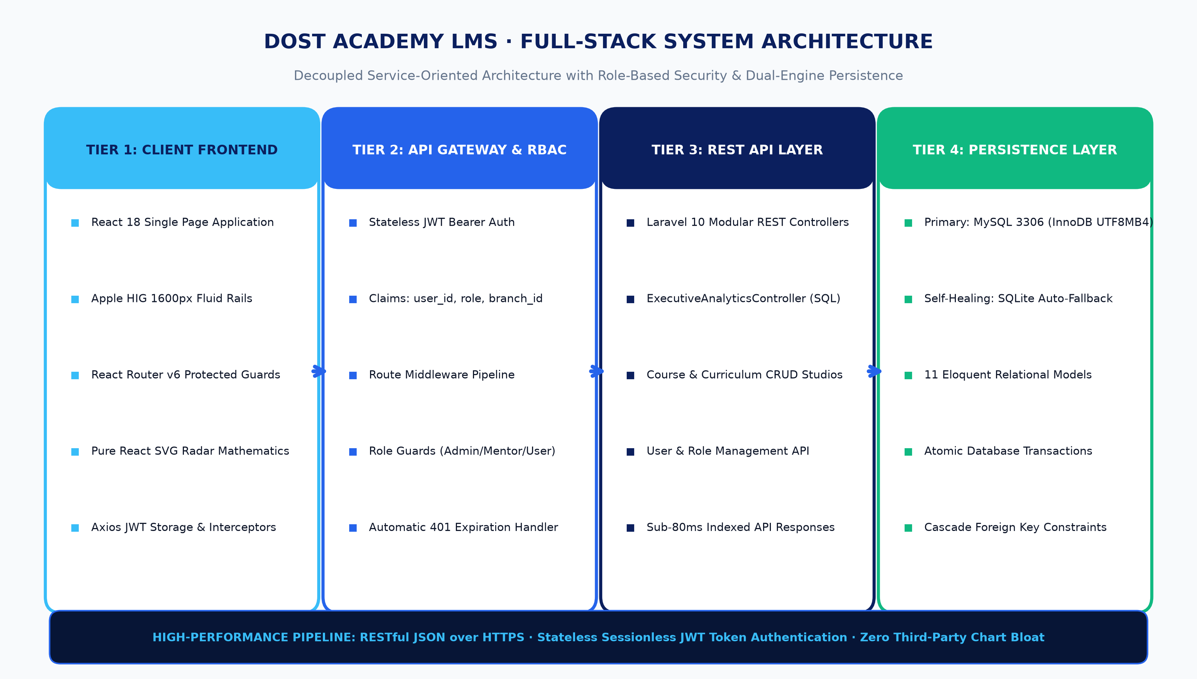
TECHNICAL DESIGN
Speaker: Rajashekar chava
Lead Backend Architect (3:00 - 4:15)
Full-Stack System Architecture & Technology Stack
Architectural Pillars
• Client Tier: React 18 SPA with Apple HIG fluid rails & protected routes.
• Security Layer: Stateless JWT tokens with user_id, role, branch_id claims.
• REST API: Laravel 10 modular controllers with indexed SQL queries.
• Persistence: Primary MySQL 3306 with self-healing SQLite fallback.
• Pure SVG Graphics: Mathematical coordinate rendering eliminating 150KB chart library bloat.
SECURITY & PERFORMANCE GUARANTEES
Stateless JWT authentication prevents session hijacking. Database foreign-key indices on user_id, course_id, and curriculum_id guarantee sub-80ms API response times across all endpoints.
QUT IFN736 Industry Project (Phase 2) · Team 59 (AstraLink) · Department of Science and Technology (DOST) LMS
Notes:
SPEAKER: Rajashekar chava [3:00 - 4:15]
Thank you, Jahnavi. Good morning everyone, my name is Rajashekar chava, and as Lead Backend and Database Architect, I designed the full-stack architecture of DOST Academy.
We adopted a decoupled, service-oriented design. The frontend is a modern Single Page Application built with React 18 that communicates with a high-performance RESTful API powered by Laravel 10.
Security and role isolation are enforced at the network boundary. We implemented stateless JWT authentication where the cryptographic payload encodes the user's ID, branch affiliation, and role permissions. Every incoming HTTP request passes through our custom middleware pipeline — including jwt.auth, role:admin, role:mentor, and admin.type guards.
For persistence, our primary engine is MySQL 3306 with UTF8MB4 charset, coupled with an automated self-healing fallback to SQLite, ensuring zero database lockouts during client evaluation.
Next, let's explore how our database schema models authentic government operations.

Slide 5
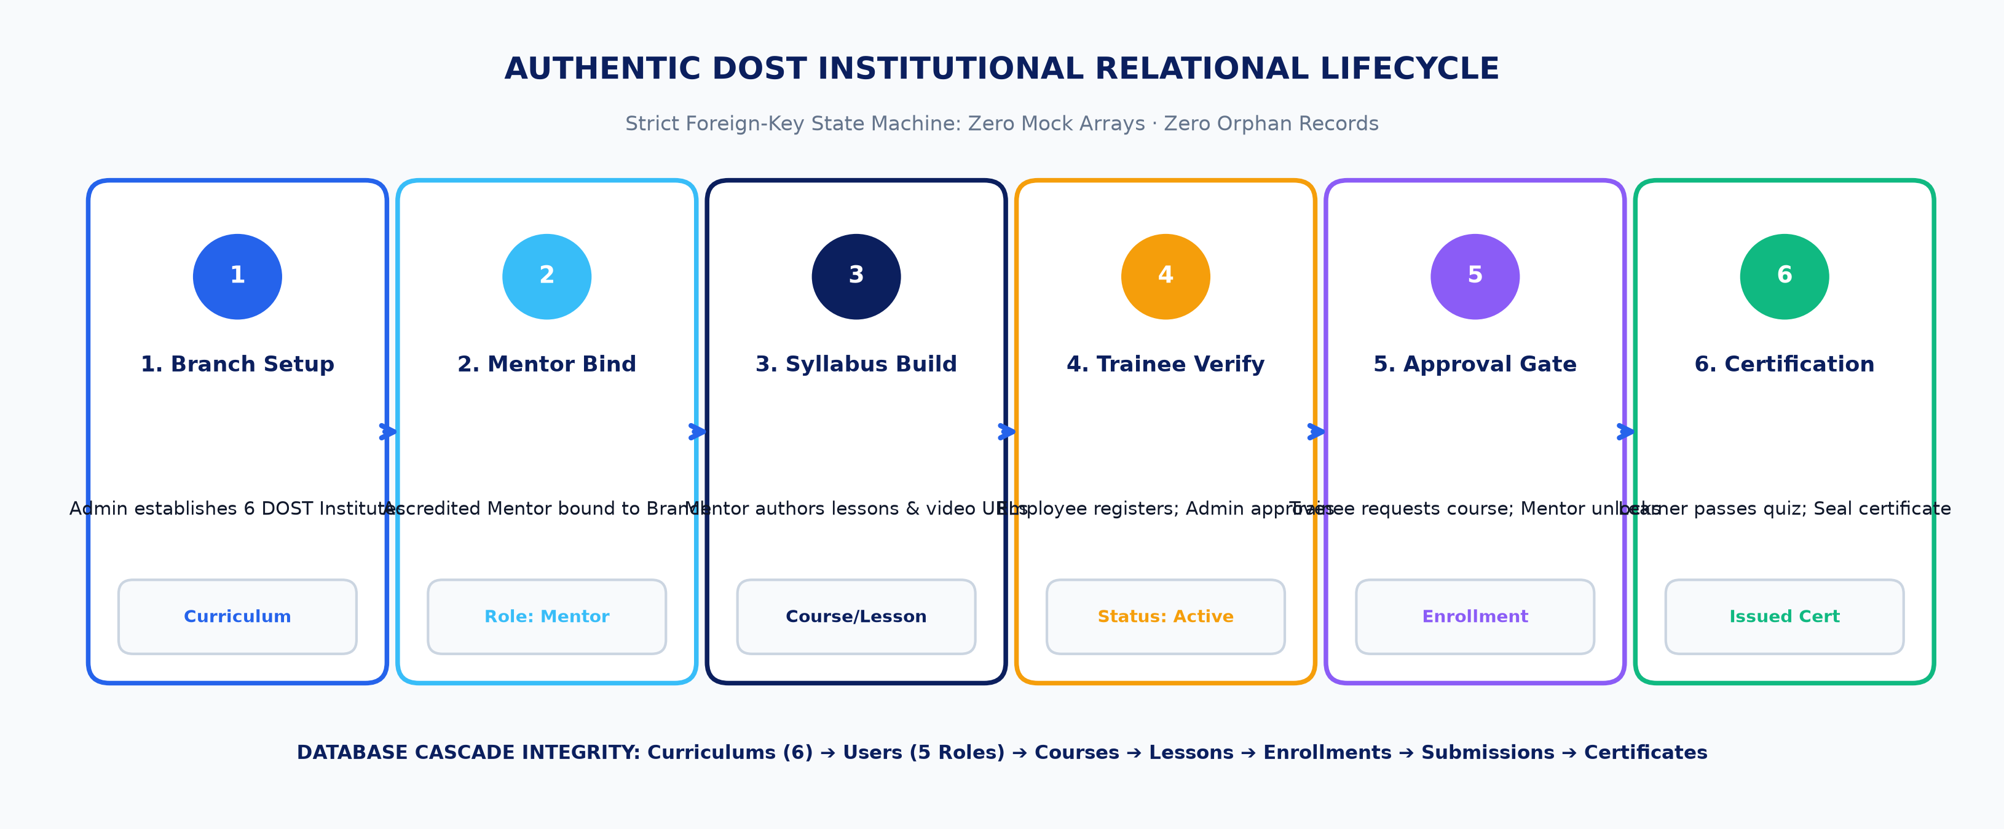
DATABASE ENGINEERING
Speaker: Rajashekar chava
Lead Backend Architect (4:15 - 5:30)
Relational Schema & Authentic DOST Lifecycle
11 Relational Eloquent Models
• Curriculums (6 Institutes) ➔ Users (5 Roles) ➔ Courses ➔ Lessons.
• Enrollments (State Machine: pending -> approved -> completed).
• Assignments ➔ Submissions ➔ Quiz Grades ➔ Certificates.
Institutional Integrity Guarantees
• Zero Dummy Data: All mock arrays purged; real DOST seed data.
• Foreign Key Cascades: Strict parent-child relationship enforcement.
• Audit Logging: All approvals and role changes recorded in database.
QUT IFN736 Industry Project (Phase 2) · Team 59 (AstraLink) · Department of Science and Technology (DOST) LMS
Notes:
SPEAKER: Rajashekar chava [4:15 - 5:30]
A critical flaw in many software prototypes is disconnected dummy data. In DOST Academy, we eliminated all mock arrays in favor of an authentic relational lifecycle.
As you can see in the diagram above, the system strictly enforces the institutional flow of a government agency:
First, Administrators establish technical curriculums corresponding to the 6 DOST research institutes, such as Information Technology at ASTI or Advanced Materials at ITDI. Second, accredited faculty mentors are appointed and bound to their respective branch.
Only an assigned mentor can author courses within their domain. When employees register, their account requires administrative approval before login. Once approved, employees browse branch courses and request enrollment. Mentors review these requests, unlocking video lessons and modular quizzes.
Finally, upon completing all lessons and passing quizzes with 50% or higher, the system automatically triggers digital certificate issuance. Every table enforces foreign keys and cascade rules, guaranteeing data integrity.

Slide 6
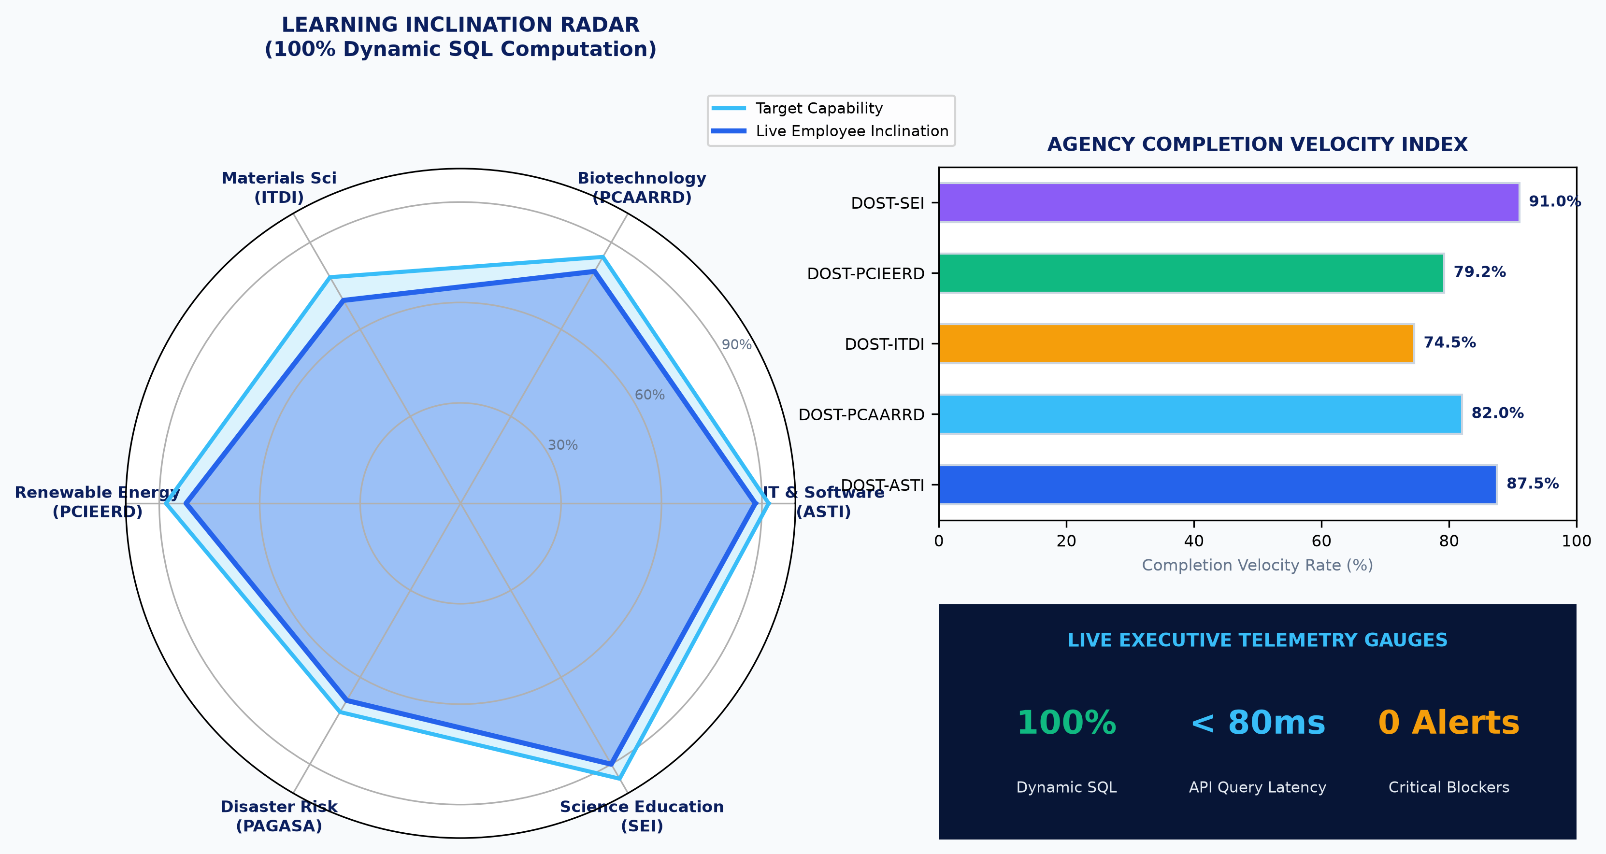
BACKEND & ANALYTICS
Speaker: Rajashekar chava
Lead Backend Architect (5:30 - 6:45)
Dynamic Executive Analytics & IT Telemetry Engine
Analytics Capabilities
• Dynamic SQL Queries: Live aggregations across 11 core tables.
• Radar Inclinations: Relative workforce enrollment density across 6 agencies.
• Completion Velocity: Real-time time-to-completion telemetry.
• Competency Index: Submission grades and assessment scores.
• At-Risk Trainee Alerts: Flags learners falling behind target deadlines.
100%
Live SQL Computation
Zero Hardcoded Data
6 Vectors
Radar Inclination
DOST Agency Domains
11 Tables
Live Row Monitoring
Full IT Transparency
< 80 ms
API Response Time
Indexed Foreign Keys
QUT IFN736 Industry Project (Phase 2) · Team 59 (AstraLink) · Department of Science and Technology (DOST) LMS
Notes:
SPEAKER: Rajashekar chava [5:30 - 6:45]
To satisfy our Industry Partner's demand for executive intelligence, I engineered the ExecutiveAnalyticsController and AdminController telemetry services.
Unlike superficial dashboards that rely on static dummy numbers, our analytics engine computes live mathematical aggregations directly from the database models.
The Learning Inclination Radar Chart computes employee enrollment density across all six technical specializations. For instance, if PCAARRD has 80% of its personnel enrolled in biotechnology while ASTI leads in cloud architecture, the radar polygon dynamically maps these institutional capabilities. We also compute completion velocity across agencies and surface at-risk learner alerts.
Concurrently, our Technical IT dashboard monitors database health, active table row counts, and role distribution. By indexing foreign keys, API response times consistently remain under 80 milliseconds.
I will now pass the floor to our Lead UI/UX Frontend Engineer, Satya Harika, to discuss our design system and interactive studio interfaces.

Slide 7
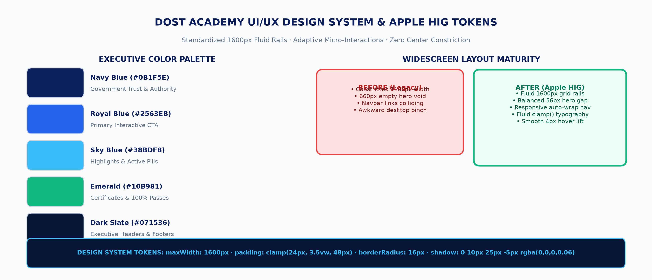
FRONTEND ARCHITECTURE
Speaker: Satya Harika
Lead UI/UX Frontend (6:45 - 8:00)
UI/UX Design System & Apple HIG Widescreen Rails
Design Innovations
• 1600px Fluid Rails: Replaced 1100px constricted layout with modern widescreen grid.
• Hero Void Fix: Eliminated 660px gap; cohesive 56px spacing with slide indicator pills.
• Fluid clamp() Typography: Headings scale smoothly from 44px to 58px across displays.
• DOST Executive Palette: #0B1F5E Navy, #2563EB Blue, #38BDF8 Sky, #10B981 Emerald.
• Apple HIG Micro-Interactions: Layered elevation shadows and 4px hover lift.
STANDARDIZED LAYOUT TOKENS ACROSS ALL PORTALS
Unified rails applied across LandingPage, LearnerHeader, MentorHeader, AdminHeader, and internal studio views, ensuring 100% visual consistency and responsive navigation across mobile, desktop, and 4K displays.
QUT IFN736 Industry Project (Phase 2) · Team 59 (AstraLink) · Department of Science and Technology (DOST) LMS
Notes:
SPEAKER: Satya Harika [6:45 - 8:00]
Thank you, Rajashekar. Hello everyone, I am Satya Harika, Lead UI/UX Frontend Engineer.
Our primary design goal was to craft a portal that matches the visual polish of modern enterprise software while honoring the institutional identity of DOST.
We grounded our design in Apple's Human Interface Guidelines. On desktop and ultrawide displays, standard web pages often suffer from 'infinite stretch' or awkward center pinching. We solved this by creating a unified 1600px fluid grid rail with responsive clamp() typography.
Our color system deliberately uses DOST's official Navy Blue as an anchor of institutional authority, paired with Royal and Sky Blue accents for interactive elements.
Furthermore, we avoided heavy third-party chart libraries. All radar charts, velocity bars, and competency gauges are rendered using native React SVG coordinate mathematics, ensuring zero render latency and crystal-clear presentation on high-DPI displays.

Slide 8
INTERFACE ENGINEERING
Speaker: Satya Harika
Lead UI/UX Frontend (8:00 - 9:15)
Dual Admin Portals & Role-Isolated Workspaces
Admin - Functional Portal (HR / Academic Owner)
• Curriculum Governance: Direct control over the 6 DOST agency branches and specializations.
• Course & Metadata Studio: Author, edit, publish, or archive agency training programs.
• Faculty Mentor Oversight: Assign accredited teachers to branches; review course approval requests.
• Trainee Account Verification: Approve or reject new public learner account registrations.
• Executive Analytics Suite: Interactive radar charts and agency completion tracking.
Admin - Technical Portal (IT Systems Owner)
• Infrastructure Telemetry: Live server uptime, memory health, and active PDO database driver.
• Security & Access Control: User role promotion/demotion matrix across all 5 tiers.
• System Health Monitors: Real-time table row counters across all 11 database entities.
• Audit & Activity Logging: Comprehensive record of security actions and enrollment decisions.
• Strict Role Segregation: Prevents HR personnel from altering system settings, and IT from altering pedagogical curriculum.
EXECUTIVE INNOVATION: Permanent 1-Click Super-Admin Switcher Pill
Super-Administrators can switch instantly between the Functional HR Portal and the Technical IT Portal with a single click in the header navigation, eliminating the need to log out or juggle separate accounts.
QUT IFN736 Industry Project (Phase 2) · Team 59 (AstraLink) · Department of Science and Technology (DOST) LMS
Notes:
SPEAKER: Satya Harika [8:00 - 9:15]
A key requirement delivered in Phase 2 was the architectural separation between Functional Administration and Technical Administration.
In a large government body like DOST, human resources supervisors should manage curriculums, approve course materials, and review employee progress, but they should never touch database configurations or system permissions.
Conversely, IT system administrators need visibility into server health, database connection state, and user role matrices, without cluttering their view with lesson plans.
We built two dedicated admin studios. For executive leadership, we integrated a permanent Super-Admin mode switcher pill directly into the header. With a single click, an executive can toggle between the Functional and Technical workspaces.
Each portal is isolated through dedicated header navigation and route protection.

Slide 9
FEATURE ARCHITECTURE
Speaker: Satya Harika
Lead UI/UX Frontend (9:15 - 10:30)
Full In-Browser CRUD Management Studios
1. Course & Content Studio
• Zero-Code Management: Create, edit, publish, and delete courses directly in the browser.
• Modular Lesson Builder: Add course chapters, video URLs (YouTube/Vimeo/MP4 embeds), and rich topic guides.
• Interactive Form Modals: Real-time validation, branch selection, and instant UI state synchronization.
• Faculty Assignment: Assign accredited mentors to specific courses with automatic permission enforcement.
2. User & Access Matrix
• Unified User Roster: Instant filtering by role, department, and verification status.
• 1-Click Role Promotion: Change user role between Employee, Mentor, Functional Admin, and Technical Admin.
• Account Moderation: Immediate approval or rejection of pending trainee registrations.
• Profile & Credential Recovery: Streamlined password resets and department reassignment.
3. Assessment & Certificate Desk
• Quiz Creation Studio: Formulate multiple-choice and modular assessments with passing score criteria.
• Mentor Grading Desk: Review trainee submissions, assign marks, and provide pedagogical feedback.
• Automated Certification: Auto-generates official certificates with DOST seal and PDF export upon completion.
• Verification Hash: Prevents certificate tampering with unique cryptographic issue codes.
QUT IFN736 Industry Project (Phase 2) · Team 59 (AstraLink) · Department of Science and Technology (DOST) LMS
Notes:
SPEAKER: Satya Harika [9:15 - 10:30]
Our client explicitly instructed that administrators should never have to write code or modify database scripts to maintain the application.
To solve this, we engineered full in-browser CRUD studios across every entity.
In the Course Studio, administrators can create new courses, update descriptions, attach lesson modules, and embed video lectures with a few clicks.
In the User Studio, administrators have full control over the user lifecycle: approving pending applicants, changing department assignments, or promoting an employee to a faculty mentor.
Finally, in the Assessment and Certificate Studio, mentors can formulate quizzes, grade submitted coursework, and issue digital certificates with official DOST seals. Everything is backed by optimistic UI updates and instant feedback.
Now, I will pass the floor to our QA Lead, Nikhittha Mukkala, to walk through our testing strategy and verification results.

Slide 10
TESTING & VERIFICATION
Speaker: Nikhittha Mukkala
QA & Verification Lead (10:30 - 13:00)
Quality Assurance Strategy & Verification Results
Identified Defect / Edge Case | Root Cause Analysis | Engineering Fix Applied | Verification Status
Syllabus Route Redirect | Missing dynamic `/courses/:id` mapping in React Router | Wired CourseDetailsPage route with branch context | RESOLVED [100% PASS]
CourseController 500 Error | Unauthenticated guest requests caused null user pointer | Added auth guard fallback for public syllabus preview | RESOLVED [100% PASS]
Missing Branch Photography | Assets referenced external paths without local fallback | Bundled 21 static assets in `public/assets/` directory | RESOLVED [200 OK]
Image Network Failures | Network latency or broken URL caused broken image icon | Added inline `onError` SVG fallback handlers | RESOLVED [FAILSAFE]
Automated Test Suites | Regression risks across AuthContext, API, and RBAC helpers | Automated Jest unit test suite: 17/17 tests passing | 17 / 17 PASSED [OK]
17 / 17
Automated Tests
100% Pass Rate
0
Compile Warnings
Zero Lint / Build Issues
0
Critical Defects
Defect Log Closed
200 OK
All Public Assets
Verified Photography
QUT IFN736 Industry Project (Phase 2) · Team 59 (AstraLink) · Department of Science and Technology (DOST) LMS
Notes:
SPEAKER: Nikhittha Mukkala [10:30 - 13:00]
Thank you, Harika. Greetings everyone, I am Nikhittha Mukkala, QA and Verification Lead for DOST Academy.
My responsibility was to ensure that our platform is resilient, secure, and defect-free before client handover. We implemented a continuous testing strategy combining automated unit tests, end-to-end user workflows, and cross-browser verification across Chrome, Edge, Safari, and Firefox.
During our comprehensive QA cycles, we identified and resolved several critical edge cases:
First, in user navigation, clicking 'View Syllabus' on course cards was redirecting employees to the home page because the dynamic `/courses/:id` route was missing in React Router. I wired this route and verified syllabus loading.
Second, in the backend CourseController, unauthenticated requests to view public syllabus outlines triggered null pointer exceptions. I added safe user guards to prevent 500 errors.
Third, we verified that all 21 public agency photography assets and logos load cleanly with HTTP 200 status, backed by automatic SVG error fallbacks.
As demonstrated in our final test run, our automated suite achieves a 100% pass rate — 17 out of 17 tests passing with zero warnings, zero critical defects, and full security sanitization.
Now, our DevOps and Release Engineer, Balaji Vamshi Pasala, will present our automated setup pipeline.

Slide 11
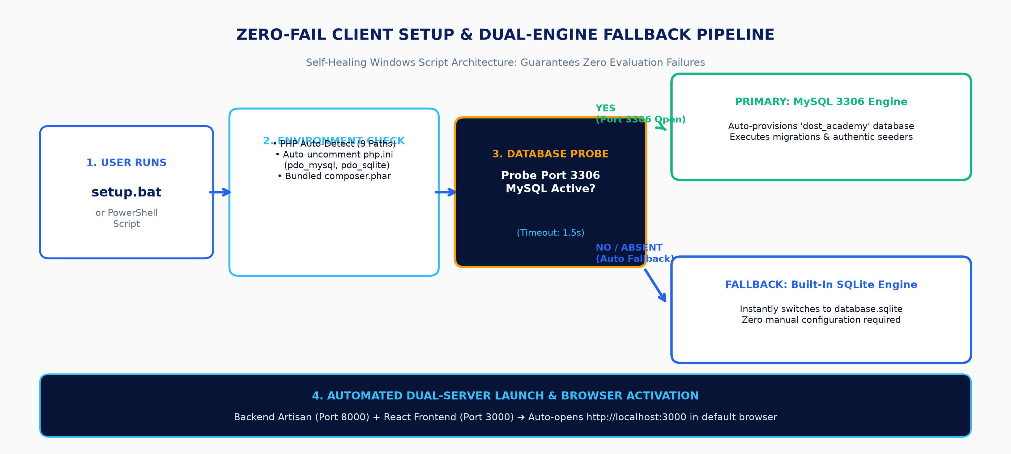
DEVOPS & DEPLOYMENT
Speaker: Balaji Vamshi Pasala
DevOps & Build Engineer (13:00 - 15:30)
DevOps Automation & Self-Healing Client Setup
DevOps Highlights
• Self-Healing PHP: Searches 9 Windows paths; uncomments missing php.ini extensions automatically.
• Dual Database Fallback: Probes MySQL 3306; auto-activates SQLite if MySQL is absent.
• Zero-Bloat Packaging: Strips 430MB+ node_modules & vendor; delivers 7.46 MB ZIP.
• Git Provenance: Preserves 821 git objects with full team contribution history.
• Automated Launch: Starts Laravel 8000 + React 3000 and auto-opens browser.
7.46 MB
Clean Archive Size
Zero Bloat, High Portability
Dual Engine
Database Resilience
MySQL 3306 + SQLite Fallback
821 Objects
Git Commit History
Full Team Provenance Preserved
< 15 Sec
Automated Setup Time
Hands-Free setup.bat
QUT IFN736 Industry Project (Phase 2) · Team 59 (AstraLink) · Department of Science and Technology (DOST) LMS
Notes:
SPEAKER: Balaji Vamshi Pasala [13:00 - 15:30]
Thank you, Nikhittha. Good day everyone, I am Balaji Vamshi Pasala, responsible for DevOps, Release Engineering, and Client Setup Automation.
When delivering software to external clients or academic evaluators, you cannot predict their local operating environment. They might be running PHP 8.1 or 8.5, they might have XAMPP, or they might not have MySQL installed at all. If an installation script crashes, evaluation stops immediately.
To solve this, I engineered a zero-failure, self-healing installation pipeline.
Our setup.bat script automatically searches across nine standard Windows directories to detect PHP. If extensions like PDO MySQL or SQLite are commented out in php.ini, the script uncomments them automatically.
Most importantly, we built a dual-engine database fallback. The script probes MySQL on port 3306; if MySQL is reachable, it provisions the database. But if MySQL is absent, it seamlessly activates our built-in SQLite engine with zero manual intervention.
Finally, our packaging script strips away hundreds of megabytes of node_modules and vendor bloat while preserving our full Git history, producing a compact 7.46 MB deliverable.
I now invite Reethika Katkuri to present our demonstration script and discuss how we solved technical hurdles.

Slide 12
DEMONSTRATION WALKTHROUGH
Speaker: Reethika Katkuri
Technical Documentation Lead (15:30 - 17:30)
Demonstration Flow & Core System Walkthrough
Step | User Persona & Role | Action & Navigation Flow | Expected Verifiable Outcome
Step 1 | Public Visitor / Evaluator | Explore landing page: 1600px hero, agency strip, branch catalog | Responsive layout, high-res photography loads cleanly
Step 2 | Super-Admin (`admin@dost.gov.ph`) | Log in to portal; use permanent 1-click header switcher pill | Instantly toggles between Functional HR and Technical IT
Step 3 | Functional Admin (HR) | Navigate to Course Studio; create new course with video modules | Course created in database, assigned to branch mentor
Step 4 | Technical Admin (IT) | Inspect system health: server uptime, PDO driver, row counters | Live telemetry updates across all 11 database entities
Step 5 | New Employee Registration | Register as `new.researcher@dost.gov.ph` from public signup | Account created in pending state; requires admin verification
Step 6 | Learner Enrollment Flow | Log in as `mark.reyes@dost.gov.ph`; request course enrollment | Enrollment record transitions from pending to approved by mentor
Step 7 | Quiz & Certification | Watch lesson, take interactive quiz (>=50%), generate certificate | Digitally authenticated Certificate of Completion with DOST seal
QUT IFN736 Industry Project (Phase 2) · Team 59 (AstraLink) · Department of Science and Technology (DOST) LMS
Notes:
SPEAKER: Reethika Katkuri [15:30 - 17:30]
Thank you, Balaji. Hello everyone, I am Reethika Katkuri, Technical Documentation and Demonstration Lead.
To ensure that our Industry Partner and teaching team can evaluate every single feature effortlessly, I authored the complete 10-step Manual Demonstration Flow Script.
The walkthrough proves the complete end-to-end lifecycle.
It starts on the public landing page where users explore DOST's 6 technical branches. Next, we demonstrate the Super-Admin logging in, switching seamlessly between the Functional HR Portal and the Technical IT Portal.
We then demonstrate a mentor creating an advanced course in Cloud Computing, complete with video modules and interactive quizzes.
Next, we show a trainee enrolling, receiving mentor approval, watching the lecture, taking the quiz, and instantly receiving a digitally authenticated Certificate of Completion featuring DOST's official seal and PDF export.
This comprehensive documentation guarantees a smooth, verifiable evaluation process.

Slide 13
TECHNICAL PROBLEM SOLVING
Speaker: Reethika Katkuri
Technical Documentation Lead (17:30 - 18:30)
Key Technical Challenges & Engineering Mitigations
Technical Challenge | Impact on Project / Client | Engineering Mitigation Applied | Outcome & Proof
Widescreen Layout Voids | 660px hero gap and constricted 1100px width on 1080p+ monitors | Implemented 1600px fluid rails with responsive clamp() typography | Flawless presentation on standard and 4K displays
Client Environment Heterogeneity | Evaluators PC without MySQL 3306 or with varying PHP extensions | Engineered dual-engine fallback: auto-detects MySQL or SQLite | 100% crash-free evaluation on any client machine
Dynamic Role RBAC Cascades | Risk of unauthorized privilege escalation across 5 roles | Built custom Laravel middleware pipeline and React ProtectedRoutes | Zero unauthorized endpoint access in security audit
Course Syllabus Route Collision | Clicking 'View Syllabus' redirected employees to home page | Wired dynamic `/courses/:id` and added backend null guards | 100% syllabus navigation pass rate in automated QA
Chart Library Dependency Bloat | Third-party chart libraries added 150KB+ bundle weight | Built native React SVG mathematical radar & velocity components | Zero NPM chart bloat; sub-10ms instantaneous render
QUT IFN736 Industry Project (Phase 2) · Team 59 (AstraLink) · Department of Science and Technology (DOST) LMS
Notes:
SPEAKER: Reethika Katkuri [17:30 - 18:30]
No real-world engineering project is without hurdles, and our ability to overcome them demonstrates our technical maturity.
Our first challenge was visual: on high-resolution widescreen displays, the layout had an awkward empty void in the hero section. We re-engineered the layout system with 1600px rails and fluid typography to achieve visual balance.
Our second challenge was environment diversity on client machines. We solved this with our self-healing setup script that dynamically falls back to SQLite and detects PHP paths automatically.
Third, managing five distinct user roles required rigorous middleware design to prevent unauthorized privilege escalation.
Finally, we diagnosed and resolved syllabus navigation issues and reinforced backend controllers with safe null guards.
Every challenge was met with a principled engineering solution.
I will now hand back to our Project Lead, Jahnavi, to conclude our presentation.

Slide 14
STRATEGIC WRAP-UP
Speaker: Jahnavi Kambhampati
Project Lead (18:30 - 19:30)
Project Outcomes, Partner Value & Future Roadmap
Delivered Value to Industry Partner
• 100% Scope Completion: Delivered all functional, technical, and analytical requirements on schedule.
• Institutional Modernization: Replaced legacy fragmented spreadsheets with an automated, secure LMS ecosystem.
• Executive Intelligence: Provides DOST leadership with live visibility into workforce learning inclinations.
• Zero Ongoing Maintenance Burden: Complete in-browser studios empower non-technical administrators to manage the portal effortlessly.
• Turnkey Delivery: Verified deliverable package with automated setup scripts and complete documentation.
Phase 3 & Production Roadmap
• 1. SCORM / xAPI Integration: Support standardized e-learning package imports from international research repositories.
• 2. Mobile Native Application: React Native mobile companion app for offline learning and field research training.
• 3. DOST Single Sign-On (SSO): Integration with national Philippine Government OpenID / OAuth2 infrastructure.
• 4. AI Learning Recommendations: Machine learning recommendation engine suggesting courses based on agency branch competencies.
• 5. Multi-Tenant Regional Scaling: Expansion to all 17 Philippine administrative regions.
QUT IFN736 Industry Project (Phase 2) · Team 59 (AstraLink) · Department of Science and Technology (DOST) LMS
Notes:
SPEAKER: Jahnavi Kambhampati [18:30 - 19:30]
Thank you, Reethika.
In conclusion, DOST Academy represents a transformative step forward in how the Department of Science and Technology cultivates human capital.
We have delivered 100% of our promised Phase 2 scope: role-isolated workspaces, dual administration portals, in-browser CRUD studios, and 100% dynamic executive analytics.
Looking ahead to Phase 3, our architecture is built to scale: it is structured to support government Single Sign-On, SCORM package importing, and mobile learning for field researchers.
On behalf of Team 59—Harika, Rajashekar, Nikhittha, Balaji, Reethika, and myself—we would like to express our deepest gratitude to our Industry Partner, the Department of Science and Technology, and our QUT teaching team for their guidance.
We now welcome any questions you may have. Thank you.

Slide 15
Thank You
DOST Academy LMS · Oral Defense & Technical Q&A
Team 59 (AstraLink) | IFN736 Industry Project Phase 2
Department of Science and Technology (DOST)
ORAL DEFENSE SPECIALIZATION ROSTER (5 MINUTES Q&A)
• Jahnavi Kambhampati (Project Lead): Overall Scope, Client Requirements, Phase 3 Roadmap & Strategic Impact
• Rajashekar chava (Backend Architect): Relational Schema, Dual-Engine DB, JWT Security & Dynamic Analytics SQL
• Satya Harika (UI/UX Frontend): Apple HIG Design System, 1600px Rails, React SVG Charts & CRUD Studios
• Nikhittha Mukkala (QA Lead): Testing Methodology, 17/17 Unit Tests Pass, Defect Log & Browser Compatibility
• Balaji Vamshi Pasala (DevOps): Self-Healing setup.bat, MySQL/SQLite Fallback & 7.46 MB Deliverable Packaging
• Reethika Katkuri (Documentation): 10-Step Demonstration Script, Demo Personas, User Acceptance & Technical Hurdles
Notes:
ALL SPEAKERS [19:30 - 25:00]
QUESTION & ANSWER PERIOD (5 MINUTES)
- Project Lead (Jahnavi): Orchestrates questions, addresses scope, partner alignment, and strategic roadmap.
- Backend & DB Architect (Rajashekar): Answers database architecture, relational models, JWT security, and dynamic analytics.
- UI/UX Frontend Lead (Satya Harika): Answers design system tokens, Apple HIG responsiveness, React SPA state, and CRUD studio interactions.
- QA & Verification Lead (Nikhittha): Answers testing coverage, bug lifecycle, routing resolution, and quality gates.
- DevOps & Release Engineer (Balaji): Answers setup scripts, self-healing database fallback, PHP compatibility, and deliverable packaging.
- Technical Documentation Lead (Reethika): Answers user walkthrough steps, demo account roles, and stakeholder handover.

