Slide 1
SEMESTER PROJECT PRESENTATION
AI-Powered Building
Damage Assessment
for Disaster Response
Detecting & Classifying Building Damage from Drone Imagery
Without Relying on Pre-Existing Maps
Texas A&M University · CRASAR-U-DROIDs Dataset · 2025

Slide 2
The Problem: Disaster Response Bottleneck
A Cyclone hits. Rescue teams are ready. But nobody knows WHERE to go first.
300 GB
~300,000
24+ Hours
Drone footage
arrives every day
Photographs
to review
Manual expert
analysis time
While experts review footage — people are still waiting for rescue.
1
2
3
4
Hour 0
Hour 2–4
Hour 6–28
Hour 28+
Hurricane
hits
Drones
deployed
Manual
review
Rescue
begins

Slide 3
Existing AI System & Its Critical Gaps
Research from Texas A&M deployed during Hurricanes Debby & Helene (2024) — but key limitations remain.
HOW IT WORKS
CRITICAL GAPS
1 Drone captures photos
Map Must Exist
Needs pre-drawn outlines. Rural/remote areas fail completely.
2 Pre-existing map overlay
⚠ 39.1% degradation from misalignment
Maps May Be Wrong
3 AI analyses inside outlines
Post-disaster reality doesn't match pre-disaster maps.
⚠ Required manual field correction
4 Damage labels assigned
Output Not Usable
Initial outputs couldn't be read by ArcGIS or standard tools.
⚠ Added delay before decision-makers

Slide 4
This Is Not Theory — It Was Already Deployed
In 2024, AI-based building damage assessment was used operationally in two real federally declared disasters.
415
18 min
91
43%
Buildings assessed
in Debby & Helene
AI processing time
vs. days manually
Professionals from
57 govt. agencies
Committed to use
in 2025 season
The question of whether AI helps in disaster response has already been answered.
Our project's question is: how do we make it better, faster, and more accessible — especially where maps don't exist?

Slide 5
Our Solution: A Two-Stage Pipeline
No pre-existing maps needed. No manual alignment. Works anywhere drones fly.
STAGE 1 — LOCALIZATION | Find the Buildings
STAGE 2 — CLASSIFICATION | Judge the Damage
— Raw drone image is the only input
— Each detected building is assessed individually
— Model scans every pixel like the human eye
— Assigned one of 4 damage labels
— Detects building shapes from visual patterns
→
— Given a confidence score for every prediction
— Draws its own outlines on detected buildings
— Uncertain predictions flagged for human review
— Works in mapped AND unmapped areas equally
— Regional priority summary generated for managers
✓ Addresses 39.1% map-misalignment gap
✓ Adds confidence scores + usable output formats

Slide 6
The Data: CRASAR-U-DROIDs
The dataset behind our entire pipeline — 10 real federally declared disasters.
52
10
21,716
219 GB
Orthomosaic
Drone Maps
Disaster
Events
Labeled
Buildings
Real Aerial
Imagery
TRAIN SET
TEST SET (Out-of-Distribution)
Hurricane Ian · Laura · Ida · Harvey
Hurricane Idalia · Hurricane Michael
Kilauea Eruption
Mussett Bayou Fire
Champlain Towers Collapse
Mayfield Tornado

Slide 7
Data Preprocessing Pipeline
6 steps transform raw gigapixel drone maps into clean AI-ready training tiles.
01
04
Load GeoTIFF + JSON
Tile into 512×512
Read the giant drone orthomosaic and building annotation files.
Cut the giant image into puzzle pieces with 128px overlap.
02
05
Alignment Correction
Smart Filter
Fix building outline offsets using aligned JSON coordinates.
Keep only tiles containing buildings. Discard empty background tiles.
03
06
Generate Masks
Augment & Normalize
Draw building polygons as white pixels on a black canvas.
Flip, rotate, brightness shifts. Standardize to ImageNet norms.
Like cutting a giant map into puzzle pieces, keeping only pieces with buildings, then training AI from every angle.

Slide 8
Stage 1 — Localization: Experimental Journey
Systematic improvement from basic CNN to Transformer architecture.
Model | Key Change | F1 | IoU | Insight
U-Net (Basic CNN) | Baseline — Dice Loss only | 0.47 | 0.31 | Dice Loss can't handle class imbalance
U-Net + ResNet34 | Stronger CNN encoder | 0.62 | 0.45 | Pre-trained encoders help significantly
U-Net + ResNet34 + Geo Split | Realistic OOD evaluation | 0.67 | 0.51 | Disaster-level splits needed for true testing
U-Net + EfficientNet-B4 | Strongest CNN encoder | 0.70 | 0.54 | Best CNN result — hit the ceiling here
UNet + MiT-B3 | Transformer encoder — global context | 0.72 | 0.60 | Transformer vision breaks through the ceiling

Slide 9
Stage 1 Final Model: UNet + MiT-B3
Mix Transformer B3 encoder — sees both global and local context simultaneously.
MiT-B3 Encoder
FINAL RESULTS
(OOD Test)
Hierarchical Transformer — sees both global and local context across the full image
0.60
UNet Decoder
Reconstructs full-resolution building mask from multi-scale features
Validation IoU
scSE Attention
0.722
Focuses decoder on building pixels vs. background noise
Validation F1 Score
ImageNet Pretrained
Starts with rich learned visual knowledge — faster convergence
Tested on 4 completely unseen disasters: Idalia · Michael · Mussett Fire · Mayfield Tornado

Slide 10
Between Stages: Mask → Individual Building Crops
1
2
3
4
5
Binary Mask
Find Buildings
Extract Features
Crop Buildings
Feed Stage 2
MiT-B3 outputs white=building, black=background
Group connected white pixels into separate regions
Bounding box · Pixel area · GPS ·
Cut each building from the original high-res image
Each crop sent to MaxViT for damage classification
Stage 1 outputs a building mask. 5 steps convert it to individual building images for Stage 2.

Slide 11
Stage 2 — Classification: Experimental Journey
Each model introduced better techniques. Hardest challenge: distinguishing Minor from Major damage.
Model | Key Techniques | Macro F1 | Accuracy | Innovation
EfficientNet-B4 | CNN baseline — Focal Loss + Label Smoothing + MixUp | 0.57 | 57% | Focal Loss handles class imbalance
ConvNeXt-Base | Stronger backbone + EMA + CutMix + OneCycle LR | 0.63 | 65% | EMA smoothing + CutMix augmentation
MaxViT-Base | Multi-axis Transformer + Lion optimizer + 8×TTA | 0.69 | 72% | Multi-axis attention: local + global
Hardest class pair: Minor (F1=0.55) vs Major (F1=0.58) — subtle damage differences require both fine texture and global structure to distinguish.

Slide 12
Stage 2 Final Model: MaxViT-Base
Multi-Axis Vision Transformer — local texture AND global structural context simultaneously.
MBConv
FINAL RESULTS
Local CNN — captures roof textures, surface cracks, and fine edge details
No Damage
0.82
Window Attention
Local transformer — captures building-level damage patterns
Destroyed
0.82
Major
Grid Attention
0.58
Global transformer — captures regional context across buildings
Minor
0.55
ImageNet-21k Pretrained
Macro F1: 0.69 | Accuracy: 72%
21M image pretraining — much stronger starting point than ImageNet-1k

Slide 13
The Complete Pipeline: Drone Image → Emergency Decision
Input: gigapixel drone map of a disaster zone. Output: ranked building priority list, ready within minutes.
Raw Drone
Image
Preprocessing
MiT-B3
Localization
Feature
Extraction
MaxViT
Classification
Output to
Managers
→
→
→
→
→
GeoTIFF
orthomosaic
Tile · Align
Mask · Filter
Val IoU: 0.60
No map needed
Crops + GPS
Macro F1: 0.69
4 damage classes
Confidence flagged buildings + Overview
SAMPLE OUTPUT — ZONE: Suwannee County, FL
222
18 + 41
67
96
HIGH
Total buildings
detected
Destroyed &
Major damage
Minor
damage
No damage
Priority
Level

Slide 14
Results: How Well Does Our System Perform?
Both stages tested on completely unseen disasters (out-of-distribution evaluation).
+25.5% improvement over baseline

Slide 15
Why Trust It? Three Layers of Reliability
Real Data, Real Disasters
Honest Predictions
Built on Proven Ground
Trained and tested on 10 actual federally declared disasters — not simulations. Hurricanes, tornadoes, wildfires, volcano eruptions, building collapses.
21,716 building labels. 200+ GB of real disaster aerial imagery.
Every output includes a confidence score. If the model is uncertain, it says so. Uncertain predictions are automatically flagged for human review.
92% confidence → sent directly to manager. 58% confidence → flagged for human expert.
The underlying AI-based damage assessment approach has been validated by real government agencies during the 2024 hurricane season.
Deployed operationally in Hurricanes Debby & Helene. Adopted by 57 agencies.

Slide 16
What We Built. Why It Matters.
Real Problem
Every day, disaster teams drown in drone footage. AI is the only practical solution fast enough to matter.
Already Proven
Base system deployed in two real hurricanes in 2024. 415 buildings assessed in 18 minutes. Adopted by 57 govt. agencies.
Fixed Key Weakness
Existing system depended on pre-existing maps that often don't exist or are misaligned. Our Stage 1 removes that dependency entirely.
Added What Was Missing
Confidence scores, regional priority summaries, and output formats emergency managers can actually use.
Works Anywhere
No map needed means this system works in rural, remote, and developing regions where existing tools completely fail.

Slide 17

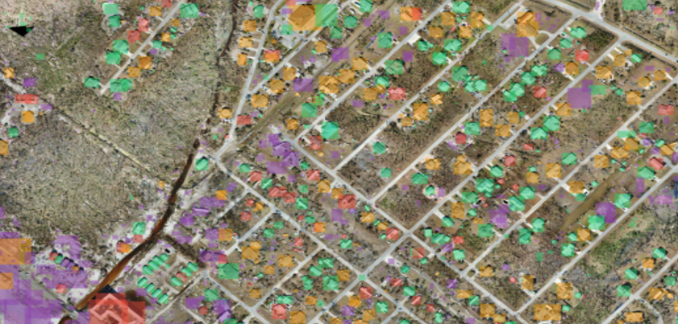

Slide 18
Thank You
AI-Powered Building Damage Assessment for Disaster Response
Open for Questions & Discussion
Dataset: CRASAR-U-DROIDs · 10 Federally Declared Disasters · 21,716 Building Labels
Based on: Manzini et al. (2025) — Deploying Rapid Damage Assessments from sUAS Imagery · AAAI 2026

