Slide 1
WEB CAM SECURITY
Vemanaboina Vikram(ST#IS#6137)
Bhavana Chimmili(ST#IS#6138)
Chamarthi Jahnavi(ST#IS#6140)

Slide 2
INTRODUCTION:
Web cam security refers to measures taken to protect the privacy and security of a web cam from unauthorized access.
With the widespread use of Laptops, Desktops and smart devices, ensuring webcam is more critical than ever.
By enabling camera whenever we are using and by disable camera when we are not using can also protect our web cams from security threats .
This includes using unique passwords,keeping software and drivers updated and being cautious of phishing scams.

Slide 3
PROJECT OVERVIEW
The project about securing our webcams from threats,unauthorized access.
By using the disable camera and enable camera we can access our webcam whenever we want,here we are securing it through a randomly generating password.
Manually also we can enable or disable the camera but by using the passwords it will become more secure.
This project includes creating a user-friendly interface to easily enable/disable their web cams.

Slide 4
PROJECT REQUIREMENTS
Hardware requirements:
Web cam
Computer
Internet connection
Software requirements:
Operating system
Programming languages
Images
Security features
Authentication and Authorization

Slide 5
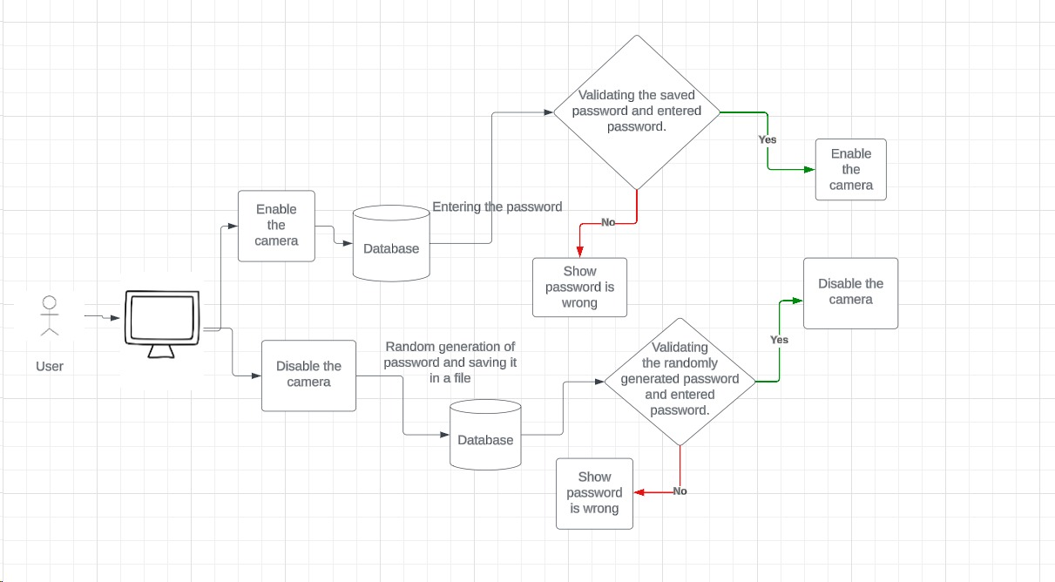
PROJECT ARCHITECTURE

Slide 6
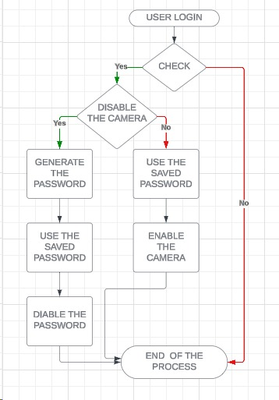
PROJECT DATAFLOW DIAGRAM

Slide 7
END USERS:
Individuals
Businesses
Educational institutions
Government agencies
Healthcare providers
Home users

Slide 8
WEB CAM SECURITY RISKS:
web cams can be hacked by cyber criminals,leading to unauthorized access to your personal space.Malware and phishing attacks can also compromise your privacy and security.
Web cam security risks include unauthorized access by hackers,malware that can hijack camera,and potential privacy breaches if the camera is compromised.
Unauthorized Access
Malware
Privacy Breaches
Phishing Attacks
Unsecured Networks

Slide 9
TIPS TO SECURING WEB CAMS:
Strong passwords
Firewall
Encryption
Disable remote access
Physical security
Firmware updates
Reduce the usage of public wifi

Slide 10
CONCLUSION:
In conclusion ,prioritizing web cam security through proactive measures such as strong passwords,two-factor authentication,and user education is paramount in safeguarding against potential threats.By stick to the best practices and protocols , individuals can mitigate the risks associated with web cam vulnerabilities and ensure a secure digital environment.

