Slide 1
PORTFOLIO
MANDAPATI JAHNAVI
jahnavimandapati6@gmail.com;20A81A0630@sves.org.in
Sri Vasavi Engineering College
Andhra Pradesh
Front-End Development[5/06/2023-15/07/2023]

Slide 2

Problem Statement
Creating a professional Portfolio…!

Slide 3

Why do we need Portfolio?
By creating a portfolio, you build your professional image. If you can show off your achievements, you do much better in the eyes of potential employers or clients. It is easy to present to clients what our company is already able to do, in which areas it has experience and what types of projects it has already implemented.

Slide 4
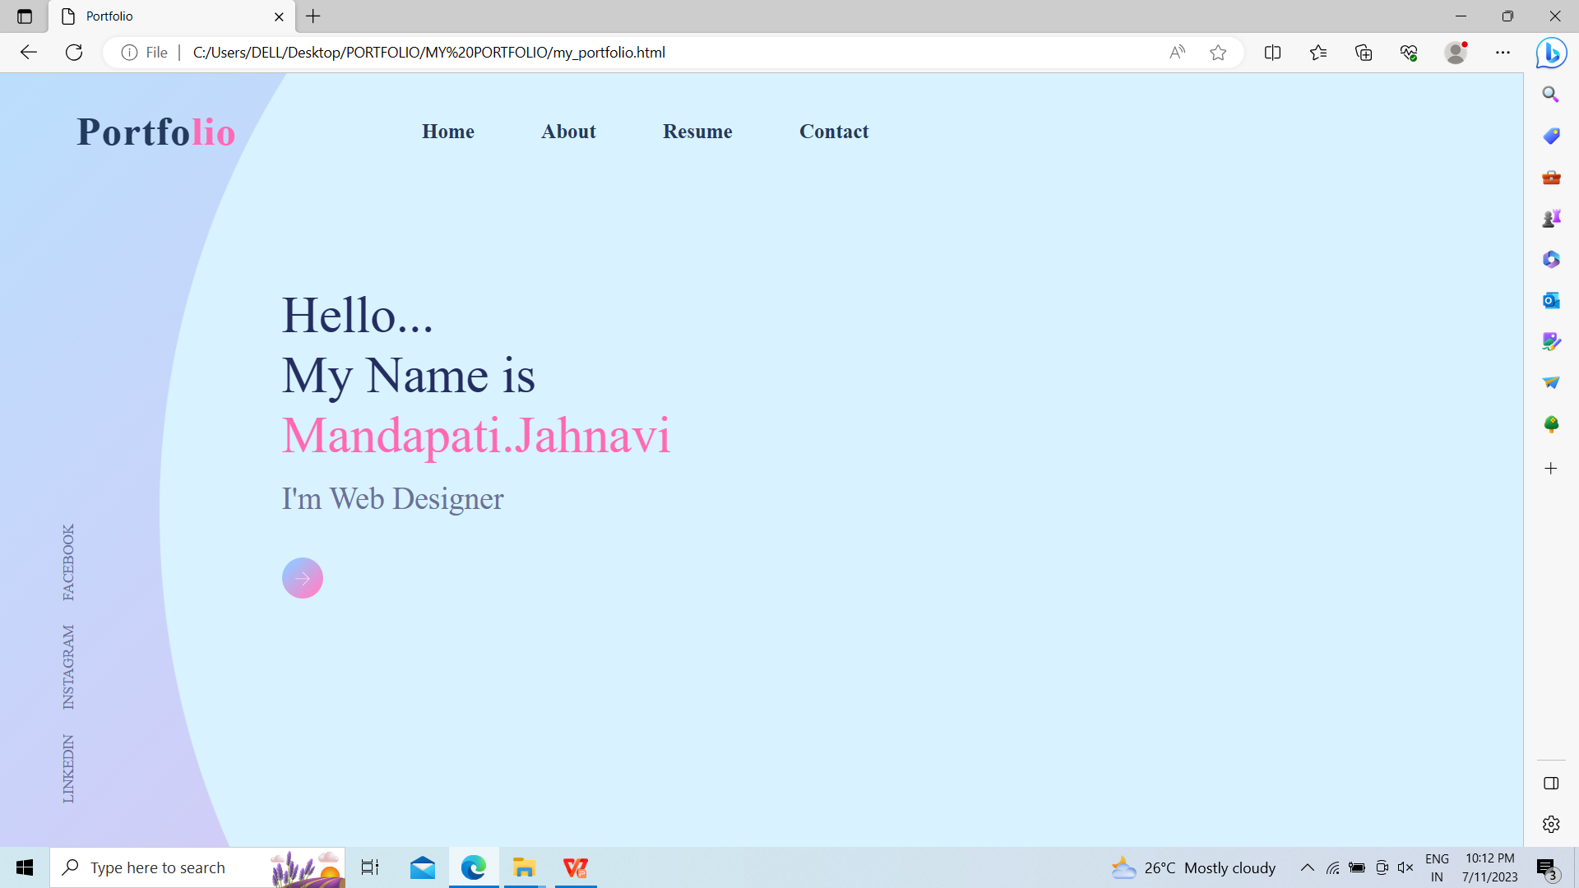
Project Overview
First Look of my Portfolio…!

Slide 5
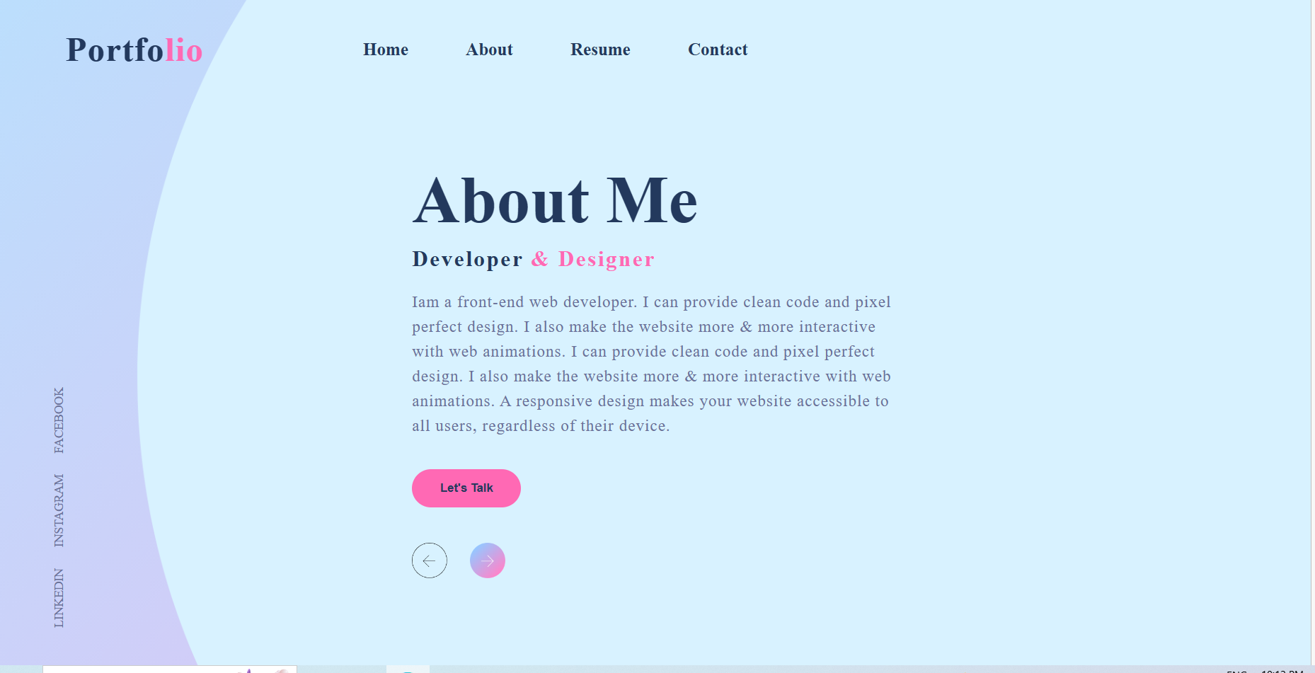
To know more about me click on About

Slide 6
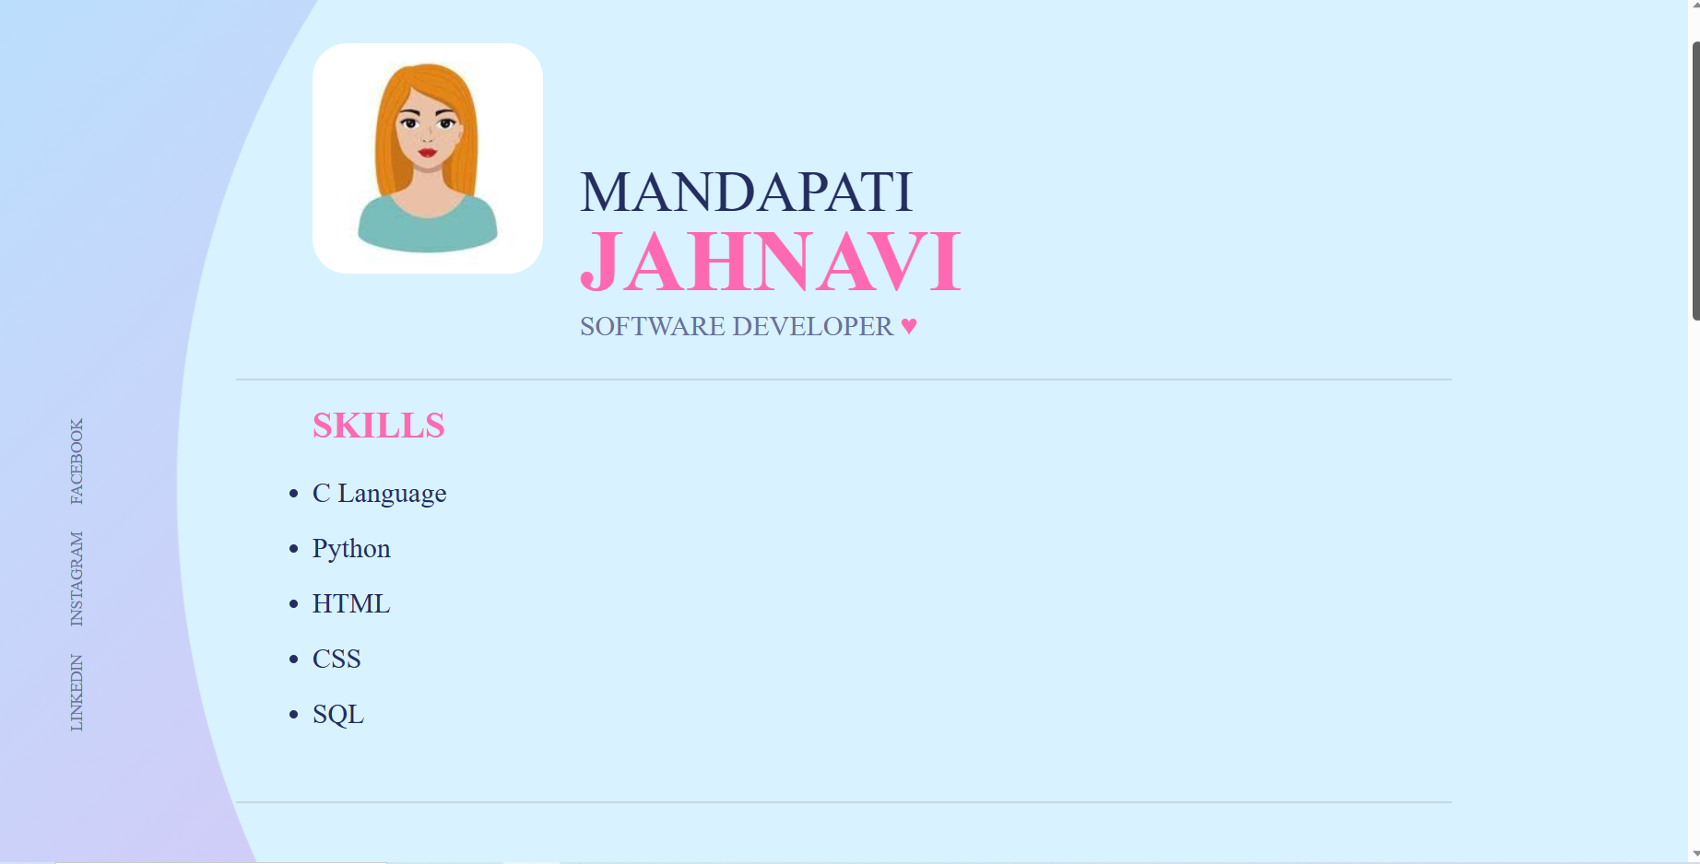
And my Resume

Slide 7
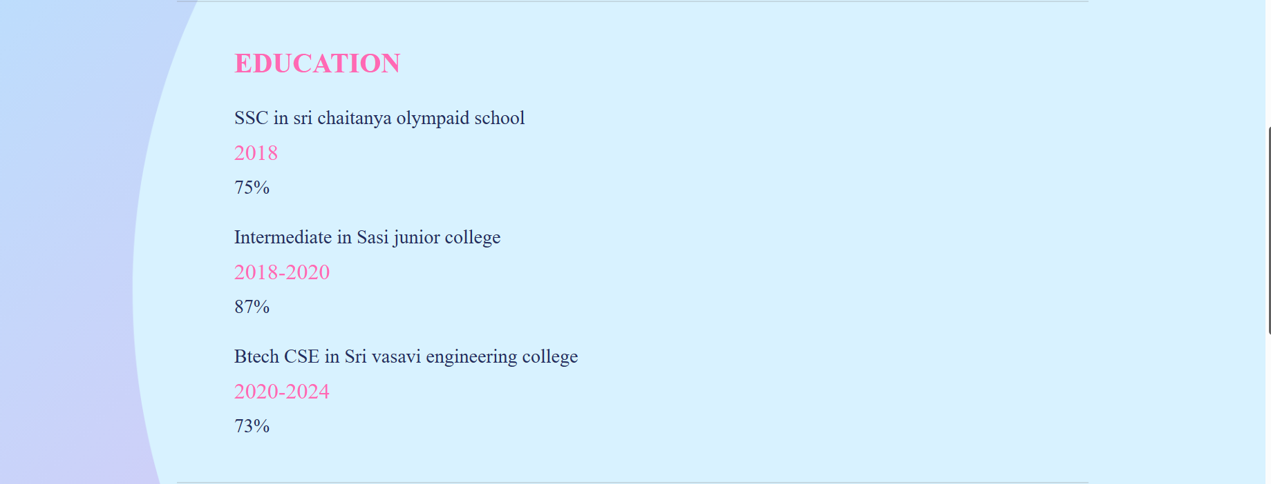
About My Education

Slide 8
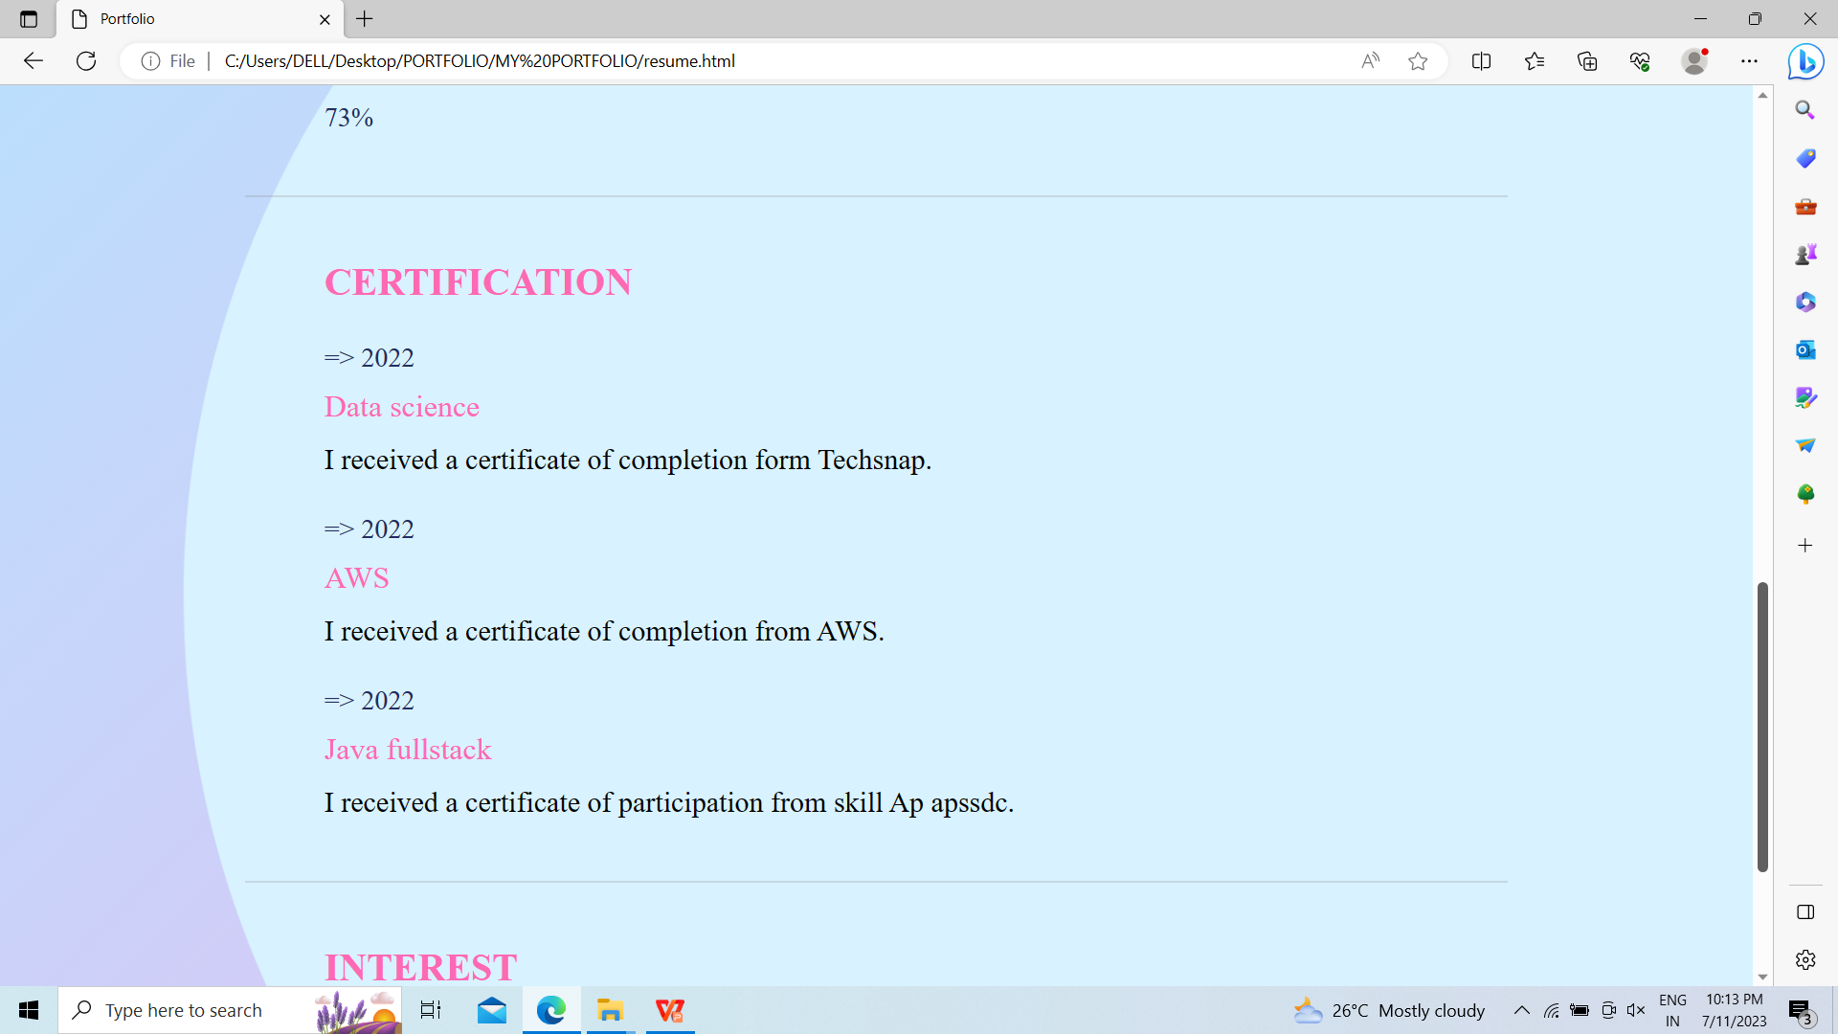
And my Certificatons are

Slide 9
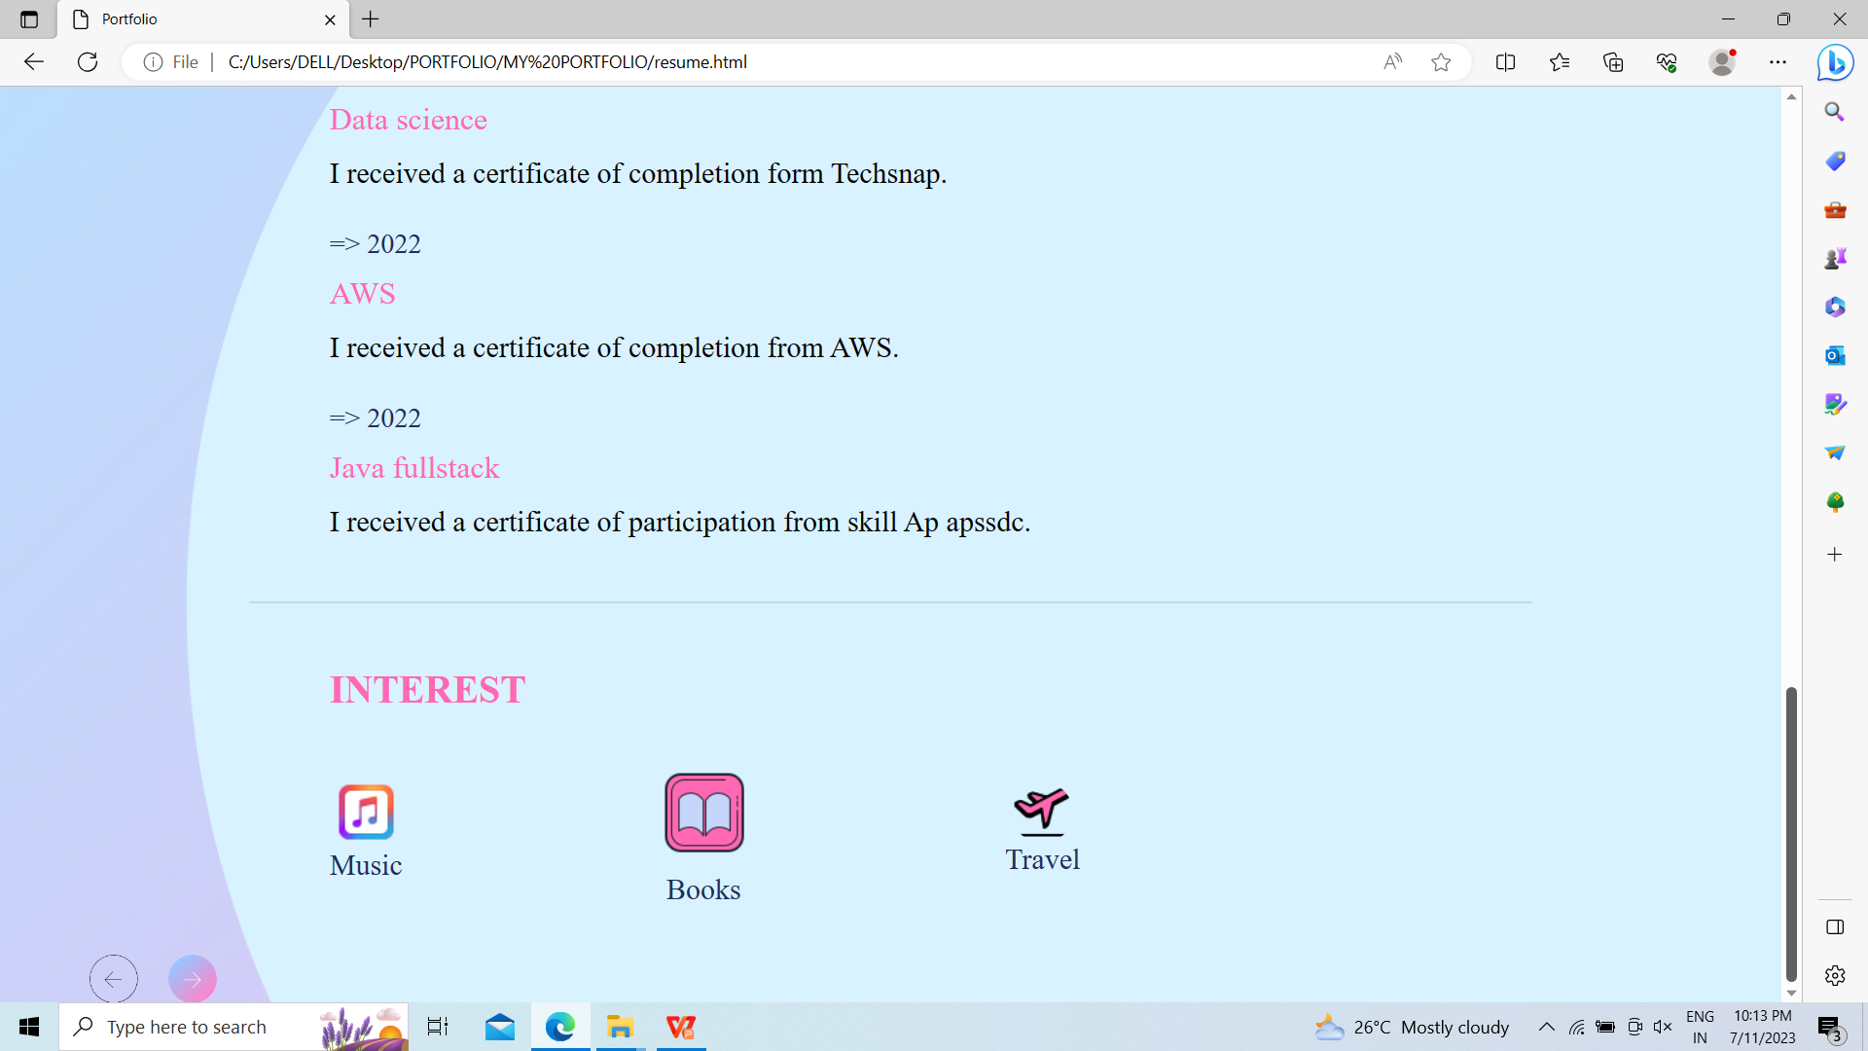
And my Interest are

Slide 10
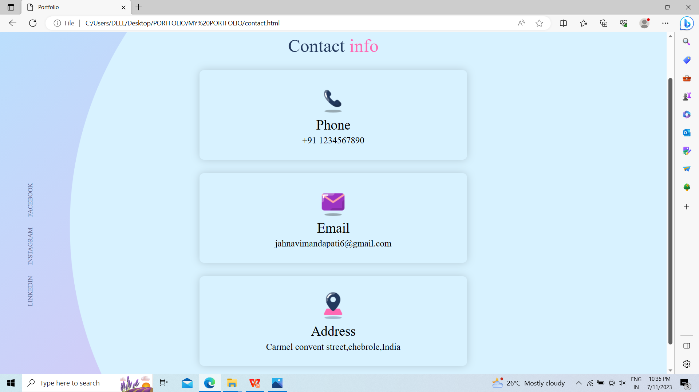
To connect with me click on Contact

Slide 11
The Recruiters task will be easy to know about me and my skills also they can contact me easily through social media links provided and also go through my Resume.
Who are the end users?

Slide 12
Customization of Project
This website completely exhibits my skills and talents owned by me. This project has pleasant colours that suite my choices. The interface is user-friendly and easily understood to any user.

Slide 13
Resources
Photos
https://unsplash.com/
https://www.freepik.com/
https://pixabay.com/
Bootstrap
https://getbootstrap.com/docs/4.4/getting-started/introduction/
https://icons.getbootstrap.com/
Project Link:
https://github.com/JahnaviMandapati/portfolio

Slide 14
THANK YOU

